Slide 1

BOC 1002 Measuring and Benchmarking Energy Performance
DATE
Instructor Name & Title
Company or Organization
PHONE
Email
Notes:
Instructor’s name: __________________________________________________________
Phone number: ____________________________________________________________
E-mail: ___________________________________________________________________
_________________________________________________________________________
_________________________________________________________________________
_________________________________________________________________________
_________________________________________________________________________
BOC 1002 Measuring and Benchmarking Energy Performance
Edition 2.01

Slide 2

Safety Message
Notes:
Equipment safety when installing or removing data loggers:
Equipment power off
Lock out/tag out
Get an electrician when installing in electrical panel
No loose articles of clothing or accessories (lanyard, ID badge, tie, etc.)

Slide 3
Agenda
Review project from previous class
Review objectives for today’s class
Energy Management Program
Energy Management Plan Elements
O&M Program Elements and Implementation
Energy/Utility Accounting
Sources, end uses and billing
Benchmark
Baseline and end use analysis
ENERGY STAR Portfolio Manager
Notes:
Class Overview
The class consists of two components. The first component will cover the necessary information required for a building operator to determine an initial assessment of the energy performance of their facility. The second component will describe how the operator can then use the initial assessment to compare his or her facility against similar buildings to determine if improvements are necessary and in what areas those improvements can be made. Finally, existing tools and programs that can assist the building operator will be discussed.

Slide 4
Project Debrief
What was your project assignment?
What did you learn from doing it?
What worked and didn’t work?
How will you use the information gathered during the assignment?
Notes:
BOC 1001: HVAC Equipment Floor Plan
BOC 1002: Benchmark Your Building in Energy Star Portfolio Manager
BOC 1003: Conduct a Lighting Survey and Calculate a Retrofit Incentive
BOC 1004: HVAC Controls Review
BOC 1005: Develop an Occupancy Schedule

Slide 5
Class Objectives – Energy Program
Understand the principles and practices of an Energy Management Plan and O&M program
Identify and prioritize conservation opportunities through improved operation and maintenance procedures.
List major energy loads in commercial buildings and understand the impact of different energy sources.
Notes:
This class is about creating a feedback loop for continuous improvement. There are two main components that we will explore: creating and managing an effective energy program, and energy accounting (since you can’t manage what you don’t measure).
Learning Objectives – Energy Program
Operators learn how energy is used in commercial buildings and how to identify and prioritize conservation opportunities. This eight-hour class includes basic principles of energy accounting, evaluation of fuel options, operation and maintenance strategies to improve efficiency, and energy management planning techniques.
After this class, an operator should be able to:
• List major energy loads in commercial buildings.
• Identify and prioritize conservation opportunities.
• Identify opportunities to improve operation and maintenance procedures.

Slide 6
Class Objectives – Energy Accounting
Calculate energy use intensity (EUI) for your building.
Demonstrate an ability to use Portfolio Manager to compute
Energy Use Intensity (EUI)
Water Use Intensity (WUI)
Greenhouse Gas Emissions Intensity (GHGEI)
Interpret the EUI and ENERGY STAR score, when available, to benchmark building performance.
Graph utility consumption profiles to identify base and seasonal loads
Notes:
Learning Objectives – Energy Accounting
Participants will learn how to perform quantifiable evaluations of their facilities' energy use in order to be able to target prospects for energy conservation.
After this class, an operator should be able to:
• Convert energy units to kBTUs and calculate energy use intensity (EUI) for the building.
• Cite the benefit of using spreadsheets or ENERGY STAR PORTFOLIO MANAGER to compute energy use indices and construct energy profiles for fuels used in the building.
• Benchmark a building.

Slide 7

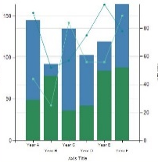



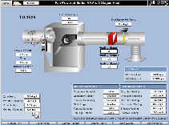
Energy Savings and Facility Management
This Photo by Unknown Author is licensed under CC BY-NC-ND
Notes:
Energy-saving initiatives have many drivers. Usually, saving energy means saving money. Resiliency can also be a result of energy-saving measures. In recent years, public policy has been a substantial driver behind efforts to save energy, largely in response to the increasing threat of global warming and its potentially catastrophic environmental and health effects. As the urgency to act has increased, states and cities have also been moving ahead with energy efficiency and decarbonization efforts.
This course will discuss some of the steps needed to put together a plan for achieving future performance goals at your facility (e.g. increased energy/water efficiency and/or reduction of greenhouse gas emissions).
It will require gathering additional information, discussions with employees and managers, and financial decisions. Yes, it is an act of juggling.

Slide 8

Group Discussion
Quick survey:
1) How well does your building perform and how do you know? 2) Who is your Energy Manager?
Notes:
How do you know how well your building performs? What is your basis of measuring ‘performance’?
Measures of performance are known as key performance indicators (KPI).
Do you know who is responsible for energy management in your facility?

Slide 9
Energy Management Program
Energy accounting: measure and evaluate performance
Identify conservation and efficiency opportunities
Implement policies, projects and new practices
Process for continuous improvement
Reference Standard:
ASHRAE Standard 100 - Energy Efficiency in Existing Buildings
Notes:
ASHRAE Standard 100: Energy Efficiency in Existing Buildings details a framework for managing a building for energy efficiency. The standard has now been revised to incorporate decarbonization of buildings, reflecting an increasing policy focus nationwide on mitigating global warming and related climate change.
Most of this class will focus on the top right: Energy Accounting. First, we will review the other elements that are aimed an improving and maintaining energy performance.
While this standard and most of the class focus on energy, water and greenhouse gas (GHG) emissions can be addressed in the same framework and document. Organizations with “ESG” (environment, social and governance) programs or broader sustainability programs can expand the scope of these tools and strategies to address other utilities and goals.
Below are links to related resources.
ASHRAE 100 User’s Guide: https://neea.org/resources/ashrae-100-users-guide
Full text preview of ASHRAE Standards (free account needed to access):
https://www.ashrae.org/technical-resources/standards-and-guidelines

Slide 10
Energy Management Overview
Energy Management Plan (EMP)
Capital improvement plan
Renovation policies
Guidelines for Audits
O&M Plan including goals, training, and PM task schedules and logs
Energy accounting: measure and evaluate performance
Identify conservation and efficiency opportunities
Implement policies, projects and new practices
Notes:
The components detailed in ASHRAE 100 that address improvement opportunities are:
Energy Management Plan (EMP) is an annually updated document detailing requirements that include a summary of energy accounting, recommended EEMs (energy efficiency measures) from audits or other assessments, status of the implementation of EEMs, and a record of O&M program updates, commissioning, staff training. It also includes a description, status and updates on the other aspects listed here (Audits, O&M program, capital improvements, etc.).
A capital improvement plan is a component of the EMP that includes a list of the energy using components and equipment and the efficiency goals for replacements. This should track the condition and life-expectancy of assets from the roof and windows, to the lighting and HVAC.
This equipment list is used also in the O&M program to ensure there is a process for maintaining optimal condition for energy using equipment and the building envelope.
One specific policy requirement in the EMP is for the energy manager to review any renovations and improvements to make sure that they do not increase the energy use, unless the performance target is also changing due to a change in activity (e.g. an office area converted to a restaurant would increase the expected/target energy use).
Guidelines for implementing audits as well as life-cycle cost analysis are also included. Audits are a formal process to document energy use conditions (and often water, waste and GHG emissions) in the building and grounds and identify improvement opportunities. There are a range of audit levels, from one specifically focused on operational improvements (also known as tune-up scoping, which is the focus of the Level II BOC course project), to a Level I audit, which further includes identification of equipment improvements with a rough estimate of cost, benefit and priority, to a Level II audit which further quantifies the building energy end uses and quantifies the cost and savings of recommended EEMs (energy efficiency measures), and ECMs (energy conservation measures).
You might see these terms - EEMs and ECMs - used interchangeably. What do you think the difference is?

Slide 11
Improvement Opportunities
Energy Efficiency Measures (EEMs)
Energy Conservation Measures (ECMs)
Energy accounting: measure and evaluate performance
Identify conservation and efficiency opportunities
Implement policies, projects and new practices
Notes:
Energy efficiency means using less energy to perform the same task. Energy Efficiency Measures (EEMs) are more focused on capital improvements. For example, a lighting upgrade or new HVAC equipment is an EEM. This would be identified in the capital or asset management plan, or through an audit.
Conservation specifically refers to refraining from using energy when it is not needed. Energy Conservation Measures (ECMs) are more focused on operational improvement but can sometimes also require a controls upgrade to implement. For example, tightening the occupancy schedule to better fit when people are in the building is a conservation measure.

Slide 12
Steps for Efficient Operations
O&M Plan
Document equipment/assets
Condition, Age and Life Expectancy
Sequence of Operations and Settings
Replacement plan
Document and schedule maintenance tasks and inspections
Track issues and log tasks
Refer to O&M Checklists in the Appendix and ASHRAE 100 User’s Guide
Notes:
The O&M Plan details goals, energy using equipment and the preventative maintenance (PM) tasks and schedules to maintain equipment and the building itself. It also includes details on staff training.
The O&M program implementation requirements are to carry out the plan, keep records, and keep the plan up to date as equipment changes are made.
Annex D of the ASHRAE 100 standard provides a list of the O&M requirements for a range of system types and components, including control systems. ASHRAE Standard 180 also details maintenance tasks for different types of equipment.
Checklists for reviewing common systems are provided in the Appendix of this handbook. Reviewing the relevant elements in your facility with these lists can help generate a list of opportunities for improvement by addressing common issues. They can be prioritized by estimated cost, anticipated savings, and simple payback.
For example, if the estimated cost is $500 and the savings is estimated at $250 per year in energy expenses, the payback (the time it takes to recover the initial cost) would be 2 years.
ASHRAE 100 User’s Guide: https://neea.org/resources/ashrae-100-users-guide

Slide 13
Operational Strategies
Improve energy efficiency
Operation & maintenance, equipment modifications
Reduce “On” hours
BAS/time clocks, building occupant sensors
Reduce the need to use energy
Conservation measures, building occupant behavior
Just meet the loads – and no more
Calibration, overheating, and overcooling
Notes:
Energy management consists of developing a set of basic strategies to meet the needs of a facility and, at the same time, reduce energy consumption and costs. When looking for energy conservation opportunities, keep these four basic concepts in mind:
Improve energy efficiency through better operational practices or by equipment or building modifications. For example: Replace failed standard electric motors with high efficiency motors; replace incandescent or fluorescent lighting and ballasts with LED lighting; perform boiler blowdown only when actually required.
Reduce “On” hours. For example: implement a policy of lights out in rooms left unoccupied for more than 15 minutes; set the time clock to reduce the hours the hot water circulation pump is on.
Reduce the need to use energy. For example: add ceiling insulation; weatherize the envelope; insulate and seal overhead doors; encourage occupants to use blinds and draperies to block heat gain and loss.
Just meet the loads -- and no more. For example: calibrate controls to avoid over-heating or overcooling; recover to desired occupied temperatures no earlier than necessary.

Slide 14
Ongoing Steps for Efficient Operation
Identify and correct problem areas
Assign responsibility
Make operational changes
Plan for capital improvements
Monitor progress
Measure and verify
Compare against baseline benchmark
Notes:
As you develop, implement and carry out your Operations and Maintenance program, some key steps help keep it on track and ensure the goals are met.
While an O&M program includes thorough maintenance tasks, it is important to step back and look for problem areas and evaluate opportunities for improvements. A Tune-Up scoping is one approach to doing this and is the focus of the BOC Level II course project. Audits, monitoring-based commissioning, and targeted analysis are other approaches to this objective.
As equipment and assets age and are replaced due to renovations, end-of-life, or efficiency and fuel-switching upgrades (e.g. electrification projects), the O&M program needs to be updated as well. Who will update the inventory and maintenance task documentation?
Another important step is to use the energy (and/or water/waste/GHG) accounting we will discuss later to evaluate if the change is performing as intended.

Slide 15
Energy Management Recap
Awareness of where and when energy is used
Proper operation and maintenance of energy systems
Realistic goals
Designate who is responsible
Evaluate actions

Slide 16
Group Exercise #1
Energy Efficiency at Your Facility
In your assigned groups, discuss the following three questions as they relate to energy consumption and energy efficiency at your facility:
What type(s) of energy is (are) consumed at your facility?
What types of energy efficiency projects have been completed?
What are the challenges to achieving energy efficiency at your facility?
Notes:
What type(s) of energy is (are) consumed at your facility?
Using the terms we’ve discussed – what have you done to improve building performance and what are the challenges to improving performance?
_______________________________________________________________
_______________________________________________________________
_______________________________________________________________
List energy efficiency projects completed at your facility.
_______________________________________________________________
_______________________________________________________________
_______________________________________________________________
List some challenges to achieving energy efficiency at your facility.
_______________________________________________________________
_______________________________________________________________
_______________________________________________________________

Slide 17
Policies for Continuous Improvement
Energy accounting: measure and evaluate performance
Identify conservation and efficiency opportunities
Implement policies, projects and new practices
A documented and implemented EMP supports continuous improvement in energy (and/or water, waste, and GHG) performance
Framework for ongoing development of policies and best practices
Notes:
A policy is a course of action that has been chosen to guide and determine present and future decision making.
The decision to have a Management Plan to address facility energy, water and waste use and greenhouse gas emissions is a policy itself and contains more specific policies to guide decisions on a range of practices and issues.
Other examples include:
Standard setpoints for occupied conditioned space will have 4-degree deadband.
New appliances and equipment will be ENERGY STAR labeled, or meet CEE Tier II standards (Consortium for Energy Efficiency).
All gas-fueled equipment will be replaced with electricity-based equipment.
What energy-related policies does your organization have?

Slide 18
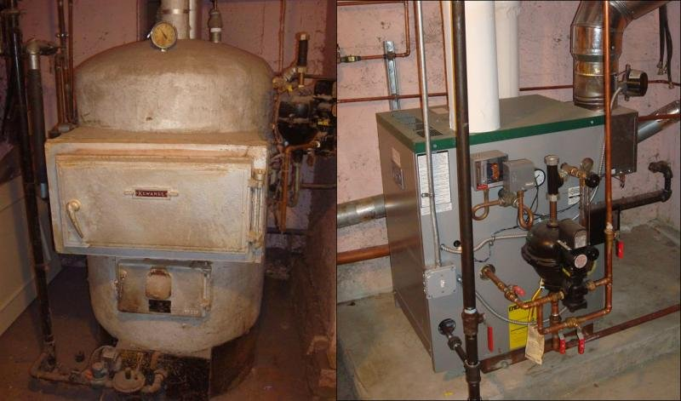
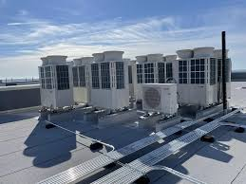
Energy Purchasing
Fuel switching = changing the primary energy source used for a specific purpose
For example:
Replacing technologies that use fossil fuels
With technologies and systems that use electricity
Images source: energy.gov
Notes:
Energy Purchasing is another opportunity for a policy or program goal. Fuel switching is one measure that can be included in an energy purchasing policy. Fuel switching is the process of changing the primary source of energy used for a specific purpose. This decision may be driven by costs, technological factors, a desire for resiliency, environmental concerns or policies, and/or other factors.
In the past, fuel switching has often referred to switching from one fossil fuel to another, such as from oil to natural gas. Increasingly, fuel switching refers to the process of electrification, which involves replacing fossil-fuel powered technologies with technologies that use electricity as their energy source. Electrification may be driven by organizational priorities or by policy requirements enacted in response to the increased focus on decarbonization in various jurisdictions. The impact of this policy strategy varies by region, depending on the energy sources supplying power to the grid.
Fuel switching can be beneficial economically as well as environmentally. In the case of electrification, pairing electricity-based technologies with onsite renewable energy generation can be especially beneficial in the long-term. But as with many energy efficiency measures, the up-front costs involved in this process can pose a challenge. We’ll discuss some potential options for funding the up-front costs of various types of capital projects next.

Slide 19
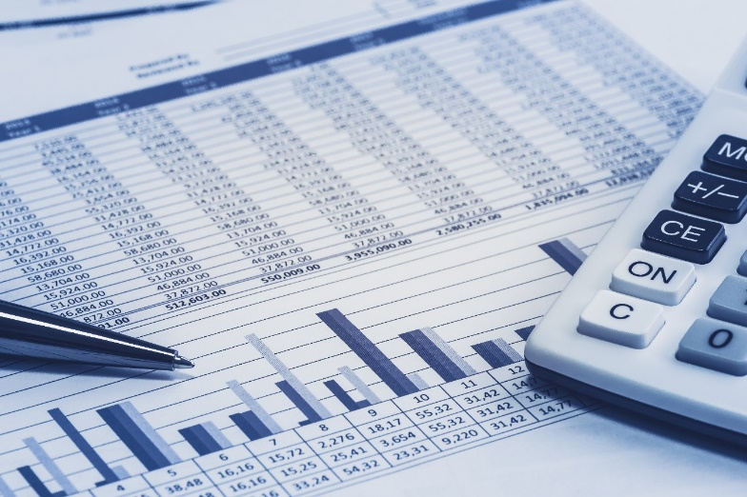
Capital Project Funding Options
Potential Options for Funding Electrification-Related Projects:
Utility Rebates/Grants
Tax Incentives
C-PACE(R)
ESPC
EaaS
PPA
Traditional Financing
Capital Budget
Notes:
Various funding mechanisms may be available to help with the up-front costs for capital projects, including efficiency upgrades, electrification, and/or integrating renewable energy.
Utility Rebates/Grants and Tax Incentives
Many electric utilities offer rebates and/or custom grant programs that pay you for energy savings, which can help lower the upfront costs of electrification or energy efficiency measures. Utilities can often provide technical assistance too. You can also check in with your state energy office. Federal and/or state tax credits or other incentives may be available for certain measures. Checking for grants, credits, or other incentives in your jurisdiction is a good place to start.
Commercial Property-Assessed Clean Energy (C-PACE) financing is available in many states. This is a financing structure in which building owners borrow money for projects and make repayments via an assessment on their property tax bill. One of the advantages of PACE is that the financing is attached to the property, not the owner, so when the owner sells the property they don't have to pay off the loan. PACE also means the loan can stay “off balance sheet” (an accounting practice that means the loan doesn’t decrease the owner’s capacity to qualify for lending). PACE is also viewed as more secure financing than some other types, which typically allows for longer-term financing at lower interest rates, which in turn enables deeper retrofits and very long-term payback measures (e.g. window replacements) that would not typically be attractive to owners who may not be planning to retain long-term ownership of the building.
PACE programs vary by state and even sometimes by county. Also, some states include resiliency in their PACE programs, such as Washington state's PACER program (the “R” is for “resiliency”). Resiliency measures could include seismic upgrades, and/or fire and flood protection measures.
Energy Savings Performance Contracting (ESPC) is another funding mechanism, in which the energy savings pay for the project. In this scenario, the customer partners with an energy service company (ESCO) to identify and implement cost-effective upgrades. The ESCO guarantees the energy savings of the implemented measures, and the customer makes service payments to the ESCO, which are offset by the energy savings. In some ESPC contracts, the ESCO manages the upgraded equipment and receives the energy savings for an agreed-upon period, after which the building owner assumes responsibility of O&M of the equipment and keeps the future energy savings. ESPC projects are often financed through a third party, but they are usually designed such that the customer’s overall savings are greater than the cost of financing plus ESCO payments over the life of the equipment.
Note: In some cases of ESPC, while the ESCO does guarantee the energy savings, these savings don’t always offset the cost of the measures with a favorable payback period. However, many agencies use ESPC as an alternative delivery method that can provide advantages such as avoiding a public bidding process and/or the up-front costs for auditing and engineering.
Efficiency-as-a-Service (EaaS) is a type of Pay-for-Performance financing solution in which the service provider pays for project development, construction, and maintenance costs, and the customer makes payments based on the actual energy savings.
A Power Purchase Agreement (PPA) is an arrangement in which a third-party provider installs, owns, and operates an energy system on a customer’s property, and then the customer purchases energy from the system (typically at a rate lower than the local utility rate) for a predetermined period, after which the customer has the option to extend the agreement or purchase the system from the provider. PPAs are typically only used to finance and deliver projects that generate energy, such as solar, wind, or combined heat and power (known as CHP or cogeneration), which may be a component of an electrification project. PPAs are not typically used to finance other types of energy efficiency measures.
More information about these and other financing options can be found at the U.S. Department of Energy Better Buildings Solution Center:
https://betterbuildingssolutioncenter.energy.gov/financing-navigator

Slide 20
Voluntary Standards
Leadership in Energy and Environmental Design (LEED™) rating system for existing buildings addresses:
Whole-building cleaning and maintenance issues
Ongoing indoor air quality
Energy efficiency
Water efficiency
Recycling programs and facilities
Exterior maintenance programs
Systems upgrades to meet green building energy, water, IAQ, and lighting performance standards
Notes:
Another policy for many owners is to certify their buildings performance. The LEED™ (Leadership in Energy and Environmental Design) Green Building Rating System™ is a voluntary, consensus-based national standard for developing high-performance, sustainable buildings. Members of the U.S. Green Building Council representing all segments of the building industry developed LEED™ and continue to contribute to its evolution.
While still more common for new construction, LEED O+M offers both initial certification as well as recertification for buildings that were certified during construction and want to track their ongoing performance.
LEED O+M is offered online at https://arcskoru.com. Any certified building already has a record here and you just need to contact them to get it activated. Below is the scale used for different ratings within LEED, based on a system that awards points for various features and components.

Slide 21
Energy Fundamentals
Types
Sources
End Uses
Units of Measure
Notes:
Before we begin to discuss the actual energy consumption in buildings, it is necessary to discuss some energy fundamentals. This next section will describe basic energy and fuel types commonly found in commercial buildings along with common units and types.

Slide 22
Energy Sources & End Uses
Facility energy sources
Electricity
Natural Gas
Fuel Oil
Liquefied Petroleum Gas (LPG/propane)
Coal
Biomass
Electricity fuel sources
Natural gas
Coal
Nuclear
Wind
Photovoltaic (PV)
Hydroelectric
Notes:
There are several energy sources used in buildings and each of them can meet any of several end uses (equipment or systems) at the building site. In addition, electricity can be generated by a few different sources.
Common site energy and the systems they might serve include:
Electricity: Lights | Motors (fans, process) | Air conditioning | Plug loads | Heating | Hot Water
Natural Gas: Heating | Domestic hot water | Process loads| Power |Back-up/emergency| Air Conditioning
Fuel Oil: Heating (dual-fuel backup) | Hot water | Process loads | Air Conditioning | Power | Back-up/emergency
Liquefied Petroleum Gas (LPG/propane): Heating | Hot water | Natural gas/oil back-up
Electricity generation comes from several fuel sources as well. These help determine the GHG emissions for electric use on that grid. There are losses from the grid as electricity is transmitted from the generation point to the buildings.
In the past, there was a shift to use natural gas directly at the building because that avoids the losses associated with transmission. But that trend is reversing as renewable power sources are implemented to generate electricity and efforts are made to reduce greenhouse gas emissions associated with building energy use.

Slide 23
Energy Units of Measure
British Thermal Unit (Btu)
Common thermal unit
1 Btu = energy needed to raise temp of 1 lb. water by 1° F
1 kBtu (kilo BTU) = 1000 Btu
Typical billing units
Electricity
kilowatt (kW)
kilowatt-hour (kWh)
Natural Gas (CH₄)
Cubic foot
Gallon
Therm
Fuel Oil and LPG (Propane C₃H₈)
Notes:
The primary units of measurement that electric utilities use to meter energy use are the kilowatt (kW) and kilowatt-hour (kWh). The kW, or demand, measures the rate of consumption. Another way to think of this is the total electrical load at a given point or interval in time. The kWh measures the amount of consumption over time. We will discuss these more in the next section.
Natural gas companies supply and measure gas in cubic feet or multiples of cubic feet such as hundreds of cubic feet (Ccf) or thousands of cubic feet (Mcf). Since the natural gas that is supplied to your facility may vary in quality or energy content, the amount of gas will be converted to a therm. One therm equals 100,000 BTUs. (See below.)
Both oil and LPG are measured in gallons.
To ensure that your energy-use study is valid, it is important to compare energy consumption on an apples-to-apples basis. The common "language" of energy consumption units across the different sources is the British Thermal Unit (BTU).
When working with the wide variety of fuel types available in most commercial facilities, it often becomes necessary to find a way to compare one fuel to another in terms of the cost of energy delivered per unit of fuel. The primary common denominator for all types and sources of energy is the "British thermal unit," better known as the Btu or BTU. Kbtu (1000 Btu) is commonly used in conversions and benchmarking.

Slide 24
Energy Unit Conversion
Common unit of building energy use is needed to compare building performance to a group or target
Electricity
1 kWh = 3.412 kBtu
Multiply your electric use in kWh by 3.412 to get electric use in kBtu
Natural gas
1 Therm = 100 kBtu
Multiply your gas use in therms by 100 to get gas use in kBtu
Notes:
We will discuss benchmarking in more detail later, but to compare buildings against a target or group of peer buildings, a common metric is needed. The most common are electricity and natural gas, shown above. A more comprehensive list of thermal equivalents of various energy sources are listed on the next page.
After we look at how energy is billed, we will come back to this concept.
In some analysis it is more appropriate to use the actual energy unit such as kWh or kW to measure the savings.
This applies to calculating estimate savings for a utility incentive or converting the savings in use to cost savings.
Building operators need to be familiar with these different units and how they relate to each other.
A detailed reference is available at https://www.energystar.gov/buildings/tools-and-resources/portfolio-manager-technical-reference-thermal-conversion-factors
Electricity: 1 kWh = 3412 Btu = 3.412 kBtu
1 kW = 1000 Watts
Natural Gas: 1 Therm = 100,000 Btu=100 kBtu
1 Cubic Foot = 950 to 1150 Btu
1 CCF = 100 cubic feet | 1 MCF = 1,000 cubic feet
1 CCF is approx 1 therm
Fuel Oil
Kerosene = 134,000 Btu/gallon | Number 2 = 140,000 Btu/gallon | Number 6 = 152,000 Btu/gallon
Propane
LPG = 91,600 to 95,000 Btu/gallon
Steam
10 PSIG = 1000 Btu/lb.
100 PSIG = 1100 Btu/lb.
Coal
Lignite = 11,000 Btu/lb. | Bituminous = 14,000 Btu/lb. | Anthracite = 13,900 Btu/lb. | Sub-bituminous = 12,600 Btu/lb.
Miscellaneous
Wood = 8,500 Btu/lb. | U₂₃₅ = 75,000,000 Btu/gram

Slide 25
Other Utility Units
Water
gallons (G)
thousand gallons (kgal)
hundred cubic feet (ccf)
Waste
cubic yards (cy)
gallons (g)
Tons (t)
Greenhouse Gas (GHG) and Carbon Emissions
greenhouse gas equivalent (CO2e)
tons (t)
kilograms (kg)
Notes:
Many organizations are tracking not only energy, but also their performance on water consumption, waste generation and diversion, and greenhouse gases and carbon emissions.
This may fall under sustainability, or ESG (environment, society/social and governance) initiatives aimed a managing the impacts of an organization or building’s operations on society and the environment.
Common units of measure you might see on your bills are shown above.
These can be converted from one unit to another just like we saw with energy thermal conversions from kWh and therms to kBtu.
For example: 100 cf = 1 ccf = 748.1 gallons
For waste conversions, there are standard conversions from volume (gallons or cubic yards) to weight (tons).
For example: 1 cubic yards of uncompacted, commercial waste is estimated to weight 95 lbs.
The EPA reference lists an extensive range of materials based on various studies. https://www.epa.gov/smm/volume-weight-conversion-factors-solid-waste
GHG emissions are complex, but like the other conversions we are discussing, standardized methods are available. If you use Portfolio Manager, the conversion will be done for you and can be shown in the summary metrics. EPA has a technical reference that provides a deeper look at the calculations.
https://www.energystar.gov/buildings/tools-and-resources/portfolio-manager-technical-reference-greenhouse-gas-emissions

Slide 26
Utility Bills and Rate Structures
Understanding how you are billed for utilities is fundamental to learning how you can reduce your cost and environmental impact.
Metered use and other service delivery
Rate structures
Billing components
Notes:
Reducing energy costs and consumption is the main objective for energy management. How well you are doing your job will be reflected monthly on the utility bill or bills for your facility. It is therefore important that you completely understand the energy rates, rate schedules, and billing methodologies for the various fuels used in your facility.
Regardless of what type of fuel you use, understanding how you are billed for energy is fundamental to learning how you can reduce energy use and costs.
The same applies to other utilities like water and waste.
Rate structures are a schedule of how the utility can charge you for energy (or other services). Energy rates are usually approved by a state commission. Water rates are usually approved by the utility, or often a local government entity that operates the utility service. These schedules are available at the utility’s website.

Slide 27
Smart Meters
Advanced metering
2-way communication
Data kept in small increments
Customer access to more data
Can be wireless
Image courtesy of PG&E
Notes:
While interval or time-of-use meters have existed for years, many utilities have more recently started using “Smart Meters” for advanced metering capability. These meters feature two-way communication between the utility and the building site, enabling strategies such as demand response (where utilities incentivize customers to reduce consumption during times of peak use). These meters also give the customer a more granular view of their energy use throughout the billing period, which can be very helpful for building energy data analysis. Contact your utility representative to find out if you have a smart meter, and how you can access the data.
These are becoming more common in electric meters, and similar capabilities are on some gas and water meters. As a start, there are transponders to help read the meters from the street rather than needing to visually read them.
Control integrations in irrigation and tenant submeters are becoming more common in new buildings to help track use for conservation and tenant billing.

Slide 28
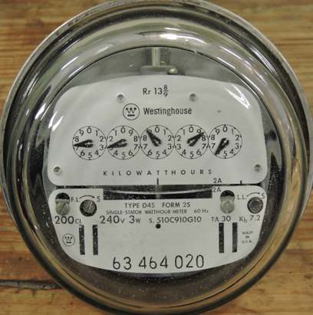
Consumption vs. Demand
Energy Consumption
Total electrical energy consumed over time
Measured in kilowatt-hours (kWh)
Energy Demand
The maximum amount of electrical energy drawn at a point in time during the billing cycle
Measured in kilowatts (kW)
Notes:
Before we look at the specifics of electric bills lets discuss electric energy consumption vs. electric energy demand. This can be a confusing issue.
Your building or facility does not consume energy at the same rate all the time. Most facilities have a greater need for power during the day, with lights, air conditioning, several computers and process energy all operating simultaneously. At other times, perhaps weekends or early mornings, your facility may only be operating some lights and a couple of computers.
In both cases, energy, as measured in kilowatt-hours (kWh), is being consumed. During the period when all the equipment is running, however, your facility has a higher rate of consumption, requiring a higher demand. Demand is measured in kilowatts (kW). Depending on a facility’s use, it is possible that the same amount of energy is consumed during both periods. During both periods, the utility is measuring the consumption of energy.
Consumption of electricity (kWh) requires an electric company to provide and charge for the poles, wires, and transformers for a building. Demand (kW) determines the required size of the wires and transformers.
Let’s look at another example involving two motors.

Slide 29


Example: Consumption vs. Demand
10 hp motor
10 hp motor at 75% load:
draws approximately 6 kW
consumes 60 kWh in 10 hours
100 hp motor at 75% load:
draws approximately 60 kW
consumes 60 kWh in 1 hour
The larger load requires:
higher demand
larger wires
larger transformer capacity
larger power plant
100 hp motor
Notes:
Let’s say there are two customers. One has a 10 horse power (hp) motor at 75 percent load and one has a 100 hp motor at 75 percent load. Each customer turns the motors on at the same time and lets them run until each consumes 60 kWh. Although each motor consumes the same amount of energy, the 10 hp motor will need to operate ten hours to consume 60 kWh while the 100 hp motor will only require one hour. The reason is that the draw, or demand, for the 100 hp motor is 10 times greater.
Since utilities will charge the same energy rate ($/kWh) to each customer regardless of whether there is a 10 hp motor being served or a 100 hp motor, they would receive the same amount of pay for the 60 kWh. However, in order to serve the customer with a 100 hp motor the utility has to provide larger wires, a larger transformer and larger protective devices. In addition, even if the 100 hp motor is not operating all the time, the larger equipment must be available at any given time to provide 60 kW for when the motor is operating.
In order to recover the costs associated with having the larger equipment available to serve the larger load, utilities charge for demand.

Slide 30
Electric Bills and Rate Structures
Sample Electric Bill
Notes:
Electricity Charges
Take a look at your electric bill. Your bill tells you how much energy and power you used along with the costs. Once you understand your electric bill, it can serve as a tool for using electricity more efficiently and reducing utility costs.
Most bills will be made up of three or more components, along with the respective charges and bill total. Although the bill is broken down into several components it is often difficult to tell exactly how the final charges were determined. How they are determined will depend on the rate structure applicable to your facility.
In addition, the different charges will vary from utility to utility, which means strategies for reducing energy costs will depend on the rate structure for your facility. If you do not know the rate structure for your building, one of the best ways to find out is to ask your utility for the information. Each utility has different rate schedules for different types of users, such as residential, small commercial, large commercial, industrial, farm, irrigation, and outdoor lighting. There may also be different schedules within each of these user groups depending on capacity, time of day use or other variables.
Lets take a look at some of the more common components of utility rate structures and how they are applied to commercial building energy use.

Slide 31
Electric Bill Components
Basic Service Charge, $/month
Fixed monthly fee
Covers meter reading, billing, and other administrative costs
Energy Charge or Rate, $/kWh
Total accumulated energy used per month, kWh
Constant or varied depending on rate schedule
Power and distribution
Power only in the case of unbundled rates
Notes:
The basic charge, or customer service charge (CSC), is a fixed monthly fee that covers the costs required for the utility to read your meter, prepare the billing and other various administrative costs.
Energy charge is based on the total energy used in the month as measured in kWh. It is determined using the appropriate rate in $/kWh for the rate schedule applied to your facility multiplied by the total energy consumed during the month. Some utilities charge the same rate for all kWh you use during the month, while others may charge different rates for different “blocks” of energy.
The energy charge typically includes both the cost for the power, along with the maintenance required to maintain the poles, wires and transformers used to distribute the energy serving your facility. In some states, utilities have “unbundled” their rates, separating the power component from the distribution component. When this is the case the energy charge is just for the power.

Slide 32
Electric Bill Components
Demand Charge, $/kW
Rate of consumption, kW
Highest interval average of month
Ratcheted or reset monthly
Distribution Charge, $/kWh
Unbundled rate component
Tied to total energy consumption $/kWh
Covers maintenance for poles, wires, transformers
Notes:
Consumption and demand were discussed earlier. The energy charge on the bill accounts for the energy consumed in a building. Demand charges are applied to the rate (how fast or slow) at which a building consumes the energy, measured in kilowatts (kW).
In the simplest terms, demand is the maximum amount of electrical energy drawn at any point in time during the billing cycle. But the way utilities calculate demand is slightly more complicated than that. Demand meters record the average level of electricity drawn for every 15 minute (or other) interval. The customer is billed for the highest interval average during the billing period. To reduce demand charges, it can help to know the length of interval used to calculate your demand.
The utility will charge for demand by either using this “peak” monthly value, or in some cases will use a “ratcheted peak” which is the highest value that has been measured during the current month or previous 12 or 36 month period. This ratcheted peak will then set the demand charge until a higher demand is measured. In either case the utility resets the demand on the meter each month.
When utilities unbundle their rates to allow a customer to purchase their own power, distribution charges are separate. The utility must still recover costs associated with the maintenance of the poles and wires that distribute the power. In this case the utility will have a distribution charge along with the energy charge.
Renewable energy sources such as solar and wind are increasingly becoming a part of the energy generation mix on the grid. These sources are often considered a type of distributed generation (also known as distributed energy resources or DER), meaning that they are produced close to or on the site where they are used. This can affect the various costs associated with providing power, and is one reason utilities are increasingly adopting unbundled rate structures.

Slide 33
Electric Bill Components
Power factor/reactive charge, $/kW
Result of inductive loads
Measured in kVAr
Minimize with capacitors
Inductive loads require two kinds of power to function properly
Active Power (kW)
Actually performs the work
Reactive Power (kVAr)
Maintains the electromagnetic field
Notes:
Power factor (PF) or reactive charges are primarily found on commercial and industrial bills due to the much larger percentage of induction loads from motors, welders, and small “dry-pack” type transformers found in these facilities. Induction-type loads require both “real power” (kW) and reactive power (kVAr) to develop the magnetic field necessary in induction loads. In order to insure that there is enough real power for the induction load, utilities must send additional volts and amps or apparent power (kVA) to the facility. The power factor is the ratio of real power to the required apparent power and is measured in percent.
PF = kW/kVA.
Reactive power is measured by kilo-Volt-Amperes reactive or kVAr. If there is no reactive power in the load (e.g. an incandescent light bulb) then the real power and the apparent power are equal and the power factor is 1.0. The closer to 1.0 the power factor is, the less apparent power is necessary.
Most utilities have a set minimum power factor. Once the power factor drops below this value the reactive charge is applied. If a facility can maintain their power factor above the minimum required, the reactive charge is zero. Because of this many customers use capacitors to correct the power factor or bring it closer to or above the minimum value to avoid the charge.

Slide 34
Electric Bill Components
Adjustment Charges, $/kWh
Power cost adjustments
Could be a charge or credit
Special Provisions
Primary metering ($/kWh or % kW)
Public purposes or benefits (% of bill)
Notes:
Adjustment charges or credits result from changes in the cost of energy purchases made by the utility to produce electricity. The utility has to pay for their oil, coal, natural gas, and/or uranium. The power cost adjustment to the rate is meant to reflect changes that occur in the cost of obtaining fuel, other commodities, etc.
Primary Metering: Transformers heat up, vibrate, etc. These are energy losses. The standard for developing the utility rate assumes that the electric meter will be on the secondary side of the transformer. In that case, these efficiency losses are lost before they go through the meter. To insure these losses are recovered, the utility includes them in the calculation of the rate.
However, industrial and large commercial customers often own the electric equipment at their facility and have the utility put the meter on the incoming or primary side of the transformer. When this is the case the meter will measure the efficiency losses associated with the transformers and if the customer is billed for the metered usage, the customer would essentially be billed twice for the losses.
To offset this, the utility will offer a primary metering discount in the form of a percentage or actual rate deduction.
Public Purposes or Benefits: In order to encourage utilities to invest in conservation, renewable energy, and low-income bill assistance several states have begun requiring utilities to collect an additional amount beyond the cost for energy. Because this additional charge is used for public purpose or public benefits, it is designated as such on the bill. Money collected must be used as earmarked and is either administered by the utility or a state agency.

Slide 35
Utility Rate Structures
Seasonal
Rates vary throughout year
Typically separated by season (summer, winter, etc.)
Time-of-Use (TOU)
Rates vary during day
Peak and off-peak periods
Block
Rates vary by monthly consumption
Flat, inverted, declining
Rates set in blocks of monthly usage (i.e. 0-500,000 kWh; 500,000 – 1,000,000 kWh)
Notes:
Up to now we have discussed many of the different components of electric bills, but not how they are combined to determine the final amount. How a utility combines the components is called the rate structure. Depending on what a utility is trying to accomplish or to provide an optimum rate for their customers, different types of rate structures have been developed. Besides the basic rate structure which charges a fixed rate for all of the energy, a fixed rate for all of the demand, a fixed rate for power factor, etc., other common rate structures include seasonal rates, time-of-day rates, and block rates.
Seasonal rates account for the fact that a utility’s energy costs is going to vary by season depending on the demand, fuel costs, water levels etc. In this case it is common to see the rates a utility charges change 3 to 4 times throughout the year. Depending on the magnitude of the variation, it is not a bad idea to consider operational strategies based on the seasons, such as shut-downs during price peaks or double shifts during dips.
Time-of-Use (TOU) rates, on the other hand, are used to send the proper price signals to a facility owner regarding the cost of energy during specific times of day. Generally, the largest demand for energy, and thus highest costs for the utility, is during the weekday from approximately 6 to 10 a.m. and again from 3 to 7 p.m. This is called “peak” period. Other times of the day and weekends are known as “off-peak” periods. In order to encourage customers to defer the energy use to times of lower costs, utilities offer TOU rates which charge a higher peak period rate and lower off-peak rates. In some cases, this is an optional rate the customer can request.
Block rates are structured by offering different rates as usage increases during the month and are often used to encourage a more efficient usage pattern. An inverted block rate is structured such that as a facility uses more energy the rate increases. This type of structure might encourage a customer to save energy and not reach the point where the higher rate is triggered. A declining block structure does the opposite and decreases the rate as the facility consumption increases. Finally, there is the flat block structure which is the most common and, as implied, charges a flat rate regardless of the facility’s consumption.

Slide 36
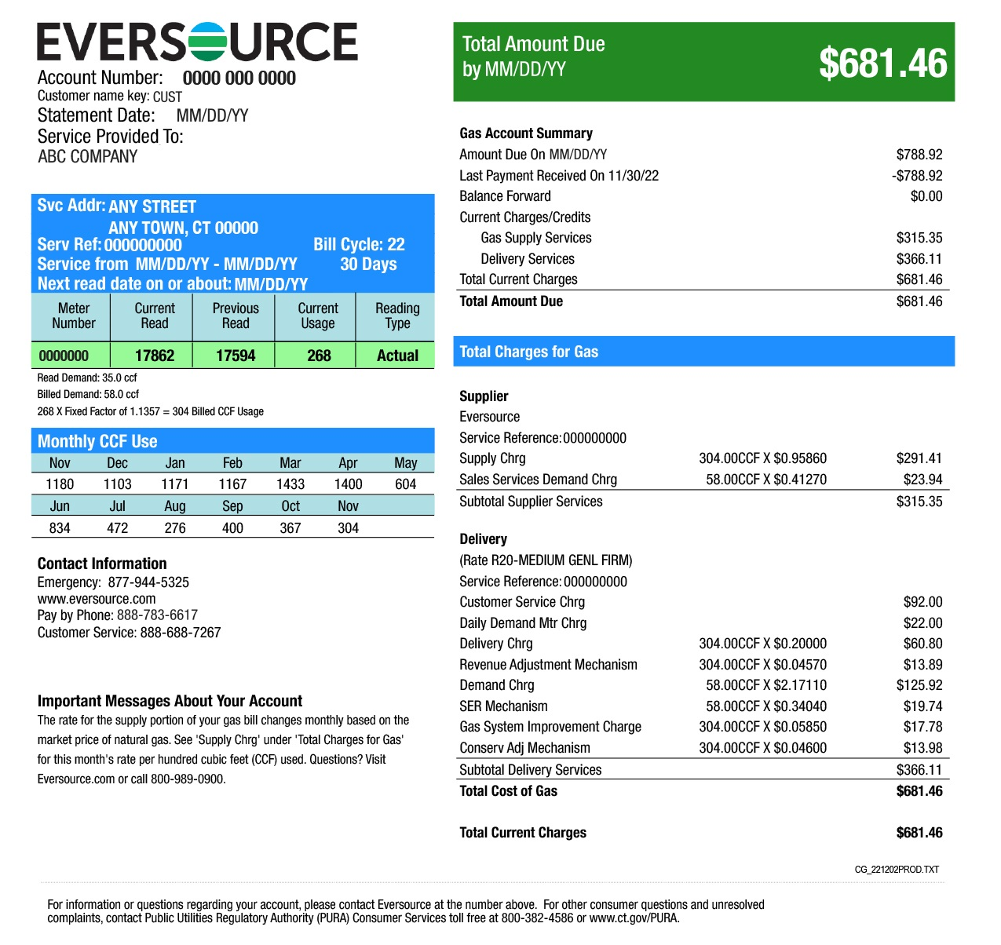
Gas Bills
Basic charges
Metered use
Demand
Delivery
Adjustments
Special Provisions
Image source: Eversource
Notes:
Like the concepts we discussed for electric bills, gas bills have a rate structure and billing components that are listed on the utility’s web site and are approved by the state utility commission.
Image source: Eversource

Slide 37
Water Bills
Metered use
Basic charges and flat rates
Tiered use rates
Often include:
Sewer charges
Fire systems
Stormwater
Irrigation may be included or billed under separate meter
Notes:
Rate schedules for water are available on the utility website. Water bills are often billed bi-monthly, which makes tracking use effectively a little difficult. In other cases, the bills might be monthly, with flat or base charges billed by calendar dates, while metered use is shown by meter reading dates.
Sewer is charged based on water consumption, so any water use that does not go down the drain – like irrigation, cooling towers, water-cooled equipment, steam sterilization should ideally be metered separately to reduce sewer charges.
A deduct meter can be added and reported to the utility if a new meter is cost prohibitive.

Slide 38
Waste Bills
Basis of charges can be weight or volume
Can be difficult to track quantity
Includes:
Trash bound for landfill or incinerator,
Recycling – mixed or single stream
Compost
Notes:
Like the concepts we discussed for electric bills, waste bills have a rate structure and billing components that are listed on the utility’s web site. Waste disposal and diversion can be challenging to track accurately. For example, you have an eight-yard dumpster, collected twice a week – but how full is it, and what is in it?
Conversion factors for different types of waste are available to help get everything into weight or volume. Similar to the kBtus to help compare energy from different sources, this is useful to understand how to measure and manage waste.

Slide 39
Group Exercise #2
Utility Billing and Rate Structures
Using the utility bill example in your handbook or a local electric, gas, water, or waste rate schedule and meter read data handout provided by the instructor, examine the billing amount you would expect to pay.
1. What type of rate structure is the utility using?
2. Discuss how this rate structure encourages or discourages either energy or demand conservation and why.
Notes:
1. What type of rate structure is the utility using?
2. Discuss how this rate structure encourages or discourages either energy or demand conservation and why?

Slide 40
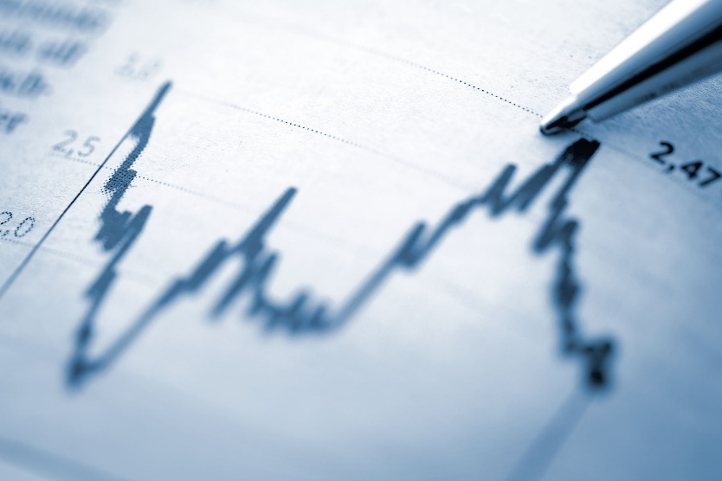
Energy Accounting
Track and account for utility costs
Benchmark performance
Identify savings potential
Justify capital expenditures
See results of conservation
Gain management support
Detect increased consumption
Identify billing errors
Rate changes
Fuel switching
Notes:
Understanding how energy is being supplied to the facility and how it is billed is a first and necessary step to managing the energy serving a facility. A familiar phrase that applies directly to improving the energy performance of a facility is:
“You can’t manage what you don’t measure.”
The next logical step to developing a successful energy management program is establishing a formal process to collect, measure, and monitor the energy consumption and the costs. Only by understanding exactly how energy is used in your facility can you begin to identify and prioritize energy management activities.
The following sections will discuss the collection, tracking, organization, and analysis of energy consumption information. This activity is commonly called “energy accounting.”
There are several reasons why good building energy management relies on good energy accounting. Energy accounting is key in enabling you to: 1) judge performance, 2) improve operations, and 3) save money. It provides a method of tracking changes and helps identify problems. Without it, you won't know the results of your efforts.
Energy accounting is the first step in determining potential savings. If building performance is poor, efforts can be aggressive. If performance is good, simple strategies may be all that is required. Without energy accounting, you may not know if your projects are performing as expected. Capital expenditures targeted to save energy benefit no one if they aren’t working properly.
Even minimal record keeping can help. Energy accounting will help track utility costs, benchmark performance, identify savings potential, justify capital expenditures, track progress toward conservation goals, gain management support, detect increased consumption and identify billing errors.

Slide 41
Energy Accounting Steps
Initial set up
Determine energy sources
Collect and organize utility and physical data
Maintain and Update
Ongoing as part of continuous improvement
Calculate building performance indicators.
Analyze and account for energy consumption trends.
Identify areas for potential improvement.
Notes:
Energy accounting is the term used to describe the formal process of providing long term organization and monitoring of utility cost and consumption data. It is a system for tracking energy usage and applying that information to control energy costs, essentially bookkeeping for energy management and is the cornerstone of good energy efficiency practices.
The basis of energy accounting generally involves collecting and recording a facility’s fuel and electrical consumption during various periods, and then developing standardized indices of consumption. If necessary, this data may have to be adjusted to account for changes in weather, occupancy patterns, production rates, or other variables which can impact consumption.
By analyzing the data further, it is possible to identify relationships between energy use and other variables, such as occupancy, floor area, and outdoor temperatures. Once seasonal patterns are established, any month’s energy use that doesn’t fit the pattern will signal that some change in business activity or energy efficiency has occurred. In this way, potential problems such as equipment failures or inefficiencies can be identified and remedied sooner.
As noted before, the same process is applied to managing water, waste and other sustainable performance measures.

Slide 42
Identify Energy Sources
Pro tip:
Check if your utility will provide data or exchange it with Portfolio Manager
Sources
Identify all energy sources and meters
Monthly bills for all sources
Use most recent data
Minimum of 1 year (preferably 2 or 3)
Usage data (kWh, therms, gallons)
Cost data ($)
Notes:
Evaluating energy performance requires good information on how, when, and where energy is being used. The first major step in energy accounting is to collect and organize all of the utility data for your facility or facilities. Make sure to identify and account for all of the energy that is used, including electricity, natural gas, oil etc. Make note of the meter ID numbers.
Building energy consumption patterns change for a variety of reasons including weather, operations, or physical building alterations. Using the most recent data available is critical. If you do not have this data in your work area, very often it can be found in the accounting or purchasing department. It may also be held centrally at corporate offices. In many instances the easiest way to obtain the data is to contact the appropriate utility representative. They should be able to get what you need.
Make sure to gather a minimum of one year’s worth of data, but it is helpful if you can get two, three, or even more years of monthly usage history. Once you have the data, make an appropriate file for it and keep it where it is easily referenced.
A little later we will discuss software tools to help with utility accounting. Many utilities will exchange your data monthly with major tools, like Energy Star Portfolio Manager. And Portfolio Manager will exchange data with other reporting and certification platforms like Measurabl and Arc Skoru.

Slide 43
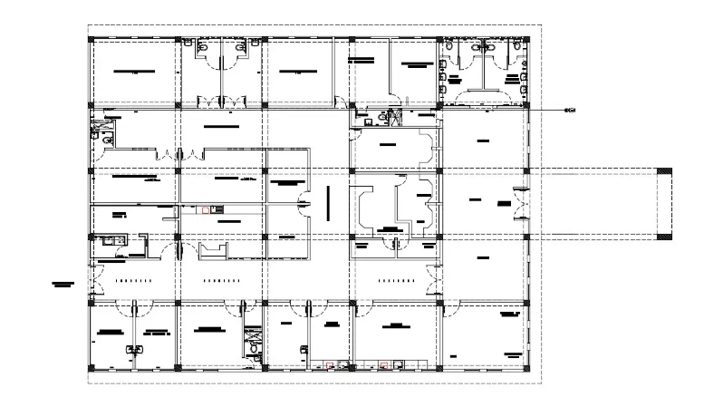
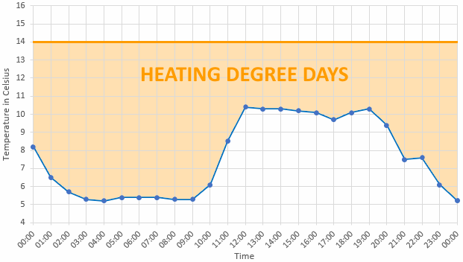
Collect Physical Building Data
Physical Attributes
Multiple buildings/meters
Construction type
Floor plans, schematics, equipment schedules, zoning
Operational Profiles
Activity types
Occupancy profiles
Operating hours
Local Weather Data
Average monthly temperatures
Heating & cooling degree days
Image source: Cadbull
Image source: DegreeDays.net
Notes:
Although this class focuses on energy management, non-energy related data is also critical to collect.
You will need to collect the physical characteristics of your facilities, such as floor plans, construction types, conditioned areas, as well as operating characteristics such as activity types, occupancy hours and schedules. Finally, it will be important to gather some information regarding historical weather patterns. Data can be obtained from your utility company, local airport reporting station, National Oceanic and Atmospheric Administration (NOAA), or weather stations.
Heating and cooling degree days are measures commonly used in energy management calculations, as a method to get an apples-to-apples comparison between two periods where the weather (and thus heating/cooling energy requirements) differ. They are based on the idea that a building needs neither heating nor cooling at a specific outdoor temperature, usually 65ºF in the U.S. Degree days are the difference between the daily temperature mean (average of high temp and low temp) and 65°F. If the temperature mean is below 65°F, we subtract the mean from 65 and the result is Heating Degree Days (HDD). If the temperature mean is above 65°F, we subtract 65 from the mean and the result is Cooling Degree Days (CDD). For example, if the mean temperature on a specific day was 50°F, we can say it had 15 HDD. If the mean temperature was 70°F, we can say there were 5 CDD on that day. We’ll discuss this concept further later.
A helpful degree day calculator can be found at the following link. https://www.degreedays.net/

Slide 44
Organize Utility & Building Data
Data Organization
By building
By meters or sub-meters
By fuel type
Organization Methods
Manual accounting
Data tracking spreadsheets
Accounting software
Notes:
Once you have collected the data, it is important to get it organized so that it can be analyzed and presented correctly. Before beginning your energy accounting program, several steps must be taken to ensure you have all the information required to do a thorough and accurate evaluation of your energy consumption.
• Make sure you receive copies of all monthly utility bills.
• Sort utility bills by building or by meter, and organize them into 12-month blocks using the meter-read dates.
• Locate all meters and sub-meters. If numerous meters are used, it is helpful to clearly label them on a master blueprint for each building being monitored.
• Determine which building or space is being served by each meter.
• Calculate total area and conditioned area (in square feet) for each building.
• Obtain historical energy data to establish a base year. If you don't have this information in your files, it can be obtained from your utility company.
• Obtain degree-day data from your utility company, local airport reporting station, NOAA, or weather stations.

Slide 45
Organize Utility & Building Data
Multiple Buildings/Fuels
Locate all meters as necessary
Elec Meters
Gas Meters
5
6
7
2
8
4
9
3
1
Central Avenue
Notes:
Monthly collection of data is usually sufficient to monitor energy management programs for most businesses and institutions. Organize all consumption data and graphs in a dedicated file and keep it up to date. Data must be recorded on a regular basis and made readily available to building operators and administrators as part of your ongoing energy management plan. It's a good idea to assign someone the responsibility of keeping the energy consumption data current.

Slide 46
Organize Utility & Building Data
Sub-meters
Notes:
If you are fortunate enough to have sub-meters, it will be very useful to organize the data so that you can monitor the individual meters.
If you do not have sub-meters and need to make estimates for each building, allocating by area is another alternative, as long as the function of the individual buildings are similar.
An even better method would be to perform some short term metering for each building. Your local utility may be able to assist you in this effort.

Slide 47
Organize Utility & Building Data
Data Tracking Spreadsheets
Common Inputs
Read dates
Days in billing period
Fuel consumption, kWh, therms, gallons
Adjusted usage
Electric demand, kW
Fuel costs, $
All fuels converted to BTUs if needed
Totals
Notes:
Spreadsheet Set-Up: The forms used for recording energy data should be clear and usable to people entering the data and to analysts and managers interpreting it. Record energy units (kWh, therms, gallons, etc.), electric demand (kW) and dollars spent for each fuel type. Units of production (number of units, occupied rooms, students, persons served, etc.) can also be included in your spreadsheet if such production is directly related to your energy consumption.
Typically, the analysis is done on an annual basis, so choosing which months represent the year is important so that it coincides with financial department budgeting. The energy-accounting year may be any 12-month period for which energy data is entered. Common spans are the calendar year or the July-to-June or October-to-September fiscal years. Choose an accounting year that best suits your needs and start your data entry for the first month of the accounting year. The same accounting year must be used for all weather and consumption data.

Slide 48
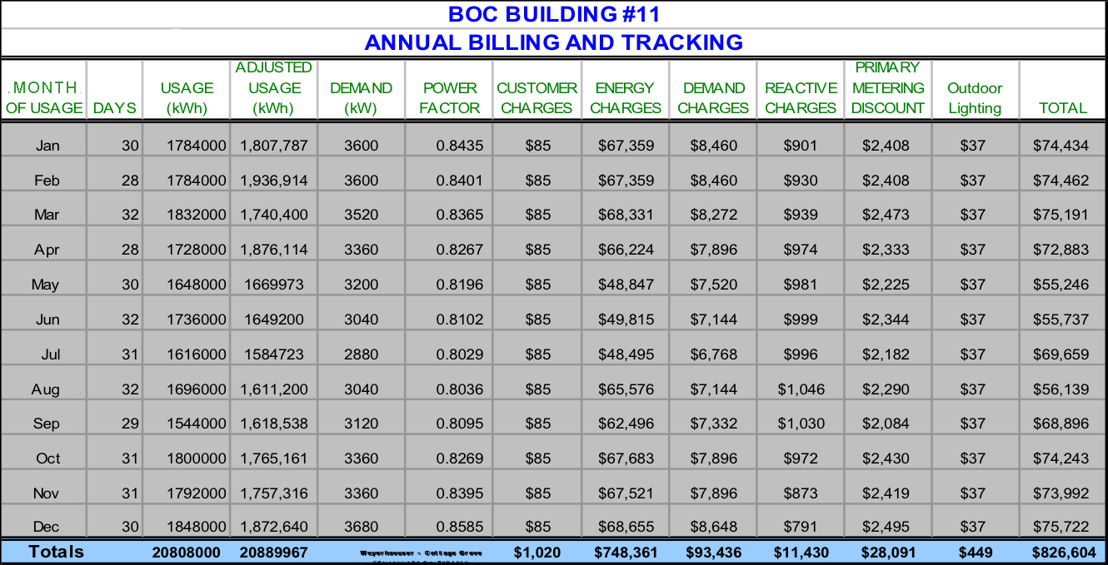
Organize Utility & Building Data
Data Tracking Spreadsheet Sample

Slide 49


Maintain and Update
Organizing Utility & Building Data
Spreadsheets
Energy Accounting Software
Update data on a regular schedule and where possible automate the updates.
Maintain and Update
Image courtesy of Resource Media
Notes:
The advantages of a software-based energy accounting system are well documented. Once the software has been personalized for a given facility and the monthly data entered, a variety of calculations and reports can be generated with little effort. Numerous software programs exist, so a careful study of individual accounting needs is necessary.
Energy accounting procedures need to be thoroughly understood to get the most out of any software tool. In practice, you might use Portfolio Manager as a central hub and for common calculations but download data to periodically create graphs or analyze and share trends or evaluate impact of improvements.
Energy Star Portfolio Manager is the most widely used, free tool for energy accounting and we will introduce it in the next steps.
What software does your organization use?

Slide 50
Determine Performance
Indicators
Energy Use Intensity (EUI) kBtu/ft²/year
Variants include Source and Site EUI, and weather normalized EUI
Electric or Gas Use Intensity to evaluate a single fuel or end use might be expressed in kWh/sf or therms/sf
Greenhouse Gas Emissions Intensity (GHGEI) kgCO2e/sf/yr
Water Use Intensity (WUI) kgal/sf/yr
Calculate building performance indicators.
Notes:
If energy accounting is the cornerstone of good energy management, then the EUI is the cornerstone of good energy accounting.
Once the utility and physical building data has been collected, performance can be determined by calculating the Energy Use Intensity (EUI). Energy use intensity is a calculation that allows us to measure the performance of a building in common units. The units are typically expressed in thousand Btus per square foot per year. This is written as kBtu/SF – these are annual summaries, so the per year (/yr) may not always be noted but is assumed.
The EUI can be used to compare energy consumption relative to similar building types or to track consumption from year to year in the same building.
Indicators enable you to track performance over time and compare performance with similar facilities larger or smaller than yours. The EUI can be used for long range planning and short-term identification of problems. If you aren't using it, you don’t know where you have been or where you are going.

Slide 51
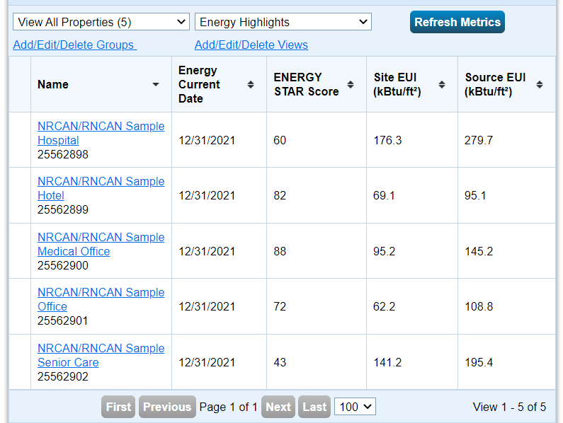
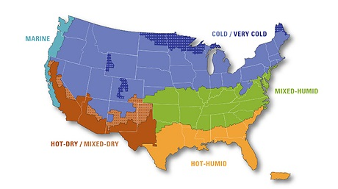
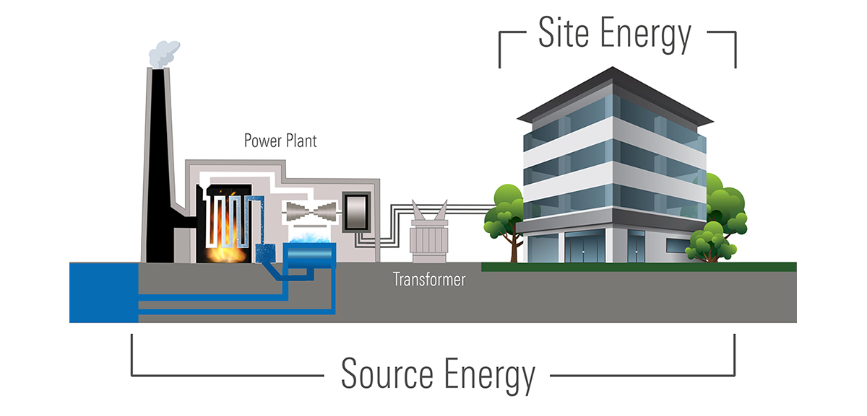
Understanding EUIs
Notes:
We will get into the details of calculating your EUI shortly. A more refined number is “weather normalized” EUI or WNEUI. You can find this value in Portfolio Manager, and it adjusts the EUI to account for weather variables by calculating what your EUI would be under average climate conditions.
This can be complicated to calculate, but a simpler option to do this yourself is to calculate kBtu/sf/HDD (or CDD in cooling-dominated climate). Recall, we discussed gathering weather data in an earlier slide. Degreedays.net has limited free downloads of recent degree day data.
Site EUI is the energy used at the site, and if not specified, you can assume an EUI is site energy. Source energy captures the energy from the point of generation and is larger due to account for transmission losses. A primary source of benchmarking data is the US Department of Energy’s Commercial (CBECS) and Residential (RECS) Energy Consumption and Expenditure Survey databases consist of a scientifically-selected sample of commercial and residential buildings and building occupants from throughout the United States. The latest CBECS survey data can be obtained from the U.S. Energy Information Administration website at eia.gov.
Climate map source: https://www.energy.gov/eere/buildings/building-america-climate-specific-guidance
Site-Source graphic: https://www.energystar.gov/buildings/benchmark/understand_metrics/source_site_difference

Slide 52
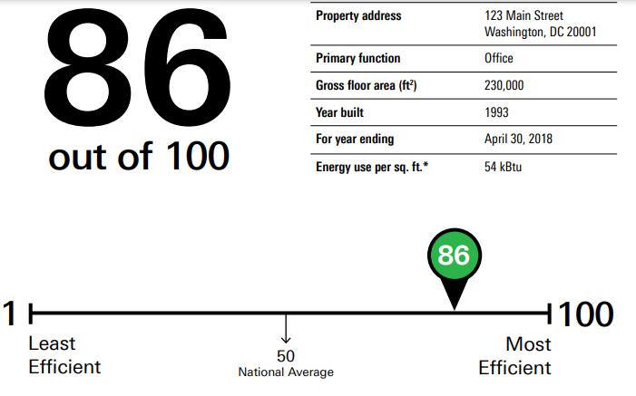
Benchmarking
A standard by which something can be measured or judged
ENERGY STAR Score – 1-100
ranking from best (100) to worst (1)
by Source EUI against national median, adjusted for weather, activity type, occupancy, hours of operations
If no Score for your building type, compare to National Median on Statement of Energy Performance
Notes:
A benchmark is a standard by which something can be measured or judged. Once you have calculated your building’s EUI, you can use it to benchmark your building. The most basic standard to compare against for your energy intensity is the median energy intensity for buildings of a similar building activity type.
Benchmarking allows you to compare the energy performance against similar facilities or an established level of performance.
For energy management purposes, it allows you to develop relative measures of energy performance, track change over time, and identify best energy management practices. It will also point you in the direction of where you need to focus your efforts. It is very important to compare apples with apples.
The U.S. Environmental Protection Agency’s ENERGY STAR Score rates commercial building’s energy performance relative to similar buildings nationwide.
Expressed as a number on a simple 1 – 100 scale, the score rates performance on a percentile basis: a building with a score of 50 performs better than 50% of its peers. Higher scores mean better energy efficiency, resulting in less energy use and fewer greenhouse gas emissions.
For fairness, ENERGY STAR scores are based on Source energy, so that buildings are not unfairly credited or penalized for their location and characteristics of the utility grid there. The underlying data for Portfolio Manager is from CBECS.

Slide 53
Benchmarking
Benchmarking Tools
ENERGY STAR® Buildings
Portfolio Manager – http://www.energystar.gov
Assess building energy performance
Online benchmarking
Building energy management
Tracking & updating
Motivate conservation
Recognition of Excellence
Statement of energy performance
Verification of energy performance
ENERGY STAR® buildings label
Notes:
There are tools which can also help you get an understanding of your building’s energy performance.
One of these is ENERGY STAR® Buildings Portfolio Manager, which is based on energy use and lets you compare the energy performance of your facilities to similar buildings nationwide. Portfolio Manager also normalizes for weather and several other important building and operational characteristics, allowing comparisons to be made on a level playing field. Once you have achieved the required performance (75 or better) your building can then be recognized and obtain an ENERGY STAR® label.
Other rating systems include:
LEED – based on points (1-110)
IGCC/ASHRAE 189.1 code
Building Energy Asset Score

Slide 54
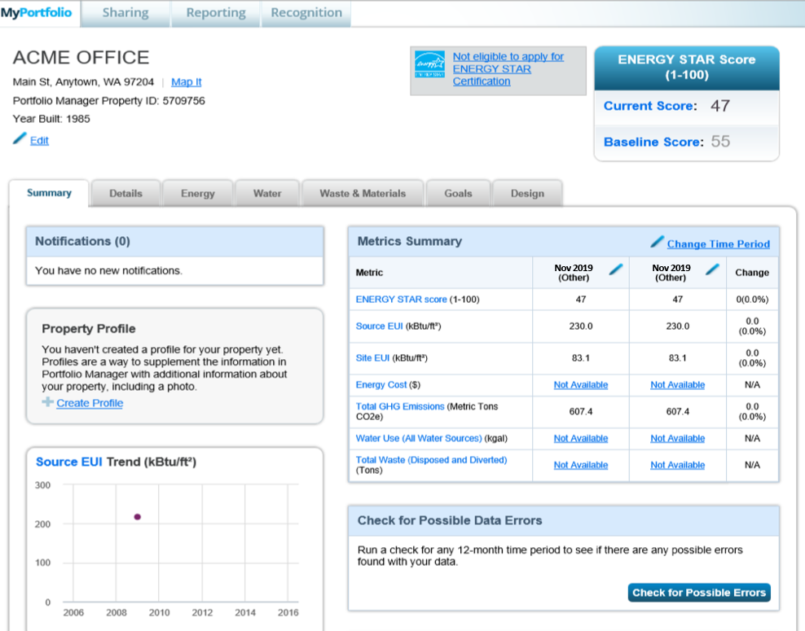
Benchmarking
Portfolio Manager
Notes:
The Summary Tab is an executive summary of all energy performance rating-related data for a property. You will see a Metric Summary to compare Energy Star Scores, Source EUI, Site EUI, Energy Cost, GHG, Water Use and Total Waste.
The Details Tab organizes information regarding your property’s use details such as property type, Gross Floor Area and Occupancy.
Energy, Water and Waste & Materials Tabs are all used to track consumption. You may either sign up for the automated data exchange with utility companies (if available) or manually enter your month by month consumption.
The Goals Tab allows users to set specific EUI targets and Energy Star Scores to achieve specific project goals. Note: An Energy Star Score is a different metric than an EUI.
A higher Energy Star Score means better performance than a lower one, while a lower EUI means better performance than a higher one.
You may also generate and download performance documents for your properties:
Statement of Energy Performance (SEP)
Score Card
Progress & Goals Report
Data Verification Checklist
The Design Tab allows users to download the Statement of Energy Design Intent (SEDI). This document provides an overview of the user’s design and metrics.

Slide 55
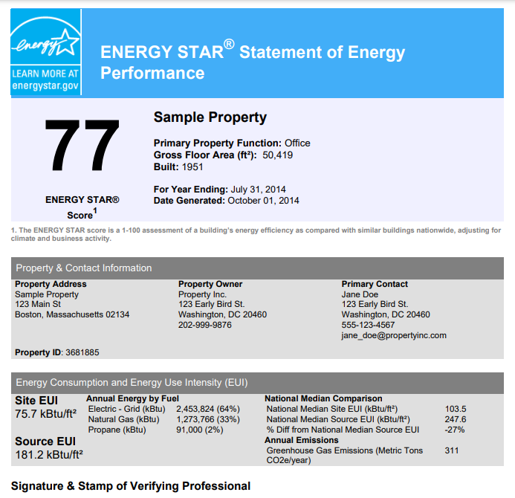
Notes:
This is a Statement of Energy Performance for an example office building in Boston, MA.
Let’s look at some key information shown here.
Property function or use category is clearly a defining characteristic.
Would you expect an office, a hospital and a school to all use the same amount of energy each year, even if they were the same size? (No!)
The property address is relevant as well since it determines the local climate and weather reference point.
Note the Site and Source EUIs are shown, as is a total and percentage break out of the different fuels used in this building.
The Nation Median Site EUI is shown for reference.

Slide 56
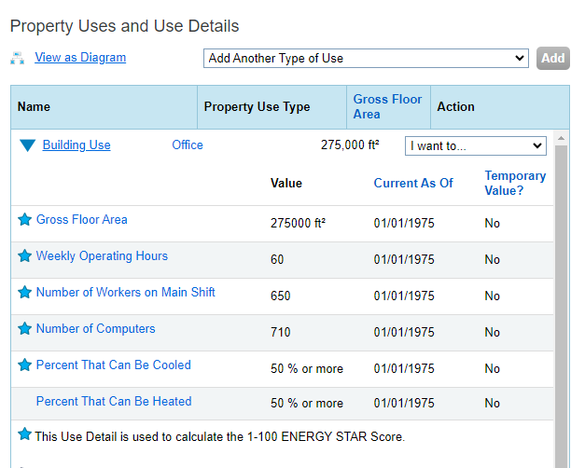
Property Use and Details
Notes:
Interpreting a building’s EUI, or any other indicator performance by comparing it to a standard, means that the standard needs to be appropriate.
Think about some of the factors, besides size, that help determine how much energy a building uses.
An overarching factor is the property use or activity category.

Slide 57
Benchmarking
Benchmarking Tools
CBECS -- Commercial Buildings Energy Consumption Survey, from the US DOE Energy Information Administration
Energy Benchmarking for Laboratories – Lawrence Berkeley National Lab – https://lbt.i2sl.org
Wegowise – https://wegowise.com
Measurabl – https://measurabl.com
Arc (LEED) – https://arcskoru.com
Notes:
There are a variety of other tools available. A few are listed here. Many of these tools interact with Portfolio Manager. A web search on “Building benchmark tools” will yield several more.

Slide 58
Exercise #3
Energy Accounting
You have collected the following information for a building:
Building Type: Office
Total Area: 28,500 ft²
Electric Consumption: 523,700 kWh/year
Natural Gas Consumption: 5,500 Therms/year
Determine:
Calculate the site Energy Use Intensity (EUI) in kWh/ft²/year
Is this building performing well and why or why not?
Notes:
Individual Exercise #3: EUI calculation
You have collected the following information for a building:
Building Type: Office
Total Area: 28,500 ft²
Electric Consumption: 523,700 kWh/year
Natural Gas Consumption: 5,500 therms/year
Calculate the Energy Use intensity in kBtu:
Step 1: Convert annual kWh and therms to kBtu
523,700 kWh x 3.412 kBtu = electric ____________kBtu
year kWh year
5,500 therms x 100 kBtu = gas ____________kBtu
year therm year
Step 2: Add the kBtu and divide by SF
Is this building performing well and why or why not?
We do not know due to lack of Geographic Location and Benchmark Comparison Chart. To determine the building performance, the EUI (Energy Use Intensity) needs to be determined and compared to a benchmark chart.
Notes:
1kWh = 3.412 kBtu, 1 Therm = 100 kBtu
EUI Charts are expressed in kBtu/ft²/year. EUI= kBtu for all energy consumption, Electric and Natural Gas combined (to be added together).
Electric _____kBtu/yr. + Gas _____kBtu/yr. = EUI _____ kBtu/sf/yr
square feet
EUI = 18.4 kWh/ft²/yr. and 62.7 kBtu/ft²/yr.
19,298 Btu/ft²/year and 19.3kBtu/ft²/year

Slide 59
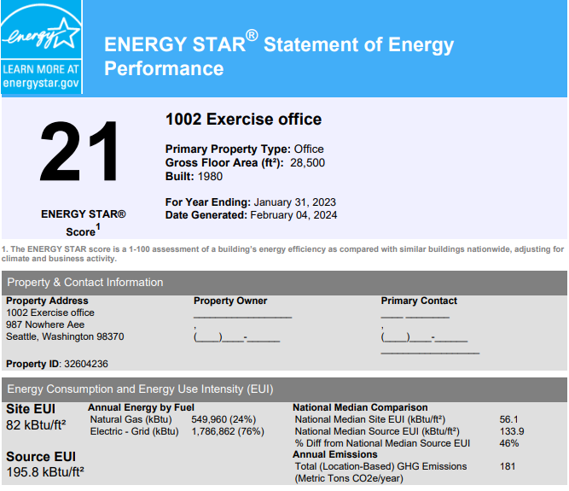
Group Exercise #4
Interpreting an EUI
This is a Statement of Energy Performance for the Exercise 3 office building.
Notes:
Using the data on the Statement of Energy Performance for the building in Exercise #3, 1. How does this building compare to the benchmark of national median EUI for similar office properties? 2. Is this building operating efficiently?

Slide 60
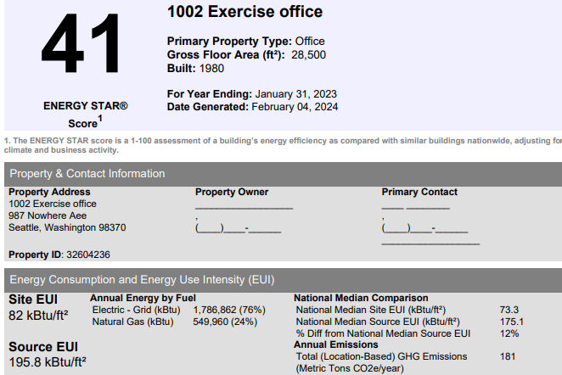
Group Exercise #4 cont.
Notes:
This is the SEP for the same building using the same annual energy use.
1. What is different on this SEP? 2. What might be different in the building set up in Portfolio Manager to cause this? See next page for some hints.

Slide 61
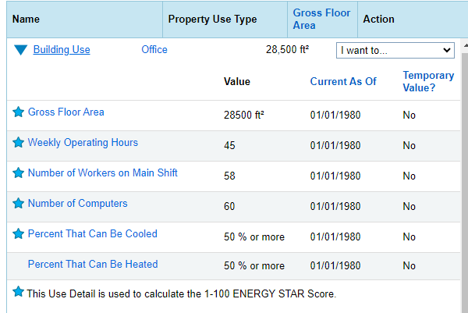
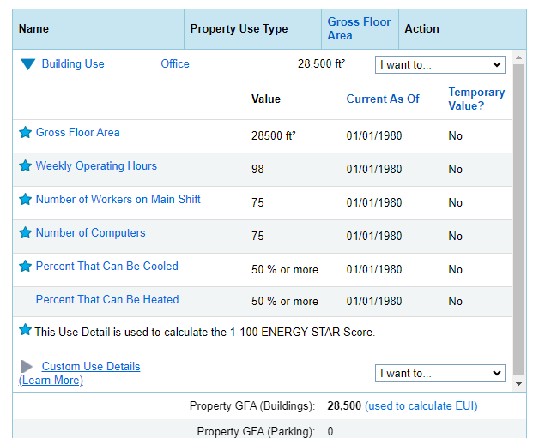
Group Exercise #4 cont.
Notes:
Notice that the EUI on both SEP reports is the same. Which set of building use details do you think goes with each SEP?

Slide 62
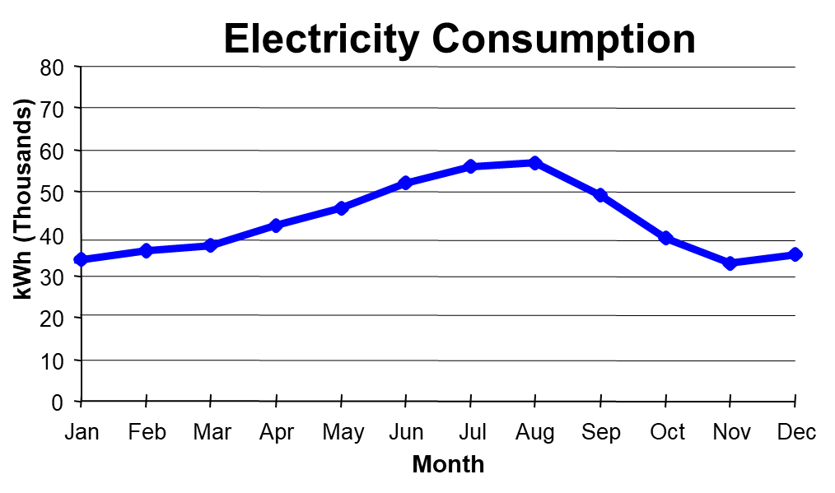
Building Data Analysis
“Good management requires good information.”
Peter Herzog, Energy-Efficiency Operation of Commercial Buildings
First Quarter Cost Breakdown
Demand kW - 34%
Power factor - 8%
Energy kWh - 58%
Notes:
Gathering the data and determining an initial performance of your building is a critical first step. Next you will want to take the data and see just what is going in your building so that you can begin optimizing your building’s operation. Benchmarking gives you a big picture view of your building's energy use and how much room for improvement there might be.
In this next section we discuss how to trend, analyze, and present the data you have collected to better understand where energy is being used in the building.
We will look at types of graphs and charts, and trending methodologies. By looking at trends of consumption an operator can see what the building is doing and know when something has gone (or is beginning to go) wrong.
Charts and Graphs help make energy data comprehensible to those who will use it, including administrators, board members, building owners or managers, and maintenance personnel, as well as accountants and energy analysts. It is important to identify and accommodate each audience that will be using the energy data to make decisions.
To best convey information, it is necessary to get the reader’s attention. Colorful graphs, tables, and pie charts present essential data in a more visually appealing form than text and can help to generate awareness, to motivate or to serve as public relations tools. Remember the saying “a picture is worth a thousand words”?
Choose the information for each graph to suit the target audience. For example, actual monthly consumption by fuel type may be of more interest to the maintenance staff, while annual costs or dollar savings information may be more appropriate for executives, board members or administrative personnel.

Slide 63
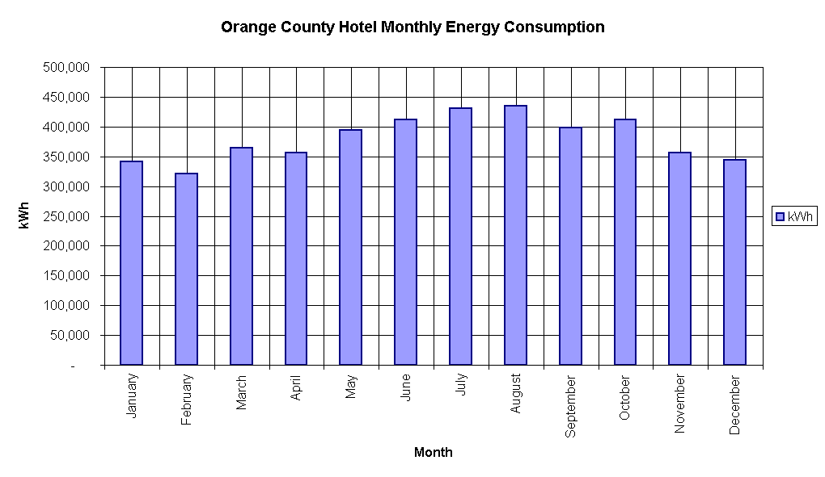
Load Profiles
Consumption Profiles
Notes:
Bar chart example showing the seasonal variation in energy use.

Slide 64
Base & Seasonal Loads
Electricity Consumption
80
70
60
50
kWh (Thousands)
40
30
20
10
0
Jan
Feb
Mar
Apr
May
Jun
Jul
Aug
Sep
Oct
Nov
Dec
Month
Notes:
Base Loads and seasonal load analysis is often done with a line graph of energy use over time.
Base loads are the energy-using systems that consume a continuous amount of energy throughout the year. The base load can be established by drawing a horizontal line across a graph of energy consumption or cost at the average point of lowest consumption for each energy type. The base load is that portion of consumption or cost below the line. Typical base loads include interior lighting, office equipment, appliances, domestic hot water, and ventilation.

Slide 65
Base & Seasonal Loads
Cooling
Electricity Consumption
80
70
60
Air Conditioning
50
kWh (Thousands)
40
30
Base Load
20
10
0
Jan
Feb
Mar
Apr
May
Jun
Jul
Aug
Sep
Oct
Nov
Dec
Month
Notes:
Seasonal Loads
Seasonal loads, such as heating and air conditioning, are identified as the portion of consumption or cost located above the base load line on the graph. Seasonal loads can be the result of changes in weather or operation of the building. For example, in a school district, school buildings may not be occupied during the summer, so summer loads are much lower than loads during the school year.
Assume the line graph above represents the baseline for your building. You can see by the shape of the line that more energy is being consumed in the summer months. This is a good estimate of the energy being used for air conditioning.
By knowing when cooling usually begins, which in the graph above is in March, a flat line can be drawn and a preliminary estimate of cooling energy can be estimated. The area above the line is air conditioning and the area below the line represents the base load. It would be a safe bet that heating for this building is not supplied by electricity.

Slide 66
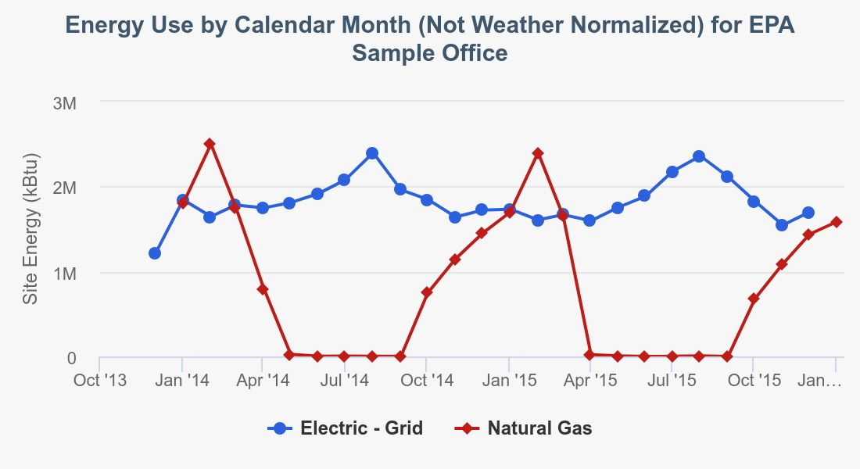
Trend Chart Example
Notes:
This trend chart from Portfolio Manager shows both electric and gas use.

Slide 67
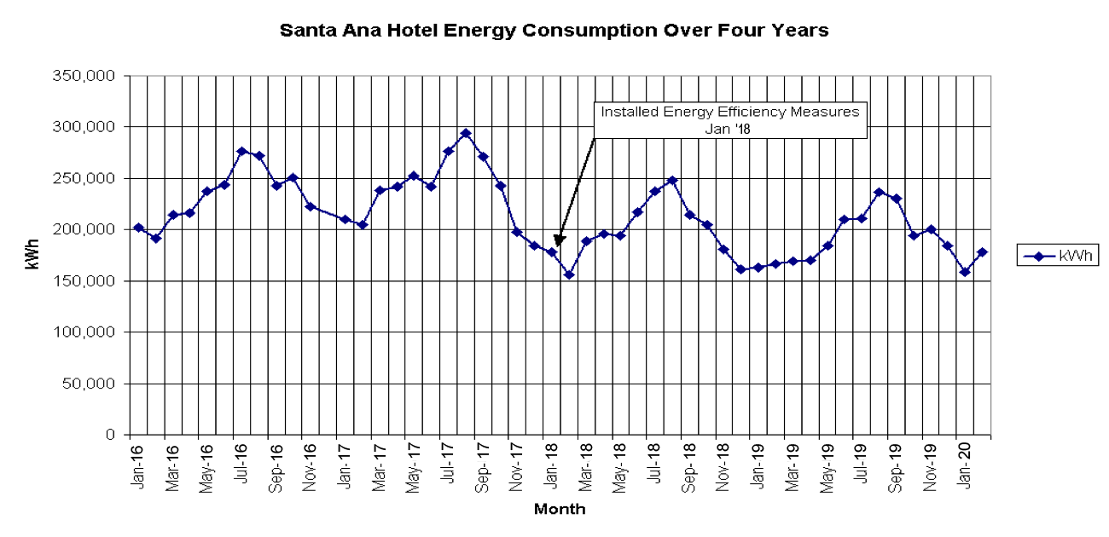
Historical Trends
Monthly electric use

Slide 68
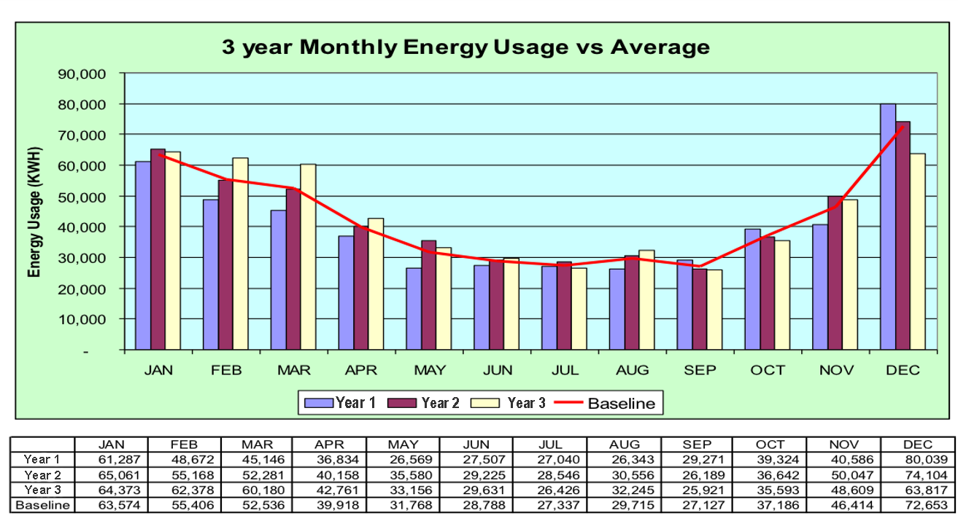
Baseline Profile
Notes:
Establishing a Baseline Year
In order for energy consumption data to have meaning, a baseline year is needed as a standard for comparison. Typically, the year previous to initiating an Energy Management Program is used in order to show how much progress has been made since that year. If complete records aren't available for that year, use a more recent year or average of several previous years to obtain typical values. By doing this you can reduce the effects of operational changes and differences in weather that might have taken place.

Slide 69
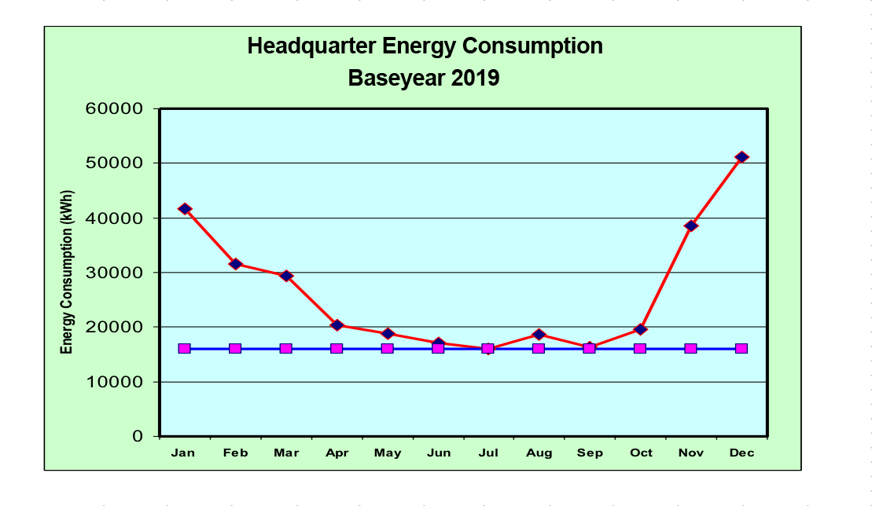
Trend Analysis
Base & Seasonal Loads - Heating
Heating
Base load
Notes:
Once you have established base loads you can begin watching for increases in either of the two components. If your base load begins to increase above your established baseline, perhaps there is a problem with lighting. Or if you see higher seasonal loads, is it weather or is there something wrong with the HVAC system?
Weather often affects seasonal loads so let’s look at a way to account for weather variations.

Slide 70
Weather Data
Weather Variations & Seasonal Loads
Heating and Cooling Degree Days
Year | CDD | HDD
1 | 83 | 4959
2 | 89 | 4937
3 | 162 | 4829
Baseline Average | 111 | 4908
4 | 273 | 4485
Notes:
The number of cooling degree days or heating degree days in a year will influence the amount of energy used to cool or heat a building. To adjust for weather effects on energy usage for heating, sum the annual heating energy use for the base year. In this case, the example is an office in Seattle. The baseline is the three year average, and the office used an average of 101,000 kWhs in electricity.
Baseline:
101,000 kWh / 4908 Heating Degree Days = 20.5 kWh/DD
Year 4
The year was warmer than the average, as indicated by fewer heating degree days. So what was the impact on energy usage?
20.5 kWh/DD x 4485 DD = 92,295 kWh
The office actually used about the same kWh in Year 4 or around 100,000 kWh which tells us that something other than the weather contributed to the office’s increased energy consumption. The building operator or manager should be looking for changes in building use or system efficiency to account for the increased energy consumption.
This same approach can be used if natural gas was the fuel for heating by using gas consumption or therms instead of kWh. Also in a cooling dominated climate you can use the cooling energy use and CDD (cooling degree days) totals and averages in exactly the same manner.
Note: See Appendix.

Slide 71
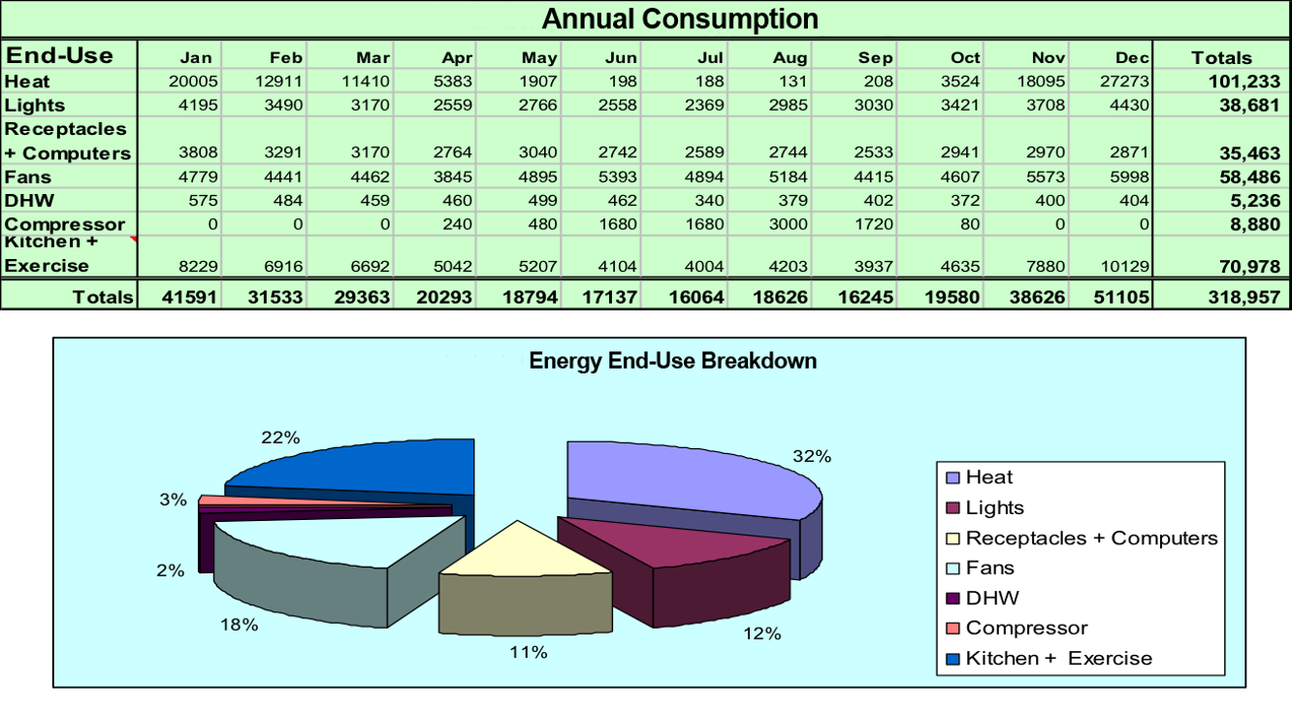
Building Data Analysis
End-use Profiles
Notes:
If you are fortunate to have sub-meters, it is possible to get to end-use profiles which allow you to look at the energy use in a facility with much greater detail. Many older buildings lack sub-meters, but they are becoming more common in newer construction. Options to retrofit systems with sub-metering equipment are increasingly available, and sometimes qualify for utility or government incentives/rebates.

Slide 72
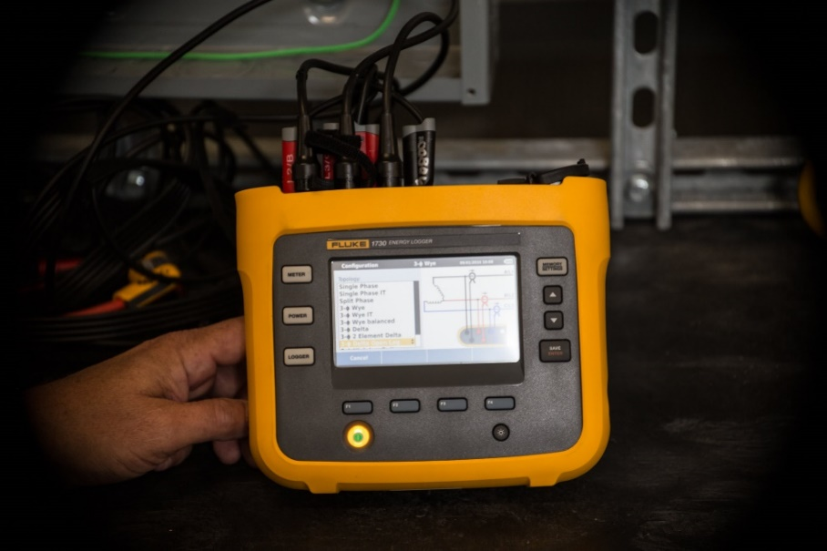
Interval and End-Use Data
On-site metering
Portable data loggers
Power meters
Multimeters
Light meters
End-use metering
Lighting
Heating
Domestic hot water
Notes:
There may be times when just analyzing monthly energy bills is not enough. You may need or want to get additional data or data at smaller intervals such as daily or even hourly. If you don’t have access to Smart meter data, one source is to contact your local utility to see if they can give you some daily meter reads on your entire building or facility. This allows you to see what is actually occurring throughout the day and/or on weekends.
Additionally, you might want to look at a specific end-uses such as lighting, heating, or hot water. The availability of data loggers has made this a relatively easy operation. Many data loggers have several channels for measuring several variables at one time. The basic loggers will be able to measure amps on a given circuit. Slightly more sophisticated loggers that measure power are also available. Data loggers are increasingly available to borrow for free from energy tool lending libraries emerging in many areas. The Smart Buildings Center Tool Lending Library website has many free tutorials available that show how to use various energy monitoring and diagnostic tools for assessing building performance and opportunities for improvement. https://www.smartbuildingscenter.org/tool-library/tool-resources
NOTE: Installing data logging instruments in electrical panels should be performed by a qualified person, as determined by your employer in accordance with OSHA Standard 1910 and NFPA 70. De-energize circuits using a lockout/tagout system before working on electrical equipment. SAFETY FIRST!

Slide 73
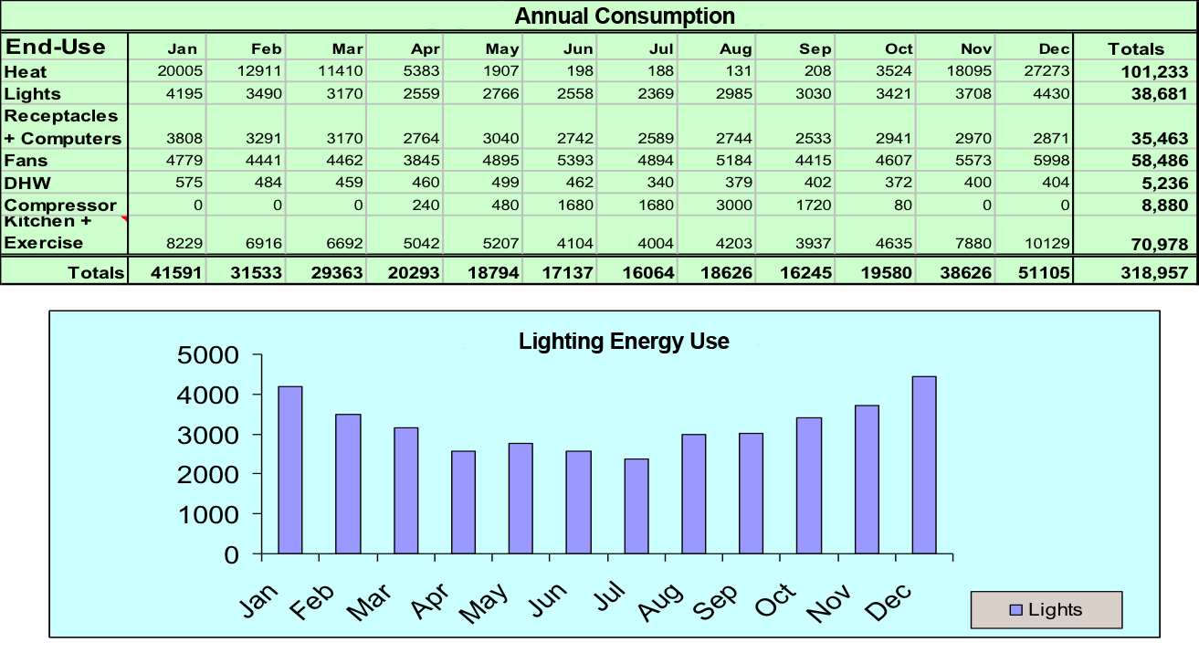
Trend Analysis
Analyzing End-use Consumption Trends
High
4,400
Seasonal
load
Low
2,200
Base
load
Notes:
Here is an example of an end-use analysis involving the lighting in a given facility. This was obtained by a combination of sub-meters and estimates. You can see that the usage lowers in the summer months. This could be for a variety of reasons. What additional information is needed to know what might be happening? Are people turning the lights off? Is there day-lighting?
High
4,400
Low
2,200
Base
load
Seasonal
load

Slide 74
End-Use Analysis
■ Heating System
• distribution system
• control conditions
• hours of operation
• envelope
■ Ventilation
• amount of outside air
• night & warm-up operation
• exhaust system interaction
■ Cooling
• distribution system
• control conditions
• economizer cycles
■ Lighting
• operation time
• lamp efficiency
• light levels
■ Service Hot Water
• temperatures
• distribution system
■ Pumps & Motors
• sizing
• energy efficiency
• maintenance
Notes:
Analyzing End-use Energy Data
Analysis of graphs and consumption data is important in understanding how energy is used at your facility and which factors affect consumption the most. This is done by identifying the systems that use energy in your building and determining how each system operates throughout the year. Some systems will operate all year long while others may only operate during the summer or winter months. Annual energy consumption is then broken into base and seasonal loads, and equipment is fit into each category. This helps identify which equipment or systems are most energy intensive so steps can be taken to reduce consumption in those areas.
Energy-Using Systems
After utility use has been broken down by seasonal and base loads, make a list of the major energy-using systems in your building and estimate when each system is in operation throughout the year. As you develop your list, think about how each system uses energy and where potential savings may exist. You can add more specific components to the list as you learn more about the building.

Slide 75
Group Exercise #5
Analyzing Building Data
As a building operator you have just finished gathering all the data available for your building. It is three year’s worth and provided in the Appendix. You now must determine how your building is performing.
In your groups, come up with a list of steps and suggestions that you would use to determine how this building is operating.
In addition, discuss how you might determine what areas should be addressed in greater detail and how you might do this.

Slide 76
Putting It All Together
Review facility and energy systems.
Apply energy accounting analysis.
Establish baseline and benchmark.
Identify operation, maintenance and conservation measure priorities.
Establish goals and timetable.
Start to implement something…anything!

Slide 77
Project Section: ENERGY STAR® Benchmarking Tool
Refer to your BOC Level I Project Workbook – Assignment 2
Use ENERGY STAR® Portfolio Manager to benchmark your facility.
Complete the four steps as noted.
Notes:
Project Assignment
Use the ENERGY STAR® Portfolio Manager to benchmark your building’s performance. You will need access to the Internet and be comfortable entering data into spreadsheets. Portfolio Manager is a free, web-based software found at www.energystar.gov.
Step 1: Use Portfolio Manager to enter the data for your building. This will include various information such as the square footage of metered space, the space usage, meter numbers, and monthly energy usage for a 12 consecutive-month period for all fuels, and the duration of the billing period.
Step 2: When completed, print the Portfolio Manager Statement of Energy Performance.
Step 3: Complete the Benchmark Analysis Worksheet in your Project Workbook.
Step 4: Submit the completed assignment to your instructor or course manager for review.

Slide 78
Project Alternative: Energy Accounting
1. Obtain current rate schedule.
2. Calculate gross square footage.
(from floor plan of BOC 1001 project)
3. Collect one year of energy consumption data for electric and gas.
4. Calculate Energy Use Index (EUI) and graph monthly energy consumption.
Notes:
Alternative Course Project
Some students may not be able to use Portfolio Manager due to lack of access to needed data or a facility that is too small or not supported by the tool. The following is an alternative project to the regular homework assignment that you may choose in place of the regular project assignment. Below is a summary of the assignment.
You may find it most useful to use the same facility for all of the Level 1 course projects. If you are unable to collect energy consumption data for a facility, contact the instructor for an alternate site to use for the exercise.
1. Locate a current rate schedule and 12 consecutive months of all utility data for one of your facilities.
2. Complete the following Energy Accounting forms and calculate energy use indices for total energy, cost, and electricity as indicated.
3. Graph monthly utility consumption by fuel in MMBTU.
If you have any questions, contact your instructor.

Slide 79
Appendix
Notes:
Appendix
Glossary A-1
Exercise #2 Sample Energy Bills B-1
Exercise #4 National and City Site EUI Averages C-1
Degree-Day Weather Correction Calculation D-1
Exercise #5 Building Data E-1
Maintenance & Operations Checklist F-1
Portfolio Manager Quick Guide G-1

