Slide 1
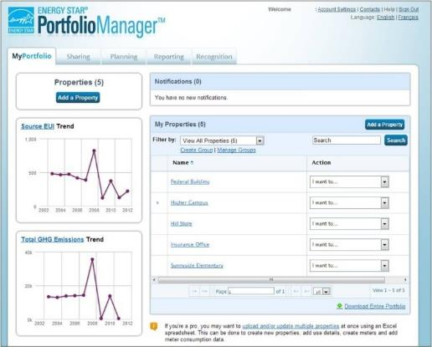
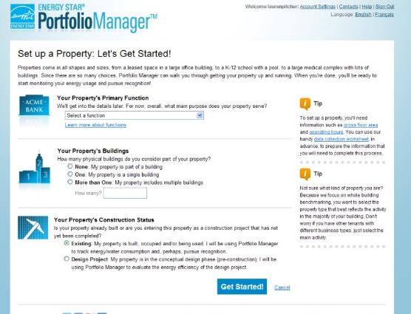

Portfolio Manager® 101
Notes:
Hello everyone and welcome to today’s ENERGY STAR webinar, “Portfolio Manager 101,” which will provide an overview of the Portfolio Manager tool. Thank you for joining us.

Slide 2
Learning Objectives
In this session, you will become familiar with EPA’s ENERGY STAR Portfolio Manager tool and learn how to:
  Navigate Portfolio Manager
  Add a property and enter its use details
  Enter energy, water, and waste & materials data
  Analyze progress using performance documents, charts and graphs and reports
  Note: ENERGY STAR also has short 5 minute videos on these introductory topics available for quick view at www.energystar.gov/buildings/training
Notes:
Today we will demonstrate the core functionality of Portfolio Manager. You will learn all of the essential "how to" information you need to get up and running with Portfolio Manager, so you can start to track your buildings’ energy, water, and waste & materials performance.
Learning objectives include: how to navigate Portfolio Manager, how to add a single property and enter details, how to enter energy, water, and waste & materials data, and how to generate reports and track progress.
Note that we have short 5 minute videos on many of these basic steps to using Portfolio Manager available at www.energystar.gov/buildings/training. These videos include “How to Set Up a Property in Portfolio Manager” and “How to Set Up Energy, Water, and Waste Meters in Portfolio Manager”.

Slide 3

  Understand whole building use and cost for
  Energy Water Waste & Materials
1
2
3
for all commercial spaces
Metrics Calculator
  More than 300 metrics for all bldg. types
  Energy (source, site, weather normalized etc.)
  ENERGY STAR 1-to-100 score (for many building types)
  Greenhouse gas emissions (indirect,
  direct, total, avoided)
  Green power
  Water (indoor, outdoor by type)
  Waste & materials (trash, recycling, compost etc.)
Management Tool
  Compare, measure and track over time
  Set baselines, goals and targets
  Identify under performers
  Track the impact of management strategies
  Create custom reports and charts
  Share data with others
  Apply for ENERGY STAR certification
  Save energy and water + reduce waste = avoid $
Free, online secure platform: www.energystar.gov/portfoliomanager
Notes:
EPA’s ENERGY STAR measurement and tracking tool, Portfolio Manager, is both a management tool and a metrics calculator for quantifying and comparing any commercial building’s energy, water, and waste. It provides a whole-building picture of consumption and costs. Organizations use this information to identify ways to improve and avoid unnecessary operational spending.
Portfolio Manager is often used as a management tool that’s just one part of a broader, strategic plan to reduce consumption and costs. It is used to:
Compare, measure and track consumption overtime.
Set baselines, goals and targets.
Generate metrics that reveal underperforming properties.
Then, based on this whole-building perspective, building managers can begin to make investment decisions about conservation and efficiency measures and track the impact of these strategies in Portfolio Manager after they are implemented.
Portfolio Manager offers more than 300 metrics to assess performance. For energy there are metrics such as source and site energy and weather normalized energy. Greenhouse gas emissions and green power is tracked. Indoor and outdoor water by type is tracked. And trash, recycling and compost can be tracked. These resources are limited and PM helps to allocate them strategically to get the greatest benefit from projects.
The marquee metric for energy in Portfolio Manager is the 1-to-100 ENERGY STAR Score, available to certain property types. If the Score is 75 or higher, a property is eligible for ENERGY STAR Certification. Recognition is an important part of a good energy management strategy, and we’ll talk more about the ES Score in just a bit.
Portfolio Manager also offers a variety of analyses tools. There are charts and performance documents as well as pre-loaded and custom reporting options. There’s even the option to request data from other users of Portfolio Manager using the custom reporting feature.
When you create a record in Portfolio Manager you are that property’s Property Data Administrator, and as such, you can share records at different levels of access with other users of Portfolio Manager, which is handy when managing multiple properties or sharing benchmarking duties with colleagues.
Finally, Portfolio Manager is a free, online, secure resource. Access it at URL shown on the slide – www.energystar.gov/portfoliomanager .

Slide 4
Benchmarking is the process of comparing use
to gain valuable perspective about building performance
Use Portfolio Manager to: | Energy | Water | Waste & Materials
Establish a baseline: |  |  | 
Compare current use to baseline overtime. |  |  | 
Compare median of national sample of similar buildings to baseline. | 
Compare normalized national sample of similar buildings to baseline. |  (ENERGY STAR 1-100 Score) |  (Multifamily 1-100 Score)
Set target reduction goal. | 
Compare properties in portfolio to each other. |  |  | 
Apply for recognition (eligible space types). |  (ENERGY STAR Certification)
4
Notes:
So, what do we mean by “benchmarking”? Benchmarking is the process of comparing use to gain valuable perspective about building performance; Portfolio Manager offers several ways to compare energy, water and waste.
For all three, use Portfolio Manager to establish a baseline. The baseline comprises 12 complete calendar months of data and is a starting point against which to compare other types of consumption.
This might be future consumption, for example. In other words, as the building operates we compare newer data to the baseline period in order to understand how consumption and costs change over time.
For energy, another way to benchmark in Portfolio Manager is to compare a property’s baseline to the median energy use of a national sample of similar buildings, which mostly comes from a dataset called CBECS, or the Commercial Building Energy Consumption Survey.
And finally for energy, certain properties will generate an ENERGY STAR Score, which reflects your property’s performance compared to a national sample of similar buildings (from CBECS and other surveys) that is normalized for the weather and attributes related to how the property operates.
In addition to the ENERGY STAR Score, there is now also a score for multifamily properties, which reflects a properties performance compared to a normalized sample of other multi-family properties.
Once a 12 mos. baseline is established, Portfolio Manager can be used to establish target reduction goals for energy based on: 1) desired energy use reduction from baseline; 2) reduction compared to median, or; 3) target ENERGY STAR Score.
Buildings can also be grouped in Portfolio Manager and compared to each other.
And, certain property types, those eligible for the ENERGY STAR Score, can apply for special recognition if the Score is 75 or higher.

Slide 5
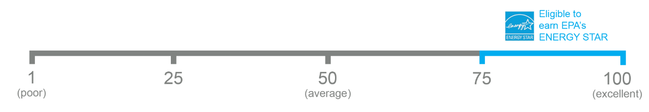

The 1-100 ENERGY STAR Score
One simple number
understood by ALL stakeholders.
Notes:
So, what is the ENERGY STAR Score? The Score is a percentile ranking of your building compared to similar buildings nationwide. The Score was developed more than 15 years ago now, to offer context for assessing the relative performance of a building compared to its peers and to provide one simple number understood by all stakeholders. On this scale, 50 represents median performance. A score of 62 means that the property performs better than 62% of its peers and a 75 means that the property performs better than 75% of similar buildings nationwide, and is the minimum score required to earn ENERGY STAR Certification.

Slide 6



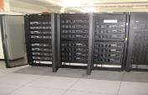













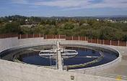

Property types with 1-100 ENERGY STAR scores
*Not eligible for ENERGY STAR Certification
Bank Branch
Barracks*
Courthouses
Data Centers
Distribution Centers
Financial Offices
Hospitals
Hotels
K-12 Schools
Office Buildings
Medical Offices*
Multifamily Housing
Residence Hall/Dormitory*
Retail Stores
Senior Care Communities
Supermarkets
Warehouses
Wastewater Treatment Plants*
Wholesale club/ Supercenters
Worship Facilities
6
Notes:
These are the property types eligible for the ENERGY STAR Score. They are eligible for the score because there is a robust reference data set for these space types where EPA has found meaningful relationships between space types and how they use energy. So, when you enter a property in PM as one of these types, your actual data can be compared to the reference data set to generate the ENERGY STAR Score. If you don’t see a particular space type on this list it means that an ENERGY STAR Score for that type is not available. Common examples include museums, libraries, police stations and convention centers. But keep in mind that while there is no Score for these property types, their performance overtime can still be tracked in Portfolio Manager using other metrics, like weather normalized energy use, for example.
For properties noted with an asterisk (barracks, medical offices, residence halls, and wastewater treatment plants) there is an ENERGY STAR Score, but these properties are not eligible for certification at this time.
For more information about eligibility: http://www.energystar.gov/buildings/facility-owners-and-managers/existing-buildings/use-portfolio-manager/understand-metrics/eligibility
6

Slide 7
ENERGY STAR Score for Multi-Use Properties
☑
☒
Eligible for Score
Ineligible for Score
Bldg. 2
☒
Bldg. 3
☑
Bldg. 1
☑
Office
60%
Hotel
60%
Office
60%
Laboratory
40%
Dry Cleaning
15%
Warehouse 40%
Office
25%
Bldg. 4
Office
40%
Warehouse 40%
Data Center 20%
☒
Notes:
It is not uncommon for a property to have multiple property types within it. A multi-use property can receive the ENERGY STAR Score and receive certification, but these two conditions apply: 1) Seventy-five percent (75%) of the property's Gross Floor Area (GFA) must be comprised of property types that are eligible for an ENERGY STAR Score; and, 2) More than fifty percent (50%) of the GFA must be comprised of one eligible property type (excluding parking).
For example, Building 1 on the slide depicts a property that is 60% office and 40% warehouse. This space is eligible for a Score and certification because both property types are eligible for a Score, and because the office is more than 50% of the total GFA.
In Building 2, even though the office is more than 50% of the GFA, this building is ineligible for the Score because it doesn’t meet the 75% minimum requirement. In other words, 40% of the space is comprised of lab, which is an ineligible property type.
Building 3 is eligible for a Score because it does meet the 75% minimum requirement—hotel and office are both eligible space types and combined make up 85% of the building GFA. This building is also eligible because the hotel is more than 50%.
Finally, Building 4 is not eligible for the Score, even though all three space types within it are eligible property types. This is because no one eligible property type is more than 50% of the total GFA.

Slide 8
ENERGY STAR Portfolio Manager - Canada
The tool has been adapted to include Canadian weather data, postal codes, both official languages, the metric system and other data specific to Canada.
    Scores are based on a model developed by Natural Resources Canada using data from Canadian buildings.
    Please direct all questions about Canadian properties to Natural Resources Canada
Property types include:
  Distribution Center
  Financial Office
  K-12 School
  Hospitals
  Ice Rinks/Curling Rinks
  Medical Office
  Non-Refrigerated Warehouse
  Office
  Residential Care Facility
  Self-Storage Facility
  Senior Care Community
  Supermarket/Grocery Store
Notes:
--As of March 2018, building certification is now available in Canada!
The Canadian property types on this slide can earn the ENERGY STAR Score now that tool has been adapted in partnership with Natural Resources Canada to include Canadian weather data, postal codes, both official languages, the metric system, and other Canadian data.
For more information about benchmarking Canadian properties, please see these FAQs:
https://portfoliomanager.zendesk.com/hc/en-us/articles/211696987-Which-property-types-can-get-a-score-in-Canada-
https://portfoliomanager.zendesk.com/hc/en-us/articles/211027228-What-is-Canada-s-role-in-Portfolio-Manager-
https://portfoliomanager.zendesk.com/hc/en-us/articles/215876957-Can-I-get-certification-for-my-Canadian-properties-
Please direct all questions about Canadian properties to Natural Resources Canada at:
Toll free: 1-877-360-5500
Ottawa local: 613-992-3245
Email: info.services@nrcan-rncan.gc.ca
Website: http://www.nrcan.gc.ca/energy/efficiency/buildings/energy-benchmarking/13603

Slide 9
Pop Quiz!
Portfolio Manager can be used to benchmark building performance for which resource types?
    Energy
    Water
    Waste
    All of the above
True or False: If your building is not eligible for the 1-100 ENERGY STAR score, you cannot benchmark in Portfolio Manager.
    True
    False

Slide 10
Pop Quiz!
Portfolio Manager can be used to benchmark building performance for which resource types?
    Energy
    Water
    Waste
    All of the above
True or False: If your building is not eligible for the 1-100 ENERGY STAR score, you cannot benchmark in Portfolio Manager.
    True
    False
You can benchmark any combination of these three resources in Portfolio Manager!
For property types not eligible for the ENERGY STAR score, there are a variety of other metrics that you can use to track performance other time, including:
  Site and Source Energy Use Intensity
  Weather Normalized Energy Use
  Greenhouse Gas Emissions
  And dozens more!

Slide 11
To Get Started in Portfolio Manager you will need:
  Property information:
  Primary function
  Name, address, postal code
  Year built
  Gross floor area
  Property use details, e.g.:
  Operating hours
  No. of computers
  No. of workers, etc.
1
2
3
At least 12 mos. of consumption data for resource/s you want to track:
Property-specific utility bills for all purchased and on-site generated energy and water
Quantity of waste and materials recycled, disposed, donated etc.
Use Portfolio Manager’s data collection worksheet to gather data upfront for your property type/s
https://portfoliomanager.energystar.gov/pm/dataCollectionWorksheet
11
Notes:
To create a record in Portfolio Manager, all you need are the items listed under number 1 on this slide: the property’s primary function, name, address and postal code, the year built and the gross floor area. Enter those details and you have a record.
If you are interested in generating the ENERGY STAR Score, you will also need property use details. The details are considered in Portfolio Manager to be the drivers of energy use in buildings. They will change according to the property type you are entering and Portfolio Manager will prompt you accordingly. The drivers of energy use in an office building will differ from those of a hotel, for example.
Lastly, you will need consumption data for the resources you’re interested in tracking. To generate metrics you will need at least 12 mos. of data because all metrics in Portfolio Manager are annualized. For energy and water this information typically comes from utility bills which you will need for all purchased and on site generated energy, and the same for water. And for waste, you will need the quantity of waste and materials recycled, disposed, donated, etc. The information may come from a measurement from your waste hauler, or from the size of the bin.
The ENERGY STAR Program offers a very handy data collection wizard that creates a PDF or a Word document with all of the necessary inputs for the property type or types you wish to enter in Portfolio Manager. You can use the wizard, then collect the necessary data, so that you have everything you need when you sit down at your computer to create the Portfolio Manager record. The collection wizard helps reduce the amount of time you go back and forth to get the data you’ll need.
Find the data collection wizard here: https://portfoliomanager.energystar.gov/pm/dataCollectionWorksheet
If you are a building owner who plans to work with a consultant such as a Licensed Professional or engineer to benchmark your building, the recommended best practice is for the building owner to create the property in their account and share it with the consultant. PM data is proprietary and belongs to the person who is the PM account owner, or the PDA.

Slide 12
How To
Navigate Portfolio Manager
Add a property and enter its use details
Enter energy, water, and waste & materials data
Generate reports to assess progress
Notes:
With this background in mind, let’s start with navigating Portfolio Manager.

Slide 13
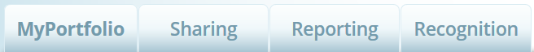

Navigate Portfolio Manager
4 portfolio level tabs
7 property level tabs
Intuitive navigation – multiple ways to get to the same place
Notes:
Portfolio Manager’s navigation is very intuitive. It uses a tabbed structure that makes it easy to find your way around the tool. There are four tabs at the portfolio level and 7 tabs at the property level.

Slide 14
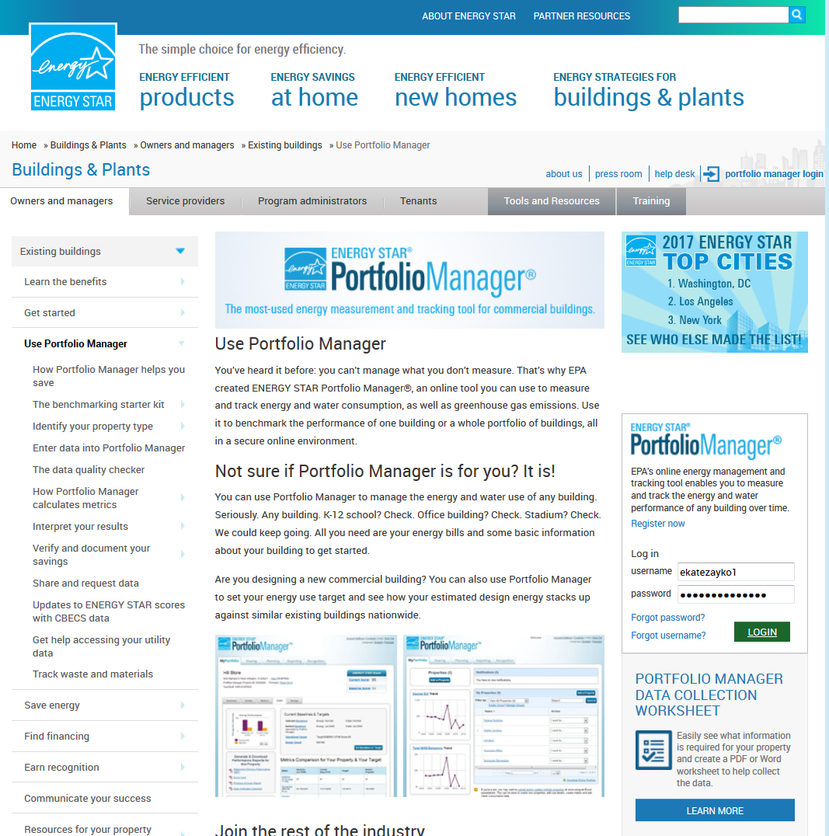
Energystar.gov/portfoliomanager
Create a username and password
Log in
Notes:
To create username and password and to login go to www.energystar.gov/portfoliomanager and follow the prompts on the screen – creating a new account is very simple.

Slide 15
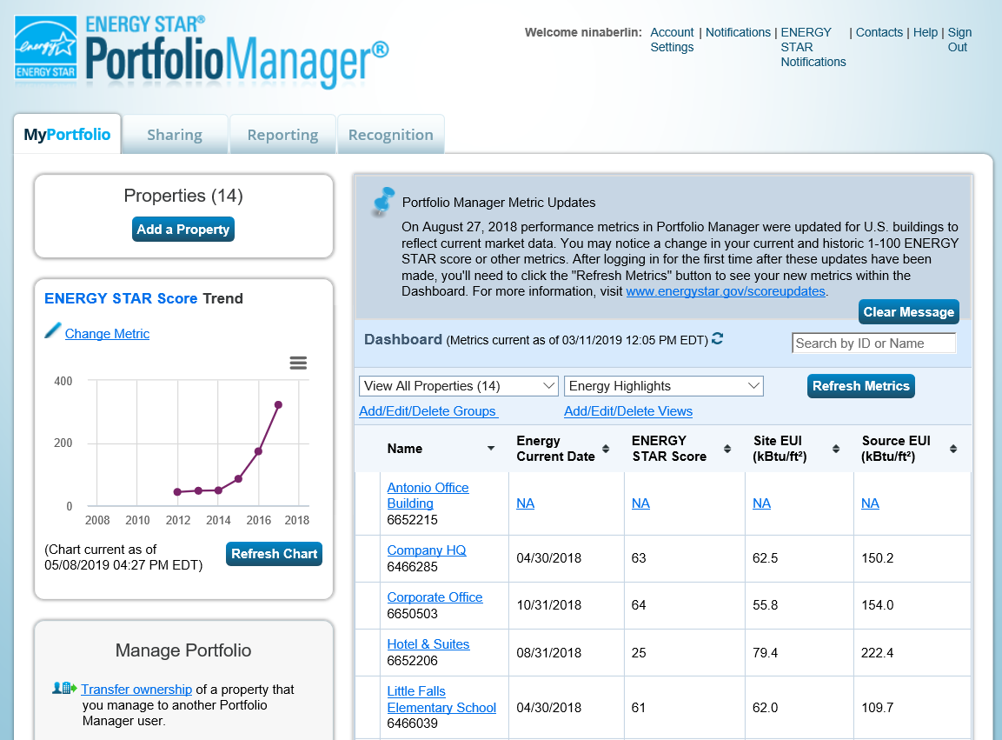
Navigate Portfolio Manager
Portfolio level view
Notes:
The point of this slide is to orient you to Portfolio Manager’s basic navigation.
The portfolio-level tabs are listed across the top of the screen. We are looking at the MyPortfolio page here. You can also click on Sharing, Reporting, or Recognition from this page.
The portfolio page automatically loads with your list of properties, a customizable chart on the left hand side, a menu of useful items to manage your portfolio, and notifications. These can be requests to connect with other users, notices that someone accepted a property that you shared, or others. There are also separate notifications from the ENERGY STAR program when there is important news or updates.
The Help button in the top right corner will bring you to the Portfolio Manager help menu.

Slide 16
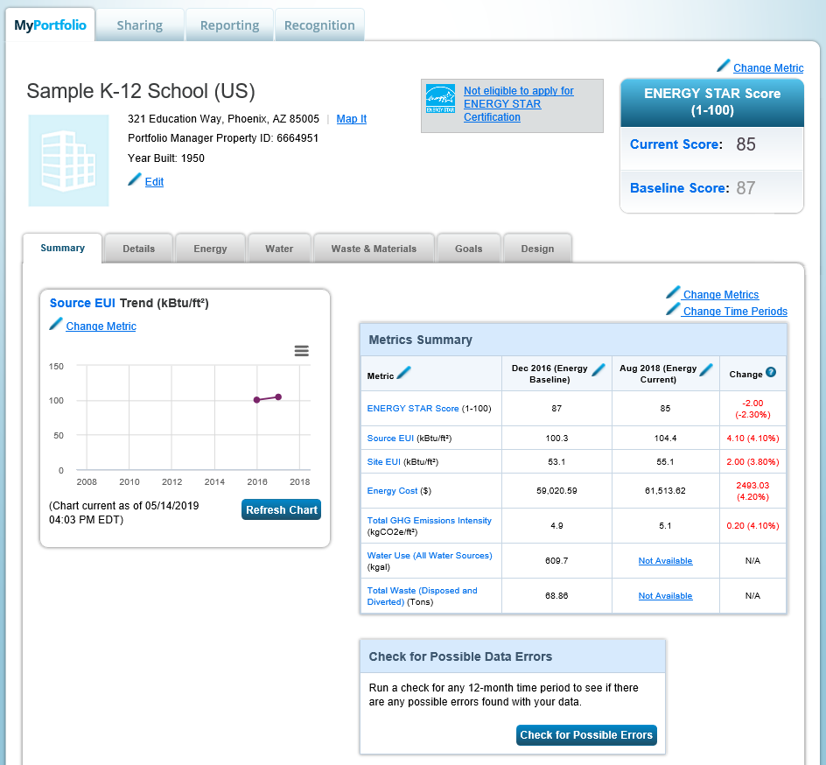
Navigate Portfolio Manager
Property level view
Notes:
After you click on a property name, you will see another set of property-level tabs. With these tabs, you can navigate between a summary of the property, property details, and meter data. You can also set and track progress against specific performance goals, and compare a building’s current energy performance against its initial design.
Clicking on the Portfolio Manager logo in the top left-hand corner will always take you back to the MyPortfolio page to see the list of all of your properties.

Slide 17
How To
Navigate Portfolio Manager
Add a property and enter its use details
Enter energy, water, and waste & materials data
Generate reports to assess progress
Notes:
This completes our first objective, navigating portfolio manager. Now, we will discuss adding a property and entering details about it.

Slide 18
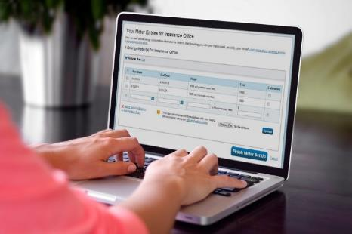
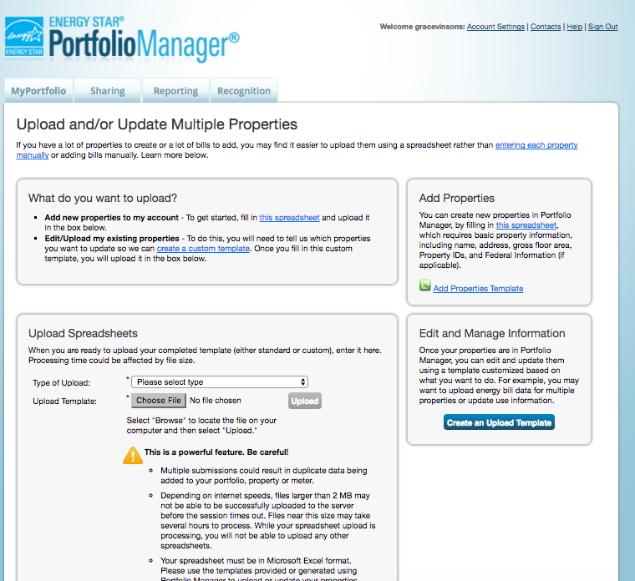
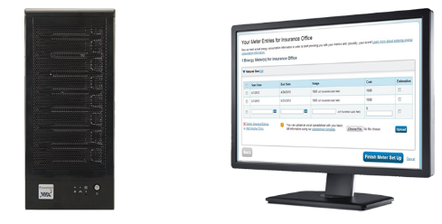
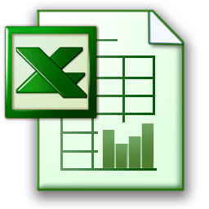
Choose the best data management method.
Get Data Into Portfolio Manager
Manual entry
Spreadsheet upload
Web services
Notes:
There are three ways to enter data for your property or portfolio:
The most basic approach is to enter data manually (create/update one property or meter at a time). This presentation walks through the steps of how to manually create a property record.
Another way is to upload data using spreadsheet templates to enter one building or multiple buildings, use details about the building or buildings, and meters and consumption data for meters.
The third way is to work with third-party providers that exchange data directly with Portfolio Manager via web services

Slide 19
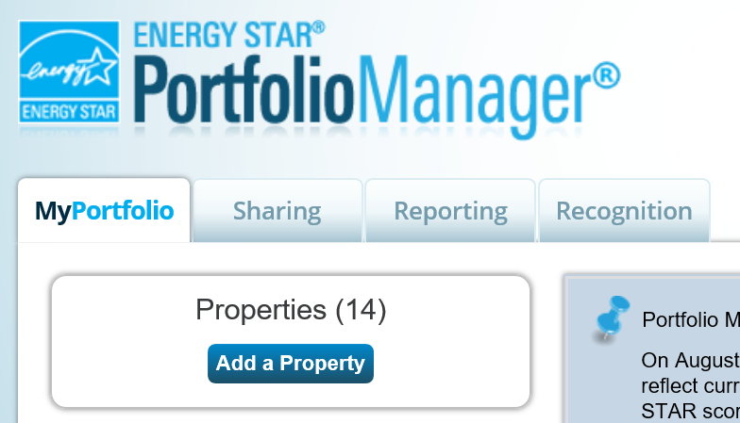
Get Data In: Manually
Notes:
To add a building manually, select “Add a Property” from the top left corner of the MyPortfolio page. Entering data manually is easier then ever because multiple prompts and tips will guide you in entering your property’s information correctly.

Slide 20
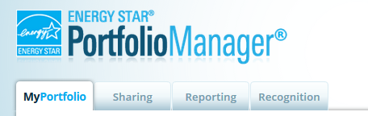
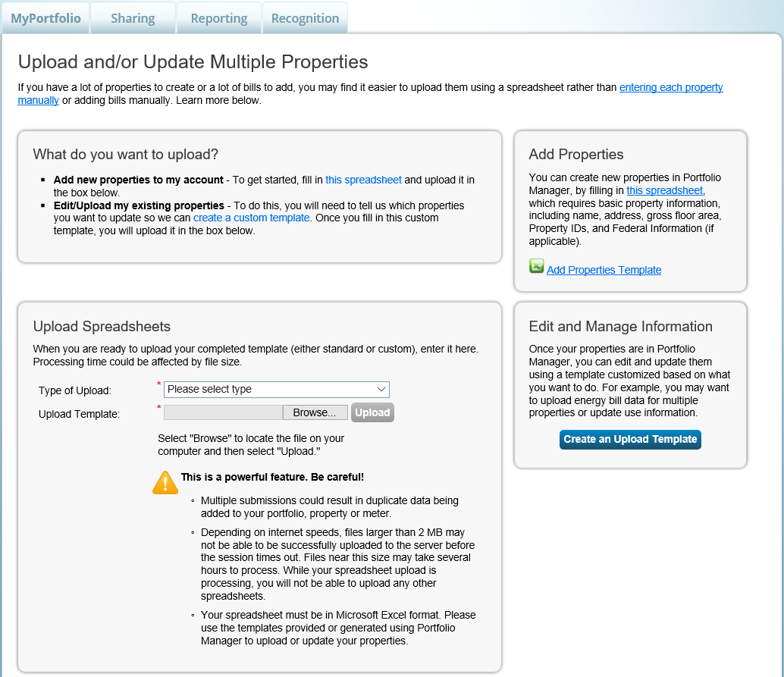
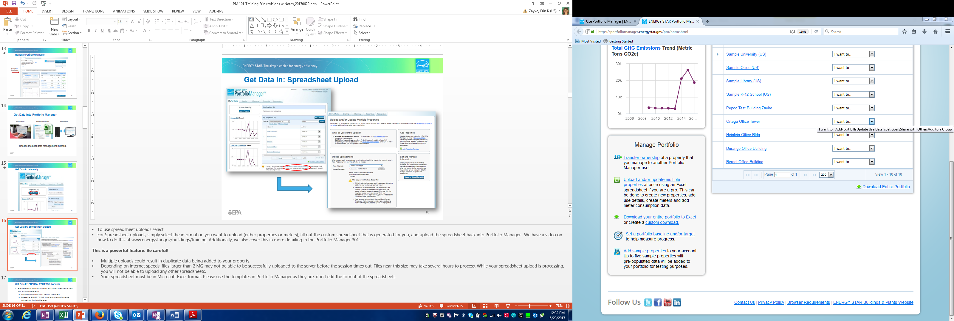
Get Data In: Spreadsheet Upload
Notes:
To use spreadsheet uploads, select “Upload and/or update multiple properties” from the Manage Portfolio menu on the bottom left of the MyPortfolio page. Then, from the page Upload and/or Update Multiple Properties, select the type of upload you would like to perform. Your options include adding properties, adding meters, adding meter consumption and updating property information. Portfolio Manager will generate a spreadsheet based on your selection. Fill out the spreadsheet and save it to your computer. Then, return to the Upload and/or Update Multiple Properties page and upload the spreadsheet. The data in your spreadsheet will be added to Portfolio Manager.
The spreadsheet upload feature is powerful, so be careful:
Multiple uploads could result in duplicate data being added to your property.
Depending on internet speeds, files larger than 2 MG may not successfully upload to the server before the session times out. Files near this size may take several hours to process. While your spreadsheet upload is processing, you will not be able to upload any other spreadsheets.
Your spreadsheet must be in Microsoft Excel format. Please use the templates in Portfolio Manager as they are, don’t edit the format of the spreadsheets.
Portfolio Manager 301 demonstrates how to use spreadsheet uploads in more details, and for more information there is a very handy 5 minute instructional video here: at www.energystar.gov/buildings/training.

Slide 21
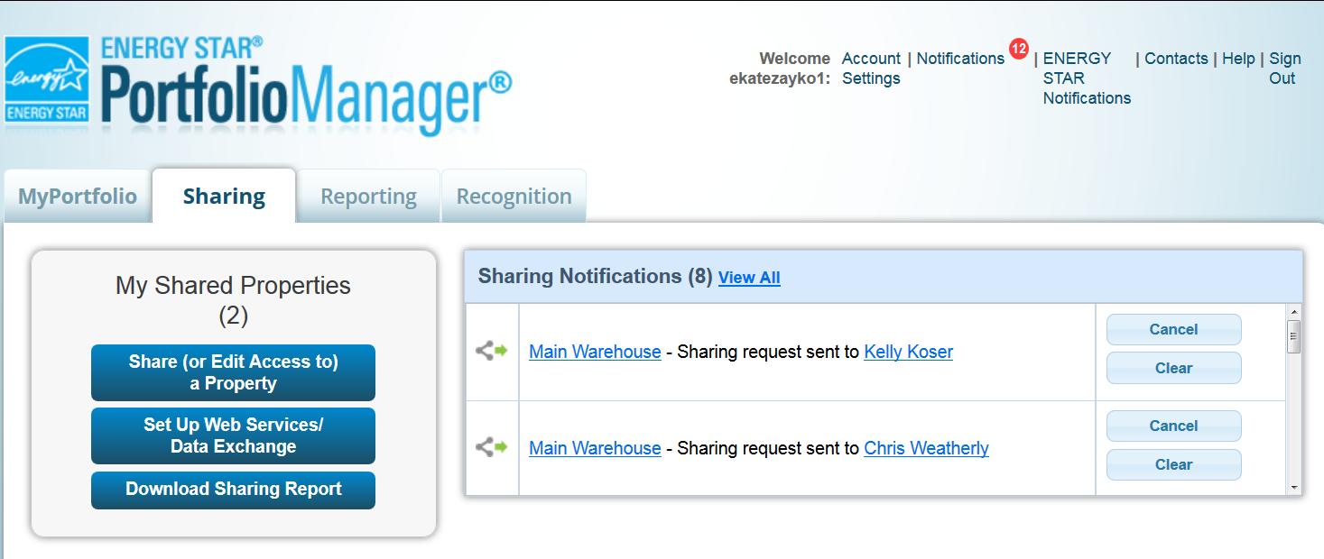
Get Data In: ENERGY STAR Web Services
Some energy service companies and utilities exchange data with Portfolio Manager to:
  Manage building and utility data for customers
  Access the ENERGY STAR score and other performance metrics
To use web services, “connect” and “share” your properties with your web service provider from the Sharing tab
Notes:
The 3rd option for entering data is to utilize the services of ENERGY STAR partners that are set up to exchange data directly with Portfolio Manager via web services. This will be an energy service company or a utility. Web services provide the advantage of avoiding manual entry. The third party service provider or utility does that for you digitally.
To utilize web services, it is necessary to connect and share with your provider, which you can do from the Sharing Tab by selecting “Set up Web Services/Data Exchange”. We discuss how to connect and share in Portfolio Manager 201 and there is very handy 5-minute video available on this topic here: at www.energystar.gov/buildings/training
Your utility or third party provider will also have a set of instructions for enabling web services. Check with your provider for more details.
Finally, there is a list of third party providers and utilities who can exchange data located towards the bottom of this page: https://www.energystar.gov/buildings/facility-owners-and-managers/existing-buildings/use-portfolio-manager/enter-data-portfolio-manager.
To see a map and PDF list of utilities who can exchange data, visit energystar.gov/utilitydata.

Slide 22
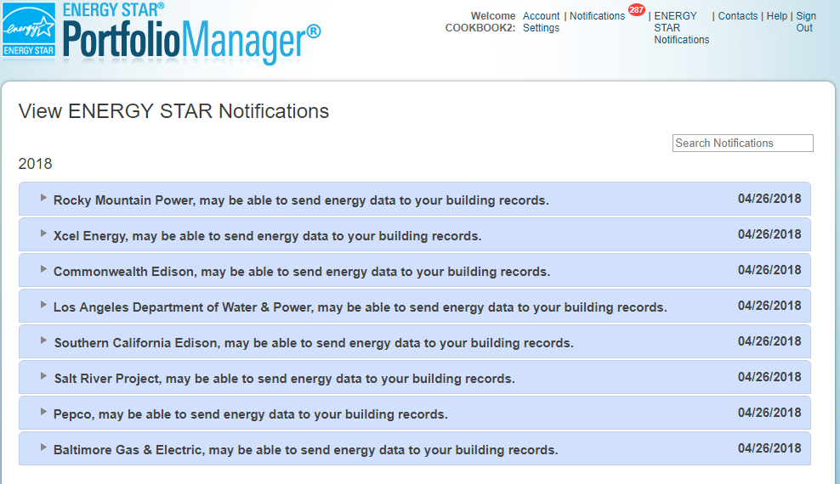
Get Data In: ENERGY STAR Web Services
Users will have an ENERGY STAR Notification when web services are available for a property
Notes:
Another way to connect with utilities who provide web services is to use the new ENERGY STAR Notifications feature.
If an account includes buildings where utility data services are available (via web services or spreadsheets), an account level notification will be displayed as a new “ENERGY STAR Notification”.

Slide 23
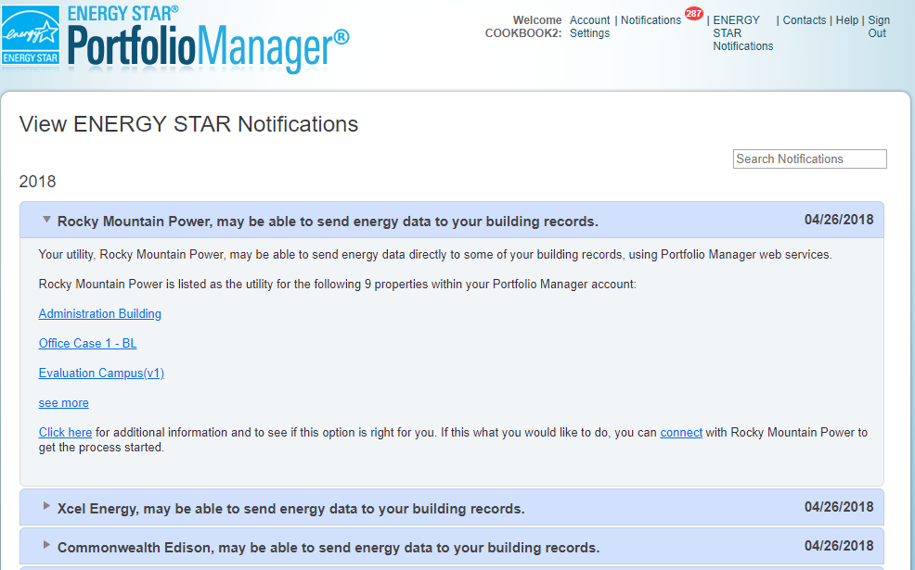
Get Data In: ENERGY STAR Web Services
Expand the notification for more information or to connect with the utility; connecting is the first step for using web services.
Notes:
Expand the ENERGY STAR Notification for more information about which buildings might be eligible to receive energy data directly from a utility.
"Click here" opens the utility’s website where more information about the web services they provide can be found.
“Connect" opens the ”Contacts & Organizations Search Results” page in Portfolio Manager with the utility's Portfolio Manager account displaying as the search result; connecting in Portfolio Manager with the utility is the first step to using web services.

Slide 24
Pop Quiz!
How many ways are there to get data into Portfolio Manager?
    One
    Two
    Three
    Four or more

Slide 25
Pop Quiz!
How many ways are there to get data into Portfolio Manager?
    One
    Two
    Three
    Four or more
You can get data into Portfolio Manager three ways:
  Manually (create/update one property or meter at a time)
  Using spreadsheet templates
  By working with third-party providers that exchange data directly with Portfolio Manager via web services

Slide 26
Add a Property
Notes:
Now, let’s walk through the process of manually entering a building. To start, click the “Add Property” button in the top left-hand corner of the “My Portfolio” tab to access a wizard to “Set up a Property.”

Slide 27
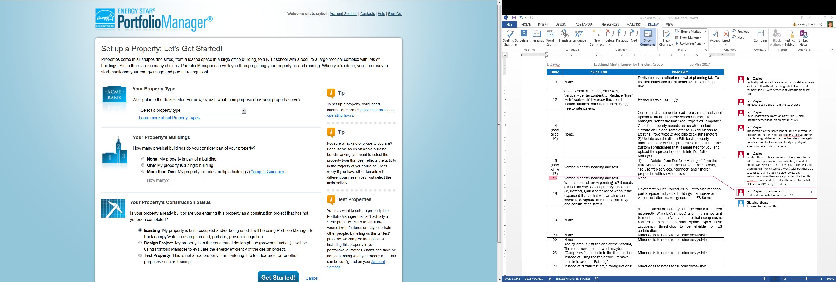
Add a Property: Existing Property
Select Property Type
Select number of buildings
Select construction status
Notes:
This wizard is the first of many prompts that will help you correctly benchmark your property.
From here, select the best property type. There are 85 options. Not all of these 85 types are eligible to earn the ENERGY STAR Score. However, as we noted earlier, benchmarking is valuable for all properties, so select the property type that best reflects your property. This will help you analyze the performance of the building and compare it to similar buildings in your portfolio.
Next, designate the number of physical buildings located on your property, either none, one, or more than one. Choose “None” if you are benchmarking part of building (a space within a building) or “One” if you are benchmarking a single building and “More than one” if you are benchmarking a campus. In the case of the latter, make sure to review the Campus Guidance for tips on entering properties with multiple buildings. Also note that spaces within a building, say a single story for example, will generate an ENERGY STAR Score but are not eligible for ES Certification. The unit for ENERGY STAR Certification is individually metered single buildings, and in some cases campuses for the property types Hotel, Multifamily, Senior Care Center, Hospital or K-12 School.
Finally, select the Construction Status of your property. Most properties will be “existing,” but properties could also be entered as “Design” for buildings that have not yet been constructed. Use the design option to evaluate the energy efficiency of the design project, to apply for Designed to Earn the ENERGY STAR Certification, and to compare designed energy use against actual use once the building is occupied and operational. “Test Property” is another option here, if your entering a fictitious property to test Portfolio Manager’s features. You can test a building in the design phase or as an existing building.
Click “Get Started” to move to the next page.

Slide 28
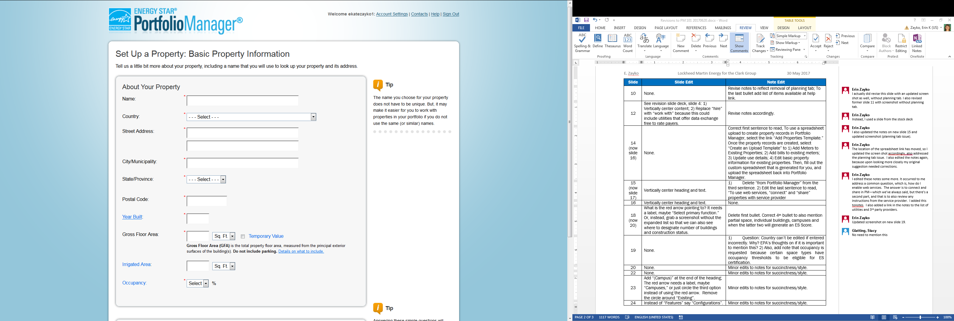
Basic Property Information
Notes:
On the next page, enter general information, including property address, size, gross floor area and occupancy percentage.
There are different ways of measuring gross floor area but in Portfolio Manager, it is the total property floor area, measured from the principal exterior surfaces of the building. Select the link next to Gross Floor Area on this page for more information.
Irrigated area is not a required field. It is used in calculating the Water Score for Multifamily housing.
Occupancy is the percentage of your property’s Gross Floor Area (GFA) that is occupied and operational. For example, if you have a 10 story office building, that on average has 9 of its 10 floors fully leased and occupied, the occupancy would be 90%. If there are people working in all floors or areas of the building then it is 100% occupied. Also, there is only one occupancy rate for each property as a whole.
The occupancy rate is not used in calculating the ENERGY STAR Score or other metrics, however, there are minimum occupancy requirements for ENERGY STAR Certification for certain property types. Offices, banks, courthouses, and financial centers require at least 55% occupancy to be eligible for ES Certification. Hotels must be at least 60% occupied and Multifamily properties must be 80% occupied.

Slide 29
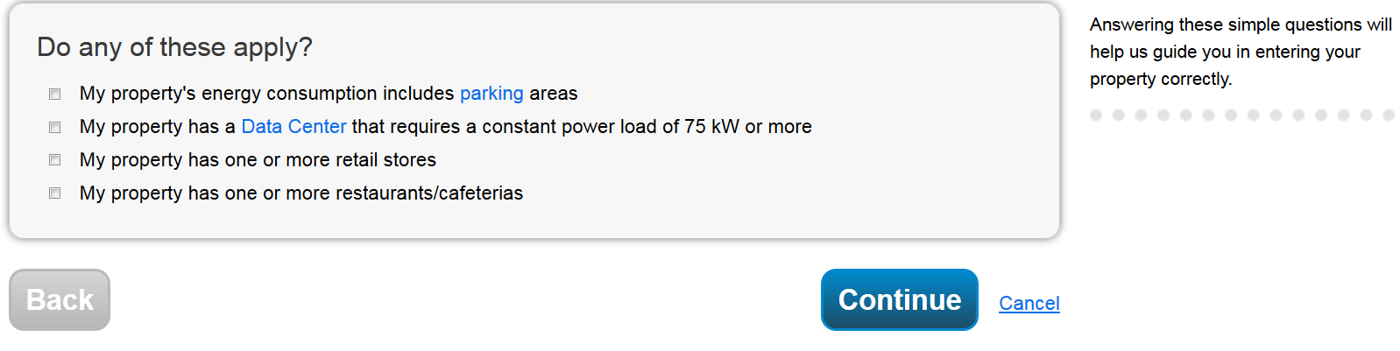
Check the statements that apply
Notes:
You will also be prompted to provide answers to a few additional questions that will help Portfolio Manager to guide you in entering your property correctly. The selection choices for “Do any of these apply?” varies depending on which primary function you choose.
For all property types, there will be a question about parking. If your parking areas are separately metered from the building, you do not need to check this box. However, it is very common for parking areas and buildings to share a meter. If this is the case, check the box. On the next screen, Portfolio Manager will prompt you to enter more information about parking. Then, because the ES Score is an assessment of building performance not parking area performance, Portfolio Manager will estimate the amount of energy parking uses and subtract that out before calculating the building’s performance.
Parking refers to buildings and lots used for parking vehicles. This includes open parking lots, partially enclosed parking structures, and completely enclosed (or underground) parking structures. Parking structures may be free standing or physically connected to the property.

Slide 30
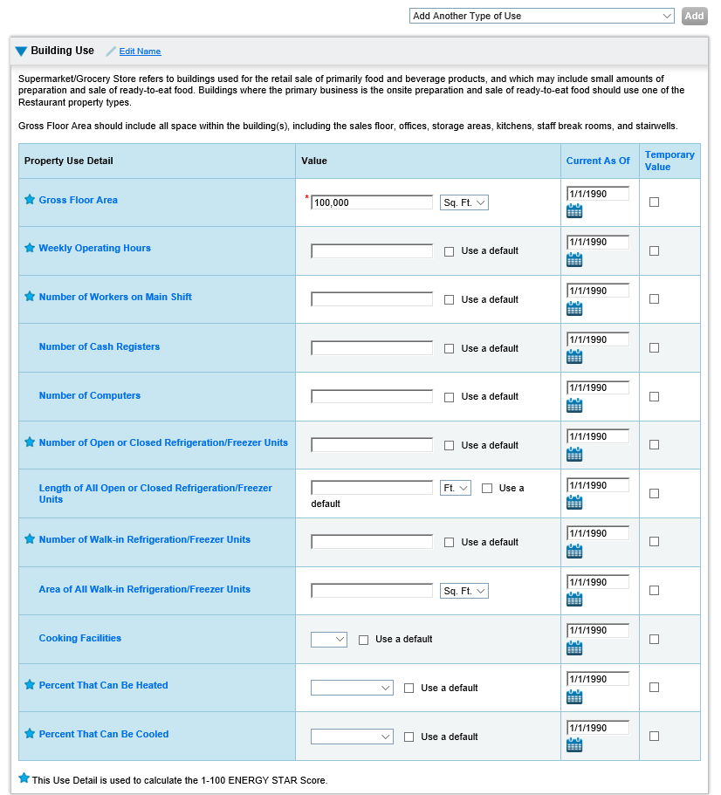
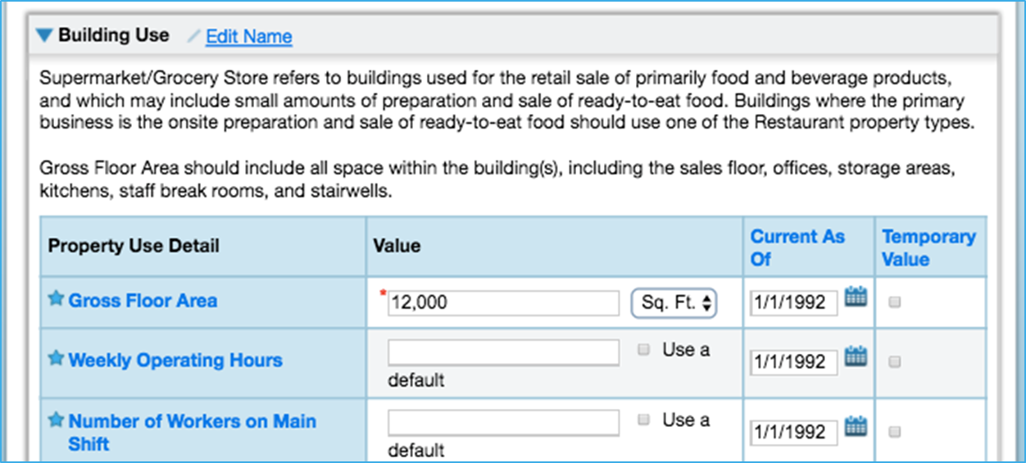
Enter Values for Property Use Details
Notes:
Next, you will be asked to provide more details for your primary property type. Each property type will have different use details. As you pass your mouse over each use detail, the definition will appear and the glossary will open if you click on the link.
You may also want to edit the name of your property type to something more specific like Office Space 1, or Occupied Office Space.
If you are in the middle of benchmarking and realize that you don’t have certain pieces of information in front of you, you can always use Default/Temporary values. However, to ensure the accuracy of your metrics and if you’re interested in applying for ES Certification, remember to update these default values with actual information once you have it.
You can also use the drop down menu on this page to “Add another type of use” for multi-use properties where the additional use type isn’t already included in Portfolio Manager’s definition of your primary property type. A good rule of them is to enter as few property types as possible. There are 4 exceptions to this rule when you should create a separate Property Use:
If it is a Property Use Type that can get an ENERGY STAR Score (note: Retail can only get a score if it is greater than 5,000 square feet):
If it accounts for more than 25% of the property's GFA
If it is a vacant/unoccupied Office
If the Hours of Operation differ by more than 10 hours from the main Property Use
Select “Add Property” when you are done entering use details.

Slide 31
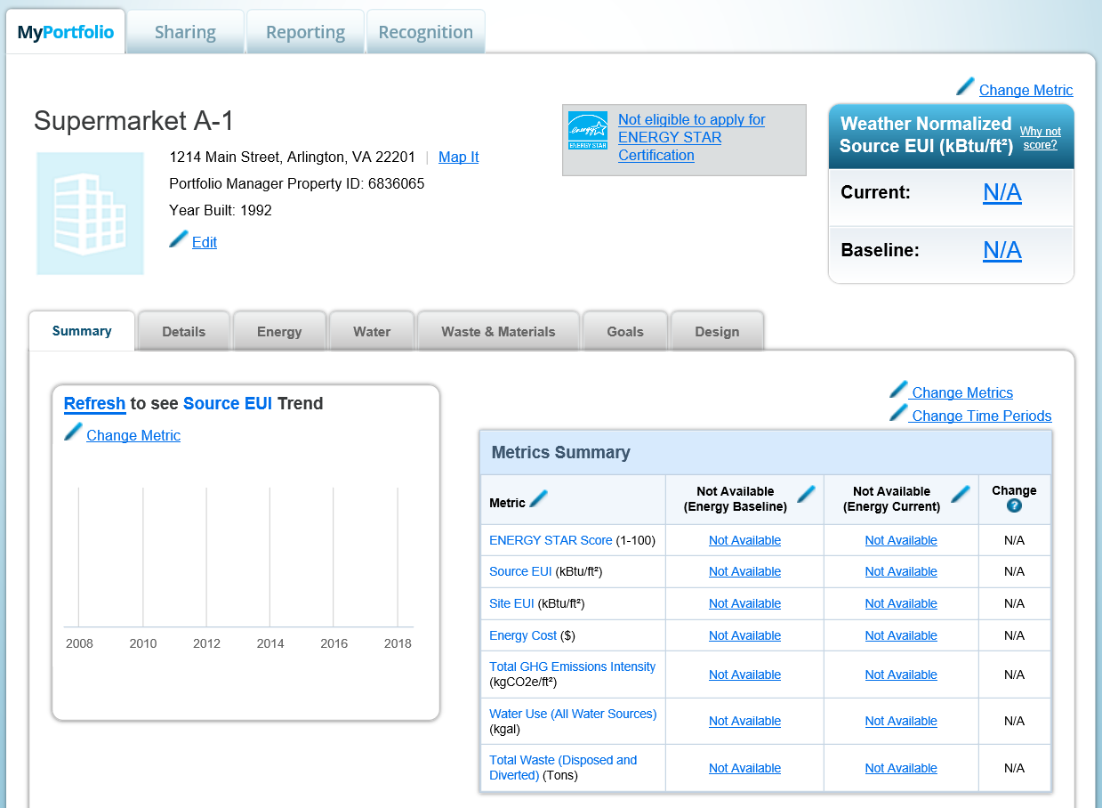
Property Summary Tab
Notes:
Now the property is created! This is the property Summary tab. From here you can view the property’s details, enter data for energy, water and waste, and set goals.
Notice that there are no summary metrics displayed in the box in the top right. This is because there’s no meter and consumption data entered for the property. So, next, we will cover how to set up meters.

Slide 32
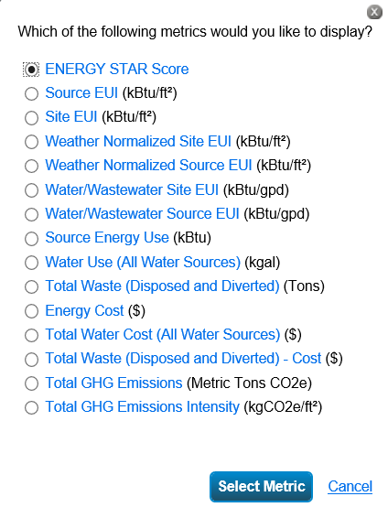
Property Summary Tab – Customized Metric Displays
Notes:
Before we move on to setting up meters, you’ll see that the metric that appears in the top right of your property record and in the trend graph on the left on the Summary tab is customizable. Selecting “change metric” from the top right of your property record or on the trend graph will open a list of 15 metrics to choose from to display on this page, such as the ENERGY STAR Score, site and source EUI, water use, total waste, and total GHG emissions.

Slide 33
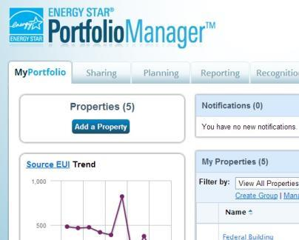
Add and Set Up a Property: More than One Building (Campus)
Notes:
Before moving on, here is some additional information about campuses. Campuses are entered as a single “parent” property with multiple “child” buildings. This allows you to report on metrics at the campus level, while still being able to track performance of the individual buildings that make up this campus (assuming that you have the necessary building-level energy, water, and waste & materials data). For properties with multiple buildings, only Hotel, Hospital, K-12 School, Multifamily, and Senior Care Communities are eligible to receive a 1-100 ENERGY STAR score at the campus level.
For more information about how to benchmark a campus, visit http://www.energystar.gov/buildings/tools-and-resources/how-benchmark-campus

Slide 34
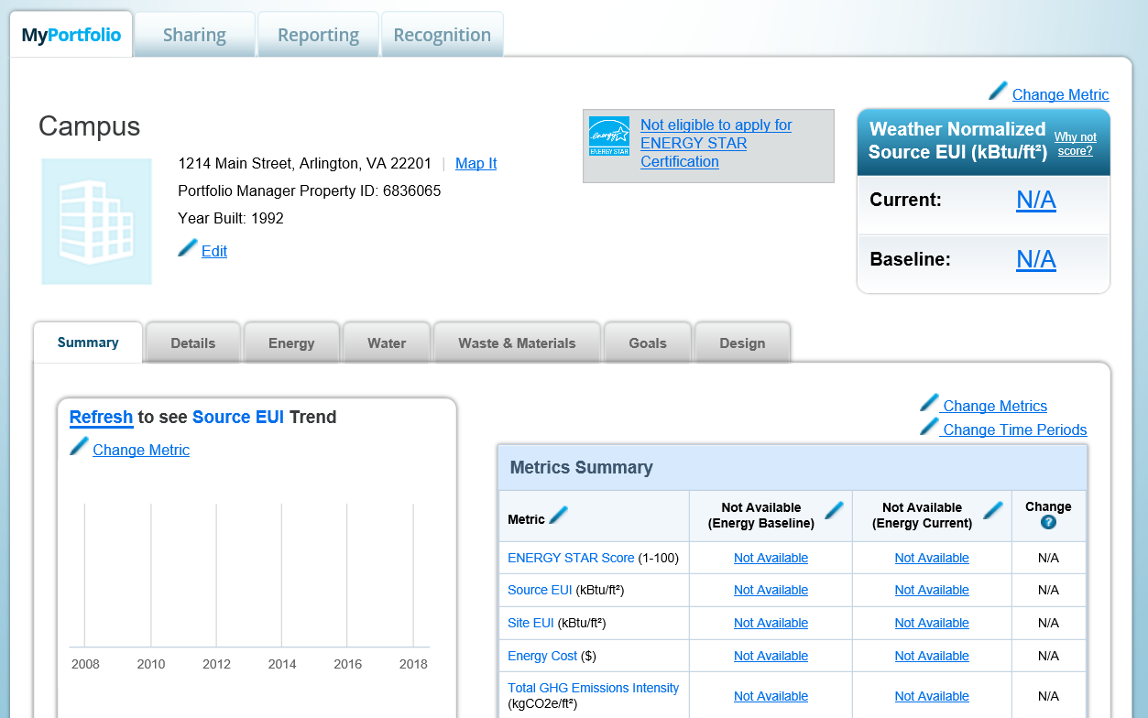
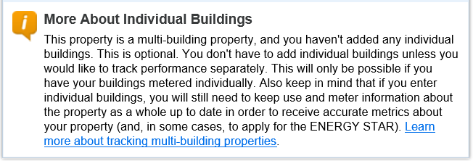
Campus Configurations
Notes:
Once you define the campus as the main property there’s flexibility in how you benchmark it. You can either benchmark the campus in aggregate, benchmark individually-metered buildings on the campus, or both.
If you enter individual buildings, you will need to keep use and meter information up to date at both the building and campus level.

Slide 35
How To
Navigate Portfolio Manager
Add a property and enter its use details
Enter energy, water, and waste & materials data
Generate reports to assess progress
Notes:
This completes our second objective, adding a property and details. Next, we will learn about entering energy, water, and waste & materials data.

Slide 36
Meters Tabs
Notes:
In the property record, there are property-level tabs for energy, water and waste & materials. For each resource you would like to benchmark you will use the tabs to set up meters and enter utility data to receive related performance metrics for your property.
Next, we’ll give an overview of each meter. Then we’ll walk through the entire process of setting up a meter using the energy meter as an example.

Slide 37
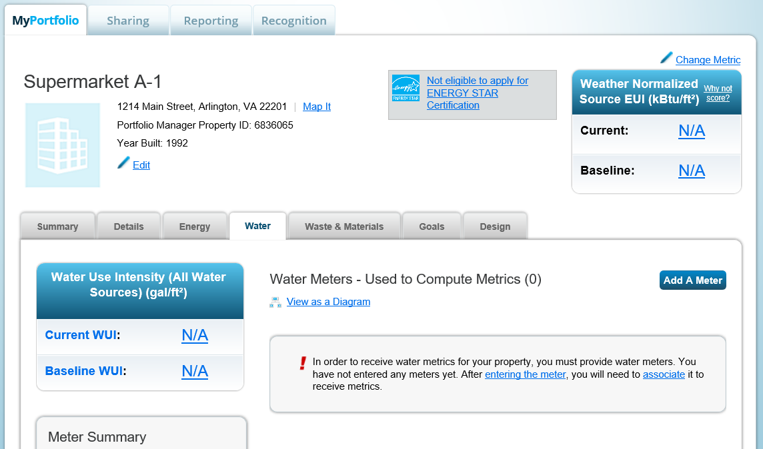
Water Tab
Notes:
Use the Water tab to enter water meters and water consumption.
To get started, click ‘Add a Meter” and follow the prompts offered by the handy wizard to enter water meters and then consumption data.
Portfolio Manager tracks water meters based on the water source. There are four types: Municipally Supplied Potable or Reclaimed Water, Well Water and Other water (e.g., condensate or rainfall collection). The metrics for each of these water sources are tracked as Indoor, Outdoor or Mixed.
Once water meters and consumption data are entered, the water metric display on the left will display water use intensity representing all sources of water entered. For multifamily properties it will display the Water Score for Multifamily if irrigated area has also been entered.

Slide 38
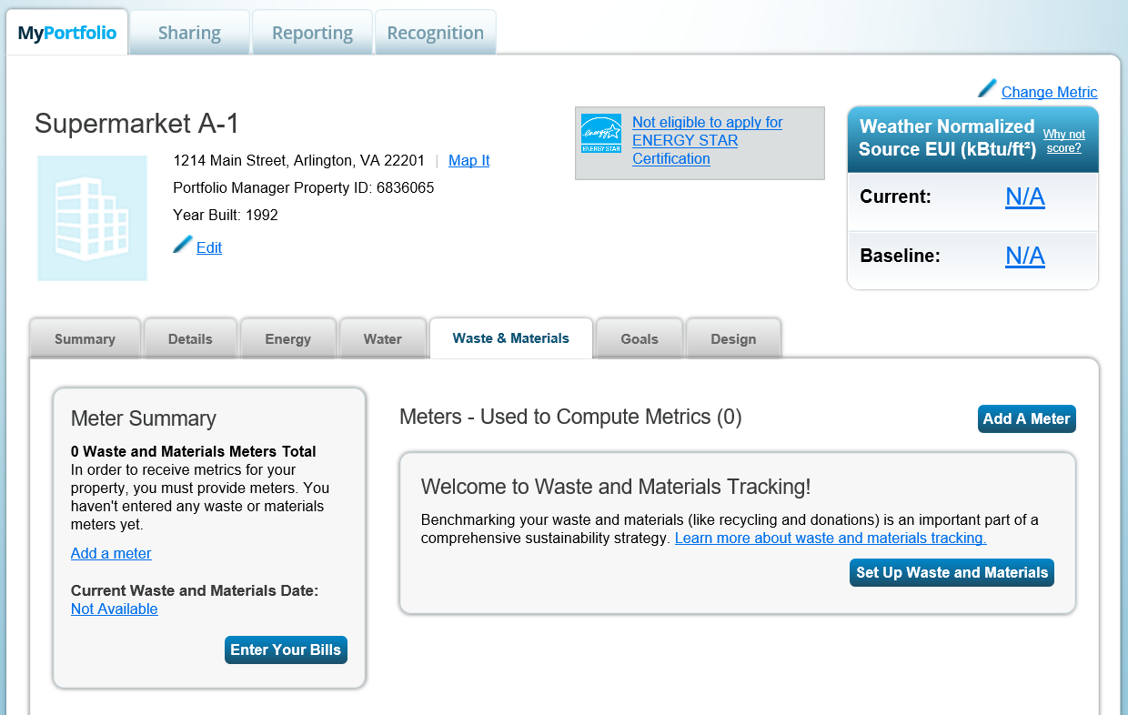
Waste & Materials Tab
Notes:
Use the Waste and Materials tab to create meters and enter waste and materials, for example, trash, recyclables, composting, and 30 others like building materials and electronics.
To get started, click ‘Add a Meter” and follow the prompts offered by the handy wizard to enter waste and materials. A new waste meter type was recently added – Recycled – Lamps/Light Bulbs. You will now be able to track lighting that is both disposed of or recycled.
You will be prompted to select what type of waste or material you would like to track, and then whether it is recycled, composted, donated/reused or disposed, and how often it is collected. Finally you are prompted to provide the weight and volume of what is collected, or Portfolio Manager provides an estimate based on the container size.
You can further categorize your disposed waste by its destination, whether it ends up in a landfill, gets incinerated, or is converted to energy.
You can also track waste or material according to whether it is picked up on a regular basis (like trash or recycling), or if the pick up is “intermittent” or one-time only like a donation of old office furniture.
Next, let’s walk through the entire process of setting up a meter using the energy meter as an example.

Slide 39
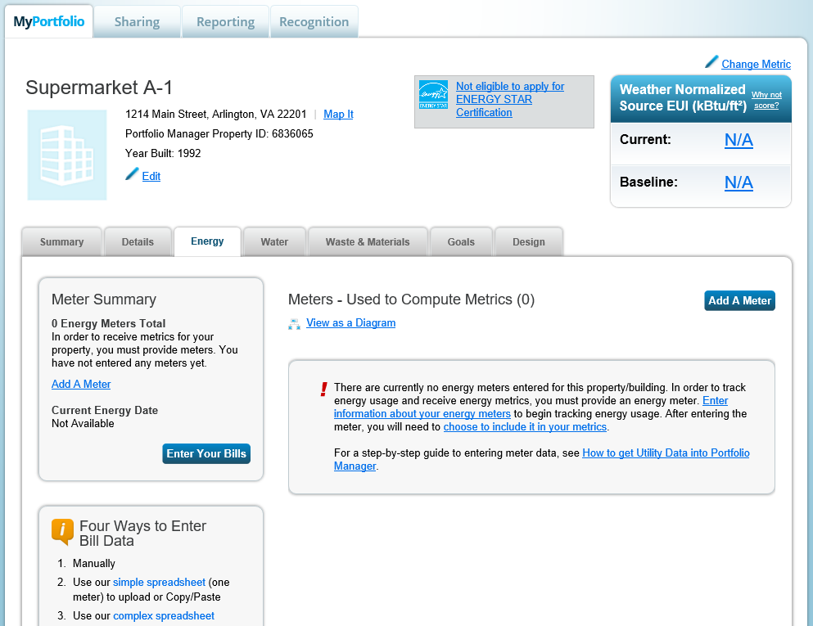
Energy Meter Tab
Notes:
Use the Energy tab to create meters and enter energy consumption.
To get started, click ‘Add a Meter” and follow the prompts offered by the handy wizard to enter energy meters and then consumption data.

Slide 40
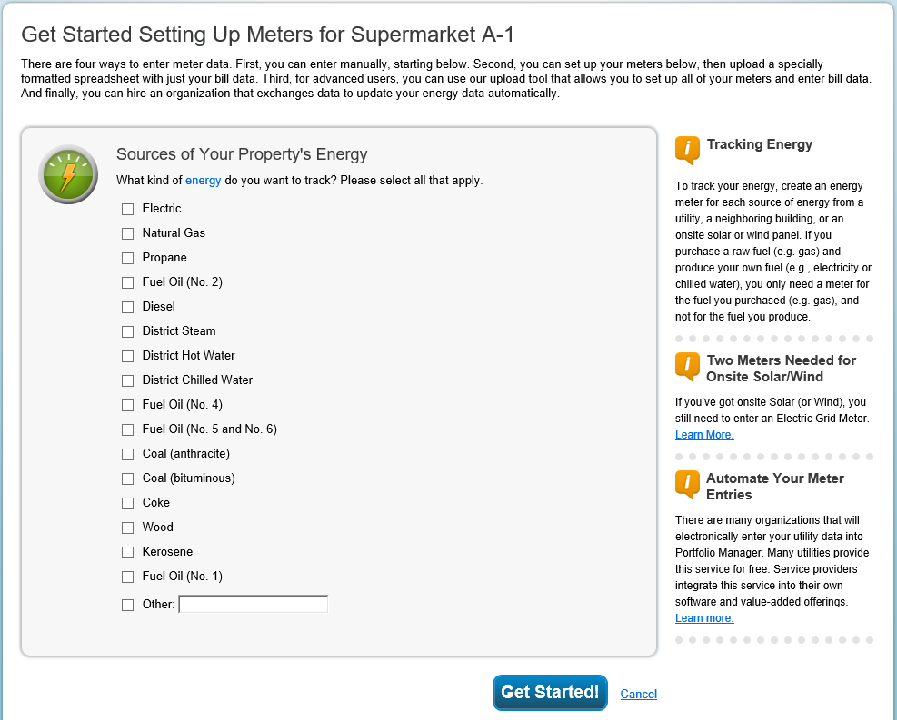
Enter Additional Information
Notes:
On the “Getting Started Setting Up Meters” page, you will be prompted to identify all sources of energy consumed at the property, as well as the number of meters for each fuel source. Make sure to include every fuel consumed.
For electricity, you will be asked to indicate whether the energy was purchased from the grid, or generated onsite via solar or wind power.

Slide 41
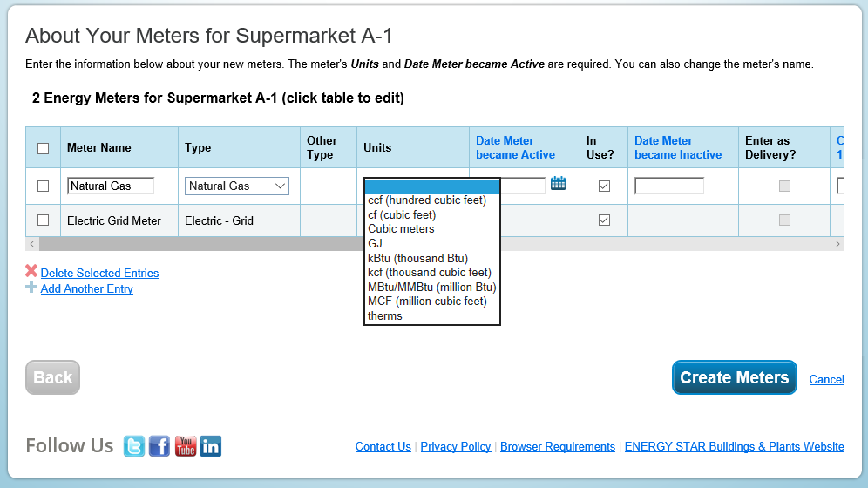
About Your Meters
Notes:
On the “About Your Meters” page, click anywhere in the table to add data about your meters
To enter units, select the accurate unit from the drop down menu.
The “Date Meter Became Active” can be the date the building was built--typically, your meter becomes active when construction is complete and the building starts operating—or it can be the first day of the first bill for the first 12 mos. period you wish to benchmark.
You only need to enter a date the meter became inactive if you want to note that a meter has been decommissioned.
If your fuel is delivered in bulk (like fuel oil or propane) then check “Enter as Delivery.”
You can also add an additional meter from this page, if on the previous page you forgot one.
Once you have defined the general characteristics of each meter, select ”Create Meters” to begin entering your bills.

Slide 42
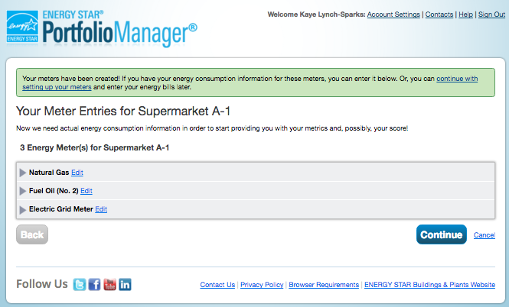
Add Energy Consumption Information
Expand meter by clicking arrow
Notes:
On the next page, you will see the meters you have established. To expand each meter record, click the arrow to the left of the meter you would like to edit.
All meters will be presented on the same page. This allows you to add data to multiple meters at the same time (no need to click through multiple meter entry pages).

Slide 43
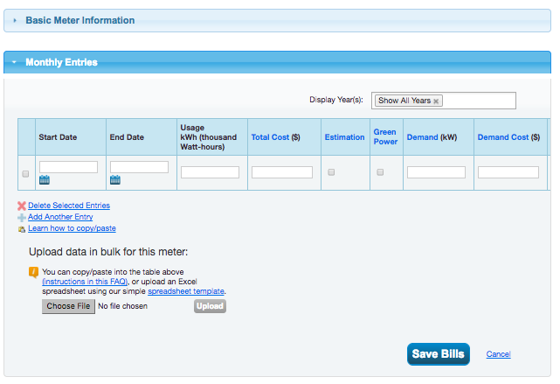
Add Meter Entries and Fill in Data
How To Guide: Electric Demand Tracking
https://www.energystar.gov/buildings/tools-and-resources/how_track_electric_demand_portfolio_manager.
Add another entry
Use a spreadsheet to upload or copy and paste
Notes:
Next, enter consumption data for each meter by selecting “Add Another Entry” to enter the start and end date, usage, and cost. As with the prior page, you can click anywhere in the table to edit the corresponding data field. When you enter a start date, Portfolio Manager auto-populates the end date. Portfolio Manager will also auto-populate the next start date when you select “Add Another Entry” again.
A quick note that PM now tracks demand and includes these three metrics in custom reports: Annual Maximum Demand (kW), Annual Maximum Demand (MM/YYYY), and Annual Maximum Demand (Meter Name (Meter ID)).” We have a How to Guide on this topic: https://www.energystar.gov/buildings/tools-and-resources/how_track_electric_demand_portfolio_manager.
“Usage” is required. Cost is not required. However it is a best practice to enter cost to have access to handy metrics like energy cost per sq. foot, for example. Use “Estimation” whenever you make an estimation, for example if you have not received your bill yet. If the value you are entering comes directly from your utility bill, you do not need to check estimated, even though some utility bills are marked this way when they contain small estimates based on how the utility read your meter.
To generate accurate metrics, enter at least 12 consecutive months of data for all fuels consumed in the building. For the most accurate metrics, enter the start and end dates on your utility bill. If the start and end dates fall in the middle of the month, you will need to enter 13 billing periods in order to get a complete 12 calendar months of data. For more information about acceptable meter entry time frames, see this FAQ: https://portfoliomanager.zendesk.com/hc/en-us/articles/211027768-Can-I-enter-energy-bills-that-are-not-monthly-Can-I-enter-one-energy-bill-for-the-entire-year
You can also enter purchased solar and wind power by checking the “Green Power” box, which will then prompt additional questions about where the energy was purchased and what type of green power it is. Tracking green power purchases will affect the greenhouse gas emissions metrics for your property. More information about entering both purchased and onsite generated green power is available here: http://www.energystar.gov/buildings/tools-and-resources/portfolio-manager-technical-reference-green-power.
Another option is to use a spreadsheet to upload consumption data, which is available on this page. It’s a simple spreadsheet; there are only 5 columns. Once you have filled in the necessary data, you can upload the spreadsheet back into Portfolio Manager via this page, OR even easier, Cut and Paste into the first box.
Make sure to select “Continue” after you populate the page.

Slide 44
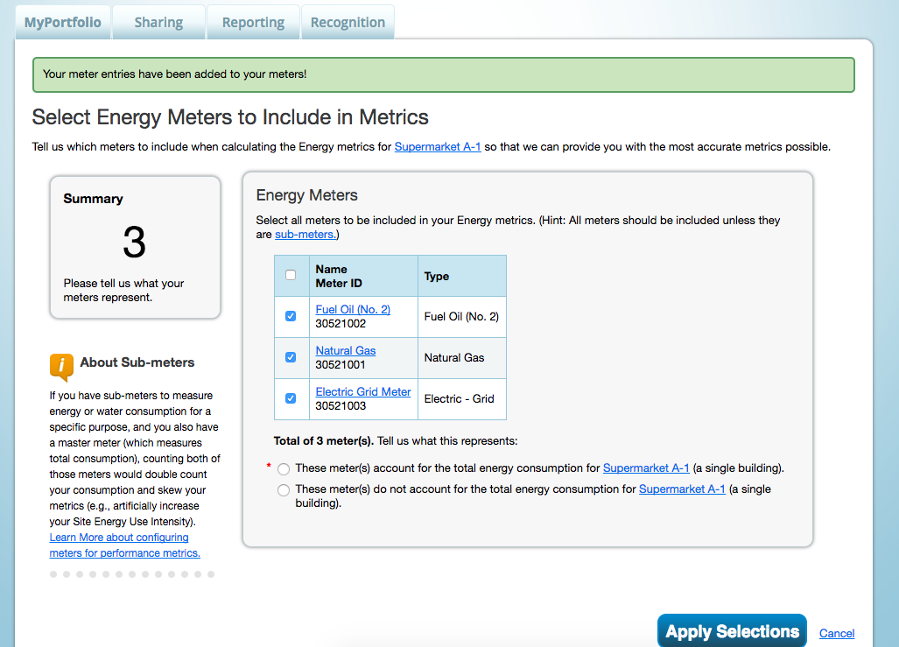
Meters to Add to Total Consumption
Notes:
The next step is to select meters to include in metrics. This page is important for Portfolio Manager to understand which meters should be applied to the total property energy consumption, and therefore should be used for calculations. Indicate that the meters do account for total energy consumption or that they do not account for total energy consumption.
A note about campuses: If you are setting up a multi-building campus, and want to roll up any building-level meters to the larger property, this is where you will do it. In the campus scenario, be aware that you need to define the meters at the building level first, before you can associate them to the property level. To avoid double counting any energy, do not add sub-meters to property totals if the energy consumption they are tracking is also captured by the main meter.
When you are done, click “Apply Selections.”

Slide 45
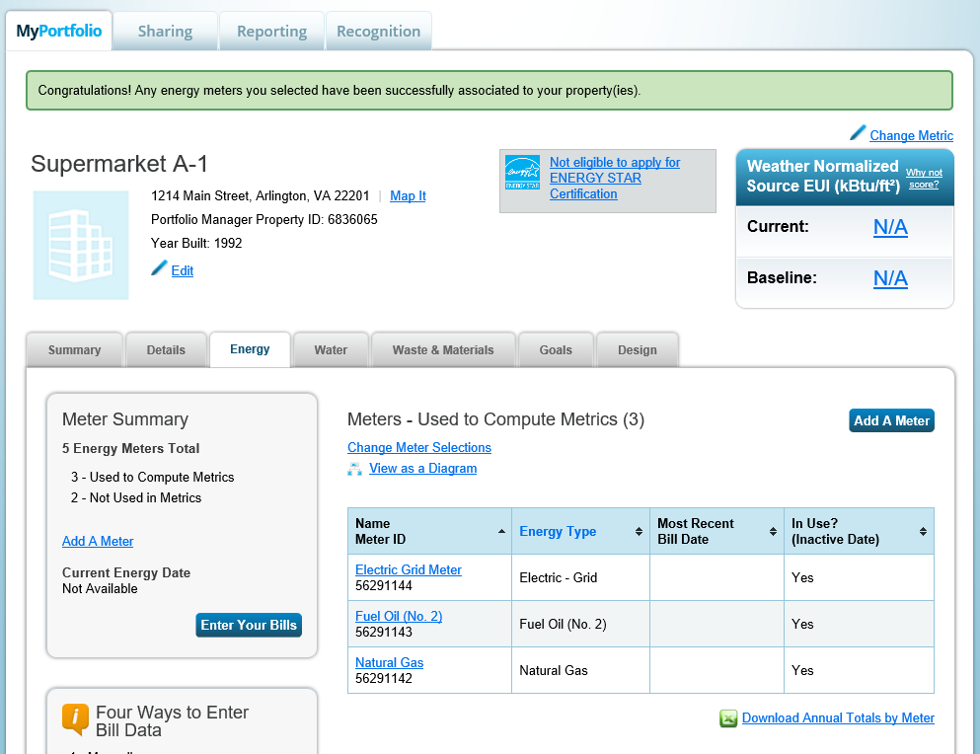
Energy Meters Tab: Meters Added and Displayed
Notification
Add or update bills
Notes:
Now, your meters are set up and you will see a note of congratulations back on the Energy tab.
Here you can review a summary of and access the energy meters that are set up for the building.
If you want to add your latest bills or update past entries, select “Enter Your Bills” or select the relevant meter.
-

Slide 46
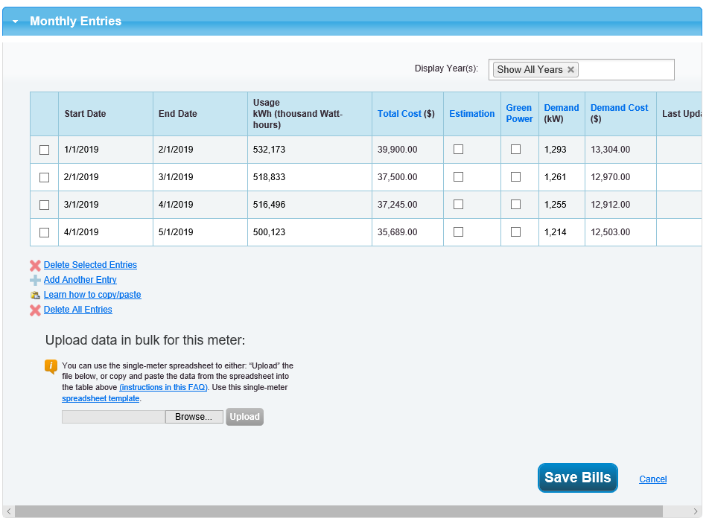
View Meter Data and Manage Bills for Your Property
Notes:
After selecting “Enter Your Bills” or clicking on the relevant meter you can add billing periods or make any necessary edits. Make sure to click “Save Bills” once you are done making updates.

Slide 47
How To
Navigate Portfolio Manager
Add a property and enter its use details
Enter energy, water, and waste & materials data
Analyze progress using performance documents, charts and graphs and reports
Notes:
That completes our third objective, entering energy, water, and waste & materials data. Now, we will discuss how to generate performance documents, charts and graphs and reports to analyze performance.

Slide 48
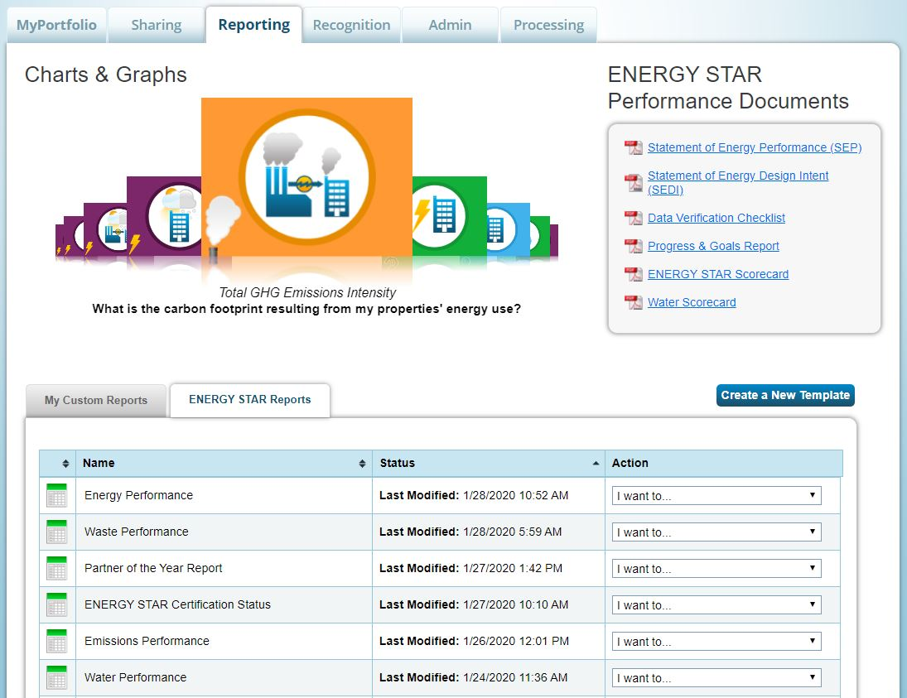
Reporting Tab
Choose from pre-set chart & graph options
Download performance documents
Create and generate templates & reports
Notes:
Benchmarking can only drive action if you can clearly access and interpret the data you have entered into Portfolio Manager. The features on the Reporting tab will help you do this. From this tab you can download Performance Documents, generate charts and graphs and create pre-loaded and custom reports to export useful energy, water and waste and materials metrics to analyze building performance across a variety of measures.
Today we’ll provide an overview of these items and we discuss them in more details during Portfolio Manager 301.

Slide 49
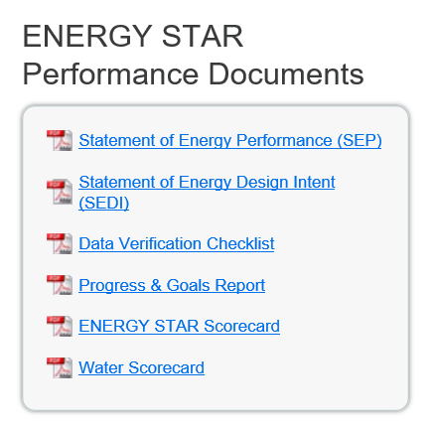
Performance Documents
Notes:
Performance Documents reflect details and performance about individual properties you have entered. There are six Performance Documents to choose from:
Statement of Energy Performance
Statement of Energy Design Intent
Data Verification Checklist
Progress and Goals Report
ENERGY STAR Scorecard
Water Scorecard
Click on the one you’d like to generate and follow the additional prompts to select which property to include in the report which downloads in .PDF format.
To save the Performance Document save the .PDF on your computer. Generated Performance Documents are not saved in Portfolio Manager.

Slide 50
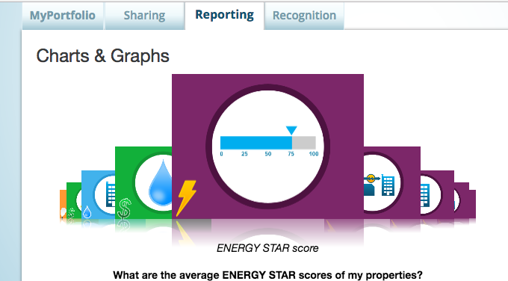
Charts & Graphs
Source EUI
Site EUI
ENERGY STAR score
Weather normalized source EUI
Weather normalized site EUI
Total GHG emissions intensity
Energy cost intensity
Indoor water intensity
Indoor water cost intensity
Scroll through to see available Charts & Graphs.
Notes:
The charts & graphs feature is a pre-defined collection of metrics for at-a-glance results for your entire portfolio. Generate these charts by selecting the name of the chart or its icon. There are nine to choose from:
Source EUI - Based on the total amount of raw fuel required to operate my properties, how much energy are my properties consuming relative to their sizes?
Site EUI - Based on the energy consumption measured by my meters, how much energy are my properties consuming relative to their sizes?
ENERGY STAR Score - What are the average ENERGY STAR scores of my properties?
Weather normalized source EUI – source energy use intensity adjusted for weather
Weather normalized site EUI – site energy use intensity adjusted for weather
Total GHG emissions intensity – emissions intensity based on fuel mix
Energy cost intensity – cost per square foot based on user-entered cost data
Indoor water intensity – water consumption per square foot
Indoor water cost intensity – cost per square foot based on user-entered cost data

Slide 51
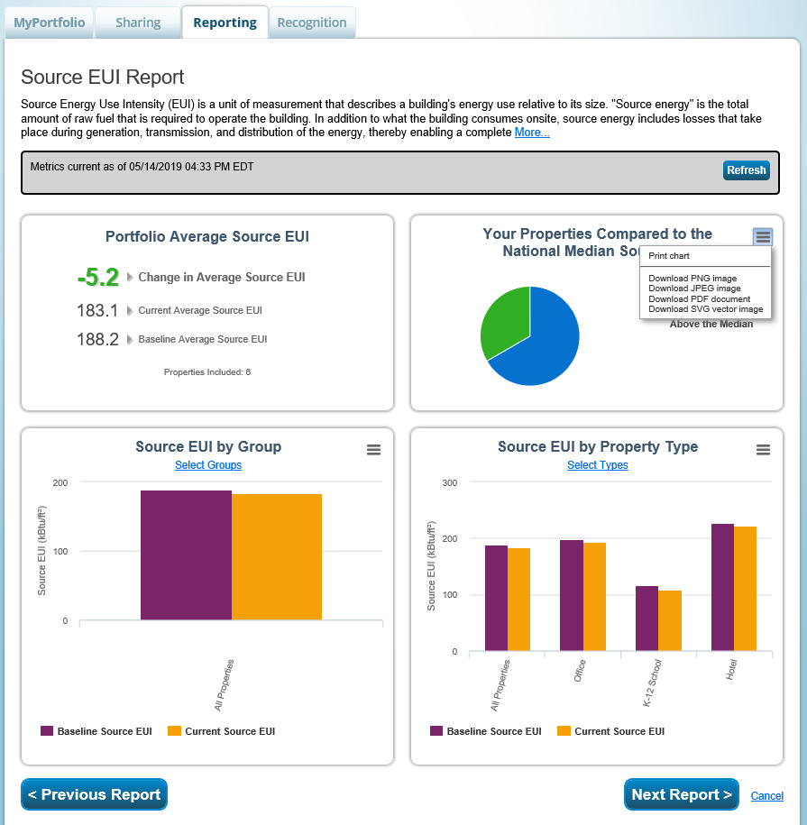
Charts & Graphs
Print or download figures for use externally
View the next chart
Scroll to bottom to view and export raw data
Notes:
Here’s an example of the “Source EUI” report. It includes portfolio averages, comparison to the national median, and energy use intensity by group and property type.
You can select a specific group and specific property types to view.
Each chart and graph in the reports can be printed or exported in a variety of formats (PDF, JPEG, PNG, SVG) for easy integration into external reports and presentations.
At the bottom of this page, you can also view and export the raw data used to create each chart/graph.

Slide 52
Reporting Tab
Create and generate templates & reports
Notes:
Towards the bottom of the Reporting tab, you will see a set of nine standard reports (listed on next slide).
These reports contain key metrics and information that you can use to easily assess your portfolio’s performance and progress across a variety of parameters.
To generate any of these reports, go to the “Action” drop-down menu and select “I want to… Generate New Report.” You will be asked to select the timeframe for this report, as well as the properties to include.
Once you generate the report, you will be able to view it from the “Action” drop-down menu. You can also download the report in Excel and XML formats, update the report to include additional properties and/or new timeframes, and generate a new report.
There is also a separate tab, “My Custom Reports,” where you can generate custom reports and data requests. In the third training, Portfolio Manager 301, we will discuss how to use the custom reporting feature to further tailor the specific reports that you can generate for your properties.

Slide 53
Standard Reports
Performance Highlights
Energy Performance
Emissions Performance
Water Performance
Fuel Performance
Waste Performance
ENERGY STAR Certification Status
Partner of the Year Report
Sustainable Buildings Checklist Report
Notes:
Here is a list of the 9 standard reports that are pre-loaded with popular combinations of metrics.
EPA has also developed a PDF document that summarizes each of these reports, as well as the list of metrics delivered for each report, available here: https://www.energystar.gov/buildings/tools-and-resources/portfolio-manager-standard-reports

Slide 54
Pop Quiz!
True or False: Portfolio Manager users must define a custom template if they want to use the Reporting functionality.
    True
    False

Slide 55
Pop Quiz!
True or False: Portfolio Manager users must define a custom template if they want to use the Reporting functionality.
    True
    False
Portfolio Manager offers a variety of standard, pre-defined Reporting features, such as ENERGY STAR Performance Documents, charts and graphs, and standard progress report templates on energy and greenhouse gas usage.

Slide 56
Recap
We learned how to:
  Navigate Portfolio Manager
  Add a property and enter its use details
  Enter energy, water, and waste & materials data
  Analyze progress using performance documents, charts and graphs and reports
Notes:
In conclusion, these are the topics we discussed today.
We hope that you will attend the follow-on training session, “Portfolio Manager 201.” In that session, you will take a deeper dive into more advanced Portfolio Manager functionalities such as:
editing existing property data
correcting and updating historical information
using the Data Quality Checker
sharing property data

Slide 57
Extra Help
Visit www.energystar.gov/buildingshelp
  Extensive list of FAQs
  Online form to submit technical questions or comments
Additional Portfolio Manager training resources available at: www.energystar.gov/buildings/training
  Step-by-step documents (PDF)
  Access to recorded trainings and short videos
  Information on upcoming trainings
Register for regular webinars at: http://esbuildings.webex.com
Portfolio Manager Technical Reference Series: http://www.energystar.gov/index.cfm?c=evaluate_performance.bus_portfoliomanager_model_tech_desc
Notes:
Please be aware of these additional resources, which will help you as you get started in Portfolio Manager.

Slide 58
Thank you for attending!
Questions?
Slides will be sent to all webinar registrants after today’s session
If you have any questions on Portfolio Manager
or the ENERGY STAR program, contact us at:
www.energystar.gov/BuildingsHelp

