Slide 1

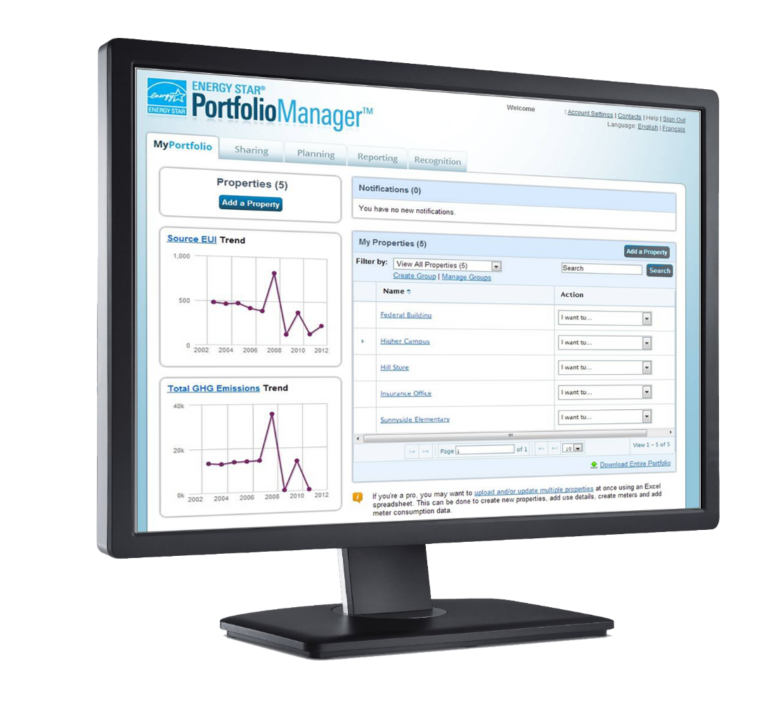
An Overview of Portfolio Manager for Commercial Building Benchmarking
2019

Slide 2

Benchmarking allows you to:
73
88
21
Compare your building to a national sample of similar buildings
Compare your buildings of a similar type to each other
Identify underperformers in your portfolio and set priorities for the use of limited staff time and/or investment capital
ANY building can be benchmarked.

Slide 3
Benchmarking allows you to:
Evaluate portfolio-wide performance
Understand individual building performance
Compare energy performance to national median
Identify and address potential problems by looking at monthly trends
Track the impact of energy, water, waste management strategies

Slide 4
Range in Energy Performance: A City’s Fire Stations
Notes:
12 similar fire stations with 12 vastly different energy usage profiles.
Why were the stations on the left using so little energy, while the stations on the right used so much? This benchmarking information enabled the town to do 3 things:
Uncover inefficiencies and best practices they didn’t even know about.
Know where to spend their money
Verify whether the changes they made were having an impact.
This is the power of information, and this is the value of benchmarking.

Slide 5
Why focus on buildings and plants?
Energy waste in commercial buildings
30%
Notes:
Buildings and plants use a lot of energy, but they don’t have to. For example, <CLICK> the average building wastes 30 percent of the energy it consumes because of inefficiencies.

Slide 6
Why focus on buildings and plants?
Low- to no-cost reduction potential
10%
Notes:
Working with thousands of organizations over the past 20 years, we’ve shown that reductions of 10 percent or more in energy use can be possible with little or no cost.
And if every building and plant in America reduced its energy use by just 10 percent, we’d save $40 billion and prevent greenhouse gas emissions equal to those from about 49 million vehicles.

Slide 7
Launched Portfolio Manager in 1999 to help organizations increase efficiency of energy use
Built on the principle that the foundation of good management is good information
  Energy tracking and management was not widely practiced; no standardization
  Designed for the use of building owners and managers, not for reporting to EPA
Added water tracking in 2006, in collaboration with EPA’s WaterSense
Added waste tracking in 2016, in collaboration with EPA’s Office of Resource Conservation & Recovery

Slide 8






Management Tool
  Assess whole building energy and water consumption
  Track green power purchase
  Share/report data with others
  Track changes in energy, water, greenhouse gas emissions, and cost over time
  Create custom reports
  Apply for ENERGY STAR certification
Notes:
Management Tool
Assess whole building energy and water consumption
Track changes in energy, water, greenhouse gas emissions, and cost over time
Track green power purchase
Share/report data with others
Create custom reports
Apply for ENERGY STAR certification

Slide 9






Hundreds of metrics, including:
  Energy use Source, site, weather normalized, demand
  Water use
  Water use intensity,
  Water Score
  (for Multifamily)
  Waste & Materials
  Waste intensity, diversion rate
  1-100
  ENERGY STAR score
  GHG emissions
  Indirect, direct, total, avoided
Notes:
Portfolio Manager offers users literally hundreds of metrics. Among them are energy consumption, water consumption, greenhouse gas emissions, and the 1 – 100 ENERGY STAR score.

Slide 10






















Benchmarking with Portfolio Manager is the industry standard
Notes:
Hundreds of thousands of commercial properties use EPA’s ENERGY STAR Portfolio Manager® tool to measure, track, assess, and report on their energy and water consumption.
34,000+ properties are ENERGY STAR certified

Slide 11
Who Is Using Portfolio Manager?
Building owners, managers, tenants, service providers
Local, county, and state governments, some with benchmarking and public disclosure policies
Federal agencies under executive orders & statutes
Green building certification programs
  LEED, Green Globes
Consumer information sites
  TripAdvisor, CoStar, Apartments.com
Energy competitions
  Kilowatt Crackdowns
Investors, via sustainability reporting and ranking
  GRESB, Greenprint, CDP
Multifamily financing industry
  Fannie Mae, Freddie Mac, HUD

Slide 12
State and Local Policies

Slide 13
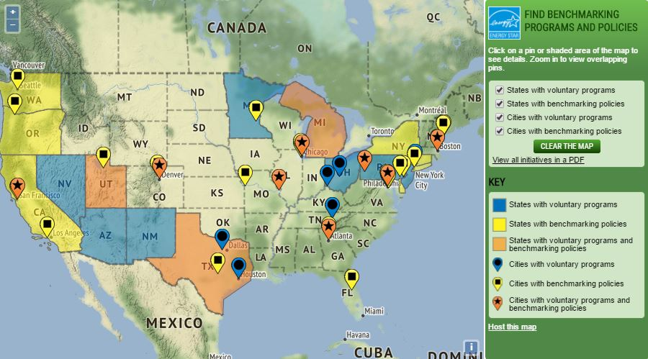
Interactive map of policies and programs
www.energystar.gov/policiesandprograms
Can be hosted on your site!
Notes:
The map shows a summary of national, state-level, and local efforts that use EPA’s ENERGY STAR Portfolio Manager to improve energy efficiency in commercial buildings
Click on shaded areas or pins to learn more about policies and programs, or download a PDF of all of the initiatives
Presented side by side with utility data access map

Slide 14

Benchmarking laws that require use of ENERGY STAR Portfolio Manager
30+ laws nationwide
Buildings must:
Benchmark their energy use
Report it on an annual basis
Disclose to public or potential buyers/lessees
EPA only advises on the use of Portfolio Manager
Notes:
29 local governments, 3 states, and 1 province have passed laws requiring building owners to benchmark their properties using ENERGY STAR Portfolio Manager and report energy and/or water use data to the them on an annual basis
All of the laws include transparency, i.e., publishing the data that’s been reported. The governments are taking different approaches to transparency but have the same intent – to increase the value of efficiency in the market

Slide 15
Government | Commercial | Multifamily | Water reporting | Utility data availability
Atlanta, GA | >25K | >25K | Yes | -
Austin, TX | >10K | 5+ units | - | spreadsheet
Berkeley, CA | >25K | >25K | Yes | web services
Boston, MA | >35K | >35K, 35+ units | Yes | spreadsheet
Boulder, CO | >20K | - | - | web services
Cambridge, MA | >25K | 50+ units | Yes | spreadsheet
Chicago, IL | >50K | >50K | - | web services, spreadsheet
Denver, CO | >25K | >25K | - | web services
Washington, District of Columbia | >50K | >50K | Yes | web services, spreadsheet
Evanston, IL | >20K | >20K | Yes | web services
Notes:
Commercial and multifamily cutoffs listed here are the terminal ones identified in the benchmarking laws. Units are square feet unless otherwise noted

Slide 16
Government | Commercial | Multifamily | Water reporting | Utility data availability
Kansas City, MO | >50K | >50K | Yes | spreadsheet
Los Angeles, CA | >20K | >20K | Yes | web services
Minneapolis, MN | >50K | - | Yes | web services
Montgomery County, MD | >50K | - | - | web services, spreadsheet
New York, NY | >25K | >25K | Yes | spreadsheet
Orlando, FL | >50K | >50K | - | -
Philadelphia, PA | >50K | >50K | Yes | web services
Pittsburgh, PA | >50K | - | Yes | -
Portland, ME | >20K | 50+ units | Yes | -
Portland, OR | >20K | - | - | web services, spreadsheet

Slide 17
Government | Commercial | Multifamily | Water reporting | Utility data availability
Salt Lake City | >25k | - | - | web services
San Francisco, CA | >10K | - | - | web services
Seattle, WA | >20K | >20K | - | web services
South Portland, ME | >5K | 10+ units | Yes | -
St. Louis, MO | >50K | >50K | Yes | -
State of California | >50K | >50K | - | web services, spreadsheet
State of Washington | >10K | - | - | web services
Province of Ontario, Canada | >50K | >50K, 10+ units | Yes | -

Slide 18
Accessible in a free,
online secure platform: www.energystar.gov/benchmark
A Metrics Calculator that generates key performance indicators.
Energy consumption (source, site, weather normalized, EUI)
  Water consumption (municipally supplied potable and reclaimed, alternative)
  Waste management (disposed, recycled, donated/reused, and composted)
  Greenhouse gas emissions (indirect, direct, total, avoided)
  ENERGY STAR 1-to-100 score (available for many building types)
A Management Tool that provides a platform for a strategic energy management
Identify high performing facilities for recognition and replicable practices.
Prioritize poor performing facilities for immediate improvement.
Understand the contribution of energy expenditures to operating costs.
Develop a historical perspective and context for future actions and decisions.
Establish reference points for measuring and rewarding good performance.
Apply for ENERGY STAR certification

Slide 19
Dozens of metrics available, these are just a few
Energy Metrics (Site and Source)
  Total Energy Use (kBtu)
  Energy Use Intensity (EUI) (kBtu/Sq. Ft.)
  Weather Normalized EUI (kBtu/Sq. Ft.)
  National Median EUI (kBtu/Sq. Ft.)
  % Difference from National Median EUI (%)
  1 to 100 ENERGY STAR Score
Water Metrics
  Total Water Use (kGal)
  Water Use Intensity (kGal/Sq. Ft.)
  Track indoor, outdoor or combined water use (kGal)
  Track municipally supplied potable & reclaimed water, alternative water generated on site, other water sources
Waste & Materials Metrics
  29 types of waste materials can be tracked
  4 waste management methods: disposed, recycled, donated/reused, and composted
Comparisons
  Total Energy Use (kBtu)
  Energy Use Intensity (kBtu/Sq. Ft.)
  Adjusted Energy Use (%)
  GHG Emissions (MtCO2e)
  Available against baseline or between any two periods.
Financial
  Annual Energy Cost
  Total Energy Cost per Sq. Ft.
  Cumulative Investment in Facility Upgrades
  Cumulative Investment per Sq. Ft.
Renewable Energy
  Total On-Site Electric Generation (kWh)
  Percent of Electricity from On-Site Renewable (%)
  Total Renewable Energy Certificates Purchased and Sold
  Total Avoided Greenhouse Gas Emissions from RECs (MtCO2e)
Notes:
A full list of metrics is available via www.energystar.gov/buildings/training

Slide 20
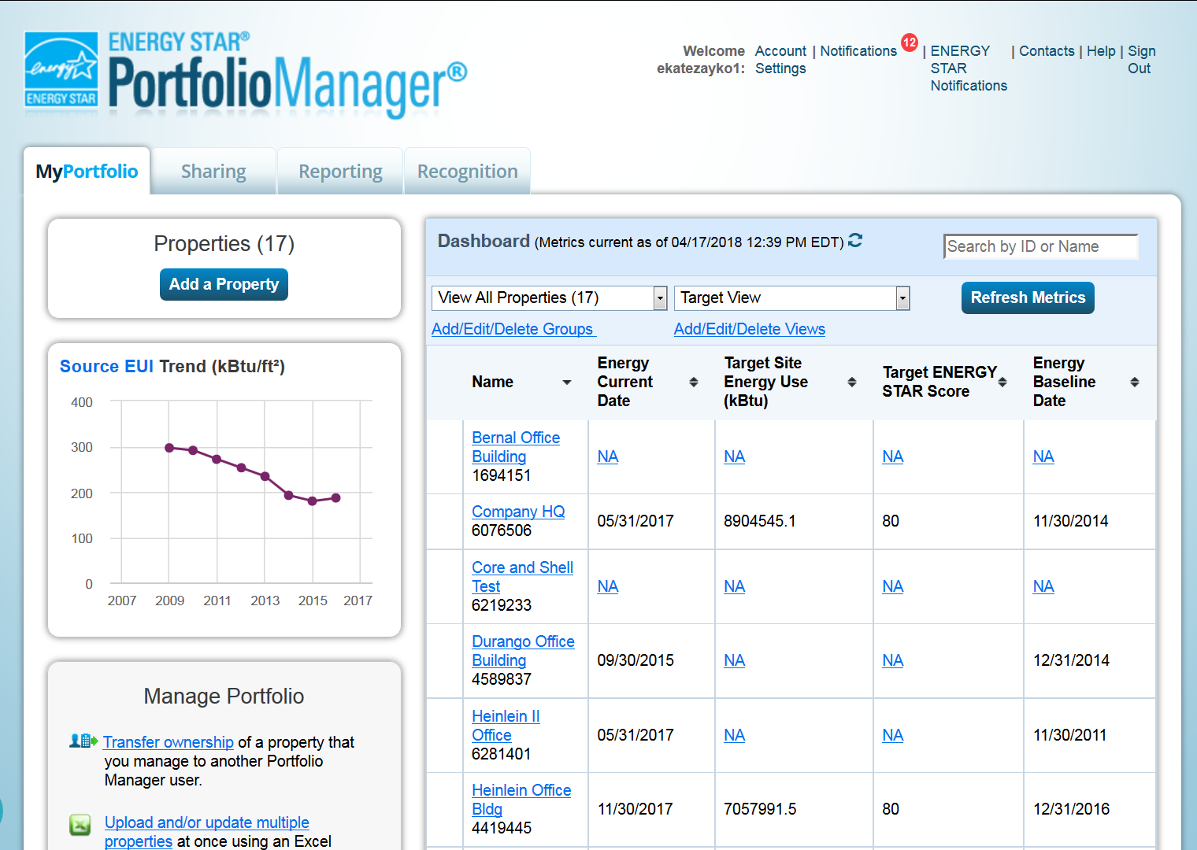
Portfolio Manager account user interface
Notes:
This is a screenshot of what the landing page of a Portfolio Manager account looks like. Note that charts on the left that show portfolio-wide energy use intensity and greenhouse gas emissions over time. The main tabs on the page are oriented toward sharing building information with others, planning by setting targets and goals at the building or portfolio levels, generating reports as well as downloadable charts and graphs, and a tab for ENERGY STAR recognition. The middle of the page shows notifications (such as other users requesting to connect, or sharing building information), and the list of properties that exist in the account.

Slide 21
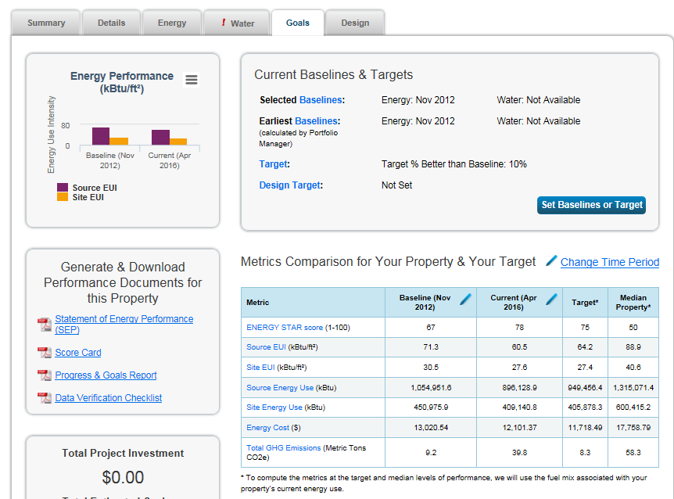
Set goals and track progress
Set performance targets and baselines
Monitor progress and document savings goals achieved
Track targets at the building or portfolio levels
Notes:
You can establish targets and goals at the building or portfolio levels. This is a screenshot of the goals tab at the building level.

Slide 22
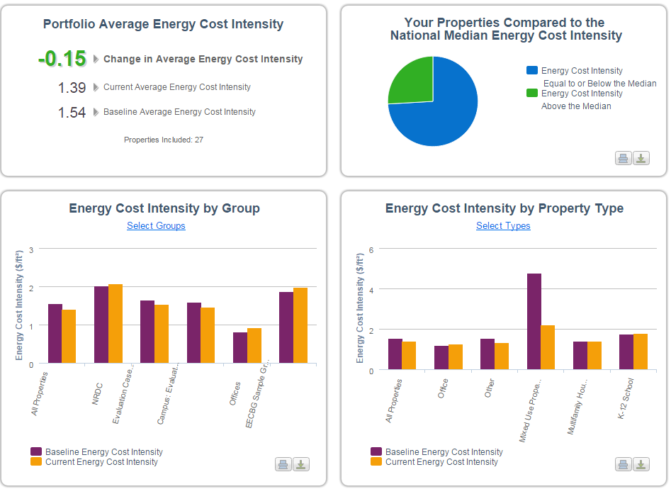
Beyond Benchmarking
Access off-the-shelf portfolio-specific reports
  Site and source EUI, water use intensity, emissions intensity, etc.
Generate custom reports
Create report templates for consistent reporting
Create data requests to collect building data from other Portfolio Manager users
Exportable charts & graphs

Slide 23
Manage your portfolio
Create customized groups of buildings to manage your portfolio
Share full or limited building information with other Portfolio Manager users
Allow shared users access to edit or share building data
Transfer buildings to other accounts
Make copies of buildings

Slide 24
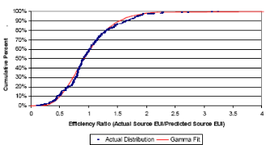
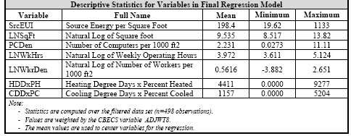
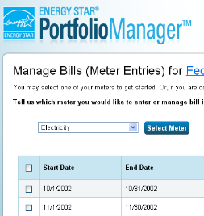

Developing a 1 – 100 ENERGY STAR Score
Data analysis
Nationally representative survey
Statistical modeling
Comparison between actual energy data and the modeled estimate
Notes:
Nationally representative survey - CBECS gathers data on building characteristics and energy use from thousands of buildings across the US
EPA analyzes & filters the data - ensuring data robustness and quality
EPA creates a statistical model that correlates the energy data of the property use details to identify the key drivers of energy use, accounting for weather variations
Compares the actual energy data for a building to the modeled estimate to determine where the building ranks relative to its peers

Slide 25



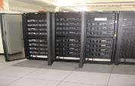















Property types with 1-100 ENERGY STAR scores
*Not eligible for ENERGY STAR Certification
Bank Branch
Barracks*
Courthouses
Data Centers
Distribution Centers
Financial Offices
Hospitals
Hotels
K-12 Schools
Office Buildings
Medical Offices*
Multifamily Housing
Residence Hall/Dormitory*
Retail Stores
Senior Care Communities
Supermarkets
Warehouses
Wastewater Treatment Plants*
Wholesale club/ Supercenters
Worship Facilities
Notes:
* Building types with an asterisk are not eligible for ENERGY STAR certification.
25

Slide 26

ENERGY STAR Certification for Commercial Buildings
Building must be in the United States or territories
Achieve an ENERGY STAR score of 75 or higher
Apply for ENERGY STAR recognition via Portfolio Manager
Application must be verified by a licensed professional
Awarded based on the calendar year of application
Must re-apply annually to keep current
1 to 100 Energy Performance Scale
National Average
Superior Energy Management!
1
50
75
100

Slide 27

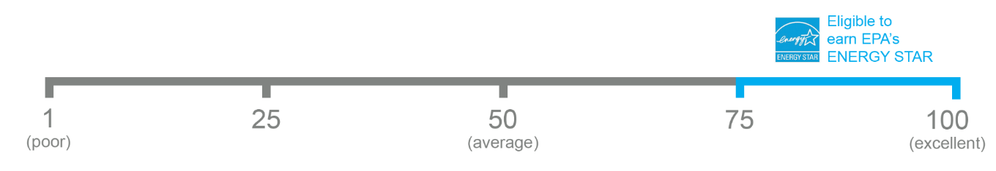
The 1-100 ENERGY STAR Score
One simple number
understood by ALL stakeholders.
Notes:
The ENERGY STAR score is one simple number that can be understood by all stakeholders.

Slide 28
ENERGY STAR in Canada
EPA’s ENERGY STAR program partnered with Natural Resources Canada (NRCan) to adapt the tool for use with Canadian properties
Portfolio Manager is available in French
Property Types eligible to receive a - 100 ENERGY STAR Score
  Commercial office
  K-12 school
  Hospital
  Ice/Curling Rinks
  Medical office
  Senior Care Communities and Residential Care Facilities
  Supermarket/grocery store
Building certification has been available since March 2018

Slide 29
Get Started: Gather the information needed to benchmark
Property information
  Building type
  Name, street address, ZIP/postal code
Property type data
  Gross floor area
  Use details (e.g., workers, operating hours)
Utility bills
  From all purchased and on-site generated energy (required for EUI and/or 1 to 100 ENERGY STAR Score only)
  From all purchased and on-site generated water
  Related to waste management
Notes:
You don’t need very much information to begin benchmarking a property in Portfolio Manager. However, it is helpful to have the information listed on this slide: things like the property’s basic function, the address, the building’s size and operating characteristics.
You will also need a minimum of 12 months of energy consumption data for all energy consumed at your property to get a 1 to 100 ENERGY STAR score or EUI.

Slide 30
Four Ways to Get Data in to Portfolio Manager
Manual Data Entry
  Type in each number for each monthly entry
Single Meter Spreadsheet
  Use a spreadsheet to update one meter a time
  Copy/paste data from Excel to Portfolio Manager
Multi-meter Spreadsheets
  Use a spreadsheet to update multiple meters from multiple properties
Web Services
  Companies electronically enter utility data into Portfolio Manager through a process of data exchange called “web services”
  Find utilities that provide aggregated benchmarking data at www.energystar.gov/utilitydata

Slide 31
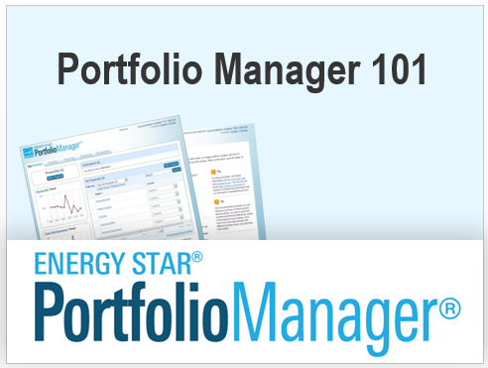
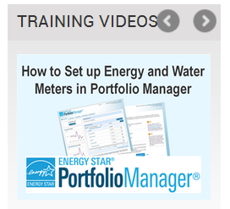
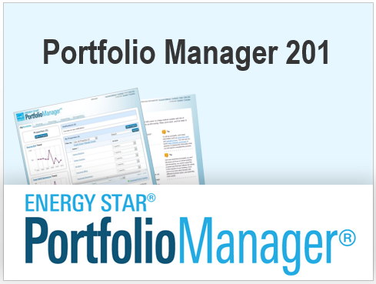
Learn more about Portfolio Manager
Visit www.energystar.gov/buildings/training
  Step-by-Step guides for using Portfolio Manager
  Access to live and recorded webinars
  Webinar slides for Portfolio Manager 101, 201, and 301
  Short videos to help you create a property, create meters, populate meters, create reports, and more!

Slide 32
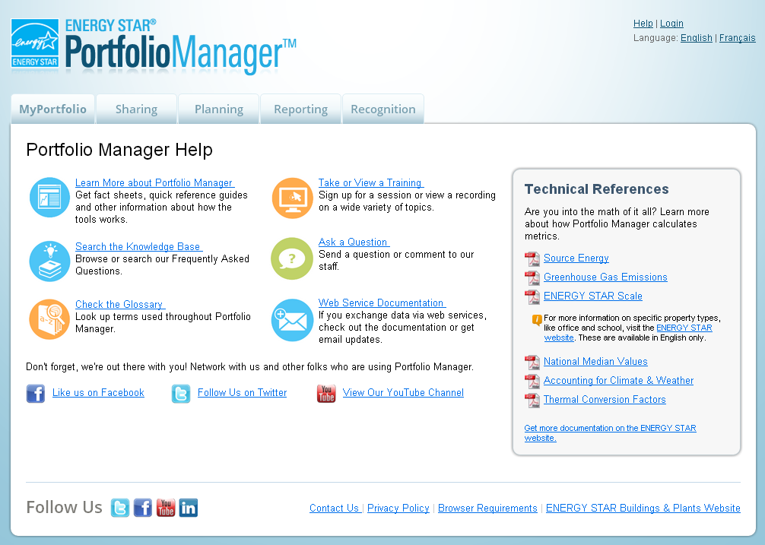
Tap into ENERGY STAR Technical Assistance
On-demand user support, and answers to frequently asked questions at www.energystar.gov/buildingshelp
Attend a live “Ask the Expert” session scheduled via https://esbuildings.webex.com

Slide 33

  Free. Online. Secure.
  energystar.gov/benchmark

