Slide 1

BOC 1004
HVAC Controls Fundamentals
Month Day, Year
Instructor Name, Position
Instructor Company
Phone
Name@email.com
Notes:
Instructor’s name: __________________________________________________________
Phone number: ____________________________________________________________
E-mail: ___________________________________________________________________
_________________________________________________________________________
_________________________________________________________________________
_________________________________________________________________________
_________________________________________________________________________
BOC 1004
HVAC Controls Fundamentals
Edition 3.00

Slide 2

Safety Message
Notes:
Let's start with a safety reminder. This may be something from the course sponsor or site host; the instructor, moderator, or a student. Topics can include anything related to safety: site, health, personal, equipment, etc. What topic shall we address today?

Slide 3
Project Debrief
What was your project assignment?
What did you learn from doing it?
What worked and didn’t work?
How will you use the information gathered during the assignment?
Notes:
BOC 1001: HVAC Equipment Floor Plan
BOC 1002: Benchmark Your Building in ES PM
BOC 1003: Conduct a Lighting Survey and Calculate a Retrofit Incentive
BOC 1004: HVAC Controls Review
BOC 1005: Develop an Occupancy Schedule

Slide 4
Class Objectives
Interpret basic control drawings, sequence of operations, and DDC graphics to understand HVAC building control strategies and applications.
Access graphical user interfaces from a building’s BAS system.
Articulate expected modes of building operation for verification.
Prepare screen check data forms and record data.
Compare expected modes of operation to recorded data.
Confirm observations with data trending.
Develop key performance indicators to ensure that correct operation persists.
Notes:
Class Overview
This one-day class provides an introduction to automatic control systems for building mechanical systems and equipment and HVAC control sequences and programming. Participants will learn to target possible inefficiencies in their HVAC systems and to evaluate potential problems as part of an enhanced operation and maintenance program. Participants are introduced to Building Automation Systems (BAS) and the graphic user interface as a cost effective tool to review real time data to identify problems and verify proper performance for air handling and central plant systems. The class covers the development and use of key performance indicators (KPIs) to ensure persistence of performance. PROJECT: HVAC Controls Review.
Learning Objectives
After this course, an operator should be able to:
List the main devices in a basic control system.
List at least two tasks required in the preventative maintenance of control systems.
Differentiate between analog, low voltage, pneumatic and digital control processes.
Interpret basic control drawings, sequence of operations, and DDC graphics to identify HVAC control applications and explain control processes.
Analyze graphical user interfaces from a building’s BAS system to gather data on building and system performance.
Prepare screen check data forms to troubleshoot building and equipment level issues.
Use BAS data to compare actual and expected modes of operation to verify operational efficiency.
Identify BAS data inconsistencies using trend data to confirm system operations.
Use key performance indicators in BAS data to troubleshoot system issues.

Slide 5
Recommended Resources
Control Systems for Heating, Ventilating, and Air Conditioning 6th Edition
by Roger Haines and Douglas Hittle, Springer Publications
DDC Online http://ddc-online.org
HVAC Controls
by Ron Auvil, ATP Publishers
Honeywell Automation Controls Manual
PNNL Retuning Controls https://buildingretuning.pnnl.gov/training/ddc_control_fundamentals/ddc_controls_part_1_pnwd-sa-8834.pdf

Slide 6
BOC 1004 Agenda
Section 1: HVAC Controls Fundamentals
Exercise – Review a DDC Controls Diagram
Section 2: Computerized Controls Systems
Exercise – Evaluate a Reset Strategy
Exercise – Examine a GUI & Find a Problem
Notes:
1004 Agenda
This class covers HVAC Controls Fundamentals and using controls strategies to improve the energy efficiency of system operation.
There are 2 primary sections:
Section 1 will cover fundamental control system concepts, devices, diagrams and controls responses.
Section 2 will cover computerized controls systems, building automation systems (BAS), BAS screen checks, whole building and equipment level troubleshooting, trend analysis, and key performance indicators to track for energy conservation opportunities.

Slide 7
Section 1:
Controls Fundamentals

Slide 8
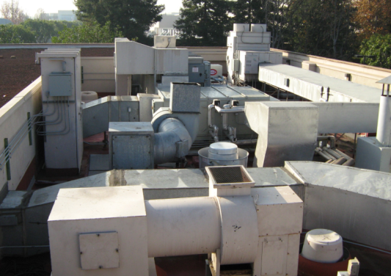
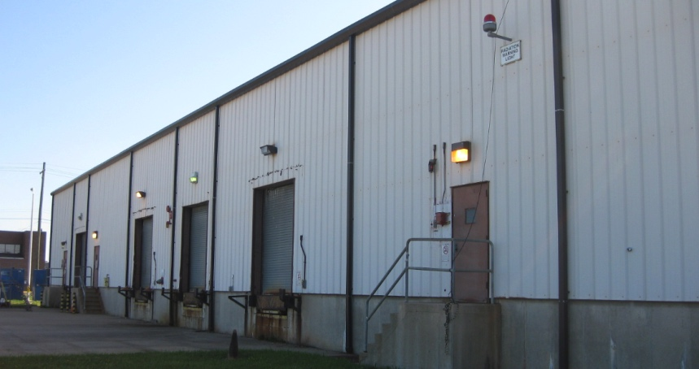
Controls Systems
  Tell building equipment how to operate
  HVAC equipment
  Lighting/plug loads
  Fire/life safety
  Security
  Elevators
  EV chargers
  Onsite energy
  generation/storage
Notes:
Most equipment installed in buildings does not operate continuously (24/7) at full power. Control systems tell the equipment (a) when to operate, and (b) how it should operate when it’s on. There are many systems and pieces of equipment requiring control. Examples include:
HVAC Systems chillers, boilers, air handling units, roof-top units, fan coil units, heat pumps and variable air volume boxes.
Lighting Systems. Both interior and exterior lights.
Plug Loads such as computers, copiers, and vending machines.
Fire/life safety items such as magnetic door holders, fire alarm strobes, and smoke dampers.
Security items such as door locks and card readers.
Elevators and escalators.
Power monitoring.
Security.
Close circuit video (CCTV).
Card and keypad access.
Plumbing and water monitoring.
Electric Vehicle (EV) chargers.
Onsite energy generation and storage such as solar photovoltaic (PV), generators, combined heat & power, battery/thermal storage.

Slide 9
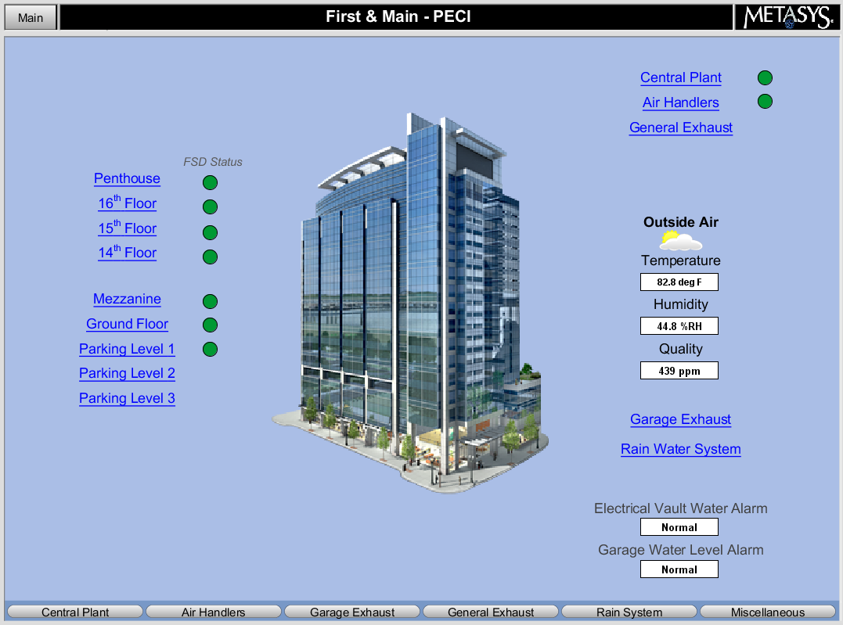
Controls Systems & Energy Sources
  Various types of control systems
  Central or self-contained
  Control methods
    Pneumatic
    Electric
    Electronic
    Microprocessor-based
Notes:
There are various types of control systems that can be used to control the particular pieces of equipment and processes in buildings. Central control systems tie all of the equipment together for control from a central location. Self-contained systems control only one piece of equipment, such as a rooftop unit thermostat that only controls the rooftop unit and does not communicate with any other systems in the building. There are various control methods as well. The concepts covered in this class apply to all of these methods.
Pneumatic control systems operate with compressed air and use mechanical means such as temperature-sensitive bimetal strips to perform control functions.
Electric control systems operate on low or line voltage and use mechanical means such as temperature-sensitive bimetal strips to perform control functions. They provide on/off or two-position control. An example of this is a simple electric baseboard heater controlled by a wall-mounted thermostat.
Electronic control systems operate on low voltage and use solid-state components to amplify input signals and perform control functions. They provide on/off, two-position, or modulating control.
Analog and digital refer to the input/output signal type. Analog is a continuously variable signal like a rheostat or air pressure in a pneumatic system. Digital is either on or off, or a precise value with step increments.
Microprocessor-based control systems operate on low voltage and use a microprocessor to perform logic and control functions, such as providing an output signal to position an actuator. Microprocessor-based controls are digital whereas electric and electronic controls are analog.
The term direct digital control (DDC) systems describe the communication method used in modern devices (hardware and software). These systems use both electronic and microprocessor-based controls. They can also control pneumatic equipment, such as large pneumatic valve actuators.

Slide 10
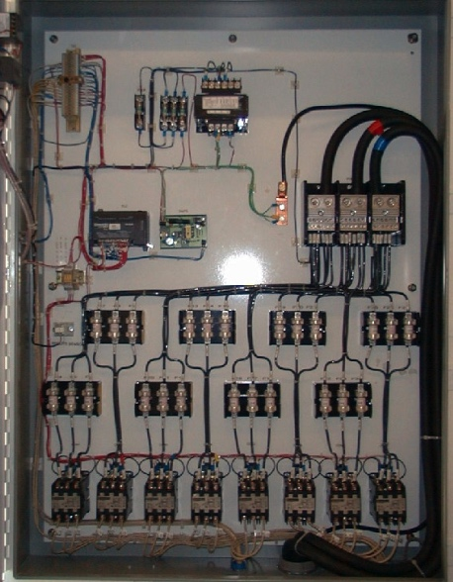
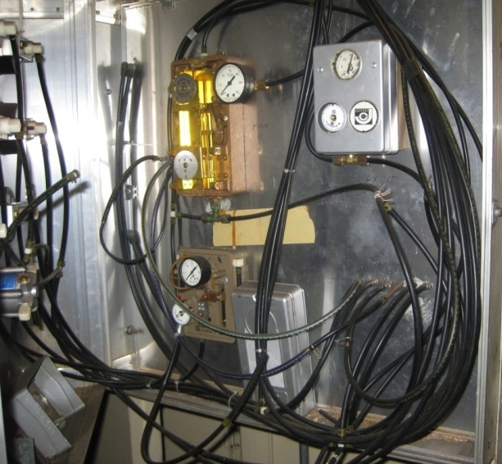
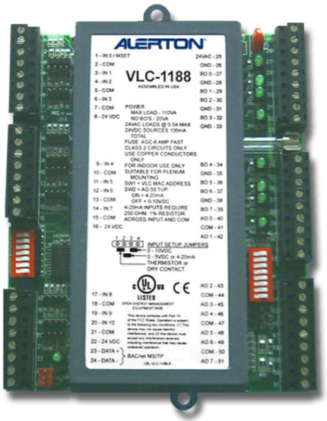
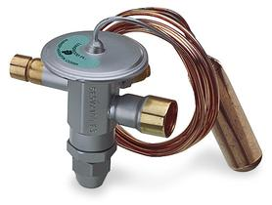
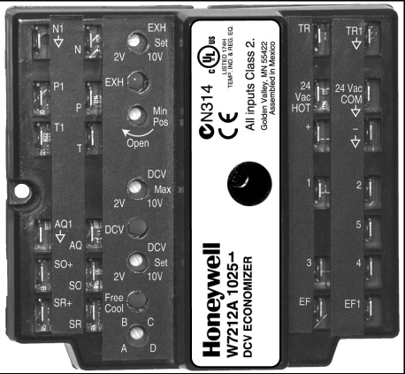
Energy Sources
Electric
Pneumatic
DDC Programmable
Electronic
TXV
Notes:
The energy that is provided to the controls systems can also be self-powered systems like Thermostatic Expansion Valves (TXV, a mechanical valve for refrigeration control of direct expansion air conditioning) or a hybrid. A hybrid is a built-up system comprised of many different parts and often many different manufacturers’ equipment.

Slide 11
Building Automation and Control Systems
Many terms and acronyms used to describe the control or automation of buildings
BAS
BCS
BMS
EMS, etc.
BACS
Notes:
Building Automation Systems (BAS) are centralized, interlinked networks of hardware and software that monitor and control the environment in commercial, industrial and institutional facilities. While managing various building systems, the automation system ensures the operational performance of the facility as well as the comfort and safety of building occupants. You may also hear any of the following terms to describe the control or automation of buildings:
Building Automation and Control Systems (BACS), Building Control System (BCS), and/or Building Management System (BMS)—same as “Building Automation System”. Collectively, DDC products controlling various building systems form the automation system.
Energy Management System (EMS)—generally understood to be the same as a “Building Automation System” but may have special emphasis on energy metering/monitoring.
Energy Management and Control System: getting the idea?
Smart (Intelligent) Building: a building equipped with a data-rich BAS.

Slide 12
Control Systems Documents
Control System Drawings
Sequence of Operation
Decision Tree
Systems Startup Training Manual
Commissioning Training Manual
Notes:
Whichever automation and control system your building has, ideally you would like to have a complete set of documentation on the system. This may include:
Control Drawings. These should include the original verified as-built plans and schematics, continually updated as changes are made.
Sequence of Operation. There should be a sequence of operation for every major piece of equipment including details of system interactions.
Decision Trees. These are a convenient way to graphically represent control sequences. They can show overall high-level strategy or detailed control loops.
There will often be documents from manufacturers training at the time of the building systems’ start-up. If the building has been commissioned, look for a systems manual with details on equipment test sequences. Most commissioning includes a training phase which should also be documented.

Slide 13
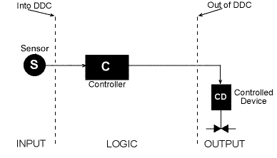
Basic Control System
Power Supply
Courtesy DDC Online Org
Notes:
The basic control system diagram for a DDC is made up of a sensor, a controller and a controlled device. These three components interact to control a variable. The controlled variable is any condition that is picked up by a sensor including but not limited to air and water temperature, pressure, flow or humidity. In the example, air temperature is the controlled variable. The sensor measures the data, the controller processes the data and the controlled device causes an action.
A sensor sends a signal to the controller. The signal can be analog (variable) or digital (two-state). A sensor sends an analog signal (input) if it modulates or varies, such as a temperature sensor. If a sensor produces an on or an off signal, it is a digital input, such as an airflow switch.
The controller is a microprocessor that reads signals from attached sensors, processes the signal data, and sends an output signal to an attached controlled device. A software control program that runs in the controller accomplishes this process. Note: a thermostat can be considered both a sensor and a controller.
The controlled device receives a signal from a controller which tells it when to operate (schedule) and how it should operate when it’s on (turn off or modulate). The signal can also be analog (variable) or digital (two-state). If the controlled device is a piece of equipment such as a pump or fan, it requires a digital signal (energy source) from the controller. If the controlled device uses the signal to allow more or less flow of hot water or air, it is receiving an analog signal from the controller. The air or water act as the control agent, which is the regulated medium or energy source that affects the value of the controlled variable. For example, in a heating coil application the discharge air temperature is the controlled variable, the valve is the controlled device, and the hot water is the control agent or control medium.

Slide 14
What is Controlled?
Valves
Dampers
Electric relays
Lights
Fans
Pumps
Compressors
Variable speed drives for fan & pump applications
Notes:
Recall that there are many types of equipment, devices and processes that can be controlled (output). Generally, building control systems begin with control of mechanical, electrical, and plumbing systems. For instance, the HVAC system is almost always controlled, including control of its various pieces of equipment referred to as controlled devices.

Slide 15
Control System Inputs & Outputs
 | Input | Output
Digital | Two state information from the building into the DDC controller or field panel Switches: Differential Pressure/Proof Smoke Alarm Level Alarm High/Low Pressure Alarm Filters | Two state information from the DDC controller or field panel out to the building’s equipment On/Off Control – fans, pumps, lights Open/Close 2-position valve damper Control of 2-speed motors Energize/De-energize E/P valves for heat/cool and day/night changeovers
Analog | Variable Information from the building into the DDC controller or field panel Temperature – room, duct, outdoor Humidity – room, duct, outdoor Pressure – static, velocity, total Flow rate – water and air | Variable information from the DDC controller or field panel out to the building’s equipment Modulate valve, damper, actuator Motor speed control Modulate fan inlet volume dampers Adjust air pressure to P/E switches
Notes:
This chart summarizes typical digital and analog inputs and outputs of a control system.

Slide 16
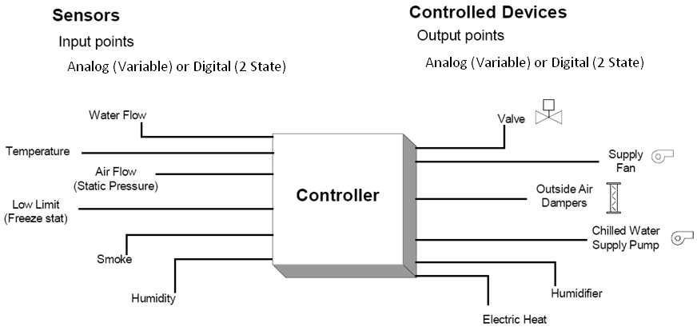
Control System Inputs & Outputs
The Controller Receives the Input and Processes an Output
Power Supply
Notes:
This basic control system diagram illustrates one controller with multiple sensor inputs and multiple controlled devices.
Power Supply

Slide 17
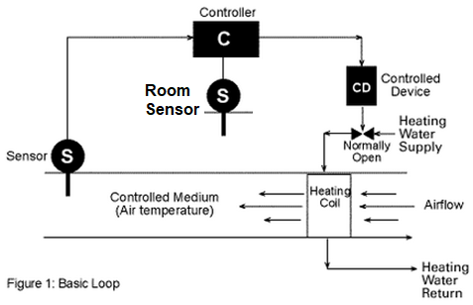
Control System Diagram
Setpoint
Control
Control
Controller
Function
Function
Controlled
Device
Valve or Actuator
Valve or Actuator
Control
Loop
Room or Space Temperature
Controlled
Variable
Room
Room
Sensor
Temperature
Temperature
Sensor
Notes:
Control System Path
The control process or system process being controlled is represented in control drawings, diagrams, schematics and decision trees. The control process can include but is not limited to steam heat, a DX (direct expansion) system, or the opening and closing of a valve or damper.
The decision tree on the left illustrates a control process for regulating room temperature. The controlled variable is the room temperature. The sensor reads the condition of the controlled variable and relays information back to the controller via a control loop. The controller is programmed for a specific setpoint or target value for the variable. The controller compares the setpoint to the data it receives from the sensor and makes a decision on the operation of the controlled device. In this case, the controller would enable a damper actuator to introduce more or less cooled air into the room based on the setpoint of the temperature. The damper actuator is the controlled device.
Let’s look at another example of a control process. The schematic diagram on the right is a simple DDC control diagram for a heating coil in a duct that operates to maintain the temperature in a room and reset the supply air temperature, as needed. In this heating coil application, the room air temperature is the controlled variable, the discharge air sensor resets as needed, the valve is the controlled device, and the hot water is the control agent.

Slide 18
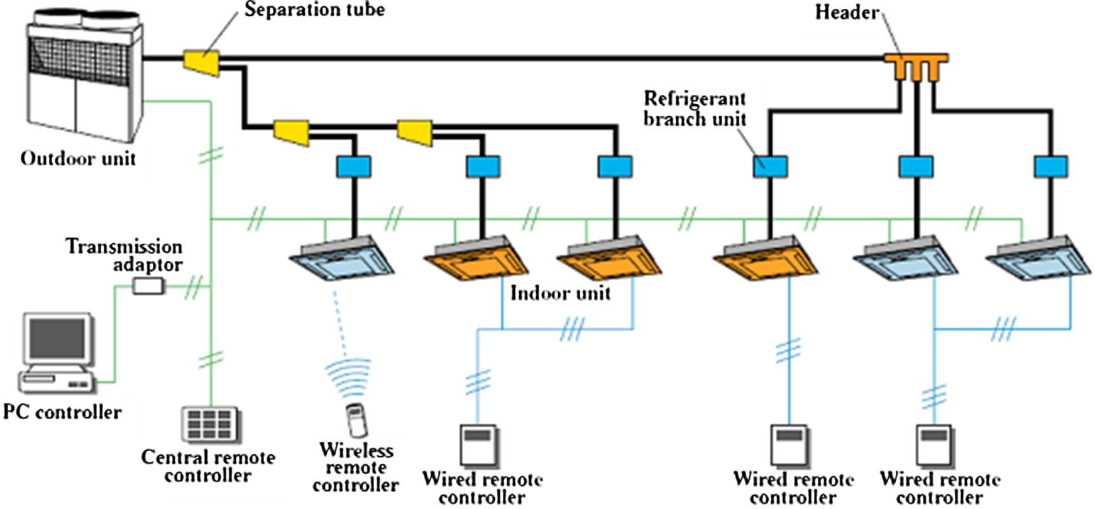
Heat Pump
Control System
Can you identify the control variable, controlled device and control agent on a VRF Heat Pump System?
Source https://ars.els-cdn.com/content/image/1-s2.0-S2090447917300023-gr2_lrg.jpg
Notes:
This diagram shows a modern VRF (Variable Refrigerant Flow) Heat Pump system. Identify the control variable, controlled device, and the control agent.

Slide 19
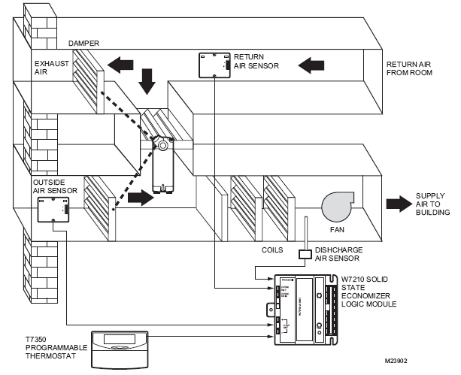
Electronic Control System
Can you identify the control variable, controlled device(s) and control agent?
Courtesy Honeywell Controls
Notes:
The Honeywell W7210 logic module is a good example of an electronic control system. These controllers have 2-10 volts of direct current (VDC) output for use with M7215 actuators and Modutrol Motors with 2-10 VDC control. The mixed-air control circuit is in the logic module and is not part of the actuator. The actuator can also be powered with the same 24 volts of alternating current (VAC) power as the logic modules, provided the internal grounding of the actuator is compatible. Note that some of the Siemens actuators are not compatible with the M7210. Older models that are no longer available are the W6210A and D models. These models were used in the mid 1990s with floating actuators.

Slide 20
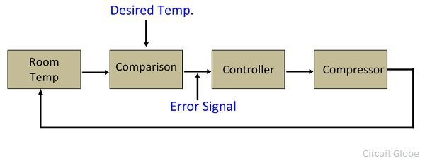
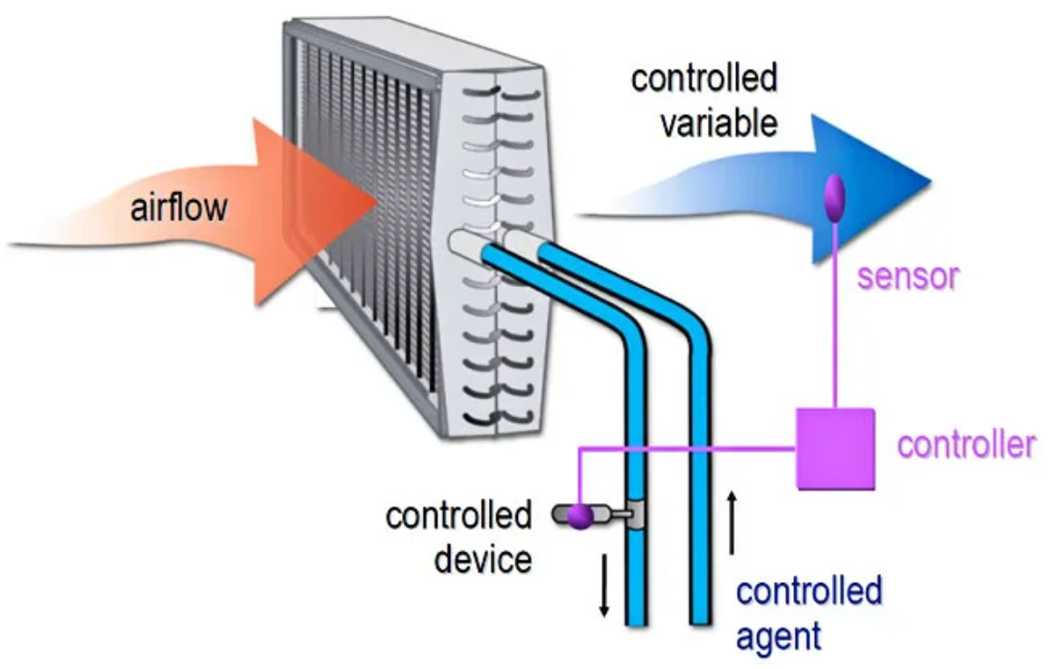
Closed Loop Systems
Notes:
Closed loop controls are common in HVAC systems. Closed loop controls are used for non-HVAC systems, too. A common example of closed loop controls is a clothes dryer with an automatic setting that uses a humidity sensor to determine when to shut off.

Slide 21
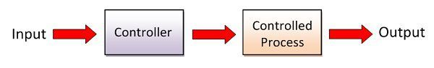
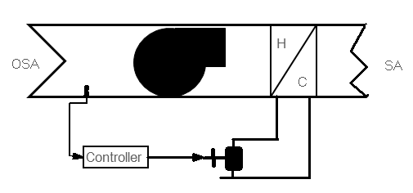
Open Loop Systems
Open Loop Systems have no Feedback
Notes:
Open loop control loops have no feedback signal from the controlled variable back to the controller. In the example shown here, outside air (OSA) temperature is used as an input to the controller to determine the position of the valve (controlled device). As the OSA temperature drops, the valve opens up. However, this system is not using feedback from the controlled variable (the air temperature downstream of the coil) as an input to the control process, making it an open loop control.
Open loop controls are not common in HVAC systems, but they do exist, even in new buildings with complex HVAC and control systems. For example, this occurs in setpoint reset strategies that rely on outside air temperature instead of feedback from HVAC zones.
For our clothes dryer example from the previous page, operating the dryer for a set amount of time regardless of the humidity level inside the dryer is an example of open loop control.

Slide 22
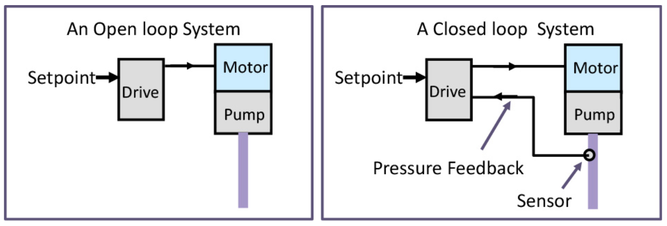
Open and Closed Loop Systems Comparison
Notes:
This drawing compares an open versus closed loop control system. Notice that the open loop has a variable speed drive (VSD) motor without feedback, but the closed loop system, which also has a VSD, includes a pressure sensor with feedback to the control.

Slide 23
Section 1: First Review
Controls documentation – what five elements can this include?
What elements make up a controls system diagram?
Name three common sensors for HVAC controls?
What is the difference between an electric and a DDC control system?
Notes:
We are coming to the end of fundamental control system concepts including control system devices, diagrams and controls responses. Let’s review what we’ve covered.

Slide 24
Section 1: Test Your
Knowledge - Question 1
1. Which control system always has feedback to the controller?
A. Open loop
B. Closed loop
C. Two-way loop
D. Three-way loop
Notes:
Question 1: Your answer is ______.

Slide 25
Section 1: Test Your
Knowledge - Question 2
2. In a control system loop, which component is considered the controlled device?
A. sensor
B. room
C. valve
D. setpoint
Notes:
Question 2: Your answer is ______.

Slide 26
Section 1: Test Your
Knowledge - Question 3
3. Which component in a control system does the room temperature sensor represent?
A. controller
B. sensor
C. control agent
D. controlled variable
Notes:
Question 3: Your answer is ______.

Slide 27
Sensor Types
Sensors & variables in HVAC applications
Pneumatic sensors
Electronic sensors
Notes:
So far we have discussed how a sensor provides input into a control system. We know that a sensor monitors and measures a variable, which can be an analog, digital or pneumatic signal. We’ll continue our examination of sensors and the types of signals they produce. We will also examine why the range of sensors is critical for proper operation.

Slide 28
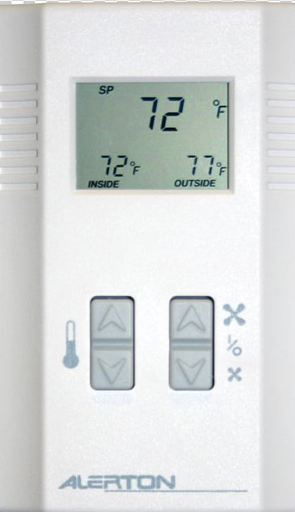
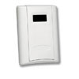
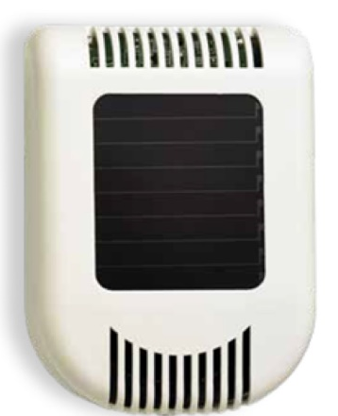
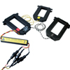
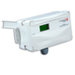
Sensors for HVAC Control Applications
Thermostat OR remote sensor
Wireless Temperature,
Humidity, and CO2 sensor
(solar powered by
ambient lighting)
KwH Power Meter
Duct Sensor
Image sources: Veris Industries, Alerton, EnOcean
Notes:
While a device may appear to be a thermostat, it may be a remote sensor with a remote set point dial and the controller is in another location. Sensors can be wired or wireless. Wireless sensors sometimes utilize solar chargers, eliminating the need to replace batteries. There are different types of sensors available for HVAC control applications including:
Humidity Transmitters
Temperature Transmitters
CO₂ for Indoor Air Quality (IAQ) via Demand Controlled Ventilation (DCV)
Power Meters
Branch Circuit Monitors
Energy Meters
Temperature sensors can be analog, digital or pneumatic.
Pressure sensors are either digital or analog.
Flow rate can be measured by air flow stations or gpm flow meters. Turbine type flow meters are most popular when measuring liquid flow.
Flow switches are normally just paddle switches located inside a pipe or duct to determine if there is minimum flow. They give out a digital signal.
Carbon dioxide sensors are used as an indicator of indoor air quality. They incorporate electronics that work by detecting infrared wavelength interference or that are chemically sensitive to CO₂. There are several types of carbon monoxide sensors. They are often confused with carbon dioxide sensors, however carbon monoxide is a deadly gas, while carbon dioxide is harmless.

Slide 29
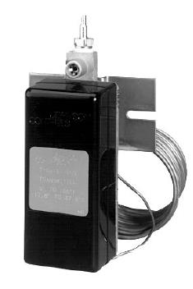
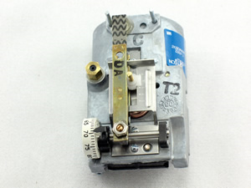
Pneumatic Sensors and Transmitters
Designed to sense variables
Produce a signal over a transmitter's range
Courtesy Johnson Controls
Notes:
Pneumatic control sensors or transmitters sense the variable and produce a 3 to 15 psig (pound per square inch, gauge) and a 20 - 105 kPa (kiloPascals) signal over a particular transmitter's range. Range refers to the variable points over which the sensors operate.

Slide 30
Electronic Sensors
Voltage sensors (1-5 VDC or 2-10 VDC)
Current sensors (4-20 mA)
Resistance Temperature Sensor Types
Thermistor Temperature Sensors (NTC or PTC)
Resistance Temperature Detectors (RTDs)
Notes:
Electronic sensors can be thermistors, thermocouples, resistance temperature detectors (RTDs), or integrated circuits. They can be used to measure conditions such as temperature, humidity, pressure, voltage, or current.
Resistance sensors are used in measuring temperature and include thermistors and RTDs. Examples are Balco elements, copper, platinum, 10K thermistors and 30K thermistors.
Voltage sensors typically have measuring ranges of 0 to 5 VDC, 1 to 10 VDC, 0 to 10 VDC, and 2 to 10 VDC (when a 500 ohm resistor is used with 4-20 mA (milliamps).
Current sensors (also known as current transducers, current transformers, or CTs) typically have measuring ranges from 4 to 20 mA.

Slide 31
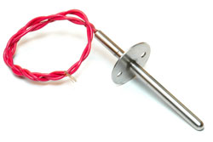
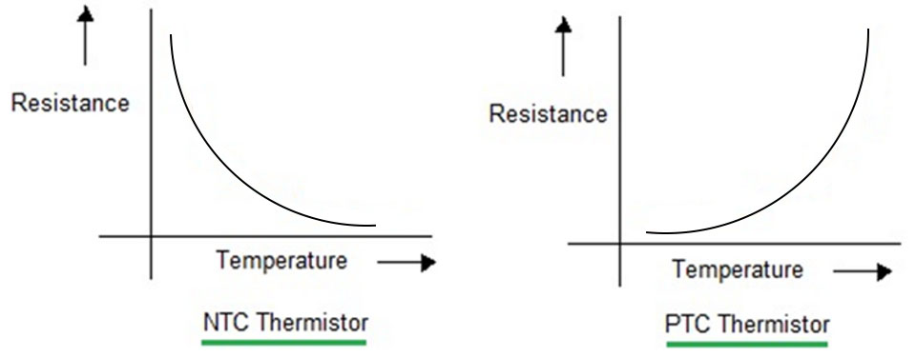
PTC and NTC Electronic Temperature Sensors
Resistance vs. temperature outputs of electronic NTC and PTC temperature sensors
Notes:
Both negative temperature coefficient (NTC) and positive temperature coefficient (PTC) thermistors’ values change as a result of temperature but impact their use differently.
For NTC thermistors, as temperature increases, the resistance drops from high to low and allows current to pass through. In a circuit, they can limit in-rush current by self-heating when current is initially applied, and then allow normal current flow since their resistance drops to a negligible amount during steady-state operation. This capability makes NTC thermistors the most commonly-used thermistor. They are also the type most commonly-used for temperature sensing applications.
In a PTC temperature sensor, as the temperature increases, the resistance increases proportionally in a positive direction. This is known as a Positive Temperature Coefficient (PTC) sensor. However, many temperature sensors are considered thermistors, and perform as Negative Temperature Coefficients (NTC).
Positive Temperature Coefficient (PTC) Thermistors
Positive Temperature Coefficient (PTC) thermistors exhibit increasing electrical resistance with increases in environmental temperature and decreasing electrical resistance with decreasing temperature.
Negative Temperature Coefficient (NTC) Thermistors
Negative Temperature Coefficient (NTC) thermistors exhibit decreasing electrical resistance with increases in environmental temperature and increasing electrical resistance with decreasing temperature.

Slide 32
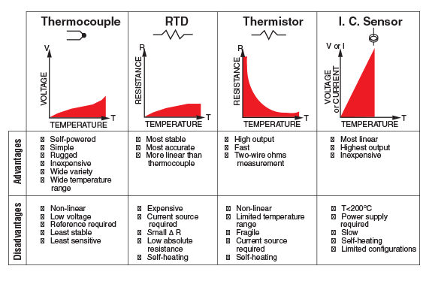
Electronic Temperature Sensors
Image: Omega Engineering
Notes:
This chart shows four types of temperature sensors. Each has advantages and disadvantages.
RTD sensors are resistance temperature detectors. See the glossary for a definition.
IC sensors are Integrated Circuit Temperature Sensors.

Slide 33
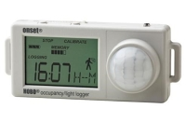
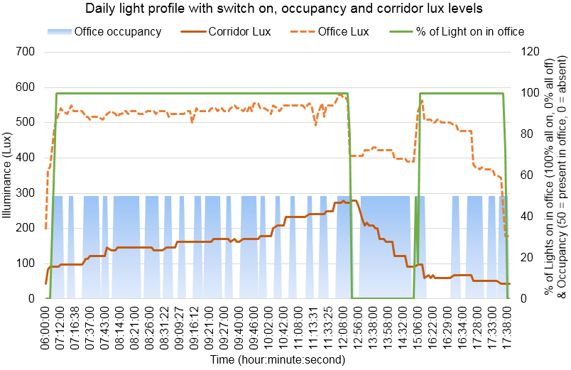
Data Logging & Verification
Light/occupancy logger
Occupancy Data Logger
Line graph of office and corridor illuminance (lux), percentage of office lights on and occupancy for one office occupant, revealing multiple absences and office lights remaining on.
Notes:
Data loggers are typically standalone systems equipped with sensors and data recording capability. Because of their portability, loggers can be used to spot check equipment operation and to verify that the control system is working. For example, are occupancy sensors in a room turning off the lights when no one is around? Just because a sensor is there doesn’t mean it’s working. Sensors fail over time. Data loggers allow you to check for this without having to do a night walk or weekend walk. This graph of data from light and occupancy loggers demonstrates this concept.
Depending on the type of logger, the sensor it is equipped with can sense and measure other conditions like CO, CO₂, temperature, relative humidity, dust, amperage, and voltage (e.g. 4-20 mA, 0-10 VDC).
Image source: Katharine van Someren, https://www.researchgate.net/figure/Preliminary-results-showing-a-line-graph-of-office-and-corridor-illuminance-lux_fig5_277273083
Data Logging and Verification
Line graph of office and corridor illuminance (lux), percentage of office lights on and occupancy for one office occupant, revealing multiple absences and office lights remaining on.

Slide 34
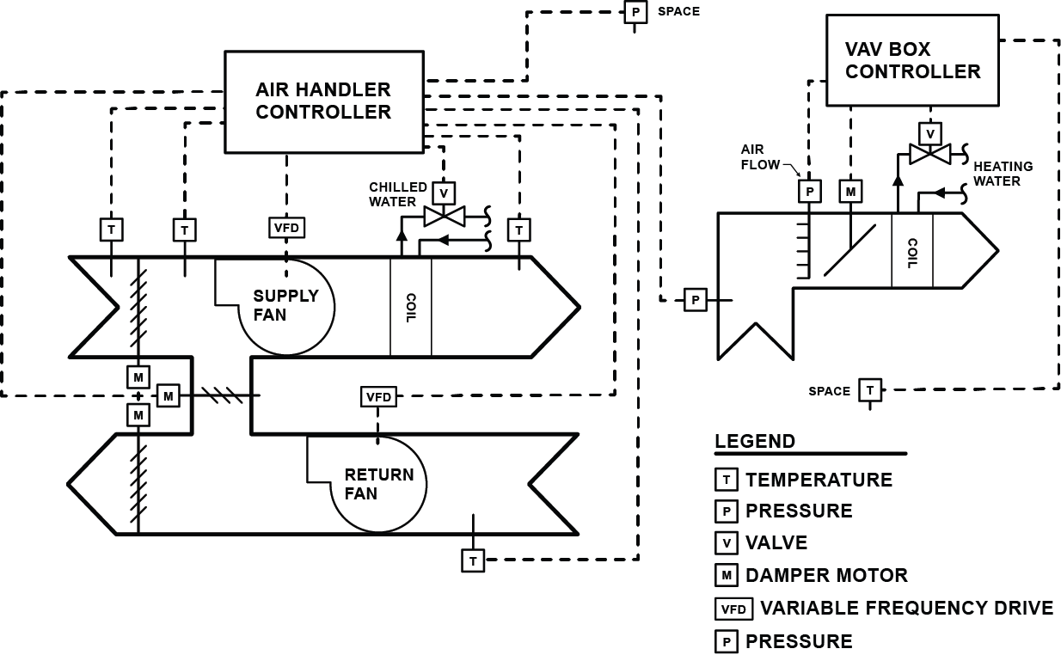

Exercise 1: Identify Controller Inputs & Outputs
Notes:
Take 5 minutes for this activity. Team up with the person next to you. Review this DDC controls diagram of the control process for a VAV system with reheat (provided by a boiler or heat pump system) and answer the questions. Share your answers during the report-out led by the instructor.
List the inputs and outputs related to the air handler controller and the VAV box controller.
___________________________________________________________
___________________________________________________________
Which sensors are digital, analog or pneumatic?
___________________________________________________________

Slide 35
Section 1: Second Review
Name three common sensors for HVAC controls?
What type of signals do sensors use to communicate to the controller?
Notes:
We are coming to the end of fundamental control system concepts, devices, diagrams and controls responses. Let’s review what we’ve covered.

Slide 36
Section 1: Test Your
Knowledge – Question 4
4. What sensor type is used for temperature?
A. Thermocouple
B. IC sensor
C. RTD
D. All of the above
Notes:
Question 4: Your answer is ______.

Slide 37
Control Responses
Two-position
Floating
Proportional
Proportional Plus Integral (PI)
Proportional Plus Integral & Derivative (PID)
Notes:
The controller is programmed to produce a control response when it receives input from the sensor. The controller compares the input with a target value such as setpoint or throttling range, and then produces an appropriate output signal and other logical decisions that are unique to the specific control application. Throttling range or modulation refer to how far the value of the controlled variable will move when the controlled device goes from full-open to full-closed. There are generally five types of control responses categorized by how the controller responds to the feedback it is getting.

Slide 38
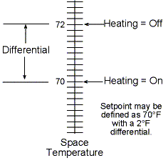
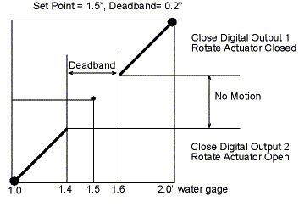
Two Position & Floating Control Response
Two-position control response
Floating control response
Notes:
In the two-position control response, the controller compares the input value of a control variable (temperature, relative humidity, pressure, current, time and/or fluid levels) with various programmed instructions and generates a two-position output. One output increases the signal to the controlled device and the other output decreases the signal. The instructions define upper and lower limit values referred to as as setpoint and differential. The two-position response can be used for simple control loops to control temperature or limit outside air. In the example on the left, a two-position control in a home heating system thermostat is set to turn on the heating system when the space temperature falls below 70º F and turn off when the temperature rises to 72º F in the space. This is an example of a 70º F setpoint with a two-degree differential.
Similar to the two-position response, a floating control response produces a two-position output based on the value of the input variable, increasing or decreasing the signal to the controlled device. The upper and lower limits are defined with the midpoint referred to as the setpoint and the deadband setting the difference between the upper and lower limits. For instance, when an HVAC thermostat is set to 68º for heating and 74º for cooling, there is a six degree deadband or neutral zone. When the sensor reads a temperature between these values, no heating or cooling is provided. Fast airside control loops respond well to floating control.
Images source: DDC Online
Two-position control response
Floating control response

Slide 39
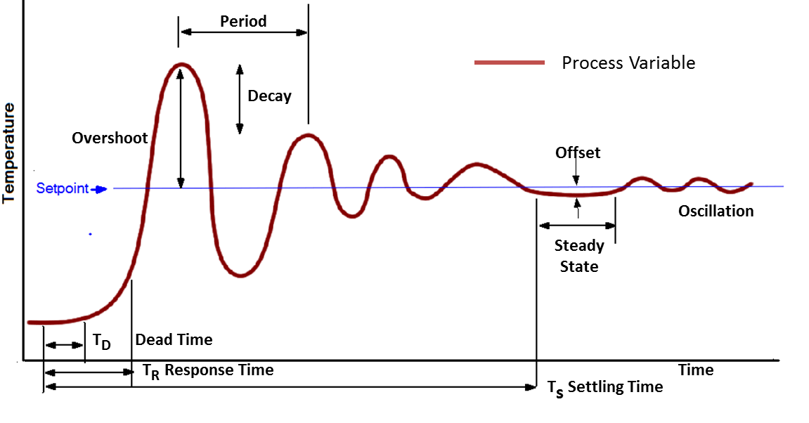
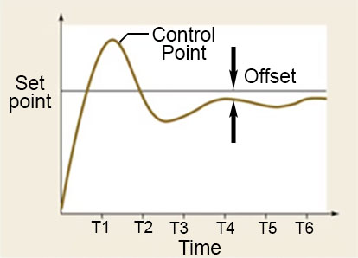
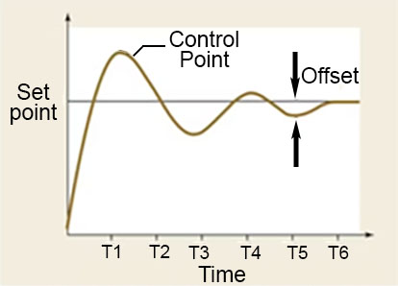
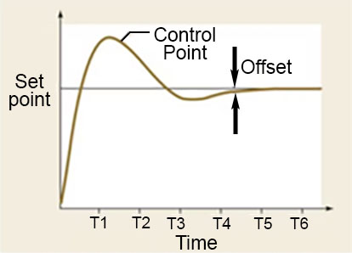
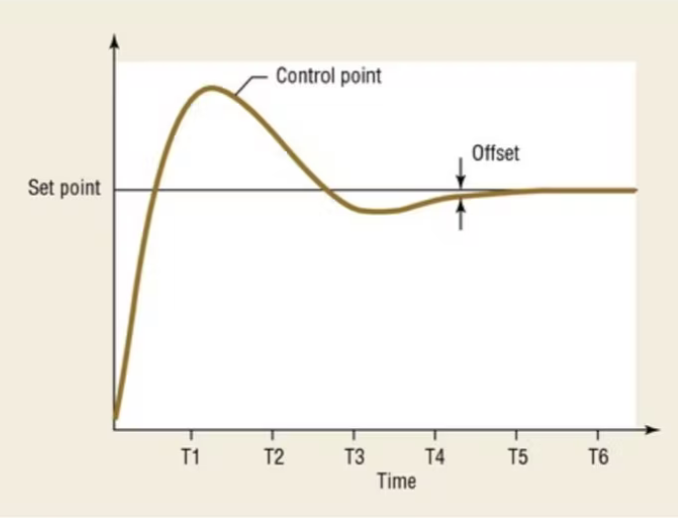
Control Cycle Graph
Proportional control
Proportional-integral control
Proportional-integral-derivative control
Notes:
In floating response applications, the sensor must be able to rapidly sense changes in the controlled device state in within the control loop. Significant thermodynamic lag in the control loop can cause the floating response to be unstable or fail as a control strategy.
This graph illustrates the timeline for controlling temperature within a control loop. The process variable is temperature. There is an initial dead time when no response is detectable. The response time is the time until the setpoint is reached. Overshoot is how far past the setpoint the temperature rises. The period is the time between the peaks of the rise and fall of the oscillation. The decay is the decrease in the size of the peaks. The settling time is the time until the system reaches steady state, when the temperature is stable. The temperature offset (differential) is the difference between the steady state temperature and the setpoint.
Images source: https://www.hpac.com/motors-drives/article/20927964/improving-hvac-with-pid-and-vfds
Proportional control
Proportional-integral control
Proportional-integral-derivative control

Slide 40
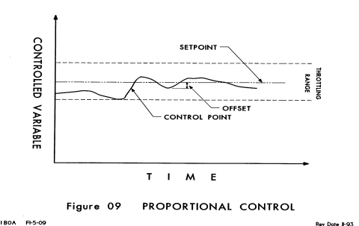
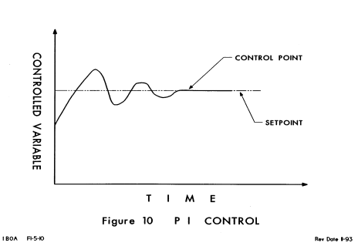
Proportional & PI
Control Strategies
Notes:
Control Actions
Courtesy of Northwest Building Operators Association
In proportional control the output varies continuously, or modulates. Proportional means that the size of the output is related to the size of the signal from the controller telling it what the offset is. The sensor, controller, and final control device act as one unit to maintain continuous control. When the controller senses that the temperature is deviating from the set point, it calculates the amount of the error and sends a signal to the actuator, which will drive open the valve or damper by a certain percentage of the deviation. The goal is to maintain set point without overshoot. The controller calculates how much the valve or damper needs to open without overshoot and will start reversing the actuator to close it at a percentage of the closed position.
PI (Proportional Integral) control is a variation of proportional control. In this case the error calculation takes into account accumulated errors from the past. The contribution from the integral term is proportional to both the magnitude of the error and the duration of the error. It is usually more precise because it eliminates residual steady state error, but if not properly tuned, it can cause overshoot or hunting (Hunting is caused when the controller is oscillating the controlled device back and forth, causing the control point to float above and below the set point, but is never stable.). Tuning is essentially applying weighting factors to the two terms.
PID (Proportional Integral Derivative) control is similar to PI with the addition of the “Derivative” term that takes into account the rate of change of the error. PID control is usually considered to be the best, however poor tuning will lead to unacceptable conditions.

Slide 41
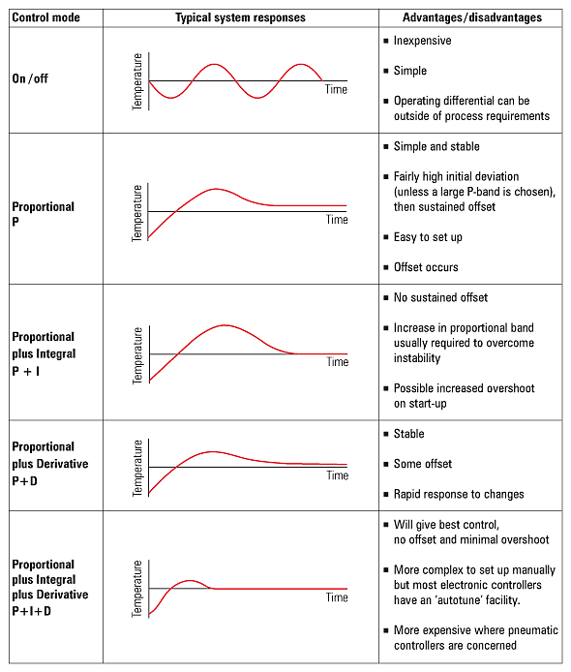
PID Control: Proportional
Plus Integral & Derivative
Effect of manual reset Source: Spirax Sarco
Notes:
Proportional Plus Integral & Derivative (PID): These systems usually combine a large proportional band, a slow reset and use derivative action. They must be properly tuned to each system.
Effect of manual reset Source: Spirax Sarco

Slide 42
Direction of Control Action
Temperature | Controller Output (voltage, amperage or pressure) | Action
 |  | Direct Acting
 |  | Direct Acting
 |  | Reverse Acting
 |  | Reverse Acting
(Fall)
(Fall)
(Rise)
(Rise)
(Fall)
(Rise)
(Rise)
(Fall)
Notes:
When the variable being controlled is going up, direct acting controls move in the same direction. When the variable being controlled is going up, the reverse acting control moves in the opposite direction.
Examples:
Direct Acting = temperature up and air pressure up
Reverse Acting = temperature up and air pressure down
Note: Time delay relays are used to deliberately provide time delays in a control action. For example, time delay relays are used in boiler systems to delay the firing of the burner until the boiler has completed the pre-purge cycle.

Slide 43
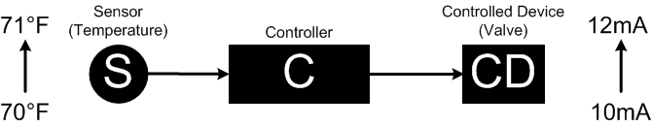
Controller Direct Action: Illustration
Source: DDC Online Org
Notes:
Direct Action means that the controller's output increases as the sensor's input increases. For example, as room temperature (the variable) changes from 70 °F (21 °C) to 71 °F (21.5 °C), the controller changes its output to a chilled water valve from 10 to 12 mA (milliamps). As the sensor reads an increasing input (temperature), the controller responds by increasing its output (amperage) to the valve, opening the valve and increasing the chilled water flow.

Slide 44
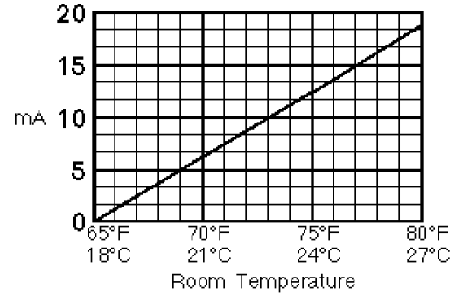
Controller Direct Action: Illustration
Source: TAC Controls/Schneider Electric
Notes:
This relationship between the input to a controller (temperature) and its output (current) can be displayed on a graph.

Slide 45
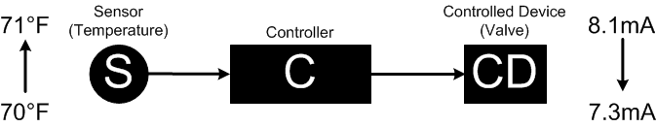
Controller Reverse Action: Illustration
Source: DDC Online Org
Notes:
Reverse Action means that as the variable (for example, temperature) increases, the controller's output decreases. For example, as room temperature rises from 70 °F to 71 °F, the controller output to the heating water valve decreases from 8.1 to 7.3 mA. In the example shown, as the sensor reads an increasing input (temperature), the controller responds by decreasing its output (amperage) to the heating valve, closing the valve and reducing the amount of heating water flow.
Source: DDC Online Org

Slide 46
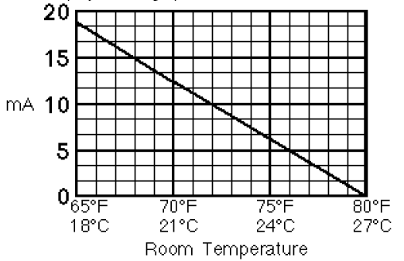
Controller Reverse Action: Illustration
Source: TAC Controls/Schneider Electric
Notes:
Reverse action is displayed on the graph above.

Slide 47
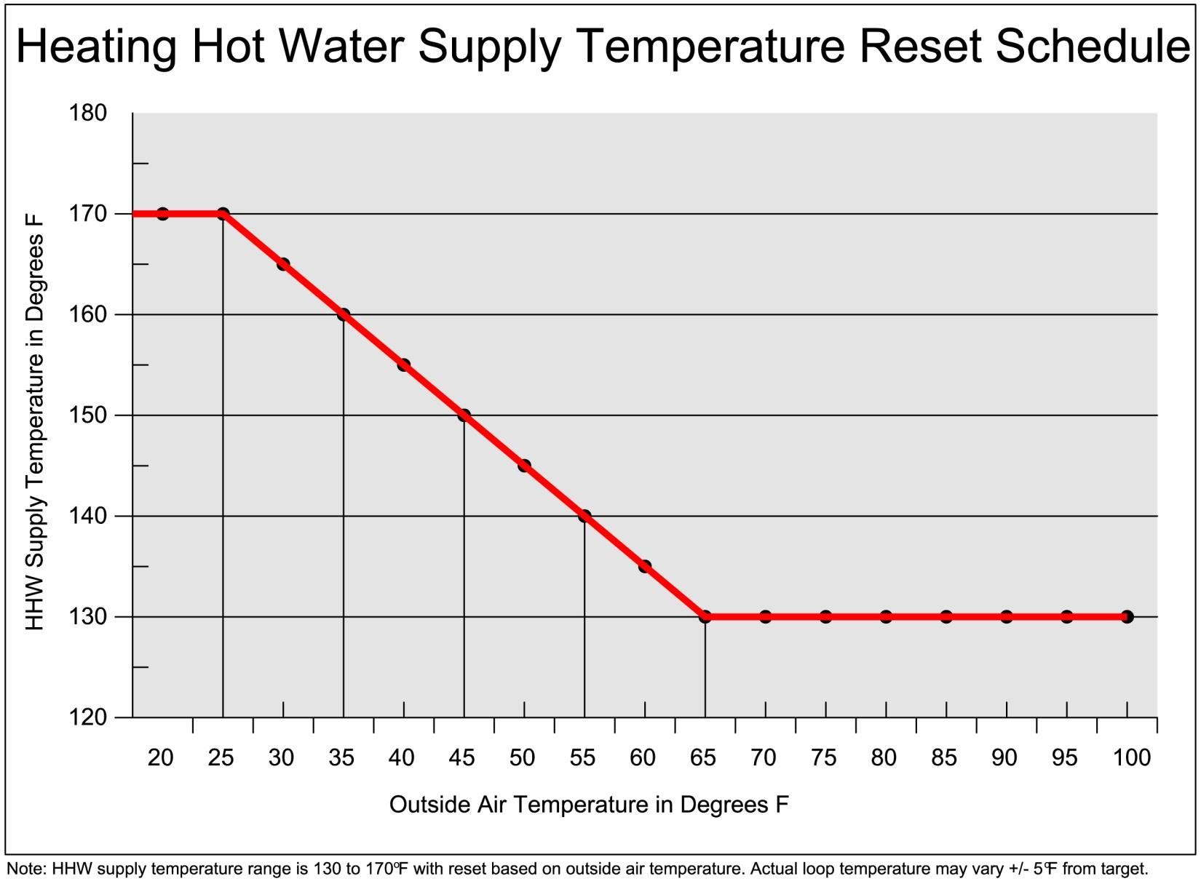
Reset Control Strategy
Notes:
“Reset” is a control strategy commonly used in HVAC systems that can result in significant operational savings. This involves modulating the level of a delivered control agent based on a related variable. For example, this image shows a heating hot water supply temperature reset schedule, where the supply temperature required to satisfy the desired conditions is reduced as the outside air temperature increases. The DDC system is programmed to modulate accordingly, using less energy versus outputting the same temperature regardless of the conditions. A similar strategy can be applied in many other scenarios. For example, in air handling systems, the supply air temperature can be reset based on outside or return air temperature. A duct static pressure reset strategy adjusts duct static pressure in response to airflow demand.
Image source: https://utilities.tamu.edu/wp-content/uploads/2013/09/Chilled-Water-CHW-and-Heating-Hot-Water-HHW-Systems.pdf

Slide 48
Section 1: Third Review
What’s the difference between two-position & floating control response?
Give examples of two-position & floating control response.
Notes:
We are coming to the end of the discussion of Controller Types and Energy Sources. Let’s review what we’ve covered.

Slide 49
Section 1: Test Your
Knowledge – Question 5
Is the control process below a direct action or reverse action? Explain why.
Notes:
Question 5: Your answer is ______.

Slide 50
Section 2:
Direct Digital Control
(DDC) Systems

Slide 51
Direct Digital (DDC)
Control Systems
Hardware
Software
Points
Features and Capabilities
Microprocessor Systems
Open source
Closed source
Wireless
Notes:
Control for simple HVAC systems can be accomplished via thermostat on-off control. More complex HVAC systems typically consist of various controllers for equipment and processes, with a central host computer controlling the whole system. (This host computer is often located onsite, but it can also be located remotely and function virtually via the Internet).
Hardware refers to devices such as the computer, monitor, keyboard, or modem.
Software is the loadable programming which runs inside of the computer. Firmware is programming that is burned into the computer chip.
Points are typically associated with real physical connection locations. Virtual points are internal software points designed to calculate or store information, but are not associated with physical points.
The features and capabilities of the DDC computerized control system are dependent upon the vendor and equipment manufacturer. The HVAC industry is increasingly incorporating “internet of things” (IoT) devices into HVAC systems. IoT devices are equipped with various sensors and can communicate with each other, resulting in more efficient processes. IoT devices sometimes operate wirelessly, which can be beneficial in reducing installation costs.
All computerized control systems are microprocessor-based systems. Most controllers in the field have resident microcomputers, often called “intelligent” or “distributed” systems.

Slide 52
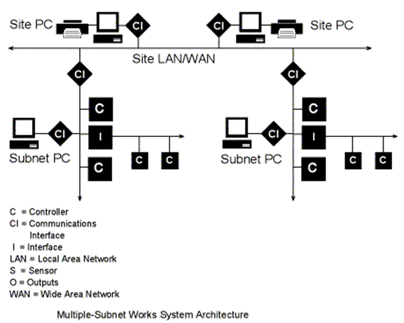

DDC Network Architecture:
Large Systems
Courtesy DDC-Online Org
Notes:
DDC system controllers are all connected together as part of an overall building DDC network, such as the network shown on this page. A local area network (LAN) or wide area network (WAN) is used to connect multiple sub-networks and site computers. A LAN is a computer network contained within a building or campus, while a WAN is a computer network that covers a broader area such as a region or nation. The Internet is an example of a WAN.
Communications interfaces may be required to allow information to be passed between various locations of the DDC network.
Information can be sent and received by each of the site computers, but cannot be subsequently shared from one computer to another. Sub-network computers may only be able to see their own sub-network. There may be a limitation on the number of site computers.
Information stored in the computers can typically be remotely accessed. This includes graphics, programming and stored trend and operational data.
Courtesy DDC-Online Org

Slide 53
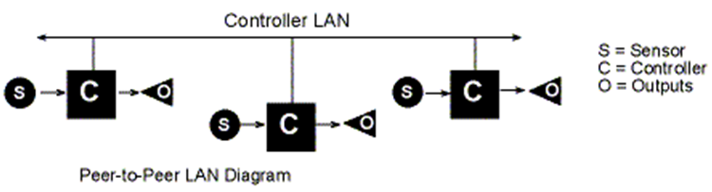
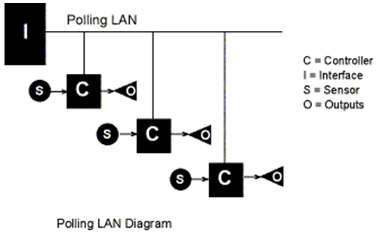
DDC Network Architecture:
LAN Configurations
Courtesy DDC-Online Org
Notes:
Communications between devices on a network can be characterized as peer-to-peer or polling. On a peer-to-peer LAN, each device can share information with any other device on the LAN without going through a communications manager.
The controllers on the peer-to-peer LAN may be primary controllers, secondary controllers, or they may be a mix of both. The type of controllers that use the peer-to-peer LAN vary between manufacturers. These controller types are defined later in this section.
In a polling controller LAN, the individual controllers can not pass information directly to each other. Instead, data flows from one controller to the interface and then from the interface to the other controller.

Slide 54
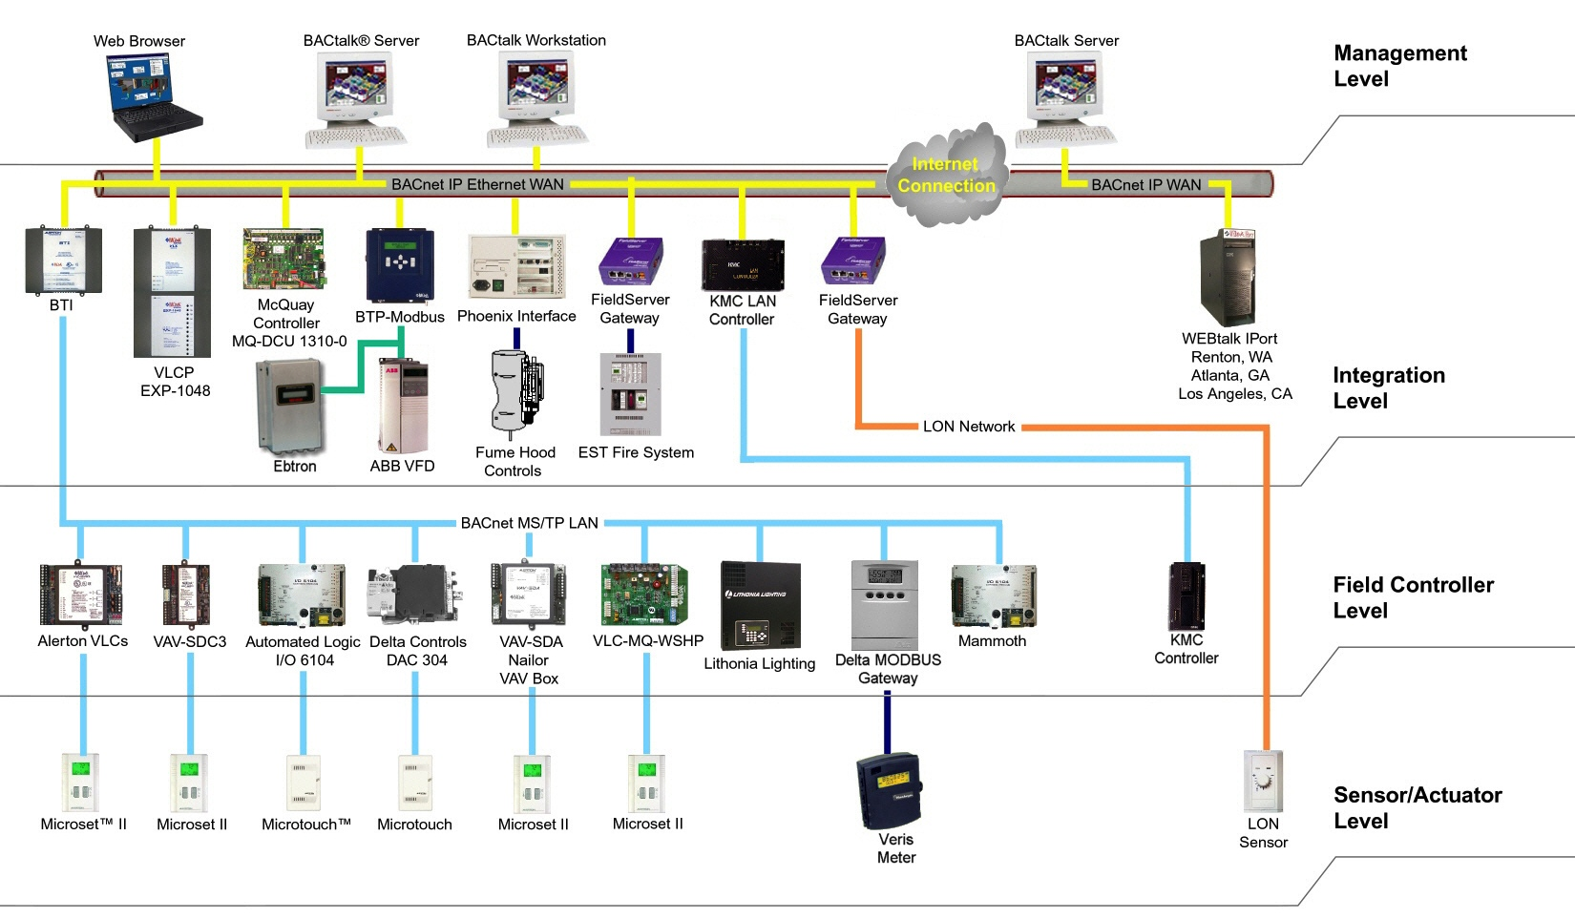
Modern DDC Controls:
Four Level Architecture
Local Operating Network (LON)
Sourde: Alerton Controls
Notes:
Large System DDC Control Networks are comprised of four levels, working from the bottom-up. They include:
Sensor/Actuator (architecture) Level
Field Controller Level
Integration Level
Management Level

Slide 55

Four Level Architecture
Level One: “Sensors”
Courtesy Alerton Controls
Notes:
This slide shows the sensor/actuator level of the four-level network architecture. This is the level that connects to the physical field level devices. Notice this includes temperature sensors, CO₂ sensors, and smart sensors.

Slide 56

Four Level Architecture
Level Two: “Field Controllers”
Courtesy Alerton Controls
Notes:
This slide shows the field controller level. This is the level that connects to the physical field level devices. Notice that this level is the point that connects the field level sensors to some level of intelligence or control. It is often very manufacturer-specific.

Slide 57

Four Level Architecture
Level Three: “Integration”
Local Operating Network (LON)
Courtesy Alerton Controls
Notes:
This slide shows the integration level control interface. This is the level that allows the various manufacturers to communicate via a IP address. Notice that this level is the point that connects the Modbus, BacNET, and specific manufacturers to one communication level including:
• HVAC
• Life safety systems
• Lighting
• Security
• Chillers
• Boilers
• Building switchgear

Slide 58

Four Level Architecture
Level Four: “Management”
Local Operating Network (LON)
Courtesy Alerton Controls
Notes:
This slide shows the final connection for management level control and interface with the DDC controls in the facilities. This is the level that central management can see the conditions of all of the various building controls in their buildings.

Slide 59
Communication Standards Software Integration
Automation systems allow communication with multiple vendors including:
HVAC Equipment
Fire alarm, security
Lighting, fan units
PLCs (Programmable Logic Controllers)
Boilers and chillers
Notes:
Software Integration is the process of utilizing a single automation system to communicate with multiple vendors. It requires a gateway or translator device that converts one protocol to another. A protocol is a set of rules that determine how data is transmitted between devices in the same network. The most widely used interoperability protocols in the HVAC industry are BACnet, Modbus, and LonMark. They all take a different approach to interoperability. BACnet and Modbus are non-proprietary, open-standard protocols. BACnet was developed by ASHRAE. LonMark is a proprietary standard. (Related standard include LonTalk and LonWorks.)
Applications include:
• Fire and security alarms
• Lighting and fan units
• PLCs (Programmable Logic Controllers)
• Boilers and chillers.
Sources:
https://www.comptia.org/content/guides/what-is-a-network-protocol
https://www.facilitiesnet.com/buildingautomation/article/BACnet-LonMark-and-Modbus-How-and-Why-They-Work--7712

Slide 60






Building Automation System (BAS) /GUI
Notes:
A common name for a computerized control system is Building Automation System, or BAS. Building operators can easily monitor real time operation through the Graphical User Interface, or GUI. Some example GUIs for different types of HVAC systems are shown on this slide.
The next few slides show examples of DDC system architecture, including how the computer with the GUI interfaces with the rest of the control system.

Slide 61

GUI Examples
Notes:
This is a high-level screen that shows a schematic of the main building areas on a high school campus. The different colors probably indicate separate HVAC systems or control zones. Each label is a hyperlink that, when selected, leads to the detail of that specific location or system.

Slide 62

What’s wrong here? →
Source: Turner Building Design
Notes:
A control point is the actual value of the controlled variable, such as the space temperature. Error or offset is the difference between the setpoint and the control point. For example, if the temperature setpoint is 75°F and the actual value (control point) is 77°F, the error (offset) is 2°F.
This screen shows the status of the hot water system. The system is currently offline – as it should be on a 70 degree day – but what do you notice about the hot water reset control points? What’s wrong here? The hot water supply temperatures are reversed. When the outside air is 0 °F, the HW Supply should be reset to 200°F and when outside air is 60°F, the HW supply should be 140°F.
What’s wrong here? →
What’s wrong here? →

Slide 63

Source: Turner Building Design
Notes:
This screen shows an overview of the functioning of the air handling unit serving the lower level of building E. The previous screen showed the outside air temperature as 69.6 °F, but the mixed air temperature is 71.9 °F with what looks like 100 percent outside air. Why do you think this is?

Slide 64

Source: Turner Building Design
Notes:
This screen drills down to the zone level conditions.

Slide 65

Source: Turner Building Design
Notes:
Here you can see the parameters for each individual space, making it easier to diagnose comfort complaints. In the next section you will learn how to systematically look at data on your GUI to provide information for better efficiency and comfort.

Slide 66
Section 2: First Review
What are the four levels of a DDC control system architecture?
Name two common applications for software integration.
A GUI offers what functionality for the building operator?
Notes:
We are coming to the end of the discussion of Building Automation Systems and Network Architecture. Let’s review what we’ve covered.

Slide 67

Exercise 2A: Identify Component Location
Zone Reheat Coil
Static Pressure Controller
Exhaust Air
Outdoor Air Intake
Preheat Coil
Cooling Coil
VSD
Notes:
Take 5 minutes to complete this activity. Review the diagram and label the location on the diagram of each of the 7 components listed below.
Zone Reheat Coil
Static Pressure Controller
Exhaust Air
Outdoor Air Intake
Preheat Coil
Cooling Coil
VSD

Slide 68

Exercise 2A: Answers
Component Location
VSD
Notes:
Answer
VSD

Slide 69


Exercise 2B: Converter
Control with Reset Schedule
What is the reset strategy shown on this slide?
How will it save energy?
Which is the primary sensor? (HWS or OSA temperature)
What type of reset is this control system? (direct reset or reverse reset)
What action is needed at the controller to warm the HWS temp?
  The steam valve opens or closes
Notes:
What is the reset strategy shown on this slide?
How will it save energy?
Which is the primary sensor for the reset strategy?
Hot Water Supply (HWS) or Outside Air Temperature (OAT).
What type of reset is this?
Direct reset or reverse reset.
What action is needed at the controller to warm the HWS temp?
The steam valve opens or closes.

Slide 70

Performance Considerations
  Calibration of sensors
  Location of sensors
  Alarms
  Optimum setpoints
Notes:
HVAC control systems have a direct influence on the energy and non-energy performance of the HVAC system.
Since control systems rely on sensors as input to determine how to operate the HVAC systems, it’s important to regularly verify the calibration of key sensors. Calibration is the verification, and adjustment if necessary, of the accuracy of a sensor or controller. Calibration should be done regularly, according to manufacturer recommendations. Examples of key sensors include outside air temperature, chilled and heating water supply temperatures, and carbon dioxide sensors, to name a few. To verify calibration, compare the reading from a calibrated handheld instrument to the DDC system reading.
It’s also important to verify the location of sensors. Some sensors may be located in areas that are not true representations of the item they’re measuring. For example, outside air temperature sensors that receive direct sunlight at certain times of day might give skewed readings during those times.
Alarms can be set up in the DDC system to notify operating staff when equipment is operating sub-optimally. It’s important to set up only important alarms in the system, to avoid nuisance alarms.
It’s common for setpoints to be constant during system operation, such as supply air temperature. However, control systems that automatically change these setpoints based on the actual demand of the system can improve energy and non-energy (e.g., space temperature) performance. For example, for multiple zone systems, perhaps the supply air temperature can be increased during cold outside air conditions, to increase the comfort level in the space and reduce the amount of energy used for reheat.

Slide 71

Performance Considerations
Verify equipment operating schedule
Avoid unintended simultaneous heating and cooling
Follow a preventive maintenance program
Notes:
HVAC control systems typically control when equipment is turned on an off. Since the most effective way to keep energy costs low is to only operate equipment when it needs to operate, regularly look at programmed equipment operating schedules, and confirm that equipment operation matches that schedule.
Most multiple zone HVAC systems have a certain amount of simultaneous heating and cooling that occurs. A slight amount may be necessary to maintain thermal comfort conditions, but sometimes it can be excessive. For example, the graphic on this page shows a system where both the heating and cooling valves are commanded open at the same time. This is an obvious example of unintentional simultaneous heating and cooling. It may be needed if there is humidity control in the system, but if there’s not a requirement for humidity control, the controls could be reprogrammed to minimize this energy waste so that only one valve is open at any one time, with a deadband in between.
Each of the items covered on this page and the previous page can be included in a facility’s preventive maintenance (PM) program. For example, verification of sensor calibration can be included as an annual PM task. BOMA (Building Owners and Managers Association) and FEMP (Federal Energy Management Program) publish O&M guides that describe the recommended frequency of checking various aspects of HVAC system controls.
There are other aspects of HVAC system control that affect energy and non-energy performance, such as economizer dampers, ventilation, and valve actuators.

Slide 72
Preventive Maintenance
x
Notes:
Good maintenance of the controls system is essential to optimal operation and efficiency. Controls require periodic calibration for accuracy. Evaluate location of sensors for accurate sensing of the medium and develop a preventative maintenance checklist using the Control Shop Drawings. Here is a sample checklist that can be used as a starting point for your own system. This and other information on O&M for control systems can be found at betterbricks.com.

Slide 73

Trend Data
Notes:
Trend data can be useful for viewing historic system performance. Most DDC systems are capable of trend logging. Trend logs can also be captured with data loggers.
This chart shows one week’s worth of supply fan VFD speed trend data for air handling unit AHU-2, gathered from a DDC system. It shows that the fan starts each day at 4 am, and stops each day at 6 pm. But what if the building is only occupied Monday through Friday from 7 am to 6 pm? To save some energy, could the fan be shut off on weekends? Could the fan start time be delayed by a couple of hours to closer to the building occupancy start time?
Also, notice that the VFD isn’t modulating during the latter half of Wednesday and most of Thursday. Why? This may warrant some investigation that could result in additional savings.

Slide 74


BAS Screen Checks
A methodology for using the GUI as a cost-effective means of keeping track of key indicators of building performance
Notes:
BAS screen checking is a highly cost-effective method of keeping tabs on mechanical equipment performance. We will use simple techniques for quickly reviewing the BAS graphic user interface screens for ongoing equipment optimization and troubleshooting.
BAS Screen Checks
The GUI as a Diagnostic Tool
Verification of GUI Accuracy
Gathering Building Information
Documenting Expected Operation
Screen Check Forms
Screen Check Process
Evaluation of Data
Reporting
Trending
Energy Efficiency
Common Problems
Key Performance Indicators

Slide 75
BAS Primary Objectives
Using the GUI as a diagnostic tool
Verifying GUI accuracy & gathering building information
Preparing screen check forms & the screen check process
Reviewing trend data
Reviewing common problems found when performing screen checks
Identifying key performance indicators
Analyzing case studies
Participating in a class activity

Slide 76

Graphic User Interface (GUI) as a Diagnostic Tool
Image: PECI
Notes:
The graphic user interface, or GUI, is a graphical representation of the equipment. In this case, an air handling unit is represented.
A quick glance at this BAS screen reveals a tremendous amount of information about the equipment and how it is operating. It shows real-time data inputs, set points, status points, and alarms. It also provides links to other related graphics. Data points are shown in schematically correct locations, assisting the user in understanding the relationships among the data.
Using the BAS as a diagnostic tool is an under-utilized and quick method of assessing how systems in your building are performing. It is often overlooked, and used only when known problems arise. Performing BAS screen checks can be a proactive way to investigate system operation and find problems quickly.

Slide 77


GUI: Air handler
Images: PECI
Notes:
Different BAS manufacturers typically have different GUIs. Although the graphics look different, the information they convey should be similar.
In this case, an air handler is shown graphically, illustrating the supply and return fans, exhaust damper, outside air dampers, cooling coils, and sensors. It shows in schematic form the equipment and sensors in their relative locations. It usually has additional useful information, including outside air temperature, relative humidity, and outdoor air quality (CO₂ concentration of outdoor air).

Slide 78


GUI: Terminal Unit
Images source: PECI
Notes:
This graphical user interface represents a Terminal Unit (TU). Most of the useful parameters and data points relevant to the equipment are shown on this screen. Some of the operating parameters include fan command status and speed, discharge air temperature, heating stage command status, flow setpoint, flow, damper position, zone temperature, effective cooling and heating setpoints, and fan low and high setpoints.
Note that using the BAS as a diagnostic tool won’t catch all problems. Since it’s essentially a snapshot of current operation, it often won’t catch problems in other modes of operation or other load or occupancy conditions.

Slide 79

Benefits of the BAS GUI
Benefits of using the BAS GUI as a maintenance tool:
■ It’s quick!
■ It’s a proactive way to identify problems and verify proper building HVAC performance.
Image: Williams, Chhen & Gray
Notes:
Using the BAS GUI as a maintenance tool is a quick way to identify problems. As mentioned earlier, experience has shown it only takes two to ten minutes to review a BAS GUI and assess equipment operation and performance. Also, observing problems in this fashion is a proactive way to identify issues before they become a tenant complaint.
Finally, catching operational problems early reduces the energy waste associated with many operational problems. Many of these problems go undetected for extended periods of time.

Slide 80
Verify the GUI for Accuracy
It’s important to first verify the GUI for accuracy.
Ensure the system has been commissioned.
Ensure sensors are calibrated.
Perform a thorough and documented point-to-point check if necessary.
Notes:
Before relying on the BAS, it is important to ensure it can be trusted by verifying its accuracy. This is done with a point-to-point check, which verifies the points are correctly mapped in the BAS. It is also important that the sensors have been recently calibrated. If your building was commissioned, a point-to-point check should have been performed and sensors should be calibrated. These efforts should be documented. But if your building wasn’t commissioned, or if you question the reliability of any previously performed point-to-point check or calibration effort, another one should be performed and documented

Slide 81
System Design & Control Sequences
Gather Building Information:
Sequence of operation
Controls drawings
Test and Balance (TAB) report
Commissioning report
System design documents
Notes:
Once you are sure the BAS can be trusted, it is important to familiarize yourself with the system design and the control sequences of the building’s HVAC equipment. Some of the documents that should be reviewed and available during the screen check process include:
Sequence of operation
Mechanical drawings and schedules
As-built control drawings
Test and balance (TAB) report
Commissioning reports (if available).
Once you are familiar with the systems and control sequences, you can identify the various modes of operation you wish to verify with the screen check process. Modes of operation can be determined by several factors including time of day, day of the week, heating or cooling load, and outside air temperature. By understanding how the building is supposed to operate under the various conditions, you will be able to review the BAS screens and quickly see discrepancies between expected building operation and actual operation.

Slide 82


Trend Data Availability
Documenting Actual Operation
Ensure trend data will be available for review.
Image source: Clear Result
Temperature
Terminal Unit (TU)
Temperature vs. Time
Time
Notes:
Ensure that trend data will be available when necessary. Familiarize yourself with which points are available to trend, and how to view the data. Some questions to ask yourself when evaluating how the data is trended are:
How far back is trend data stored?
What is the sampling rate of the data?
Sampling rate will impact how far back the trend data will go. Therefore, establishing a reasonable sampling rate is important when setting up your trending capability. Fifteen-minute intervals for stable points should be adequate, while one- to five-minute intervals for fluctuating values is more appropriate.
You should also familiarize yourself with how to export the trend data into Excel. This will help in analyzing the data. Often, only one day can be viewed graphically in the BAS system, but importing the data into Excel will allow you to plot trend data over a longer period of time.
Finally, consider setting up customized trends. These can be a collection of data points that are routinely viewed and that will likely provide you with the most insight into system operation.
Terminal Unit (TU)
Temperature vs. Time

Slide 83
Screen Check Forms
Forms should be tailored to specific types of equipment.
Air handlers, chillers, boilers, pumps, exhaust fans
Data to be recorded:
Inputs, outputs and setpoints
Active alarms
Date, time, OSA temperature, user’s initials.
Notes:
Screen check forms are simple data forms specific to each equipment type. They should include all the points that are used to control the equipment such as inputs, outputs, setpoints and active alarms. Which points are recorded is determined by the type of equipment. Air handlers will have different data points than chillers and boilers. The number of points recorded for each piece of equipment is also related to the equipment’s complexity. An AHU will have more data points recorded than an exhaust fan, for example.
An electronic spreadsheet can be a useful format for a screen check form. When preparing your screen check forms, don’t forget to include a location to record the date, time and outside air temperature. Parameters such as day, time, and outside air temperature determine the mode of operation of the equipment. It will be helpful to document these values when comparing actual system operation to expected operation. It is also important to have a record of these conditions for future reference, if necessary.
The user’s initials should be recorded as well, in case a question comes up later.

Slide 84
Screen Check Forms
Examples of Inputs, Outputs and Setpoints:
Building static pressure
Duct static pressure
Outside air damper position
Terminal unit minimum and maximum CFM setpoints
Valve positions
Fan and pump VFD % speed.
Notes:
Specific data points that should be recorded depend on the equipment being evaluated. Building static pressure and duct static pressure may be relevant to the evaluation of an air handler, but may not be relevant to a terminal unit’s operation. Other examples of data points that can be recorded include outside air damper position, terminal unit minimum and maximum CFM setpoints, heating or cooling valve position, fan and pump VFD speed, and alarms.

Slide 85
Screen Check Forms
Terminal Unit TU-1624 | Value/Notes
Max Fan Speed Setpoint (CFM)
Min Fan Speed Setpoint (CFM)
Current Fan Speed (CFM)
Room Temperature Setpoint (F)
Room Temperature (F)
Primary Air Temperature (F)
TU Discharge Air Temperature (F)
Date/Time/Initials
TU Fan Command (ON/OFF)
Reheat ON/OFF (Stage 1, 2, 3)
Notes
Notes:
An example of a screen check form is shown here for a terminal unit. The screen check form needs to be tailored to the specific type of terminal unit used. In this case, a fan powered TU is being evaluated, evident by the max and min fan speed data entries. This list is not comprehensive. Can you think of other data points that should be recorded? For example, outside air temperature, heating valve position, primary air damper position, etc.

Slide 86
Screen Check Process
Order of checks
Start with the central plant systems and equipment, including boilers, chillers, cooling towers and pumps.
  Complete one system at a time.
Try to get through all of the checks on the same day.
Central plant
One system at a time
Same day
Notes:
When performing BAS screen checks, start with the central plant systems first. Doing so will tell you whether heating and/or cooling is available to the terminal units or other distribution equipment. For air handling units, complete one system at a time.
Also, try to get through all of the checks in the same day. This is important, because it enables you to make all observations under similar weather and occupancy conditions. This will limit the range of possible explanations for observed conditions. It’s also more likely that you’ll spot problems, because your observations about each system’s operation tends to inform your understanding of all the other systems.

Slide 87

Screen Check Process
Order of Checks
VAV systems: AHU, then zone temperatures.
Spot check several TUs, especially those serving zones with the greatest deviation from setpoint.
Image source: Clear Result
Notes:
For VAV systems, after reviewing the air handler, spot check several TUs. Look for zones that are not consistent with adjacent zones, or are showing elevated temperatures. This may indicate a problem. It will also allow you to establish a mode of operation for the TU being reviewed. As shown in this BAS screen image, TU-1437 is reading 79.6 °F, and TU-1427 is reading 78.6 °F. Both of these are above the setpoint of 75 °F. Therefore, what would you expect the mode of operation of these TUs to be? (Answer: Cooling)

Slide 88

Screen Check Process
As you record the data, question whether it makes sense.
Does the data indicate expected and proper operation?
Do other systems operate in a similar fashion?
cogscilibrarian.blogspot.com
Notes:
When you are evaluating the data, ask yourself if the observed conditions make sense.
To successfully do this, it is important to know how the systems are intended to operate. Knowledge of the equipment and sequence of operations will allow you to determine if the data indicates expected and proper operation. For example, if it is 3 p.m. on a sunny 85 °F weekday, you would probably expect properly operating HVAC equipment to be in a cooling mode. Air handler outdoor air dampers would likely be stroked to a minimum OSA position, and mechanical cooling would likely be enabled. You wouldn’t expect to see a heating coil valve open or a gas burner firing. The supply fan of a variable volume system would likely be operating towards the upper end of its capacity. One or more chillers would likely be running, and boilers would probably be disabled by outdoor air temperature. Can you think of anything else that you would expect to see in these conditions? How about with respect to temperature setpoints (room, discharge air, mixed air and return air)?
You can also look at other similar equipment and make sure it is operating in a similar fashion.

Slide 89
Screen Check Process
Frequency
Depends on the facility. Complex systems may require daily or weekly checks.
For typical buildings, check quarterly or semi-annually to capture seasonal effects.
Incorporate into your PM schedule.
Notes:
The required frequency of performing BAS screen checks varies by building type and by equipment complexity. For typical buildings, performing them quarterly or semi-annually is recommended. This will capture variations in operating conditions resulting from variations in outside air temperature, while not allowing an excessive amount of time to pass between checks. For example, checking outside air dampers and economizer operation would be necessary during mild weather when the economizer is likely to be operating. Very complex HVAC systems may require more frequent checks, including monthly, weekly or even daily. At a minimum, even for basic equipment, screen checks should be performed seasonally in order to capture variations in operating conditions resulting from hot and cold weather conditions.
Incorporating BAS screen checks into your PM schedules is one way of ensuring they are completed at these regular intervals.

Slide 90
Screen Check Process
Complete the screen check forms in their entirety.
Pursue anomalies until systems are working properly.
Document and communicate your findings.
Document by incorporating into PM schedule.
Communicate your findings and take necessary corrective action.
Be persistent!
Notes:
It is important to complete each screen check form in its entirety. This will paint a complete picture of how the equipment is operating.
Pursue questionable system operation and indicators that don’t make sense.
Document and communicate your findings as necessary to ensure corrective action is taken. Incorporating screen checks into your PMs can be an effective way to do this. It may not be readily apparent to you what the problem is, so documenting and communicating your observations can ensure the issue gets resolved.
If you note a discrepancy in equipment operation that doesn’t make sense, pursue it! It could be an indication of a significant problem, or possibly a larger problem, affecting more equipment and systems than the one you are testing. If it is not clear what the problem is or is inconsistent with other data, examine trend data. Minimal trend log review can reveal operating conditions over the course of a day, possibly providing valuable insight into system performance.

Slide 91

Trending
Review trend data when more information is needed to support a screen check.
Ability to trend depends on BAS capability.
What to trend:
Outside air temperature
Supply air temperature
Hydronic temperatures
Setpoints, etc.
Notes:
The BAS screen only gives a snapshot of how the equipment is running, so trend data may need to be reviewed in order to get a more comprehensive picture of system performance.
Your ability to review trend data to support your BAS screen check effort depends on the characteristics of your BAS system.
If you note data that doesn’t make sense, appears to indicate problems, or is inconsistent with other data, it is often helpful to examine trends. As an example, consider that you note a high building static pressure during an air handler screen check. With minimal trending, you can see whether the static pressure is always that high, whether it drops to near zero when the air handling unit is off, whether it’s related to the operation or failure of some exhaust fan, whether it is a recurring or one-time event, etc.
Reviewing trend data will also allow you to see what is happening with the system at night. This will allow you to verify equipment shuts off after hours as it should, temperatures are reset as expected, pressure sensors are calibrated (as mentioned above), etc.

Slide 92
Trending
Multi-point trends
Combine associated data point trends into groups.
Include an independent variable in the group to assist in the analysis (time, OSA temperature).
Proving the trends
Collect the data and see if the trends work.
Does the data behave as you expect?
Customize additional points as necessary.
Notes:
Trends can also be customized into multi-point groupings. This can make it easier to see patterns in equipment operation, as well as deficiencies. Plotting these data points against an independent variable, such as outside air temperature, can make it easy to see what happens when an air handler goes into economizer mode, for example.
Some logical data point groupings include:
• Supply fan speed, discharge air static pressure, and discharge air static pressure setpoint.
• Exhaust fan speed, building static pressure, and building static pressure setpoint.
• Outside air temperature, mixed air temperature, return air temperature, discharge air temperature, and discharge air temperature setpoint. Damper positions may also be useful in this group.

Slide 93
Energy Efficiency
Common problems:
Simultaneous heating & cooling
OA damper position not correct
MAT, OAT, RAT and OA damper position not proportionally correct
Mechanical cooling on when it’s not needed.
Notes:
Some of the common problems with HVAC systems include simultaneous heating and cooling, incorrect damper position, and mechanical cooling that is on when not needed. All of these problems can result in significant amounts of wasted energy. The longer they go unnoticed, the more energy is wasted. Being able to quickly identify these problems through BAS screen checks is a tremendous benefit of their use.
Acronyms:
OA = outside air
MAT = mixed air temperature
OAT = outside air temperature
RAT = return air temperature

Slide 94
Energy Efficiency
Key Performance Indicators (KPIs)
These will present themselves upon reviewing BAS data and filling out the screen check forms.
They can be anomalies in the data or deviations from what you’d expect to see.
They may indicate a problem with the system and should be investigated!
The following two case studies provide examples.
Notes:
What are key performance indicators (KPIs)? They are indicators in the BAS data that suggest how equipment is running. Many of the trended data points in the BAS can be considered key indicators. But by themselves, they may not provide much value. They provide value when they are included with all of the other relevant data points associated with a piece of equipment or system. Combined together the data points tell a story about how the equipment is operating. By performing BAS screen checks, these key performance indicators will reveal themselves, as the next two case studies demonstrate.

Slide 95

KPI Case Study: AHU
Case Study #1
Notes:
A completed BAS screen check form for an air handling unit is shown. Key performance indicators have been highlighted. They indicate that return air temperature (RAT) is much lower than the average zone temperature, and close to the discharge air temperature (DAT). This is not what you would expect to see. Typically return air temperature is close to average zone temperature.
To investigate what might be causing this anomaly, a smoke test was performed on the air handling unit, introducing smoke into the outside air intake. Within seconds, it was observed that smoke began pouring out from the exhaust dampers. The contractor removed the supply discharge section panel and found the factory had omitted two sheet metal strips that were to seal off gaps at the transition to the supply ductwork. There was a 4”x 6’ long opening directly to the return air plenum. Up to two-thirds of the supply air was short-circuiting directly to the return section. Not only did this constitute a major waste of energy, but also a serious compromise of unit capacity.

Slide 96

KPI Case Study: Chiller
Case Study #2
Notes:
Key performance indicators have been highlighted in this example as well. They indicate that DAT is much greater than setpoint. Also, zone temperatures were not near setpoint. On the chilled water system side, chilled water flow was low (indicated as being 34 gpm) with both pumps running. Note that review of past trend log data recorded during commissioning indicated that chilled water flow was 140 to 200 gpm under similar conditions. Other concerning observations were:
Chiller #1 enable was false, but the isolation valve was open.
Chiller #1 flow switch status also indicated this chiller as being off.
This raised some concerns since the load in the building clearly wasn’t being met, indicated by the high zone temperatures. The maintenance crew investigated and found both chillers’ flow switches had problems. One needed adjustment and one needed to be replaced. It was also found that the flow values in the BAS controller were out of calibration significantly.
Can you find another indication of a problem? Hint: It’s related to the chilled water supply temperature.

Slide 97
Exercise 3: Part A & B
Class Activity
This is a 20 minute activity.
1. Examine the graphics on the following pages. The first consists of a diagram of AHU-1701. The second is a graphic of a series fan powered terminal unit.
2. Review the graphics, fill out the tables, and attempt to answer the questions.
3. Discuss the screens images, tables, and questions as a group and review answers.

Slide 98

Exercise 3A
Image: PECI
Notes:
Part 3A: Given the BAS screen from AHU-1701 shown above, fill in the table of values from the GUI of AHU-1701 and answer the questions on the following page.

Slide 99
Exercise 3A
Part I: Fill in the table of values from the GUI of AHU-1701.
Point | AHU-1701
Discharge air temperature (F)
Discharge air temperature setpoint (F)
Mixed air temperature (F)
Outside air temperature (F)
Return air temperature (F)
Duct static pressure (in wc)
Duct static pressure setpoint (in wc)
Supply fan VFD % status
Return fan VFD % status
Cooling output 1 status
Cooling output 2 status
Return air CO₂
Filter pressure drop
Notes:
Part 3A: Answer the following questions
Given that the economizer lockout temperature is 70 °F, should the AHU be in economizer mode? Why or why not? ________________________________________________________________________________________________________________________________________________________________________________________________
What operational issue do you notice about the MAT? What could be a possible cause?
________________________________________________________________________________________________________________________________________________________________________________________________
Assuming this screen image was taken after 6 p.m. and the building operational hours are from 7 a.m. to 6 p.m., what would you conclude? ________________________________________________________________________________________________________________________________________________________________________________________________

Slide 100
Exercise 3A: Answers
Part I: Fill in the table of values from the GUI of AHU-1701.
Point | AHU-1701
Discharge air temperature (F) | 48.2 F
Discharge air temperature setpoint (F) | 48.0 F
Mixed air temperature (F) | 70.2 F
Outside air temperature (F) | 79.6 F
Return air temperature (F) | 72.1 F
Duct static pressure (in wc) | 2.499
Duct static pressure setpoint (in wc) | 2.50
Supply fan VFD % status | 88.3
Return fan VFD % status | 93.1
Cooling output 1 status | 100 %
Cooling output 2 status | 3.7 %
Return air CO₂ | 551 ppm
Filter pressure drop | 0.66
Notes:
Given that the economizer lockout temperature is 70 °F, should the AHU be in economizer mode? Why or why not?
Answer: Since the outside air temperature (79.6 °F) is above the economizer lockout temperature, the AHU should not be in economizer mode.
What operational issue do you notice about the MAT? What could be a possible cause?
Answer: Mixed air temperature is 70.2 °F. This is less than both the return air temperature and the outside air temperature. The sensor is likely in need of calibration.
Assuming this screen image was taken after 6 p.m. and the building operational hours are from 7 a.m. to 6 p.m., what would you conclude?
Answer: The equipment is incorrectly running after-hours when it should be turned off.

Slide 101

Exercise 3B
Image source: Clear Result
Notes:
Part 3B: Given the BAS screen from TU-1626 shown above, fill in the table of values from the GUI and answer the questions on the following page.

Slide 102
Exercise 3B
Part II: Fill in the table of values from the GUI of TU-1626.
Point | TU-1626
Flow Setpoint (CFM)
Effective Heating Setpoint (F)
Effective Cooling Setpoint (F)
Zone Temperature (F)
Flow (CFM)
Discharge Air Temperature (F)
TU Fan Command
Fan Command Percent Speed (%)
Fan Low Setpoint (%)
Fan High Setpoint (%)
Reheat Stage 1
Reheat Stage 2
Reheat Stage 3
Zone CO₂/ Zone Quality (ppm)
Notes:
Part 3B: Answer the following questions
Given a sequence of operation that states that fan speed should vary linearly between 16 percent (minimum) and 22 percent (maximum) corresponding to CO₂ levels between 800 ppm and 1200 ppm, respectively, what would you expect the fan speed to be at the current operating condition (approximately)? ________________________________________________________________________________________________________________________________________________________________________________________________
What is one other operational problem you see with TU-1626? ________________________________________________________________________________________________________________________________________________________________________________________________

Slide 103
Exercise 3B: Answers
Part II: Fill in the table of values from the GUI of TU-1626.
Point | TU-1626
Flow Setpoint (CFM) | 153.2
Effective Heating Setpoint (F) | 69.0
Effective Cooling Setpoint (F) | 74.0
Zone Temperature (F) | 72.9
Flow (CFM) | 156.6
Discharge Air Temperature (F) | 57.4
TU Fan Command | on
Fan Command Percent Speed (%) | 16
Fan Low Setpoint (%) | 16
Fan High Setpoint (%) | 22
Reheat Stage 1 | On
Reheat Stage 2 | Off
Reheat Stage 3 | Off
Zone CO₂ / Zone Quality (ppm) | 1,056
Notes:
Given a sequence of operation that states that fan speed should vary linearly between 16 percent (minimum) and 22 percent (maximum) corresponding to CO₂ levels between 800 ppm and 1200 ppm, respectively, what would you expect the fan speed to be at the current operating condition (approximately)?
Answer: Zone quality is 1,056 ppm. If fan speed is supposed to vary linearly between 16 percent (at 800 ppm) and 22 percent (at 1200 ppm), performing linear interpolation, the fan speed should be operating at or near 20%.
What is one operational problem you see with TU-1626?
Answer: One of the heating stages is on when it shouldn’t be. This is indicated by the zone temperature being greater than the setpoint.

Slide 104
Controls Service Contract
Annual Training?
Updated Training?
Updated Software?
Alarm Troubleshooting?
What are you getting for your $?

Slide 105
Section 2: Second Review
Give an example of how a BAS screen check for an AHU can help diagnose a problem?
Name two steps for verifying GUI accuracy.
What is trend data?
Notes:
We are coming to the end of the discussion of BAS Screen Checks, Key Performance Indicators and Trending. Let’s review what we’ve covered.

Slide 106
Section 2: Test Your
Knowledge - Question 1
What is the potential benefit of using the BAS GUI as an ongoing maintenance tool?
A. It allows building operators to review how their building has been performing so they can react to problems identified by the tenants.
B. It ensures the system is calibrated and performing as to be expected.
C. Alarms can be quickly reacted to and corrected before they become major problems.
D. It provides a proactive and quick way to identify problems and verify proper building HVAC performance.
Notes:
Question 1: Your answer is ______.

Slide 107
Section 2: Test Your
Knowledge - Question 2
When performing a BAS screen check, and you note some of the conditions observed don’t make sense or are inconsistent with other data, it’s often helpful to confirm system operation by examining:
A. The Test and Balance Report
B. AHU Mechanical Schedules
C. As-Built Control Drawings
D. Available Trend Data
Notes:
Question 2: Your answer is ______.

Slide 108
Summary
The BAS GUI can be an effective diagnostic tool.
Prepare for BAS screen checks by becoming familiar with the sequence of operation and other documents.
Prepare screen check forms specific to equipment.
Perform screen checks regularly.
Review trend data when necessary.
Look for key performance indicators to identify if equipment is operating properly.

Slide 109
Project Section
Using the building or building section from the BOC 1001 project assignment:
Take operational readings and observations of the facility heating, cooling, and ventilation systems.
Review the control sequence and compare it to actual system operations.
Notes:
Your instructor will now review the instructions for your 1004 project assignment titled “HVAC Controls Review”. Refer to your project workbook folder.
For this section of your project, you will need to take some readings and observations of how the facility heating, cooling, and ventilation systems are operating. While reviewing the system functions, evaluate whether it is operating as designed and efficiently.
As has been mentioned in previous classes, maintenance gives your equipment the capacity to perform and operate well while operations actually delivers the performance. If maintenance is deferred or absent, the ability to operate efficiently is diminished. Likewise, if operations is not focused on performance, saving opportunities will be lost.

Slide 110
  ? Questions

Slide 111
Appendix
Notes:
Appendix
Glossary A-1
Exercise 2 Answers B-1
Exercise 3 Answers C-1

