Slide 1

BOC 1006
Common Opportunities for
Low-Cost Operational Improvement
Month Day, Year
Instructor Name, Position
Instructor Company
Phone
Name@email.com
Notes:
Instructor’s name: __________________________________________________________
Phone number: ____________________________________________________________
E-mail: ___________________________________________________________________
_________________________________________________________________________
_________________________________________________________________________
_________________________________________________________________________
_________________________________________________________________________
BOC 1006
Common Opportunities for
Low-Cost Operational Improvement
Edition 2.10

Slide 2

Safety Message
Notes:
Let's start with a safety reminder. This may be something from the course sponsor or site host; the instructor, moderator, or a student. Topics can include anything related to safety: site, health, personal, equipment, etc. What topic shall we address today?

Slide 3
Agenda &
Today’s Objectives
Project Debrief
Introduction
Defining operational problems
Identifying and fixing common problems
Using data loggers
Two small-group problem solving activities
Four case studies
Notes:
Today’s class builds on the lessons from previous BOC classes to familiarize participants with operational problems common to all commercial buildings. In earlier classes, we discussed the design and operation of HVAC equipment, lighting systems, and building controls. We also debriefed on the project assignments you completed to document the equipment and systems in your buildings -- HVAC equipment and floor plan, lighting systems and controls, ENERGY STAR score, and HVAC controls.
Today we will focus on identifying and fixing operational problems common to the equipment covered in earlier classes and documented in your project assignments.
We will look at four areas: 1) Scheduling equipment on and off times; 2) Detecting sensor error; 3) Simultaneous heating and cooling; and 4) Use of outside air.
We will also discuss diagnostic tools for tracking operational conditions over time, and consider which tools make sense for your building. At the end of today's class, we hope everyone will leave with a short list of operational changes to make in your building.
Learning Objectives
After this class, an operator should be able to:
Describe common operational problems in commercial buildings
Identify operational problems in their own building and report to management
Recommend solutions to operational problems
Describe the benefits of using data loggers to identify operational conditions
Identify applications for loggers.

Slide 4
1005 Project Debrief:
Your Building’s Occupancy Schedules
Who can describe the assignment?
Who was able to complete it?
Name something you learned from the assignment.
Did you discover a scheduling improvement for the building?
Notes:
In the previous slides, we discussed the benefit of periodically reviewing operation schedules for HVAC and lighting equipment. Equipment that operates when it’s not needed is a source of energy waste. It’s also a common problem in buildings because occupancy schedules are rarely static.
Your BOC 1005 project assignment involved a review of your building’s occupancy schedule. It had 2 parts. In Part 1, you created an occupancy profile for your building. In Part 2, you compared the profile to the operating hours of the HVAC equipment.
Let’s discuss what you did and learned from the assignment.
Who was able to complete the assignment?
Name something you learned from the assignment.
Did you discover a scheduling improvement for the building?

Slide 5
What is a low-cost operational improvement?
What is a “low-cost operational improvement”?
Yes or No?
__ Tune up boiler __ Fix a broken damper
__ Replace boiler __ Adjust HVAC schedule
__ Replace filters __ Install new garage lights
Definition: Adjustments to the operation of building systems and equipment to improve performance which do not require a large capital investment
Notes:
Operational activities can ensure that building systems and equipment perform optimally. For example, if air conditioning compressors are poorly staged or if they operate when economizer cooling could be used, they are wasting energy and adding wear and tear to the equipment. These activities can be readily implemented by the building operator without making a large capital investment.
What are other examples of low-cost operational improvements? List here.
____________________________________________________________
____________________________________________________________
Can these improvements be implemented by the building operator?
____________________________________________________________
____________________________________________________________

Slide 6
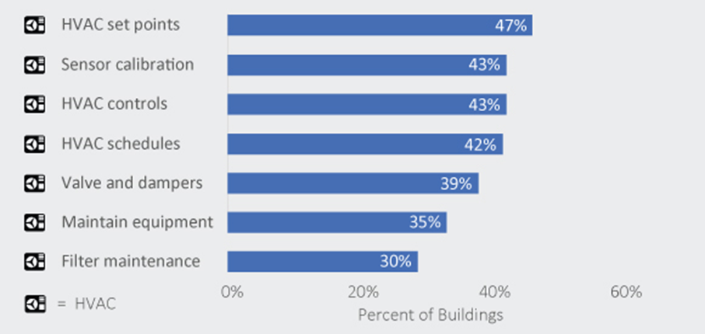
Most common operational problems
Source: City of Seattle
Notes:
As you review the chart above, notice that heating, ventilation, and air conditioning (HVAC) measures dominate the most commonly found deficiencies in commercial buildings. This chart summarizes data from investigations of 330 buildings in Seattle, WA in 2019. These problems are not unique to Seattle buildings. They are commonly found in all commercial buildings.
Observe that HVAC set points problems are common in half of all buildings above 100,000 SF. Two other common problems are HVAC control issues and sensors that are uncalibrated, not functioning, or located inappropriately.
Most, if not all, of these problems can be addressed through low-cost “tune-up” actions. They do not require a large capital investment by the building owner. When done properly, building tune-ups can generate 10-15% in energy savings and contribute to climate goals.

Slide 7
When operational problems aren’t fixed…
What happens?
More work for the building operator
Higher operational costs
Energy and water waste
Uncomfortable tenants
Complaints to management
Notes:
When operational problems don’t get fixed, they can get worse over time, making tenants and occupants uncomfortable and generating more complaint calls for the facilities staff to address.
Above are some examples of what happens.
Are there others you would add to the list?

Slide 8
When operational problems ARE fixed…
What happens?
Less work
Money saved
Recognition for green operations
Proud management
Comfortable, happy tenants
Notes:
When operational problems DO get fixed, the outcomes are positive, especially for the building operator and the building management.
Here are some examples.
Less work for the building operator responding to complaint calls
Saving money on energy and water bills for the company
Comfortable, happy tenants and good reports on tenant surveys
Company recognition in the community for its green operations and commitment to the environment
Proud management
What are your experiences?

Slide 9
Four Opportunities
Four common opportunities for low-cost operational improvement:
Equipment scheduling
Sensor error
Simultaneous heating and cooling
Outside air usage
Notes:
To save energy through improved building operation first requires determining frequent problems that have the largest savings potential. Most operations- and maintenance-related energy waste falls into four major categories:
Equipment scheduling: Equipment runs when it is not needed.
Sensor error: Erroneous sensor data causes increased heating, cooling, or equipment operation which can affect occupant comfort.
Simultaneous heating and cooling: The same air gets heated and cooled, or hot and cold air streams get mixed together to achieve the correct supply temperature.
Outside air usage: Economizer does not function optimally, or excessive outside air causes increased heating and/or mechanical cooling. Sometimes too little outdoor air compromises indoor air quality.

Slide 10
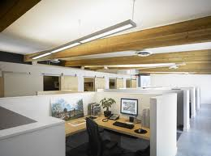
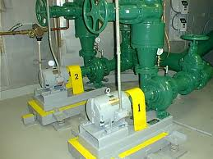
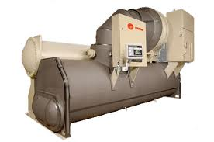
Equipment Scheduling
The easiest way to save equipment energy is to turn it off!
Longer operating hours:
  Result in shorter equipment life
  Increase the frequency of parts replacement
  Cause the need for more frequent cleaning (chiller bundles, boiler tubes, fan coils, etc.)
A good first step is to walk through the building when it is unoccupied.
Image: Ledalite
Image: LBL
Image: Trane
Notes:
A plan or procedure should be put in place to check occupant requirements and re-evaluate equipment operating schedules regularly. Typically, the plan should be performed twice a year and whenever there is a major tenant change.
Walking through the building when it is unoccupied is a good first step in identifying unnecessary equipment operation. If equipment is running, look for a reason. It is usually obvious that a lamp or printer should be off, but HVAC equipment may be running to supply a computer room that needs continuous conditioning, or to condition a process load (Better Bricks, 2009).
Systems that experience scheduling problems include:
Lighting
Plug and process loads
Fan systems
Chillers and boilers
Pumps

Slide 11
Equipment Scheduling:
Lighting
Time clock control:
Does the programming match the occupant schedule?
Does the schedule account for holidays and weekends?
Is someone responsible for checking the programming regularly to make sure it meets current occupancy requirements?
Do the lights actually turn off as programmed?
Have temporary, special event schedules been reprogrammed back to normal schedules?
Motion sensors:
Are they properly oriented to sense occupants?
Has the time interval to switch the lights off after occupancy been properly set?
Building automation system (BAS) integration:
Is lighting control managed through the BAS?
Notes:
Manually controlled wall switch lights are usually turned on by occupants as they arrive, but not always turned off as they leave. Occupants may not hesitate to turn off lights in a small room, but they may be reluctant to turn off large banks of lights if they think someone else might still be in the space.
Lighting control systems are increasingly tasked to interoperate with other building systems such as building automation systems (BAS) to share information and automate building functionality. Ensuring communication and smooth interoperability is called integration. Integration of lighting into the BAS is complex, according to the Lighting Controls Association. It is necessary to identify the intent of building automation, how to integrate a lighting control system with other systems, and provide a comprehensive sequence of operations.
Integration ensures systems can communicate effectively. It may include:
sharing hardware, such as a single touchscreen used to operate lighting, A/V, and window shades in a conference room
an occupancy sensor signaling the lighting, HVAC, plug load, and security systems; or,
an access control triggering lighting to turn ON or OFF.
This provides potential benefits of optimized energy savings, custom control capabilities, and a very granular degree of building responsiveness to occupants.

Slide 12
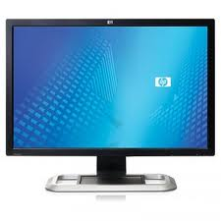
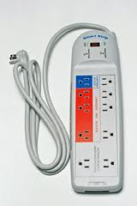
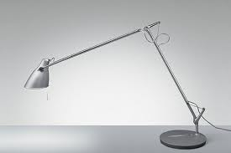

Equipment Scheduling:
Plug Loads
Plug loads:
Does IT department have a policy or system in place to make sure computers with an Energy Star power saving mode have it enabled?
Does IT have a policy to encourage employees to turn off their equipment when leaving?
Are computer monitors, printers and scanners turned off when not in use?
Images: Amazon.com, Energy Star, allmodern.com
Notes:
Plug and process loads are generally manually controlled by occupants. Like manually controlled lighting, these loads are normally turned on by occupants, but are often left on longer than necessary.

Slide 13
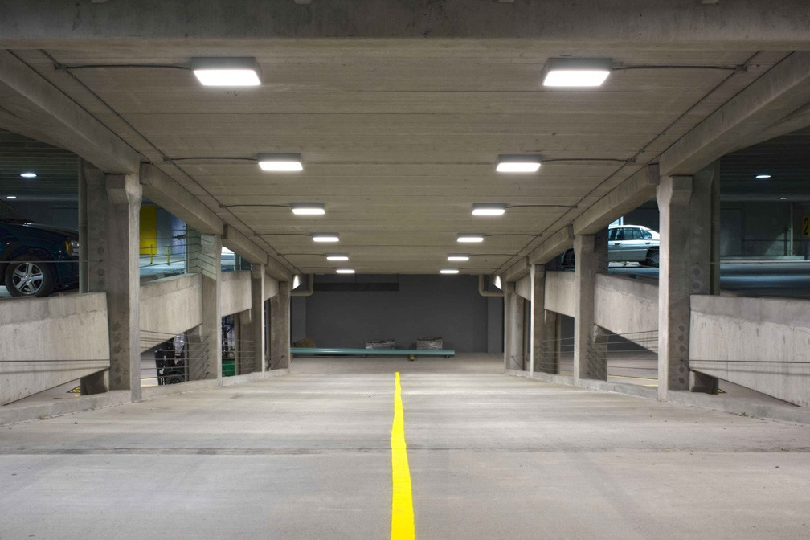
Case Study: DOL Parking Garages
U.S. DOL Headquarters, Washington, DC
Project:
  Occupancy sensor
  controls on LEDs
  Time delay on occupancy sensor adjusted from default setting (10 mins) to 2.5 mins
Result: 12% energy savings with no occupant complaints
Image: www2.providence.org
Notes:
Case Study: U.S. Dept. of Labor, 2 parking garages, Washington, DC
Like many commercial office buildings, the DOL headquarters has a fairly predictable use pattern, with most of the activity in its two dedicated subterranean parking garages occurring between 8 am and 6 pm on weekdays, and much lower and more sporadic use at other times.
The two garages at DOL headquarters were lit with LED luminaires in one section of a middle floor. Those LED luminaires, which have an integral occupancy sensor that can control their output through bi-level dimming, were monitored over a period of about a year to evaluate their performance. The results showed energy savings increased substantially with the use of the occupancy-sensor controls, which reduced the luminaire power draw to 10 percent (6.2W) while in the low state.
After the first few months of operation, it was determined that the motion sensors’ default delay setting (i.e., the time between the last detected motion and switching to the low state) was much longer than necessary and was leaving considerable energy savings on the table. After all, the delay setting only needs to be long enough to cover the typical time required for a vehicle to enter the area and park, with perhaps a short additional period while occupants gather their things before exiting the vehicle.
When the time delay was reduced from the default setting of 10 minutes down to 2.5 minutes, it was found that the average period of high-state operation among the metered luminaires decreased by approximately two-thirds — from about 60 percent down to 25 percent or less during the work week. The energy savings of the LED luminaires in combination with the occupancy-sensor controls, relative to the incumbent HPS system, amounted to 76 percent at the 10-minute setting, but increased to 88 percent at the 2.5-minute setting. Notably, no complaints about the shorter delay setting have been received from users, possibly because few have even noticed the change.
Source: https://www1.eere.energy.gov/buildings/publications/pdfs/ssl/deptoflabor_brief.pdf

Slide 14
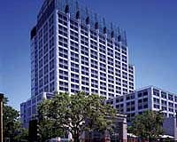
Case Study: Joe Serna Building in Sacramento, CA
Building type: Office
Building size: 950,000 ft²
Project type: Personnel scheduling (no-cost move for janitorial scheduling)
Project cost: $0
Annual labor savings: $110,000
Annual energy savings: $100,000 (8%)
Photo: California EPA
Case Study From IFMA
Notes:
The Joe Serna Jr. Building houses the California Environmental Protection Agency. Building management implemented daytime cleaning hours as a means to saving energy. Besides having no cost associated with the change, there were additional benefits.
Rather than after-hours cleaning, building management instituted day shifts from 11 a.m. to 8 p.m. The result was an immediate 8% reduction in energy use, which translated to an annual estimated savings of $100,000. Since cleaning crews do not come in after hours, the number of unoccupied hours can increase.
On top of the energy savings, a 70% reduction in tenant complaints was equivalent to saving an additional $110,000 in labor costs. Under the new setup, tenants can communicate their preferences directly to janitorial staff. Additionally, the potential for unwanted moving of paper, equipment and furniture was reduced.

Slide 15
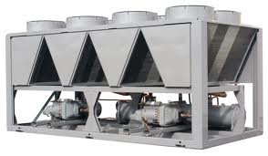
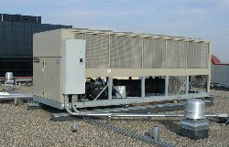
Equipment Scheduling:
HVAC Equipment
  Do programmed schedules for fans, pumps and other equipment match requirements, and is the schedule being implemented?
  Are general exhaust fans scheduled off when building unoccupied?
  Is optimum start and stop programming being used? (Intelligent Start/Stop of HVAC system based on OSA and space temperature)
  Are minimum CFM schedules used to control VAV boxes for unoccupied operations?
Images: Carrier, McQuay
Notes:
Common energy savings opportunities may include:
Bathroom/general exhaust fans: Turn off during unoccupied hours.
Fan powered boxes with reheat used during for morning warm up: Warm up at zone level rather than whole building.
Baseboard heating: Match use with occupancy schedule (vs. manual on/off) to prevent simultaneous heating and cooling.

Slide 16
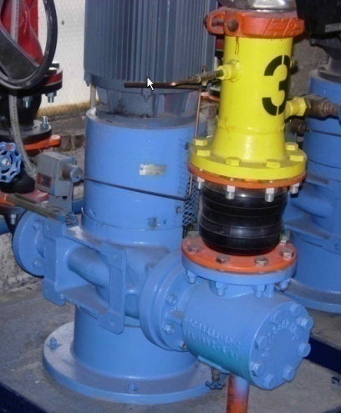
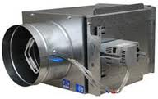
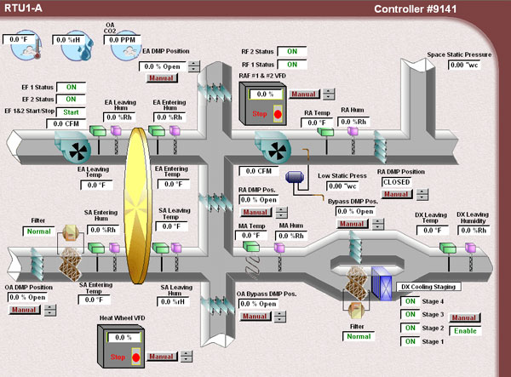
Equipment Scheduling:
HVAC Equipment (continued)
  Are fan-powered boxes scheduled for morning warm-up?
  Are baseboards scheduled to match occupancy and not allowed to create simultaneous heating and cooling situation?
  Are the chiller and boiler prevented from operating at the same time?
  How are after-hours overrides being used?
  Are programmable thermostats that are networkable and accessible through the Internet for packaged equipment appropriate?
Images: PECI, McQuay

Slide 17

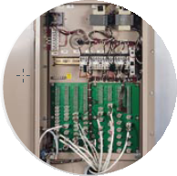
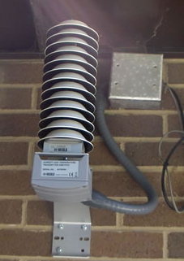
Sensor Error
  Sensors are the interface between controls and the system.
  Inaccurate sensors = inaccurate information = bad system decisions
  Sensor error attributed to:
  Improper application (wrong
  sensor for job)
  Improper installation (improper system mapping)
  Out of calibration/failure
Images: BetterBricks
Notes:
Sensor error can increase energy use, compromise occupant comfort, and prevent plant and system loads from being met. For example, an outdoor air temperature sensor that is registering a temperature that is 10 degrees lower than actual will cause supply air reset schedules to be incorrect and may cause heating at an inappropriate time. Both will cause occupants to be less comfortable leading to an increase in maintenance calls.
Examples of improper sensor location:
Outside air temperature sensors installed in direct sunlight or in misleading micro-environments
Zone temperature sensors near heat-producing equipment or in diffuser air stream
Flow sensors too close to elbows or transitions or in wrong location in relation to branches.

Slide 18
Sensor Error
Control sensors with the most potential to have a significant effect on energy use are generally those used to implement resets and control outside air at air handling units and central plants. While the impacts can be huge, the fix is simple – regular calibration.
Critical control sensors include:
Outside air temperature
Supply air temperature
Chilled water temperature
Heating water supply temperature
Notes:
A critical control sensor is any sensor in a large system that is used as an input in a control sequence.
While building systems use many sensors, critical control sensors are the most likely to cause severe energy penalties. For example, while space temperature sensors result in energy waste and comfort problems, the effect on energy is usually minor and restricted to one zone. On the other hand, errors from a critical control sensor, such as the temperature of return air at the air handling unit, can cause large energy penalties affecting many zones, yet may not cause comfort issues. Sensor error is hard to detect unless the sensors are calibrated regularly.

Slide 19
Sensor Error
Many sensor problems can appear to be other issues:
Plant and system loads not met
Reset schedule not working
Outside-air economizer malfunctioning
Boilers and chillers on when not needed
Equipment not modulating as expected
Simultaneous heating and cooling
Notes:
Often, sensors that are not reading properly may cause operators and facility managers to think that there is something wrong with major pieces of equipment. For example, a dry-bulb economizer uses outdoor air for cooling whenever the outdoor air temperature is less than a specified value, typically between 55 ºF and 70 ºF. If the outdoor air temperature sensor is not calibrated correctly, it may cause the economizer to modulate open/close at the wrong times. This may cause operators to troubleshoot the control sequence, linkages or economizer controller—when the real issue is associated with the sensor itself.

Slide 20
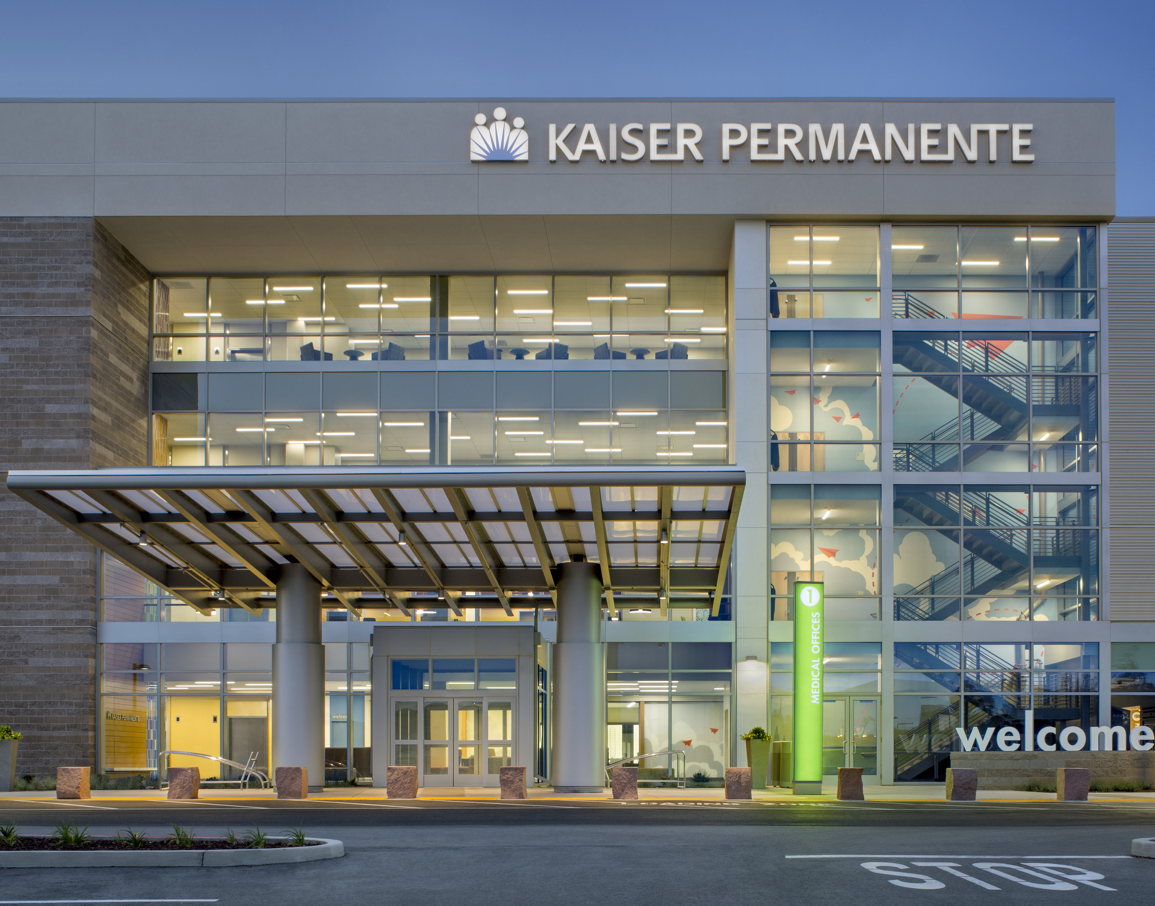
Case Study: Kaiser Permanente
Medical Office Building
Kaiser Permanente, Portland, OR
Project:
  Evaluated sensor functionality
  Recalibrated critical control sensors
Results:
  Cost savings of $6,000 per year
  Reduced occupant complaints by 23%
Notes:
Case Study: Kaiser Permanente Medical Office Building, Portland, OR
The hospital facility team implemented a building tune-up project which included: Checking air handlers for mechanical failures; Documenting sequences of operations; Examining schedules and set points; Verifying connectivity of equipment; Evaluating sensor functioning; and, Setting up trend data. The team identified and fixed a number of problems such as stuck dampers, disconnected reheat coils and miscellaneous issues with the variable air volume (VAV) boxes.
Source: BetterBricks -https://betterbricks.com/uploads/resources/KaiserOpsCaseStudyFinal.pdf

Slide 21
Check Your Knowledge
Question #1
In a large, multi-story office complex in Las Vegas, the economizers are fully open at 2 p.m. on a hot summer day in late August. This may be caused by:
a VAV box that has unnecessarily gone into reheat mode.
improper outdoor air temperature sensor location, failed sensor, or jammed damper blades.
a controls contractor who improperly set a temperature deadband of 2 °F.
allowing occupants to control space temperature setpoints.
Notes:
Your answer: ____________

Slide 22
Simultaneous Heating and Cooling
  The Golden Rule:
  Don’t use energy for both heating and cooling within the same system at the same time.
Common culprits of simultaneous heating and cooling:
  VAV systems with reheat
  Constant volume systems with reheat
  Dual duct systems
  Multizone fans
  Central air conditioning systems w/ perimeter heating
Notes:
Central fan systems are designed to supply space conditioning to multiple areas in a building. Each area has its own space conditioning needs. Typically, a central fan supplies cool air to one or more zones. To meet the conditioning requirement of each zone, most central HVAC fan systems use some form of reheat. At the zone level, the quantity of air is usually modulated to satisfy the cooling load or may be reheated to meet a heating load. A typical office building floor will have electric or hydronic coils installed in the ductwork or in the fan boxes serving the perimeter areas, while the central area is cooled only. The temperature of the cool air leaving the air handler at the primary supply determines the amount of reheat required in the various zones.
Control strategies optimize the supply air temperature and reduce reheat. Usually, the supply air is reset to the highest temperature that can still meet the largest cooling load. If the control strategy is not optimized, the supply air will be cooler than necessary and reheating it will use more energy than necessary.

Slide 23
Causes of Simultaneous
Heating and Cooling
  Excess minimum outside air
  Overlapping control loops
  Leaking valves or dampers
  Sloppy valve or damper controllers (especially pneumatic)
  Rogue zones
  Abandoned overrides
  Missing/damaged pipe or duct insulation
Notes:
Energy codes and standards, including ASHRAE 90.1, already have provisions to prohibit simultaneous heating and cooling. However, with widespread heat-cool overlap observed in so many buildings constructed under an energy code, there must be a disconnect somewhere between the code phase and the operations phase. (Steve Doty)
In addition to energy costs, simultaneous heating and cooling increases operational costs. When the central system delivers cooler air than required, the zone reheat coils must temper the air before it is delivered to the space. The heating and cooling systems work against each other.
Sometimes, when one part of the system is not operating correctly, this can be disguised by other functions compensating for the failure. A typical example of this is when more heat than necessary is delivered to an area while, at the same time, the temperature is controlled by the cooling system. This leads to both excessive heating and cooling being delivered unnecessarily to the same place.

Slide 24
Solutions to Simultaneous
Heating and Cooling
Cause: Offending system types
Constant volume dual duct
Potential solution:
Tune the controls to minimize simultaneous
heating and cooling
Intelligent supply temperature reset schemes
Double-deck multi-zone
Central AC w/ perimeter reheat
VAV reheat
Heating and cooling setpoints at least 5º F apart
Deadband & throttling ranges that prevent hunting between heating and cooling
Notes:
If your facility exhibits symptoms of simultaneous heating and cooling, here are several potential solutions to minimize energy waste. Recall that deadband is the temperature range above and below setpoint when no heating/cooling occurs. ASHRAE requires a deadband of at least 5 degrees; in other words, if temperature setpoint is set to 70.0º F, the controller will not take corrective action unless the space temperature is below 67.5º F, or above 72.5º F. To minimize the occurrence of simultaneous heating and cooling, building operators should evaluate and implement supply air reset schemes based on industry standards.

Slide 25
Solutions to Simultaneous
Heating and Cooling
Potential Solution:
Mechanical heating and cooling both on (or cycling between them).
Cause: Overlapping control loops
OSA damper at minimum, cool OSAT, and mechanical cooling
OSA damper greater than minimum setting and heating valve open
Notes:
Overlapping or competing control loops can adversely affect HVAC systems. For instance, chilled water valve operation can be controlled by both humidity and temperature sensors. Care must be taken that the outputs from each sensor do not fight each other.

Slide 26
Solutions to Simultaneous
Heating and Cooling
Cause: Unusual zone load
  i.e., server room drives down supply air temperature setpoint, forcing excessive use of reheat
Potential solutions:
  Remove rogue zone from SAT reset sequence and serve zone with separate fan coil unit
  Increase air flow to rogue zone
  Weight other zones more heavily in SAT reset sequence
Notes:
Rogue or wild zones are caused by zones that have loads that are not anticipated during design (i.e., space initially intended to be for storage becomes a data room and houses many servers. This forces the entire zone into cooling, regardless of what the other spaces within the zone require). A potential solution is to remove this zone from the SAT reset sequence and serve this zone with a dedicated unit.

Slide 27
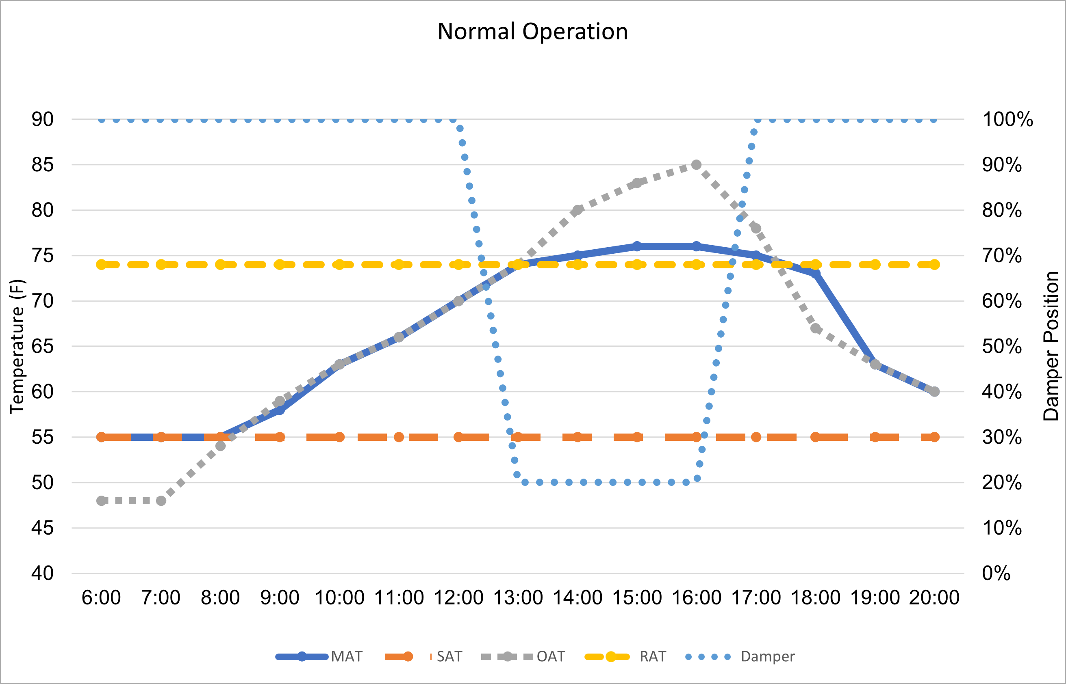
Simultaneous Heating and
Cooling: Trend Data
Figure A:
Normal Operation
See MAT formula on next note page.
Notes:
Figure A: Normal Operation of Economizer
To determine if there are issues, it is helpful to generate trend logs using the following data:
• Outside Air Temperature (OAT) • Return Air Temperature (RAT)
• Mixed Air Temperature (MAT) • Supply Air Temperature (SAT)
• Economizer damper position
It is also helpful to see how MAT varies with respect to the SAT, the RAT, and the OAT as well as seeing if the MAT curve changes slope when the dampers go to minimum position.
Figure A shows that MAT tracks RAT closely, as the outside air damper is set at 20 percent when the OAT is warmer. When the OAT is cooler than RAT, the MAT should equal the OAT because the system is completely (100 percent) in economizer cooling mode. This illustrates normal, efficient operation of the system.

Slide 28
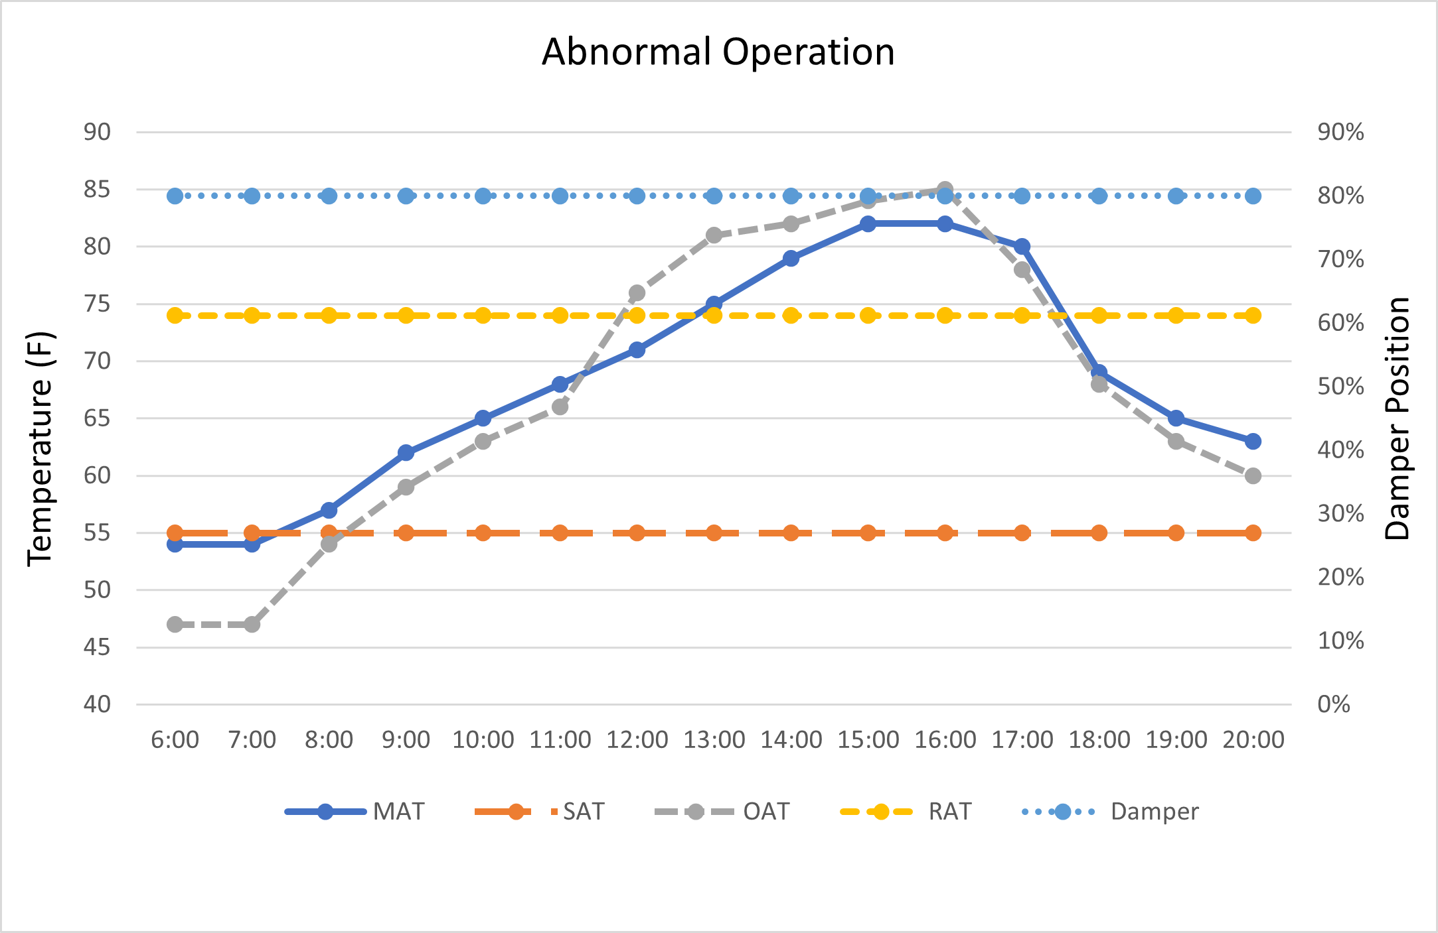
Simultaneous Heating and
Cooling: Trend Data
Figure B:
Abnormal Operation
See MAT formula in notes
Notes:
Figure B: Abnormal Operation of Economizer
Figure B shows that MAT tracks OAT closely, with the outside air damper set at 80 percent when the OAT is warmer than the RAT. This graph demonstrates a fixed damper position, rather than one that modulates/economizes with OAT. If your graph looks like this, you could be drawing in too much outside air. If the graph profile changes over time, another fan system may be affecting the space with the problem. It could also be caused by external wind pressure, which is discussed below.

Slide 29
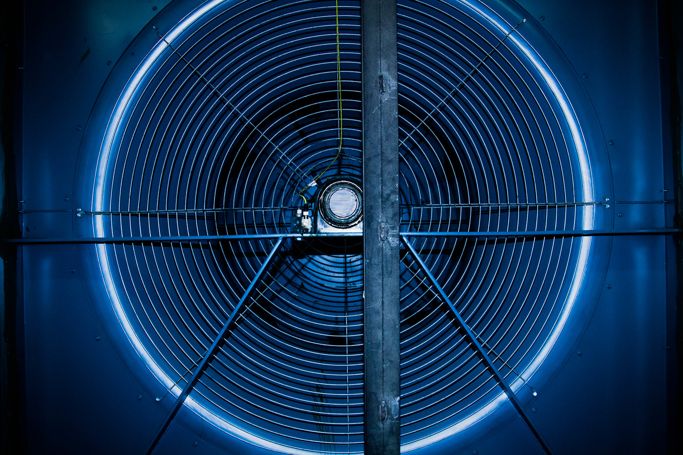
Class Discussion:
Two HVAC Systems
We will examine two HVAC systems with simultaneous heating and cooling:
  VAV with reheat
  CV with reheat
Goals:
1. Understand how to identify the problem
2. Describe tune-up steps to fix the problem
Photo courtesy of Resource Media
Notes:
Most HVAC systems can experience at one time or another the problem of simultaneous heating and cooling. These systems include:
VAV with reheat
CV with reheat
Dual duct systems
Multizone fan systems
Central AC with perimeter heating
Ductless systems
Variable refrigerant flow (VRF)
Dedicated outdoor air system (DOAS)
In the next slides, we will examine two HVAC systems exhibiting simultaneous heating and cooling: VAV with reheat and CV with reheat. As we discuss the scenarios, we will look at system setpoints, how the system is operating, and the steps to take to address the problem. How do we detect the problem? What tune-up steps can we take to fix the problem?
Keep in mind that:
Control strategies are used to optimize the supply air temperature (SAT) and reduce reheat.
The SAT can be reset based on time of year, time of day, outside air temperature (OAT), return air temperature (RAT), the temperature in a representative space, the temperature in a worst-case cooling zone, or some combination of these. If existing controls do not automatically reset SAT, it should be manually reset at least seasonally.
The temperature of primary supply air is commonly set to about 55 ºF for cooling design with central-fan systems. Resets can typically increase primary SAT to 60 ºF during cold weather and, with very good design, up to 65 ºF.

Slide 30
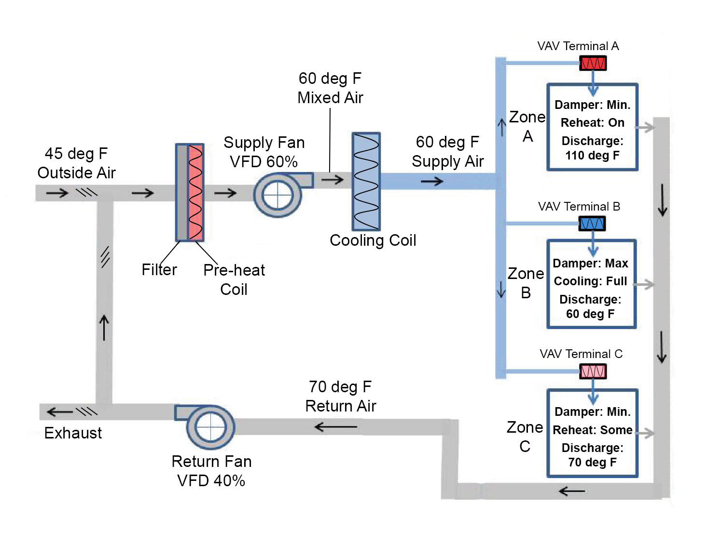
Class Discussion:
VAV with Reheat
Central fan supplies cool air to VAV
VAV modulates flow as needed to cool space
When heating needed, VAV reduces flow to minimum & uses reheat coil to control discharge temp
Image adapted from insulation.org
Notes:
HVAC System: VAV with Reheat
Image adapted from insulation.org

Slide 31
Class Discussion:
VAV with Reheat
Discussion Question:
1. If the primary SAT were fixed at 55 ºF (instead of reset to 60 ºF), would the heating energy for Zones A and C increase or decrease?
Image adapted from insulation.org
Notes:
The central fan supplies cool air to the VAV boxes, and the VAV boxes modulate flow as needed to cool the space. When heating is needed, the VAV boxes reduce flow to minimum and use the reheat coil to control discharge temperature.
In this example, the economizer is modulating to produce 60 ºF mixed air, matching the setpoint temperature of the primary supply air. No cooling is needed from the cooling coil. The three VAV boxes use the 60 ºF supply air to meet the zones HVAC demands.
Zone A needs heating, so the VAV box reduces flow to minimum and turns on the heating coil to increase the discharge temperature from 60 ºF to 110 ºF.
Zone B needs full cooling, so the VAV box provides full flow at 60 ºF.
Zone C needs no cooling or heating, so it reduces flow to minimum and uses reheat.
This example illustrates that the temperature of the cool air leaving the air handler (primary SAT) determines how much reheat is required both in heating zones and in neutral zones.
Primary targets of a VAV tune-up should be the control strategy for primary SAT and the related sensors and dampers. The following items all have a major impact on the temperature of primary supply air and related energy use:
Calibration of the temperature sensor for primary air, mixed air, return air, outside air
Economizer dampers
Discussion Question:
If the primary SAT were fixed at 55 ºF (instead of reset to 60 ºF), would the heating energy for Zones A and C increase or decrease?
Answer: ________________________________________________________
HVAC Systems: VAV with Reheat

Slide 32
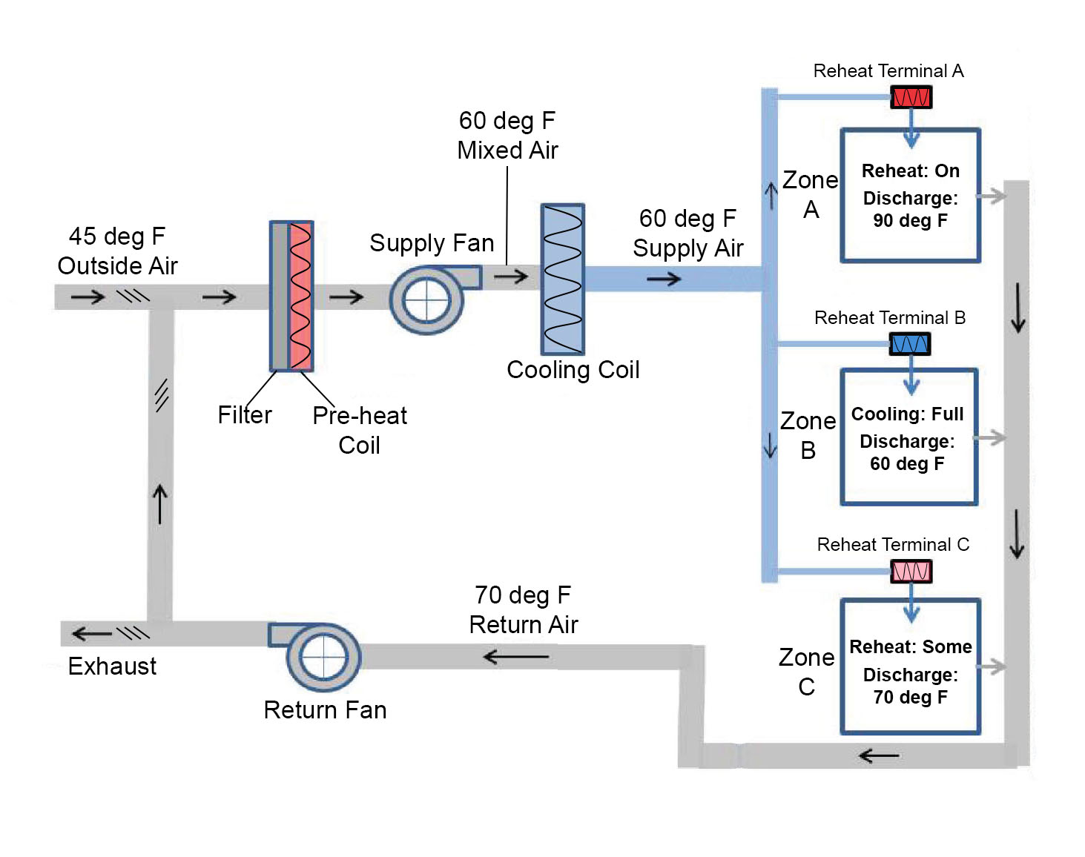
Class Discussion:
Constant Volume with Reheat
Central fan supplies cool air to reheat boxes
Reheat coil used to control discharge temp
CV fan systems with reheat are highly energy intensive
Image adapted from insulation.org
Notes:
HVAC Systems: Constant Volume with Reheat
Image adapted from insulation.org

Slide 33
Class Discussion:
Constant Volume with Reheat
Discussion Questions:
1. How much cooling is needed from the cooling coil?
2. Why?
Image adapted from insulation.org
Notes:
The central fan supplies cool air to the reheat boxes, and the reheat coil is used to control discharge temperature. CV fan systems with reheat are generally no longer allowed in new construction because of their high energy use.
In this example, the economizer is modulating to produce 60 ºF mixed air, matching the setpoint temperature of the primary supply air. The three reheat boxes use the 60 ºF supply air to meet the zones’ HVAC demands.
Zone A needs heating, so the reheat coil increases the discharge temperature from 60 ºF to 90 ºF .
Zone B needs full cooling, so the reheat coil is off and the discharge temperature is 60 ºF.
Zone C needs no cooling or heating, so the reheat coil increases the discharge temperature from 60 ºF to 70 ºF providing neutral air to the space.
This example illustrates that the temperature of the cool air leaving the air handler (primary SAT) determines how much reheat is required both in heating zones and in any zone that needs less than full cooling.
Primary targets of a tune-up of a CV-reheat system should be the control strategy for primary SAT and related sensors and dampers. The following items all have a major impact on the temperature of primary supply air and related energy use:
Calibration of the temperature sensor for primary air, mixed air, outside air
Economizer dampers.
Discussion Questions:
1. How much cooling is needed from the cooling coil?
Answer: ___________________________________________________
2. Why?
Answer: ___________________________________________________
HVAC Systems: Constant Volume (CV) with Reheat

Slide 34
Small Group Activity:
Resolve simultaneous heating and cooling
Work in small groups to examine an HVAC system with simultaneous heating and cooling
Take 20 minutes
Follow the instructions on the next pages
Review operation of HVAC system:
Central AC with perimeter heating
Answer the questions on the notes page
Volunteer one answer in the “report out”
Your instructor will assign small groups

Slide 35
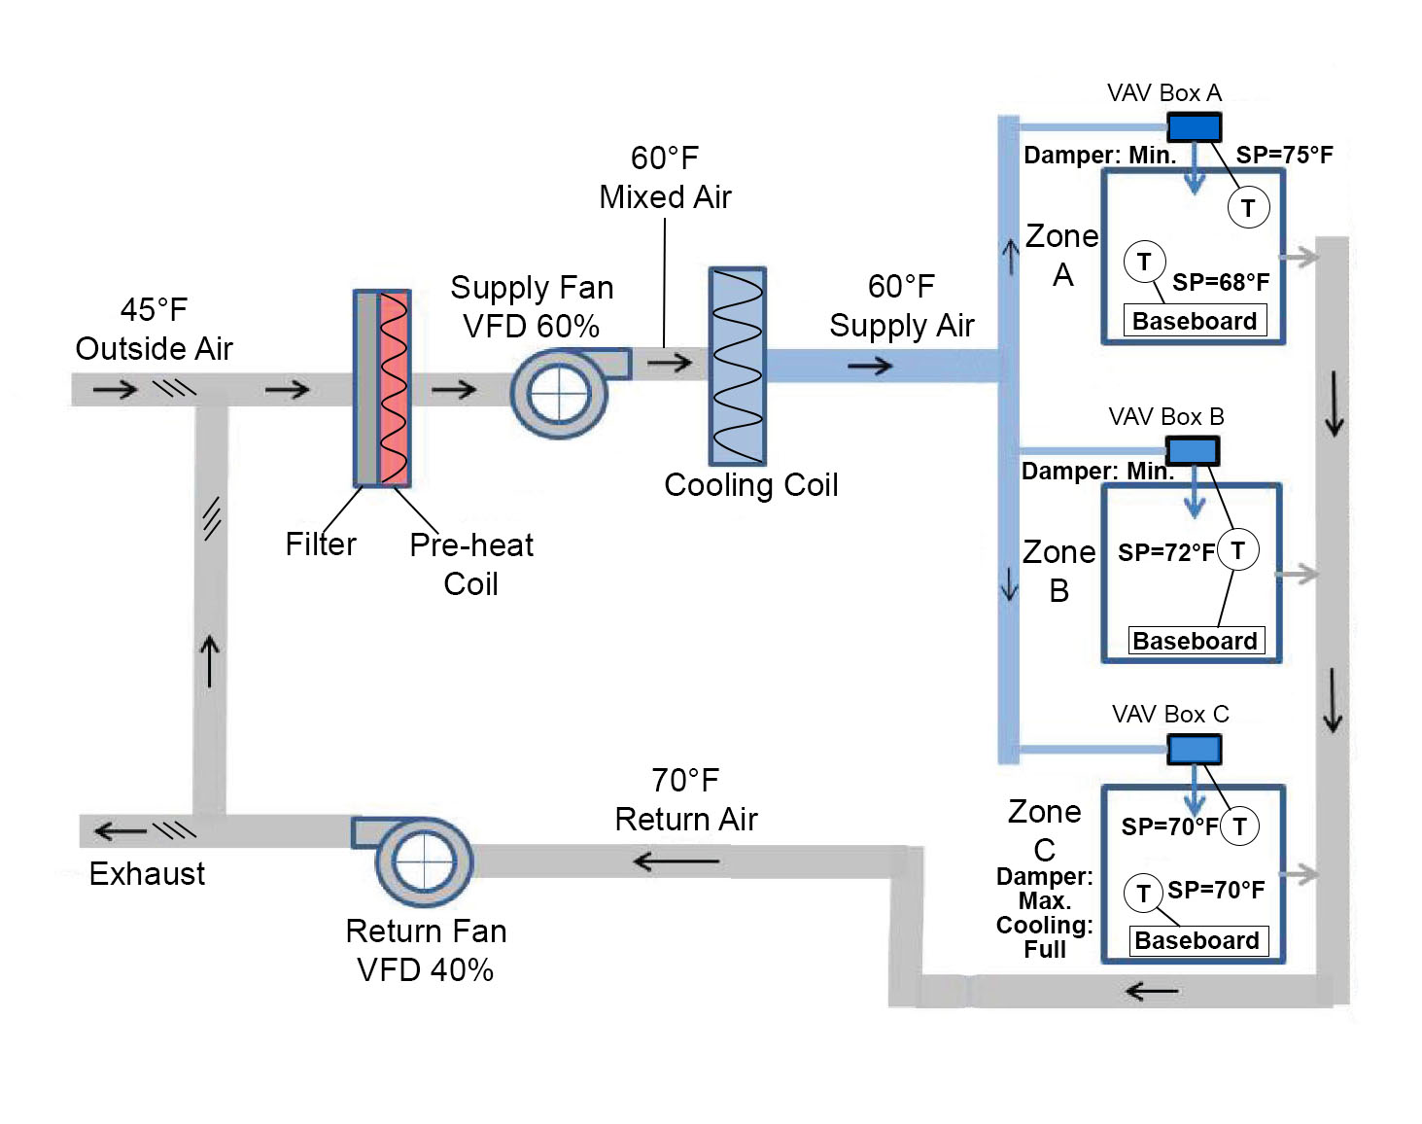
Small Group Activity: Central AC with Perimeter Heating
Central AC is a VAV system with no reheat, providing ventilation & cooling
Perimeter heating is baseboard that offsets heat loss from the building shell when needed
Areas served by VAV & baseboard are open to each other
Image adapted from insulation.org
Notes:
Small Group Activity: Central AC with Perimeter Heating
Image adapted from insulation.org

Slide 36
Small Group Activity: Central AC with Perimeter Heating
Questions:
How can simultaneous heating and cooling be prevented in each zone:
1. Zone A?
2. Zone B?
3. Zone C?
Image: Better Bricks
Notes:
Instructions:
Look at the illustration of the Central AC System on the previous page.
Read the description of its operation below.
Answer the 3 questions.
Description:
The central AC in this example is a VAV system with no reheat, and the perimeter heating is baseboard. The areas served by the VAV and baseboard are open to each other. The VAV system provides ventilation and cooling, while the baseboard offsets heat loss from the building shell when needed.
In this example, the VAV system is producing 60 ºF supply air and varying it as needed to cool the space and/or provide ventilation. The three zones each have baseboard heat at the perimeter in addition to VAV supply toward the interior.
Central AC perimeter heating systems should be tuned to prevent or minimize simultaneous heating and cooling. Things to look for include:
Regular calibration of space-temperature sensors and thermostats
Heating and cooling setpoints at least four degrees apart
Deadbands and throttling ranges that prevent hunting between cooling and heating
Locks or protective covers that prevent occupants from changing thermostat settings.
Questions:
In each zone, how can simultaneous heating and cooling be prevented?
Zone A solution
Answer: _____________________________________________________________________
_____________________________________________________________________________
2. Zone B solution
Answer: _____________________________________________________________________
_____________________________________________________________________________
3. Zone C solution
Answer: _____________________________________________________________________
_____________________________________________________________________________
Small Group Activity: Central AC with Perimeter Heating

Slide 37
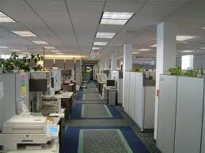
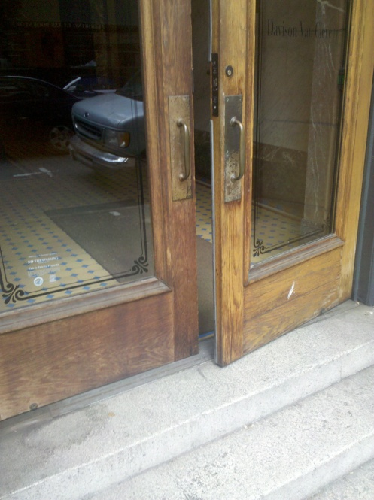
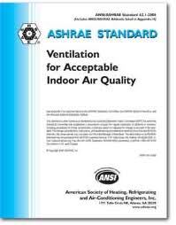
Outside Air Usage:
Quick Review
Why use outside air?
  Code requirements (minimum ventilation rates)
  Maintain proper building pressures
  Maintain indoor air quality
Images: CT.gov, Better Bricks, ASHRAE
Notes:
We discussed outside air usage in BOC 1001 and 1005. Let’s take a moment to review how and why buildings use outside air.
Outside air is supplied to a building by the ventilation system in order to displace indoor air pollutants and provide adequate ventilation for the building occupants. Proper ventilation rates are needed to maintain indoor air quality. Building codes require a minimum ventilation rate, usually based on ASHRAE Standard 62.
Common causes of poor outside air control:
Minimum ventilation rate never adjusted for a change in occupancy
Minimum ventilation rate is set by damper positions rather than by measured air flow
Damper leaks when closed during unoccupied times
CO₂ sensor is improperly located.
Note the photo of the door. Doors and windows that aren’t properly shut may result in over ventilation of spaces. In many spaces, open doors or windows during a heating or cooling cycle may be providing plenty of outside air to a space without requiring delivery by a mechanical system. Because the control system has no way of knowing if extra air is being brought in, mechanical systems will provide the scheduled amount of outside air.

Slide 38
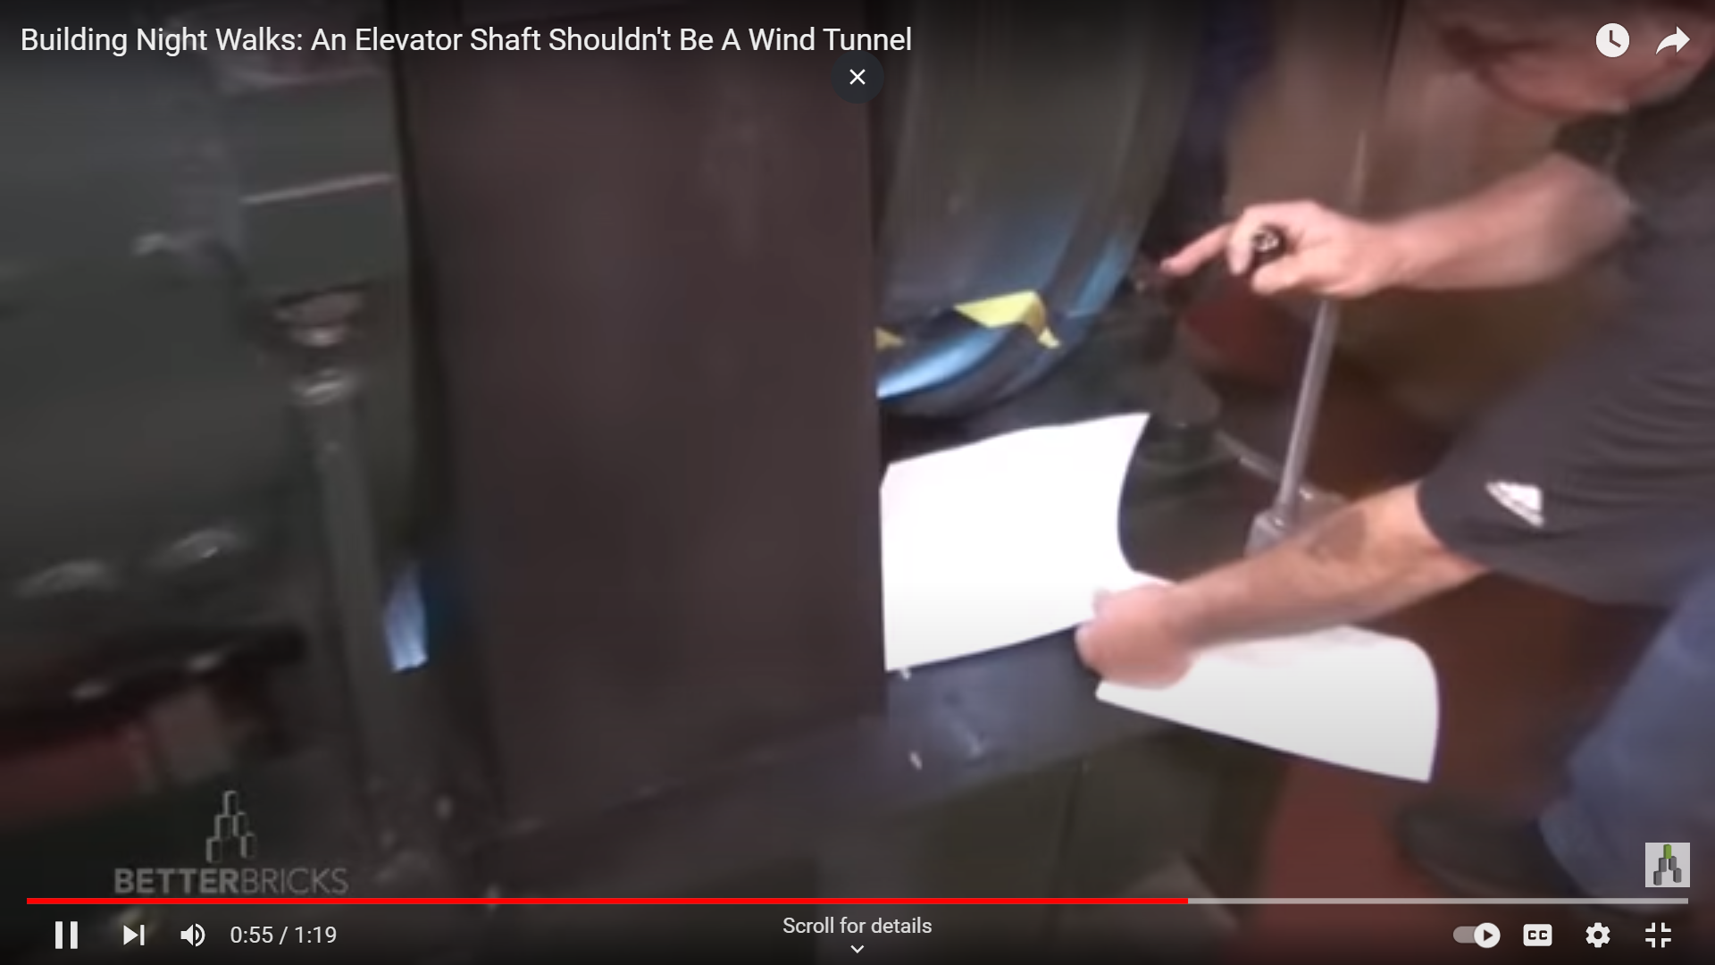
Watch the Video (1:19 minutes)
Outside Air Usage: Envelope/Building Pressure
Video link: http://youtu.be/QlZwHjaHJBI
Notes:
As this video demonstrates, a leaky envelope may introduce excess outside air into the building through:
Building shell penetrations
Gravity damper or no damper control at stairwell and elevator pressurization fans
Gravity damper or no damper control for toilet and general exhaust fans
Makeup air too much/too little.
When conditioned air is lost, this wastes energy and money. In addition, most buildings maintain a slightly positive static pressure; a leaky envelope makes this difficult. Energy use will increase as the system attempts to maintain this pressure.
Video may be accessed online at - http://youtu.be/QlZwHjaHJBI
In-Class Video Demonstration

Slide 39
Outside Air Usage:
Minimum Requirements
ASHRAE Standard 62.1 - Ventilation Requirements
Education | CFM/ person | CFM/ sq. ft.
Art Rooms | 10 | .18
Auditoriums | 7.5 | .06
Classrooms | 10 | .12
Laboratories | 10 | .18
Libraries | 5 | .12
Lecture Rooms | 7.5 | .06
Music Rooms | 10 | .06
Media Centers | 10 | .12
Wood/Metal Shop | 10 | .18
Offices | CFM/ person | CFM/ sq. ft.
Conference Rooms | 7.5 | .06
Office Spaces | 10 | .12
Reception Areas | 10 | .18
Other | CFM/ person | CFM/ sq. ft.
Cafeterias/Dining | 7.5 | .18
Kitchens | 7.5 | .12
Shipping/Receiving | 10 | .12
Warehouses | 10 | .06
Notes:
Refer to your local mechanical code to determine minimum ventilation requirements for your space type and occupancy. Many jurisdictions follow the International Mechanical Code or ASHRAE Standard 62.1 requirements.
ASHRAE Standard 62.1 defines ventilation requirements for most commercial building space types. Minimum outside air requirements will vary based on:
Number of people in a space
Occupancy type (e.g. classrooms, laboratories, warehouses, etc.)
Total area & volume occupied.
A simple calculation for the outdoor airflow required for a single ventilation zone is:
(CFM/person) x (number of people in the space) + (CFM/sq. ft). x (total sq. ft.)
For example, a 600 sq. ft. classroom designed for 30 students would require:
10 CFM x 30 people + .12 CFM x 600 sq. ft. = 372 CFM
Systems that serve multiple ventilation zones require more complicated calculations and are usually based on meeting the requirements of the most critical zone.
Note: Ventilation for hospital facilities is defined in ANSI/ASHRAE/ASHE Standard 170: Ventilation of Health Care Facilities. This standard’s guidelines provide environmental control for comfort and odor, as these two things can be compromised without proper care and act as a hindrance to patient recovery.

Slide 40
Outside Air Percentage
How do you know if you are delivering enough fresh air?
Multiply this % by total volume of supply air
(return air) – (mixed air)
(return air) – (outside air)
% of outside air delivered =
x 100
Notes:
To calculate the percent of outside air being provided to a space, use the formula shown above with temperature readings taken at the air handler level. Mixed air temperature should be measured after the filter bank, before the heating/cooling coils. Also, keep in mind that this is a point-in-time measurement to help understand what may typically be happening in your system. This process should be performed in heating season and in cooling season, on days representative of the hottest/coolest days typical of your climate, respectively. These readings should also be taken when the system is NOT economizing, since economizing will bring in more outside air than when solely in mechanical conditioning mode.
Supply air volume can be determined in a number of ways, for example by using an anemometer to take a duct traverse measurement, using a flow hood at a supply grill, or estimating the volume based on duct size and fan speed.
To determine if you are delivering enough fresh air to a space, multiply the percentage of outdoor air you are providing by the total volume of air, then compare that number to the amount required by the ventilation standard your are subject to. You can also use this method to identify areas where you may be over-ventilating and thus wasting energy.

Slide 41

Case Study: Providence
Hospital
Providence St. Peter Hospital
Olympia, WA
Project goal:
Ensure all rooms meet minimum ACH for code compliance
Result:
$120,000/year savings
Identify areas being over-ventilated
Notes:
Healthcare facilities are subject to a multitude of regulatory requirements designed to ensure a safe and healthy environment for patients and medical staff. The goal of this case study was to ensure that all rooms in the hospital met the minimum air changes per hour (ACH) required under the ventilation standards for the space use. The study covered office spaces, public spaces such as reception areas and cafeterias, and medical spaces such as laboratories, clinics and operating rooms. A total of 5,000 rooms were investigated by the facilities staff, and the ACH for each space was documented.
Using facility controls, the facility manager reviewed air volume to ensure every room was getting code-compliant minimum ACH.
Discovery: Many rooms were found to be either over-ventilated or did not meet code minimum airflow rates.
Why: Space uses had changed over time but airflow rates were not reviewed and adjusted. For example, a pharmacy space was re-purposed for office use. The ventilation requirements for each are different.
Result: The facility manager adjusted air volumes in more than 100 rooms to meet ventilation requirements. In all, the adjusted ventilation levels resulted in a reduction in fan energy of 3,000 cfm/year. This reduction in fan energy also led to an associated reduction in heating/cooling energy, resulting in savings of approximately $120,000/year.

Slide 42
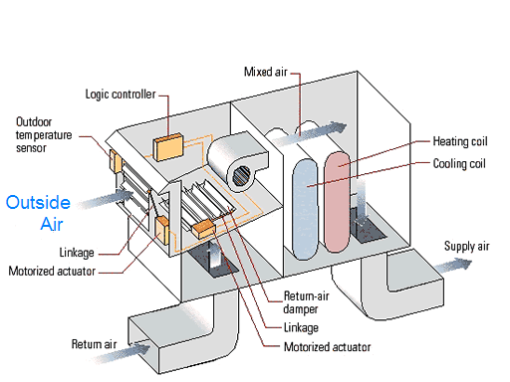
Outside Air Usage:
Economizers
Economizers = FREE COOLING
However, if you have one, it may not be working properly!
Failed outside air sensor
Incorrect thermostat
Incorrect control logic
Broken damper linkages or actuator motor
Image: Better Bricks
Notes:
Many buildings use an outdoor air economizer, which uses outside air for “free” cooling when its temperature is below the return air temperature. The economizer varies the outside air quantity from the minimum ventilation rate up to 100 percent outside air as needed to cool the building.
Economizer scheduling: Energy codes generally require that outside air dampers be closed when the building is unoccupied, and open to the minimum ventilation rate when it is occupied and being heated. When the building requires cooling, the economizer activates and allows additional outside air when the outside air is cooler than the return air.
Based on studies of packaged economizers in the Pacific Northwest:
Nearly 60% of RTUs exhibited issues with OA adjustment or economizer.
One-third of economizers were not working at all.

Slide 43
Outside Air Usage:
Economizer Issue
Mixed air temperature near outside temperature in heating mode
  If the system is working properly, the MAT should normally be closer to the RAT (which is warmer) than to the OAT.
  A depressed MAT can force the heating system to expend more energy to reach the required SAT.
  The heated air available from the return air system is wasted to the outside.
  Review the formulae for sensible, latent and total heat in your handbook.
RA
OA
MA
Supply Air
Source: Better Bricks
Notes:
Economizers can save energy in buildings by using cool outside air as a means of cooling the indoor space. When the enthalpy of the outside air is less than the enthalpy of the recirculated air, conditioning the outside air is more energy efficient than conditioning recirculated air. Free cooling occurs when the OA is both cool and dry and no additional conditioning of the air is required.
Enthalpy is equivalent to the total heat content of a system, including both latent and sensible heat.
Sensible heat – energy that is the result of a change in temperature.
Quantity of sensible heat = 1.08 x CFM x ▲temperature difference
Latent heat—heat associated with a change in phase (i.e. condensation, water vapor, etc).
Quantity of latent heat = 0.68 x CFM x ▲ specific humidity
Quantity of total heat = 4.5 x CFM x ▲enthalpy

Slide 44
Outside Air Usage:
Confirming the Issue w/ DDC
Normal Operation
Actual Operation
Image: Better Bricks
Notes:
Graph A depicts how this building is designed to operate. The position of the OA damper modulates based on the OA temperature, keeping the MAT just below the SAT. This strategy uses the outside air to cool the 72ºF return air.
By plotting trend data (Graph B), a building operator may notice that the operation is not optimized. Keeping the economizer damper in a fixed position brings in too much cool outside air. In order to maintain the desired SAT, the air being provided to the space will have to be conditioned.
Example diagnostic steps:
Inspect the dampers and their operators when the condition occurs.
Cycle the dampers via the DDC system and make sure they are responding properly and do not bind.
A. Normal Operation
B. Actual Operation

Slide 45
Outside Air Usage:
Demand Controlled Ventilation
Objective: Minimize the use of ventilation air.
Uses CO2 or occupancy sensor
Maintains CO2 levels around 400-500 ppm above ambient (outdoor)
Sensor location and calibration: critical
Notes:
Demand-controlled ventilation (DCV) adjusts the amount of outside air based on the number of occupants in the space. It is especially effective in areas with large variations in occupancy such as auditoriums, gymnasiums and large conference rooms. By adjusting the ventilation rate to meet actual, rather than peak, occupancy requirements, you save energy.
CO₂ is an easily measured by-product of humans and thus is used as a representation of the level of occupancy. DCV typically uses CO₂ sensors in the ventilation zone to control the minimum ventilation rate based on the difference between ambient outdoor-air CO₂ levels and indoor space CO₂ levels. Typical DCV control strategies maintain the CO₂ level at around or below 400-500 parts per million (ppm) above the ambient (outdoor) level, varying depending on minimum CFM rates/person. Outdoor levels are determined either using an outdoor CO₂ sensor or assuming a conservative concentration of around 400 ppm. Sensor location and calibration are critical for adequate control. It is typically recommended that zone sensors should be located between 3 feet and 6 feet above the floor or at the anticipated height of the occupants’ heads.
Alternately, DCV can utilize occupancy sensors to control ventilation rates.
Source: ventcon.lbl.gov/guidance-development/3-2-co2-sensor-placement

Slide 46
Causes and Symptoms of
Poor Outside Air Control
Economizers
Control strategy
(straight line vs. MAT setpoint)
Improper OA sensor location
Indoor Air Quality (IAQ)/
Minimum Ventilation
OA lockout after hours and during warm-up or cool-down cycle (depending on climate)
Too much/too little ventilation
Poor RAT and MAT readings
Jammed damper blades
Failed damper motor actuator
Operator initiated lockout
Broken damper linkages
Changeover setpoint
Minimum ventilation rate never adjusted for change in occupancy
Minimum ventilation rate set by damper positions rather than by measured airflow
Damper leaks when closed during unoccupied times
Improper CO₂ sensor location
Notes:
Regulating the outside air flow is a challenge. With excess ventilation air, the air handling system serves an unnecessary heating load during cold outside conditions, and an unnecessary cooling load during hot and humid conditions. Many issues with outside air are caused by set points or control strategies that have never been updated when space use has changed. Building operators should take time to review the OA requirements of their facilities and make any needed adjustments as allowed. The lists shown present several examples of poor outside air control that are easily fixed.

Slide 47
Check Your Knowledge
Question #2
Demand controlled ventilation (DCV) saves
energy by:
  A. adjusting amount of outside air based upon number of occupants in space by measuring CO₂ levels.
  B. operating chillers only during peak demand times.
  C. increasing supply air based on decreased CO₂ levels.
  D. allowing space occupants to change room setpoints.
Notes:
Your answer: ____________

Slide 48
Data Loggers
What is a data logger?
Types of loggers (battery, wireless, etc.)
BAS similarity
Energy saving applications
Demo of collecting and analyzing data
Notes:
In this section, we will cover the basics of using data loggers to record performance data and how to use that data/information for diagnosing and troubleshooting energy-related issues.

Slide 49
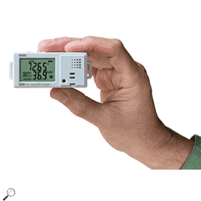
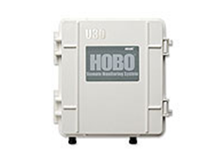
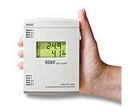
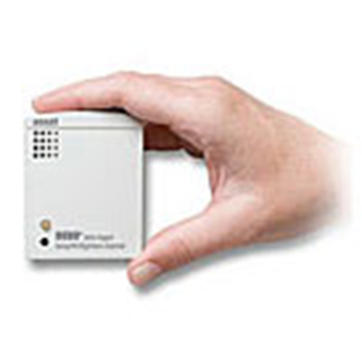
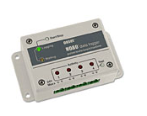
What is a Data Logger?
Record measurements over time (temperature, relative humidity, light intensity, etc.).
Standalone or wireless
Most use proprietary software to create graphs/charts of data (i.e., “data visualization”).
Images source: Onset Computer Corp.
Notes:
First we’ll start out with a brief introduction to data loggers. What is a data logger?
Typically, data loggers are small, battery-powered devices that are equipped with a microprocessor, data storage, and sensor. Generally, loggers are standalone devices that you deploy wherever needed for the time span you need (at least 1-2 weeks or so). Depending on the type, you can download the data from it manually to a computer using a USB cable, or retrieve it wirelessly through Bluetooth technology or a wireless network.
Most data loggers use turn-key software to prepare the logger for collecting data, and to download and view the data after it has been collected. A data logger contains sensors that record measurements over time, such as:
Temperature
Relative humidity
Light intensity
On/off
Open/closed
Voltage/amps
Pressure
Events.
How would each of the data points above be useful in building operations?

Slide 50
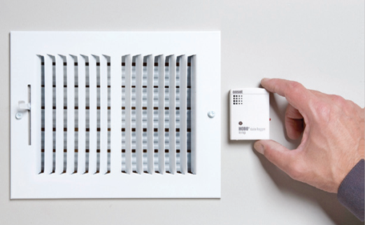
What Are Loggers Used For?
Track data on individual pieces of equipment.
Monitor conditions in specific areas.
A wide variety of applications.
Source: Onset Computer Corp.
Notes:
Data Loggers are used in building operations to track data on individual pieces of equipment, for example, motor run-time, fan speeds, lighting on or off, and dampers when opened or closed. They are also used to monitor conditions in specific areas, for example, temperature, humidity, CO₂.
Data loggers can be used in a wide variety of applications and are ideal for:
HVAC tests
Troubleshooting/diagnostics
Quality studies

Slide 51
Why Data Loggers?
Ease of use
Pinpoint particular areas or equipment
Can be used with OR instead of BAS collection capabilities
Flexibility
Notes:
Ease of use:
Small size - not intrusive and can fit anywhere.
Simple to use - not complex technology, no advanced computer skills required, no programming, etc.
No wires - no connecting to existing systems, loggers are stand-alone devices.
Flexible:
Can be used almost anywhere.
Wide range of data types that can be collected.
Data logger can be used over and over again, in multiple locations – not a fixed installation.
Easily pinpoint specific areas of a building or individual piece of equipment.
Loggers can be used as a supplement to BAS data collection capabilities, for example, points that are not trended via the BAS can be collected using loggers.

Slide 52
Data Loggers & BAS
Both can be used to record data
Loggers can be used as standalone or to verify BAS accuracy
Data analysis concepts are the same
Notes:
It is important to note that data loggers and BAS/building controls systems have some overlapping capabilities.
Building Automation Systems can also be used to collect data from wide range of data points. This data can also be logged and used for analysis, troubleshooting, etc.
However, loggers have some advantages, such as small size/portability, and can be used to supplement BAS data-collecting capabilities and/or collect data for points that BAS cannot.
Sometimes people will use loggers to verify that their BAS is accurate/functioning correctly – an independent way to verify.
Sometimes a BAS is an older/legacy system and its operators are not trained in using data collection capabilities of BAS. Loggers are inexpensive way to work outside of legacy systems.
If BAS is up-to-date and staff is comfortable with it, then BAS can work well. But in cases where training on BAS is limited, or where BAS data collection is not really adequate, loggers are best solution.
Some of the graphing and data visualization lessons gained in today’s class could be applied to data sets that are collected from BAS.

Slide 53
How To Use Loggers: Overview
Data loggers work with specialized software.
Basic steps:
Connect logger to computer
Initiate/launch logger. Verify logging operation.
Deploy logger for intended use.
Reconnect logger to computer.
Read out data in graph form.
Notes:
First, the data logger is connected to a computer.
Then the data logger software is used to select logging parameters (sampling intervals, start time, etc.) and initiate the logger.
The logger is then disconnected and deployed in the desired location. It records each measurement and stores it in memory along with the time and date. Note: make sure to verify that the device is indeed logging data before leaving it for the logging period.
The logger is then reconnected to the computer and the software is used again to readout the data and see the measurements as a graph, showing the profile over time. The tabular data can also be viewed, or exported to a spreadsheet for further data manipulation and graphing capabilities.

Slide 54
Safety Guidelines for
Using Data Loggers
De-energize equipment before placing loggers
Devices that measure power, voltage, or current must be installed by an electrician
Consult manufacturer guidelines
Notes:
Always be sure to follow appropriate safety precautions when using loggers around equipment, especially electrical equipment.
De-energize equipment using a lockout/tagout system before installing data logging instruments. Instruments used to measure electrical power, voltage, or current, such as current transformers (also known as current transducers, CTs, or “donuts”), must be installed by a licensed electrician.
IMPORTANT: Always consult manufacturers’ safety guidelines for using loggers and related equipment (see next slide for sample).

Slide 55
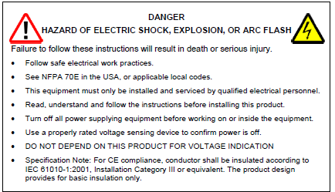
Safety Guidelines
From Onset Corp. Split-core AC Current Transformer (CTV) User Manual
Notes:
Sample of safety guidelines from user manual for Split-core AC Current Transformer (CTV) - AC Amperage to DC Voltage Transducer, for use with HOBO U12 series data loggers.

Slide 56
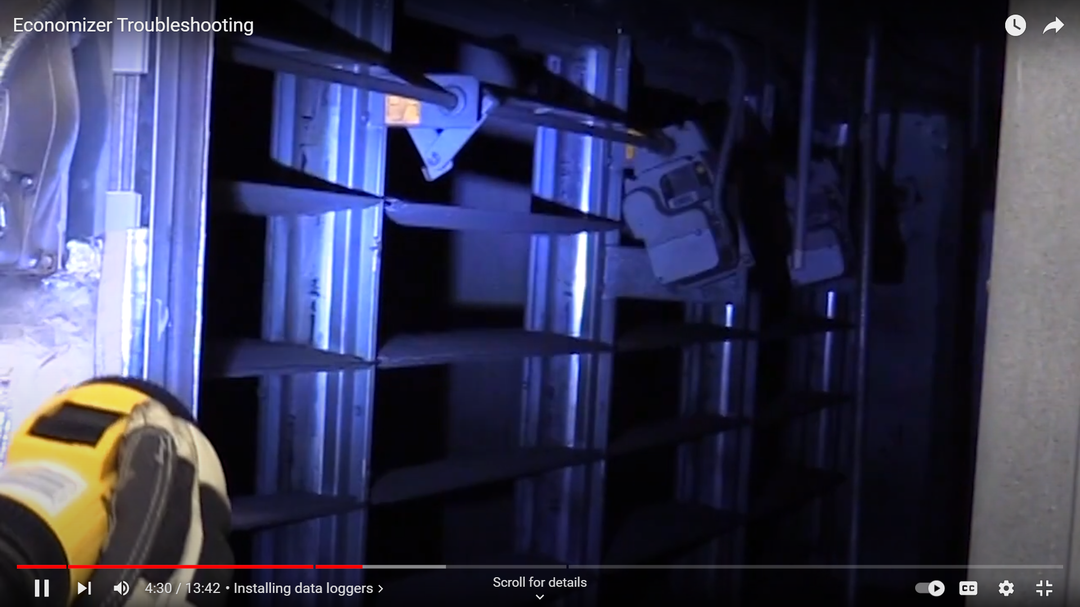
Watch Video & Discuss:
Troubleshooting with Data Loggers
Video link: https://youtu.be/rv6Hsd0IUF8
Notes:
Now, we will view a video on troubleshooting with data loggers. As you watch and listen, think about the questions on the following page.
After the video, your instructor will lead a class discussion about your “take-aways” from the video and questions you may have about using data loggers to troubleshoot equipment in your building.
VIDEO: Economizer Troubleshooting with Data Loggers (approx.13 minutes)
Hosted by the Smart Buildings Center, this video takes you through the various steps of how data loggers can help you collect and analyze data on packaged air handler unit economizers so you can reduce energy costs and troubleshoot problems.
Video link: https://youtu.be/rv6Hsd0IUF8
Video Demonstration

Slide 57
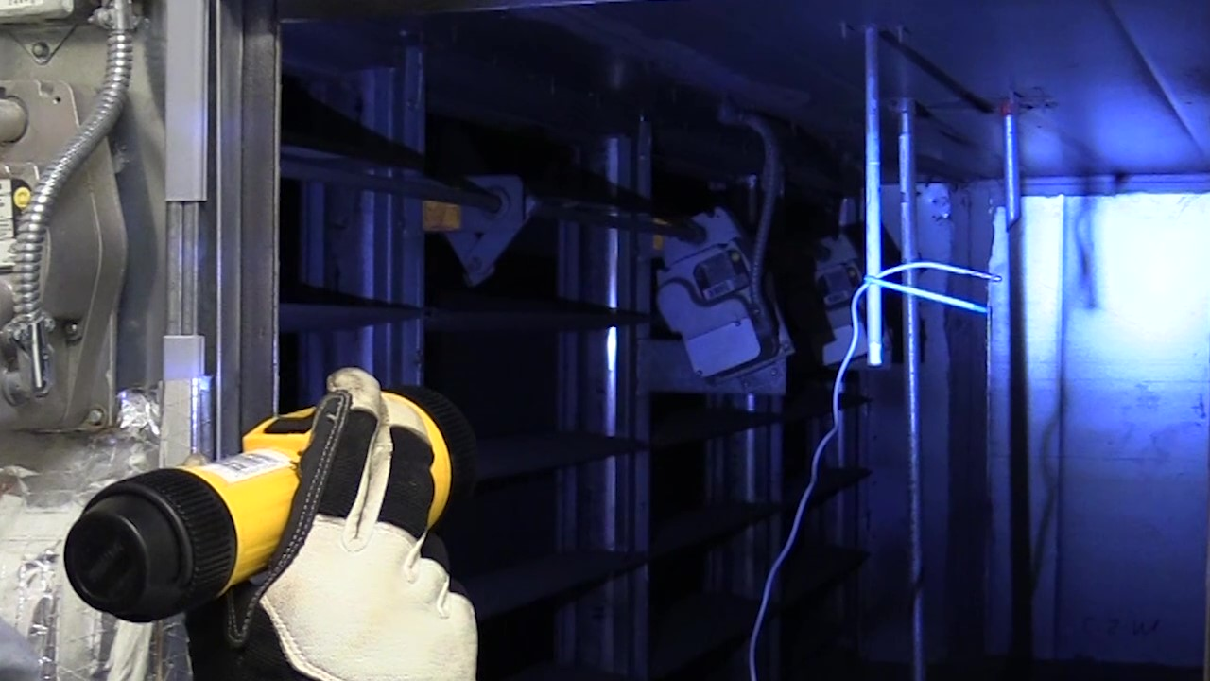
Class Discussion:
Your questions and “take-aways”
Let’s discuss
questions on the notes page below.
Measuring outside air temperature by placing a data logger sensor near the outside air damper inside a packaged AHU
Source: Smart Buildings Center
Notes:
Discussion Questions:
1. Four data logger sensors were placed in/near the packaged unit. What conditions were they measuring? (check all that apply)
____ Supply air temperature ____ Mixed air temperature
____ Relative humidity ____ Return air temperature
____ Compressor amperage ____ Outside air temperature
2. What type of data logger was used to capture the data? _______________
3. Over how many days was the data collected? _____________________
4. The data was downloaded and graphed for analysis. Name two things the data analysis showed about the operation of the packaged unit.
A. ________________________________________
B. ________________________________________

Slide 58


Saving Energy With Loggers
Trending with loggers/BAS.
Troubleshooting with loggers.
EUIs for end-use equipment.
Notes:
These are some of the ways that data loggers can be used toward reducing energy consumption:
Trending with logger/BAS:
You can “visualize” your data – see and measure how the equipment or energy use is changing over time, ability to see trends can help identify anomalies and inefficiencies, so we can better manage energy use in the building.
Examples: Peak demand, simultaneous heating & cooling.
Troubleshooting with loggers:
Loggers can help identify sources of problems: Everything seems to be running normally, so why does the data look strange?
Examples: Stuck dampers, faulty sensors.
Energy Use Indices (EUIs) for end-use equipment:
Loggers can be used to determine how much energy is consumed by individual pieces of equipment.

Slide 59
Let’s review three data logger applications
Night setback: Is equipment being turned off or down during unoccupied hours?
Electric Peak demand: Are electric costs being driven up by short-lived spikes in demand?
Economizer operation: Are economizers working properly to take advantage of “free” cooling/heating?
Notes:
We will now discuss three real-world examples of using data loggers to identify energy-saving opportunities.
The first example is very simple: We record data to determine whether equipment is being turned off or down during unoccupied hours.
The second example records electricity usage data to determine whether demand charges could be the cause of high electricity bills.
The third example shows how loggers can be used to diagnose how, or if, the economizers are operating in the building.

Slide 60
Night Setback
Is night and weekend temperature setback being used effectively?
Is HVAC system on during scheduled off times?
Notes:
Data loggers can be used to determine whether HVAC equipment is turned off when not needed. A simple on/off logger is used to record status of a supply fan for a week. If the fan is found to be operating during unoccupied periods, the operator can make adjustments to the operating schedule to align it with building occupied hours. This adjustment can result in reduced energy costs and less wear and tear on equipment.

Slide 61
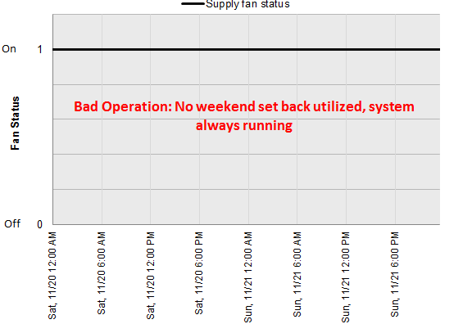
No Night or Weekend Setbacks
Graph of supply fan on/off status for weekend operation with no setback.
Source: Pacific Northwest Lab Building Re-tuning Program
Notes:
This is a graph of the supply fan on/off status for a weekend period with no night or weekend setbacks. The straight blue line indicates that the supply fan is on 24 hours a day, and possibly 7 days a week. No night setback, no weekend setback means lots of room for improvement.
If this was a condition in your building, what improvements would you recommend be made? Write in below.
1. ___________________________________________
2. ___________________________________________
3. ___________________________________________

Slide 62
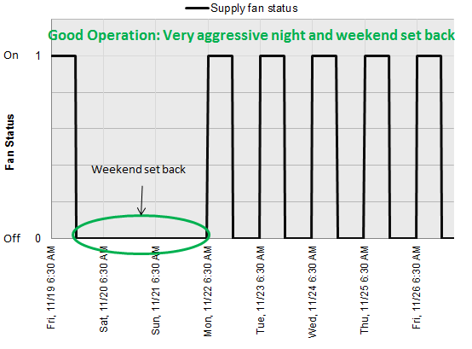
Night and Weekend Setbacks Implemented
Graph of supply fan on/off status for one week period, after night/week-end setbacks implemented.
Source: Pacific Northwest Lab Building Re-tuning Program
Notes:
This is a graph of the supply fan on/off status for a one-week period after night and week-end setbacks were implemented. “On” time indicates where plotline is at 1; “off” time indicates where plotline is at 0.

Slide 63
Peak Demand
High electric costs: Are we paying unnecessary demand charges due to high peak energy use?
Is it possible to avoid this by changing equipment schedules?
Create demand profile graph of electric power usage; look for spikes in demand.
Notes:
The cost of electricity consists of two charges: The customer is charged for electricity use (kWh), and is also charged for electricity demand (kW), i.e., capacity – the highest amount of electricity needed per billing cycle).
A spike in demand, even if very short in duration (15-30 minutes), can drive up total cost of electricity because of the demand charge.

Slide 64
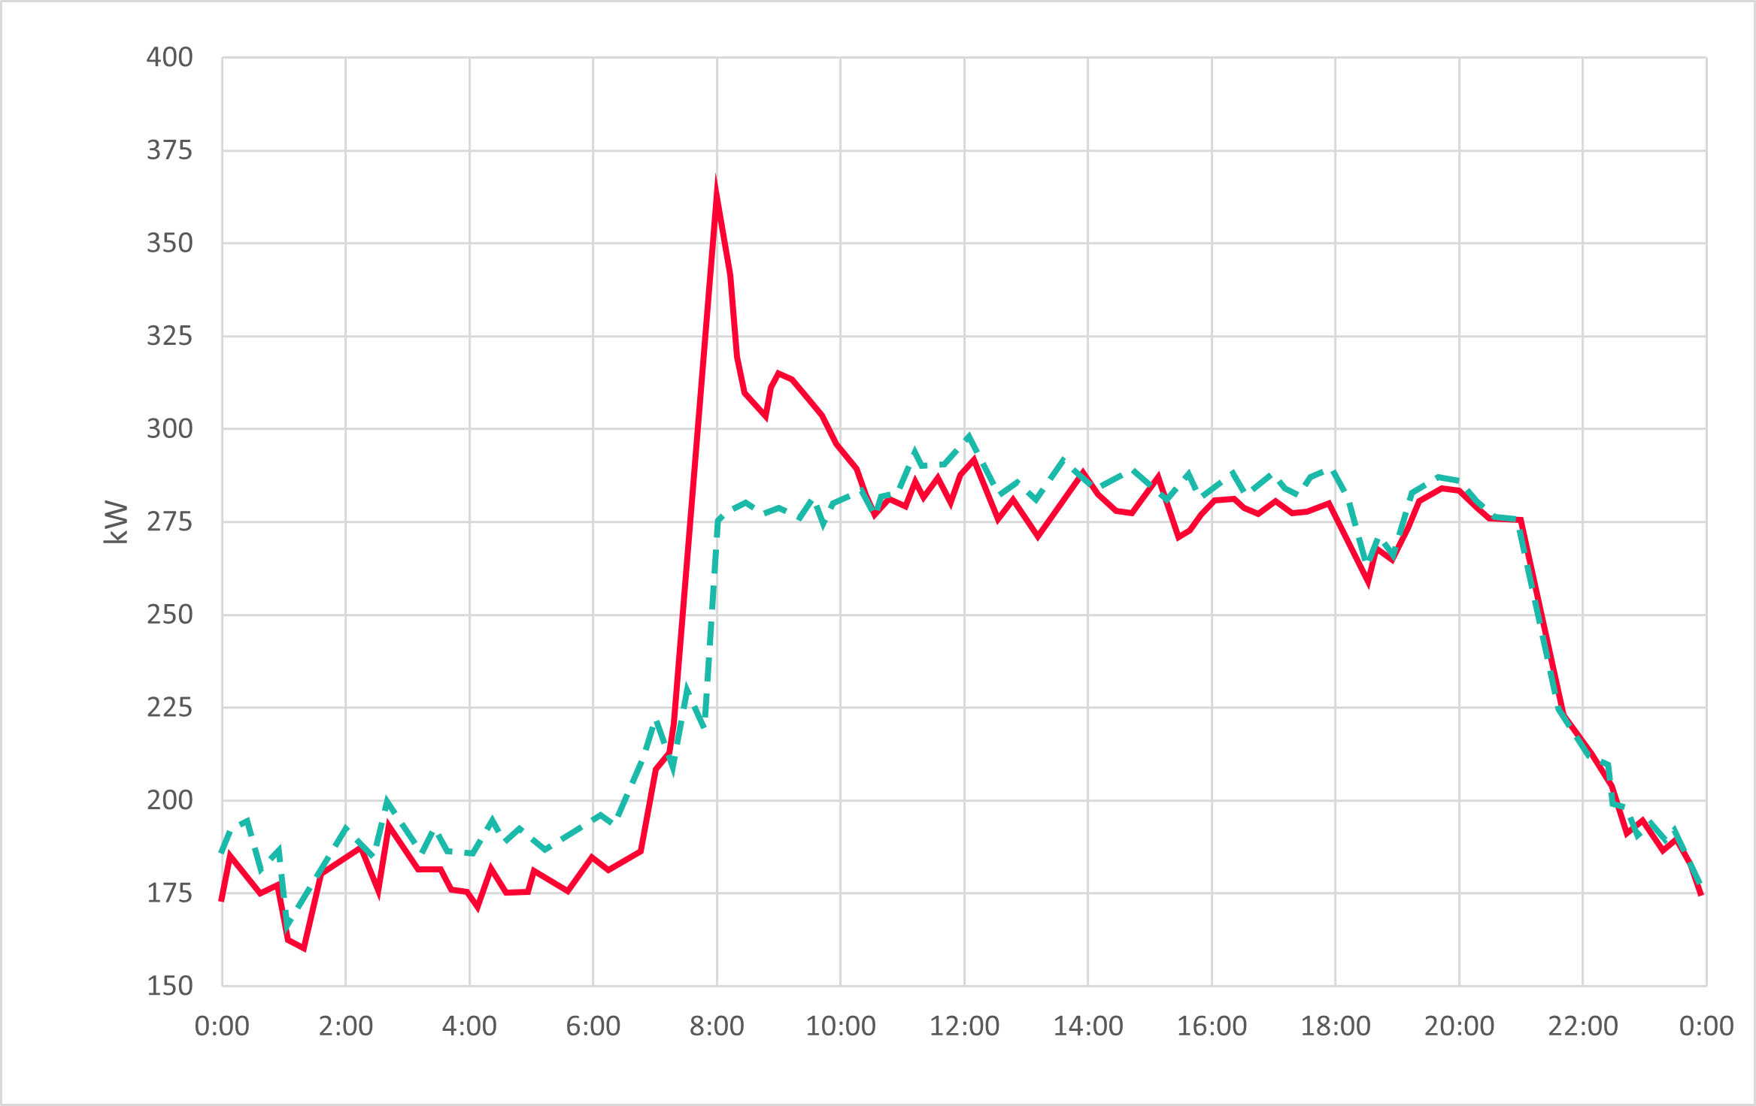
Peak Demand
Source: Onset Computer Corp.
Red solid line: Electric demand profile – large one-time spike.
Green dashed line: Demand profile after making changes to freezer defrost schedule.
Notes:
Solid line: Electric demand profile – large one-time spike.
Dashed line: Demand profile after making changes to freezer defrost schedule.
In this example, a grocery store was experiencing high electric costs, but did not know the cause. Electric demand (SOLID LINE) shows a significant spike at 8:00 a.m. every morning. The cause of this was identified: Simultaneous defrosting of all freezers every morning at 8:00 a.m. To reduce spike in peak energy use, timers were installed to defrost freezers in sequence rather than all at the same time. The resulting load profile one week later (DASHED LINE) shows the large spike is avoided. Billing demand was reduced from 359 kW to 302 kW, resulting in annual savings of almost $10,000.
Data loggers are used to obtain load profiles by collecting data from electric mains for a facility (a current transducer is required to be used with the data logger, and additional calculations are required using Excel or other spreadsheet program).
Using this data, we can obtain a demand profile and look for any peaks in demand that may be driving costs.

Slide 65
Economizer Operation
Is the economizer operating properly?
What do the readings of OAT, DAT, RAT, & MAT tell us?
Use data logger to record temps, graph data and look for MAT
How does MAT behave with respect to OAT, RAT, & DAT?
Notes:
The following example shows how the data from an air handler can be used to diagnose how well the economizer is (or is not) working.
In this example, data loggers were used to record temperatures of outdoor air (OAT), return air (RAT), mixed air (MAT), and discharge air (DAT) for a single air handling unit (AHU). In ideal operations of an economizer, outside air is brought in to help heat or cool the return air, rather than relying 100 percent on mechanical heating or cooling.

Slide 66
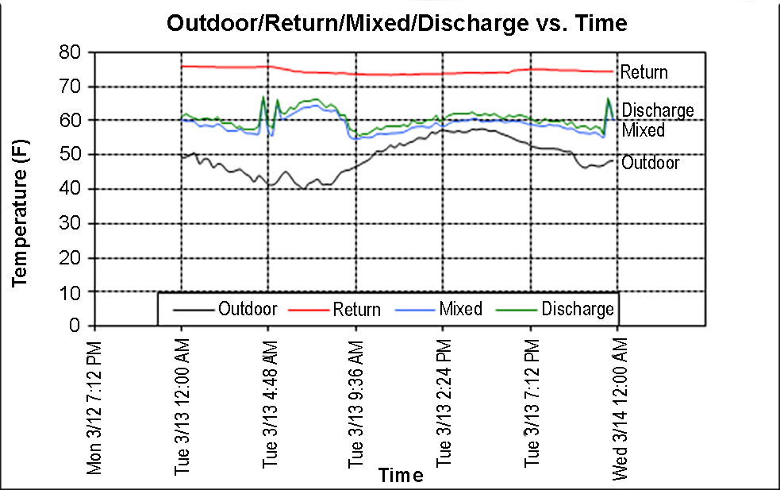
Graph of Economizer Operation
Economizer operating normally: Mixed air temp (BLUE) correlates with discharge air temp (GREEN).
Source: Pacific Northwest Lab Building Re-tuning Program
Notes:
This graph shows the plots of the four air temperatures: outside air (black), return air (red), mixed air (blue), and discharge air (green).
The economizer is operating normally. The outdoor air temperature is lower than 60 ºF, which is when an economizer should be used.
The mixed and discharge air temperature are very close to the same, which tells us that the damper is modulating to maintain the discharge air setpoint (or some kind of mixed air setpoint).
Return
Discharge
Mixed
Outside

Slide 67
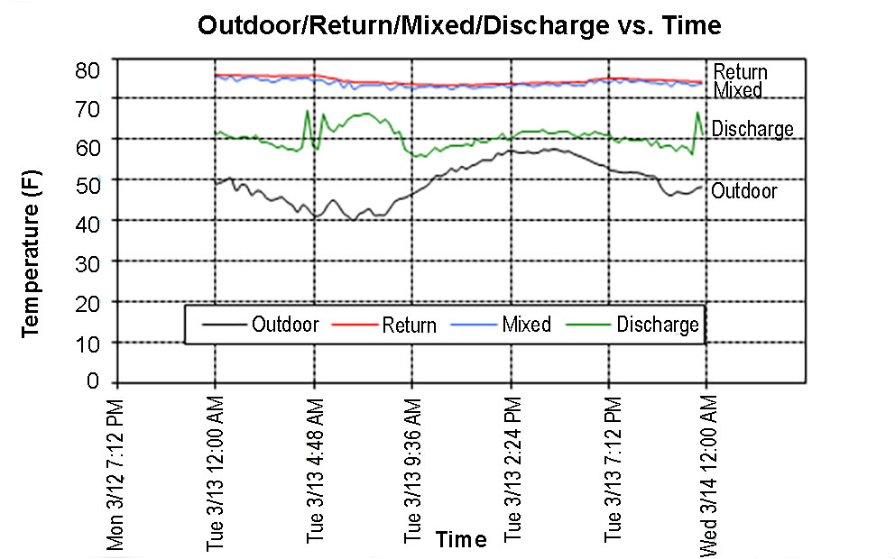
Graph of Economizer Operation
Notice difference in Mixed air temp…
What does this say about economizer operation?
Source: Pacific Northwest Lab Building Re-tuning Program
Notes:
This graph is showing a different story. Outdoor air temps are below 60 ºF, so we are still in economizer season, but the mixed air temperature (blue) is running up with the return air temperature (red). Therefore we can determine that no fresh air is coming into the building, which would cool down the mixed air. It is very likely that the outdoor air damper is stuck closed.
Return
Discharge
Mixed
Outside

Slide 68
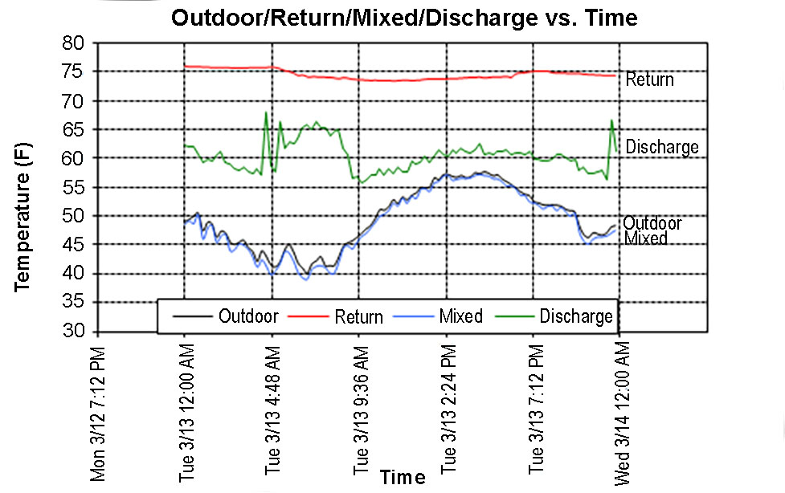
Graph of Economizer Operation
Notice difference in Mixed air temp again…
What does this say about economizer operation?
Source: Pacific Northwest Lab Building Re-tuning Program
Notes:
This graph also shows improper functioning of economizer. This time mixed air temperature is running down with the outdoor air temperature. Heat is almost certainly being wasted due to mixed temperature being lower than discharge temperature. The likely cause is that the outdoor air damper is stuck fully open.
Return
Discharge
Mixed
Outside

Slide 69
Check Your Knowledge
Question #3
Data loggers are ideal for:
identifying anomalies, unnecessary energy use.
identifying sources of problems (i.e., stuck dampers, faulty sensors).
determining energy use intensity (EUI) for end-use equipment.
all of the above.
Notes:
Your answer: ____________

Slide 70
Class Discussion:
Review a Central Plant BAS to identify operational problems
Take 15 minutes
Look at two screen shots
- Chiller Plant BAS
- Boiler Plant BAS
Review the BAS points and audit notes
Answer the questions on the next 2 pages
Notes:
Let’s work on this assignment together. Take 15 minutes to look at the screen shots on the next pages. We will answer 5 questions about the equipment operating conditions, operational improvements needed, and the benefits of each improvement.
Civic Center Buildings
A 70,000 square foot civic center was audited. The Center comprises two buildings (library and city hall) that are served by a common heating and cooling central plant. Conditioned air is supplied in each building by separate VAV air handling units with VAV boxes with HW reheat coils in each zone. The total building energy use intensity (EUI) is 200 kBtu/sf/yr.
Below is a list of observations made about facility operation from a review of the BAS:
BAS Points/Audit Notes Observation
Chiller and boiler annual operation Both pieces of equipment operate year round.
BAS Chilled Water Supply Temperature 34 ºF
BAS Pump Operation BAS review shows that when Pump 1 enabled, both pumps are running
Boiler Outside Air Lockout Temperature 110 ºF
Occupied Heating Setpoint 73 ºF
Occupied Cooling Setpoint 74 ºF
Economizer Damper Position Economizer 100% open at 90 ºF outside air temperature
CO₂ Sensor reading CO₂ sensors reading 300 ppm higher than hand-held CO₂ sensor
Stairwell daylighting Stairwell and corridors are well lit with skylights, yet electric lighting was observed to remain “ON” 24/7.

Slide 71
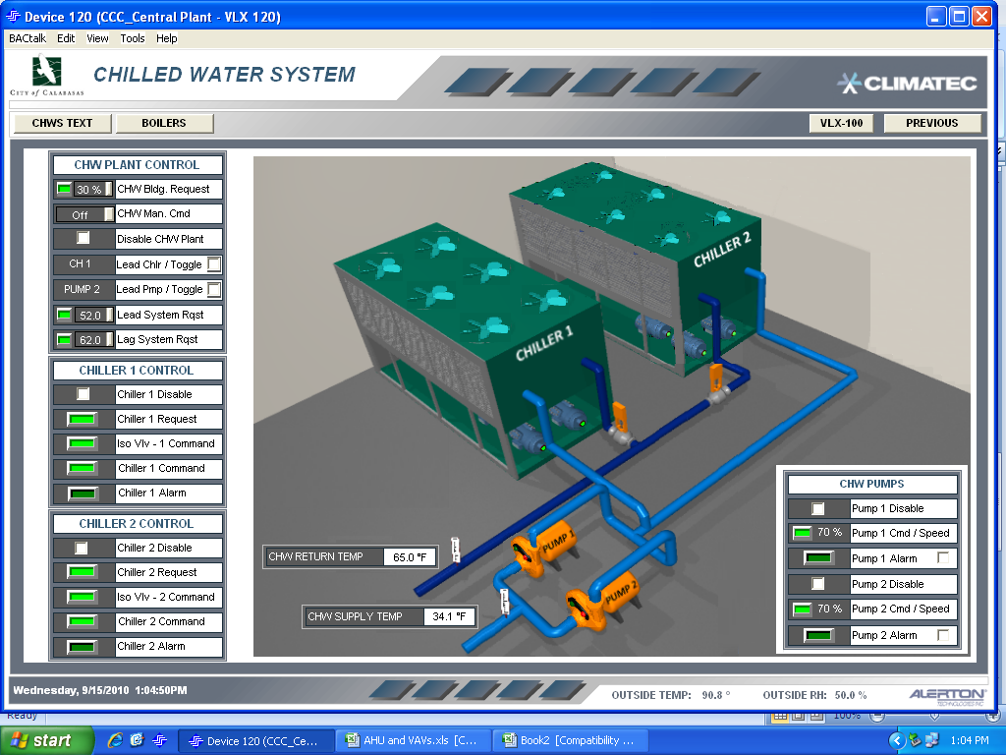
Chiller Plant BAS
Screen Shot

Slide 72
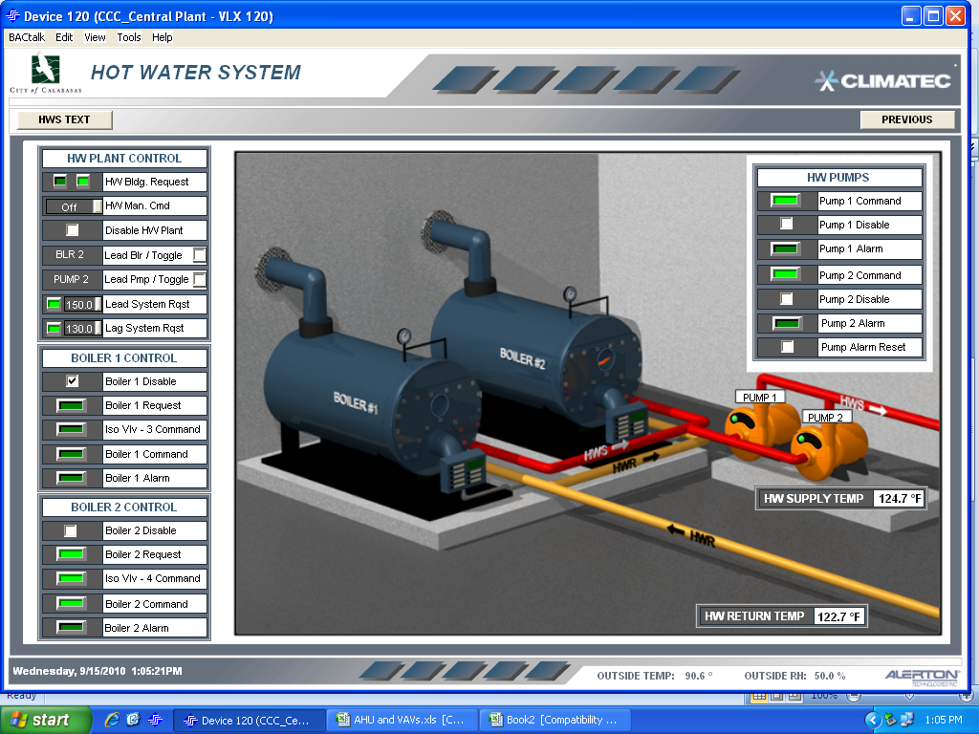
Boiler Plant BAS
Screen Shot

Slide 73
Class Discussion:
Observations and recommendations
What did you see?
What are the problems?
What are your recommendations?
Notes:
Note answers to the questions here.
What are the operational issues/problems for this facility?
How is energy being wasted?
What are possible causes for each of the observed conditions?
4. What are the no-cost/low-cost opportunities for operational improvement for this facility?
5. Identify the energy and operational benefits of each improvement.

Slide 74
What did we do today?
Talked about operational problems in buildings
Identified four common problems
Learned the benefits of data logger tools
Practiced solving HVAC system problems
What did you learn? (name one thing)
Notes:
We discussed how to identify and fix operational problems common to HVAC equipment, lighting systems, and building controls.
We focused on four common problems: 1) Scheduling equipment on and off times; 2) Detecting sensor error; 3) Simultaneous heating and cooling; and, 4) Use of outside air.
We discussed diagnostic tools for tracking operational conditions over time.
We hope you will leave with a short list of operational changes to make in your building.

Slide 75
Resources
  BetterBricks: Common Opportunities: The Top Five
  https://betterbricks.com/resources/common-opportunities-the-top-five
  Better Bricks website: www.betterbricks.com
  Energy Star: www.energystar.gov home page provides energy management guidelines, tools and more
  Better Buildings: https://betterbuildingssolutioncenter.energy.gov/
  Your local utility energy efficiency program(s)

Slide 76
Appendix
Notes:
Appendix
Glossary A-1
Small Group Activity: HVAC Systems Review (answers) B-1
Check Your Knowledge Questions (answers) C-1
Class Activity: Central Plant BAS Review (answers) D-1

Slide 77
HVAC Systems:
VAV with Reheat Answer
The central fan supplies cool air to the VAV boxes, and the VAV boxes modulate flow as needed to cool the space. When heating is needed, the VAV boxes reduce flow to minimum and use the reheat coil to control discharge temperature.
Question: If the primary SAT were fixed at 55 ºF (instead of reset to 60 ºF), would the heating energy for Zones A and C increase or decrease?
Notes:
In this example, if the primary SAT were fixed at 55 ºF (instead of reset to 60 ºF) the heating energy for Zone A and Zone C would increase.

Slide 78
HVAC Systems:
Constant Volume with Reheat
Answer
The central fan supplies cool air to the reheat boxes, and the reheat coil is used to control discharge temperature. CV fan systems with reheat are generally no longer allowed in new construction because of their high energy use.
Question: In the scenario described below, how much cooling is needed from the cooling coil and why?
Notes:
No cooling is required by the cooling coil because the economizer is modulating to produce air that matches the setpoint temperature for the supply air.

Slide 79
HVAC Systems: Central AC with Perimeter Heating
Answer
The central AC in this example is a VAV system with no reheat, and the perimeter heating is baseboard. The areas served by the VAV and baseboard are open to each other. The VAV system provides ventilation and cooling, while the baseboard offsets heat loss from the building shell when needed. There are many variations of this layout that use different cooling or heating equipment, but they all produce simultaneous heating and cooling along the air border between the perimeter and interior spaces.
Notes:
In Zone A, the baseboard and VAV box use separate space-temperature sensors and have setpoints that should prevent or minimize simultaneous heating and cooling.
In Zone B, the VAV box and baseboard use the same sensor, and a DDC system would control the VAV box and baseboard to prevent simultaneous heating and cooling. Hunting between heating and cooling would be prevented if a proper deadband and throttling range are programmed.
In Zone C, the baseboard and VAV box use separate space-temperature sensors and have setpoints that would cause simultaneous heating and cooling. Each thermostat is set to 70 ºF causing overlap in the throttling range between heating and cooling. Even if the cooling thermostat is set to 72 ºF and heating thermostat is set to 70 ºF, there is little tolerance for throttling range or sensor calibration error.

Slide 80
Answers to:
Check your knowledge questions
Question #1 – answer is B.
Question #2 – answer is A.
Question #3 – answer is D.
Notes:
Question #1 – answer is B.
This may be caused by improper outdoor air temperature sensor location, failed sensor, or jammed damper blades.
Question #2 – answer is A.
Demand control ventilation saves energy by adjusting the amount of outside air based upon number of occupants in space by measuring CO₂ levels.
Question #3 – answer is D.
Data loggers are ideal for (“all of the above”): identifying anomalies and unnecessary energy use, identifying sources of problems (i.e., stuck dampers, faulty sensors), and determining EUIs for end-use equipment.

Slide 81
Class Activity: Central Plant BAS Review
Answers
BAS Screen Shot: Chiller Plant
BAS Screen Shot: Boiler Plant
Notes:
1. What are the operational issues/problems for this facility?
Low chilled water supply temperature setpoint
Both chilled water pumps may be operating unnecessarily.
High boiler lockout temperature
Possible too low chiller lockout, or no lockout (shouldn’t operate all year)
One degree separation between heating/cooling setpoints
Heating setpoint higher than cooling
Economizer fully open with high OAT
CO₂ sensors are not reading correctly
Only 2 degree delta between HW supply and return (excess flow symptom).
2. How is energy being wasted?
Excess flow/unnecessary pump energy
Boilers enabled all year long (heating possible all year round)
Simultaneous heating and cooling with one degree separation between heating/cooling setpoints
Demand Controlled Ventilation (DCV) control logic will sense spaces more densely occupied with falsely high CO₂ level and will provide more ventilation air than what is required.
Electric lighting in stairwell on when not needed
Economizer bringing in 90 ºF air. This air will need to be cooled before being supplied to the spaces.
Chiller on in cool weather when economizer should provide cooling.

Slide 82
Class Activity: Central Plant BAS Review
Answers
BAS Screen Shot: Chiller Plant
BAS Screen Shot: Boiler Plant
Notes:
3. What are possible causes for each of the observed conditions?
Control logic/setpoints not optimized
Boiler lockout temperature too high
CO₂ sensors out of calibration
Critical control sensors not calibrated (OST, MAT, RAT)
Daylighting controls not functioning/not installed
No chiller lockout
Economizer controller failed or not programmed correctly
Chiller possibly needed for data center or other process (not a problem but a cause).
4. What are the no-cost/low-cost opportunities for operational improvement for this facility?
Increase chilled water supply temperature
Lower boiler lockout temperature
Review chilled water pump control logic
Increase separation between heating/cooling setpoint to four degrees
Review control logic for economizer and reset
Calibrate CO₂ sensors
Install daylighting controls in stairwell and other applicable spaces.
Install smaller packaged cooling for data center if appropriate—not necessarily low-cost but probably a quick payback.
5. Identify the energy and operational benefits of each improvement.
Energy savings, lower maintenance costs, improved occupant comfort, fewer maintenance calls, chance of over-ventilation decreased
Since this is a civic center, the city’s desire to save energy/money may boost public image.

