Slide 1

BOC 1013
Smart Buildings Fundamentals
Month Day, Year
Instructor Name, Position
Instructor Company
Phone
Name@email.com
Notes:
Instructor’s name: __________________________________________________________
Phone number: ____________________________________________________________
E-mail: ___________________________________________________________________
_________________________________________________________________________
_________________________________________________________________________
_________________________________________________________________________
_________________________________________________________________________
BOC 1013
Smart Buildings Fundamentals
Edition 1.20

Slide 2

Safety Message
Notes:
Let's start with a safety reminder. This may be something from the course sponsor or site host; the instructor, moderator, or a student. Topics can include anything related to safety: site, health, personal, equipment, etc. What topic shall we address today?

Slide 3
BOC 1013
Learning Objectives
Define Smart Buildings
Understand the Role of Smart Buildings in the Modern Energy Grid
Describe and Understand Zero Energy Buildings
Survey and Identify Smart Building Technologies
Understand Energy Information and Analytics
Describe and Understand Distributed Energy Resources
Understand System Integration
Describe Grid-Interactive Efficient Buildings
Describe Key Steps Toward Better Cybersecurity
Understand Operational Strategies for Smart Buildings

Slide 4
BOC 1013 Smart Buildings Fundamentals
Section 1: Introduction to Smart Buildings
Section 2: Survey of Smart Building Technologies
Section 3: Operational Strategies for Smart Buildings
Notes:
This eight-hour class on Smart Buildings Fundamentals covers the introduction to building systems with an emphasis on integration of systems to enable smart building capabilities for sustained high energy efficiency performance and integration with the modern smart energy grid. The class material is divided and presented in the three sections above.

Slide 5
BOC 1013 Agenda
Section 1 Introduction to Smart Buildings
What is a Smart Building?
Why do we need Smart Buildings?
What is a Zero Energy Building?
Section 2 Smart Building Technologies
Smart Lighting and HVAC Systems
Smart Meters and Automated Shading Systems
Distributed Energy Systems
Systems Integration
Grid-Interactive Efficient Buildings
Section 3 Operational Strategies for Smart Building Technologies
Best Practice in Operating Smart Buildings
Cybersecurity for Building Systems
Summary and Key Takeaways

Slide 6
Section 1
Introduction to Smart Buildings
Notes:
Our energy infrastructure is undergoing a major transformation. Brought about by an environmental movement to move away from fossil fuels, many states are now adopting aggressive climate action plans that include renewable energy and energy efficiency to meet their carbon reduction goals. The new energy grid is now comprised of distributed energy generation that varies in output and capacity. For the new energy grid to work, distributed energy resources along with the loads that they serve will have to work together seamlessly to make the smart energy grid a reality. Buildings are and will continue to be significant sources of energy consumption and greenhouse gas emissions but at the same time, buildings also represent the greatest potential for energy efficiency and sources for distributed renewable energy. To realize this potential, buildings will have to rely on technology to enable smart and efficient building operations. Even more crucial is the need for building operators to have the skillset to understand and operate these complex systems so Smart Buildings can realize their full potential to save energy and reduce their underlying carbon emissions.
As buildings continue to get smarter and evolve, it is becoming ever more challenging to keep up with the technologies that enable buildings to be smart and energy efficient. This class provides an overview of what makes a building smart, looking at interconnections that can tie together different standalone systems such as HVAC, lighting, power monitoring and other systems to enhance the operational and occupant user experience, resulting in energy savings and better indoor air quality. Concepts discussed include smart buildings and the modern energy grid, technology in building systems, networking and integration, cybersecurity, data analytics, and operational strategies.

Slide 7
What is a Smart Building?
Space Use Optimization
Energy Performance
Comfort & Safety
Notes:
Smart Buildings are a classification of buildings that are equipped with technology-based systems that are typically integrated to deliver a building environment that is safe, efficient, comfortable, high-performing, and sustainable.

Slide 8
What is a Smart Building?
Integrated Building Systems, e.g. HVAC, Lighting, Electrical, Fire Access and Security, IT Infrastructure
Connected - Common Communication Protocol with Sensors and Logic Based Control
Data Analytics and Automated Diagnostics
High Performance, Ultra Low Energy Consumption, Distributed Energy, Zero Energy
On Site Renewables, Energy Storage, Distributed Energy Resources
Autonomous Operation
Grid Responsive
Notes:
Smart Buildings are a classification of buildings that are equipped with technology-based systems that are integrated and capable of interoperability to deliver a building environment that is safe, productive, comfortable, high-performing, and sustainable. Some of the features that smart buildings may contain are listed above.
Note: a building doesn’t necessarily need to be the newest and most modern to be equipped with or have potential for aspects of smart building technology.

Slide 9
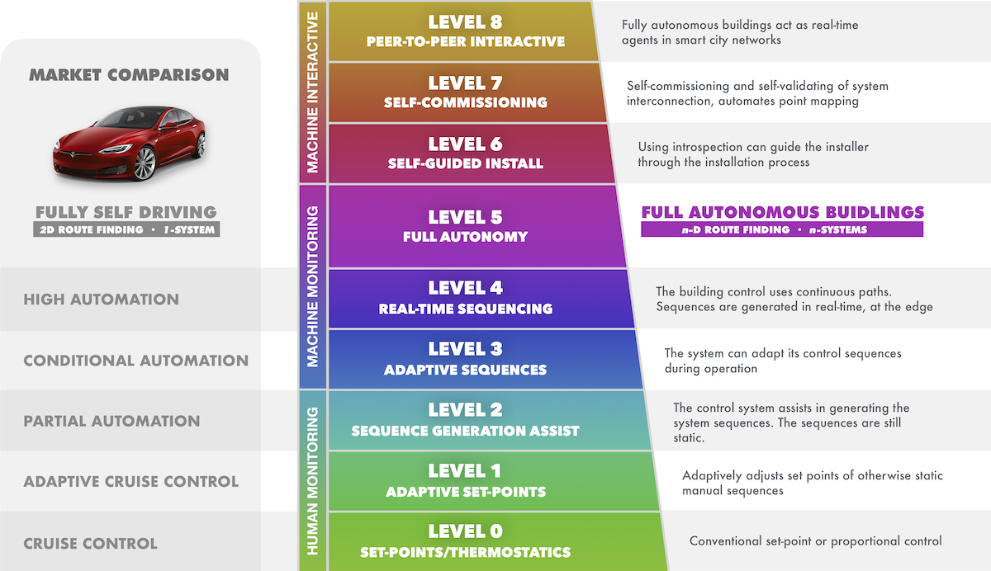
Taxonomy of Smart Buildings
Image source: http://automatedbuildings.com/news/sep19/articles/passivelogic/190829111606passivelogic.html
Notes:
One way to think about the wide spectrum of smart buildings technology is to compare it to the evolution of self-driving cars, as shown in this chart.
Source: http://automatedbuildings.com/news/sep19/articles/passivelogic/190829111606passivelogic.html

Slide 10
Smart Buildings Standards
Examples include:
Wired Score
Spire (TIA)
Intelligent Buildings Index
Readiness Indicator
Notes:
Just as we’ve seen certification standards for sustainability in buildings such as LEED, Energy Star, Green Globes, WELL, etc. proliferate, we’re also seeing certifications emerging to define whether a building is smart.
Links:
https://wiredscore.com/
https://tiaonline.org/what-we-do/technology-programs/smart-buildings/
https://www.irbnet.de/daten/iconda/CIB3885.pdf
https://energy.ec.europa.eu/topics/energy-efficiency/energy-efficient-buildings/sm art-readiness-indicator_en

Slide 11
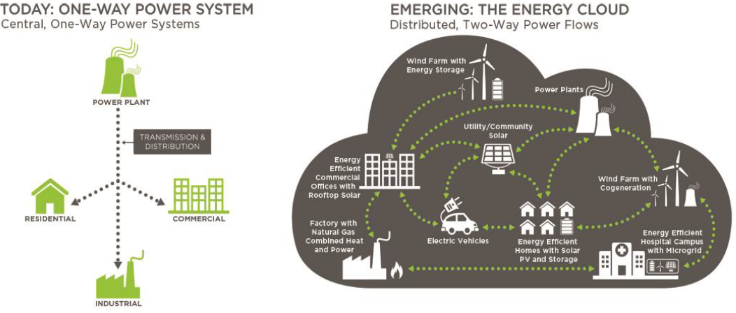
The Modern Energy Grid
Images Source: DOE Grid Interactive Buildings/Navigant
Notes:
Today’s electric grid has been transformed from a centrally source power generation and one-way power flow to a distributed and decentralized power grid where energy generation sources are located at or near the load that they serve and where power flows in multiple directions anywhere on the grid. Another key feature of the modern grid is the ever-increasing number and capacity of distributed energy generation from variable renewable sources and energy storage. Smart Buildings will play a critical role in the success of the new smart grid by providing load flexibility enabled by smart building technologies.

Slide 12
Role of Smart Buildings in the
Modern Grid
Reduce energy load (Automated Demand Response)
Provide load and resource flexibility
Serve as shock absorber
Serve as clean energy resources
Provide critical grid services
Notes:
Due to environmental, economic, and climate policy, jurisdictions across the nation are developing and adopting energy codes and policies to reduce energy consumption, generate savings, and reduce greenhouse gas emissions. As a result, the installation and deployment of renewable energy sources are experiencing historical growths. The modern energy grid is now comprised of Distributed Energy Resources (DER) such as wind, solar, and battery energy storage. With increasing DERs the resource variability has also increased due to abundant renewable generation resources during daily periods of low demand and the requirement for traditional generation during daily periods of high demand. Smart Buildings with the technology to reduce and shift their energy loads can provide the flexibility that the grid needs to compensate for resource variability and availability.
DERs
Variable Energy Sources
Generation vs Demand Timing Mismatch
The need for Grid Flexibility

Slide 13
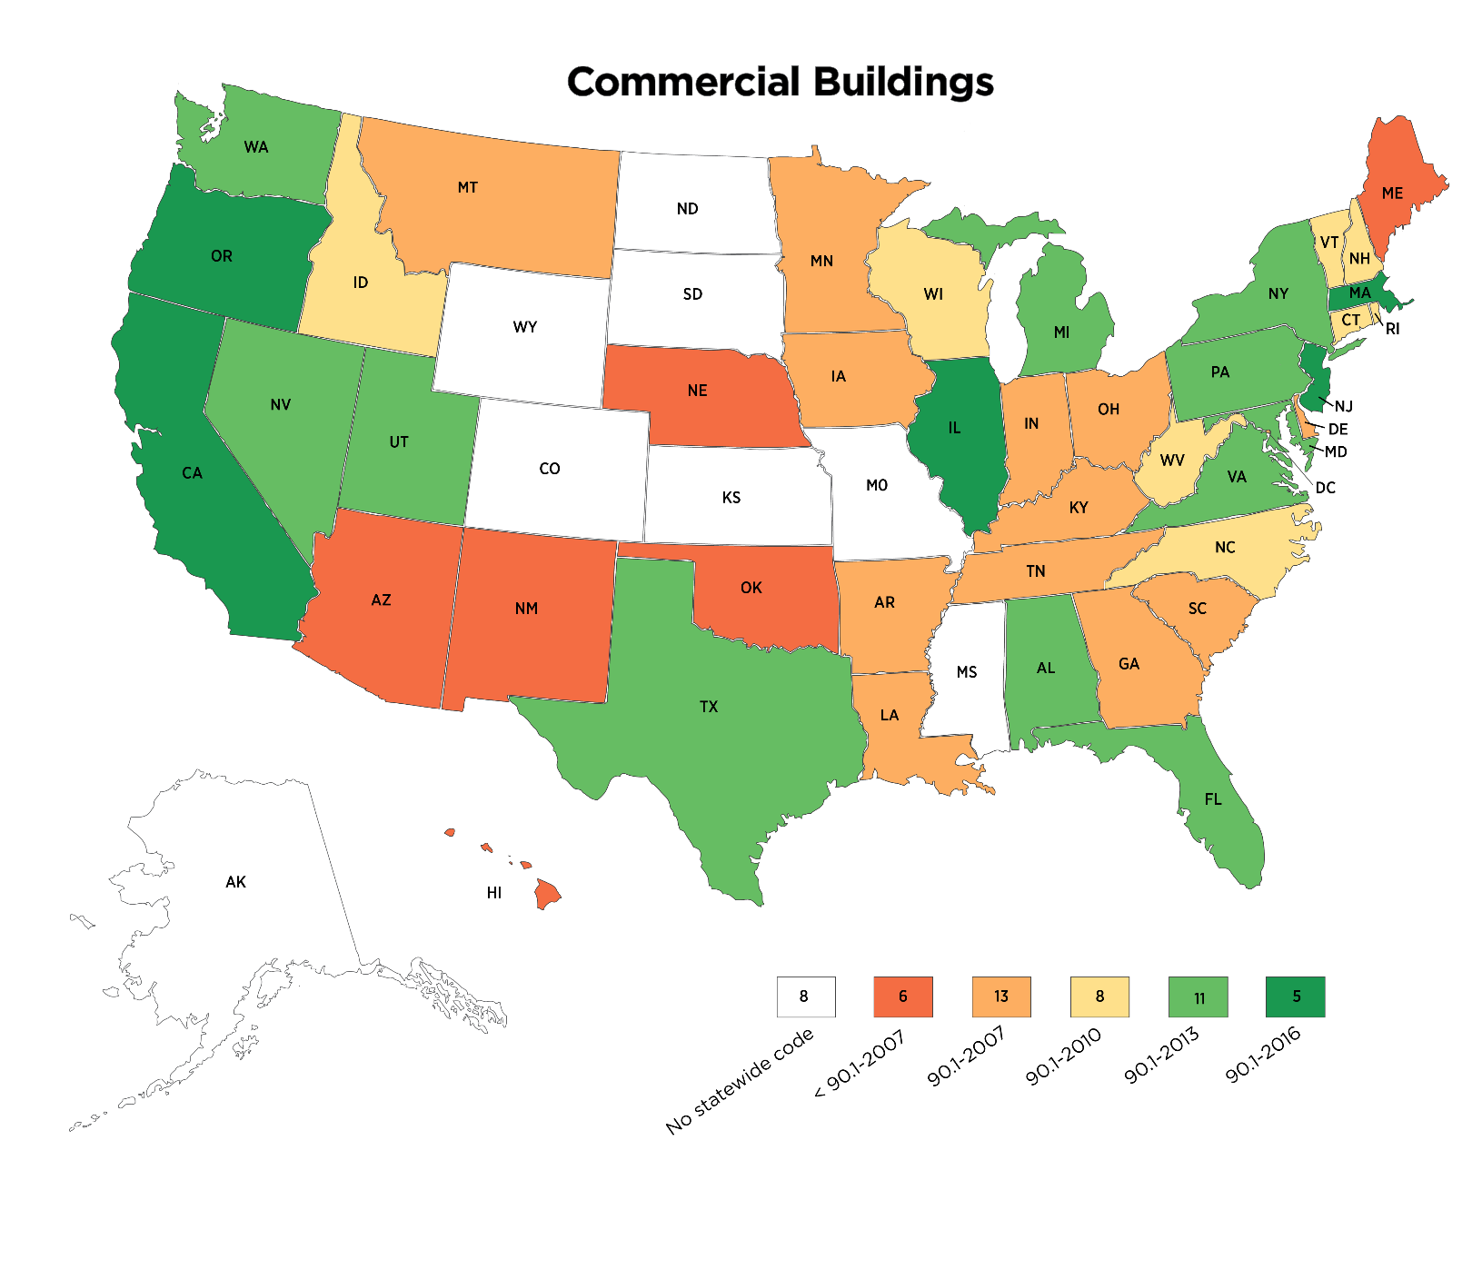
Building Energy Codes
Image Source: US DOE Building Energy Codes Program
Notes:
Many jurisdictions develop or adopt building energy standards to minimize building energy consumption and to reduce their carbon footprint. Although there is no national energy code, each state adopts their own energy code to establish minimum energy performance standards for new and existing buildings. One example of an energy code that has been adopted by numerous states is the ASHRAE 90.1 Energy Standard for Buildings Except Low-rise Residential Buildings. Zero Energy Buildings are Smart Buildings that are designed to not only meet the latest energy code but are more than capable of exceeding minimum energy efficiency requirements due to their energy efficient designs and their use of renewable energy resources.
Are you familiar with the energy code in your jurisdiction? Do you know which standard it is based on?
The U.S. Department of Energy has provided helpful resources and a lookup tool for the energy code in your state, which can be found at the following link:
https://www.energycodes.gov

Slide 14
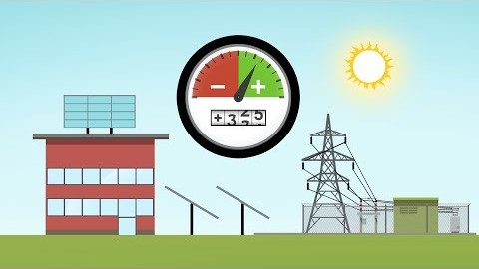
What is a Zero Energy Building?
Source: https://youtu.be/FysJKq5yCfg
Notes:
Zero Energy Buildings are Smart Buildings that are ultra energy efficient, equipped with smart building technologies that are designed and operated to be extremely high-performing. In addition to being extremely energy efficient, Zero Energy Buildings have the ability to offset their energy usage over the course of an entire year with renewable energy typically produced on site. The US Department of Energy’s Office of Energy Efficiency and Renewable Energy provides an introductory description of a Zero Energy Buildings in this short video:
https://youtu.be/FysJKq5yCfg

Slide 15

IoT - Internet of Things
Image Source: Chitkara University Punjab
Notes:
The Internet of Things (IoT) is an ever-growing collection of physical devices that can communicate and exchange digital data over a physical network such as the Internet. IoT is one example of a technical advancement that can enable smart systems in buildings. Smart IoT devices include controllers, sensors, and control devices that enable building systems to accomplish more complex tasks through advanced hardware, software, logic, and data processing over digital networks. The following are examples of IoT enabled Smart Building systems:
HVAC Systems
Digital Lighting Systems
Window Shading Systems
Plug Load Control
Energy Management Information Systems
Distributed Energy Resources (DER) i.e. solar photovoltaic (PV), wind, energy storage, etc.
Do you have any IoT components in your building?

Slide 16
Section 1:
Review Questions
What special characteristics do Smart Buildings have?
What role will Smart Buildings play in the modern Smart Grid?

Slide 17
Section 1: Check Your
Knowledge Question 1
What enabling technology can be found in many Smart Building systems?
Digital networks
Advanced software
Internet of Things (IOT)
Direct Digital Control (DDC)

Slide 18
Section 1: Check Your
Knowledge Question 2
2. What does the acronym DER stand for in power grids?
Direct Energy from Renewables
Distributed Energy Resources
Demand Enabled Resource
Direct Energy Resources

Slide 19
Section 1: Group Exercise
You have been given an opportunity to provide input to the building design team to list a set of priority features for the design of a new smart building that you will eventually maintain once completed. Break out in groups and list your top four features you would want to see in the design:
A.
B.
C.
D.

Slide 20
Section 2
Survey of
Smart Building Technologies
Notes:
According to a research study conducted by American Council for an Energy Efficient Economy (ACEEE), Smart Buildings equipped with information and communication technologies such as IOT enabled devices can make buildings more comfortable and more energy efficient by enabling automated building operations and control.
Source: King, J., and C. Perry. 2017. Smart Buildings: Using Smart Technology to Save Energy in Existing Buildings. Washington DC: ACEEE.
https://www.aceee.org/toolkit/2020/02/intelligent-efficiency-commercial-and-industrial-buildings

Slide 21
Smart Building Technologies
IOT ENABLED SMART LIGHTING SYSTEMS
SMART HVAC SYSTEMS
SMART PLUG CONTROL
SMART METERS
GRID INTERACTIVE Buildings and DISTRIBUTED Energy Resources
Notes:
Smart Buildings such as Zero Energy Buildings are equipped with the following technology based building systems that allow optimized operations that can result in improved comfort for occupants and ultra low energy consumption. These Smart Building Technologies can be found in the following building systems:
Lighting and Shading
HVAC
Plug Control Management
Energy Management Information System (EMIS) with Smart Meters
Distributed Energy Resources

Slide 22
Energy Savings from
Smart Building Technologies
Notes:
Source: King, J., and C. Perry. 2017. Smart Buildings: Using Smart Technology to Save Energy in Existing Buildings. Washington DC: ACEEE.
https://www.aceee.org/sites/default/files/publications/researchreports/a1701.pdf

Slide 23

Smart Lighting Systems
Energy efficient light sources
Technology-based controls
  Communication
  Advanced sensing/control features
  Data analytics
  Integration capabilities
Notes:
A smart lighting system consists of energy efficient light sources equipped with technology-based controls for communication, advanced sensing/control features, data analytics and integration capabilities.

Slide 24
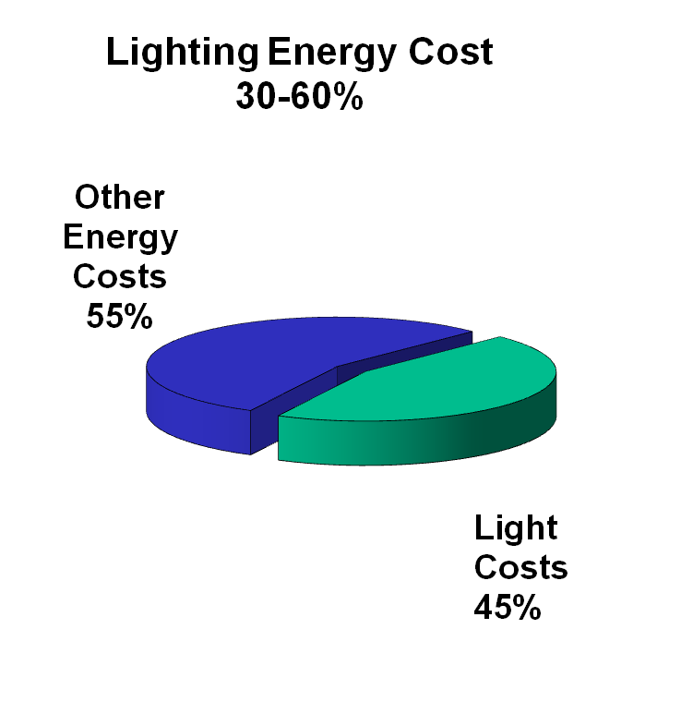
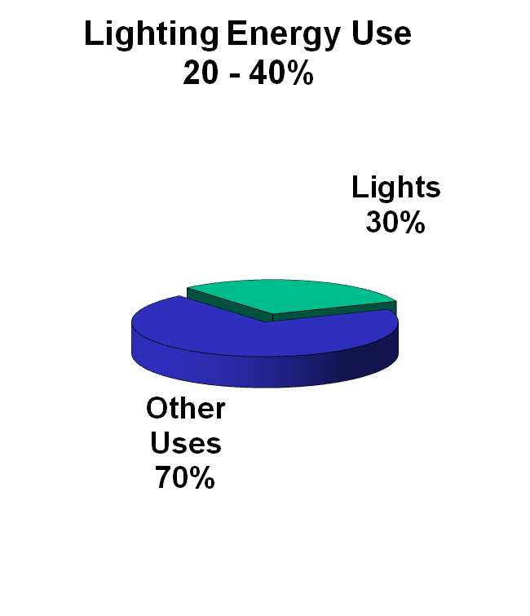
Lighting Energy
Easy energy savings opportunity
$ saved = income for organization
Improved lighting can provide better learning/working spaces
Energy efficient LED lighting with integrated lighting controls can reduce commercial building lighting energy use by up to 90%*
Notes:
For many parts of the United States, electricity is an expensive energy source. Lighting systems can be more expensive to operate than other building energy systems, such as heating that uses natural gas.
These figures are typical ranges for a wide variety of commercial buildings and utility rates in the United States. The reason that lighting energy costs are a higher percentage of total energy cost than the percentage of energy use is usually because of demand charges.
Notes:
Percentage calculations are based on numerous independent studies.
*Source: King, J., and C. Perry. 2017. Smart Buildings: Using Smart Technology to Save Energy in Existing Buildings. Washington DC: ACEEE.
https://www.aceee.org/sites/default/files/publications/researchreports/a1701.pdf

Slide 25
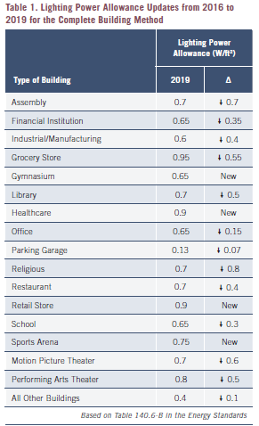
Reducing Lighting Energy - Energy Codes and Standards
For example, 2019 California Title 24 Part 6 Building Energy Efficiency Standard reduced allowable power allowances in commercial building lighting by an average of 30% for indoor and 20% for outdoor spaces
Notes:
There is a growing trend in energy codes to adopt more restrictive power allowances to reduce energy consumption from lighting systems in new building construction and existing building retrofits. For example, the 2019 California Title 24 Part 6 Building Energy Efficiency Standard reduced allowable power allowances in commercial building lighting by an average of 30% for indoor and 20% for outdoor spaces.
Energy efficient LED lighting with integrated smart technology-based controls will be required to meet these new requirements.

Slide 26
Smart Lighting
Control Attributes
Addressable Devices and Sensors
Occupancy Control
Task Light Level Tuning
Dimming/Daylight Harvesting
Fixture Level Energy Metering
Demand Response Control
Integration With Other Building Systems
Notes:
According to the ACEEE, energy efficient LED lighting with integrated lighting controls can reduce commercial building lighting energy use by up to 90%*. Smart Lighting attributes include the following:
Addressable Devices and Sensors – e.g. programmable switches, occupancy sensors
Occupancy/Motion Sensing Control – occupancy and vacancy sensing
Task Light Level Tuning – remote and addressable manual override switches for reducing light levels based on personal preference
Daylight Harvesting – Photo sensors enable automatic control of space artificial lighting based on available natural lighting
Fixture Level Energy Metering
Demand Response Control – Automated Demand Response control sequence allows fixture level reduction in lighting power
Integration with other building systems – Occupancy data can be shared with the building energy management system to allow HVAC zones to be commanded to unoccupied or standby modes for improved energy efficiency. Thermal sensing and geopositioning can also be integrated into Smart lighting systems that communicate with HVAC systems.
*Source: King, J., and C. Perry. 2017. Smart Buildings: Using Smart Technology to Save Energy in Existing Buildings. Washington DC: ACEEE.
https://www.aceee.org/sites/default/files/publications/researchreports/a1701.pdf

Slide 27
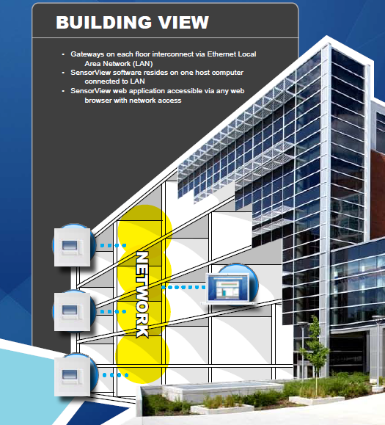
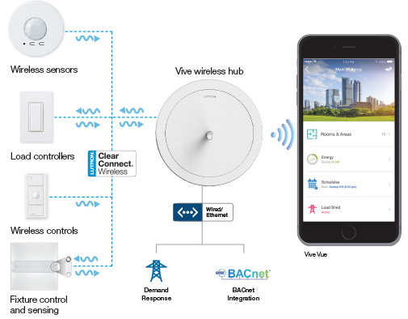
Smart Lighting
Control Options
WIRED
WIRELESS
Source: Nlight.acuitybrands.com
Source: Lutron.com
Notes:
Smart Lighting Control systems can be configured as follows:
1. Wired Solution – Digital addressable devices and controllers are interconnected via hardwired communicated network such as Digital Addressable Lighting Interface (DALI), BACNET
2. Wireless Solution – Lighting devices and controllers equipped with wireless radio transmitters are interconnected via a wireless communication protocol such as ZigBee, Bluetooth, DALI Wireless, BACNET or other standards
3. Hybrid Solution – smart lighting control based on a combination of wired and wireless devices and controllers

Slide 28
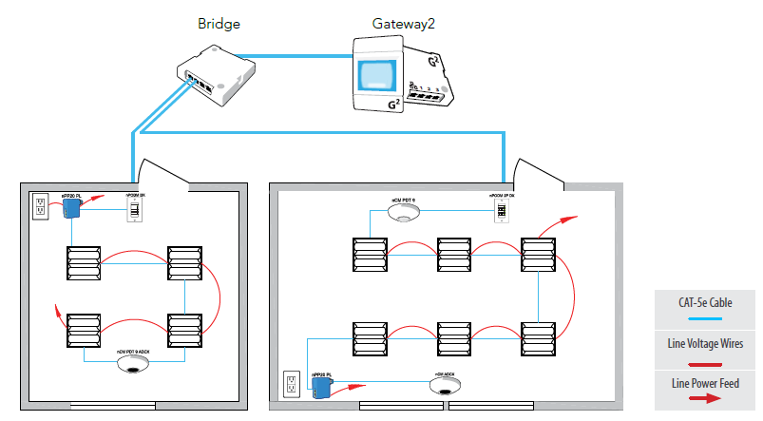
Smart Lighting
Configuration - Wired
A sample layout of a wired lighting control system using a proprietary communication protocol and Internet Protocol (IP) over Ethernet
Source: Acuity Nlight
Notes:
The wired solution for Smart Lighting control systems consist of addressable devices and controllers that are capable of communicating digital data over a hardwired network utilizing standard communication protocols such as DALI, DMX, Ethernet or other proprietary protocol.
Advantages of a wired Smart Lighting System versus a wireless lighting system:
Not prone to radio interference
Virtually no range limitation
More advantageous in new construction
No power limitation due to batteries
Relatively more electronically secured over wireless systems

Slide 29
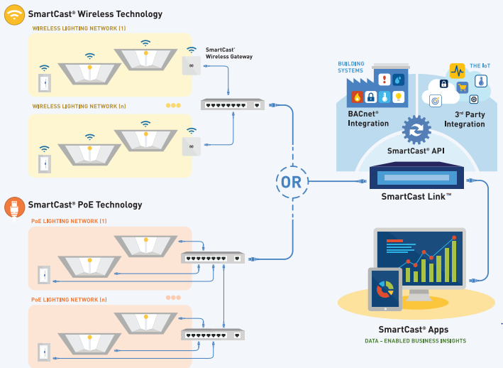
Smart Lighting
Configuration - Wireless
Source: Cree SmartCast
Notes:
Wireless Smart Lighting systems consist of addressable devices such as sensors, switches, and fixtures with built in wireless radio transceivers to communicate over a wireless network via a standard communication protocol such as ZigBee, EnOcean, Wi-Fi, Bluetooth and BACnet for integration with other building systems.
Advantages of wireless smart lighting systems over wired lighting systems:
Quicker installation and setup
Less overall cost over wired systems in retrofit applications
Provides control alternatives in buildings with inaccessible spaces for wiring devices
Disadvantages
Potential device range limitations and radio interference
Battery maintenance for self powered devices

Slide 30
Smart Lighting Systems -
Online Resources
DesignLights Consortium Qualified Product Listing
https://www.designlights.org/lighting-controls/
UC Davis California Lighting Technology Center
https://cltc.ucdavis.edu/
Advanced Lighting Control Case Studies
https://www.designlights.org/lighting-controls/case-studies/

Slide 31
Small Group Discussion
Divide into small groups and share:
Advanced lighting features in your building
Your experience
Your wish list
Notes:
In a small group, reflect on the aspects of advanced or smart lighting controls discussed in the previous section and share your answers to the following questions:
Does your building incorporate any aspects of the advanced or smart lighting control concepts we’ve discussed? If so, what has been your experience with them (from a standpoint of maintenance, user experience, etc.)?
______________________________________________________________________________________________________________________________________________________________________________________________________________________________
2. Which aspects of smart lighting do you think would be beneficial in your building?
______________________________________________________________________________________________________________________________________________________________________________________________________________________________

Slide 32

Smart HVAC Systems
High efficiency mechanical equipment
Technology-based controls
  Communication
  Sensing
  Data analytics
  Fault diagnostics
  Integration capabilities with other building systems
Notes:
A building’s HVAC system typically represents a significant source of energy consumption in commercial buildings. To reduce energy use from building HVAC systems, most commercial buildings utilize an Energy Management or Building Automation System. To save even more energy in HVAC systems, Smart Buildings utilize technology enabled smart sensors and control devices coupled with automated fault detection and analytics to optimize and fine tune HVAC equipment operations.

Slide 33
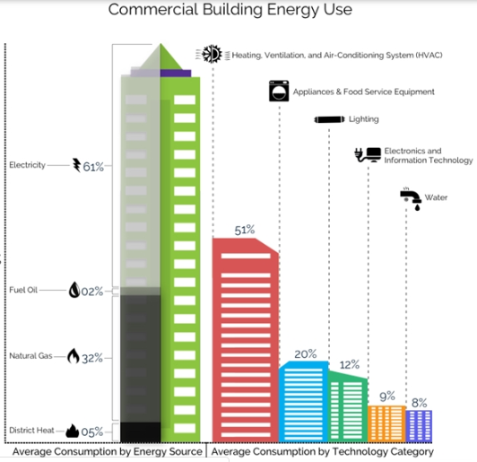
Smart HVAC Systems
Commercial Building
Energy Use
HVAC ~40% of total building energy
Source: https://city.milwaukee.gov/bbc/services/Technology
Notes:
Commercial buildings consume nearly 20% of the total primary energy in the U.S. and the energy attributed to heating, cooling and ventilation of commercial buildings accounts for about 40% of total building energy consumption*. There is a big opportunity to reduce HVAC energy use and improve efficiency by using technology to make HVAC systems smart.
According to a study conducted by the American Council for an Energy Efficient Economy**, Smart HVAC Systems have the potential to significantly reduce HVAC energy consumption by utilizing smart sensors, control devices, advanced control sequences and software for automated fault detection and energy data analytics that can result in optimized, more energy efficient operations.
*Source: US Energy Information Administration 2012 Commercial Building Energy Consumption Survey
** Source: King, J., and C. Perry. 2017. Smart Buildings: Using Smart Technology to Save Energy in Existing Buildings. Washington DC: ACEEE.
https://www.aceee.org/toolkit/2020/02/intelligent-efficiency-commercial-and-industrial-buildings

Slide 34
Smart HVAC
Control Layers
Auto Fault Detection EIS and Data Analytics
HMI
Graphics/
Alarms
Energy Management System Network
DDC
Controllers
Notes:
A Smart HVAC System consists of multiple layers of interrelated systems that are capable of transferring data across each subsystem and processing this data into actionable information to enhance and improve the efficiency of the entire HVAC system. These subsystems consist of the following layers:
DDC Controller Level
Energy Management System
Human Machine Interface (HMI) Graphics, Alarms, Scheduling
Automated Fault Detection, Energy Information System, and Data Analytics

Slide 35
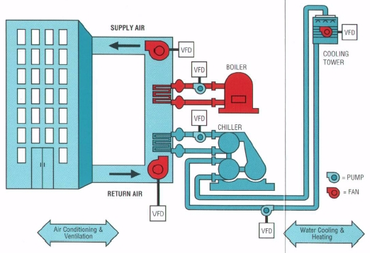
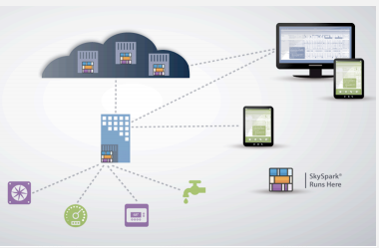
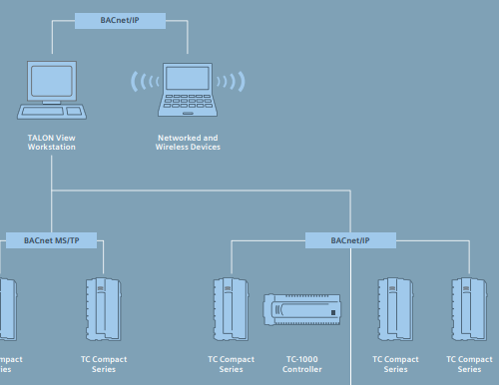
Elements of a
Smart HVAC System
HVAC EQUIPMENT
DATA ANALYTICS & DIAGNOSTICS
ENERGY MANAGEMENT SYSTEM
+
+
Image Source: MckinnonHeating.com
Image Source: Skyfoundry
Image Source: Siemens
Notes:
A Smart HVAC System consists of a collection of smart devices, controllers and software that works seamlessly with the building HVAC equipment and energy management automation system. These smart devices and software enhance the capabilities of standard building HVAC equipment to collect and process system data to improve comfort and energy efficiency. Most Smart HVAC systems utilize advanced software for data analytics and fault diagnostics that typically integrates with the building EMS system to monitor the entire HVAC system for abnormal conditions, find new energy saving opportunities and report system performance.

Slide 36
Elements of a Smart HVAC
Sensors and Smart Control Devices
Weather Data
Equipment Capacity and Performance Database
Utility Rate Schedules
Occupancy Patterns
Building Schedule
Optimized Start and Stop
Base Energy Management System
Open Integration Communication
Energy Reporting
Data Analytics and Automatic Fault Detection Software
Predictive Algorithms
Data Sharing with Controls Integration w/ Other Building Systems
Notes:
Smart HVAC systems rely on a collection of technology enabled devices, controllers, specialty software, fast communication networks and advanced control sequences as listed in the following examples:
Smart Devices
Sensors
Valves and Actuators
Advanced Multi-Function Meters
Variable Speed Drives
Power Inverters
Controllers
Smart Thermostats
Smart RTU (Rooftop Unit) Controller
Software
Energy Information System
Automated Fault Detection and Diagnostics
Data Analytics and Visualization

Slide 37
Smart HVAC Advanced Features and Capabilities
Dynamic Setpoints Reset by System Demand
HVAC Pre Ventilation/Pre-Cooling/Pre-Heating Based on Predicted Building Loads
Hourly Energy Performance Tracking
Demand Response Enabled
Occupancy Data from Lighting System
Ventilation Control from Indoor/Outdoor CO2 or VOC sensors
Diagnose and Report Excessive Runtime, Economizer Damper Malfunction, Non-responsive Valves/Actuators, Defective Sensors
Alternate Logic or Sequence of Operation Based on Abnormal Conditions
Equipment Sequencing Based Time of Day and Cost of Energy

Slide 38
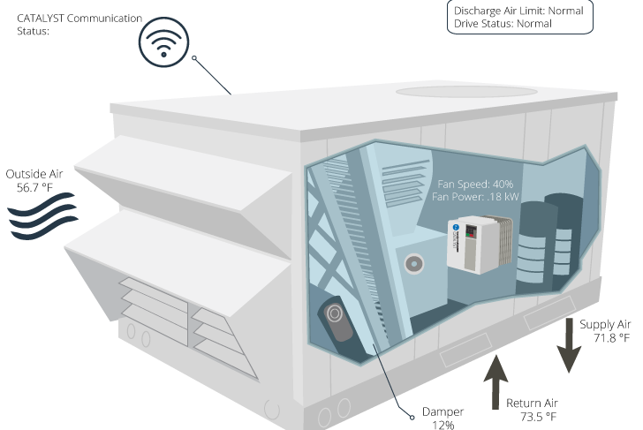
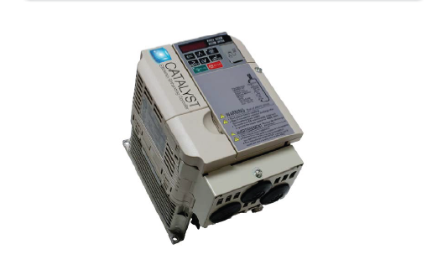
Smart HVAC Applications -
Advanced RTU Controller
Features:
Variable Speed Drive
Economizer
Web Access
Fault Detection
Energy Monitoring
Demand Response
Image Source: Transformative Wave
Notes:
The Advanced Rooftop Unit (RTU) Controller is an example of an all-in one retrofit solution to transform standard factory supplied analog controllers on packaged rooftop HVAC units to digital controls with the following energy saving features:
Variable Speed Fan Control
Multi-stage cooling and heating control
Advanced economizer control
Smart sensor inputs
Fault Detection
Networked Remote Communications (Wired/Wireless)

Slide 39
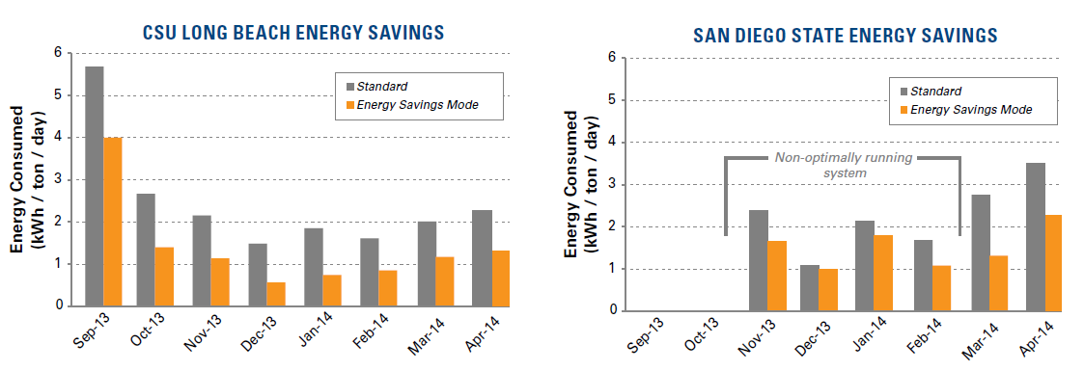
Smart HVAC – Advanced RTU Controller Energy Savings
51% Savings
29% Savings
Image Source: Transformative Wave
Notes:
An advanced RTU controller has the potential to save significant amounts of energy from rooftop packaged HVAC units as shown in this illustration of the results from two demonstration sites. Energy savings were primarily attributed to fan power savings and optimization of the cooling and heating stages.

Slide 40
Smart HVAC Process Flow
Inputs
Smart Sensors
Logic
Predictive
Action
Optimized Control Signal
SP Reset
Advanced Control Sequences
Weather
Building/Equipment Performance Profile
Energy Rates
Cost Reporting
Performance Analytics
PID
Demand Response Reduction
Integration Outputs
Utility Signals
Auto Fault Detection
Corrective/Optimization Measures
Notes:
Smart HVAC systems utilize smart sensors with advanced control strategies as illustrated above. The process flow can be described by elements within the following categories:
Inputs
Smart Sensors
Weather Data
Building Profile
Equipment Performance
Energy Rates
Utility Signals i.e. Demand Response
Logic
Proportional Integral Derivative (PID)
Predictive
Setpoint Reset
Advanced Control Sequences i.e. ASHRAE Guideline 36
Action
Optimized Control Signal
Demand Response Reduction
Performance Analytics
Corrective/Optimization
Cost Reporting

Slide 41
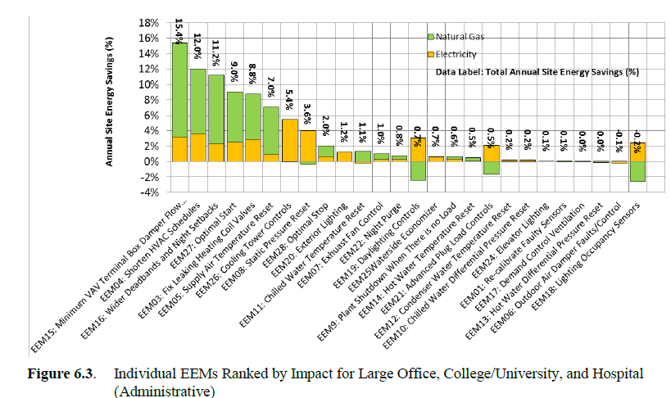
Energy Savings from
Advanced EMS Measures
Individual EEMs ranked by impact for large office, college/university, and hospital (administrative)
Source: DOE/Pacific Northwest National Laboratory
Notes:
In a research study from the Pacific Northwest Laboratory, the top advanced energy management system (EMS) control strategies that had the most significant energy efficiency impacts for Large Offices, College, University and Hospital buildings include the following control functions:
Minimum VAV Terminal Settings
Shortened HVAC Schedules
Wider Setpoint Deadbands
Optimal Start and Stop of HVAC Systems
Supply Air Temperature Reset
Cooling Tower Controls
Fan Static Pressure Setpoint Reset

Slide 42
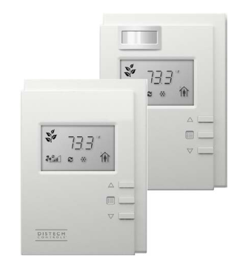
Features
Temperature
Humidity
CO2 – (Indoor Air Quality)
VOC - (Indoor Air Quality)
Occupancy/Vacancy
Footcandle/Photo
Override Function
Digital Display
HMI Port
Smart HVAC –
Multi-function Smart Sensors
Image Source: Distech
Notes:
Smart HVAC Systems utilize smart sensor technologies to detect and process advanced control strategies to optimize HVAC system performance and to reduce energy consumption. Smart sensors are multi-function input devices that include a combination of the following features:
Temperature
Humidity
CO2
VOC (Volatile Organic Compounds)
Occupancy/Vacancy Sensing
Footcandle Daylight Sensing
Override Function
Digital Display
Wired/Wireless Digital Communication
HMI Port

Slide 43
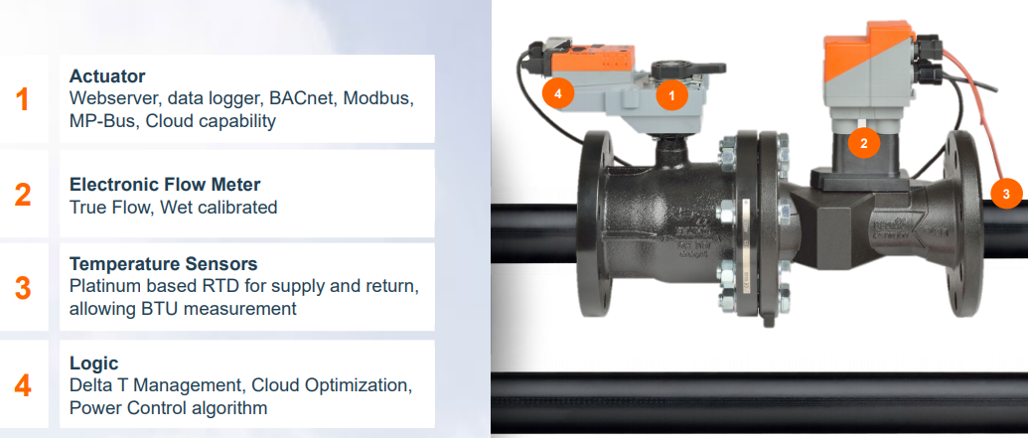
Smart HVAC – Smart Valve
Image Source: Belimo
Notes:
Smart HVAC Systems utilize technology in smart control devices to optimize control signals to HVAC equipment such as valves, dampers, fans, cooling and heating equipment to increase performance and to reduce energy consumption. In this example, a Smart Valve is a multi-function control device that includes the following features:
Smart Actuator
Data Logging
Remote Communication
Electronic Flow Meter
Temperature Sensing
Flow Control Management

Slide 44
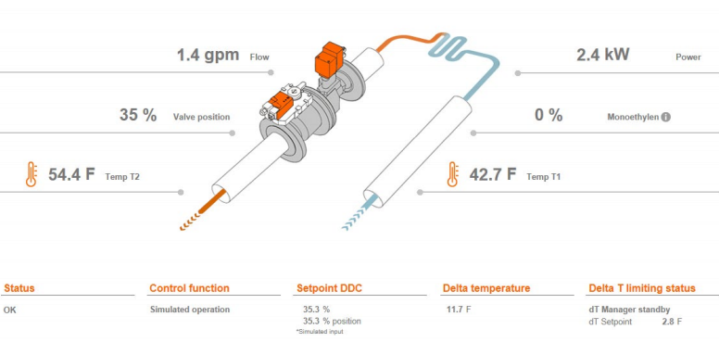
Smart HVAC –
Control Devices
Smart Valve with optimized control, data analytics, fault diagnostics and energy metering
Image Source: Belimo
Notes:
This illustration is a snapshot of a collection of dynamic performance data from a smart valve indicating key performance data such as:
Valve Status
Coil Input and Output Temperatures and Differential Temperatures (delta T)
Flow in GPM
Valve Position
Energy Consumption in BTU/KW

Slide 45
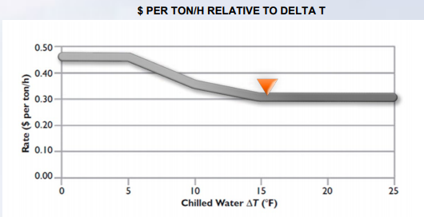
Smart HVAC
Energy Valve Savings
Image Source: Belimo
Notes:
HVAC systems rely on heat exchangers such as heating and cooling coils to deliver or remove heat from a conditioned space. A key performance indicator of energy efficient operation within a heating or cooling hydronic loop is the measurement of system differential temperature (delta T). A hydronic system that operates with a narrow delta T is typically a sign of inefficient operation. A Smart Valve is capable of controlling the flow through a heating or chilled water coil to optimize energy consumption by monitoring the dynamic delta T across the coil as illustrated in this slide.

Slide 46

Smart HVAC – Advanced Economizer Controller
Image Source: Belimo
Notes:
Most commercial HVAC systems rely on economizers to utilize outside air as a source of free cooling when outdoor conditions permit, thereby saving energy by minimizing the need for mechanical cooling. Well maintained and functioning economizers are key to energy efficiency in HVAC systems. Unfortunately, economizers have been found to be one of the most common source of failures in packaged rooftop units and central air handling systems. Smart HVAC systems utilize technology such as a smart economizer controller to monitor and control economizer operations for sustained energy efficiency by utilizing the following features and capabilities:
Multiple sensor input
Digital display function
Alarm notification
Direct control outputs
Communication module for remote monitoring and integration

Slide 47
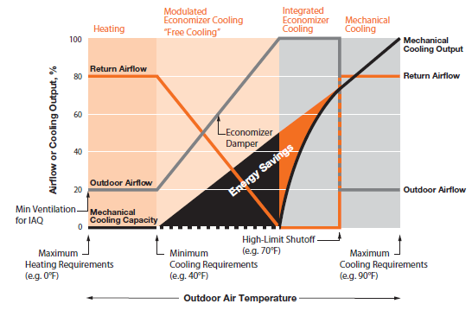
Smart Economizer
Controller
Smart Economizer Controller
Image Source: Belimo
Notes:
Energy savings from airside economizer control is attributed to minimizing outside air when outdoor conditions are not beneficial to heating or cooling modes of operations. In cooling mode, maximum efficiency can be reached by ensuring outdoor air is utilized as the first stage of cooling. A smart economizer ensures mechanical cooling is locked out until outdoor air is at full open position.

Slide 48
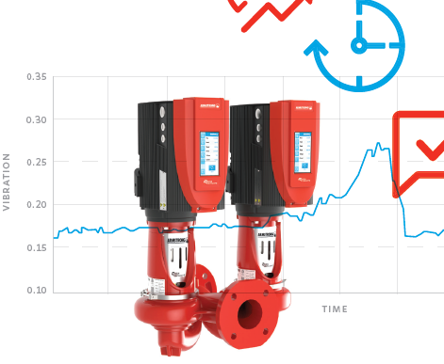
Smart Pumps Variable Speed
Controller
Analytics
Smart Pumps
Image Source: Armstrong Pumps
Notes:
Smart Buildings are equipped with mechanical equipment with integrated smart technologies. Modern pumps for hydronic system applications are now offered with smart features to optimize operation and improve energy efficiency. These advanced features include the smart capabilities:
Flow analytics
Active monitoring of pump operating parameters such as excessive vibration, dead head, cavitation, broken coupling, pump in hand etc.
Optimization for energy efficiency
Adaptive learning
Connectivity
Automated alerts and reporting

Slide 49
Fault Detection & Analytics
Fault Detection System
VAVS
AHU
Sensors
Meters
Boilers
Chillers
Valves / Dampers
Deployed over EMS
Automated Fault Reporting
Energy Analytics
Site/Cloud Hosted Software
Mobile Device Accessibility
Notes:
According to research conducted by Lawrence Berkeley National Laboratory*, 5 to 30% of the energy use in commercial buildings is wasted energy from undetected faults and failures in building HVAC energy management systems. Smart HVAC systems utilize a building EMS system with advanced features or specialized software for automated fault detection and system diagnostics that consist of the following:
Typically deployed with or over a building EMS system
Regular and automated fault reporting with email/mobile notification
Energy consumption and cost analytics
Software can be site or cloud hosted
Remote accessibility via specialized apps and mobile devices
*Source: Grunderson J., Singla R., Mayhorn E., Erhlick P, Vrabie D., Frank S. 2017. Characterization and Survey of Automated Fault Detection and Diagnostic Tools. Lawrence Berkeley National Laboratory. https://eta-publications.lbl.gov/sites/default/files/lbnl-2001075.pdf

Slide 50
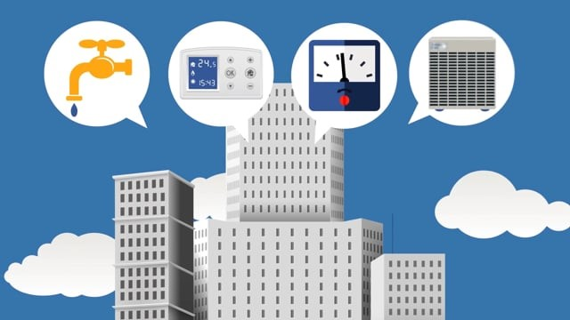
Automated Fault Detection and Diagnostics System Overview
Source: Skyspark.com https://vimeo.com/143578172
Notes:
One example of a specialized automated fault detection and diagnostics (AFDD) system is the SkySpark platform. Faults detected from this system are called system “Sparks” which are actionable corrective actions communicated to building operators and managers. SkySpark is one of several AFDD platforms available on the market.
Source: Skyspark.com. https://vimeo.com/143578172
Note: The BOC program has no affiliation with SkyFoundry or Skyspark. The marketing information is shown as an example only and is not intended to promote any one platform over another.

Slide 51
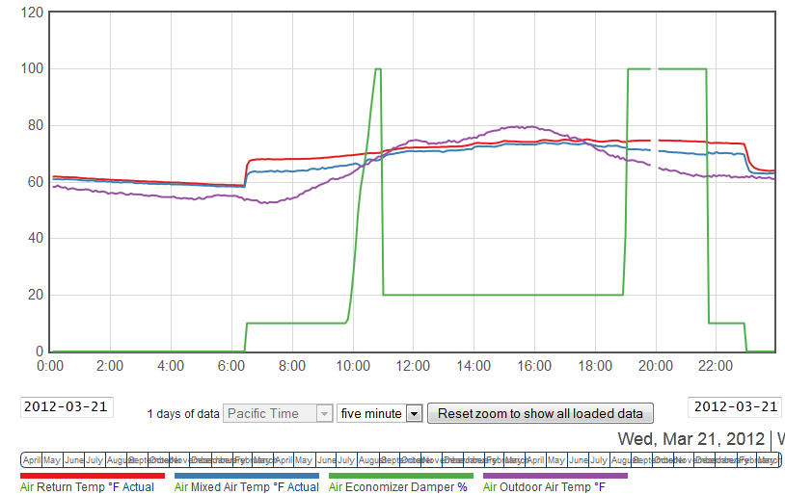
Economizer Operations
Sample Fault
Condition Analysis
Source: CSULB Enernoc Energy Dashboard
Notes:
Automatic Fault Detection software allows building operators and facility managers the ability to visualize HVAC equipment and associated controls in real time and over a specific historical time period to verify control sequences, equipment operational condition, and isolate system faults for possible corrective action.

Slide 52
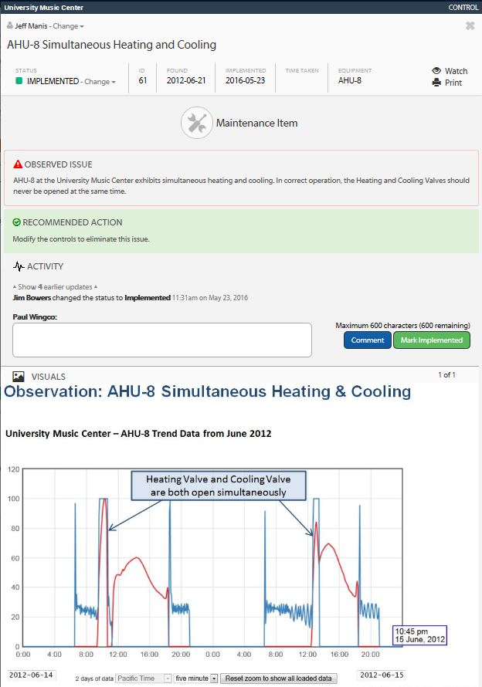
Simultaneous Heating and Cooling
Sample Fault
Condition Reporting
Source: CSULB Enernoc Energy Dashboard
Notes:
Automatic Fault Detection software is capable of verifying equipment or control fault conditions and issuing reports for corrective actions. Some software is even capable of generating work orders when integrated with a computerized maintenance management system (CMMS).

Slide 53
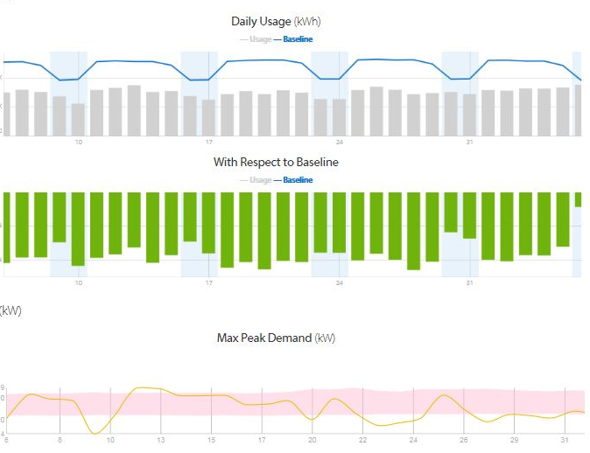
Sample
Energy Performance Report
Source: CSULB Enernoc Energy Dashboard
Notes:
Some fault detection software is bundled with advanced features for energy performance and cost reporting. Energy Information Systems (EIS) monitor, track, and report energy performance over a time period such as daily, monthly, annually, and in some instances even hourly profiles. Additionally, the EIS software can perform benchmarking analysis and consumption projections using energy modeling and local weather data.

Slide 54
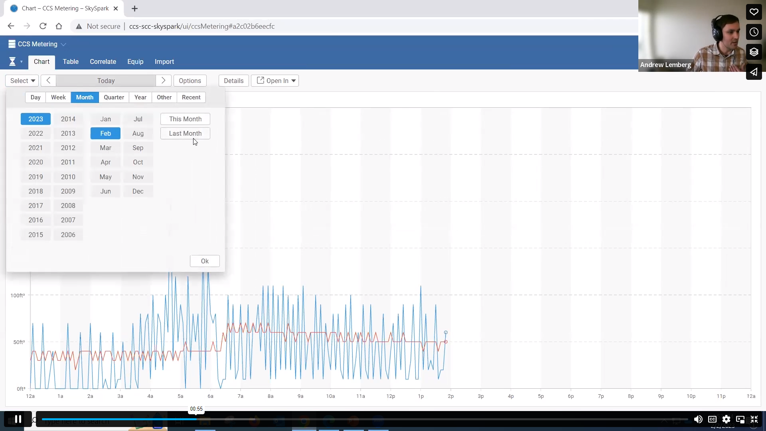
Video: Energy Information System Demonstration
Source: CSULB Enernoc Energy Dashboard
Video link: https://vimeo.com/805723011
Notes:
This video (~4 minutes) demonstrates an energy information system (EIS) in use and highlights some of the useful features. Let’s watch the video and then discuss the following questions:
Which parameters did the presenter analyze using the EIS interface?
______________________________________________________________________________________________________________________________________________________
What was the presenter able to glean by comparing the gas usage with the weather trend data?
______________________________________________________________________________________________________________________________________________________
What was something that the data prompted him to investigate more closely?
______________________________________________________________________________________________________________________________________________________

Slide 55
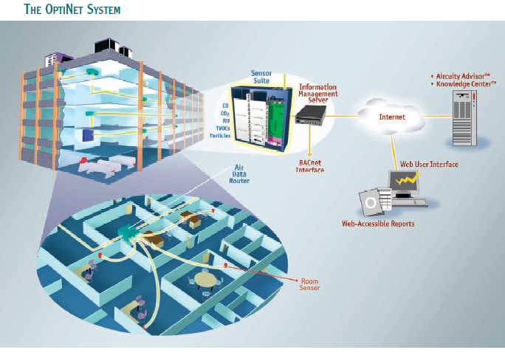
Application in
Lab Ventilation
Central Sensor Suite
Multi-Sensors
Occupancy Sensing
Alarm Monitoring
Reporting
Diagnostics
Minimize HVAC ENERGY USE when air quality is within acceptable parameters
Image Source: Aircuity
Notes:
One example of a Smart HVAC application is a centralized sensor suite monitoring and control system designed to monitor indoor air quality in laboratory spaces to lower ventilation rates when room condition permits. The system is capable of monitoring room air quality by measuring multiple air variables such as temperature, CO2, VOC, CO, particulates, humidity and occupancy. It centrally processes this data which is then passed on to the ventilation control system to reduce or increase ventilation rates based on dynamic air quality variables within the room. This Smart HVAC application has been proven to significantly reduce energy consumption and generate savings in 100 percent outside air systems such as science laboratories, pharmaceutical spaces, hospitals, and clean rooms. The system is also capable of generating alarms and notifications if indoor air quality is outside of acceptable parameters.

Slide 56
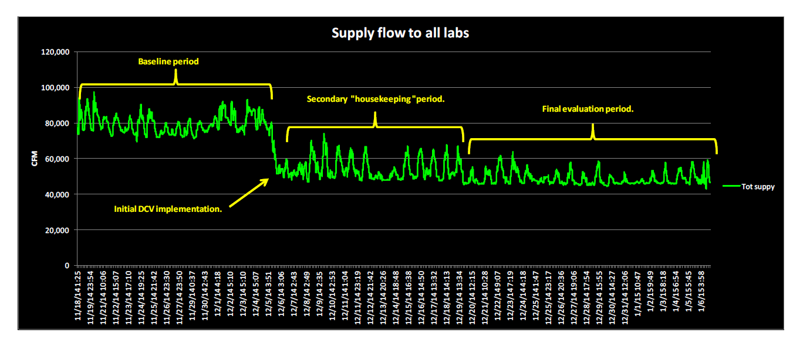
Smart HVAC – Lab Ventilation Energy Savings
Image Source: Aircuity CSULB Molecular Life Science Building
Notes:
The figure above illustrates actual air flow measurements during a baseline period compared to a performance period when the Smart HVAC system is enabled during a commissioning period and fine tuned for over final evaluation period showing significant reduction in supply fan airflow which directly resulted in energy savings.
It is worth noting that in addition to energy savings, reducing fan airflow also results in reduced equipment runtime, which translates to longer equipment life. It also results in operational efficiencies such as reduced filter loading, decreasing the frequency of filter changes.

Slide 57

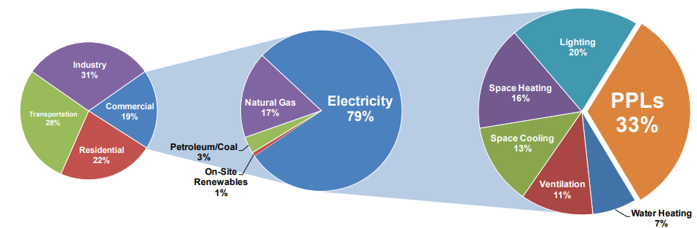
Plug and Process Loads
U.S. Primary Energy Breakdown
Commercial Buildings Energy Sources
Commercial Buildings Energy Use Breakdown
Source: National Renewable Energy Laboratory: https://www.nrel.gov/docs/fy13osti/54175.pdf
Fastest growing energy consumption source in commercial buildings
Consumes up to 33% of electricity use in buildings
Projected to increase up to 50% by 2030
Notes:
Commercial buildings consume about 20% of the primary energy produced in the U.S. and a significant portion of this energy consumption is in the form of electricity. Moreover, over 70% of this energy consumption is from electricity usage and plug and process loads (PPLs) represent up to about 33% of total electrical consumption in commercial buildings. In fact, there is an upward trend in electricity consumption from PPLs and these loads now represent the fastest growing consumption source in commercial buildings. As predicted from research by the U.S. National Renewable Energy Laboratory, energy consumption from PPLs is projected to increase to 50% of commercial building electrical loads by 2030*. Therefore, managing Plug and Process Loads will become a key measure in controlling energy consumption from these sources. In fact, advanced energy standards now address PPLs by requiring controllable plugs in building spaces. Smart buildings utilize multiple technology enabled control schemes and devices to manage PPLs.
*Source: Addressing and Reducing Process and Plug Loads in Office Buildings. US National Renewable Energy Laboratory: https://www.nrel.gov/docs/fy13osti/54175.pdf

Slide 58
What are Plug and
Process Loads (PPLs)?
Energy loads that are NOT related to lighting, heating, ventilation, cooling, and cooking:
Office equipment such as computers, printers, copiers, monitors, audio/video equipment, etc.
Personal radiant heaters, air purifiers, air conditioners and under counter refrigerators
Servers and telecommunication equipment
Small appliances such as refrigerators, ice machines, freezers, vending machines, and drinking fountains etc.
Elevators and escalators
Notes:
Plug and process loads have been found to be the fastest growing energy loads in commercial buildings according to the U.S. National Renewable Energy Laboratory (NREL) Commercial Building Research group. To address and reverse this growing trend, NREL has developed the following guidelines on addressing and reducing Plug and Process Loads in commercial buildings*:
Establish a PPL champion
Institutionalize PPL measures
Benchmark current equipment and operations including performing a site audit and developing a metering plan
Develop a business case for addressing PPLs
Identify occupant needs
Meet occupant needs efficiently
Turn it all off when possible
Address unique PPLs
Promote occupant awareness
Address PPLs in design of new construction and retrofit of buildings
*Source: Addressing and Reducing Process and Plug Loads in Office Buildings. US National Renewable Energy Laboratory: https://www.nrel.gov/docs/fy13osti/54175.pdf

Slide 59
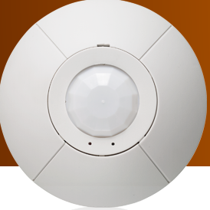
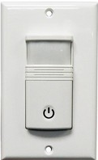
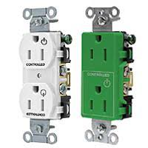
Receptacle Control
Standards
Occupancy Sensor
Lighting or EMS System
OR
Controlled Receptacle
120 VAC
Control Relay
Notes:
One of the ways that plug loads can be managed is through controllable outlets such as the example illustrated above. In this example of a wired solution, the controllable outlets are powered on when occupancy is sensed within the space through a ceiling or wall type motion sensor. This option can be controlled via the lighting or HVAC system via a control relay that allows the controlled outlets to be energized.

Slide 60
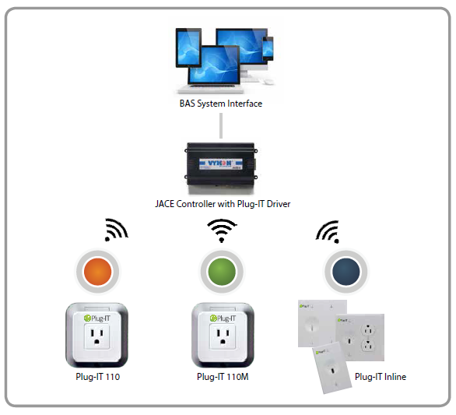
Smart Plug Technology
Available features:
Wireless
Addressable
Power metering
Scheduling
Group control
Integration with building lighting,
EMS or HVAC
Report and Analysis
Dashboard
Notes:
Plug and process load management can be enhanced by utilizing technology enabled smart plug control devices which can be individually addressed and can be integrated with the smart building’s energy management or lighting systems.

Slide 61

Smart Meters
Smart Meters can:
Measure and report energy consumption
Generate energy load performance profiles
Benchmark energy performance
Provide cost analysis and tracking
Sub-meter equipment
Provide energy load projections
Notes:
Smart Buildings are equipped with smart enabled technologies such as Smart Meters to measure, track, and report building energy consumption for energy benchmarking, cost analysis, and energy accounting. They use established digital communication protocols over wired or wireless media. Smart Meters are used to measure the following building energy and utility consumption:
Electricity
Natural Gas
Domestic Water
Steam
Chilled or Hot Water

Slide 62
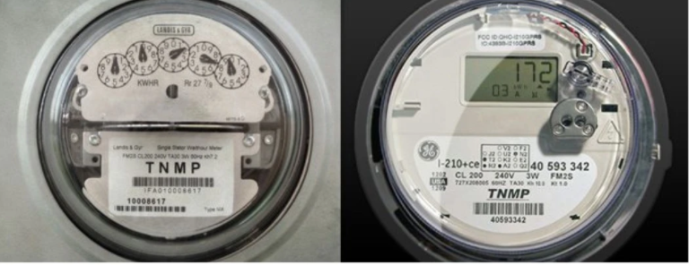
SMART METERs
Smart Meters
Access to Energy Data
Reporting
Analytics
Validation
Utility Re-billing
End Use Energy Accounting
Image Source: https://techwellness.com/blogs/expertise/safe-smart-meter-emf-dangers-opt-out-for-health
Notes:
Utility companies have been deploying smart meters over the past few years as part of their metering infrastructure upgrade. These meters provide the following additional benefits over standard analog meters they replaced:
Remote meter reading
Energy data analytics and historical archiving
Remote meter validation and testing
Customer access to consumption data

Slide 63
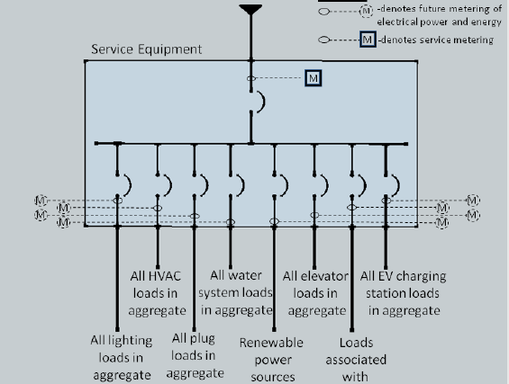
2019 energy code – Section 130.5(B)
Meter requirements for separate load types
Metering Requirements For Building Energy Loads
Image Source: 2019 California Title 24 Part 6 Building Energy Efficiency Standard
Notes:
The latest building energy efficiency standards such as California’s Title 24 Part 6 standard now require building electrical loads to be separately metered per load type as seen in this diagram. The following load types are electrically metered in this building to allow end use analysis of system level energy consumption:
Lighting
HVAC
Plug
Water Heating and Pumps
Renewable Energy
Elevator and Escalator
EV Charging Stations

Slide 64
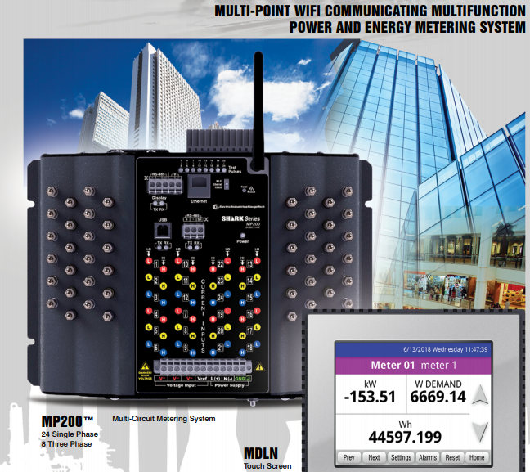
Smart Electric Meters
MULTI-CIRCUIT
SMART METER
Multi-function
Digital display
24 single-phase circuits
or
8 three-phase circuits
Wi-fi enabled
Image Source: Electro Industries
Notes:
Smart electric meters are digital multi-function meters with enhanced features for measuring, archiving, and reporting real time electrical properties including energy consumption.
A multi-circuit smart electrical meter can provide a more economical option over individual meters for metering multiple load types.
Do you have access to any type of smart meters in your building(s)?

Slide 65

Smart Window Shading Technology
Smart Shading Systems
Clear State
Tint State
Image Source: View dynamic Glass
Automatic Roller Shades
Switchable Film
Smart Glass
  Thermochromic
  Electrochromic
Notes:
According to a study by American Council for an Energy Efficient Economy on Smart Building Technologies, about one-third of building HVAC energy use is from outside heat gain and heat losses. The study cited information from the California Energy Commission indicating 40% of HVAC cooling load of a typical building in the state comes from heat gains through windows. To reduce the influence of exterior heat gains and losses through windows, several energy conservation measures are typically undertaken to reduce the energy impact of external heating loads to buildings. These measures include the following:
Exterior mechanical louvres
Automatic roller shades
Switchable films on windows
Dynamic Smart Glass including Thermochromic and Electrochromic technologies

Slide 66
Benefits of Smart Glass Technology
Visual Comfort
Outdoor View
Thermal Comfort
Energy Efficiency
Customized Settings
Integration with Building Systems
Lighting Control
Notes:
In addition to the benefits listed here, smart glass technology can qualify for glazing credits under standards such as the 2019 California Energy Code Title 24 Part 6.

Slide 67
Dynamic Glass – Peak Cooling Load Savings
Data Source: View Glass
Notes:
Dynamic smart glass systems can significantly reduce solar cooling loads by automatically adjust shading levels in smart glass equipped windows. The above example illustration compares the performance and energy savings of Dynamic Glass over LOW E glass.

Slide 68
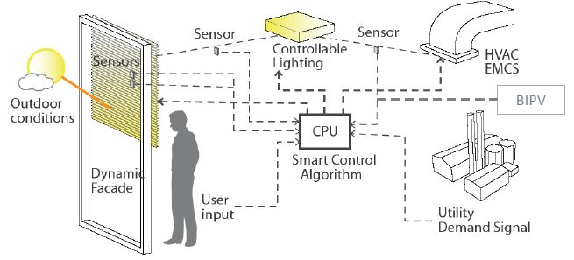
Integrated Dynamic
Façade System
Image Source: US DOE
Notes:
Smart Façade systems such as automatic roller shades, switchable films, and dynamic glass can be integrated with other building systems such as building HVAC, lighting, and EMS. In this scenario, the smart façade system controller receives input from outdoor and interior sensors such as temperature and light level and automatically adjusts the window shading level to reduce solar cooling load and adjust interior lighting to maintain an appropriate light level.

Slide 69
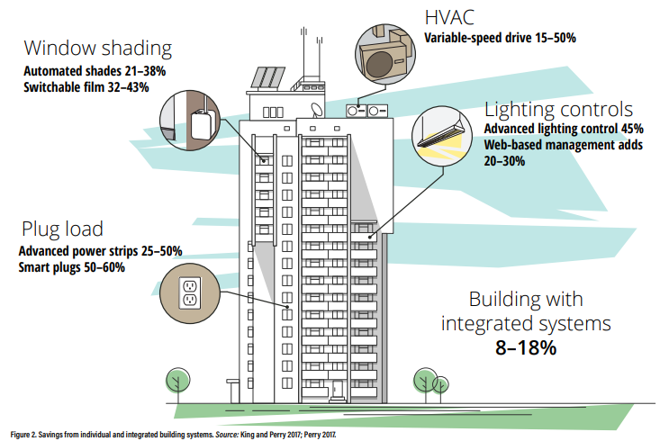
Integrated Building Systems
Optimized Energy Performance
Image Source: American Council for an Energy Efficient Economy
Achieving Deeper Energy Savings Through Integrated Building Systems
Notes:
Smart Buildings have the capability for sustained and highly energy efficient performance due to their ability to integrate and coordinate building systems that are traditionally operated independently or in stand alone mode. According to a study by the American Council for an Energy Efficient Economy, buildings with integrated systems can save 8-18% of whole building energy consumption*. This integration can be made through software and using standard communication protocol to enable systems to communicate via common established standard. Most integrated building systems use one or more of the following communication protocols to share and pass along data to be used for integrated controls:
BACNET
MODBUS
LONWORKS
DALI
Enocean (wireless)
Zigbee (wireless)
* Source: American Council for an Energy Efficient Economy, Achieving Deeper Energy Savings Through Integrated Building Systems, https://www.aceee.org/sites/default/files/eo-smart-buildings.pdf

Slide 70
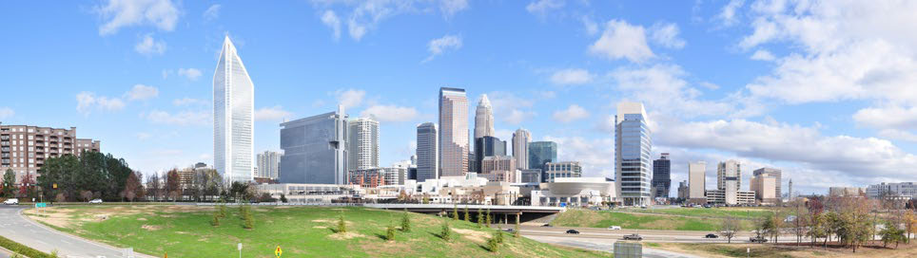
Case Study:
Duke Energy Center
16 separate building systems integrated on one network
22% reduction in energy consumption
Rainwater harvesting provides 80% of cooling tower needs and 100% of irrigation
Notes:
Originally designed as a replacement for Wachovia’s One Wachovia Center headquarters in Charlotte, North Carolina, it was intended to be a state-of-the-art, sustainable and efficient corporate base for the firm.
Although that vision was realized, the building was instead occupied by Duke Energy, and has become an iconic fixture in the center of Charlotte. Each time the Carolina Panthers, the city’s football team, scores a touchdown, LED lights color the tower blue, reflecting the team colors.
16 separate building systems are integrated on one network, including HVAC, security, metering, lighting, water management and emergency preparedness; this reduces operational expenses and energy consumption by 22%
Digital sensors are used to manage energy consumption, allowing building temperatures to be adjusted within a predetermined range
A lighting control system reduces energy consumption by dimming perimeter lights in response to available natural light and turning lights off when the room is vacant; the lighting control system learns occupant behavior over time and automatically adjusts according to how long the office will be occupied
“Destination Dispatch” elevator controls assign elevators to passengers with common destinations, which will then transport them while making the fewest possible stops
The building reuses approximately 10 million gallons of harvested water each year including groundwater, rainwater and HVAC condensation, meeting roughly 80% of the cooling tower’s water needs and 100% of the building’s irrigation needs
Reprinted from https://s33644.pcdn.co/wp-content/uploads/2020/06/Intelligent-Building-Top-5-Smart-Buildings-ebook.pdf

Slide 71
System Interoperability
Integration through standard communication protocols
Workstation 1
HVAC
Lighting
Plumbing
Workstation 2
Fire/Security
Electrical
Key Access
DATA
Notes:
Smart Buildings rely on integrated building systems to pass and share information from one system to another with consistency and reliability to ensure occupant safety, comfort, and sustained high level of energy performance. To ensure maximum interoperability, building systems must have the capability to communicate through a common communication language. This common language is often referred to as the “common protocol”. Today one of the most common protocols used in many building systems is the BACNET or Building Automation and Controls Network.

Slide 72
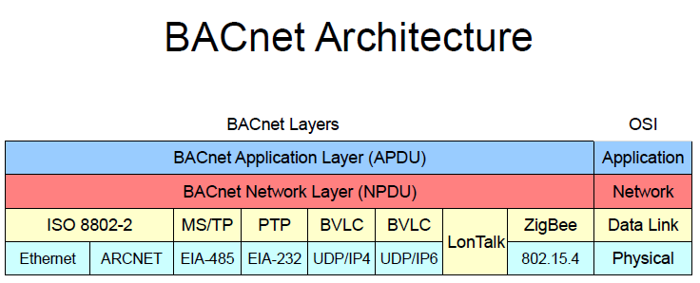
System Integration
Through BACnet
What is BACnet?
BACnet stands for Building Automation and Controls Network, a standard data communication protocol for building systems.
Why was BACnet Established?
BACnet ASHRAE Standard 135 was developed by the American Society of Heating Refrigeration and Air Conditioning Engineers to allow systems from different vendors to communicate with each other.
Notes:
BACnet utilizes a compressed four-layer version of the seven-layer OSI (Open System Interconnection) standard communication architecture format. The BACnet communication architecture is comprised of the following four layers:
Physical Layer (Media) - the physical layer is responsible for the transmission and reception of unstructured raw data between a device and a physical transmission medium. It converts the digital bits into electrical, radio, or optical signals
Data Link Layer – provides node to node data transfer within the same network of devices. Additionally this layer detects and can attempt to correct errors in the physical layer.
Network Layer – provides the methods and means to transfer node data within one network to nodes of another network
Application Layer – BACnet utilizes the application layer using Objects and Services for monitoring and control of data points

Slide 73
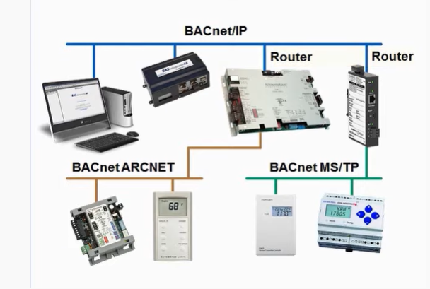
System Integration
Through BACnet
Image Source: Contemporary Controls
Notes:
This example system layout illustrates a common BACnet network showing the capabilities of BACnet to communicate over different physical/data link layers. The most physical/data link used by BACnet in building control systems is the MS/TP (Master Slave/Token Passing) for the control level and the IP or Internet Protocol for the inter-network level data communications.

Slide 74
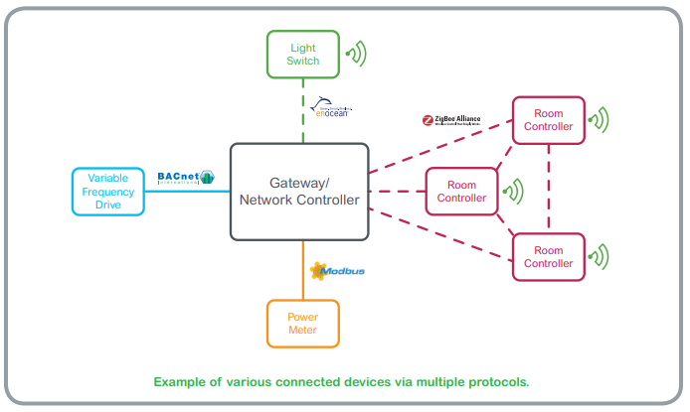
System Interoperability
Image Source: Schneider Electric Guide to Open Protocols
Notes:
Gateways provide the means and methods to communicate data between BACnet networks and non BACnet networks such as proprietary LONWORKS, DALI, MODBUS, etc. Non BACnet equipment manufacturers and vendors typically provide optional gateways as their means to integrate to BACnet or other communication protocols.

Slide 75
Common Points of Integration in Building Systems
Occupancy data from Lighting to HVAC system
Fire Alarm activation to HVAC system (i.e. Smoke Evacuation/Containment)
Key Access system data to Security Alarm System
HVAC Data to Computerized Maintenance Management System
Maintenance Management System Data to Financial Data Systems
HVAC and Lighting data to Energy Management System
(energy performance and tracking data)
Plumbing system data to CMMS (compliance reporting)
HVAC system data to Plumbing system (critical alarms)
Lighting system data to electrical system (fault detection)

Slide 76
Distributed Energy Resources (DER)
Combined Heat/Power/Cooling (CHPC)
Solar PV
Wind
Battery Energy Storage
Thermal Energy Storage
IC Internal Combustion Engines
Notes:
Distributed Energy Resources are small scale energy generation units generally found at or near the energy load they serve. There is a growing trend in the increase of DERs particularly from clean renewable sources such as Solar PV and Wind Turbines. Other forms of DER are as follows:
Turbine Generators Combined Heat and Power (CHP)
Internal Combustion Engines (ICE)
Battery Energy Storage
Thermal Energy Storage

Slide 77
Distributed Energy Resources Challenges
Stand Alone Systems
3rd Party Owned/Operated
Closed Communication
Accessibility to Performance Data
Grid Independent
Uncontrolled Output
Interconnection Limits
Notes:
Distributed Energy Resources (DER), particularly from cleaner renewable sources, are proven technologies that can significantly reduce greenhouse related emissions from electrical generation. Additionally, DER are generally more efficient in generating electricity compared to traditional power plants due to avoided transmission losses because of their closer proximity to energy loads that they serve. This makes DERs popular options for building owners and current trends indicate a continued growth in DER installations. There is however a downside to increase in DER on the electric grid due to uncoordinated generation output and misalignment with the loads that they serve. These problems stem from the following inherent characteristics of standalone DER:
Stand Alone Systems
3rd Party Owned/Operated
Closed Communication
Lack of accessibility to Performance Data
Grid Independent
Uncontrolled Output
Utility Interconnection Limits
Do you have any DER deployed in your building(s)? What has been your experience?

Slide 78
Smart Technologies
Integrated DERs
Smart Inverters and Meters
Automated Switchgear
Smart Sensors
Ultra Fast Communications
Micro Grid Control System
Integration Software
Grid Responsive
Output Control
Islanding Capabilities
Notes:
The modern electrical grid will include a growing amount of Distributed Energy Resources. To maximize the effectiveness and value of DER within the new electric grid, DER will have to be equipped with smart technologies, so their output and operation are well coordinated with other components of the grid. These capabilities will enable DER to control their output based on actual demand from the grid. These smart technologies include the following:
Smart Inverters and Meters
Automated Switchgear
Smart Sensors
Ultra Fast Communications
Micro Grid Control System

Slide 79
Grid-interactive Efficient Buildings (GEB)
DEFINITION:
  “Buildings that operate dynamically with the grid
  to make electricity more affordable and integrate distributed energy resources while meeting the needs of building occupants”
US Department of Energy Building Technology Office
Notes:
Buildings are a significant source of electricity consumption. Buildings in the U.S. represent up to 70% of total electricity consumption and up to 80% of peak electrical load according to a study by Lawrence Berkeley National Laboratory. This energy consumption profile makes buildings a primary candidate for load reduction opportunities when the electric grid resources or transmission are constrained. Due to their variation of energy loads, buildings can be sources of load flexibility which is a key requirement of the new smart grid. The U.S. Department of Energy Building Technology Office is spearheading an initiative to research the characteristics and benefits of buildings that can provide load flexibility. This type of buildings is referred to as Grid-interactive Efficient Buildings*.
*Source: US DOE Building Technology Office, Grid-interactive Efficient Buildings Technical Report Series, https://www1.eere.energy.gov/buildings/pdfs/75470.pdf

Slide 80
Why Do We Need GEBs?
Growing Peak Electrical Demand
Transmission and Distribution Constraints
Increasing Variable Renewable Energy Resources
Increasing Demand for Low Cost and Renewable Energy Resources
Growing Complexity of Distributed Energy Resources (DER)
The Need to Maintain Grid Reliability
The Need for Demand Flexibility
Notes:
The modern electrical grid now consists of distributed energy generation sources with the capabilities to supply energy closer to the loads that they serve such as buildings. Moreover, the energy flow on the modern grid is now allowed to flow in two-way direction with power flowing into and from the grid whenever conditions permit. Buildings can play an important role in making the modern grid more reliable and more sustainable with cleaner generation from renewable energy sources. For the modern energy grid to work, some level of load flexibility will be needed to take energy from the grid during a condition of over generation and to reduce load when there is a shortfall of generation. Grid-interactive Efficient Buildings with smart technologies can fulfill this role.

Slide 81
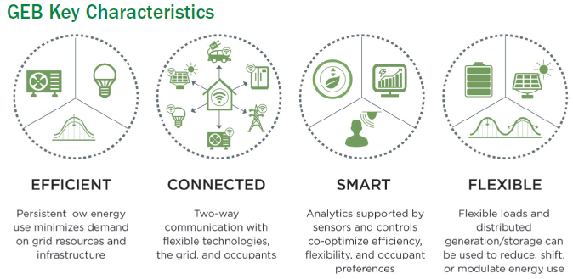
Key Characteristics of GEB
Image Source: DOE Grid Interactive Efficient Buildings
Notes:
Grid-interactive Efficient Buildings can provide the load flexibility that the modern electrical grid requires for reliable operation. The key characteristics for GEB are as follows:
Efficient
Connected
Smart
Flexible

Slide 82
Benefits of Grid-interactive Efficient Buildings
Energy Savings from Efficiency
Revenues From Demand Response and Other Grid Services
Improved Operations from Smart Technologies
Optimization of Distributed Energy Resources
Improved Comfort and Indoor Air Quality
Improved Resilience from Grid Vulnerabilities
Access to Building Performance Data
Notes:
Grid-interactive Efficient Buildings that are enabled by smart technologies can provide multi-faceted benefits to the energy supply, demand and transmission within the smart grid. These benefits can have direct impact to building owners from energy savings and can have multi-layered benefits to the energy grid from load flexibility.

Slide 83
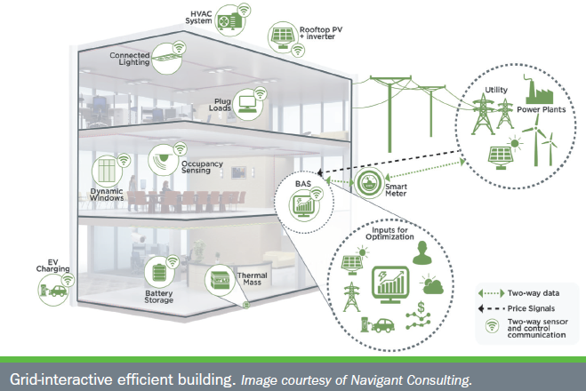
GEB Smart Technologies
Image Source: DOE Grid Interactive Efficient Buildings
Notes:
Grid-interactive Efficient Buildings represent a class of high-performance buildings that are energy efficient and are capable of dynamically responding to the demands of the smart grid. These type of buildings are equipped with smart building systems that are integrated and configured to deliver grid demand flexibility. This means GEBs are capable of multiple modes of operations depending on what the grid needs. For example, GEB are capable of ramping down their DER when there is sufficient supply on the grid or absorb power from the grid when there is abundant energy supply. GEBs can financially benefit from these capabilities by providing grid services and from energy cost savings.

Slide 84
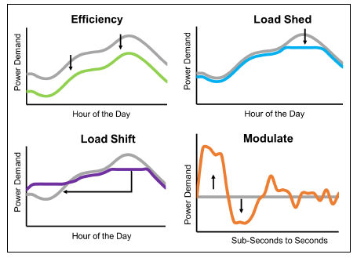
How building load profiles from demand flexibility benefits the grid:
- Efficiency
- Load Shed
- Load Shift
- Modulate
Demand Flexibility
Image Source: DOE Grid Interactive Efficient Buildings
Notes:
Grid-interactive Efficient Buildings can benefit financially from demand flexibility by controlling their load profiles based on the need of the grid. The value of building demand flexibility can be monetized by utilities or third party aggregators to deliver the following grid services:
Energy Efficiency
Load Shed
Load Shift
Modulate

Slide 85
Grid-interactive Efficient Buildings Demand Reduction Scenario
System Operator
Monitors Grid Conditions
Utility
Triggers Demand Response (DR) Program
GEBs
Forecasts Supply vs Demand
Issues Notification and Alerts for Demand Response
Receives Signal to Lower Demand
Issues Third Party Aggregator DR Programs
Receive DR signal from Utility or 3rd Party Aggregator
Trigger Automated Demand Reduction Measures
Utilize DER or Energy Storage to meet local demand
Notes:
Regional power grids are typically managed by system operator entities. In California, the ISO or Independent System Operator is the party responsible for managing how power flows into and out of the state electrical system. In case of a projected generation shortfall due to increase in demand or shortage of generation, the ISO sends notifications to load serving entities such as local utilities to initiate their load demand reduction programs. One example of a load demand reduction program is ADR or Automated Demand Reduction which sends a signal to customers to initiate local demand reduction measures. For GEBs, this signal is automatically processed by the building EMS and triggers local demand reduction measures such as the following:
Shutdown major electric equipment i.e. chillers, cooling towers, AC equipment
Adjust/lower zone setpoints
Adjust window shading systems
Enable thermal storage
Control DER such as Battery Energy Storage to discharge to supply local power and lower demand from the grid
Grid-interactive Efficient Buildings can process utility signals for demand reduction or even power take-up when the electrical grid must get rid of extra grid capacity making GEBs essential parts of the modern smart grid.

Slide 86
Common Demand Reduction Measures
Building pre-cooling
Zone level setpoint reset
Turn off or lower lighting levels in empty or non-critical spaces
Turn off non-essential loads (water fountains, signage/marquees)
Turn off large cooling equipment e.g. chillers, compressors
Enable thermal or battery energy storage
Shut down or shift production times
Notes:
Smart Buildings can help relieve the electrical grid during periods of capacity shortages or transmission constraints by participating in demand response programs directly with local utilities or through third party aggregators. Organizations can financially benefit from DR programs based on the amount of capacity enrolled and actual demand reduction during DR events.

Slide 87
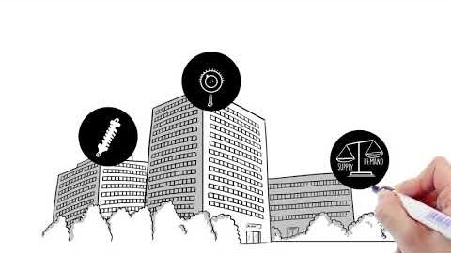
Smart Buildings – Key Roles in Transactive Energy
Video source: https://bgintegration.pnnl.gov/transactivecontrol.asp
Notes:
GEB can provide the necessary demand flexibility on the smart grid to absorb or make up the variation in energy output from renewable sources. This service can be monetized as Transactive Energy so building owners can be compensated for the value they bring to the grid, considered as grid services.
View this video at:
https://bgintegration.pnnl.gov/transactivecontrol.asp

Slide 88
Section 2: Review Question 1
Name at least four Smart Building technologies that can save energy.

Slide 89
Section 2: Review Question 2
Smart Meters enable smart buildings to be energy efficient. Provide at least four benefits that smart meters bring to Smart Buildings.

Slide 90
Section 2: Check Your
Knowledge Question 1
Which of the following is not considered to be a smart building technology?
Smart Lighting System
Automatic Window Shading System
Digital Multi-function Meters
Electronic Door Locks

Slide 91
Section 2: Check Your
Knowledge Question 2
Which of the following Smart Building technologies have the biggest energy saving potential?
Smart Glass
Advanced Lighting System
Smart Thermostat
Smart Plug

Slide 92
Section 2: Check Your
Knowledge Question 3
What following feature enables a building’s HVAC system to be smart?
Advanced Multi-function Sensors
Energy Management System
High Efficiency Chiller
Data Analytics and Fault Diagnostics

Slide 93
Section 2: Check Your
Knowledge Question 4
Which equipment below is not considered a building Plug/Process load?
Small Electrical Appliances
Central Air Handling unit
Personal Computer
Personal Radiant Heater

Slide 94
Section 2: Check Your
Knowledge Question 5
Which of the following is considered a DER?
Site Solar Photovoltaic System
Battery or Thermal Energy Storage
Wind Turbine
EV Charging Station
All of the above

Slide 95
Section 2: Check Your
Knowledge Question 6
Which of the following is not considered a benefit of a GEB?
Energy savings from efficiency
Improved Comfort and IAQ
Higher Life Cycle Cost
Improved Operations

Slide 96
Section 2:
Small Group Discussion
Break into small groups and discuss the following:
How could smart tech could help solve those issues?
What are the main challenges with your building systems?
Notes:
Break into small groups and assign a spokesperson. Take turns sharing the top one or two challenges with your building systems. Then discuss with the group how smart technology could help solve those issues. After reconvening the whole class, the instructor will invite the spokesperson of each group to share some highlights from the discussion.

Slide 97
Section 3
Operational Strategies for
Smart Buildings

Slide 98
Managing
Smart Building Systems
Define clear areas of responsibility
(e.g. management and in-house support staff)
Create good relationships with IT staff for support and resources
Consider outsourcing tech support service contracts if needed
Plan and budget for hardware/software upgrades & maintenance
Plan for on-going staff training; skill share between OT/IT staff
Implement robust cybersecurity policies/measures
Specify systems with a common standard communication protocol (e.g. BACnet)
Plan for system scalability
Notes:
Smart Buildings are high performance buildings enabled by one or more smart building systems and must be managed and operated as such. This new generation of buildings features energy efficient mechanical and electrical equipment equipped with the latest technology enabled smart devices that will require technicians with advanced skills in technology systems. Operators will need to become aware of IT at a strategic level and collaborate with their IT department. Moreover, responsible facility managers must dedicate and allocate the appropriate level of human and capital resources to ensure system effectiveness and reliability.
What are some challenges you can see in collaborating with IT staff? How can those challenges be overcome?

Slide 99
Operational Strategies for
Smart Building Systems
Maintain accurate inventory of systems and components
Perform regular system database backups and network integrity checks
Maintain accurate sequence of operations
Schedule hardware and software upgrades
Maintain critical parts inventory
Regularly monitor and timely correct system alarms
Adhere to network security policies
Develop disaster recovery and alternative control plans
Plan contingencies for outsourced critical support services

Slide 100
Cybersecurity Risk
DEFINITION:
“Risk of financial loss, operational disruption, or damage, from the failure of the digital technologies employed for informational and/or operational functions introduced to a manufacturing system via electronic means from the unauthorized access, use, disclosure, disruption, modification, or destruction of the manufacturing system.”
National Institute of Standards and Technology (NIST)
Notes:
Cybersecurity risk does not only apply to a manufacturing system but can be a threat to any systems that rely on technology as part of any operations.
We’ll discuss cybersecurity in the next few pages, and there are additional cybersecurity resources in the Appendix.

Slide 101

Understanding
Cybersecurity Threats
Image source: https://ingenuity.siemens.com/2020/07/the-top-five-trends-shaping-cybersecurity-in-smart-buildings/
Notes:
Since cybersecurity risks can be present in any technology-based operation including smart buildings, facility owners, managers and operators must be familiar with the most common forms of cybersecurity threats as described below:
Cyber Attacks e.g. Denial Of Service, Man-in-the-middle (MiTM) session hijacking
Malicious codes and viruses e.g. spyware, trojans, malware, ransomware
Database breaches and data theft
Unauthorized access and tampering of operational systems, files and settings
These threats can have negative impacts on the organization, including the following consequences:
Disruption to operations or production
Loss of productivity
Significant financial implications (losses)
Theft/fraud
Damage to brand/loss of client trust

Slide 102
NIST Cybersecurity
Framework Core Elements
Identify
Protect
Detect
Respond
Recover
Image Source: NIST Framework for Improving Critical Infrastructure Cybersecurity
Notes:
Securing smart buildings from cybersecurity risks is everyone’s responsibility but the organization’s IT department must take the lead in developing and implementing a robust cybersecurity plan for all technology systems that makes up a smart building.
The following is an excerpt from the US National Institute of Standards and Technology technical paper on Framework for Improving Critical Infrastructure Cybersecurity.
“Cybersecurity can be an important and amplifying component of an organization’s overall risk management. To better address these risks, the Cybersecurity Enhancement Act of 2014 (CEA) updated the role of the National Institute of Standards and Technology (NIST) to include identifying and developing cybersecurity risk frameworks for voluntary use by critical infrastructure owners and operators. Through CEA, NIST must identify “a prioritized, flexible, repeatable, performance-based, and cost-effective approach, including information security measures and controls that may be voluntarily adopted by owners and operators of critical infrastructure to help them identify, assess, and manage cyber risks.”
The Framework Core is a set of cybersecurity activities, desired outcomes, and applicable references that are common across critical infrastructure sectors. The Core presents industry standards, guidelines, and practices in a manner that allows for communication of cybersecurity activities and outcomes across the organization from the executive level to the implementation/operations level. The Framework Core consists of five concurrent and continuous functions—Identify, Protect, Detect, Respond, Recover. When considered together, these functions provide a high-level, strategic view of the lifecycle of an organization’s management of cybersecurity risk. The following provides more details for each of the five core elements:
Identify – Develop an organizational understanding to manage cybersecurity risk to systems, people, assets, data, and capabilities.
Protect – Develop and implement appropriate safeguards to ensure delivery of critical services.
Detect – Develop and implement appropriate activities to identify the occurrence of a cybersecurity event.
Respond – Develop and implement appropriate activities to take action regarding a detected cybersecurity incident.
Recover – Develop and implement appropriate activities to maintain plans for resilience and to restore any capabilities or services that were impaired due to a cybersecurity incident. “

Slide 103

Smart Technologies & Cybersecurity
Image source: https://www.arcweb.com/blog/it-ot-cybersecurity-convergence-arcs-virtual-industry-forum
Notes:
In many organizations, the Operational Technology (OT) team and the Information Technology (IT) team have traditionally been somewhat siloed. As buildings become smarter and more connected, the security risks also increase, and the importance of building good relationships and communication with your IT team (whether in-house or outsourced) cannot be overstated. Cross-training between teams to share at least a base level of knowledge can be helpful in the effort to maintain the highest level of security possible.
Some recommended Best Practices:
Recognize the importance of IT and OT (Information versus Operational Technology) teams working together
Perform Risk Assessment and Inventory
Implement Robust Security Measures – this applies to cyber security as well as physical security (for example, don’t share passwords or post them in plain sight for anyone to see).
Develop System Access Policies
Implement Tiered Access/Passwords
Adopt Cyber Security Standards, e.g. NIST Framework for Improving Critical Infrastructure Cybersecurity, BACnet Secure Connect
Implement IOT Security Guidelines, e.g. NIST Considerations for Managing IOT Cybersecurity and Privacy Risks
Certification i.e. ISO 27000:2018 Information Security Management System

Slide 104

BACnet Secure Connect
Image source: BACnet International Journal
Notes:
ASHRAE has developed a technology called BACnet Secure Connect (BACnet/SC), which uses the latest techniques for security and has been integrated into the BACnet standard. It integrates easily with IT infrastructure and enables the ability to create secure communication between BAS devices. It is compatible with all existing BACnet devices and works both within facilities and across the cloud.
Sources: Fisher, D. (2020). BACnet/SC: The Big Picture. BACnet International Journal, (18). Retrieved March 7, 2023, from https://bacnetinternational.org/wp-content/uploads/sites/2/2022/07/BIJ-18-BACnetSC-Article.pdf.
More information about BACnet/SC from ASHRAE can be found at:
https://bacnet.org/press-releases/bacnet-secure-connect-reference-implementation-released/

Slide 105
Summary
The growth of smart high performance buildings is critical to meeting climate and energy goals
Smart technologies enable energy efficiency in Smart Buildings
Grid-interactive Efficient Buildings will enable clean, reliable and cost- effective energy
Smart Buildings will be key assets within the Smart Grid
Smart Buildings require smart operators w/ advanced technology skills
Cybersecurity is a must to secure smart building systems
Knowledge of Smart Building technologies will increase adoption, innovation and cost effectiveness
Notes:
NOTE: Additional cybersecurity resources can be found in the Appendix.

Slide 106
Key Takeaways
Incorporate smart technologies in retrofit and new construction
Consider open versus closed system communication architecture
Evaluate multiple vendors
Enhance building operator skills on smart technologies
Evaluate software support needs and maintenance costs
Develop cybersecurity policies and implement measures
Enable Smart Building systems to achieve GEB capabilities
Seek out revenue opportunities for your GEBs
Operations and IT teams must work together to manage risks

Slide 107
Resources
Nexus Labs
National Renewable Energy Laboratory (NREL)
New Buildings Institute (NBI)
Lawrence Berkeley National Laboratory (LBL)
Pacific Northwest National Laboratory (PNNL)
National Institute of Standards and Technology (NIST)
Notes:
Links:
Nexus Labs - https://www.nexuslabs.online/
NREL - https://www.nrel.gov/
NBI - https://newbuildings.org/
LBL - https://www.lbl.gov/
NIST - https://www.nist.gov/
NIST Special Publication: Guide to Operational Technology (OT) Security
https://doi.org/10.6028/NIST.SP.800-82r3

Slide 108
Section 3: Review Question 1
Provide at least four operational strategies for Smart Buildings
A.
B.
C.
D.

Slide 109
Section 3: Check Your
Knowledge Question 1
Which of the following is not considered as part of the NIST Framework on Cybersecurity?
Identify
Recover
Block
Detect

Slide 110
Section 3: Check Your
Knowledge Question 2
Which of the following is not considered a good practice for managing smart buildings?
Plan and budget for software and hardware upgrades
Consider human and financial resource requirements
Consider systems with proprietary software
Plan for scalability

