Slide 1

BOC 1014 Electrification and Building Operations
Month Day, Year Instructor Name, Position
Instructor Company
Phone Name@email.com
Notes:
Instructor’s name: __________________________________________________________
Phone number: ____________________________________________________________
E-mail: ___________________________________________________________________
_________________________________________________________________________
_________________________________________________________________________
_________________________________________________________________________
_________________________________________________________________________
BOC 1014 Electrification and Building Operations
Edition 1.10

Slide 2

Safety Message
Notes:
Let's start with a safety reminder. This may be something from the course sponsor or site host; the instructor, moderator, or a student. Topics can include anything related to safety: site, health, personal, equipment, etc. What topic shall we address today?

Slide 3
Project Debrief
What went well?
What didn’t go well?
Why did things happen?
What will you do differently next time?
How will you use this?
Notes:
BOC 1001: HVAC Equipment Floor Plan
BOC 1002: Benchmark Your Building in Energy Star Portfolio Manager
BOC 1003: Conduct a Lighting Survey and Calculate a Retrofit Incentive
BOC 1004: HVAC Controls Review
BOC 1005: Develop an Occupancy Schedule

Slide 4
BOC 1014 Learning Objectives
Understand the motives and measures for electrifying buildings
Understand how electrification influences building performance, safety, and operations and maintenance
Identify benefits and barriers to electrification
Execute basic maintenance on electricity-powered mechanical systems
Explain how electrification impacts the role of building operators

Slide 5
BOC 1014 Agenda
Section 1 - Introduction to Electrification Concepts
What is Electrification?
Environmental Drivers
Policy Trends
Benefits
Barriers & Solutions
Section 2 - Electrification Technology & Equipment
Space Heating and Cooling
Domestic Hot Water Heating
Cooking
Distributed Energy Resources
Grid-Interactive Efficient Buildings
Energy Storage
Section 3 - Impact of Electrification on Building Operators
New Construction
Retrofit Planning
O&M Considerations
Energy Accounting

Slide 6
Section 1 Introduction to Electrification
Notes:
Our energy infrastructure is undergoing a major transformation. Brought about by an effort to move away from fossil fuels, many states and cities are now adopting aggressive climate action plans that include renewable energy and energy efficiency to meet their carbon reduction goals.
Buildings are significant consumers of energy and producers of greenhouse gas emissions but at the same time, buildings also represent great potential to contribute to the transition to a clean energy economy. Buildings are also potential sources for distributed renewable energy. To realize this potential, buildings will increasingly have to rely on non-fossil-fuel-based equipment. Even more crucial is the need for building operators to have the skillset to understand and operate electrified equipment and reduce their buildings’ underlying carbon emissions.
This class provides an overview of electrification and examines how it is increasingly a part of a building operator’s responsibility. Concepts discussed include drivers, benefits, barriers/solutions, key technologies, and maintenance and operation of electrified equipment.

Slide 7
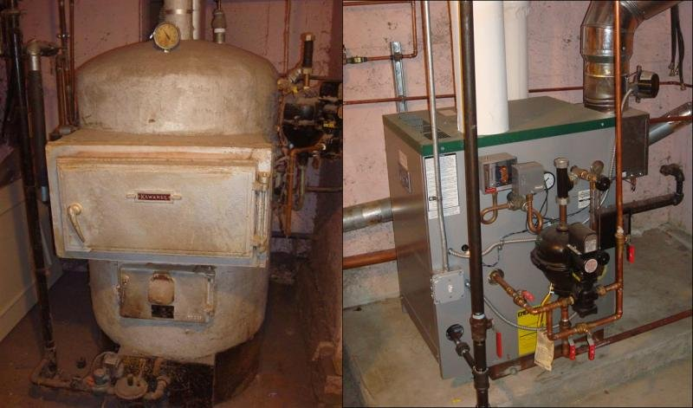
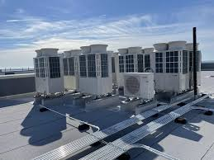
What is Electrification?
Replacing technologies that use fossil fuels on-site
Natural gas
Petroleum/diesel
Image source: energy.gov
With technologies and systems that use electricity on-site
Image source: energy.gov
Notes:
A simple definition of electrification is replacing fossil-fuel powered technologies with technologies that use electricity as their energy source. This term can apply to many sectors, including industry, electrical generation, transportation, and operation of buildings. Electrification is also sometimes referred to as “fuel switching.” This class will focus on electrification in existing buildings, though you will see that there is some overlap between this and other sectors, especially electrical generation and transportation.

Slide 8
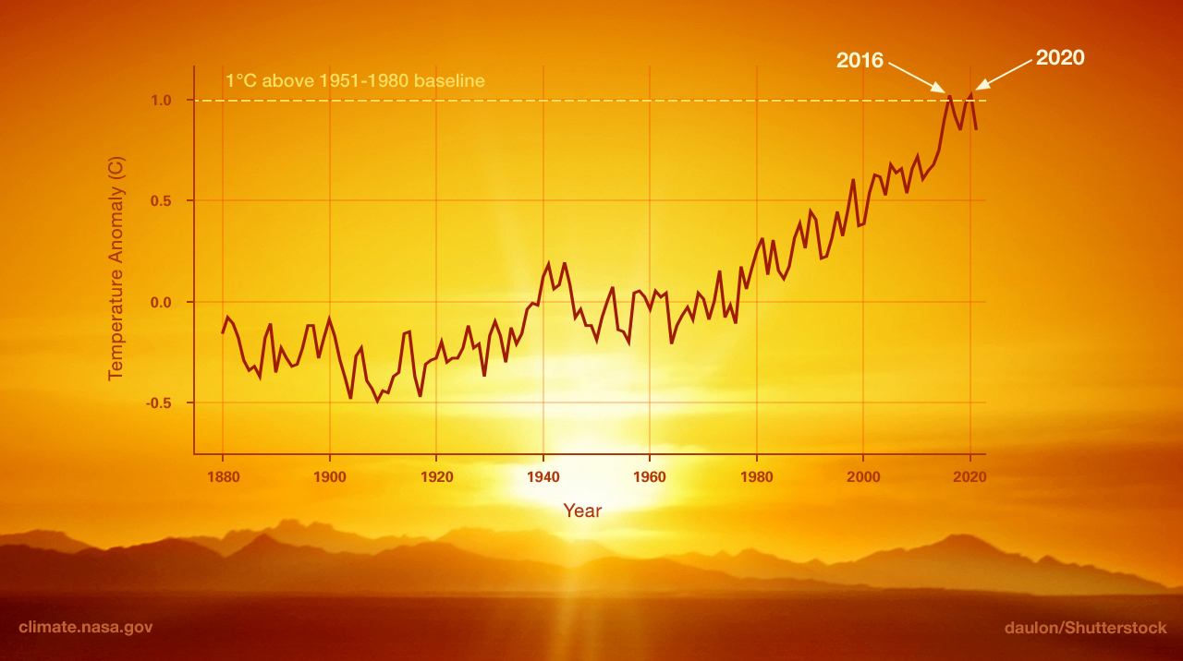
Greenhouse Gas (GHG)
Emissions
Image credit: NASA/JPL-Caltech
Notes:
Buildings account for almost 40% of the planet’s heat-trapping greenhouse gas (GHG) emissions. Greenhouse gases include carbon dioxide (CO₂), methane, nitrous oxide, and fluorinated gases. These heat-trapping gases, which remain in the atmosphere for hundreds of years, are driving global warming and in turn, climate change and its increasingly extreme weather effects. Natural processes can contribute to changes in climate, but most climate scientists agree that this current warming trend is overwhelmingly due to human activities, primarily fossil fuel burning, since the dawn of the industrial age around the turn of the 20th century. The warming is increasing at an unprecedented rate. The resulting climate change is evident by diminishing glaciers, rising ocean levels, and more frequent and extreme climate and weather events such as droughts, hurricanes, and floods, affecting all regions globally. Science indicates that temperatures will continue to rise and that some of these changes will be irreversible for hundreds or thousands of years. However, if we can reduce emissions now, we may avoid some of the most damaging effects in the future.
This graph from NASA’s Goddard Institute for Space Studies illustrates the change in global surface temperature relative to 1951-1980 average temperatures, with the year 2020 tying with 2016 for hottest on record.

Slide 9
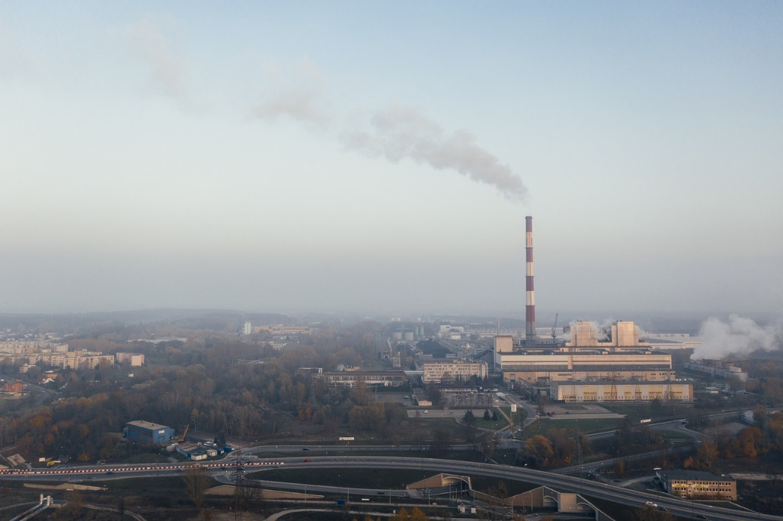

Health Impacts
Image by Marcin from Pixabay
Image by Jeff Yen from Pexels
Notes:
In addition to global warming and climate change, burning fossil fuels pollutes the air we breathe, causing many different health issues, including asthma, respiratory disorders, cancer, stroke, heart disease, and premature death. It has also been linked to Alzheimer’s disease and autism. Research from Harvard University, University of Leicester and University College London found that fossil fuel-based air pollution was responsible for about 1 in 5 deaths worldwide in 2018.
According to a report by the Medical Society Consortium on Climate & Health, Wisconsin Health Professionals for Climate Action, and Natural Resources Defense Council (NRDC), health costs related to climate change and fossil fuel pollution are estimated at about $820 billion per year in the U.S.
Sources: https://www.hsph.harvard.edu/c-change/subtopics/fossil-fuels-health/
https://www.nrdc.org/sites/default/files/costs-inaction-burden-health-report.pdf

Slide 10
Buildings’ Share of U.S. Primary Energy Consumption
Source: U.S. Energy Information Administration (EIA), 2021
Notes:
Introduction
Commercial and residential buildings combined use about 40% of total energy produced, higher than any other sector in the United States. These buildings consume 72% of electricity and 55% of natural gas, at a cost of $202.3 billion annually. The energy used inefficiently or unnecessarily is estimated to be as much as 30%, with buildings accounting for 38% of the carbon dioxide emissions in the country.

Slide 11
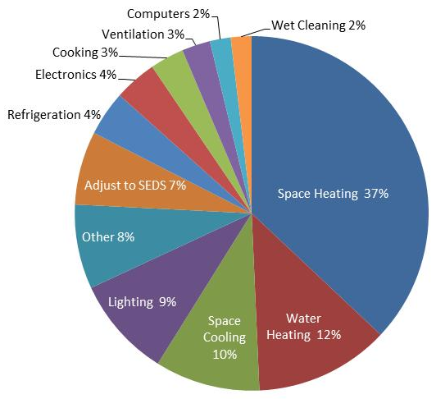
Commercial Sector Buildings Energy End Use
Notes:
As this graph shows, nearly half of the energy consumed in commercial buildings is used for space and water heating, which is often accomplished by fossil fuel-burning equipment.
Source: PECI
Note: State Energy Data (SED) Systems are comprehensive state-level estimates of energy production, consumption, prices and expenditures by source and sector.

Slide 12
Group Exercise #1
Break into small groups and designate a spokesperson for the group.
Share your building sector type and the primary end use loads.
Discuss which systems consume the most energy and why; what percentage would you estimate?
Compare to primary end uses typical in commercial buildings shown on the graph on the previous page.
Rejoin the whole class and report out the highest end use loads for the group.
Notes:
Break into small groups and designate a spokesperson for the group. Share with the group your building sector type and the primary end use loads. If possible, give a rough estimate of the percentage of total energy use for each of the primary loads. Note any similarities or differences from primary end uses typical in commercial buildings shown on the graph on the previous page. Then rejoin the whole class and report out the highest end use loads for the group.

Slide 13
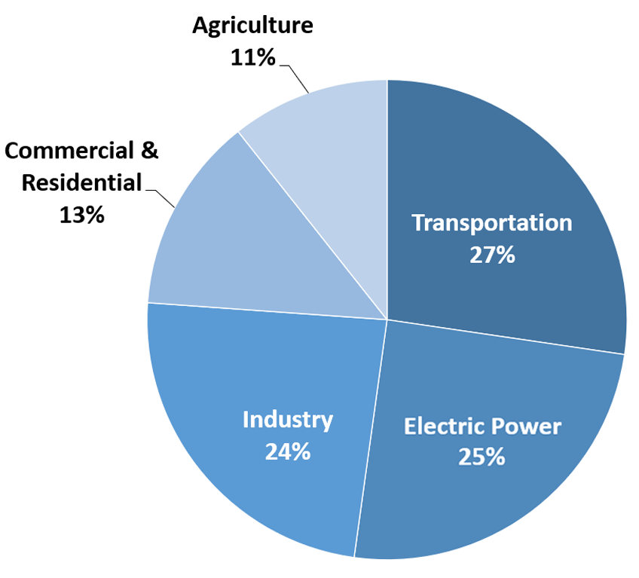
The GHG Emissions Impact of Buildings
Sources of U.S. Greenhouse Gas Emissions in 2020
U.S. Environmental Protection Agency (2022). Inventory of U.S. Greenhouse Gas Emissions and Sinks: 1990-2020
Notes:
In the U.S., buildings are responsible for about 38% of greenhouse gas (GHG) emissions, both direct and indirect. Direct emissions come from the building itself, by burning fossil fuels to power mechanical equipment, largely for space heating, water heating, cooking, and space cooling (such as with a gas-fired chiller). Indirect emissions are generated when fossil fuel-based energy that the building consumes is created, such as electricity that comes from a coal or natural-gas electrical generation plant. 63% of U.S. electricity generation is from burning fossil fuels, although the power grid is increasingly shifting toward cleaner sources (and will need to continue to do so in order to meet carbon reduction targets). Many regions have a much higher mix of clean energy sources in their power generation portfolios, with some areas powered by 100% renewable sources, including hydro, solar, wind, biogas, and others.
Indirect emissions also come from production and transportation of goods and waste consumed and/or produced in buildings. As the graph here shows, U.S. buildings directly generate 13% of greenhouse gas emissions, but indirect emissions from electric power, transportation, and industry result in even larger impacts.

Slide 14
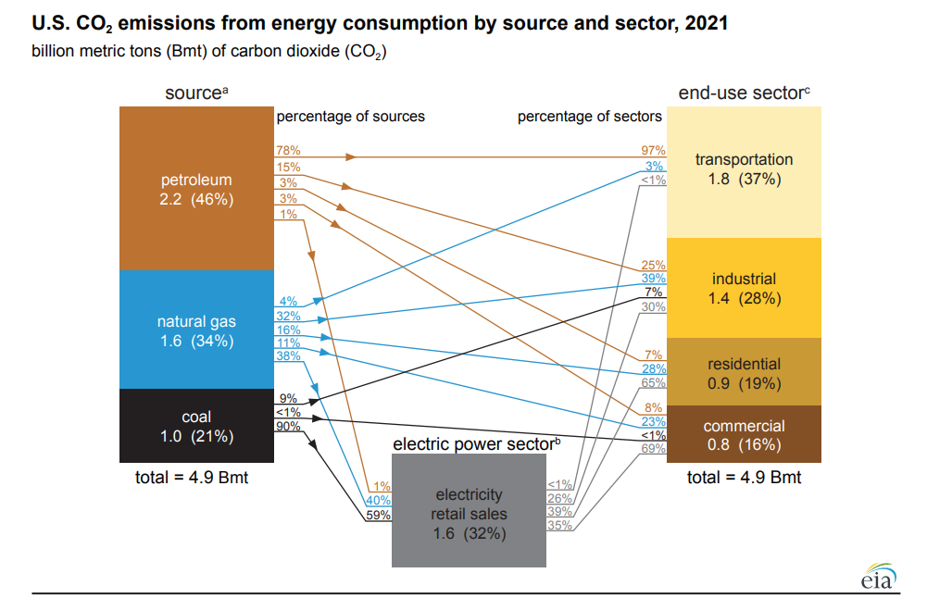
Emissions by Sector
Notes:
When factoring in use of electricity generated from fossil fuels, commercial buildings account for 16% of CO2 emissions in the U.S.
Source: U.S. Energy Information Administration

Slide 15

Why Existing Buildings?
5.6 million commercial buildings in the U.S.
These Commercial Buildings Generate:
16% of total CO₂ emissions
35-45% of municipal solid waste
These Commercial Buildings Consume:
18% of all energy used in U.S.
35% of all electricity
17% of all potable water
Notes:
Use of energy generated by burning fossil fuels has many human and environmental costs. Pollutants from fossil fuels diminish air quality, which can severely affect human health. It is important to consider the impact of our commercial buildings on resources such as natural gas and water, as well as the consequences of GHG emissions, which contributes to global warming and climate change. Waste generated in buildings has an impact too, since it must be transported, which is often accomplished using fossil fuels.
As a response, many nations, states, cities, and other jurisdictions are enacting mitigation strategies for the building sector, including:
Decarbonizing the electric grid
Switching to all-electric equipment (in new construction and existing buildings)
Increasing energy efficiency to help accommodate the larger electric loads
Sources:
Waste: https://www.epa.gov/facts-and-figures-about-materials-waste-and-recycling/national-overview-facts-and-figures-materials
CO2: Energy-related carbon dioxide (CO₂) emissions by source and sector for the United States, 2021 (million metric tons), https://www.eia.gov/tools/faqs/faq.php?id=75&t=11
Energy: https://www.eia.gov/consumption/
Electricity: https://www.energy.gov/eere/buildings/about-commercial-buildings-integration-program
Water: https://www.awwa.org/

Slide 16
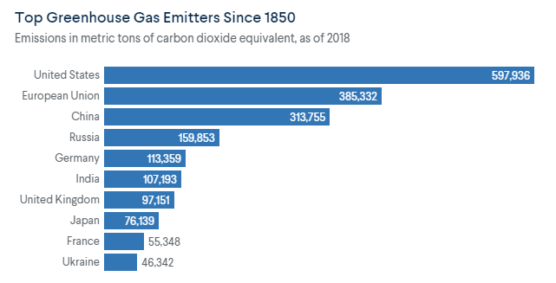
Global Response
Image source: Council on Foreign Relations
Notes:
Climate scientists and other experts have been sounding the alarm for several decades about global warming and its potential catastrophic environmental effects. The Intergovernmental Panel on Climate Change (IPCC) was formed in 1988 by the UN, and regularly produces consensus-based reports from the latest climate science assessments. In 1992, 197 countries including the U.S. formed the UN Framework Convention on Climate Change (UNFCCC), the first global treaty addressing the issue. This led to the Kyoto Protocol in 1997, the first legally binding climate treaty, which required developed countries to reduce emissions by an average of 5% below 1990 levels. In 2015, the Paris Agreement was reached, requiring all countries to set emission-reduction targets. The Paris Agreement is an effort to keep the global average temperature from rising 2° Celsius (3.6° Fahrenheit) above preindustrial levels, with the goal of keeping it below 1.5° C, which is the level the IPCC has determined will result in severe effects worldwide.
A 2021 IPCC report estimated that the earth’s average temperature has already increased about 1.1° C. Unfortunately, even with these treaties in place, most countries haven’t done enough to cut emissions to the level needed to reduce the rise in temperature. The U.S. has generated the most emissions total since pre-industrial times.
Sources:
https://www.cfr.org/backgrounder/paris-global-climate-change-agreements
Image data source: https://www.climatewatchdata.org/

Slide 17
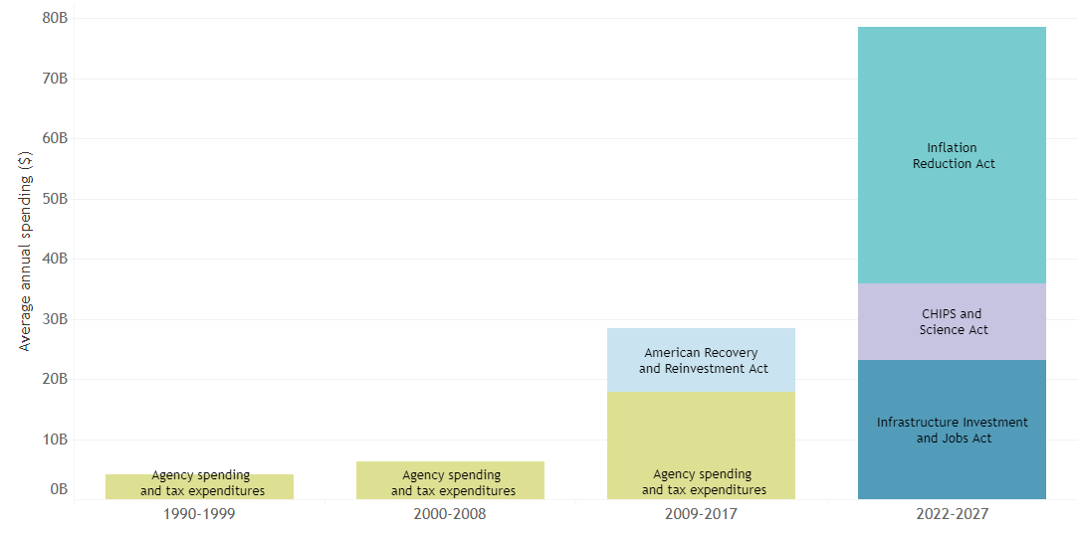
National Policy Trends
Recently, we have seen historic investment in federal climate spending. In the next few years, spending on climate with more than triple historic levels.
Source: https://public.tableau.com/app/profile/jun.shepard2722/viz/FederalSpending1990-2029/FederalSpending1990-2029
Notes:
As the urgency to act has increased, the U.S. has committed to transforming the electric grid to 100% renewable energy by 2035 and a net-zero emissions economy by 2050, which means that the amount of greenhouse gases emitted is balanced with the amount removed. Additionally, the U.S. has made historic investments to address the climate crisis in three large, distinct pieces of legislation: The Infrastructure, Investment and Jobs Act, The CHIPS and Science Act, and, most recently, the U.S. Congress passed H.B. 5376, known as the Inflation Reduction Act, establishing funding that will contribute to electrification efforts nationwide in the transportation, electricity generation, and in buildings. It is considered by some to be the most significant climate legislation ever passed in the U.S.
Graph notes: Average annual spending, adjusted for inflation. Note that time periods shift from 2000-2008 to 2009-2017. This is to 1) consolidate the impact of the American Recovery and Reinvestment Act to one bar and 2) address missing data between 2018-2021. The analysis that includes these data ends at 2017.
Values are based on Rocky Mountain Institute (RMI) estimates using agency spending data from the Government Accountability Office (GAO), tax expenditure data from the Joint Committee on Taxation (JCT), and internal analysis on 2021-2022 legislation (Infrastructure Investment and Jobs Act, CHIPS and Science Act, Inflation Reduction Act). Spending from the American Recovery and Reinvestment Act is based on a White House memo on clean energy spending from 2010.
Image source: https://public.tableau.com/app/profile/jun.shepard2722/viz/FederalSpending1990-2029/FederalSpending1990-2029
Recently, we have seen historic investment in federal climate spending. In the next few years, spending on climate with more than triple historic levels.

Slide 18
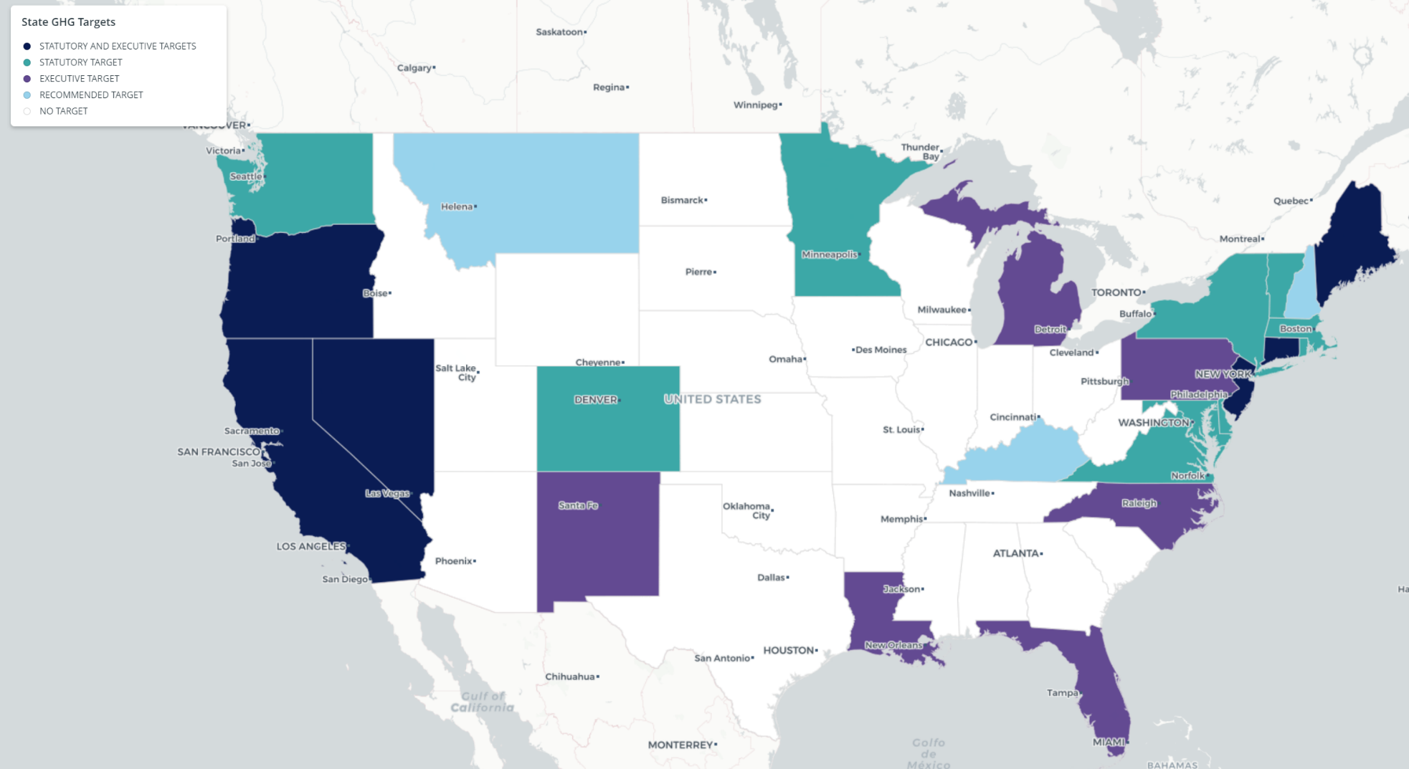
Regional Policy Trends
Image source: Center for Climate and Energy Solutions
Notes:
States and cities have also been moving ahead with their own decarbonization and energy efficiency efforts. The map above shows the states that have set GHG emission reduction targets as of 2023, totaling 25 states plus the District of Columbia.
For example, California has enacted the several decarbonization initiatives including:
SB-100 (Carbon Neutral Electricity by 2045)
B-55-18 (Executive order for economy-wide neutrality by 2045)
SB-32 (CA Global Warming Solutions Act 2016, with a goal of reducing GHG emissions to 40% below 1990 levels by 2030)
In 2019, Washington State enacted the Clean Buildings Performance Standard, requiring commercial buildings to meet use-specific energy use intensity (EUI) targets.
Many cities have adopted related initiatives as well, for example in New York City, Local Law 97 establishes a carbon cap on existing buildings, which has helped to accelerate the discussion of colder-climate electrification. And the Berkeley, California Existing Buildings Electrification Strategy adopted in 2021 focuses on beneficial electrification retrofits for existing buildings, with a timeline to transition completely off fossil fuels in buildings by 2045. Several cities have enacted laws banning new gas hookups in new construction.
Image source: https://www.c2es.org/document/greenhouse-gas-emissions-targets/

Slide 19
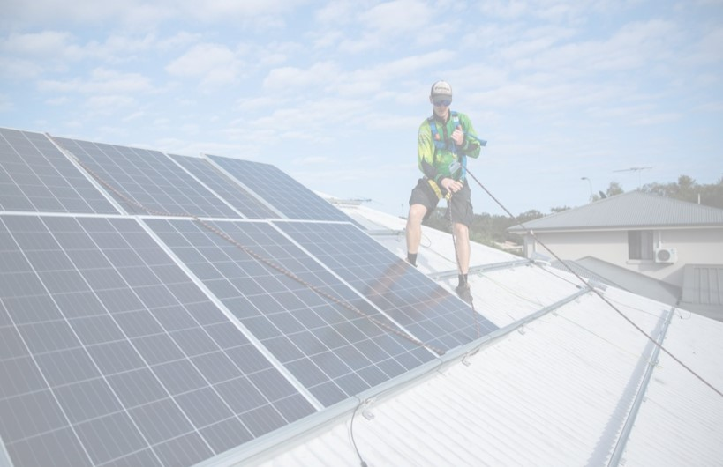
Policy Trends
Research & Development
Codes & Standards
Incentives
Energy affordability – beneficial electrification
Clean energy job creation
Notes:
Decarbonization policy strategies vary by jurisdiction but typically utilize a variety of mechanisms, often addressing codes and standards for new construction and sometimes including funding for research and development of new technologies. Policy strategies are increasingly considering energy affordability and energy cost burden. Financial incentives for efficiency measures or electrification projects are commonly included, a necessary step toward making these actions viable across the economic spectrum. Many strategies also focus on clean energy job creation.
For example, Illinois’ new clean energy law (SB 2408) phases out investor-owned utility coal plants by 2030, and the remaining coal plants and all gas-fired plants by 2045. The law funds conversion of coal facilities to solar farms, including job retraining programs geared toward displaced coal workers. As another example, Washington State Department of Commerce is preparing to make $9.7 million of total funding available under the Clean Energy Fund Building Electrification grant program.
Source: https://www.ncsl.org/research/energy/2022-legislative-energy-trends.aspx

Slide 20
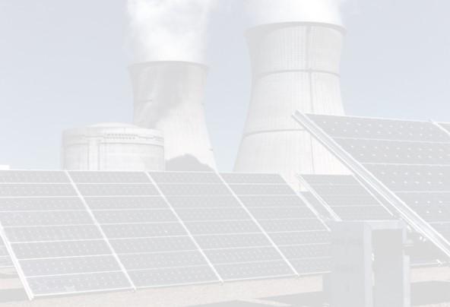
Utility Response
Less fossil fuel based non-intermittent sources
More intermittent sources (renewable energy)
Energy efficiency incentives
Demand Response
Distributed Energy Resources (DERs)
Energy storage
New infrastructure
Notes:
With this focus on electrification, the electricity capacity available on the grid will also need to grow. According the Washington State Department of Commerce, 2021 State Energy Strategy, the peak load on the electric grid will nearly double by 2050.
Utilities must find ways to meet these increased capacity needs. This growth necessitates a shift in electric utility operation and presents many challenges. The energy grid has long relied on non-intermittent sources such as coal, oil, and natural gas to provide an uninterrupted supply of energy from power plants. The shift to clean energy brings an increased mix of intermittent sources that don’t generate energy constantly, for example wind and solar power. In some regions, the peak loads will shift from summer to winter as heating increasingly becomes electrified.
Strategies to meet the shifting sources and increased loads include incentivizing energy efficiency, implementing demand response programs (incentivizing customers to reduce loads during peak hours), leveraging distributed energy resources (onsite renewable energy generation and storage), and building new infrastructure for transmission and distribution.

Slide 21





Electrification Benefits
Mitigation of the most severe effects of climate change
Improved air quality/health
Energy cost savings
Job creation
Improved comfort/productivity
Notes:
With thoughtful design and foresight in planning, electrification can be beneficial to the environment, utility ratepayers, and to society as a whole. There are many potential benefits to electrification, both energy and non-energy related. These include reduced CO2 emissions, slowing the rate of global warming and helping to mitigate the effects of climate change; improved air quality and health outcomes; energy cost savings; creation of new jobs; and improved comfort in the indoor environment which, in turn, increases productivity.

Slide 22
Barriers & Solutions
Technical/Logistical
Economic
Social
Infrastructure capacity upgrades
Hardware and software integration
Smart buildings
On-site renewables and battery storage
Capital costs
Consider Total Cost of Ownership (TCO)
End-of-life equipment retrofit opportunities
Energy costs
Incentives, rebates, grants, and other funding sources
Trade skills and capabilities
Diversity, Equity and Inclusion
Health and Safety
Notes:
Of course, there are many challenges to electrification as well, including technical, logistical, and economic barriers. For example, depending on the region, electricity rates may be more expensive than gas. While electrification technologies often bring increased efficiency, first costs are sometimes prohibitive, so finding viable funding mechanisms that consider return on investment (ROI) over the life of the equipment is key.
Leveraging opportunities to replace end-of-life equipment with electrified technologies can be very beneficial. Upgrading electrical service capacity to a building to accommodate increased loads can be costly, so it is important to address energy efficiency opportunities to reduce loads before implementing big electrification retrofits. Reliability is a technical challenge that can be overcome by careful planning and innovation. Technologies and strategies to overcome these challenges are rapidly developing, and costs will continue to come down with economies of scale.
Decarbonization policy strategies are increasingly addressing social equity concerns of electrification, with jurisdictions and utilities offering incentives so that electrification initiatives don’t put extra strain on lower-income communities. Some programs leverage the skills of fossil fuel industry workers by retraining them to fill the many jobs coming online in clean energy industries. Taking a holistic view of the social and health benefits in addition to economic considerations can tremendously increase the perceived value of electrification initiatives.

Slide 23

Funding Options
Potential Options for Funding Electrification-Related Projects:
Utility Grants
Tax Incentives
C-PACE(R)
ESPC
EaaS
PPA
Traditional Financing
Capital Budget
Notes:
Various funding mechanisms may be available to help with the up-front costs for electrification-related projects, including implementing efficiency measures to support electrification by reducing demand and/or integrating renewable energy.
Utility Grants and Tax Incentives
Many electric utilities offer grant programs and/or rebates that can help lower the upfront costs of electrification or energy efficiency measures. Federal and/or state tax credits or other incentives may also be available for certain measures. Checking for grants, credits, or other incentives in your jurisdiction is a good place to start.
Commercial Property-Assessed Clean Energy (C-PACE) financing is available in many states. This is a financing structure in which building owners borrow money for projects and make repayments via an assessment on their property tax bill. One of the advantages of PACE is that the financing is attached to the property, not the owner, so when the owner sells the property they don't have to pay off the loan. PACE also means the loan can stay “off balance sheet” (an accounting practice that means the loan doesn’t decrease the owner’s capacity to qualify for lending). PACE is also viewed as more secure financing than some other types, which typically allows for longer-term financing at lower interest rates, which in turn enables deeper retrofits and very long-term payback measures (e.g. window replacements) that would not typically be attractive to owners who may not be planning to retain long-term ownership of the building.
PACE programs vary by state and even sometimes by county. Also, some states include resiliency in their PACE programs, such as Washington state's PACER program (the “R” is for “resiliency”). Resiliency measures could include seismic upgrades, and/or fire and flood protection measures.
Energy Savings Performance Contracting (ESPC) is another funding mechanism, in which the energy savings pay for the project. In this scenario, the customer partners with an energy service company (ESCO) to identify and implement cost-effective upgrades. The ESCO guarantees the energy savings of the implemented measures, and the customer makes service payments to the ESCO, which are offset by the energy savings. In some ESPC contracts, the ESCO manages the upgraded equipment and receives the energy savings for an agreed-upon period, after which the building owner assumes responsibility of O&M of the equipment and keeps the future energy savings. ESPC projects are often financed through a third party, but they are usually designed such that the customer’s overall savings are greater than the cost of financing plus ESCO payments over the life of the equipment.
Note: In some cases of ESPC, while the ESCO does guarantee the energy savings, these savings don’t always offset the cost of the measures with a favorable payback period. However, many agencies use ESPC as an alternative delivery method that can provide advantages such as avoiding a public bidding process and/or the up-front costs for auditing and engineering.
Efficiency-as-a-Service (EaaS) is a type of Pay-for-Performance financing solution in which the service provider pays for project development, construction, and maintenance costs, and the customer makes payments based on the actual energy savings.
A Power Purchase Agreement (PPA) is an arrangement in which a third-party provider installs, owns, and operates an energy system on a customer’s property, and then the customer purchases energy from the system (typically at a rate lower than the local utility rate) for a predetermined period, after which the customer has the option to extend the agreement or purchase the system from the provider. PPAs are typically only used to finance and deliver projects that generate energy, such as solar, wind, or combined heat and power (known as CHP or cogeneration), which may be a component of an electrification project. PPAs are not typically used to finance other types of energy efficiency measures.
More information about these and other financing options can be found at the U.S. Department of Energy Better Buildings Solution Center:
https://betterbuildingssolutioncenter.energy.gov/financing-navigator

Slide 24
Check Your Knowledge #1
What is one way to reduce emissions in your building(s)?
Can you name two common greenhouse gases?
What are three benefits to building electrification?

Slide 25
Section 2 Electrification Technology & Equipment
Notes:
In this section, we’ll focus on electrification technologies increasingly being applied in commercial buildings. The most common opportunities are in space heating and water heating. We’ll also discuss opportunities for cooking. The main technology options in these areas are:
Space/water heating: heat pumps, electric resistance, energy/heat recovery
Cooking: electric induction cooktops, other electric commercial/industrial appliances

Slide 26
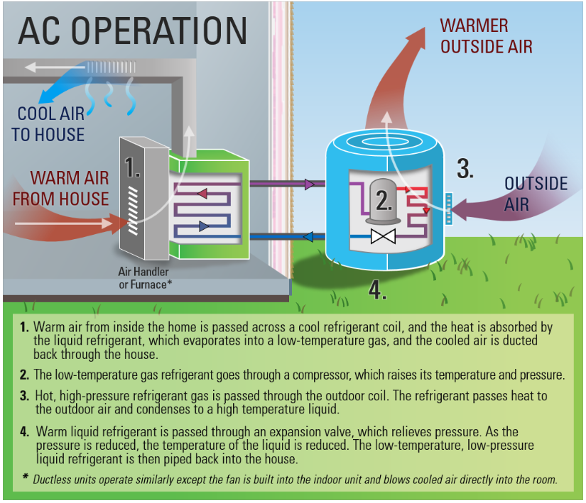
Heat Pumps
Notes:
Heat pumps are a key technology for beneficial electrification because they are extremely energy efficient. Rather than creating heat, they move heat. They source heat from air, water, or the ground and transfer it to an air or water load. Though first costs for heat pumps can sometimes be higher than other options, they often have a favorable payback resulting from substantial energy savings over time. As demand increases and more manufacturers are developing the technology and leveraging economies of scale, prices continue to come down. Heat pumps are based on the refrigeration cycle, but unlike air conditioners, they are capable of reverse operation to switch between heating and cooling by moving heat to or away from a space. Because heat pumps are typically all-electric, they can be a good choice for satisfying electrification initiatives.
Note: The image above references a residential heat pump system, but the concept is the same for commercial systems.
(Refer to the latest version of ASHRAE Systems and Equipment for more information.)
Image source: https://www.energystar.gov/products/ask-the-experts/how-does-a-heat-pump-work

Slide 27
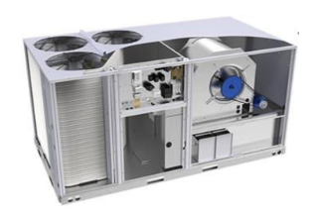
Heat Pumps (cont.)
Move heat
Heating or cooling
Water, air, or ground source
Water or air load
Very efficient operation
Image credit: United Technologies Research
Notes:
Heat pump technology is advancing quickly and they can work in all types of climates. They have a number of configurations and can thus be integrated with many other systems. They can work in the central plant, on a roof top, or next to a building. They are highly efficient, reliable and safe.
Learn more at: https://iea-industry.org/app/uploads/annex-xiii-part-a.pdf
Image source: https://www.energy.gov/eere/buildings/articles/high-performance-commercial-cold-climate-heat-pump

Slide 28
Ratings
COP= power out/power in = kW/kW
EER2= cooling out (Btuh)/energy in (watts)
SEER2= same as EER, but add seasonality
HSPF2= SEER2 for heating
kW/ton = kW/nominal tons cooling capacity
IPLV (integrated part load value) = 25% / 50% / 75% / 100%
Notes:
Heat pump operating efficiency in the heating mode is measured as the Coefficient of Performance (COP). Electric resistance heating has a COP of 1.0 meaning that for every BTU of heat output the system consumes the electrical equivalent of one BTU. A COP of 2.0 is twice as efficient as electric resistance heat. The higher the COP number, the more efficient the system. The COP is calculated by dividing the heat delivered by the electrical energy supplied (with both values converted to a common unit such as KBTUs).
Energy Efficiency Ratio (EER): is a measure of the instantaneous energy efficiency of cooling equipment. EER is the steady-state rate of heat energy removal (e.g., cooling capacity) by the equipment in Btuh divided by the steady-state rate of energy input to the equipment in watts. This ratio is expressed in Btuh per watt (Btuh/watt). EER2 is the latest version of the standard, dictated by the U.S. Department of Energy.
SEER - Seasonal Energy Efficiency Ratio is a measure of the seasonal cooling efficiency of a heat pump or a consumer central air conditioning system. SEER2 is the latest version of the standard. The minimum SEER2 rating for equipment sold in the U.S. is 13.4, but SEER2 ratings typically range up to about 21. Energy Star certified equipment must be at least 15.2. A SEER2 rating above 18 could be considered a very efficient system.
HSPF - Heating Season Performance Factor, The Heating Season Performance Factor - HSPF - is a measure of the overall heating efficiency of a heat pump.
The HSPF can be regarded as an "average" COP for an entire heating season. It is common to compare BTUs of heat output to watts of electrical energy input. HSPF2 is the latest version of the standard. The minimum HSPF2 rating for equipment sold in the U.S. is 6.8. For Energy Star, the minimum is 7.2. The most efficient heat pumps have an HSPF2 of between 9 and 10.5.

Slide 29

Reversible Refrigeration Cycle Illustration
Notes:
As you learned in BOC 1001, a heat pump contains a reversing valve to allow the condenser to become the evaporator and the evaporator to become the condenser.
Refrigerants at atmospheric pressure boil at very low temperatures. Assume that a reservoir of liquid refrigerant at room temperature will be at high pressure. If it is transported through a pipe and allowed to be released to a lower pressure through a valve (called an expansion valve), its temperature will drop to its boiling point temperature at the lower pressure due to partial or complete vaporization in the evaporator coil. The space around the coil will be cooled, primarily by providing the energy for the latent heat of vaporization of the refrigerant liquid at its low boiling point temperature. Therefore, all we need is a constant supply of refrigerant under pressure.
Instead of a large supply of refrigerant to be exhausted as it is used, a method to recycle the refrigerant had to be developed. A compressor is added to raise the refrigerant gas back to its original elevated pressure. A condenser is added to reject the heat of vaporization that was absorbed from the material being cooled, thus condensing the high-pressure vapor back to a high-pressure liquid. The high-pressure liquid is then returned to the liquid reservoir.
The expansion valve serves as a restriction that holds the upstream side at high pressure. On the downstream side of the expansion valve, the pressure is low since it is on the suction side of the compressor.
Video link: https://www.youtube.com/watch?v=G53tTKoakcY

Slide 30
Heat Pump (Cooling)
Notes:
Warm air from inside the building is passed across a cool refrigerant coil, and the heat is absorbed by the liquid refrigerant, which evaporates into a low-temperature gas, and the cooled air is ducted back through the building.
The low-temperature gas refrigerant goes through a compressor, which raises its temperature and pressure.
Hot, high-pressure refrigerant gas is passed through the outdoor coil. The refrigerant passes heat to the outdoor air and condenses to a high temperature liquid.
Warm liquid refrigerant is passed through an expansion valve, which lowers pressure. As the pressure is reduced, the temperature of the liquid is reduced. The low-temperature, low-pressure liquid refrigerant is then piped back in the building.
*Ductless units operate similarly except they have no ductwork and blow cooled air directly into the room, typically via wall, ceiling, or console indoor units.
Note: The image above references a residential heat pump system, but the concept is the same for commercial systems.

Slide 31
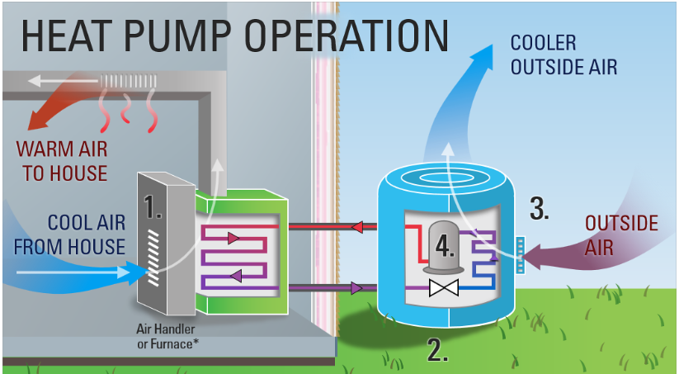
Heat Pump (Heating)
Notes:
Cold air from inside the building is passed across the high temperature, high pressure gas in the indoor coil, which transfers heat to the cold air. The refrigerant condenses to a liquid, and the warm air is circulated through the building.
Warm liquid refrigerant is passed through an expansion valve, which lowers pressure. As the pressure is reduced, the temperature of the liquid is reduced, and the cold refrigerant passes through the outdoor coil.
Heat energy transfers from the outside air to the low-pressure, low-temperature liquid refrigerant.
The low-temperature gas refrigerant goes through a compressor, which raises its temperature and pressure and passes it back to the indoor coil.
*Ductless units operate similarly except they have no ductwork and blow warmed air directly into the room, typically via wall, ceiling, or console indoor units.
Note: The image above references a residential heat pump system, but the concept is the same for commercial systems.

Slide 32
Heat Pump Classification
Source
air, water, or ground
Distribution
ducted or ductless
Configuration
packaged or split

Slide 33
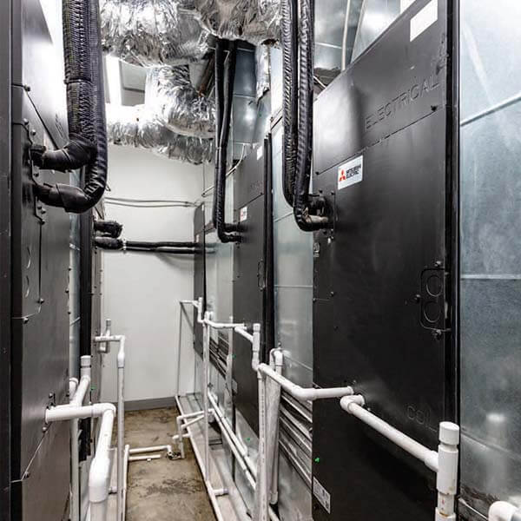
Ducted Heat Pump Systems
Air Source Heat Pumps (ASHP) or Water Source Heat Pumps (WSHP)
Types:
Packaged
Ducted split
Notes:
Ducted heat pump systems can be a good option for retrofits where there is already ductwork in place. One disadvantage to any ducted system is the potential for efficiency losses due to leaky ductwork. However, leaks can often be easily corrected or avoided, and ducted systems can be lower cost than installing multiple ductless indoor units. The primary disadvantage with ducted heat pump systems is the added fan energy required to move conditioned air through ductwork.

Slide 34
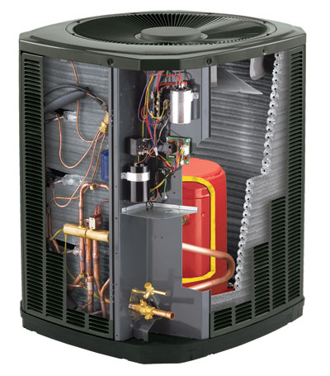
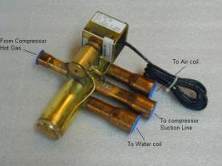
Air-to-Air Heat Pumps
Conventional operating characteristics
Reversing valve
Defrost controls
Optimum operation
Photo: Courtesy of Trane
Notes:
Air-to-air heat pumps move heat from one air source in one location to an air load in another location.
Heat pumps that operate in ambient conditions below 32° F must have controls for automatic defrost to remove ice build up on the outdoor coil.
Newer multi-speed units increase efficiency to as high as coefficients of performance (COP) = 2.2 at low ambient temperatures of 0°F.
When selecting an air-source electric heat pump, look for the ENERGY STAR® label.
Photo source: Trane

Slide 35
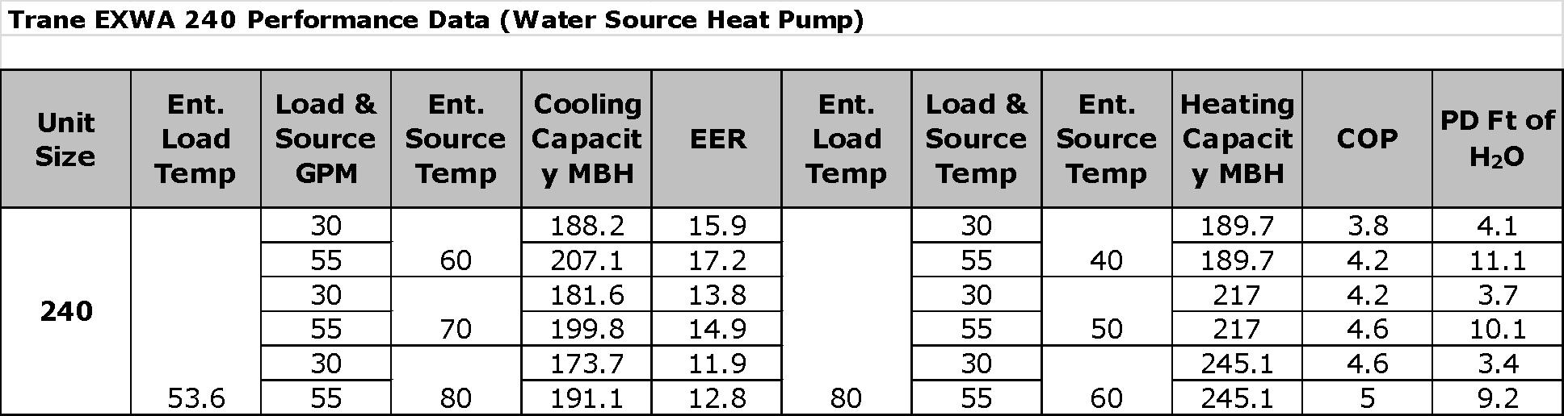
Heat Pump Performance
4-ton unit
20-ton unit
GPM
GPM
Notes:
Cooling is measured in tons, where one ton is 12,000 BTU per hour.
These are typical examples of the published performance characteristics of two common heat pumps. The first table is for a 4-ton air-to-air unit and the second table is for a 20-ton water-to-air unit. As can easily be seen from the chart, air-source heat pumps provide their highest heat output when the actual heating load on the space is the lowest. As outside air gets colder, and the space heat requirement gets higher, air-source heat pumps lose heat output capability and operating efficiency when the heat is needed most.
Traditionally, geothermal systems were the most viable option for cold climate heat pumps. However, technology is evolving quickly, and advances in variable speed inverter-driven compressor technology have resulted in more options for air-source heat pumps that can operate well in cold climates.
Source: https://rmi.org/heat-pumps-a-practical-solution-for-cold-climates/

Slide 36
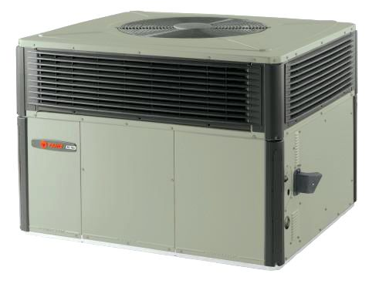
Packaged Heat Pump Rooftop Units
Use existing ductwork
Can replace gas packs
Relatively low first-cost
Moderate efficiency
Image source: Trane.com
Notes:
Packaged heat pump RTUs can be a good replacement for gas-fired packaged RTUs, with a relatively low first cost and simple installation (though they may require slightly more roof space than comparable gas packs). They are moderately efficient compared with other types of heat pumps. They are typically available in capacities from about 3-25 tons, sometimes with the option of auxiliary electric resistance heating. Some manufacturers report cold-weather operation down to 0° F. They are also available in dual fuel models, where the heat pump operates down to about 17° F, then switching over to an integrated gas furnace to handle the colder load.
Packaged rooftop heat pumps come in air-sourced and water-sourced models.
Source: U.S. Department of Energy. (n.d.). Decarbonizing HVAC and Water Heating in Commercial Buildings. Retrieved October 10, 2022, from https://betterbuildingssolutioncenter.energy.gov/sites/default/files/attachments/Decarbonizing%20HVAC%20and%20Water%20Heating%20in%20Commercial%20Buildings%2011.21.pdf

Slide 37
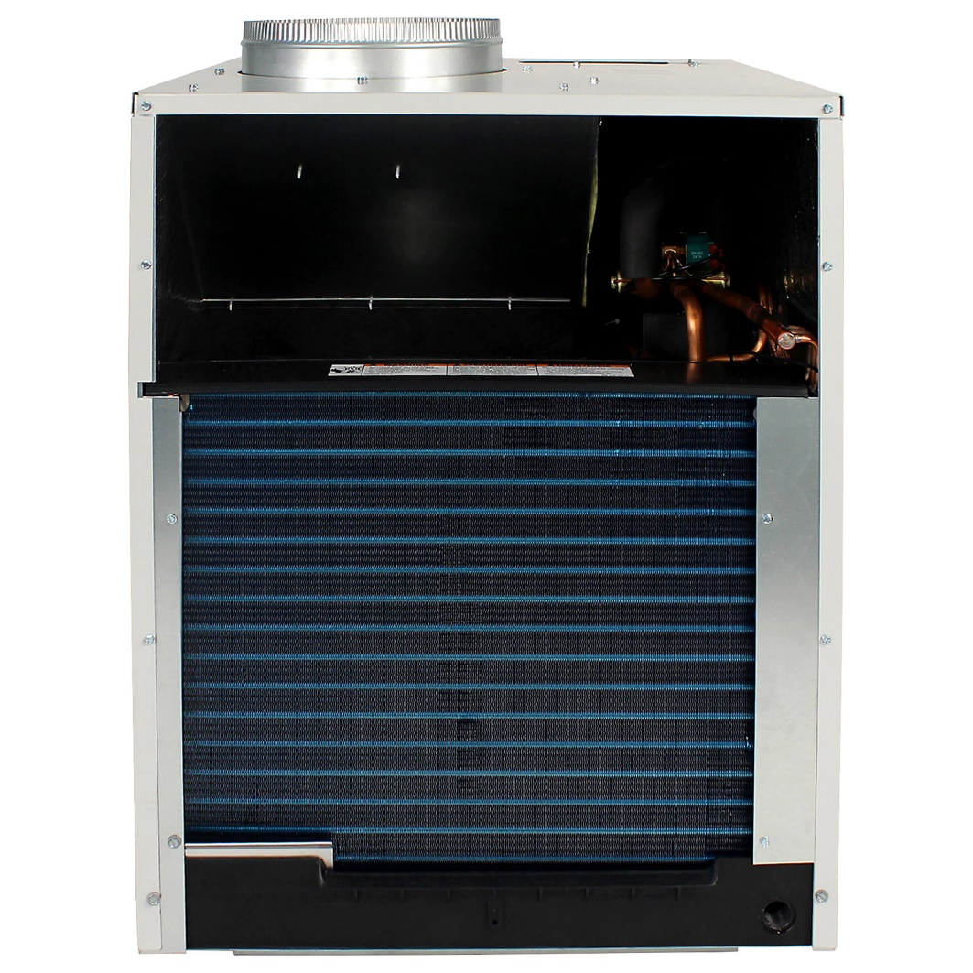
Vertical Terminal Heat Pump
Through-wall
Short duct run
Low first-cost
Moderate efficiency
Image source: friedrich.com
Notes:
Vertical Terminal Heat Pumps, also known as VTAC, are self-contained through-wall units with a short duct run. They have a relatively low first cost and room-by-room controls. They do take up some interior floor space and tend to be lower efficiency than other types of heat pumps. They are typically found in hospitality or multifamily buildings.

Slide 38
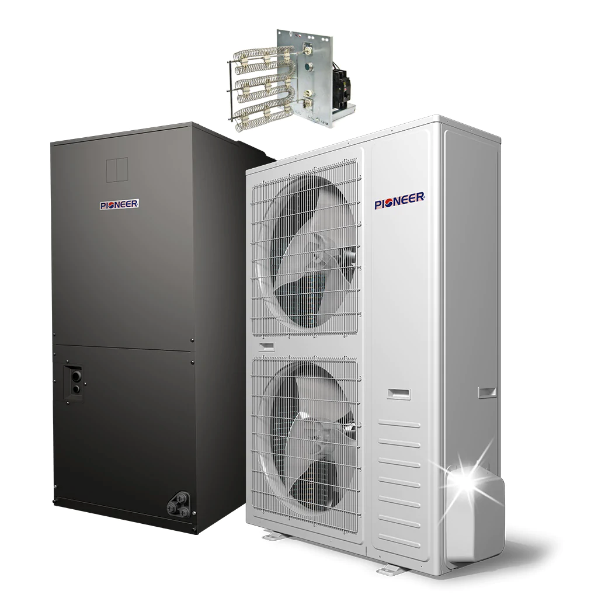
Ducted Split Systems
Image source: pioneerminisplit.com
Notes:
Ducted split heat pump systems have an outdoor unit and an indoor unit with refrigerant lines connecting the two. They can be a replacement for split system AC and gas furnace heating with existing ductwork. Sometimes they are configured to use the existing furnace supply fan and the gas furnace for back-up heating. They are typically available for light commercial capacities (6-20 tons). One drawback is that they have fewer zoning options than ductless systems.

Slide 39
Group Exercise #2
Your commercial office facility manager is considering upgrading all rooftop packaged AC units.
The facility manager has solicited your input to provide preferred features to be considered for the replacement units.
In your group, provide a list of features to make the new units highly efficient and to satisfy a decarbonization initiative.
Notes:
Split into small groups and appoint a spokesperson for your group. Complete the exercise above and then report out to the whole class.

Slide 40
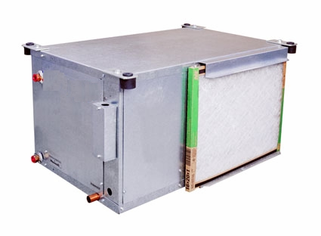
Water Source Heat Pumps
Water loop piping
Supplemental heat in winter
Heat dump (heat sink) in summer
Reversing valve (heats & cools)
Optimum use/operation (moves heat around)
Used in reverse for drying indoor pool air and heating water
Also known as “water-to-air heat pumps”
Notes:
Water-to-air heat pumps (also known as water source heat pumps) move heat between a water source and an air stream.
Distributed heat pumps are a low first cost system, involving less duct and piping than many other systems. They can be very cost effective to operate in a facility with a core that requires year-round cooling and a perimeter that can use the waste heat in winter. In all perimeter-type buildings like schools and nursing homes they are typically only cost effective for the building owner when coupled with a geothermal source for energy.
Conventionally they are used to move heat from a hot location in a building requiring air-conditioning to a cold location requiring heating.
They are also popular for using geothermal water from the earth to heat and cool air, or to use moist air from a pool room to recover heat to heat the pool water, while drying the pool room air.

Slide 41
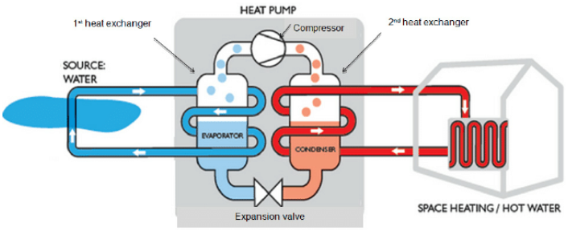
Water Source Heat Pump
1st heat exchanger
2nd heat exchanger
Diagram of a typical water source heat pump
Notes:
Heat pumps typically use either air, water or earth as a source from which to draw heat. The above example is a water source heat pump. Water and earth heat pump systems generally run higher Coefficients of Performance (COP) due to the high heat-carrying capacity and stable temperature of water and the ground. The actual water source can be an internal water loop, well water or ponds. Earth source systems use water piping buried in the ground or deep wells to absorb and reject heat energy. Water and earth source heat pump systems have COPs of 3.5 and greater regardless of outdoor weather conditions. They have a long life-expectancy, typically 20 years or more. They are also available in packaged rooftop models.
Image source: https://www.researchgate.net/figure/A-typical-diagram-of-a-water-source-heat-pump_fig2_286358619

Slide 42
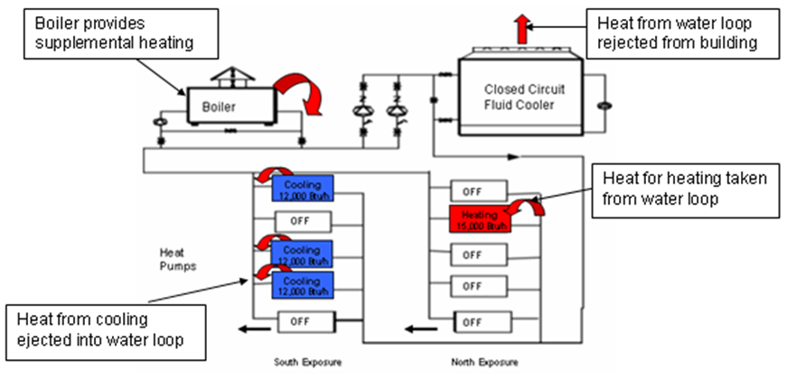
Water Source Heat Pump System
Notes:
The entire water source heat pump system is shown in the illustration above. The system is comprised of these primary components:
Circulation loop
Boilers
Heat pumps
Cooling tower

Slide 43
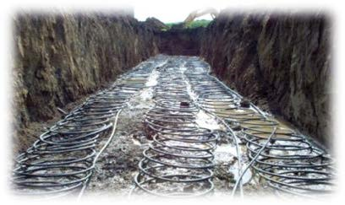
Ground Source Heat Pumps
Also known as geothermal
Very efficient
Work well in cold climates
Can provide domestic hot water (DHW)
Require large area, expensive to install
Photo courtesy of 21acres.org
Notes:
Geothermal heat pumps (also known as ground-source heat pumps) utilize the ground around the facility as a source of heat energy, with a water or refrigerant loop dug into the ground. At a few feet below the surface, the earth stays a constant temperature (roughly 45-60° F), providing a consistent source of conditioning energy for the heat pump. A heat exchanger transfers the energy from the heat pump to a distribution system, either hydronic or air. Geothermal heat pump systems are extremely efficient and quiet, require little maintenance, and have a long life (20+ years for the heat pump and 50+ years for the ground loop). In addition to space conditioning, geothermal heat pumps can also provide domestic hot water (DHW). Geothermal heat pumps have been in use since the late 1940s.
Because they require a large footprint underground (either horizontal or vertical), geothermal heat pumps are most commonly installed in new construction applications. They are costly to install, but their high efficiency can result in a favorable payback, sometimes within 5-10 years.
Geothermal heat pumps can use a body of water such as a pond or lake to provide energy to the loop. In this case the loop should be at least eight feet under the surface to prevent freezing.
Source: https://www.energy.gov/energysaver/geothermal-heat-pumps

Slide 44
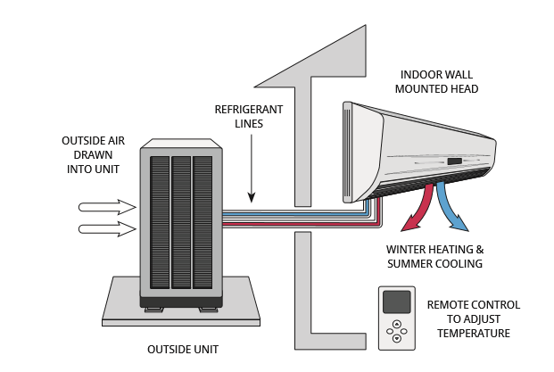
Ductless Systems
Image Source: https://betterhomesbc.ca/products/what-are-ductlessmini-split-heat-pumps/
Notes:
Ductless systems use no ductwork. Ductless configurations can provide some advantages, since ducts can be a culprit for dust allergies and respiratory issues. Also, ducts are often leaky; duct losses can account for 30% or more of energy consumption for space conditioning. However, refrigerant lines in ductless systems also have the potential to leak, so care must be taken to install them properly. It is also good practice to check for refrigerant piping leaks as part of routine maintenance.
A common commercial application of ductless heat pumps is in multifamily housing buildings. Another common use is for server rooms or similar spaces that require a much different conditioning load than the rest of the building. They are also common as retrofits in houses that use non-ducted heating systems, such as hydronic, electric resistance baseboard heating, radiant panels, or space heaters (electric, kerosene, propane, or wood stoves). And they are used in retrofit applications where central system ducting modifications are not feasible, such as in room additions.
Source: https://www.energy.gov/energysaver/ductless-mini-split-air-conditioners

Slide 45
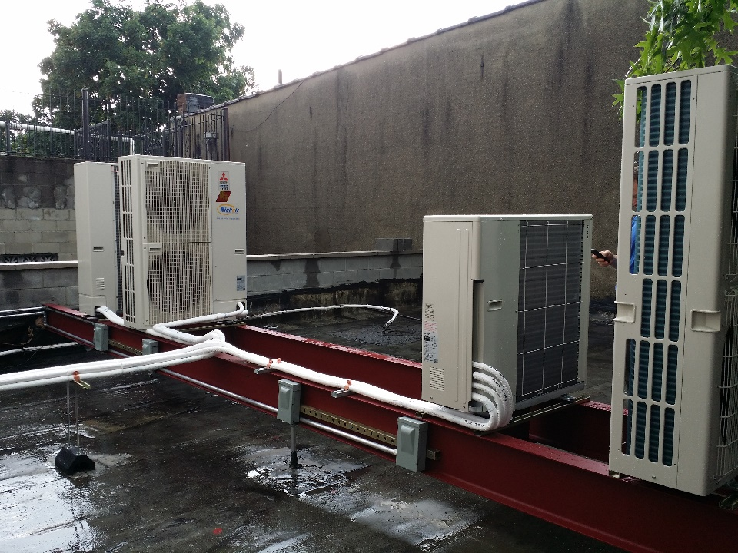
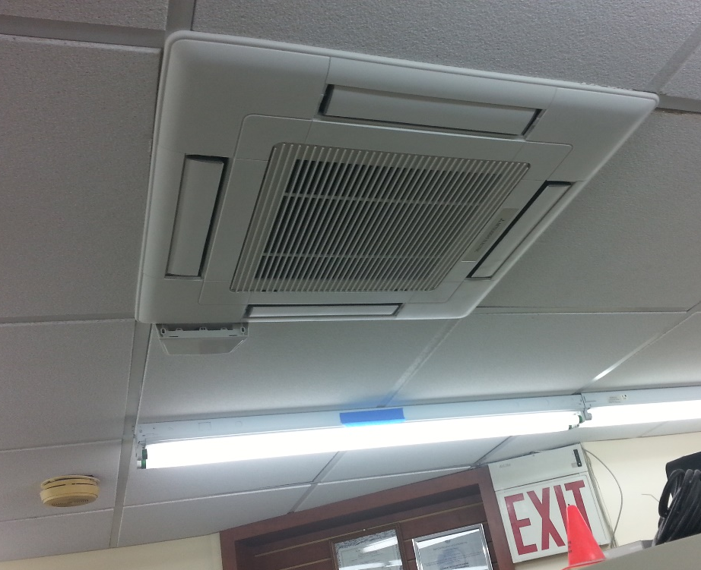
Ductless Mini-Split
Image source: richairductless.com
Notes:
Ductless mini-splits utilize an outdoor unit and refrigerant lines connecting 1-4 indoor units that directly condition zones with no ductwork. They use inverter-driven variable-speed compressors for very high efficiency. They have room-by-room controls and can also use a ducted fan coil. They are typically used in residential and small commercial applications like restaurants, server rooms, and portable structures. They can offer some flexibility for interior design, suspended from a ceiling, mounted flush into a drop ceiling, or mounted on a wall. One logistical disadvantage is that they require a condensate drain for every indoor unit. They can sometimes have a higher first cost than other systems, but lower operating costs often mean a favorable payback period, and some utilities offer rebates or other financial incentives to install them.

Slide 46
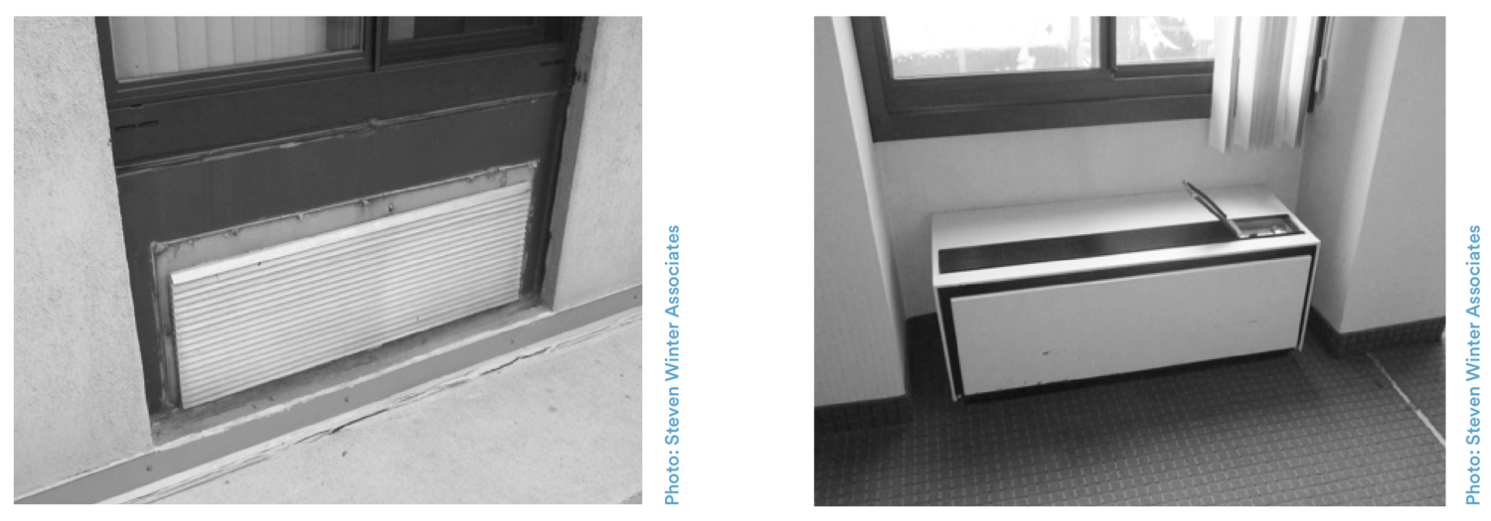
Packaged Terminal Heat Pump
Outdoor view
Indoor view
Notes:
Packaged terminal heat pumps (PTHPs) are self-contained through-wall air-to-air units. They are most commonly used in hotels and multifamily buildings. Some advantages include low first-cost and room-by-room controls. They are moderately efficient but can be noisy, and they take up interior floor space.
These are sometimes confused with packaged terminal air conditioners (PTACs), which use inefficient electric resistance heat. PTHPs can be a good replacement for PTACs.
Source: https://be-exchange.org/tech_primer/tech-primer-packaged-terminal-heat-pumps-pthps/

Slide 47
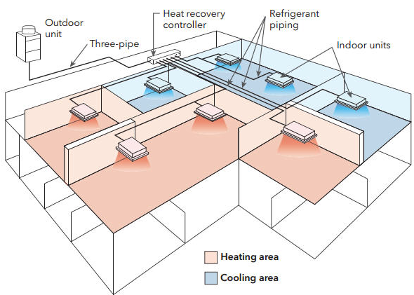
Variable Refrigerant Flow (VRF)
Very efficient
Multiple zones
Heating and cooling
All electric
Can provide DHW
Image courtesy of Slipstream Inc.
Notes:
Variable refrigerant flow (VRF) systems (also known as variable refrigerant volume or VRV) distribute heating and cooling throughout a building via refrigerant piping instead of ductwork. VRFs are very efficient and have many other benefits. One single outdoor unit can serve multiple zones with different heating and cooling loads in a building, and they can operate in a wider range of outdoor temperatures than traditional heat pumps, including very hot and cold climates. Compared to air-to-air heat pumps, VRFs offer better part-load efficiencies. They can also integrate heat recovery. They can be used to generate domestic hot water. VRFs are becoming more common in new construction as well as retrofit applications, for example to replace existing boilers and chillers.
Ductless mini-split systems are smaller VRF systems commonly used in light commercial and residential applications. They provide room solutions for isolated loads where a central system can not provide sufficient flexibility. However, they can be difficult to sub-meter to determine energy use from individual tenants.
Because VRF systems are typically all-electric, they can be a good choice for satisfying electrification initiatives.
Source:
https://facilityexecutive.com/2019/04/variable-refrigerant-flow-technology-commercial-facilities/

Slide 48
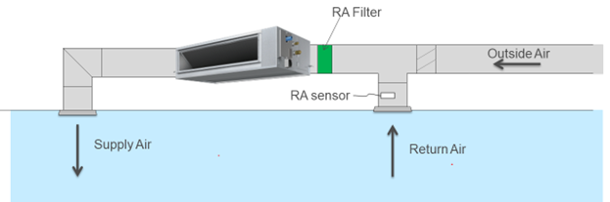
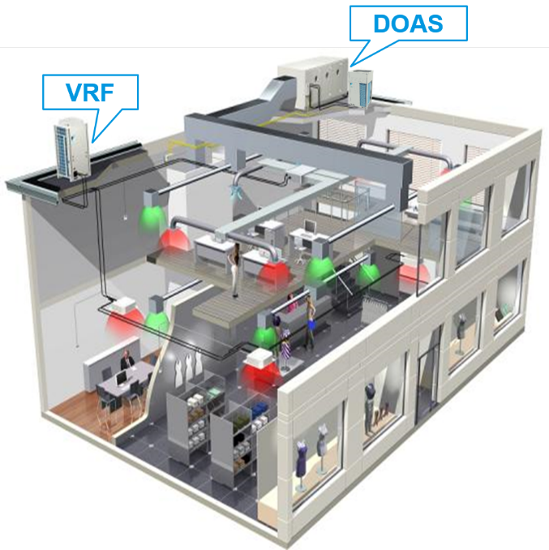
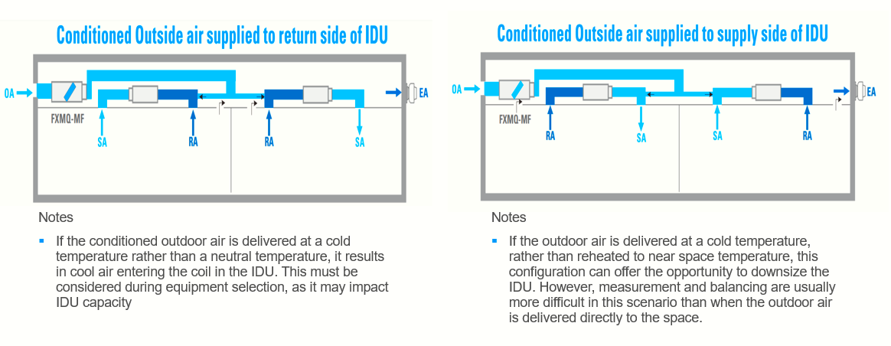
VRF Ventilation Strategies
Direct
Integrated
Decoupled
Notes:
VRF systems must be paired with ventilation, which is typically accomplished using one of three main strategies: Direct, Decoupled, and Integrated.
Direct In this strategy, the VRF indoor unit conditions the mixed air (return and outdoor air). It is often the cheapest to install, because it doesn’t require separate ventilation ducts or additional equipment. However, there is no conditioning of the ventilation air unless the space calls for heating or cooling, which may introduce comfort issues. This method is best suited for mild to moderate climates.
Decoupled In this strategy, ventilation air is supplied directly to the conditioned space via a separate system, such as a dedicated outdoor air system (DOAS), which uses dew point control to condition and deliver neutral ventilation air to the space. The VRF system maintains comfort by heating or cooling the air in the conditioned space. A benefit of this method is the ability to supply any amount of outside air needed separately from any heating or cooling requirements, which results in increased efficiency. However, since this strategy requires additional ductwork and separate diffusers, the installation costs are typically higher than a direct ventilation strategy.
Integrated In this strategy, pretreated outdoor air is supplied to the VRF indoor unit by a dedicated system such as DOAS or an energy recovery ventilator (ERV). It reduces some of the installation costs and space required for additional ductwork and diffusers, and can result in better comfort and/or performance, especially at part load operation.
Source: https://www.linkedin.com/pulse/integrating-ventilation-air-vrf-system-chris-soh/

Slide 49
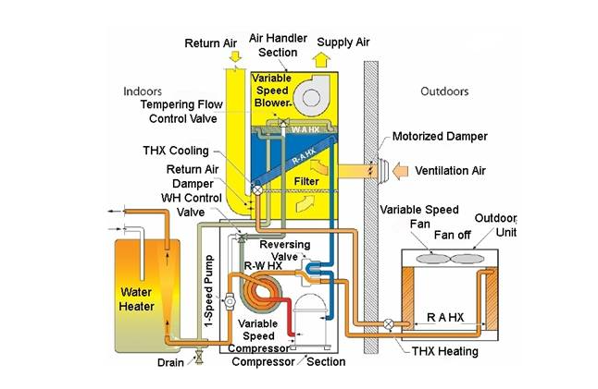
Multifunction Systems
Notes:
Multifunction systems are designed to serve multiple functions such as space heating/cooling, domestic hot water, and ventilation. They are comprised of various combinations of:
Heat pump
Ventilation
Hot/chilled water lines
Storage tank
They often utilize waste heat recovery to achieve higher efficiencies. They can be relatively expensive to install compared to separate systems, but as more of these types of products become available in the U.S., economies of scale will likely bring the first costs down. They are typically designed for smaller loads.

Slide 50
Group Exercise #3
Break into small groups
Choose a spokesperson
Answer the following questions
1. What are three different sources of heat from the environment?
2. What is the best application for installation of a ductless mini split system?
3. What are two advantages of VRF systems?

Slide 51
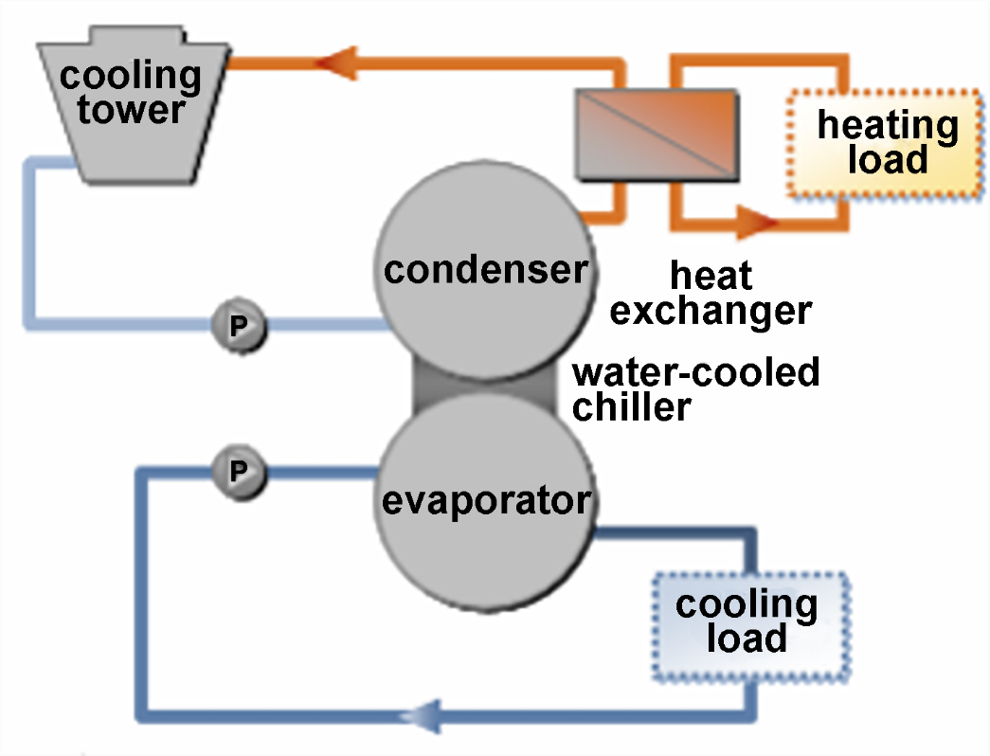
Energy/Heat Recovery
Paired with heat pump systems to increase efficiency
Energy recovery ventilators (ERVs) or heat recovery ventilators (HRVs)
Heat recovery chillers
Notes:
Many commercial buildings have simultaneous heating and cooling loads. This presents an opportunity to harvest waste heat from cooling loads for other heating needs within the building, and vice versa. For example, water-cooled chillers can recover heat that would normally be rejected to the atmosphere by cooling towers, transferring that heat to needed loads and significantly reducing energy costs. This can be accomplished either by using a heat exchanger or by using an additional condenser. The diagram above shows the heat exchanger version.
Image and material Source:
https://oaktrust.library.tamu.edu/bitstream/handle/1969.1/5243/ESL-IC-06-11-104.pdf?sequence=4&isAllowed=y

Slide 52
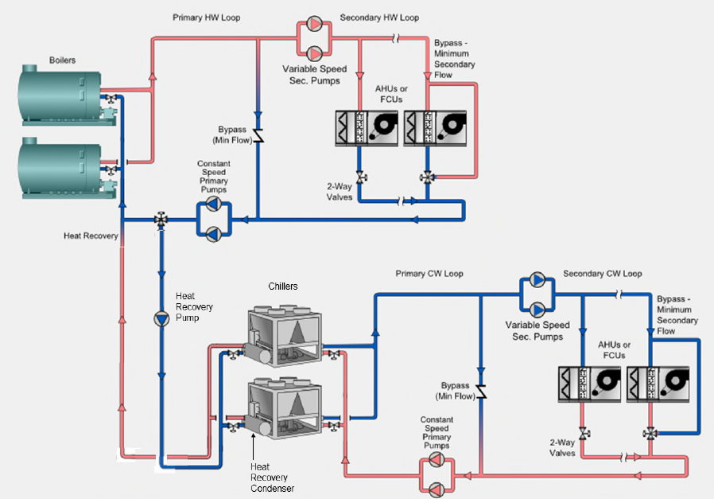
Heat Recovery Chiller
Simplified diagram of heat recovery plant with air-cooled chillers with heat recovery condensers
Notes:
A heat recovery chiller integrates a chiller that utilizes a heat exchanger to transfer waste heat to a heating load.
This can be a very efficient option for buildings that have both a heating and cooling load year-round. Heat that would normally be evaporated from the chiller loop to the atmosphere via a cooling tower is instead recovered and used to preheat heating loads, such as perimeter zone heating or hot water. It uses water as a distribution mechanism, not refrigerant. This diagram shows an example of a heat recovery chiller system that transfers heat to a boiler plant.
This type of system can integrate a heat pump to replace an existing boiler and chiller system. It is not a plug and play retrofit, however, and requires a good deal of engineering. But the high operating efficiency (COPs of 5.0+ are possible) can mean a favorable payback. Heat recovery chillers are becoming increasingly available on the market.
Image source: https://www.shareddocs.com/hvac/docs/1004/public/08/hap_ehelp_032.pdf
Simplified diagram of heat recovery plant with air-cooled chillers with heat recovery condensers

Slide 53
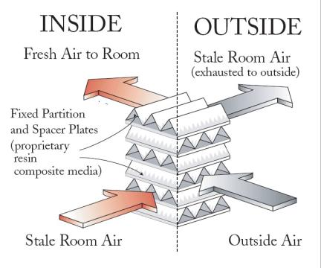
Ventilation Energy Recovery
Air-to-Air Energy Recovery Units
Heating or cooling
50-70% efficient
Fixed plate or wheels
Do not over ventilate!
Check CO₂
Image source: Renewaire
Notes:
Another source of heating energy for buildings is the recovery of heat from exhaust air streams.
The International Building Code, IBC-2006: 503.2.6 Energy recovery ventilation systems, states “Individual fan systems that have both a design supply air capacity of 5,000 cfm (2.36 m3/s) or greater and a minimum outside air supply of 70 percent or greater of the design supply air quantity should have an energy recovery system that provides a change in the enthalpy of the outdoor air supply of 50 percent or more of the difference between the outdoor air and return air at design conditions. Provision should be made to bypass or control the energy recovery system to permit cooling with outdoor air where cooling with outdoor air is required.”
Image source: Renewaire

Slide 54
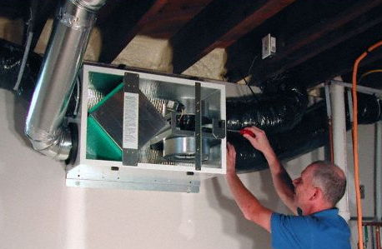
Energy Recovery Ventilator
Notes:
An energy recovery ventilator (ERV) combines a ventilation system with an air-to-air heat exchanger to recycle heat energy in a building. Air-to-air heat exchangers were developed in colder regions of the U.S., Canada, Europe, and Scandinavia, where tightly built modern houses were developing problems of excess humidity during the winter, creating indoor air quality issues. The ventilator brings in fresh air that is preheated through the heat exchanger by the outgoing warm exhaust air.
Source: https://www.sciencedirect.com/topics/engineering/energy-recovery-ventilator

Slide 55
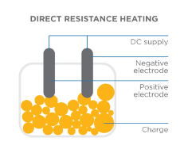

Electric Resistance Heating
Electric baseboard
Wall heaters
Radiant heat
Space heaters
DIRECT RESISTANCE HEATING
DC Supply
Negative
electrode
Positive
electrode
Charge
This Photo by Unknown Author is licensed under CC BY-SA-NC
Notes:
Electric resistance devices create heat by running electricity through a material. Technically 100% of the energy used is converted to heat, which equates to a COP of 1.0. So they are much less efficient and thus more expensive to operate than other electrification technologies available for space heating such as heat pumps.
Image source: https://www.energypolicy.columbia.edu/research/report/low-carbon-heat-solutions-heavy-industry-sources-options-and-costs-today

Slide 56
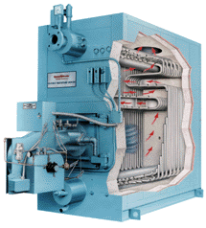
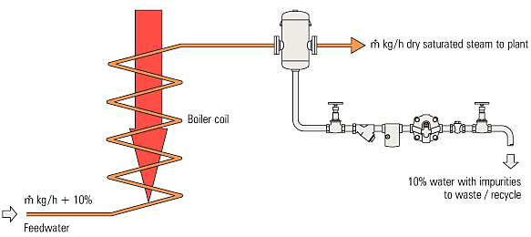
Electric Boilers
High $/BTU
High efficiency
Can provide variability of water temperatures
No direct emissions
Less floor space required than gas boilers
Image source: Spirax Sarco, Module 3.4 Misc Boiler Types
Notes:
Electric Boilers
• come in a variety of sizes.
• occupy less floor space.
• don’t have burners or air supply issues.
• don’t have stack losses or emissions issues.
• typically much higher cost per BTU output. Electric boilers are most often used for small hydronic systems, swimming pools and domestic hot water. They are also used as a backup heat source in heat pump systems.

Slide 57
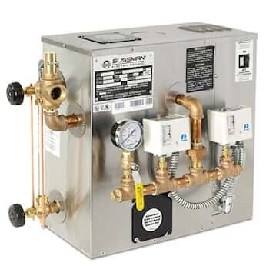
Hospitals, Labs and Medical Facilities
Replace gas steam boilers with electric for:
Autoclaves and sterilizers
Lab glass washers/sanitizers
Humidification
Electric Steam Boiler

Slide 58
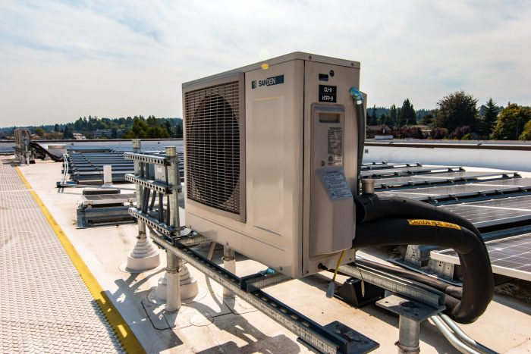
Domestic Hot Water Heating
Heat Pump Water Heaters (HPWH)
Unitary
Split
Components:
Heat pumps
Hot water storage
Temp maintenance
Controls
Notes:
Heat pump water heaters (HPWHs) have been used in Europe and Asia for many years and have become more increasingly widespread in the U.S. as decarbonization/electrification initiatives ramp up, resulting in lower costs due to economies of scale. HPWHs are especially cost-effective in buildings with large hot water loads, such as multifamily, hospitality, and buildings with commercial kitchens. These systems consist of heat pumps, primary hot water storage, temperature maintenance systems, and controls. Installations vary, from custom engineered solutions with equipment from different manufacturers, specified built-up systems in which all equipment comes from a single manufacturer, and packaged systems that combine these components into a single skid-mounted box that can be installed in place. The latter method simplifies the design and installation process.
HPWHs can be air, water, or ground sourced. In the case of air sourced HPWHs, the COP drops at low outdoor temperatures. Efficiency and capacity go up as the delta between outdoor air temperature and load temperature (also known as “lift”) is reduced. The type of refrigerant used also makes a difference in efficiency and temperature range. For example, heat pumps using CO₂ as the refrigerant (known as R744) do very well, in fact better, in very low temperatures, since they require a very high lift (e.g. from 60° F to 180° F) to work efficiently. CO₂ as a refrigerant has the important benefit of having a low Global Warming Potential (GWP). Low-GWP system options are becoming increasingly available for different temperature conditions, which is a key aspect in contributing to the overarching goal of reducing global warming. We will discuss GWP related to refrigerants in more detail later in the class.
Technology is advancing quickly and viable options for cold weather HPWHs are increasing. Some systems incorporate heat recovery with wastewater, which requires wastewater storage but can dramatically reduce the electrical load needed, sometimes by up to 50%. This strategy works especially well in buildings such as multifamily or hospitality, for example, where showers provide a simultaneous demand for load with wastewater disposal. Even when not incorporating energy recovery from wastewater, adding hot water storage capacity can drive down the heat pump load, reducing first costs related to equipment capacity as well as operational costs.
HPHWs can be a good replacement for domestic hot water boilers. Traditional boiler efficiencies typically range from about .8 to .95 for the most efficient condensing boilers (which aren’t always running in condensing range). In comparison, HPWHs typically provide a COP of 2.5 to 4.5. With proper maintenance, which is minimal, these systems can see a 20 to 30-year life span. First costs can be more than traditional domestic hot water boilers, but the operational savings over time often pencil out to a favorable payback. Even more operational savings can be achieved in areas with a time-of-use (TOU) utility rate structure, by utilizing hot water storage to shift the water heating load to off-peak hours.
Many HPWHs incorporate backup electric resistance heating for periods of high hot water demand, so it is important to take these extra electrical needs into account when replacing a gas system.
Source: https://drintl.com/commercial-heat-pump-water-heaters-the-game-changing-technology-we-need-now/

Slide 59
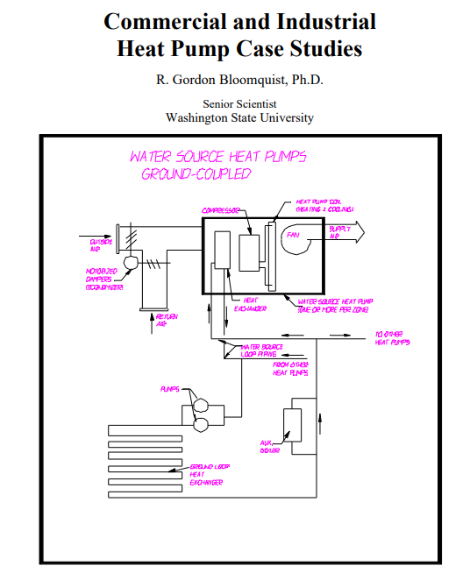
Case Study
“The builder/engineer, James Minges, calculated in 1997 that the choice of the geothermal heating and cooling system had saved the “amazing amount of $5,200,000 in operation and maintenance costs over its first 27 years of existence over a conventional fossil fuel system.”
Notes:
Source: https://www.geothermal-energy.org/pdf/IGAstandard/ISS/2003Germany/II/10_1.gor.pdf
The Exchange Location: Farmington, Connecticut
Building Type: 265,000 sq.ft. commercial and office complex
System Type: Open loop, distributed water source heat pump system
Age: 28 years
Energy Use: 17.18 kWh/sq.ft./year total: 6.2 kWh for the heating and cooling system
Estimated Maintenance Cost: approximately $0.16/sq.ft./year
Building Characteristics: The Exchange is a three-story, semi-octagonal commercial office building located in Farmington, Connecticut. The 265,000 square foot complex, built in 1971, is an AIA award winner.
The building contains primarily office space, but a number of restaurants and commercial establishments are found on the ground and mezzanine levels. The Exchange was built as part of a Planned Unit Development that also contains 500 single family rental and condominium units. The construction of The Exchange is of exposed, heavy timbers without conventional wall and ceiling finishes in both retail and office areas. The sloping roof with dormer-type windows keeps the building small and low in scale for its size. The walls and ceiling are insulated with 3.5 inches of mineral wood (R-13). The roof is asphalt shingle on plywood deck.
The building contains 7,500 square feet of insulated glass. Floors are a combination of concrete on grade (1st floor) and heavy planks. The building has a recently-installed energy management system (EMS). The $160,000 cost for the EMS had a one-year payback.
Geothermal Heat Pump System Characteristics The 55ºF geothermal source is provided by four wells that have been used continually since 1971. The system uses a shell and tube heat exchanger between the wells and the circulating fluid that supplies the heat pumps. Well number 1, lying to the east of the building, is 350 feet deep, and provides 55 gpm. Wells 2, 3, and 4 lie to the west of the building and provide 148 gpm, 204 gpm, and 60 gpm, respectively. The wells are all at a depth of 350 feet. Wells 1 and 2 have 2-inch pipes to depth while number 3 has a 3-inch pipe and number 4 has a 4-inch pipe. Well number 1 is served by a 7.5-hp pump, well number 2 by a 15-hp pump, well number 3 by a 20-hp pump, and well number 4 by a 10-hp pump. All of the pumps are submersibles. The water is disposed of into a nearby creek at a maximum of 85ºF.
HVAC System Description The system circulates tempered water from the tube and shell heat exchanger to each of the 495 individual water-to-air heat pumps that serve the building. The units are designed for a 20ºF delta T in cooling mode and 10ºF delta T in heating mode. A 220-ton screw compressor can provide supplemental heat to the loop in the winter, but since 1971, when it was installed, it has operated a total of less than 8,760 hours or less than 3 percent of the time. During the summer, when the loop temperature exceeds 100ºF, a cooling tower rejects heat to the air. The building has a design heating loss of 8,745,000 Btu/hour and a design cooling heat gain of 7,685,000 Btu/hour. Outside air ventilation is 50,000 cfm. The building is served by a total of 495 individual heat pumps or a total of 1,094 tons. The heat pumps range in size from 1 tons to 4 tons. During periods of severe cold, the incoming well water can be boosted through the use of a 220-ton screw chiller run in reverse. During the summer, the loop temperature can be moderated by sending a portion of the water to a cooling towers.
Selection of the Heat Pump System
The selection of the heat pump system was entirely consistent with the overall concept of the project and the desire of the principals to make the complex as environmentally responsible as possible. The consulting engineers, James S. Minges and Associates, Inc., also had previous experience with the use of well water for cooling.
Operating History
The system has been in operation for 28 years, and has been extremely reliable. The builder/engineer, James Minges, calculated in 1997 that the choice of the geothermal heating and cooling system had saved the “amazing amount of $5,200,000 in operation and maintenance costs over its first 27 years of existence over a conventional fossil fuel system.”
Operation and Maintenance has never been a major problem throughout the system’s 28 years of operation and operation. Most maintenance is taken care of by in-house staff. Over 28 years, only nine of the 495 units has had to be totally replaced. Three of the down hole pumps, however, have had to be replaced. The tube bundle in the shell and tube heat exchanger was replaced at a cost of $42,000. In 1998, for example, nine compressors had to be replaced. However, the work is done in-house and total cost per unit is $700, including parts and labor. In addition, 11 fan motors had to be replaced. One major change in operation has been the requirement to install a monitoring system for environmental control of water that is dumped into a nearby stream. The monitoring system cost $20,000, and samples must be taken and sent in for testing 4 times per year at a cost of $400 per quarter. Total maintenance is estimated to be approximately $0.16/sq.ft./year.
System Economics James Minges, of The Minges Associates, performed an energy analysis on the building in 1997 and calculated that over the 26-year operating history, the building had saved approximately $5,200,000 as compared to a conventional system made up of hot water boilers and conventional chillers and cooling towers. He calculated that the 1997 maintenance cost was $0.16 per square foot/year, operating costs amounted to $0.60 per square foot/year, and replacement costs $0.05 per square foot/year for a total of $0.81 per square foot per year. The total electrical load for the building in 1997 was 4,552,560 kWh. This amounts to 17.18 kWh per square foot/year. Based on the numbers presented by Mr. Minges, the heat pump system uses about 6.2 kWh per square foot/year.

Slide 60
Group Exercise #4
Break up into small groups
Choose a spokesperson to report out
Divide and discuss the case study
Answer the following questions
What is one thing that surprised you?
What is one thing that confused you?
What is the most applicable or important thing that you learned from this case study?

Slide 61
Check Your Knowledge #2
True or False:
Electric Resistance heat is highly efficient.
VRF stands for Variable Refrigerant Flow.
Heat recovery systems are inefficient.

Slide 62
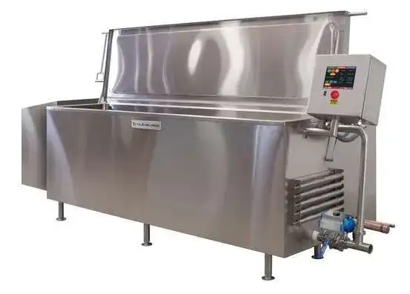
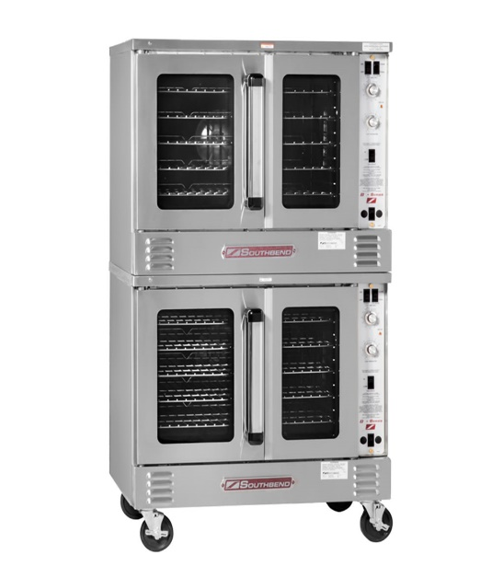
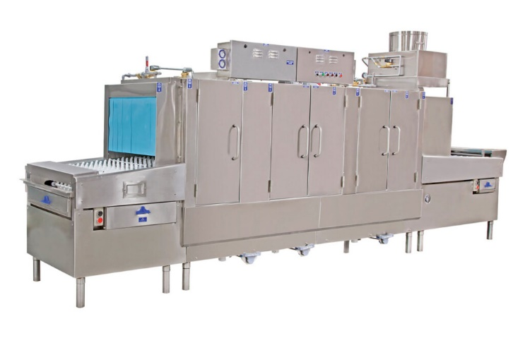
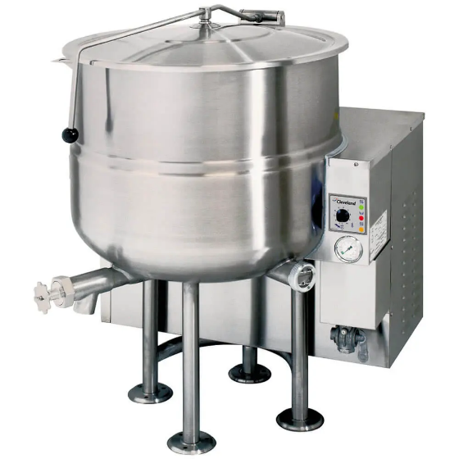
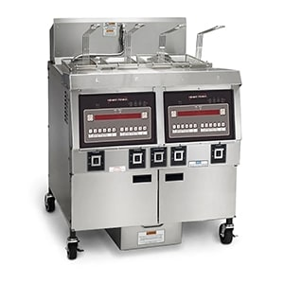

Commercial Kitchen Electrification
Combination ovens
Electric fryers
Induction cooktops
Conveyer dish machines
Chill/cook tanks
Steam kettles
Combination oven
Cook/chill tank
Fryer
Conveyer dish machine
Steam kettle
Induction cooktop
Notes:
Shown here are examples of electric commercial/industrial cooking equipment that can replace equipment that would otherwise use gas (either directly or via steam generated by gas boilers). This type of equipment is commonly used in campus cafeterias and industrial food production facilities.
Additional resources:
https://caenergywise.com/report-library/
https://fishnick.com/resources/#case-studies

Slide 63


Induction Cooking
Fast heating
Energy efficient
Increased safety
Better indoor air quality
MAGNETIC FIELD
Current in coil
Induced current
Notes:
Though natural gas cooktops have long been a staple in commercial kitchens, decarbonization mandates such as restrictions on natural gas hookups in new construction will require alternate solutions. Not only does natural gas combustion contribute to greenhouse gas emissions in the atmosphere, but it can also create indoor air quality and safety hazards such as burns and fires. Electric induction cooking appliances are becoming increasingly commonplace, and can be a great replacement for gas appliances, offering fast cooking times, greater energy efficiency, reduced risk of burns and/or fires, and better indoor environmental quality.
Induction appliances use magnetic fields to directly heat cookware instead of heating the stovetop, resulting in faster heating times and precise control. They are available in many different types:
Table-top
Standalone
Drop-in
Warming and holding
More information on energy efficient foodservice equipment can be found at https://fishnick.com/
Image source: https://www.energypolicy.columbia.edu/research/report/low-carbon-heat-solutions-heavy-industry-sources-options-and-costs-today

Slide 64

Distributed Energy Resources (DER)
Notes:
Distributed Energy Resources are small scale energy generation units generally found at or near the energy load they serve. There is a growing trend in the increase of DERs particularly from clean renewable sources such as Solar Photovoltaic (PV) systems and Wind Turbines. DER’s “can provide positive net value to the grid, such as avoided infrastructure investments, improved resilience and increased integration of clean energy. However, integration of these resources will require…” modernization of the grid for two-way energy flows and incorporation of new, connected technologies (sometimes referred to as the internet of things or the internet of energy), new policy and rate solutions that minimize cost impacts to consumers and a capable workforce to bring it all to life and keep it working.
Other forms of DER are as follows:
Turbine Generators Combined Heat and Power (CHP)
Battery Energy Storage
Thermal Energy Storage
Material source: https://blog.aee.net/distributed-energy-resources-101-required-reading-for-a-modern-grid

Slide 65
DER Challenges
Stand Alone Systems
3rd Party Owned/Operated
Closed Communication
Accessibility to Performance Data
Grid Independent
Uncontrolled Output
Interconnection Limits
Notes:
Distributed Energy Resources particularly from cleaner renewable sources are proven technologies that can significantly reduce greenhouse related emissions from electrical generation. Additionally, DERs are generally more efficient in generating electricity compared to traditional power plants due to avoided transmission losses because of their closer proximity to energy loads that they serve. This makes DERs popular options for building owners and current trends indicate a continued growth in DER installations. There is however a downside to increase in DER on the electric grid due to uncoordinated generation output and misalignment with the loads that they serve. These problems stem from the following inherent characteristics of standalone DER:
Stand Alone Systems
3rd Party Owned/Operated
Closed Communication
Lack of accessibility to Performance Data
Grid Independent
Uncontrolled Output
Utility Interconnection Limits

Slide 66

Case Study – La Paz Place
Gas heating, cooking, domestic hot water, laundry converted to electric.
Projected energy use reduction: 65%
Projected carbon emissions reduction: 44%
Image source: Bickerdike Redevelopment Corporation
 | Pre-retrofit Annual Cost | Post-retrofit Annual Cost (w/o solar) | Post-retrofit Annual Cost (w/ solar) | Percent Cost Savings
Tenant | $61,452 | $49,362 | $48,811 | 21%
Common areas | $14,253 | $21,034 | $13,692 | 4%
Total | $75,705 | $70,396 | $62,504 | 25%
Notes:
Excerpts reprinted from a report produced by Elevate¹:
“Reducing carbon emissions in existing buildings presents a wide set of challenges, even more so in affordable housing. Elevate and its community partners present findings thus far from a retrofit of La Paz Place, a 44-unit affordable housing property in Chicago. Construction began in November 2021 across the three buildings at the property, where natural gas equipment for heating, cooking, hot water, and laundry was converted to all-electric heat pumps, smart thermostats, electric stoves, and electric dryers. Rooftop solar will be added after electrification is complete. The project is projected to reduce energy consumption by 65% and carbon emissions by 44%, without increasing utility costs for the tenants or owner.
La Paz Place is projected to offset annual site energy use by 65% across the entire property, including the impact of solar PV. These savings represent a total across the entire portfolio – the amount of expected energy saved from electrification is dependent on factors such as the time of year and tenant unit size and orientation. The change in utility costs from electrification also varies between owner- and tenant-paid utilities, as seen in the table shown here where the annual cost impacts of decarbonization are shown based on current electric rates for the local utility, ComEd.
Across all tenants, utility costs are expected to be reduced by 21%, including the impacts of solar (although solar represents a small portion of cost savings for tenants, approximately 1%). Owner costs are expected to be reduced by 4%, including the impacts of solar. Solar helps mitigate increases in owner utility costs; without solar, owner utility costs would increase by nearly $7,000 annually. This is for two reasons: (1) the increase in water heating costs on the common area meter, and (2) the relatively low impact of removing the fixed gas fee relative to the impact this had for tenant units. While the HPWHs are expected to save energy compared to the existing gas central water heaters, this technology is still expected to have higher utility costs. In addition, while removing gas service from the building eliminates fixed gas fees for both owner and tenants, the monthly fixed gas cost (approximately $35) substantiates a much higher portion of tenants’ monthly bill as compared to the owner’s common area gas meter.
ComEd supply charge of $0.125/kWh was used. Initially during the modeling phase, we used the average electric rate because this is the accepted standard for estimating utility cost impacts in energy efficiency programs. While the average rate provides a conservative estimate for utility bill savings, marginal rates will improve the estimate accuracy, especially for electrification projects where multiple end uses previously fueled by gas are now electric and electric use is impacted significantly more than a typical efficiency project (e.g., lighting upgrades).
As mentioned, because of the increase in owner utility costs, we pursued adding solar to the project to offset these costs. In addition, there is some variation in the expected energy and cost savings across tenant units. This is primarily because larger tenant units have air-source heat pumps with larger capacity, which in this case have lower efficiencies compared to smaller units. These ASHPs serving units with larger heating loads have electric resistance back up heat, which also reduced energy savings. From the energy modeling, it was predicted that four of these units could potentially increase utility costs. Because of this, all units with electric resistance back up heat will also be connected to the solar system to reduce the risk of increased utility bills.”
Short video (~1 min.) highlighting benefits to residents:
https://youtu.be/aRcb4A1nguo?si=7CcqE5SZ_t6KL89e
Source:
1. Francisco, A. et al. (2022, May). Decarbonization retrofits for affordable housing: A Chicago Case Study. Elevate. https://www.elevatenp.org/wp-content/uploads/Decarbonization-Retrofits-for-Affordable-Housing-A-Chicago-Case-Study.pdf

Slide 67

Smart Technologies Integrated DERs
Smart Inverters and Meters
Automated Switchgear
Smart Sensors
Ultra Fast Communications
Micro Grid Control System:
Integration Software
Grid Responsive
Output Control
Islanding Capabilities
Notes:
The modern electrical includes a growing amount of Distributed Energy Resources. To maximize the effectiveness and value of DER’s within the new electric grid, DER will have to be equipped with smart technologies, so their output and operation are well coordinated with other components of the grid. These capabilities enable DER to modulate output based on actual demand from the grid. These smart technologies include the following:
Smart Inverters and Meters
Automated Switchgear
Smart Sensors
Ultra Fast Communications
From Pew Charitable Trusts Research:
“Microgrids are small groupings of interconnected power generation and control technologies that can operate within or independent of a central grid, mitigating disturbances and increasing system reliability. By enabling the integration of distributed resources such as wind and solar, these systems can be more flexible (and resilient) than traditional grids.”
Micro Grid Control Systems generally include:
Integration Software
Grid Responsive
Output Control
Islanding Capabilities
Graphic and Material source: https://www.pewtrusts.org/en/research-and-analysis/issue-briefs/2016/02/why-and-how-microgrid-technology-is-a-good-power-source

Slide 68

Grid-interactive Efficient Buildings (GEBs)
Notes:
DEFINITION:
“Buildings that operate dynamically with the grid to make electricity more affordable and integrate distributed energy resources while meeting the needs of building occupants”
US Department of Energy Building Technology Office
Buildings are a significant source of electricity consumption. Buildings in the U.S. represent up to 70% of total electricity consumption and up to 80% of peak electrical load according to a study by Lawrence Berkeley National Laboratory. This energy consumption profile makes buildings a primary candidate for load reduction opportunities when the electric grid resources or transmission are constrained. Due to their variation of energy loads, buildings can be sources of load flexibility which is a key requirement of the new smart grid. The U.S. Department of Energy Building Technology Office is spearheading an initiative to research the characteristics and benefits of buildings that can provide load flexibility. This type of buildings is referred to as Grid-interactive Efficient Buildings*.
*Source: US DOE Building Technology Office, Grid-interactive Efficient Buildings Technical Report Series, https://www1.eere.energy.gov/buildings/pdfs/75470.pdf
Image source: https://sftool.gov/learn/about/638/grid-interactive-efficient-buildings

Slide 69
Why Do We Need GEBs?
Growing Peak Electrical Demand
Transmission and Distribution Constraints
Increasing Variable Renewable Energy Resources
Increasing Demand for Low Cost and Renewable Energy Resources
Growing Complexity of Distributed Energy Resources (DER)
The Need to Maintain Grid Reliability
The Need for Demand Flexibility
Notes:
The modern electrical grid now consists of distributed energy generation sources with the capabilities to supply energy closer to the loads that they serve such as buildings. Moreover, the energy flow on the modern grid is now allowed to flow in two-way direction with power flowing into and from the grid whenever conditions permit. Buildings can play an important role in making the modern grid more reliable and more sustainable with cleaner generation from renewable energy sources. For the modern energy grid to work, some level of load flexibility will be needed to take energy from the grid during a condition of over generation and to reduce load when there is a shortfall of generation. Grid-interactive Efficient Buildings with smart technologies can fulfill this role.

Slide 70

Key Characteristics of GEB
Image Source: DOE Grid Interactive Efficient Buildings
Notes:
GEBs:
Enable achievement of ambitious climate & resilience goals by bringing buildings & the grid together;
Draw from a toolbox that includes energy efficiency, renewables, energy storage and load flexibility;
Employ these capabilities to flexibly reduce, shed, shift, modulate or generate electric load as needed;
Respond to utility price signals to reduce costs and enhance resilience for both building and utility
Material Source: https://sftool.gov/learn/about/638/grid-interactive-efficient-buildings
Image Source: https://www.energy.gov/eere/buildings/grid-interactive-efficient-buildings

Slide 71
Benefits of Grid-interactive Efficient Buildings
Energy Savings from Efficiency
Revenues From Demand Response and Other Grid Services
Improved Operations from Smart Technologies
Optimization of Distributed Energy Resources
Improved Comfort and Indoor Air Quality
Improved Resilience from Grid Vulnerabilities
Access to Building Performance Data
Notes:
Grid-interactive Efficient Buildings that are enabled by smart technologies can provide multi-faceted benefits to the energy supply, demand and transmission within the smart grid. These benefits can have direct impact to building owners from energy savings and can have multi-layered benefits to the energy grid from load flexibility.

Slide 72

GEB Smart Technologies
Image Source: DOE Grid Interactive Efficient Buildings
Notes:
Grid-interactive Efficient Buildings represent a class of high-performance buildings that are energy efficient and are capable of dynamically responding to the demands of the smart grid. These type of buildings are equipped with smart building systems that are integrated and configured to deliver grid demand flexibility. This means GEBs are capable of multiple modes of operations depending on what the grid needs. For example, GEB are capable of ramping down their DER when there is sufficient supply on the grid or absorb power from the grid when there is abundant energy supply. GEBs can financially benefit from these capabilities by providing grid services and from energy cost savings.
Image courtesy of Navigant Consulting.
Source: U.S. Department of Energy Office of Energy Efficiency & Renewable Energy, Grid-interactive Efficient Buildings Technical Report Series: Overview of Research Challenges and Gaps. https://www1.eere.energy.gov/buildings/pdfs/75470.pdf

Slide 73

Demand Flexibility of GEBs
How building load profiles from demand flexibility benefits the grid: > Efficiency > Load Shed > Load Shift > Modulate
Image Source: DOE Grid Interactive Efficient Buildings
Notes:
Grid-interactive Efficient Buildings can benefit financially from demand flexibility by controlling their load profiles based on the need of the grid. The value of building demand flexibility can be monetized by utilities or third-party aggregators to deliver the following grid services:
Energy Efficiency
Load Shed
Load Shift
Modulate

Slide 74
Grid-interactive Efficient Buildings Demand Reduction Scenario
System Operator
Monitors Grid Conditions
Forecasts Supply vs Demand
Issues Notification and Alerts for Demand Response
Utility
Receives Signal to Lower Demand
Triggers Demand Response (DR) Program
Issues Third Party Aggregator DR Programs
GEBs
Receive DR signal from Utility or 3rd Party Aggregator
Trigger Automated Demand Reduction Measures
Utilize DER or Energy Storage to meet local demand
Notes:
Regional power grids are typically managed by system operator entities. In California, the ISO or Independent System Operator is the party responsible for managing how power flows into and out of the state electrical system. In case of a projected generation shortfall due to increase in demand or shortage of generation, the ISO sends notifications to load serving entities such as local utilities to initiate their load demand reduction programs. One example of a load demand reduction program is ADR or Automated Demand Reduction which sends a signal to customers to initiate local demand reduction measures. For GEBs, this signal is automatically processed by the building EMS and triggers local demand reduction measures such as the following:
Shutdown major electric equipment i.e. Chillers, Cooling Towers, AC Equipment
Adjust/lower zone setpoints
Adjust window shading systems
Enable thermal storage
Control DER such as Battery Energy Storage to discharge to supply local power and lower demand from the grid
Grid-interactive Efficient Buildings can process utility signals for demand reduction or even power take-up when the electrical grid must get rid of extra grid capacity making GEBs essential parts of the modern smart grid.

Slide 75
Common Demand Reduction Measures
Building pre-cooling
Zone level setpoint reset
Turn off or lower lighting levels in empty or non-critical spaces
Turn off non-essential loads i.e. water fountain pumps, signage/marquees
Turn off large cooling equipment i.e. chillers, compressors
Enable thermal or battery energy storage
Shut down or shift production times
Notes:
Smart Buildings can help relieve the electrical grid during periods of capacity shortages or transmission constraints by participating in demand response programs directly with local utilities or through third party aggregators. Organizations can financially benefit from DR programs based on the amount of capacity enrolled and actual demand reduction during DR events.

Slide 76

Demand Response and the Modern Grid
Image source: https://sitn.hms.harvard.edu/flash/2017/multitude-technologies-needed-electricity-storage/
Notes:
Demand response is further enabled by modern communication and energy technology resources, sometimes referred to as the Internet of Energy (IOE). Here we can see that solar and energy storage, on the left, are not nearly as effective as they could be with demand response applications (i.e. behaviors, technologies, policies, incentives, etc.).
Image source: https://sitn.hms.harvard.edu/flash/2017/multitude-technologies-needed-electricity-storage/

Slide 77

Smart Buildings – Key Roles in Transactive Energy
Video source: https://bgintegration.pnnl.gov/transactivecontrol.asp
Notes:
GEBs can provide the necessary demand flexibility on the smart grid to absorb or make up the variation in energy output from renewable sources. This service can be monetized as Transactive Energy so building owners can be compensated for the value they bring to the grid, considered as grid services.
View this video at:
https://www.youtube.com/watch?v=ECTNZAgyYtM

Slide 78

What is a Net Zero Energy Building?
Source: https://youtu.be/FysJKq5yCfg
Notes:
GEBs can provide the necessary demand flexibility on the smart grid to absorb or make up the variation in energy output from renewable sources. This service can be monetized as Transactive Energy so building owners can be compensated for the value they bring to the grid, considered as grid services.
In the transactive energy future, which is burgeoning, “…buildings and homes routinely “talk” with the power grid and other energy sources, seamlessly coordinating energy supply and demand. The result? Energy and cost savings, a more stable grid, and improved use of renewable energy—all of which benefit consumers, the environment, and the nation’s energy and economic security.”
The “transactive energy and associated building-grid technology development…” is facilitated by scientists at PNNL and elsewhere and is resulting in advancements in the following key areas:
control systems to manage building and home operations
data analytics and modeling
interoperability and connected equipment
energy storage
grid and building cybersecurity
Material and image source: https://www.pnnl.gov/building-grid-integration
Video here: https://youtu.be/FysJKq5yCfg

Slide 79

Energy Storage
Image source: https://www1.eere.energy.gov/buildings/pdfs/80376.pdf
Peak period electrical energy consumption in residential and commercial buildings for major end uses.
Notes:
Currently, seasonal peaking load is met primarily by fossil fuel based electrical generation plants with long-term fuel storage capacity. In the U.S., natural gas is the primary heating fuel for a large share of buildings (42% of commercial and 49% of residential), so in most regions the seasonal peak electrical consumption on the grid is in the summer for electric cooling. Modeling shows that the electrification effort underway will eventually result in a switch from summer to winter peaking as a result of shifting the heating load from fossil fuel-based equipment to electrical equipment.
DERs and onsite energy storage will be required as a replacement to meet the seasonal peaking fluctuations without fossil fuels. Energy storage comes in many forms but the most common deployed in buildings are:
Thermal storage
Electrical storage (electrochemical batteries, capacitors)
Technology in both thermal and electrical storage continues to evolve quickly, as there is a concerted research and development (R&D) effort underway at a federal level to overcome technical and market barriers to more widespread adoption.
Source:
https://www.nature.com/articles/s41598-022-15628-2

Slide 80


Thermal Energy Storage
Image source: https://www.pnnl.gov/thermal-energy-storage-system
Notes:
Because almost 50% of building energy demand consists of thermal end uses (space cooling/heating, water heating, refrigeration), thermal energy storage (typically in the form of ice or hot water produced during off-peak hours) can be a good solution to buffer demand from the grid. Thermal storage can provide flexibility to shift or shed loads, resulting in better grid reliability and energy cost savings. Thermal storage can also provide increased thermal comfort for occupants and can contribute to heat pump performance and affordability.
Step 1
During night time, off-peak hours, water that contains 25% ethylene or propylene glycol is cooled by a chiller. That solution circulates inside the heat exchanger within the Icebank tank, freezing 95% of the water that surrounds the heat exchanger inside the tank. The water surrounding the heat exchanger never leaves the tank.
Step 2
Ice is created uniformly inside the tank in this case, using counter-flow-heat exchanger tubes. As ice forms, water still moves freely, which prevents damage to the tank. To fully charge this type of tank takes from six to 12 hours.
Step 3
During the day-time on peak hours, the glycol solution circulates through the ice storage tanks to deliver the stored energy to the building to augment or offset electric chiller cooling. The cold glycol is delivered at the proper temperature to the cooling coil in an air handler.
Step 4
A fan blows air over the coils to deliver cooling to the occupant spaces. People feel cool and comfortable and never know ice storage is being used to save money on cooling costs.
Sources:
https://www.nature.com/articles/s41598-022-15628-2
https://www.energy.gov/eere/buildings/thermal-energy-storage
https://betterbuildingssolutioncenter.energy.gov/sites/default/files/attachments/BB%20Energy%20Storage%20Guide.pdf
http://www.calmac.com/how-energy-storage-works

Slide 81

Electrical Energy Storage
Battery energy storage system paired with a solar PV system at the AES Lawai Solar Project in Kauai, Hawaii
Image source: NREL
Notes:
Electricity can be stored for later use when needed. Electrical energy storage in commercial applications are typically either electrochemical batteries or capacitors. The most common electrochemical technologies are advanced lead acid, lithium ion, and flow batteries. Lead acid batteries are relatively low cost and are often used for renewables integration, demand charge management, and backup power. Lithium ion batteries have good power, energy density, and cycle life and are typically used for renewables shifting/smoothing, demand response, and demand charge management. Flow battery chemistries include zinc bromine and vanadium redox and are used for long duration (>4 hour) energy shifting or backup power.
Capacitors (also known as “supercapacitors” or “ultracapacitors”) don’t use a chemical process, but rather they store potential energy electrostatically. They are capable of discharging small bursts of power, can store energy for very long periods and can be charged up repeatedly without a degradation in voltage. Batteries, on the other hand, lose voltage capacity over time and use. Capacitors are used for voltage or reactive power control (for example, in electric motors), frequency regulation, renewable smoothing, and wind turbine pitch control.
Sources: https://betterbuildingssolutioncenter.energy.gov/sites/default/files/attachments/BB%20Energy%20Storage%20Guide.pdf
https://www.energy.gov/eere/solar/solar-integration-solar-energy-and-storage-basics

Slide 82

EVs as DERs
Image source: https://www.energy.gov/eere/femp/bidirectional-charging-and-electric-vehicles-mobile-storage
Notes:
The International Energy Agency (IEA) conservatively estimates that 130 million electric vehicles (EVs) will be on the road globally by 2030. As the number of EVs grows and especially as larger trucks and buses electrify with larger batteries, there will be opportunities to use those batteries to also support the grid.
Bidirectional plug-in electric vehicles (PEVs) present immense potential for increasing the country's energy security, resilience, economic vitality, and quality of life while supporting the electrical grid. A bidirectional EV fleet could serve as both a sustainable mobility option as well as an energy storage asset that sends power back to everything from critical loads and homes to the grid. A bidirectional fleet could also create new revenue opportunities for EV owners or fleets.
Sources:
https://www.energy.gov/eere/articles/department-energy-announces-first-its-kind-collaboration-accelerate-vehicle
https://eepower.com/news/using-ev-batteries-as-renewable-energy-storage-for-office-buildings/#
https://www.energy.gov/eere/femp/bidirectional-charging-and-electric-vehicles-mobile-storage
Image source: https://www.energy.gov/eere/femp/bidirectional-charging-and-electric-vehicles-mobile-storage

Slide 83
Check Your Knowledge Question #3
Which of the following is considered a DER?
Site Solar Photovoltaic System
Battery or Thermal Energy Storage
Wind Turbine
EV Charging Station
All of the above

Slide 84
Check Your Knowledge Question #4
Which of the following is not considered a benefit of a GEB?
Energy savings from efficiency
Improved Comfort and IAQ
Higher Life Cycle Cost
Improved Operations

Slide 85
Section 3 The Impact of Electrification on Building Operators

Slide 86

Need for Speed… and Scale
Gt CO2
10
Non-residential (indirect)
8
6
Non-residential (direct)
4
Residential (indirect)
2
Residential (direct)
0
2010
2030
Residential(direct)
Residential (indirect)
Non-residential (indirect)
Non-residential (indirect)
CO2 emissions from the operation of buildings in the Net Zero Scenario, 2010-2030
Notes:
If buildings are going to hit the mark for energy, cost and carbon savings, the work cannot wait. To meet 2030 Net Zero goals, the carbon footprint of buildings, for instance, will need to be more than halved in the next few years.
Source: https://www.iea.org/data-and-statistics/charts/co2-emissions-from-the-operation-of-buildings-in-the-net-zero-scenario-2010-2030

Slide 87

New Construction
Operator knowledge is key
New technologies and approaches to construction require vigilant engagement
Abiding by increasingly deliberate codes and standards is both an opportunity and a challenge
Image Source: https://www.energycodes.gov/infographics
Notes:
Building operators play an important part in new building construction as well. When appropriately engaged in projects, operators can provide valuable insights and perspectives on the decisions that will affect the life cycle cost and care of the building. Responsible owners, designers and builders know that operator knowledge and involvement is critical to the long-term success of their project. They also know that new technologies and approach to building will require new sets of skills and experiences. Ensuring that appropriate system maintenance training is provided in the construction phase is one way to help with the transition from builder to operator. Designers and contractors need to abide by an increasingly stringent set of codes and standards. Operators who are familiar with these codes and standards can help ensure that compliance is not just an afterthought.
While a range of challenges still exists in this process, green building designers increasingly use the integrated design process to help formulate and incorporate a holistic view of a building prior to its construction.
What is an integrated process?
As it relates to green building, an integrated process is a method used for the design and operations of sustainable built environments. What it boils down to is getting everyone who will be involved in the project, from the design phase to construction to the actual day-to-day operations, together right from the start to collaborate.
Why is this important for buildings?
Conventional planning, design, building, and operations processes often fail to recognize that buildings are part of larger, complex systems. As a result, solving for one problem may create other problems elsewhere in the system.
In contrast, an integrated process is highly collaborative. This approach requires the whole project team to think of the entire building and all of its systems together, emphasizing connections and improving communication among professionals and stakeholders throughout the life of a project. It breaks down disciplinary boundaries and rejects linear planning and design processes that can lead to inefficient solutions. Although the term integrated design is most often applied to new construction or renovations, an integrated process is applicable to any phase in the life cycle of a building.
Material source: https://www.usgbc.org/articles/green-building-101-what-integrated-process

Slide 88

Retrofit Planning
Opportunity to:
Accomplish energy efficiency
Incorporate electric replacement options
Update electrical infrastructure and meet power requirements
Introduce and integrate technologies for control and load reduction
Image source: https://www.achrnews.com/
Notes:
Building operators are regularly called upon to perform a range of construction planning efforts and projects. When its time for a retrofit or major modernization, there is a fantastic opportunity for building electrification efforts to take root in existing structures. It won’t be easy, but it will be necessary. Everything from replacing rooftop units, to incorporating heat pump water heating to preparing for electric vehicle charging infrastructure can be part of the modernization process. This can help owners think holistically and make, at least, preparatory steps toward full electrification.

Slide 89
Retrofit and Replacement Considerations
Logistical considerations
Type of equipment to be replaced
Size/layout of building and equipment
Climate zones
Load profiles
Energy distribution temperatures required
Electrical service capacity/distribution
Maintenance skills required
Cost Considerations
First cost vs. total cost of ownership (TCO)
Technical Considerations: i.e. Refrigerant types and GWP
Preventative and reactive maintenance programming, training and technical skills
Refrigerant management program
Utility rate structures, incentives and value of resilience
Notes:
There are many logistical factors to consider when planning for electrification retrofits. Asking the following kinds of questions can help in narrowing down the viable options:
What type of equipment is to be replaced and what are some potential replacement options for your climate (considering winter design temperature)?
What maintenance skills will be required for the replacement options?
What are the size and/or layout limitations in your building?
What are the load profiles in your building? When do those loads occur? Are there simultaneous heating/cooling loads that could benefit from energy recovery?
What are the distribution temperatures required?
What is the electrical service capacity of your building? What is the condition of your electrical distribution system?
Of course, a major consideration is cost. It is wise to think beyond first cost, and to use total cost of ownership (TCO) to appropriately weigh maintenance and operation costs over the life of the equipment.

Slide 90
Retrofit and Replacement Considerations (cont.)
Power requirements
Rate structures (e.g. TOU)
Load demand reduction
Low/no-cost improvements
Load shifting/demand response
Onsite Renewables
Energy storage
Right-sizing replacement equipment
Notes:
Many considerations are not simply put into a technical, logistical or cost bucket. They are interrelated and overlapping. For instance, identifying power requirements and solving to ensure appropriate power is available may be a no cost, low cost or high cost challenge. Understanding the scope and scale of the challenge early will require knowledgeable, engaged operations staff.
Identifying the power requirements of your new equipment and the service capacity to your building is key. If an electrical upgrade is needed, check with your utility to make sure the transformer capacity in your neighborhood or city can handle the upgrade.
The best strategy is to try to avoid costly utility service upgrades by reducing your peak energy load. Performing retro-commissioning to identify low/no-cost efficiency improvements can make a significant difference. Other efficiency measures such as building envelope improvements or lighting retrofits can help to reduce the overall load.
Consider the time of day when loads are used. Can you spread the demand out by shifting certain loads to avoid spikes? If your utility rates are based on time-of-use (TOU), this can also lead to substantial energy consumption savings. Many utilities are moving toward implementing TOU rates, so even if you aren’t currently subject to that type of rate structure, chances are good that you will be in the future. Utilities are also increasingly offering demand response programs that can reap favorable cost savings.
Incorporating onsite renewable electrical generation and/or energy storage can reduce your grid demand, especially if energy is generated or storage is drawn from during peak rate periods. When factoring in energy cost savings and utility/government incentives, installing renewables can pay back favorably.
Reducing your loads is the first step, and then measuring the actual energy needed to meet those load is a critical next step for right-sizing replacement equipment. In the case of heating/cooling, understand the temperature differentials the equipment needs to overcome before specifying equipment. Don’t rely on the nameplate capacity of the equipment being replaced and assume you should swap in like-for-like; chances are good that the original equipment was oversized in the first place, and you will likely spend more than you need on oversized equipment.
Source: https://betterbuildingssolutioncenter.energy.gov/sites/default/files/attachments/Decarbonizing%20HVAC%20and%20Water%20Heating%20in%20Commercial%20Buildings%2011.21.pdf

Slide 91
Identifying Replacement Options
Scenario | Replacement Option
Small buildings Conventional RTU | Heat pump RTU, ERV/HRV, VRF
Medium buildings VAV Reheat | Heat pump AHUs, ASHPs, multi-pipe with heat recovery
Large buildings Steam boilers Hot water boilers Chillers | Reduce load, weatherization, radiator redesign, VRF ASHPs, WSHPs, VRF Heat recovery chillers, chilled water return as source for heat pumps
Notes:
Of course, every building is unique and equipment retrofits require careful consideration and planning. Let’s discuss some general options for various scenarios. In smaller buildings such as small office buildings and schools, replacing conventional RTUs with heat pump RTUs can work well. Consider integrating ERV/HRV, and make sure to select the correct equipment for your OAT range. In cold climates, focus on inverter controls on compressors. Some of these units utilize electric resistance backup heat and minimizing this costly method as much as possible is advised. Specifying heat pump capacity for the correct climate zone is key. HP capacities sometimes drop substantially below 41° F. However, advances in technology, such as enhanced vapor injection, continue to improve the performance of heat pumps in cold climates.
VRF systems can be very competitive on a first cost basis because the small refrigerant piping required makes them relatively straightforward to retrofit. However, refrigerant leakage can be more of a concern than with factory sealed equipment like a packaged RTU. This can also be the case with mini-split systems. Some VRF manufacturers preclude O&M staff from doing maintenance, instead requiring maintenance agreements.
In medium sized office buildings with VAV reheat systems, which are often inefficient due to distribution losses, potential retrofit options include heat pump AHUs, ASHPs, and multi-pipe systems with heat recovery (ASHP-HR). These are often modular and scalable with several units to meet capacity needs. Boilers serving air handlers can be replaced with ASHPs with heat recovery.
In large buildings (e.g. high-rise office buildings, healthcare and labs) with traditional chillers, cooling towers, and/or boilers (steam or high-temperature water), existing distribution infrastructure and required temperatures can be a limiting factor. For example, with steam, the high distribution temperatures required (typically 180° F) can be more difficult to achieve with heat pumps. Most air-to-water and water-to-water heat pumps provide hot water from 110-140° F. Taking steps to reduce the load required, for example through weatherization measures, may be necessary. Another approach might be radiator redesign. Connecting multiple heat pumps in a modular way and/or adding thermal storage tanks can help achieve higher capacities. Another option is to decommission the boiler/piping system and replace it with VRF or a distributed ductless split system.
For gas-fired chiller systems, heat recovery chillers are a good solution, especially in cases where there are simultaneous heating and cooling loads throughout the year. Another approach is to use chilled water return as a source for water sourced heat pumps, to reduce the continuous load on the chillers. Adding thermal energy storage can help with shifting loads, but one challenge with this approach is the footprint required for storage tanks. Augmenting the system capacity with ground-source heat exchange is an option but this presents a similar challenge.
With any of these retrofit strategies, getting the controls right is very important. Choosing a knowledgeable controls contractor with experience designing these types of systems is key.

Slide 92

History and Evolution of Refrigerants
Refrigerants: CFC, HCFC, HFC, HC, HFO, Ammonia
Notes:
Since many of the electrification technologies we’ve discussed require refrigerant, another consideration when planning an electrification retrofit is the type of refrigerant used. High-GWP refrigerant leaks are a substantial contributor to the concentration of greenhouse gases in the atmosphere. Let’s do a little review about refrigerants.
The chlorine in the refrigerant classes CFCs (chlorofluorocarbons) and HCFCs (hydro-chlorofluorocarbons) damages the ozone layer. The Montreal Protocol of 1987, an agreement signed by 180 nations, targets CFCs and HCFCs as ozone depleting substances, and requires that CFCs and HCFCs be phased out over a 40-year period that began in 1995. In response, a new family of refrigerants was developed. HFCs (hydrofluorocarbons, including HFC-134a, HFC-407C and HFC-410A) are ozone-friendly. So why doesn’t the new refrigerant family solve the problem? The reason is that HFCs have been found to have a very high Global Warming Potential (GWP), which is a scale that compares the global warming effects of different gases, using CO₂ as a reference. CO₂ (which when used as a refrigerant is referred to as R-744) has a GWP of 1, while some HFCs have a GWP of 1400 or more.
Hydrofluoroolefin (HFO) and Hydrocarbon (HC) refrigerants are 1234yf, and 1234ze, often referred to as fourth-generation refrigerants for the 21st century following chlorofluorocarbons (CFCs), hydrochlorofluorocarbons (HCFCs), and hydrofluorocarbons (HFCs). These classes of refrigerants have a much lower GWP than many HFCs. Research and development of electrification technologies using refrigeration technology is increasingly focused on low GWP refrigerants, including “natural refrigerants” such as ammonia, carbon dioxide, hydrocarbons, air, and water. Ammonia is an industrial refrigerant with 0 GWP, and is often used for medium and low temperature food processing and storage facilities.
On January 1, 2030, a ban on remaining production and import of all HCFCs will take effect. The refrigerant phase out requires owners and administrators to take the long view when making decisions. In addition to the logistical standpoint of future availability of the type of refrigerants used in equipment, it is important to consider the climate impacts that refrigerant choices can have as well. Refrigerant leaks do happen, and GWP can be a significant determiner of the resulting impact. Refrigerants are often invisible and odorless, so they can be hard to detect. For any refrigerant-based equipment, preventive maintenance should include regular inspection using a refrigerant leak detector tool, and immediate repair of any leaks.
Sources: https://www.epa.gov/sites/default/files/2019-12/documents/fact_sheet_0.pdf
https://www.epa.gov/sites/default/files/documents/ASHRAE_PD_Natural_Refrigerants_2011.pdf
Image source: https://coolingbestpractices.com/technology/refrigeration-compressors/state-refrigerants-commercial-chillers

Slide 93





The Montreal Protocol and the Kigali Agreement
GHG Mitigation Impact
Notes:
The Montreal Protocol, the first treaty to be ratified by every country in the world, is a good example of countries working together to take quick action for the greater good. The agreement to phase out CFCs entirely worldwide has worked, with the ozone layer expected to recover entirely. According to the U.S. State Department, “by 2065, the Montreal Protocol is estimated to have prevented 443 million skin cancer cases, 2.3 million skin cancer deaths, and more than 63 million cases of cataracts in the United States alone.”
Material Source: https://www.vox.com/science-and-health/23373026/kigali-amendment-signed-biden-republican-hfc-climate-change-montreal
Image source: https://medium.com/naturalrefrigerants/first-year-of-the-kigali-amendment-kicks-off-287ee950299a

Slide 94
Comparison of Refrigerants
Refrigerant | Refrigerant Family | GWP
R22 | HCFC | 1,810
R32 | HFC | 675
R134A | HFC | 1,430
R290 (propane) | HC | 3.3
R404a | HFC | 3,922
R407c | HFC | 1,774
R410a | HFC | 2,088
R717 (ammonia) | Inorganic compound | 0
R744 (CO₂) | Inorganic compound | 1
R1234ze (E) | HFO | ~1
Notes:
This table shows a comparison of the global warming potential (GWP) of common refrigerants. Heat pump manufacturers are increasingly designing equipment that uses high-performing, low-GWP refrigerants such as CO₂ and propane. CO₂ as a refrigerant performs especially well at low ambient temperatures. For example, some CO₂ based heat pumps can produce 150° F from -10° F air. R32 can often be used as a drop-in replacement for 410a, and though R32 still has a high GWP of 675, it is less than a third than that of 410a (2,088), so it can be a good option for reducing the potential GHG harm from leaks in existing equipment.
Source: https://www.cibsejournal.com/cpd/modules/2015-09/

Slide 95

Refrigerant Considerations
Comparison of R-744 (CO₂) to other refrigerants
Notes:
The graph shown here explores various aspects of CO2 (R-744) to some other common types of refrigerants. There are many factors that determine how to choose the best, most cost effective low-GWP refrigerant for a particular use and particular climate. Refrigerant-based technologies are evolving rapidly, as are the policies regulating refrigerants. When specifying new or replacement equipment, it is important to consider these various aspects including environmental impact as well as regulations that may impact cost and/or availability of the associated refrigerants, both in the short and long-term.
Image source: “Commercial CO2 Refrigeration Systems: Guide for Subcritical and Transcritical CO2 Applications” produced by Emerson Climate Technologies (now Copeland), 2016.
https://www.copeland.com/documents/commercial-co%E2%82%82-refrigeration-systems-en-us-1800328.pdf

Slide 96
Group Exercise
Break into small groups
Choose a reporter
Review the content from Sections 2 and 3
Answer the following questions
What are 3 things that you learned?
What are two things that are confusing you?
What is one “Aha”?
Notes:
Take 15 Minutes in total for this exercise – 5 in review of content and 10 in large group conversation.

Slide 97

Building Operations
Operational Energy represents 80-90% of a building’s life cycle energy consumption
Notes:
Buildings, as we have established, are large consumers of materials, energy and money. They are large investments with much of their impact and influence on people and planet coming well after they are designed and constructed.
Source: https://css.umich.edu/publications/factsheets/built-environment/commercial-buildings-factsheet

Slide 98

O&M Considerations
Preventive maintenance
Staffing/training
Outsourced support
Safety protocols
IT Security
Automation and Programming
Notes:
As with any mechanical system, performing regular preventive maintenance on heat pumps and related equipment can make a big difference in the operational efficiency and overall lifespan. The difference in energy consumption between well-maintained equipment and neglected equipment can range between 10 to 25%.
Refer to the manufacturer specifications for maintenance, follow the recommended activities and intervals, and document the maintenance performed. Some maintenance may be performed by in-house staff, but some may need to be performed by a contracted service technician. In either case, with any new equipment, it is important for operators responsible for the equipment to receive training from the manufacturer’s rep or installation service company. Awareness of how the equipment is intended to operate, what to look for when troubleshooting, which types of activities can or should be done in-house, and/or when it may be necessary to call an outside contractor are all important considerations.
Since electrification technologies are often refrigeration-based, having at least a general understanding of the refrigeration cycle and typical components is helpful for operators responsible for this type of equipment.
In addition to training for staff, communicating with and educating building occupants about changes to equipment and controls is important. With energy efficiency initiatives paired with electrification retrofits of HVAC equipment, controls accessible to occupants may be different than what they are used to (for example, in the case of a lighting controls retrofit). The way the equipment operates may also feel or sound different. For example, heat pumps often run more quietly than traditional equipment, and occupants may have a perception that the system isn’t working because they can’t hear it.
Sources: https://www.energy.gov/energysaver/operating-and-maintaining-your-heat-pump
https://aristair.com/blog/heat-pump-maintenance-faq-and-checklist/
Image Source: IFMA

Slide 99



Heat Pump Maintenance
Air-source and/or air-load
Images courtesy of Resource Media
Notes:
With air-source and/or air-load heat pumps, clean or replace filters and inspect/clean coils (indoor and outdoor) regularly. While powered down, clean fans and check the blower wheel for balance. Inspect belts for tightness and wear. Remove vegetation and clutter from around the outdoor unit, maintaining at least two feet of clearance around the unit. Clean supply intake and return vent screens. Inspect ducts and remedy any leaks, excess dust or debris. Flush and clean the condensate drain line and pan.
With all heat pumps, periodically measure and verify the refrigerant charge. Check for and repair any refrigerant leaks. Upon installation, get a snapshot of line and system discharge pressures, and periodically make sure they are within the manufacturer’s expected range. (Pressures may change seasonally.) Inspect electrical wiring and replace any damaged wiring or insulation. Clean and tighten connections as needed. Inspect and lubricate motors and bearings.

Slide 100

Heat Pump Maintenance
Water Source Heat Pumps
Image source: https://appliance-standards.org/product/water-source-heat-pumps
Notes:
Many of the same maintenance tasks for air-based heat pumps apply to water-source and/or water-load heat pumps as well. But additionally, with WSHPs, the condenser side of the system and heat exchangers should be periodically descaled using a food-grade descaling solution. (Ball valves are typically installed to isolate the heat exchanger for this purpose.) Strainers should be checked for correct mesh size and cleaned regularly. Inspect the metering valve to make sure it is moving smoothly and that the water temperature is as expected.

Slide 101


VRF Maintenance
https://www.trane.com/content/dam/Trane/Commercial/global/products-systems/equipment/ductless/variable-refrigerant-volume/VRF-SVX26D-EN_02012017.pdf
Image courtesy of Resource Media
Notes:
Every system has its own set of unique maintenance requirements. Know the specifications of the unit and access the manufacturer’s recommended service checklist online for most modern units and brands. This maintenance checklist from Trane is but one example of such a list: https://www.trane.com/content/dam/Trane/Commercial/global/products-systems/equipment/ductless/variable-refrigerant-volume/VRF-SVX26D-EN_02012017.pdf
Maintenance of any VRF system will require knowledge, familiarity and special training to handle and manage refrigerants. VRF typically have long refrigerant lines, so it’s especially important to be aware of refrigerant charge and to periodically check for leaks. When installed properly, VRF systems are very durable and should be leak-free for years. To prevent damage, use care when working on other systems near the copper tubing running throughout the building. Another consideration is that since the heat pumps serving VRF systems run all year, there may be more wear and tear than on cooling-only units.

Slide 102

DHW Maintenance
Image source: https://www.energystar.gov/products/water_heaters/high_efficiency_electric_storage_water_heaters/how_it_works
Notes:
Maintenance for air-source HPWHs is similar to space conditioning heat pumps. When evaporators are located in environments with heavy airborne contaminants, such as in a cooling application for a kitchen, additional focus should be placed on periodic cleaning or replacing evaporator air filters. Where substantial dust or grease is present, coils may require increased cleaning intervals. The condenser and heat exchanger should be descaled regularly.
In the case of unitary HPWHs (pictured in the diagram here), the refrigeration systems are typically sealed at the factory. But with split systems, the individual components are connected in the field and charged with refrigerant. As with any refrigeration-based system, leak testing should be performed regularly and any leaks should be repaired by a qualified refrigeration technician as soon as possible.
Hot water storage or swing tanks should be flushed periodically to remove sediment buildup out of bottom of the tank, and anode rods should be replaced on a regular basis. Inspect the tank pressure relief valve to make sure it is functioning properly. Assess the temperature maintenance system by measuring the time it takes water to reach a faucet and adjust circulation to make sure water is warm when faucets are opened. Check the thermostatic balancing valve by ensuring each branch has the same flow and temperature. Periodically disassemble and clean mixing valves to individual fixtures according to manufacturer documentation. These are an important life safety requirement since water is often stored at potentially hazardous temperatures, typically around 160° F. In the case of an electric resistance tank, inspect the resistance elements.
As with all mechanical systems, regular preventative maintenance can be extremely valuable in terms of avoiding costly unexpected failure. And with regular maintenance, the time it takes for hot water to reach fixtures shouldn’t degrade as a building ages.

Slide 103

Control System Maintenance
Notes:
As with other mechanical systems, controls are an important aspect of operation that can also serve as a valuable tool in maintaining the system. Whether controlled at the equipment level or through a BAS, periodically check that the controls are working as they are designed by performing functional testing, including initiating the defrost cycle to verify proper sequence of operation. Use the GUI to monitor flow and temperatures; watch for erratic supply temperatures or spikes, and pay attention to whether efficiency degrades over time. Verify that temperature sensors are calibrated accurately, and that they are properly situated. Inspect the control box and wiring, especially if exposed to weather. Be careful of electrical circuits; these are often low voltage but can be high voltage as well.
Image Source: Li, Xinming & Gul, Mustafa & Sharmin, Tanzia & Nikolaidis, Ioanis & Al-Hussein, Mohamed. (2014). A framework to monitor the integrated multi-source space heating systems to improve the design of the control system. Energy and Buildings. 72. 398–410. 10.1016/j.enbuild.2013.12.049.

Slide 104

Solar PV Maintenance
Notes:
Solar photovoltaic (PV) systems can be a great investment, delivering savings on energy expenses and reducing a building’s carbon footprint. They can last 25-30 years and require relatively little maintenance, but they should be inspected and cleaned routinely. Depending on the location and accessibility of your panels and other infrastructure, you may want to consider contracting maintenance work out to a licensed solar professional. If done in-house, always pay attention to safety first.
Dirty solar panels can result in reduced energy generation. Panels should be cleaned at least once a year or more, depending on the climate and conditions. They should be cleaned when the outdoor temperatures are cooler (early morning or late afternoon depending on the orientation).
Maintain a logbook of system maintenance. Routine monthly maintenance should include checking panel infrastructure (including wiring) to ensure it is stable and free of damage. Check that the panels themselves remain free of rust or corrosion. Make sure isolator or cut-off switches are clearly accessible and free from obstructions. Panel performance should also be assessed and monitored under different conditions. Assessing the performance at the same time of day once a month for a whole year and making note of weather conditions (e.g. cloudy, sunny, rainy, etc.) and outdoor temperatures can provide a picture of how the system should be performing on average. Over time, this can serve as a baseline to compare to and identify any degradation in performance.

Slide 105


Battery Storage Maintenance
Image source: pacbattery.com
Image source: sempower.com
Notes:
SAFETY FIRST! Improper handling of battery storage systems can be hazardous. Always wear personal protective equipment (PPE) such as gloves and protective eyewear when handling equipment.
Consider contracting with your installer or other qualified professional to provide regular maintenance of the system.
If performing maintenance in-house, the first step is to make sure you’re familiar with the devices in the system. Consult your installer for training and refer to the manufacturer recommendations for the various components. Most importantly, understand the types of batteries you have and their specific maintenance protocols. The type and amount of maintenance required varies by battery type.
Regular maintenance can help prevent hazards such as fires, explosions, chemical spills, or other accidents. It can also ensure longevity and peak performance of the equipment, and reduce costs associated with premature replacement and downtime due to system failures.
Below are some general maintenance tips that apply to most battery systems.
Visually inspect and clean the battery system regularly. Look for any signs of leaking, bulging, or other physical damage. Tighten any loose cable connections on the terminals. If you see corrosion deposits on battery terminals and cables, remove the cable clamps and clean corrosion on terminals and clamps with a wire brush soaked in a solution of water and baking soda, then rinse with water. Reattach clamps, ensuring tightness, and apply a thin layer of anti-corrosive spray or grease to prevent future corrosion.
Control the ambient temperature in the space where batteries are stored to promote longevity of the system. Avoid extreme heat or cold, or direct sunlight, where the batteries are located. Refer to manufacturer specifications for the ideal temperature range for your battery type.
Monitor the state of charge regularly to avoid overcharging or deep discharging. Pay attention to battery voltage, cell equalization, and cell water levels where applicable. Refer to your installer’s instructions and manufacturer recommendations.
Test system capacity to assess its health and identify any potential issues. Refer to your installer’s instructions.
Document inspections by logging maintenance tasks performed, condition of components, and system performance.
Sources:
https://toolsense.io/maintenance/battery-maintenance-for-equipment-8-tips-for-maintaining-batteries/
https://energy5.com/blog/battery-storage-maintenance-guide

Slide 106


Energy Accounting
https://rmi.org/insight/the-economics-of-electrifying-buildings/
https://rmi.org/insight/the-economics-of-electrifying-buildings/
Notes:
You can’t save what you don’t measure! Get a baseline before the retrofit project so that you can determine the resulting savings. Data can come directly from your building and your utility bills but often starts with looking at external case studies for buildings like yours… so you can know what order of magnitude is ahead and where to focus your limited resources.
Submeters are increasingly standard for major new equipment and will help to get a more granular picture of the energy used/saved. For existing systems and those without modern energy management hardware and software, you can use temporary submetering equipment such as power logging meters or data loggers with current transducers (CTs). This is an inexpensive and simple way to see and show the value of an idea. Just be sure to have a trained electrician or technician along for the ride, as installing and setting up a metering and data logging device can be dangerous and technically challenging.
In the end, the goal is to sell a project idea and convince someone to make an investment for safety, performance and energy savings. It may be your job to document a favorable investment scenario and prove the value. Consider all costs/benefits over the life of the equipment (installation, operation, maintenance, disposal, etc.). If possible, include estimates of non-monetary benefits such as increased health and productivity outcomes resulting from removal of combustion equipment.
Finally, performing a lifecycle cost assessment (LCA) to include external environmental benefits such as GHG emission reductions can complete the picture of the benefits of your electrification project.
Image sources:
https://rmi.org/insight/the-economics-of-electrifying-buildings/
https://www.eaton.com/content/dam/eaton/services/eess/eess-documents/bms-epms-combination-right-wp027012en.pdf

Slide 107
Summary
Section 1 - Introduction to Electrification Concepts
What is Electrification?
Environmental Drivers
Policy Trends
Benefits
Barriers & Solutions
Section 2 - Electrification Technology & Equipment
Space Heating and Cooling
Domestic Hot Water Heating
Cooking
Distributed Energy Resources
Grid-Interactive Efficient Buildings
Energy Storage
Section 3 - Impact of Electrification on Building Operators
New Construction
Retrofit Planning
O&M Considerations
Energy Accounting
Notes:
We covered a lot in this course – from the basic definition of electrification and why its important, to the considerations and challenges involved to the technologies, applications and processes to make it happen.

Slide 108

Review Questions
What are three considerations for electrifying an existing building?
What are GEB’s and ZEB’s and are they different? If so, how?
Which has a greater emissions impact?
a. Design and construction
b. Building Operations

