Slide 1

BOC 2001A Building Scoping for Operational Improvements
Month Day, Year Instructor Name, Position
Instructor Company
Phone Name@email.com
Notes:
Instructor’s name: __________________________________________________________
Phone number: ____________________________________________________________
E-mail: ___________________________________________________________________
_________________________________________________________________________
_________________________________________________________________________
_________________________________________________________________________
_________________________________________________________________________
BOC 2001A Building Scoping for Operational Improvement
Edition 3.00

Slide 2

Safety Message
Notes:
Let's start with a safety reminder. This may be something from the course sponsor or site host; the instructor, moderator, or a student. Topics can include anything related to safety: site, health, personal, equipment, etc. What topic shall we address today?

Slide 3

Warm Up Activity
Tell us about yourself.
Notes:
Take 10 minutes to get to know your instructor and your colleagues in the course.
Your instructor will lead a discussion.
Possible Questions:
Where do you live – city/town?
What do you like to do in your free time (e.g., a hobby)?
What is your job?
What do you like best about your job?
What would you like to get out of the BOC Level II course?
Warm Up Activity

Slide 4
Agenda – 2001A & 2001B
Part 1 – 2001A
Requirements for Level II
High performance buildings
Building scoping process
Utility consumption data
What time will we end?
Part 2 – 2001B
Four common opportunities
Interpret electric meter data
The building walkthrough
The scoping report
Notes:
Class Overview
In this class, you’ll build on the knowledge gained from BOC Level I training to gather and analyze data about building operation to find opportunities for energy-saving operational adjustments and to create a prioritized scope of work for a building tune-up project.
Agenda – 2001A
Requirements for Level II
High Performance Buildings
Building scoping process
Collecting and analyzing data
Interpreting electric meter data
Project Assignment #1
2001A Test

Slide 5
Learning Objectives 2001A
Explain requirements to earn Level II Training Certificate of Completion
Describe components of the Level II project assignment
Summarize characteristics and benefits of a high performance building
Calculate an energy use intensity (EUI) for a case study building
Analyze seasonal trends for energy consumption
Prepare to complete Assignment 1
Notes:
Learning Objectives – 2001A
After this class, an operator should be able to:
Explain requirements for completing the Level II training certificate
Describe components of the Level II project assignment
Summarize characteristics and benefits of a high performance building
Calculate an energy use intensity (EUI) for a case study building
Analyze seasonal trends for a case study building
Prepare for completing Project Assignment #1

Slide 6
BOC Level II Overview Trends in Building Operations
Increase in demand for credentialed operators
Federal Buildings Personnel Training Act
O&M practices driving high performance
More focus on whole building tuning
Low cost/no cost processes and adjustments
Need for electrification-related skill sets
Notes:
Building operators work in a variety of places including factories, hospitals, hotels, office and apartment buildings, schools, real estate firms, and shopping malls. Some are employed as contractors to a building or plant. In recent years, the demand for credentialed operators in facility and property management has grown as employers seek assurance that their building operations personnel have the knowledge to safeguard the value of building stock, comply with evolving energy codes, and carry out mission-critical directives to drive down energy usage and costs.
In 2010, Congress enacted the Federal Buildings Personnel Training Act which requires federal building personnel to be trained in energy-efficient operations. The goal of the legislation is to ensure an adequate pool of skilled building operator technicians to support energy-efficiency projects mandated by energy-efficiency legislation and programs.
Many companies are adopting building rating systems such as ENERGY STAR and LEED to improve energy performance. ENERGY STAR certified buildings use, on average, 35 percent less energy than similar buildings nationwide (Energy Star 2020). The LEED for Existing Buildings: Operations & Maintenance (LEED-EBOM) rating system, for which building technicians play a significant role, has experienced explosive growth.
Many states have enacted building energy disclosure laws requiring building owners to publicly report annual energy use. Energy disclosure improves building management and overall performance while spurring competition and demand for energy-efficient buildings. Building operators can play a significant role in collecting, reporting, and using building energy performance data. From a professional development perspective, this marks a significant impact on the technician’s skill set with regards to data mining processes and technologies, and team-based processes like energy audits, commissioning, and retro-commissioning initiatives.
Other recent trends point to growing demand for new skill sets and credentialing for building technicians. Faced with high energy costs, businesses are adopting practices and hiring skilled workers to help them achieve energy efficiency. According to a 2019 Energy Efficiency Indicator survey by Johnson Controls, 73 percent of respondents noted that greenhouse gas footprint reduction is extremely or very important. Green building certification continues to grow, with 76% planning to achieve voluntary certification compared with 58% in 2018. (Johnson Controls, 2019).
Awareness of heat pump technology as a cost-effective method of achieving efficient operations has increased. Another benefit of heat pumps is that they use electricity rather than fossil fuels. As greenhouse gas reduction efforts ramp up, many jurisdictions are mandating decarbonization requirements, which means replacing fossil fuel consuming equipment with electrified equipment such as heat pumps. Since heat pumps utilize refrigeration technology, there is an increasing need for building operations professionals to be familiar with the associated operations and maintenance (O&M) skills for refrigeration-based equipment.

Slide 7
BOC Operator Credentials
Verify your experience and knowledge to do an effective job
Demonstrate commitment to professionalism
Enhance job opportunities
Help increase job safety
Help improve job productivity and building performance
Notes:
The Value of Professional Credentials
BOC 2001 is the first class in the Level II course of Building Operator Certification (BOC®). BOC is an industry-recognized training and credentialing program for personnel who operate and maintain commercial and institutional buildings in the US and Canada. The BOC credentials distinguish operators as knowledgeable and skilled in best practices for improved energy management in buildings.
The Role of Building Operator in Energy Efficient Building Operations
Whether formal or informal, operator training has historically placed little emphasis on energy-efficient building practices. Nor was there an understanding of the important role technicians play in improving and maintaining building energy performance. According to a study by the Washington State Energy Office, trained and motivated building technicians can reduce utility costs at facilities by at least 5 to 15 percent. Reported savings in a review of over thirty studies of O&M improvements ranged from 5 to 20 percent. Today, the role of the operator in affecting energy savings and costs is well established through an ample body of evaluation research. One of the key jobs to ensure energy efficiency in buildings is through building maintenance and operations. As noted in BOMA Magazine, “In order to be successful in a sustainable world, the operating engineer must not only have extremely high technical skills, but must also know how to operate buildings efficiently.” This requires in-depth training from an established program that has proven success. Building Operator Certification is one means to provide this training with proven results. In a comparison of BOC-certified and non-certified technicians, certified technicians were 30 percent more likely to engage energy efficiency practices and preventive maintenance. BOC is the only training program in the industry with validated energy savings based on third-party evaluation research. BOC-certified operators implement practices that are estimated to reduce electricity and fossil fuel costs by $.06/sq ft/year.
Job and Task Analysis for Operators
Building operations is a dynamic, evolving profession and the role of the building operator is changing. The BOC program conducts regular job and task analyses (JTA) for building operators. Building operators, researchers, and industry leaders review the duties, tasks, knowledge, skills, abilities, and tools the operator uses. Each task and activity is rated based on its importance to the job and the years of experience needed to perform the task with expertise. The BOC JTA determined that building operators perform job tasks in four critical areas:
Maintaining Energy Using Building Systems, Equipment, and Envelope to Minimize Energy Use
Operating Energy Using Systems for High Performance
Performing Technical and Administrative Duties
Maintaining Indoor Environmental Quality to Standards.
TIP: A current JTA provides the basis for the BOC curriculum and its on-going enhancement to support the BOC credential. A skills self-assessment form based on the JTA can be found on the BOC web site. Use it to take an inventory of the skills needed to operate buildings efficiently, identify opportunities to develop your skills, and promote and utilize your skills effectively.

Slide 8
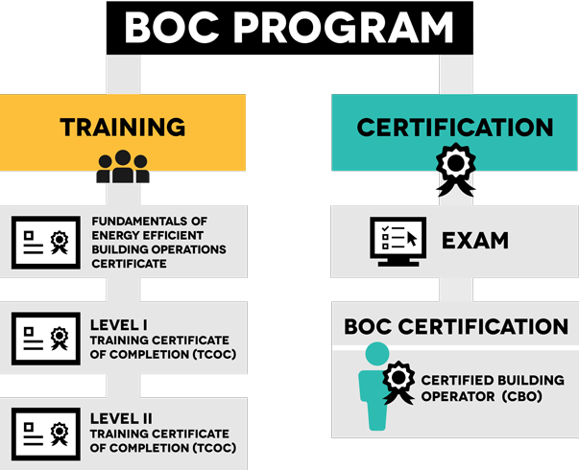
Four professional credentials Stackable and earned over time
BOC Credentials
Notes:
The BOC program offers four professional credentials for building operators. These credentials demonstrate that you have acquired specific knowledge, skills, and/or competencies that can be used on the job. All four give you a competitive edge in the industry.
Certificates: Two credentials are training certificates of completion which recognize those operators who have successfully completed a BOC Level I or II training course. These individuals may use the designation BOC Level I Certificate or BOC Level II Certificate. Additionally, successful completion of the Fundamentals of Energy Efficient Building Operations training results in a Certificate that can be paired with one year of experience for a student to meet eligibility requirements for BOC Level I.
Certificates provide a valuable credential for operators interested in demonstrating completion of over 60 hours of study and project work in their profession to enhance knowledge and skills in building operations.
Certification: The third credential is a certification which recognizes operators who have successfully passed a comprehensive BOC Certification Examination. These individuals may use the designation Certified Building Operator (CBO). A CBO certification provides assurance to employers that operators have mastered the knowledge gained from work experience, study, and passing a comprehensive national exam.
The BOC credentials are stackable which means they are part of a sequence of credentials that can be accumulated over time to build up your qualifications and help you to move along a career pathway or up a career ladder to different and potentially higher-paying job. (Source: TEGL 15-10, www.doleta.gov)

Slide 9
Credential Sequence Options
Many options
No single path
Pick the best one for you and your career goals
Start with Fundamentals certificate
Level I Certificate only
Certification only
Level I Certificate and Certification
Level I & II Certificates
Level I & II Certificates and Certification
Notes:
Stackable credentials allow building operators to balance education and training with job schedules, family needs, and financial resources by earning short-term, industry-validated credentials one at a time.
There is no single path for credentialing through BOC. Your career goals, time availability, support from your employer, and financial means will dictate the best path for you as an individual.
Many operators find that a single credential such as BOC Level I Certificate meets their goals while others will opt for all three. The choice is a personal one for every individual.
The BOC Level II Training Certificate of Completion demonstrates to your employer a commitment to advancing your knowledge in the profession beyond Level I, and staying up-to-date with the rapid changes in building technology and practices in your profession.

Slide 10
How to earn BOC Level II Certificate
There is no separate Level II certification exam
Level II Training Certificate of Completion
Following completion of Level II training:
Submit application for BOC Level II training certificate of completion (TCOC)
Designate credential on correspondence – “BOC Level II Certificate”
Maintain TCOC annually through continuing education
Notes:
Operators who successfully complete the requirements of Level II training may apply for the BOC Level II training certificate of completion (TCOC). There is no separate certification exam for Level II.
The requirements for successfully completing Level II training are attendance of the six Level II training classes, a passing score on each of the class tests, and a passing grade on the project assignments.
Maintenance of the BOC Level II credential is annual on March 31, and requires 10 hours of continuing education, equivalent to 10 maintenance points.

Slide 11
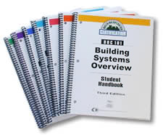
Level II Classes
2001 - Building Scoping for Operational Improvement
2002 - Optimizing HVAC Controls for Energy Efficiency
2003 - Introduction to Building Commissioning
2004 - Water Efficiency for Building Operators
(20xx - Supplemental Class)
2005 - Project Peer Exchange
Notes:
These intensive classes provide the student with the fundamental knowledge to operate and maintain essential facility systems. All Level II classes (or recognized equivalents) are required for the Level II training certificate of completion (TCOC). Tests for each class must be completed at a passing level of 70 percent correct answers. Project assignments must be approved by the BOC course manager to receive the Level II TCOC. Each class in this series is taught by an instructor who meets rigorous requirements based on a review of their subject matter expertise, direct experience in buildings, and the ability to teach effectively.
The Level II core classes are listed above. A supplemental class, chosen by the course administrator, is also included in the course. The supplemental class is sequenced between 2004 Water Efficiency for Building Operators and the final class, 2005 Project Peer Exchange.

Slide 12
Level II Tests
Tests are given at the end of
each class
■ Cover the current day’s materials with 20 multiple choice questions
■ One hour to complete the test
■ Open-book
■ There is no test for BOC 2005
Notes:
TIP: Complete the test without opening the book first, then refer to the book as needed.
There is no test for BOC 2005. Students will receive a Pass/Fail grade for attendance and participation. In order to receive a passing grade, students must satisfy the following requirements. Failure to complete these requirements will result in a failing grade.
Attend the class.
Prepare and deliver a 10-minute presentation on their building scoping report (Project Assignment #5).
Listen to their peers’ presentations and provide constructive feedback for each presenter, according to the instructor’s directions.

Slide 13
Level II In-Facility Project
Demonstrates your ability to apply skills in BOC training to your own facility
Required to earn the BOC Level II certificate
Notes:
Purpose: The purpose of the BOC Level II project is to reinforce classroom learning through assignments completed back on the job at your building. Completion of the project assignments demonstrates your ability to perform skills addressed in the BOC training. The assignments require you to gather information about your facility and provide descriptions and recommendations in the form of a building scoping report. The project culminates with a short presentation of your scoping report. This gives you the opportunity to practice your presentation skills, which are becoming more and more important to employers in today’s building operations industry. Communication skills like these are helpful in influencing financial decision makers to implement the energy-saving opportunities you find, and can enhance your visibility within the organization, which can lead to career advancement opportunities. Short presentation skills modules are included throughout the course to help prepare you to deliver your final presentation with confidence.
Requirements: Completion of the Level II Project Workbook is REQUIRED for the BOC Level II Training Certificate of Completion (TCOC).
Organization: There are five individual project assignments in Level II. The assignments are provided in the Level II Project Workbook for you to review and complete on the scheduled due dates. Your instructor will review the assignment in class to prepare you to successfully complete the work back at your facility. The first project assignment will be assigned by your instructor in today’s 2001A class. You should complete Assignment 1 and bring it to the next class for review and sign off by your training coordinator.
Check-Off Sheet: At the end of the course series, your course manager will submit this assignment record to your training provider as proof of completion.

Slide 14
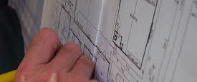
What is the Level II project?
Assignments (1-5):
1- Energy Use Intensity & ENERGY STAR Portfolio Manager
2 – Scoping Interview & Building Systems Summary
3 – Sequence of Operations and Functional Test
4 – Establish building walkthrough plan
5 – Conduct the building walk through, Building Scoping Report and Presentation (prepare and present)
Find detailed descriptions in your Level II Project Workbook
Five assignments
Example projects will be provided
Apply classroom learning to your facility
Notes:
The Level II project is completed through a series of assignments between each class design to help structure the scoping assessment and presentation steps. These steps guide operators through interconnected activities to evaluate the operational performance of their buildings with a focus on improving energy and water efficiency. Each project assignment will be completed between class sessions. The project culminates with a presentation of a building scoping report in the 2005 class.
Assignment 1: Set up the building in ENERGY STAR Portfolio Manager (or update and validate if there is already a profile); calculate and interpret the building energy use intensity (EUI) and analyze energy data for seasonal trends and baseloads.
Assignment 2: Complete a scoping interview with other building staff and complete a building operations map, which is a summary of equipment, controls, and operating schedules.
Assignment 3: Complete a sequence of operations and functional test for an air handler.
Assignment 4: Complete a building walkthrough plan.
Assignment 5: Perform a building walkthrough. Prepare a building scoping report for operational improvement based on findings from the walkthrough. Report is due at the supplemental class (e.g. 2010, 2014 etc.).
Refer to the Project Workbook for detailed descriptions of each assignment.

Slide 15

How Do I Complete the Level II Project?
Choose one building
Work independently or with others
Get stuck? Contact instructor or Course Manager
Submit completed assignments by due dates provided in syllabus
Exchange project findings with your peers on the final day of the course
Submit to Course Manager or Administrator for final grade
Notes:
______________________________________________________________________
______________________________________________________________________
______________________________________________________________________
______________________________________________________________________
______________________________________________________________________
______________________________________________________________________
______________________________________________________________________
______________________________________________________________________
______________________________________________________________________
______________________________________________________________________
______________________________________________________________________

Slide 16
How is my project evaluated?
Your peers:
Exchange projects with you
Provide feedback (doesn’t influence grade)
Your instructor:
Leads a “report out” discussion intended to facilitate feedback
Your Course Manager, Administrator or instructor:
Reviews and grades the two components of the project:
5 Project Assignments (passing grades 70% or higher, based on rubric)
Presentation (pass/fail based on attendance and participation)
Notes:
You and your peers will share with each other a short presentation (10 min.) of your scoping report findings.
This training is intended as a workshop experience with lots of exchange. Some deviations from the book content may occur to explore other areas of interest to operators.
Your peers do not grade your project assignment. The grade is given by the course manager or instructor, based on whether you completed the written assignments and gave a presentation.

Slide 17
Credential Maintenance and Exam Info
What is the annual maintenance requirement?
Am I eligible for the Certification Exam?
Notes:
What is the annual maintenance requirement for my credential?
Operators who hold the BOC Level II certificate must earn 10 maintenance
points annually to maintain their credentials. Go here for maintenance
activities and due dates.
http://www.theboc.info/continuing-education/maintaining-credentials/
Am I eligible for the Certification Exam for CBO designation?
If you have earned a BOC Level I TCOC or Certification in the past, you are eligible to take the Certification Exam. The exam provides a valid and verified assessment of knowledge and skills in energy efficient building operation.
The exam is 3 hours long, 120 questions, and closed book. More information about the exam is here: http://www.theboc.info/certifications/exam/

Slide 18
Activity 1 – Why are you here?
Answer 6 questions (5 mins)
Review answers with person next to you or in the breakout room (5 mins)
Volunteer your answers during the “report out.”
Notes:
Activity 1 – Why are you here?
Write the answers to your questions in the space provided.
How many years have you been in the profession? ______________________
How did you learn the skills to be a building operator? ______________________________________________________________________
Why are you attending BOC Level II? __________________________________
______________________________________________________________________
4. Is your employer supporting your time and tuition to attend BOC training?
___Yes ___No
5. What has your employer told you they expect from you after training?
______________________________________________________________________
6. Does your employer recommend or require BOC training for employees in this profession? Recommend – yes/no Require – yes/no

Slide 19
High Performance Buildings
“A building that integrates and optimizes all major high performance building attributes including energy efficiency, durability, life cycle performance, and occupant productivity.”
Source: National Institute of Building Sciences
Can high performance work in older buildings?
Does high performance mean earning a certification?
What is your experience with high performance buildings?
Notes:
The National Institute of Building Sciences (NIBS) defines a “High-Performance Building” as the integration and optimization on a life cycle basis of all major high performance attributes, including energy conservation, environment, safety, security, durability, accessibility, cost-benefit, productivity, sustainability, functionality, and operational considerations.
A building does not need a certification from LEED, ENERGY STAR or other programs in order to be high performing. The BOC Level II course is designed to help building operators learn about the technologies and practices to improve their building’s performance. You may not have a high performance building now but there are things you can do in any building to make it more energy efficient. For those who have a high performance building, the course will help you find ways to correct problems and maintain performance over time.
The benefits of having a high performing building include the following:
Lower operating costs
Improved indoor environmental quality
Increased productivity and worker satisfaction
Help meet organization’s sustainability goals
Attract building tenants
Increased building value
Public relations and community benefits

Slide 20
High Performance Building Attributes
High Performance Buildings
Sustainable
Safe/
Secure
Functional
Aesthetics
Productive
Accessible
Cost Effective
Energy efficiency
Durability of building materials
Life cycle performance
Occupant productivity
Sustainability
Notes:
Building operators play a key role in achieving and maintaining the performance of their building. A high performing building requires skilled and qualified workers, particularly as building technologies become more advanced. The National Institute of Building Sciences and the U.S. Department of Energy (DOE) have developed voluntary national guidelines, known as the Better Buildings Workforce Guidelines (BBWG), to improve the quality and consistency of commercial building workforce credentials.
The NIBS definition identifies four key performance attributes:
Energy Efficiency
The Energy Independence and Security Act (EISA) of 2007 established a new and aggressive plan for achieving energy independence in our nation’s building stock by the year 2030. The act requires that federal buildings (new and renovations) achieve fossil fuel-generated energy consumption reductions of 100 percent in 2030. The act also requires that sustainable design principles be applied to siting, design, and construction.
Many large organizations have formal established goals for reducing energy consumption and improving sustainability in their building operations. High Performance buildings maximize energy savings through the use of high efficiency building systems and equipment in combination with improved operation and maintenance practices to achieve organizational goals.
Durability of Building Materials
Over the life of the building the durability of building materials will have a significant impact on total owning and operating costs. High performance buildings emphasis the use of materials that have long life and meet or exceed industry standards for durability and performance. ASTM International is one of the world’s largest standards development organizations. ASTM Standard STP691 Durability of Building Materials and Components is the first major international review of durability research for a comprehensive range of building materials and components.
Life Cycle Performance
The goal for high performance buildings is to achieve the lowest owning and operating cost over the life of the building. When making decisions about energy using systems or equipment or building materials, owners and operators of high performance buildings will use life cycle performance in the decision process. Life cycle costing accounts for the owning and operating cost over the life of the system or equipment. These costs are adjusted for inflation and include maintenance costs where required. Systems and equipment with the lowest life cycle cost should be prioritized. For example, high efficiency HVAC systems and equipment often have a higher first cost than code minimum equipment which can be a barrier to installation. Over the life of the equipment lower operating costs and perhaps longer equipment life will result in a lower cost of ownership.
Occupant Productivity
Recent research into the effects of LEED certification on 562 financial institutions (93 LEED certified, 469 non-certified) found that:
Annual utilities cost per employee in green facilities was $675.26 lower than in non-green facilities.¹
Employees working in the LEED-certified branches of the same financial institution were found to be "more productive and engaged in their work." ²
Using LEED-certified buildings increases revenue generated by bank branches even when they offer the same products and services.³
These productivity gains are not limited to financial institutions. For example, recently conducted scholarly research in the field of behavioral psychology has also found that companies that adopt more rigorous environmental standards are associated with higher labor productivity—an average of 16% higher--than non-green firms. ⁴
Other research has found that office workers with the best possible view, as opposed to no view, performed 10% to 25% better on tests of mental function and memory recall.⁵
LEED-certified buildings are also demonstrating increased recruitment and retention rates and increased productivity benefits for employers. 2.5 million employees are currently experiencing better indoor environmental quality in LEED buildings. This group of employees is expected to exceed 21 million by 2030, resulting in an economic value of $90 billion from increased productivity.⁶
¹Conlon, E. and Glavas, A. (2012). The Relationship Between Corporate Sustainability and Firm Financial Performance. Accessed June 28, 2020 via https://pdfs.semanticscholar.org/2dbe/6f88953acfe045746bcb165a8b39e93706be.pdf
²Conlon, E. and Glavas, A. (2012). The Relationship Between Corporate Sustainability and Firm Financial Performance. Accessed June 28, 2020 via https://pdfs.semanticscholar.org/2dbe/6f88953acfe045746bcb165a8b39e93706be.pdf
³Conlon, E. and Glavas, A. (2012). The Relationship Between Corporate Sustainability and Firm Financial Performance. Accessed June 28, 2020 via https://pdfs.semanticscholar.org/2dbe/6f88953acfe045746bcb165a8b39e93706be.pdf
⁴Delmas, Magali A. and Pekovic, Sanja (2012). Environmental standards and labor productivity: Understanding the mechanisms that sustain sustainability. Accessed June 28, 2020 via http://onlinelibrary.wiley.com/doi/10.1002/job.1827/pdf
⁵Heschong Mahone Group, Inc. (2003). Windows and Offices: A Study of Office Worker Performance and the Indoor Environment –CEC Pier 2003. https://newbuildings.org/wp-content/uploads/2015/11/A-9_Windows_Offices_2.6.101.pdf

Slide 21


High Performance Building Case Studies
Pacific Tower
Seattle, WA
JohnsonDiversey Corporate Headquarters
Sturtevant, Wisconsin
Notes:
JohnsonDiversey Corporate Headquarters, Wisconsin
JohnsonDiversey’s global headquarters, located in Sturtevant, Wisconsin, is a three-story mixed-use facility constructed in 1997. The building floor area is 277,440 square feet, of which 70% is office space and 30% is research laboratories. The building was designed based on green-building principles, including high-energy efficiency, extensive use of natural lighting, and individual control of workspace environments. Because it was built with sustainability in mind, applying LEED-EB to the building was primarily a matter of fine-tuning the building’s operations practices and improving the documentation of existing sustainable practices. The JohnsonDiversey Global Headquarters was certified LEED-EB Gold in March, 2004.
Participating in LEED-EB and achieving LEED-EB certification has produced a number of benefits for the company:
Energy savings exceed $90,000 per year, relative to a similar building designed without integrated design approach and energy efficiency measures.
Use of collected stormwater for turfgrass irrigation reduces potable water use by 2-4 million gallons per year.
For the first time, the company has documented that over 50% of site generated solid waste is recycled.
Participation in the LEED-EB program has renewed focus on integrated pest management, cleaning worker training, certified cleaning chemicals, systems approach to cleaning, and cleaning equipment, and has allowed JohnsonDiversey to construct an integrated cleaning program in alignment with LEED requirements.
CO2 monitoring has confirmed adequate airflow design in occupied building areas, and allows building operators to respond to unusual incidents or conditions.
Individual/personal environment controls (air flow, temp, acoustics and lighting) significantly increase occupant comfort, virtually eliminate hot/cold calls to maintenance, and allow for general building zone temperature range to exceed normal building comfort ranges thereby resulting in additional energy savings.
Occupant interest and involvement in environmental aspects of building operation have increased.
Pacific Tower, Washington
The 16-story Pacific Tower located in Seattle, Washington was built in 1932, and has served a number of different functions. It was originally a US Marine hospital, afterwards housing Amazon from 1998 to 2011, and currently holds Seattle Historical Landmark and National Register of Historic places status.
In 2015 the building was substantially renovated to prepare the building for the next 80 years of use. All major building systems were replaced with state of the art high performance building systems and equipment. The building was certified as LEED-EB Silver in 2018.
Some of the high performance systems, equipment and activities include:
Tenant engagement activities focusing on plug use and lighting controls
High performance LED lighting fixtures with Luminaire Level Lighting Controls (LLLC). Each fixture has integral occupancy sensor and daylight sensing control and is tunable through a networked control system
Each temperature zone has CO2 sensors to ensure optimal energy efficiency and ventilation in all zones of the building, called demand control ventilation (DCV)
Sophisticated software and data analytics mine building performance data and provide data visualization to identify performance issues in real time
High performance air-to-water heat pump supplies low temperature hot water to reheat coils in the VAV terminal units
Advanced sub-metering is installed to monitor real-time energy consumption of every electrical panel in the building as well as chilled and hot water delivery systems

Slide 22
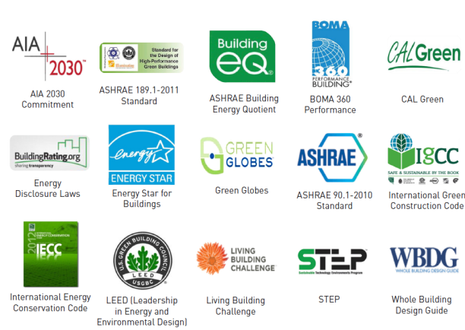
High Performance Building Standards
A diverse landscape of building performance standards
Notes:
There is a diverse landscape of high performance building standards. Formalized standards provide requirements, specifications, or guidelines that can be used by building owners and operators to operate their building for high performance. Some of the standards such as ENERGY STAR, LEED, Green Globes and the Living Building Challenge offer a certification for verifying the building’s performance. As noted earlier, it is not necessary for a building to be certified in order to become high performing. Identifying a standard to follow for your building operation procedures is a good starting point for improving building performance.
US Green Building Council
LEED or Leadership in Energy and Environmental Design is the most widely used third-party verification system for both new and existing high performance buildings. LEED works for all buildings—from homes to corporate headquarters—at all phases of development. Projects pursuing LEED certification earn points across several areas that address sustainability issues. Based on the number of points achieved, a project then receives one of four LEED rating levels: Certified, Silver, Gold and Platinum.
International Green Construction Code
The International Green Construction Code (IGCC) is the first model code to include sustainability measures for the entire construction project and its site — from design through construction, certificate of occupancy and beyond. The new code is expected to make buildings more efficient, reduce waste, and have a positive impact on health, safety and community welfare.
ASHRAE 189.1
ASHRAE Standard 189.1 “Standard for the Design of High Performance Green Buildings” provides total building sustainability guidance for designing, building, and operating high-performance green buildings. From site location to energy use to recycling, this standard sets the foundation for green buildings by addressing site sustainability, water use efficiency, energy efficiency, indoor environmental quality (IEQ), and the building's impact on the atmosphere, materials and resources.
AIA 2030 Commitment
In 2006 the American Institute of Architects issued the Architecture 2030 vision which calls for all new buildings, developments, and major renovations to be carbon-neutral by 2030. To support this call to action the AIA created the AIA 2030 Commitment—a national framework with simple metrics and a standardized reporting format—to provide a structure for tracking progress and help architects meet the challenge. This is a volunteer national initiative that provides a framework to help firms evaluate the impact of project design on energy performance.
The Architecture 2030 goal calls for buildings to be carbon neutral by 2030. This is also referred to as a “Net Zero Energy” building. Net zero energy buildings are designed and operated to maximize energy efficiency with resulting reductions in energy consumption. Renewable energy systems such as solar and wind can now be sized for the lower energy demand which improves the life cycle performance of renewable energy and provides a carbon neutral solution.

Slide 23
Activity 2 – High Performance Buildings
Take 20 minutes
Break into groups of 4 people
Review and answer 3 questions below
Discuss your answers with each other
Volunteer one answer during the “report out”
Notes:
Activity 2 – High Performance Buildings
As a group discuss each key high performance building attribute and list ways you can improve the performance of your building in each category in the matrix below.
Write your answers in the matrix boxes.
What role do building operators have in increasing a building’s performance? __________________________________________
__________________________________________________________

Slide 24
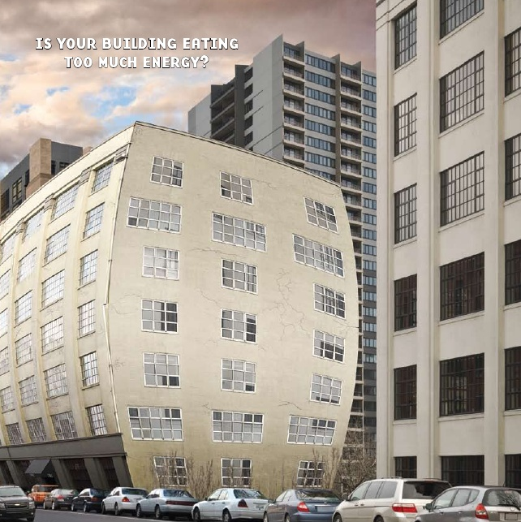
Is Your Building Eating Too Much Energy?
Most buildings can cut total energy use by 5-20% while fully maintaining or improving comfort and function.
Let’s discuss how.
Notes:
Most buildings can cut total energy use by 5-20% while fully maintaining or improving comfort and function (Source: ENERGY STAR O&M Best Practices, PECI)
Over time though, most buildings get a little out of shape and consume more energy than they need to in order to operate and keep tenants comfortable. In the next section, we will discuss how to scope the building for energy tune up opportunities.
Below are three O&M practices for high performing buildings.
Operating energy-using equipment only as much as needed
Operating energy-using equipment as efficiently as possible when it is needed
Performing strategic maintenance to enhance and maintain efficient operation

Slide 25
Terminology
Energy Efficiency Measure (EEM)
Energy Conservation Measure (ECM)
Retro- and Re-Commissioning
Air-Balancing
Small Capital Projects
Large Capital Projects
Notes:
Let’s discuss some common terminology related to operational improvement.
Energy efficiency typically refers to optimizing the operation of energy-using equipment, for example tuning a boiler or replacing a furnace with a heat pump. Performing predictive and preventive maintenance regularly can contribute to efficient equipment operation. Energy conservation generally includes actions to reduce the amount of energy end use required, for example adjusting schedules or setpoints.
ASHRAE defines commissioning as "a quality-oriented process for achieving, verifying, and documenting that the performance of facilities, systems, and assemblies meets defined objectives and criteria.” Retrocommissioning is a collaborative and systematic process for commissioning existing buildings that did not receive adequate commissioning during construction. Recommissioning is a persistence strategy that periodically reapplies the original commissioning or retrocommissioning tests in order to keep the building systems operating according to design and the owner’s current operating requirements. We’ll discuss these concepts in depth in BOC 2003, Introduction to Building Commissioning.
Air balancing (sometimes referred to as “testing, adjusting, and balancing, or TAB”) is a process of ensuring air-moving systems meet the correct airflow as required. This includes fresh outdoor air coming in and exhaust air going out.
A capital project involves a permanent alteration or restoration to a property that typically improves it and increases its value, and/or adapts it to new uses. They are typically more involved than repairing existing equipment or structural elements. Capital projects often have significant costs that must be considered. Careful planning is essential in implementing capital projects effectively.

Slide 26
Building Scoping vs. Building Energy Tune-Up
The outcome of a building energy scoping is a proposed scope of work for a building energy tune-up
A building energy tune-up is a periodic process intended to fix problems and to improve operation
Scoping
Tune-Up
Notes:
What’s the difference between a building scoping project and a building energy tune-up?
A building scoping involves a review of the building operation and is intended to provide only enough technical and financial detail to obtain commitment for a deeper analysis and correction process, which is a building energy tune-up. A building scoping is different from a Level I audit (as defined by ASHRAE and is typically performed by a certified auditor), which may include capital opportunities and does not usually include a direct proposal for tune-up services. A building energy tune-up, as defined in this course, is concerned only with low-cost operation and maintenance improvements to energy-consuming systems and equipment. It is different from a building commissioning project which provides for more in-depth, comprehensive investigations that look at all systems and types of opportunities.
This course focuses on building scoping to identify opportunities for further attention or investigation. Typically, the scoping process is separate from the tune-up process, although there may occasionally be some overlap when issues are found during the scoping walkthrough that are easily addressable at the time. For example, if you discovered a scheduling override left in place erroneously, you might correct it at the time of discovery to avoid a return trip. Document corrections you make so that you can later assess any energy savings as a result of your action.

Slide 27
Building Scoping Focus
Operation & maintenance (O&M) improvements
- Example: Equipment scheduling around occupied hours
Does not focus on capital equipment improvements
- Example: Replace old boiler with new, efficient one
Notes:
It is important that the plan for the building scoping project is understood prior to the physical investigation. You should be focusing on quickly evaluating opportunities. While there may be some worthwhile capital projects identified, the scoping should be focused on low or no-cost operational improvements.
During the scoping assessment, it is ok to identify capital equipment opportunities, such as a conversion to a variable speed drive, but the emphasis should be on O&M related issues. This includes the envelope, lighting, indoor and outdoor water as well as HVAC systems.

Slide 28
Quick Review of O&M
Maintenance = Capacity
Caring for, cleaning, lubing, repairing
Primarily physical
Operation = Performance
Scheduling, implementing efficient control strategies, sequencing of equipment
Primarily organizational
Notes:
Separating the O from the M helps us think about how the two types of activities are different. Performing most maintenance activities largely involves physical skills, whereas performing most operational activities involves mainly mental skills.
Maintenance activities ensure that all building equipment and systems, including water systems, have the capacity to run effectively. For example, dirty condenser coils reduce the capacity of the air conditioning system by not allowing sufficient heat transfer to occur.
Operational activities ensure that the control settings for all building equipment and systems, including water systems, allow the equipment to perform optimally by conserving energy wherever possible. If air conditioning compressors are poorly staged or operating when free cooling could be used, they are wasting energy and can also affect comfort by overcooling spaces.
Operation and maintenance activities are different, but equally important.

Slide 29
O&M for Energy Efficient Operation
Operating energy-using equipment only as much as needed
Operating energy-using equipment as efficiently as possible when it is needed
Performing predictive maintenance to enhance and maintain efficient operation
Notes:
The first two items above summarize the goals for sound operational practices that will result in equipment and systems performing optimally. The third item, predictive maintenance, looks at doing just enough maintenance at the right time. An example of this would be changing filters when they need to be changed as opposed to changing them on a schedule whether or not they need it at that point in time. Another example would be replacing failed sensors that have the most effect on operating efficiency, such as outside air sensors, mixed air sensors, discharge air sensors and any sensors responsible for resets.
Predictive maintenance (PdM) techniques are designed to help determine the condition of in-service equipment in order to predict when maintenance should be performed. This approach promises cost savings over routine or time-based preventive maintenance, because tasks are performed only when warranted.
SOURCE: Peter Herzog’s book “Energy-Efficient operation of Commercial Buildings: Redefining The Energy Manager’s Job focuses on this last element almost entirely.

Slide 30
Scoping vs. Tune-up Steps
Scoping
Gather information
Plan walkthrough
Tune-up
Implement O&M corrections
Further evaluate upgrade cost and payback
Perform walkthrough
Evaluate findings (O&M focus)
Prepare report
Investigate complex issues
Notes:
A scoping process sets the stage for the tune-up. The scoping takes a broad-brush approach to identify areas of potential improvement and allows the tune-up to appropriately focus on details in a systematic way.
Scoping:
Gather information on building performance (utility data) and current operations (interview and building systems 'map’)
Plan and carry out walkthrough assessment, focusing on O&M opportunities
Evaluate findings
Prepare a report communicating a scope for identified issues, recommended solutions, potential benefits, cost estimates (if possible), items for further investigation and potential capital investments
Tune-Up:
Implement recommended O&M fixes
Investigate complex issues (you might need more resources or expertise such as retrocommissioning, balancing, or data logging to further diagnose)
Further evaluate equipment upgrade cost/payback

Slide 31

Why Do Scoping?
Plan ahead for a systematic tune-up process
Know where the best investment of time is for detailed analysis
Determine the appropriate level of effort and cost
It’s a good tool to gather and present information to managers
Notes:
A scoping is a good internal sales tool to make the case to management for starting a tune-up project.
Identify range of opportunities for further action and investigation.
Prioritize opportunities by effort, impact and cost.
Communicate to decision makers and stakeholders for buy-in and budget.

Slide 32
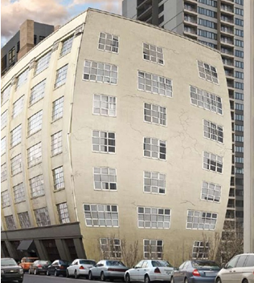
Perception is Key
A building tune-up is outside the scope of day-to-day O&M
Look for opportunities vs. finding problems
Outcome = a building that is easier to maintain
Avoid creating extra work for staff
Involve other staff
Get building owner buy-in
Notes:
It is important for the success of your project to set the right tone and be respectful of other operations staff members as well as contracted maintenance providers. Be clear that any building tune-up project resulting from the scoping is an activity that occurs only every three years or so and is outside of the day-to-day duties of staff. Go in with the attitude that you are not looking to criticize current operations, but that you are looking for opportunities that take extra effort to find. Acknowledge that your co-workers may already have pretty good ideas of where opportunities lie, but they also have their hands full keeping the building systems running and keeping the tenants comfortable—which are rightly the top priorities. Emphasize that the result of the project will be a building that is easier to maintain and run, not just a new list of PMs to perform. Involve other staff members whenever possible in your investigation; it’s good training for them to get a fresh perspective on the building systems and good for the project to have their support. Likewise, the building owner or management needs to commit the time and funding to support the tune up.

Slide 33

Scoping Process Steps
Completion of a scoping interview.
Development of a scoping action plan.
Conducting the walk-through.
Revision and analysis of findings.
A final report presented to decision makers with a specific scope of work for a building energy tune-up.
Notes:
Each step in the scoping process is designed to provide the information necessary to support the next step. There are many methods that can be used to scope a building. The scoping process detailed in this course is based on the combined experience of skilled professionals who each developed their own methodology over time. Scoping should always result in a specific proposed scope of work for a building tune-up that is submitted for approval. The last step helps ensure that the report will not just gather dust on a shelf.

Slide 34
Activity 3 – Your experience with building scoping
Take 15 minutes
Review and answer the questions (6 minutes)
Break into small groups
Compare your answers
Volunteer one answer during the “report out”
Notes:
1. Have you participated in an energy audit or building scoping project?
__________________________________________________________
2. If yes, why was the audit or scoping project done?
__________________________________________________________
3. List two operational improvements you’ve already made in your building:
__________________________________________________________
4. What was the outcome of these improvements?
__________________________________________________________
5. Do you have a building in mind for your project?
__________________________________________________________
6. Are there issues you anticipate in performing the scoping process?
__________________________________________________________
7. What do you hope to learn in the BOC Level II classes that would help you with your next project?
__________________________________________________________

Slide 35
Check Your Knowledge – Question 1
What is the primary outcome of a building scoping?
a. To collect all of the data necessary to complete a building energy tune-up
b. Repair deficiencies found during the scoping walkthrough including replacing dirty filters, broken or cracked belts, etc.
c. A scope of work for a building energy tune-up
d. Identify and implement operational changes that reduce building energy costs in gas and electricity
Notes:
Question 1: Your answer is ______.

Slide 36
Check Your Knowledge – Question 2
How will your Level II project assignment be evaluated?
Peer review with your classmates
A “report out” led by your instructor
Grading by your course manager
All of the above
Notes:
Question 2: Your answer is ______.

Slide 37
Review
What is a building energy tune-up?
What is scoping, and why is it needed?
Approach to scoping
The five main steps of a building tune-up scoping
Now, let’s get started with the first step—planning.
Notes:
So far, we have defined a building energy tune-up as a detailed, systematic problem diagnosis and repair that focuses on areas of opportunity identified in the scoping. These activities are outside the day-to-day responsibilities of a building operator and require careful planning.

Slide 38
Develop a Scoping Report Action Plan
It is tempting to jump into an onsite assessment or walkthrough, but up-front work is needed to:
Reduce investigation time
Avoid extra follow-ups that may not be budgeted or disrupt normal operation
Notes:
______________________________________________________________________
______________________________________________________________________
______________________________________________________________________
______________________________________________________________________
______________________________________________________________________
______________________________________________________________________
______________________________________________________________________
______________________________________________________________________
______________________________________________________________________
______________________________________________________________________
______________________________________________________________________

Slide 39
Developing a Scoping Report Action Plan
Gather
Basic building information
Energy bills
Daily utility load data (if available)
Analyze
Energy Use Index (EUI)
Benchmark result
Trends/load factors
Daily load data findings
Interview
What documents are available
Known problems
Staffing
Plan
Building walkthrough plan
Report
Document your findings in a report
Notes:
Here are the recommended elements of the scoping report action plan. You can see that quite a bit of effort needs to be put into gathering information before the plan is written. We will go over each of the steps with examples. The plan itself can be pretty simple. We will be writing a plan for a fictitious building, the ACME Office Building. Details about the building will be given as we go through the steps, and we will finish with an example scoping report for ACME Office.

Slide 40
Developing a Scoping Action Plan
2001A Utility Accounting Analysis
Gather
Analyze
2001B
Building Operation Conditions 3. Interview
Map Systems
Notes:
We will cover the first two steps in 2001A – Gathering building information and analyzing data.
2001B will cover steps 3 and 4 – Interviewing a building manager and mapping out the building systems.
An understanding of the four steps will prepare you to complete the project assignments for 2001A and 2001B.

Slide 41
Activity 4 – Tune-Up Scoping Example
Read description of ACME Office Building HVAC System (5 min)
List two sources of ACME building problems and complaints (5 mins)
Share your list during the discussion (5 mins)
Notes:
For this Activity, we will examine an example building, ACME Office Building. This is a typical office building with a central plant. The facility manager is concerned that this building has higher energy bills than similar buildings that the company owns, even though the equipment is relatively newer, and the building is well maintained by in-house staff.
Review the information about the ACME building on the next page. In your opinion, what are two potential sources of the problems and complaints? (write in below)
___________________________________________________
___________________________________________________
Why did you pick these two sources?
___________________________________________________

Slide 42
Our Example Building
ACME Office Building
Urban area in a moderate climate
100,000 gross sq.ft., 10 stories
High bill complaints
Owner-occupied with 20% subleased
Central plant cooling with electric reheat
Gas for warm-up and DHW
DDC control
Notes:
Constructed in 1985, ACME Office Building is a 10-story office building located in a metropolitan area consisting of approximately 100,000 square feet of office space. Occupancy is 7:30 am to 6 pm Monday through Friday with some Saturday usage.
The HVAC system consists of multiple variable air volume (VAV) rooftop air handlers. Fan powered VAV boxes with electric reheat serve the perimeter zones of the building and standard VAV boxes without reheat serve the core. Cooling is provided by two air-cooled chillers. One of the air handlers is dedicated to the computer room. Main coil heating is provided by natural gas fired hot water boilers.
HVAC controls are full direct digital control (DDC). The system is reasonably flexible, but is somewhat underutilized. Current controls provide supply air reset, economizer control, start/stop of the water chillers, boilers, fans, and space temperatures, but it does not provide monitoring or control of lighting or the VAV boxes.
Although occupancy is typical for an office, the HVAC system operates extra hours to maintain space temperatures for cleaning crews. Additionally, the boilers and chillers are available and used year-round, due to occupant comfort issues.
Staff Identified Complaints/Problems: Very high energy bills; Boiler operations required all year; Numerous occupant comfort complaints.

Slide 43
Utility Accounting ENERGY STAR - Portfolio Manager
ENERGY STAR Portfolio Manager as a Management Tool:
Users can assess whole building energy and water consumption
Track changes in energy, water, waste, greenhouse gas emissions, and utility costs over time
Track green power purchases
Share and report data, create custom reports
Generate performance metrics:
Energy Use Index (source, site, weather normalized)
Water consumption (municipally supplied potable and reclaimed, alternative)
Greenhouse gas emissions (indirect, direct, total, avoided)
ENERGY STAR 1-to-100 score (available for many building types)
Notes:
These are the highlights of the Portfolio Manager tool.

Slide 44

Step 1. Gather basic building information
Basic Information for Energy Performance Benchmarking
General Office 1:
Required:
100,000 Gross floor area (SF)
56.5 Weekly operating hours
400 # of workers on main shift
455 # of personal computers
100 Percent of floor area that is air conditioned
100 Percent of floor area that is heated
No Parking
Notes:
Now we will gather information about the characteristics of the ACME building to plan our building scoping project.
We will begin with benchmarking the energy performance of ACME building. You may recall that we covered Energy Benchmarking in the BOC Level I training. It was a Level I take-home project assignment.
We will use Energy Star’s Portfolio Manager to benchmark the ACME building. Portfolio Manager is a free, online tool that is widely used for benchmarking. You will use the same tool for the Level II project assignment given later in today’s class.
The Energy Star data collection worksheet helps organize the data required for benchmarking different building types with their Portfolio Manager. In addition to this basic information, at least 12 months of electric and gas utility consumption needs to be entered to generate a benchmarking score. If, for some reason, actual numbers are not available, a reasonable estimate is acceptable for scoping.
Note: The Energy Star Data Collection Worksheet is available on the energystar.gov website and can be found in the BOC 2001A Appendix. The information needed for our example office building is on the slide. The worksheet illustrates how the data requirements differ for various building types.

Slide 45
Activity 5 - ENERGY STAR Worksheet Review
Take 20 minutes.
Turn to Appendix B 1-6 in your student handbook
Read the instructions in notes below – 5 mins
Complete the activity – 5 mins
Share during the discussion – 5 mins
Notes:
Turn to Appendix B 1-6: ENERGY STAR Data Collection Worksheet
Complete page 1 for your building – 5 mins
Review pages 2-6 and circle all of the space types in your building – 5 mins
- For example, office space, data center, retail space, etc.
- Circle each type for your building
3. Pick one of the space types you circled and complete the fields. You will do this from memory, then revise as you work on the take-home project – 5 mins
4. Prepare to share what you have with your instructor and the class during the discussion.

Slide 46
BOC 2001 Supplemental Reading
ENERGY STAR Portfolio Manager
Want to know more about energy benchmarking?
Check out the 2001 Supplemental Reading and webinars at the URL below.
Your instructor may provide examples of energy benchmarking during class as time permits.
Notes:
ENERGY STAR Portfolio Manager
Portfolio Manager is an interactive resource management tool that enables you to track and assess energy and water use across your entire portfolio of buildings … all in a secure online environment.
More importantly, it can help you implement every step of your energy management program, from setting a baseline and identifying which buildings to target to setting goals and tracking improvements. It’s also the tool for getting recognition from EPA for your efforts.
Use it to help you save energy, save money … and save the environment.
Visit the web site:
https://www.energystar.gov/buildings/facility-owners-and-managers/existing-buildings/use-portfolio-manager

Slide 47

Step 2 – Gather Energy Meter Information
Utility data: Make sure to include all meters and fuels!
Electric
Gas
Steam
Chilled water
Oil
On-site generation (used on site)
Daily load data
Notes:
To get a clear picture of a building’s energy use you must be sure to include all utility meters that serve the building. If there is on-site generation, be sure to include all of the energy that is produced and consumed on site, because you are interested in any energy used—even renewables such as a solar electric system or solar hot water. In a mixed-use building, this can be complicated by the need to get permission from each tenant that is separately metered. In some cases, you may choose to exclude a tenant space if it is also served by a separate HVAC system.
We have gathered all the necessary information for ACME Office, including daily load data, which we will examine later.

Slide 48
Utility Consumption Data
Turn to Appendix D-1 in your Student Handbook
Let’s review terminology on D-1 spreadsheet
kWh & therms
Demand kW
Load factor (LF)
Percent excess use
Notes:
TERMS
kWh is kilowatt-hours, a unit of measure of electricity consumption
Therms is a unit of measure for natural gas consumption
Demand kW is rate of using electricity. Example: Ten 100-watt lamps consume electricity at the rate of 1,000 watts, or 1 kilowatt.
LF is a ratio of the lowest daily use for the year divided by what the use would be if the building operated for a full 24 hours at the lowest daily demand for the year.
Percent excess use is an expression of how much the billed use for the month exceeds the base use.
Base load is an energy using system that consumes a continuous amount of energy throughout the year

Slide 49
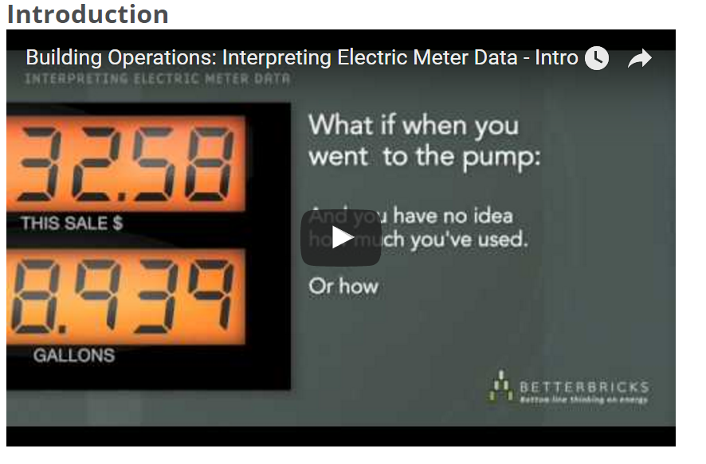
Watch Video: Electric Meter Data
https://betterbricks.com/articles/interpreting-electric-meter-data-series#Introduction
Notes:
Assignment: Your instructor will show a short video “Introduction to the electric meter data series.” After the video, you will discuss your “take-aways” and what you learned.
Assignment Outcomes:
Determine the accessibility of electric meter data for your building
Describe what electric meter data says about your building
Identify the benefits of having access to electric meter data for your building

Slide 50
BOC 2001 Supplemental Reading
Electric Meter Data Series
Want to know more about electric interval data and how to use the data to identify building operation problems?
Check out the videos at the URL below.
Your instructor may provide examples of electric load shapes and common problems during class as time permits.
Notes:
Energy interval data is energy use data that is time stamped in intervals. It can give you valuable information on the operation of energy using equipment and occupancy patterns. This is useful for building scoping to identify operational problems and for diagnostic work during an energy tune up.
Visit the web site below to view additional videos in the series we viewed earlier:
http://betterbricks.com/articles/interpreting-electric-meter-data-series

Slide 51
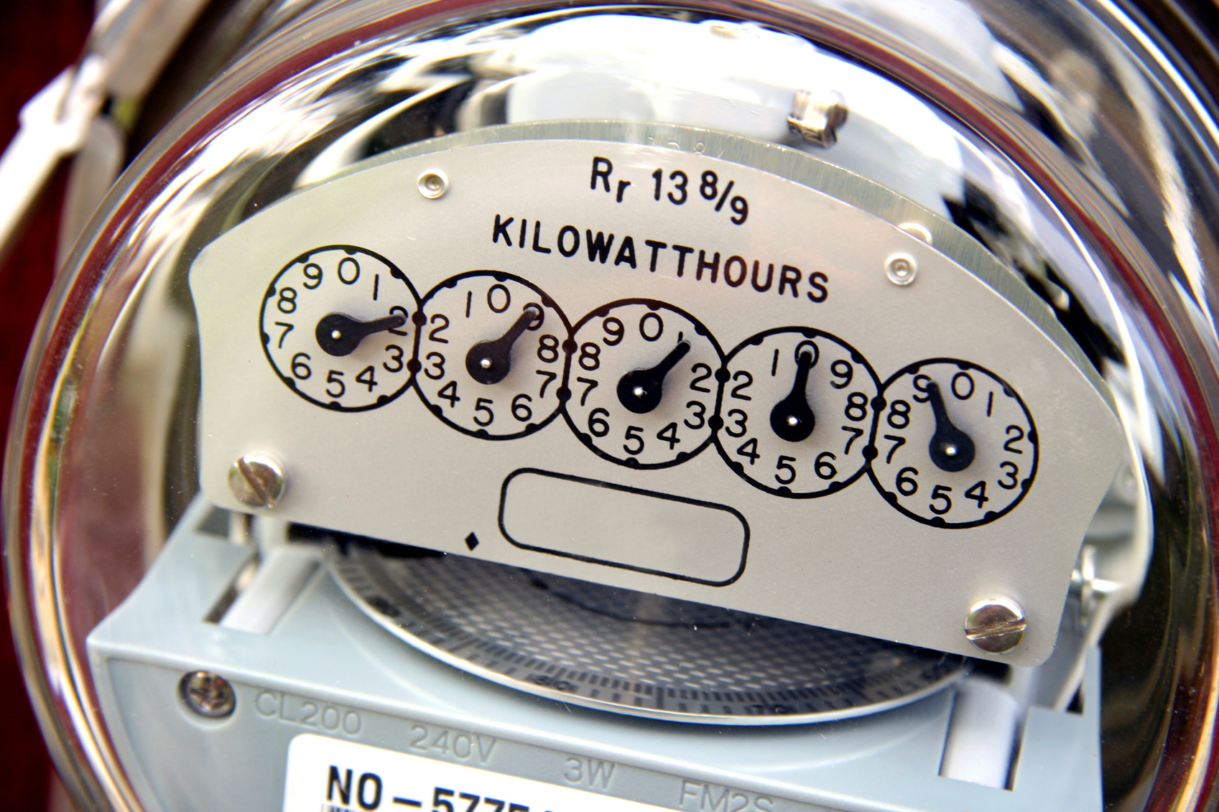
Activity 6 - What are Your Take-Aways?
Let’s discuss
Notes:
Discussion Questions
Do you have access to utility meter data for your building?
___Yes ___No
How would you go about obtaining utility data for your building?
______________________________________________________________________
Do you have load data (interval data) available?
___Yes ___No
What does utility data tell you about your building? _______________________
______________________________________________________________________
List at least three ways you could use building utility data to improve the energy performance of your building.
_________________________________________________________________________
_________________________________________________________________________

Slide 52
Developing a Scoping Action Plan
Gather
Basic building information
Energy bills
Daily utility load data (if available)
Analyze
Energy Use Index (EUI)
Benchmark result
Trends, load factors
Daily load data findings
Interview
What documents are available
Known problems
Staffing
Plan
Building walkthrough plan
Notes:
So far, we have collected basic building information and energy bills. We have also determined whether daily utility load data is available. Now, let’s move on to analyzing our data.

Slide 53
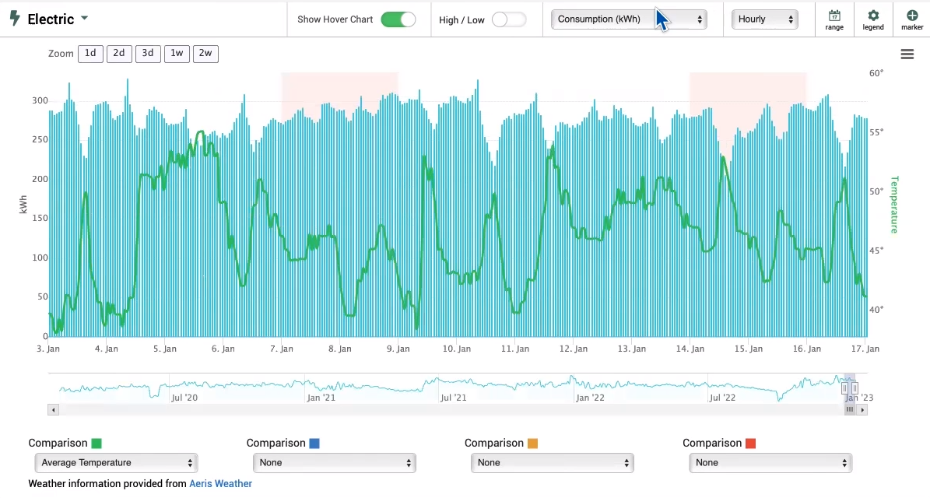
Watch Videos: Identifying Opportunities
Energy Savings: https://vimeo.com/806910213
Demand Reduction: https://vimeo.com/806910396
Notes:
Assignment: Your instructor will show two short videos demonstrating the use of Portfolio Manager and utility interval data to identify energy savings opportunities (~5 minutes) and to identify demand reduction opportunities (~6 minutes). After each video, you will discuss your “take-aways” and what you learned.
Assignment Outcomes:
Determine the accessibility of electric meter data for your building
Describe what electric meter data says about your building
Identify the benefits of having access to electric meter data for your building

Slide 54

Watch Video: What If I Don’t Have Interval Data?
Image source: https://urjanet.com/blog/4-objectives-effective-energy-data-analysis/
https://vimeo.com/806910564
Notes:
Assignment: Your instructor will show a short video “What If I Don’t Have Interval Data?” (~2 minutes). After the video, you will discuss your “take-aways” and what you learned.
If you don’t already have access to interval data, are there any ways you could obtain similar information to inform your analysis?
_____________________________________________________________________

Slide 55
Activity 7 – What does the utility consumption data tell us?
Take 20 minutes.
Team up with the person next to you.
Review and answer the questions – 10 minutes
Discuss your answers together.
Instructor will call on two groups to report out.
Notes:
Turn to Appendix D1-D3: ACME Building Utility Data
INSTRUCTIONS:
Team up with the person next to you.
Review the questions below and determine the best answer.
Write your answer on the line provided.
Prepare to share your answer during the class discussion.
1. What are the two fuel types used in ACME Building? See ACME Utility Data spreadsheets on Appendix D1-2.
____________________________________________
2. How many years of utility consumption data is provided? _______________
3. What is the daily use of electricity kWh for the month of May in Year 1?
____________________________________________
4. What is the monthly base use for May in Year 1?
____________________________________________
5. Take a look at the billed use electricity data for Years 1-3. What is happening with consumption in the summer months? ________________________________
6. Find the natural gas consumption data for Year 1. Do you think gas is used for domestic hot water? For space heating?
______________________________________________________________________

Slide 56

Energy Use Intensity
Calculate Energy Use Intensity (EUI)
Total Energy Use/sq ft conditioned space/year
Commonly expressed as kBtu/sq ft/yr
Or
Use Portfolio Manager to get the EUI and a benchmarking score:
ACME Office Energy Star Score = 26
EUI = 94.4 kBtu/sq ft/year
Notes:
The monthly electric and gas usage may be summed for the year and divided by the building square footage to directly calculate the Energy Use Intensity. The building EUI should include all energy types converted to a common unit, usually kBtu. You may also use ENERGY STAR Portfolio Manager (PM) to generate an EUI.
Portfolio Manager benchmarking scores are based on source energy. Source energy includes the energy needed to generate the electricity that is delivered to the site. Two different EUIs are given by Portfolio Manager, one for source energy and one for site energy. Each is listed on the ENERGY STAR Statement of Energy Performance (SEP) and noted as Source EUI and Site EUI. It is best for building operators to use the EUI for site energy to reflect what is actually billed to the building owner.
Note: The ACME ENERGY STAR Statement of Performance was generated from Portfolio Manager. It is included in the BOC 2001A Appendix. If your building type isn’t eligible to earn a score on the 1-100 scale, the SEP will indicate so with an NA in the score box. It will provide an EUI for the building regardless of whether it has a score.

Slide 57
Analyze
What else can we get from a monthly utility bill analysis?
Seasonal trends
Do they look like you would expect?
Base load consumption
Electric load factor
Compare with occupancy factor
Estimate of heating and cooling consumption
Notes:
Generally, you would expect to see electricity use peak in the late summer and decrease in the shoulder months when free cooling is available. Usage in winter will depend on what type of heating fuel is used. The base load, the lowest daily consumption for the year, for an all-electric building would be expected to be seen in the spring or fall. In a building with only gas heat, the lowest daily electric consumption could occur in winter.
A comparison of the Electric Load Factor (ELF) with the Occupancy Factor (OF) can give an indication of excess use during unoccupied hours.
Depending on the mix of fuel types for heating and cooling, you may be able to reduce the annual heating and cooling consumption by subtracting the base load from the total annual use.

Slide 58
Seasonal Trends—Electric
Year | Month | Bill Start | Bill End | Billing Period Days | Billed Use - kWh | Demand - kW | LF | Daily Use - kWh | Daily Base Use - kWh | Monthly Base Use | % Excess Use
Year 3 | Jan | 1/1/20xx | 1/31/20xx | 30 | 192,313 | 472 | 57% | 6410 | 5,129 | 153,870 | 20%
Year 3 | Feb | 1/31/20xx | 2/28/20xx | 28 | 176,678 | 518 | 51% | 6310 | 5,129 | 143,612 | 19%
Year 3 | Mar | 2/28/20xx | 3/30/20xx | 30 | 180,782 | 456 | 55% | 6026 | 5,129 | 153,870 | 15%
Year 3 | Apr | 3/30/20xx | 4/30/20xx | 31 | 172,117 | 433 | 53% | 5552 | 5,129 | 158,999 | 8%
Year 3 | May | 4/30/20xx | 5/30/20xx | 30 | 209,316 | 482 | 60% | 6977 | 5,129 | 153,870 | 26%
Year 3 | Jun | 5/30/20xx | 6/30/20xx | 31 | 207,557 | 482 | 58% | 6695 | 5,129 | 158,999 | 23%
Year 3 | Jul | 6/30/20xx | 7/31/20xx | 31 | 225,147 | 550 | 55% | 7263 | 5,129 | 158,999 | 29%
Year 3 | Aug | 7/31/20xx | 8/30/20xx | 30 | 240,391 | 554 | 60% | 8013 | 5,129 | 153,870 | 36%
Year 3 | Sep | 8/30/20xx | 9/30/20xx | 31 | 210,098 | 541 | 52% | 6777 | 5,129 | 158,999 | 24%
Year 3 | Oct | 9/30/20xx | 10/31/20xx | 31 | 195,635 | 495 | 53% | 6311 | 5,129 | 158,999 | 19%
Year 3 | Nov | 10/31/20xx | 11/30/20xx | 30 | 214,202 | 417 | 71% | 7140 | 5,129 | 153,870 | 28%
Year 3 | Dec | 11/30/20xx | 1/2/20xx | 33 | 169,251 | 430 | 50% | 5129 | 5,129 | 169,257 | 0%
Billed Use
# Days in Billing Period
% Excess Use =
Monthly Billed Use – Monthly Base Use
Monthly Billed Use
Daily Use =
Monthly Base Use = (Lowest Daily Use) x (# Days in Billing Period)
Notes:
You can learn a lot just from monthly utility bills. Here is the last year of electric data for ACME Office. The months usually don’t exactly line up with the dates for the bill start and bill end. To normalize, divide the total consumption for the month by the number of days in the billing period to get the daily use for that month.
Next, we will make the assumption that the lowest daily use is equivalent or close to a base use for the building, which includes all the non-weather related energy use. This will include fans for ventilation, lights, plug loads, elevators, data centers, etc., since they are required year-round. The monthly base use is then calculated as the daily base use times the number of days in the billing period. The percent excess use is an expression of how much the billed use for the month exceeds the base use. This should follow the normal expected seasonal pattern. If our building only used gas for heating, the excess use in the winter and shoulder months would indicate simultaneous heating and cooling. Since ACME Office has electric reheat, it is reasonable to assume that this is the cause of excess use in those months. Even so, the excess use in the relatively mild fall months could point to the opportunity to reset the supply air temperature to avoid excessive reheat.

Slide 59
Seasonal Trends—Gas
Month | Therms
Jan | 2116
Feb | 1394
Mar | 1294
Apr | 1194
May | 1094
Jun | 844
Jul | 694
Aug | 694
Sep | 994
Oct | 1194
Nov | 1444
Dec | 2044
Base Use = 694 therms/month = DHW End Use
Total Use – Base Use x 12 = 6,672 therms = Heating/year
Notes:
It is reasonable to make an assumption that the lowest usage in July and August is only for domestic hot water (DHW) and that the usage is steady throughout the year. In that way, you can estimate the natural gas use that is solely for morning warm-up in the colder months.
Base Use = 694 therms/month = DHW End Use
Total Use – Base Use x 12 = 6,672 therms = Heating/year

Slide 60
Seasonal Trends
Year 3 base use = 5,129 kWh per day
Assume excess use is for cooling and electric reheat
Year 1
Year 2
Year 3
Notes:
Here is a three-year graph of monthly electricity use. Trends are often easier to spot when graphed. You can see that the base use is pretty steady with peaks in the middle of summer. If available, you could also superimpose cooling degree days and/or heating degree days for each month to see if any other patterns emerge.

Slide 61
Load and Occupancy Factors
Electric Load Factor
Occupancy Factor
ELF =
Total kWh throughout 24 hours_
Highest Daily Demand x 24 hours
OF =
Weekly Occupied Hours_
24 hours x 7
Example for the month of April:
5552 kWh____
433 kW * 24 hrs
56.5 hours/week________
24 hours/day * 7 days/week
ELF =
= 53.4%
OF =
= 33.6%
The ELF is significantly greater than the OF, indicating that there may be excessive after-hour use.
Notes:
Comparing the Electric Load Factor (ELF) to the Occupancy Factor (OF) is another way of looking at the same data.
The ELF is a ratio of the kWh consumption of a day divided by the peak demand multiplied by 24 hours. Looking back at our spreadsheet, you can see that the average daily use was 5,552 kWh in the month of April, and the peak demand was 433 kW, resulting in an ELF of 53.4%.
The OF is a ratio of the actual weekly operating hours divided by all the hours in the week. Our occupancy factor is 33.6%.
Since our ratio of consumption is higher than our ratio of occupancy, it is reasonable to conclude that electric use during unoccupied hours is worth further investigation.

Slide 62
Analysis Results for ACME Building
ACME Office Energy Star score = 26
EUI = 94.4 kBtu/sqft/year
Electric base use = 5,129 kWh per day
Load and occupancy factors suggest excess after-hour use
Gas base use = 22.4 therms/day = DHW end use
Total use –base use*12 = 6672 therms = heating/year (15,000 – 8,328 = 6,672)
Notes:
This is a typical office building with a central plant. The facility manager is concerned that this building has higher energy bills than similar buildings that the company owns, even though the equipment is relatively newer and the building is well maintained by in-house staff.

Slide 63
Developing a Scoping Action Plan
Gather
Basic building information
Energy bills
Daily utility load data
Analyze
Energy Use Index (EUI)
Benchmark result
Trends, load factors
Daily load data findings
Interview
What documents are available
Known problems
Staffing
Plan
Building walkthrough plan
Notes:
Now we have analyzed monthly utility data a number of ways and have determined that:
ACME Office Energy Star score = 26
EUI = 94.4 kBtu/sqft/year
Electric base use = 5,129 kWh per day
Load and occupancy factors suggest excess after-hour use
Base use = 694 therms/month = DHW end use
Total use – base use = 6672 therms = heating/year
The analysis of the daily load data, also known as interval data, is addressed in the next section.

Slide 64
Check Your Knowledge - Question 3
What is the first step in conducting a building energy scoping action plan?
Information gathering
Walk through the building at night
Walk through the building during occupied hours
Set up trend logs
Notes:
Question 1: Your answer is ______.

Slide 65
Check Your Knowledge - Question 4
What is a building EUI?
a. Total annual electric use per square foot of conditioned space
b. Total annual energy use per square foot of conditioned space
c. A building’s energy performance relative to buildings within a 100 mile radius
d. An energy score of 1-100 created by Energy Star
Notes:
Question 1: Your answer is ______.

Slide 66
Check Your Knowledge - Question 5
The base load for natural gas would be typically found in what season?
Fall
Winter
Spring
Summer
Notes:
Question 1: Your answer is ______.

Slide 67
BOC 2001 Supplemental Reading
Interpreting Electric Load Data
Want to know more about energy interval data?
Check out the 2001 Supplemental Reading at the BOC website (URL below)
Your instructor may provide examples of energy interval data during class as time permits
Notes:
Supplemental Reading
This material provides an overview of Interval Data and how it can be used by building operators for building scoping, energy management, and to detect equipment operation issues.
Interval data is meter data collected at defined intervals, typically every 15 minutes or hourly. It used to be that you had to install sub-meters and manage an on-site database to capture interval data. Today, the advent time-of-use rates, smart meters, and real-time communication networks means that a large and growing number of buildings have access to interval data hosted on their utility web sites.
Supplemental reading material is available to students registered for BOC training at this URL. Please use the password below to access it.
http://www.theboc.info/student-partner-login/boc-supplemental-class-materials/
Password: BOCstudent

Slide 68
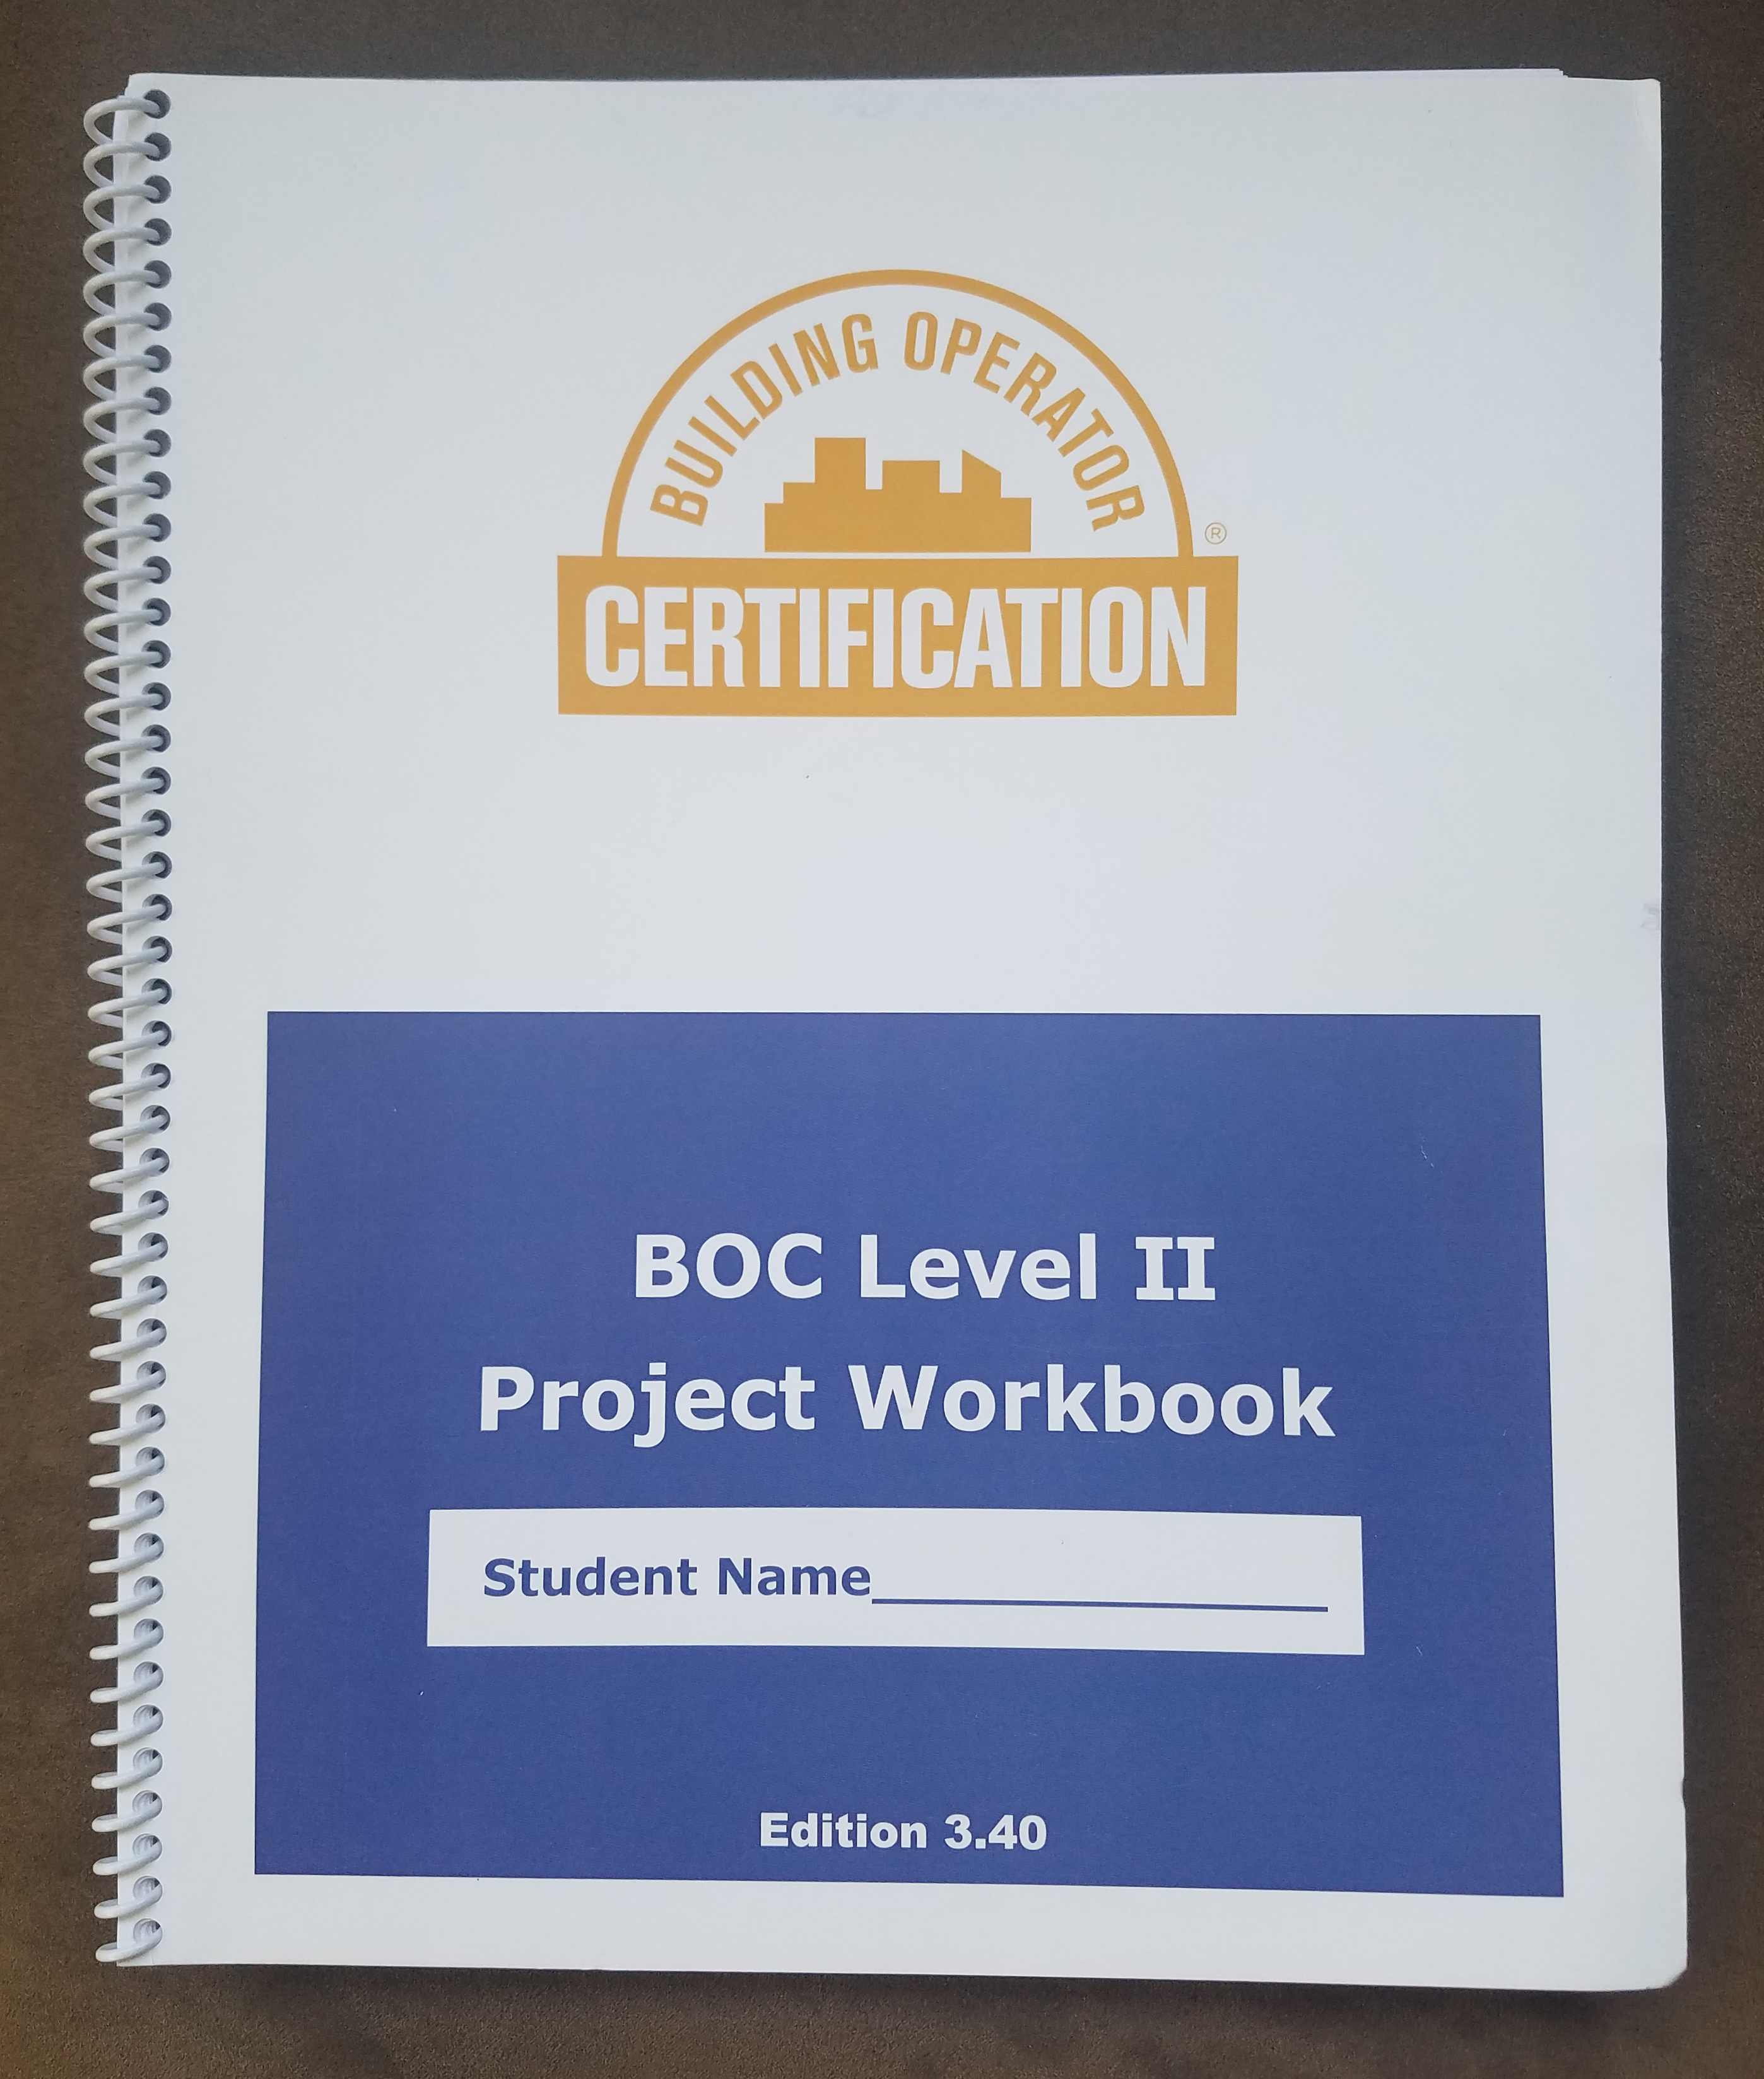
Project Assignment #1
Open your Level II Project Workbook
Let’s review Assignment 1
- Calculate energy use intensity (EUI)
- Set target goal for EUI
- Examine 12 months energy consumption by fuel type
- Estimate baseload and seasonal energy use by fuel type
Notes:
The purpose of this project assignment is to apply the data collection steps discussed today to your building. At the completion of the assignment, you will have an energy use intensity (EUI) for your building and an ENERGY STAR score (for eligible buildings). The EUI and score can be used to track energy consumption and costs over time, to set goals for energy improvements, and to evaluate the impact of energy efficiency upgrade projects you implement.
Open your Level II Project Workbook. Refer to Assignment 1 for BOC 2001. Read the description of the assignment and the rubric used for grading.
In this assignment, you will complete the following:
Gather Building Data
Document the most recent 12 months energy consumption by fuel type
Calculate EUI and Energy Star Score for your building
- Set a target goal (EUI or Energy Star Score) and determine annual energy savings potential
- Estimate baseload for electricity and seasonal energy use by fuel type

Slide 69
Project Review Calculate EUI
1. Calculate Energy Use Intensity (EUI)
Total Energy Use/sqft conditioned space/year
Commonly expressed as kBtu/sqft/yr
Or
Use Portfolio Manager to get the EUI and a benchmarking score
2. Set target EUI or ES Score for your building and estimate potential annual energy savings
Notes:
The monthly electric and gas usage may be summed for the year and divided by the building square footage to directly calculate the Energy Use Intensity (EUI). The building EUI should include all energy types converted to a common unit, usually kBtu. You may also use Portfolio Manager to generate an EUI.
ENERGY USE INTENSITY (EUI) = Total Annual Energy Use in Btu
Building Conditioned Floor Area FT²
Portfolio Manager benchmarking scores are based on source energy. Source energy includes the energy needed to generate the electricity that is delivered to the site. Two different EUIs are given by Portfolio Manager, one for source energy and one for site energy. They are listed on the Energy Star Statement of Performance as ‘Energy Intensity’. Use the EUI for site energy to reflect what is actually billed to the building owner.

Slide 70
Activity 8
Take 25 minutes
Break into groups of 3 to 4 people.
Discuss the questions provided. Exchange information about your professional experiences.
Share your insights with the class.
Notes:
Activity 8
Turn to the Appendix D1-3 in the BOC 2001 Student Handbook. Use sample data for the ACME Building to complete the calculations and answer the following questions:
What is the total kWh electrical consumption for Year 3? ______ Kwh
2. What is the total natural gas consumption for Year 3? _____ Therms
3. Calculate the Energy Use Intensity (kBtu/SF/Yr) for the building assuming the following fuel conversion factors:
1 therm of natural gas = 100,000 Btu
1 kWh electricity = 3,413 Btu
kBtu/FT²/YR
4. If you set a target goal of reducing the ACME Building EUI by 10% what is the potential annual energy savings?
kBtu/YR
5. Review the graph plot of the annual monthly energy consumption by fuel type.
6. Using the consumption data and plot of monthly energy use calculate the baseload for each fuel type.
Natural Gas Baseload Therms/Month
Electric Baseload kWh/Month
7. Using the consumption data and plot of monthly energy use estimate the seasonal energy use by fuel type. Assume the building is gas heated and electrically cooled.
Estimated Annual Heating Energy Therms/Yr
Estimated Annual Cooling Energy kWh/Yr
Additional Questions:
Do you have access to Utility data? ___Yes ___No
Who can help you with your project assignment? _________________
Can you partner with a classmate to complete the assignment? Yes/No

Slide 71
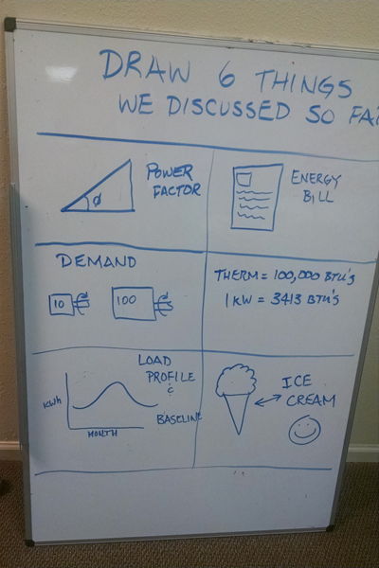

Activity 9 –
2001A Review
Take 10 minutes.
Draw 6 things we discussed today.
Pick one to share with the class during “report out”.

Slide 72
BOC 2001A Test
The test is administered by your instructor, or online at the Learning Management System (LMS).
The test is open book and open notes.
You have one hour to complete the test.
Notes:
BOC 2001A Test
The test is designed to review the important content prescribed by the learning objectives and covered during the class day.
The test is open book. You have one hour to complete the test.
You will work independently to answer the questions. Teaming up with a classmate is not permitted.
If the test is administered via paper, provide your answers on the answer sheet, not the test booklet. Upon completion of the test, you may return the test booklet and your answer sheet to the instructor or your course manager.
The test will be graded following the class, and your score will be provided to you no later than at the next scheduled class in the BOC course series.
Good luck!

Slide 73
Appendix
Glossary of Terms
ENERGY STAR Portfolio Manager Worksheet
ACME Building Statement of Energy Performance
ACME Building Utility Data Sheet
A lasting resource for the future

