Slide 1

BOC 2001B
Building Scoping for
Operational Improvement
Month Day, Year
Instructor Name, Position
Instructor Company
Phone
Name@email.com
Notes:
Instructor’s name: __________________________________________________________
Phone number: ____________________________________________________________
E-mail: ___________________________________________________________________
_________________________________________________________________________
_________________________________________________________________________
_________________________________________________________________________
_________________________________________________________________________
BOC 2001B
Building Scoping for
Operational Improvement
Edition 3.00

Slide 2
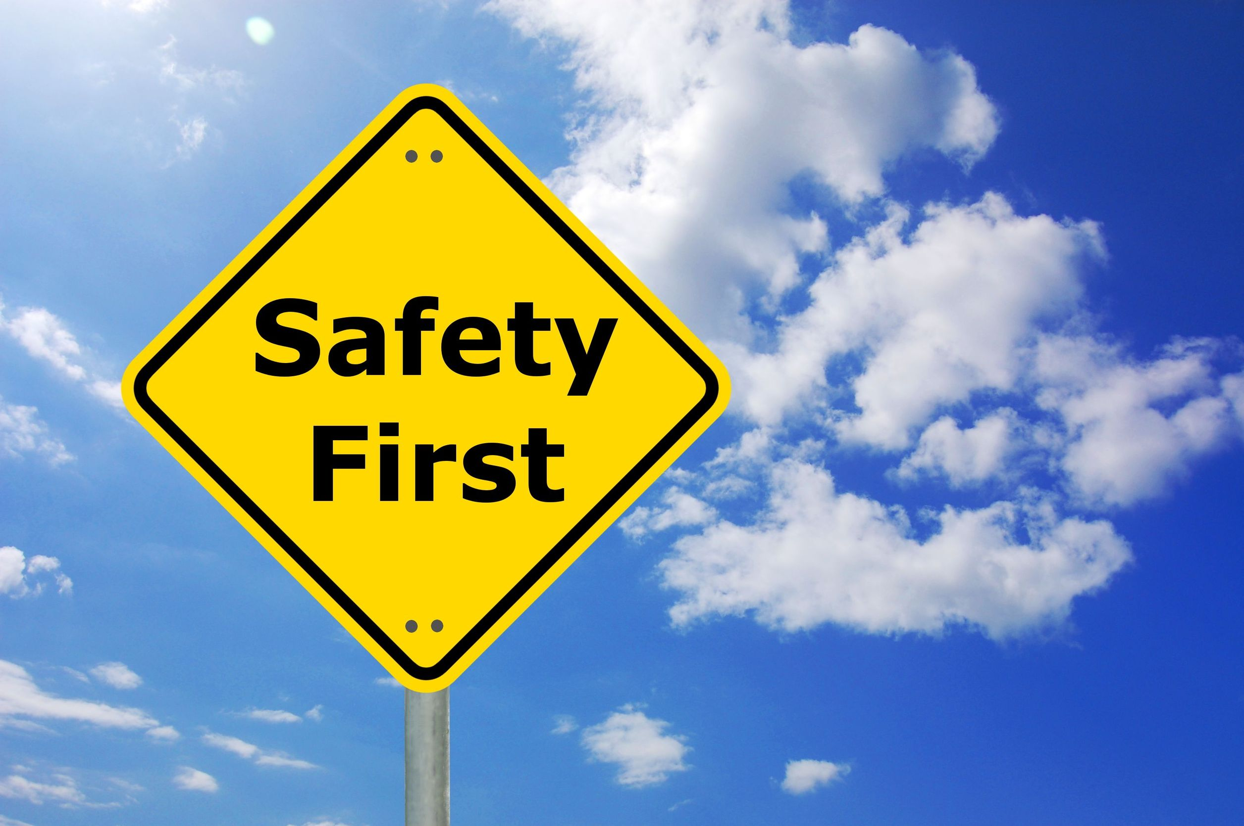
Safety Message
Notes:
Let's start with a safety reminder. This may be something from the course sponsor or site host; the instructor, moderator, or a student. Topics can include anything related to safety: site, health, personal, equipment, etc. What topic shall we address today?

Slide 3
Agenda
2001A assignment review
Building scoping interview guide
Four common opportunities
Building systems operations map
Conducting a building walkthrough
2001B project assignment
Presentation skills
Test
What time will we end today?
Can you recall what we covered in 2001A?
Notes:
Class Overview
BOC 2001 builds on the knowledge gained from BOC Level I training to gather and analyze data about building operation to find opportunities for energy saving operational adjustments and to create a prioritized scope of work for a building tune-up project.
In 2001A, we covered the requirements for earning the Level II credential, high performance building operation, the steps involved in scoping the building for operational improvement, and collecting and analyzing energy consumption data for your building. In 2001B, we will cover the remaining steps in a building scoping for operational improvements. Your instructor will also lead a short Presentation Skills activity to help prepare you for presenting your scoping report findings in the 2005 Project Peer Exchange class.
Agenda – 2001B
2001A assignment review
Building scoping interview guide
Four common opportunities
Building systems operations map
Conducting a building walkthrough
2001B project assignment
Presentation skills
Test

Slide 4
Learning Objectives –
2001B
Report your findings from the 2001A project assignment
Explain the purpose of the building scoping interview guide
Describe four common opportunities for improving building performance
Practice using O&M tune-up checklists
Prepare for a building walkthrough
Describe the 2001B project assignment
Notes:
Learning Objectives
After this class, an operator should be able to:
Report your findings from the 2001A project assignment
Explain the purpose of the building scoping interview guide
Describe four common opportunities for improving building energy performance
Practice using O&M tune-up checklists
Prepare for a building walkthrough
Describe the 2001B project assignment

Slide 5
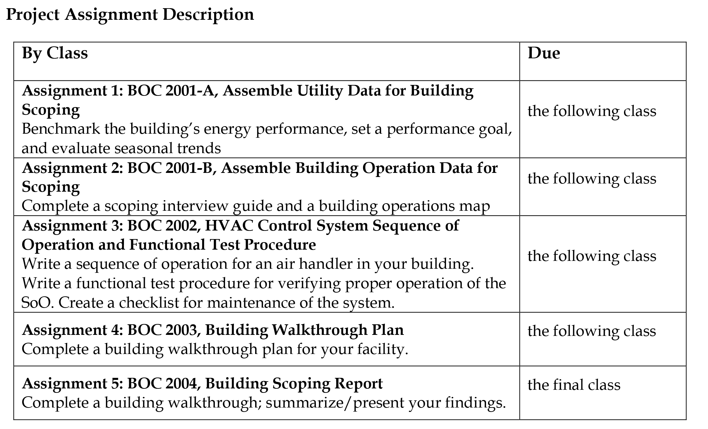
Level II
Project Assignments
Final assignment:
Develop presentation of scoping report for 2005 Project Peer Exchange
Notes:
Shown here is an overview of the Level II Project Assignments, as listed in your Project Workbook. Each assignment builds on the one before, all culminating in a presentation of findings from your building scoping report, delivered in the final class, 2005 Project Peer Exchange.

Slide 6
Review - BOC 2001A Project Assignment
Your project assignment was:
Update your building’s energy consumption data in ENERGY STAR Portfolio Manager
Evaluate performance
Estimate savings potential
Identify seasonal trends and baseload
How did it go? Let’s review.

Slide 7
Activity 1
Project Assignment Review
Reference your work on the 2001A Project Assignment and reflect on these questions:
Were you surprised by the Energy Star score or benchmark EUI on your building?
Are you able to determine what the annual energy use on base loads (lights, equipment, fans, DHW) is?
Approximately how much of annual use is base loads vs. seasonal? How will this analysis influence your scoping?

Slide 8
Activity 1
Project Assignment Discussion
Pair with another student
Exchange a summary of each other’s project
(5 minutes)
Answer the questions
(10 minutes)
Participate in the instructor-led debrief with the whole group
(10 minutes)
Notes:
Answer these questions about your classmate’s assignment.
ENERGY STAR Portfolio Manager
What is the major space type (e.g., office, hospital, etc.)? _________________
Is the account up to date with 12 months of utility consumption data?
What is the energy performance rating? _________________________________
What is the site energy use intensity? _________________________________
Utility Data
What is the daily use of electricity for January and August?
January: _____________ August: _____________
How does this compare to the daily base use of electricity?
_____________________________________________________________________
What did you find interesting about your classmate’s project?
_____________________________________________________________________
_____________________________________________________________________

Slide 9
Developing a Scoping
Report Action Plan
2001A
Utility Accounting Analysis
Gather
Analyze
2001B
Building Operation Conditions
3. Interview
Plan
Notes:
We covered the first two steps for the Scoping Action Plan during BOC 2001A – Gathering building information, and analyzing data.
In this class, BOC 2001B, we will cover steps 3 and 4 – Interviewing a building manager, and planning the building walk-through, starting with developing a building systems map.
An understanding of the four steps will prepare you to complete the project assignments for 2001. These steps are also key in completing your final Level II assignment, your building scoping report.

Slide 10

Example
Scoping Presentations
Notes:
Your instructor will show examples of other BOC student scoping report presentations.

Slide 11
Developing a Scoping Report
Action Plan: Step 3
Gather
  Basic building information
  Energy bills
  Daily utility load data
Analyze
  Energy Use Index (EUI)
  Benchmark result
  Trends, load factors
  Daily load data findings
Interview
  Available documents
  Known problems
  Staffing
  Review:
    Top four opportunities
    O&M task lists
Plan
  Operations map
  Walkthrough plan
Report
Notes:
We have completed the first two steps of the the scoping process. Now, we’ll conduct an interview to gather more information.

Slide 12
Interview
Interview other staff to:
Evaluate overall O&M practices and capabilities
Identify any known issues with equipment
Identify existing comfort and maintenance problems
Notes:
The purpose of the building scoping interview is to develop a strong understanding of the building’s systems and use, existing O&M practices, occupants’ needs, desired operating performance, and any ongoing problems that have already been identified. Interviews with building operations and maintenance staff can provide insight into what’s really behind low or high building performance.
The interview is best done in advance of the walkthrough as it will identify issues to investigate during the walkthrough. It is especially useful to know what documentation will be available and what problems are already known to staff. The example interview guide is included in the Appendix. The guide is written from the perspective of someone new to the facility, but it is also useful to organize information if you are already familiar with the building.
Note: Some points to consider in the ACME building interview are:
The major equipment is only 8 years old—young enough to be reasonably efficient, but old enough to have accumulated inefficiencies in operation.
Make sure to include the Saturday hours in the occupied period. Look for ways to isolate the subleased area and minimize equipment use. Also make sure systems are shut down all day Sunday.
Dissatisfaction with the contractor is a red flag. Give attention to these systems.
8, 9, 10. Frequent cold calls could indicate calibration problems. This is reinforced by the answer to 12 and 13.
15. Known problems need to be included in final scoping report.
18. Plan for limited trending in tune-up phase.

Slide 13
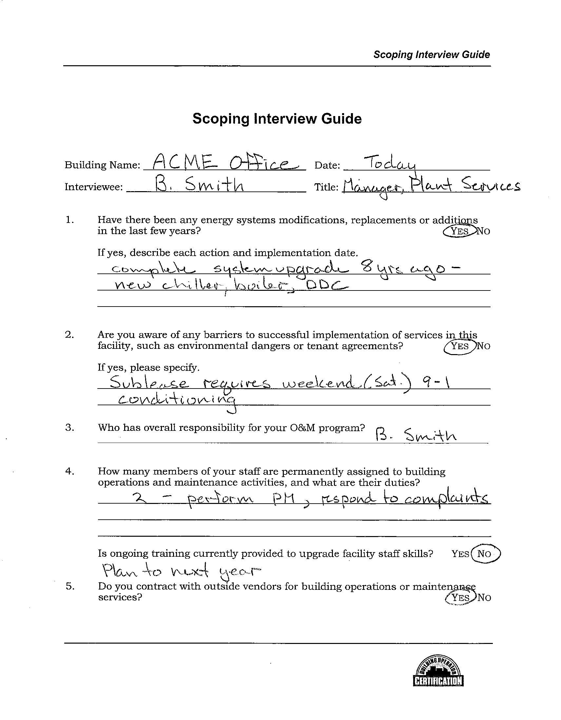
Class Discussion: Building
Scoping Interview Guide
Review the Guide
Answer questions on notes page below
Your instructor will lead a discussion
Volunteer your answers
Notes:
Let’s review the Scoping Interview Guide. Find the Guide for ACME Office Building in the Appendix. Answer these questions about the ACME Building.
What is the purpose of the interview guide?
___________________________________________________________________________
What equipment do outside contractors maintain for the ACME building?
___________________________________________________________________________
Go to Questions #10 and 15. What are the known problems in the ACME building?
___________________________________________________________________________
What is the financial criteria for evaluating O&M projects?
___________________________________________________________________________

Slide 14
Activity 2
Scoping Interview Guide
Take 15 minutes. Work individually on this activity.
Go to Level II Project Workbook for Interview Guide
Review Interview Guide
(5 mins)
Answer the questions below
(10 mins)
Participate in
discussion (5 mins)
Notes:
Your next project assignment is to complete the blank Scoping Interview Guide for your building. Find the Guide in the Level II Project Workbook. This activity prepares you to complete the assignment.
Who will you interview at your building?
Name: ___________________________ Job title: __________________________
Why did you pick this person to interview? __________________________
What is the purpose of the interview? ______________________________________
What documentation will your need to complete the interview?
__________________________________________________________________________
Go to Question #15. Identify 1 or more known problems in your building:
_________________________________________________________________
Do you feel that you can complete this interview guide for your project assignment?
___ Yes ___ No ___ Maybe

Slide 15
Developing a Scoping Report
Action Plan: Review
Gather
  Basic building information
  Energy bills
  Daily utility load data
Analyze
  Energy Use Index (EUI)
  Benchmark result
  Trends, load factors
  Daily load data findings
Interview
  Available documents
  Known problems
  Staffing
  Review:
    Top four opportunities
    O&M task lists
Plan
  Operations map
  Walkthrough plan
Report
Notes:
Now we have completed the first three steps of the interview. Before we start on the walkthrough plan, let’s take a few minutes to review some important topics that have been presented in other BOC classes.
First, we will review the top four opportunity areas for a building scoping and tune-up. We’ll also use O&M checklists to make sure our investigation is thorough. These concepts should be at the front of your mind when planning and executing the walkthrough.
Next, we will look at a building systems operations map, a useful tool for organizing your knowledge of the building systems.

Slide 16
Remember these?
Top Four Opportunity Areas for a Building Tune-Up
Notes:
There are four common opportunities for improvement in most buildings. You may remember them from the BOC Level I class titled BOC 1006 - Common Opportunities for Low-Cost Operational Improvement. These opportunities are useful to keep in mind during a building scoping because it’s likely that one or more of these problems will be encountered during the scoping work. We will take a few minutes to refresh your memory of the top four opportunity areas for a building tune-up.

Slide 17

Top Four Opportunity Areas for a Building Tune-Up
Equipment scheduling
Sensor error
Simultaneous heating and cooling
Outside air usage
Notes:
Have you ever worked in building where there are no opportunities for improvement? Not likely.
There are usually many opportunities to make the building work better. The four on the slide here are core opportunities for a building tune up. Someone could categorize these a different way but here are the top four recommended by the BOC program: equipment scheduling, sensor error, simultaneous heating and cooling, and outside air usage. The building shell or envelope is also one to think about. For example, it may be useful to look for sterile pressurization fans and elevator pressurization fan back draft dampers. Often times those are absent and basically become a chimney for heat loss or heat gain depending on the season. These certainly present some opportunities as well. We are not covering these in the next few slides but will focus on other important areas of opportunity with equipment scheduling, sensor error, outside area usage, and simultaneous heating and cooling.

Slide 18

Equipment Scheduling
The easiest way to save equipment energy is to turn it off!
Also, longer operating hours:
Result in shorter equipment life
Increase the frequency of parts replacement
Cause the need for more frequent cleaning (chiller bundles, boiler tubes, fan coils, etc.)
A good first step is to walk through the building when it is unoccupied.
Notes:
Equipment scheduling provides many opportunities. Obviously if something doesn't run, you’re reducing wear and tear, increasing operational life, and also saving energy. One of the big ways to find scheduling opportunities is to do a night walk of the building. A night walk lets you check equipment operation after hours when the building is largely unoccupied. What's on that shouldn't be on? We will discuss night walks in more detail later. For example, how does your custodial staff schedule work? Do they go through a building floor by floor, and as they finish each floor, do they turn the lights off and move to the next one? Or do they turn the lights on in the whole building until the cleaning is complete?
Ask yourself, do things turn off as programmed? Lights of course are a big one. But other areas that to think about are putting time clocks on coffee pots. Coffee pots left on over the weekend and at night use energy needlessly. Computers and computer screens are another opportunity for shut down after hours.

Slide 19
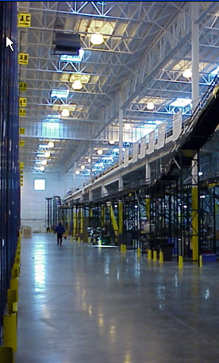
Lighting and
Plug Load Scheduling
Some things to look for:
Does the custodial staff turn off lights after hours as they go through the building?
Does lighting control account for weekends and holidays?
Do the lights actually turn off as programmed?
Have special event schedules been reprogrammed back to normal?
Is there a system in place to make sure computer power saving modes are enabled?

Slide 20
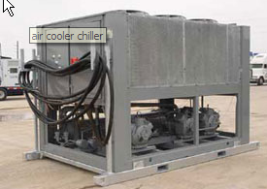
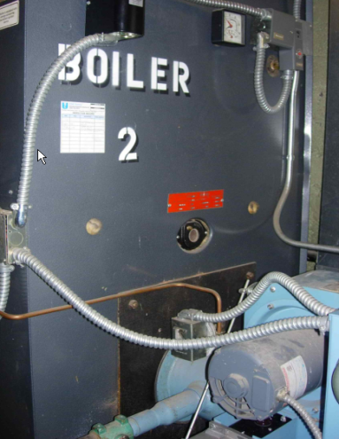
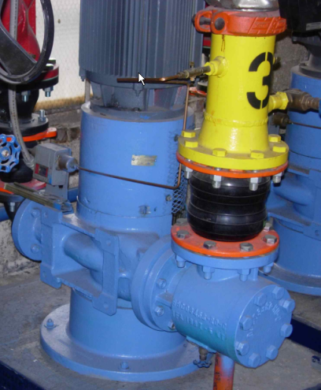
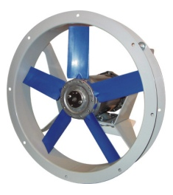
HVAC Load Scheduling
  Do schedules for fans, pumps and other equipment match requirements?
  Is optimum start used?
  If fan-powered boxes or baseboards can operate independently from the air handler, are they programmed to match occupancy?
  Do the chiller and boiler have lockouts based on outside air temperature?
  Are DHW circulating pumps scheduled?
Notes:
An area to investigate with HVAC load scheduling is overrides. Have changes been made to the schedule where there is a weekend need? If so, was the override turned back?
Another high value opportunity is the clock setting on programmable thermostats. In some buildings, as many as 60% of programmed thermostat clocks are inaccurate, particularly around daylight savings time. Often times those aren't changed. The date is actually a Wednesday on the clock, when it's Thursday. Are things turning on and off at their proper times?
Many new programmable thermostats now include holiday scheduling features, as well as wi-fi connections, making programming and schedule maintenance easier, particularly with multiple thermostats.
Other opportunities to consider are:
- Optimal start. Can you create a warm up cycle to minimize the amount of run time?
- Outside air lockout. Can you use fan power VAV boxes with reheat to do your morning warmup instead of running the main fan systems?
- Domestic hot water circulation pumps. Is a chilled water pump scheduled off? Are condenser water pumps off? Sometimes you need the condenser water pump. But there is lots of opportunities to think about how to turn systems off. These are the types of things you can also look at during the night walk. Go to the plant, look for the pumps to see if are they running, and think about whether they really need to be.

Slide 21
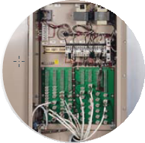
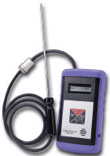

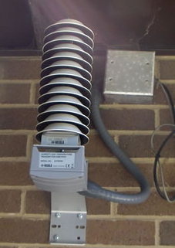
Sensor Error
  Incorrectly placed
  Failed
Notes:
Building control systems rely on the information provided to them by the various sensors throughout the building. Sensors for temperature, light level, carbon dioxide (CO2), and enthalpy (or total energy content of air) are just a few examples. If the critical sensors in a building are inaccurate due to failure, the building will not work efficiently, costs will increase, and comfort issues will result.
Critical control sensors are those whose values drive control sequences, such as the outside air temperature or supply air temperature. If a critical control sensor is placed in a poor location, it can affect equipment performance by sending inaccurate readings to the control system. Examples of poor location or placement include the following:
A static pressure sensor is located too near the supply fan.
A CO2 sensor is mounted on the wall in the office rather than the return air duct. Sampling the air from the return air ducts can insure you are getting the most consistent average air quality for each zone in the building.
An outside air sensor is in direct sunlight. Placing the outside air temp sensor on the south side of a rooftop penthouse may result in a reading of 10-15 degrees higher than the actual outside air temperature.
A mixed air temperature sensor is not an averaging sensor. You end up with a poor sensor reading on the mixed air temperature.

Slide 22
Sensor Error
Critical control sensors
Return air temperature
Outside air temperature
Supply air temperature
Chilled water supply temperature
Heating water supply temperature
Carbon dioxide
Sensor issues in disguise
Loads not met
Economizer not working
Equipment on when not needed
Simultaneous heating and cooling
Over or under ventilation
Notes:
Critical control sensors are used to drive strategies and configure energy efficiency strategies in your building. Mixed air temperature, for example, is being used for economizer control, or other types of control. Return air temperature often times drives discharge air reset off. Outside air temperature will drive numerous things such as optimum start and economizer operation.

Slide 23
Simultaneous Heating and Cooling
Very common in dual duct and multi-zone systems
Examples:
  Supply air temperature is lower than it needs to be, causing more reheat.
  A water control valve is leaking, allowing hot and cold water to mix.
Result: Equipment capacity is lowered, and energy use is increased.
Notes:
Dual duct and multi-zone systems are particularly vulnerable to this problem. In fact, some simultaneous heating and cooling is unavoidable, because the systems are designed to mix hot and cold air together. However, careful attention to supply air setpoints and reset strategies can minimize energy waste.

Slide 24
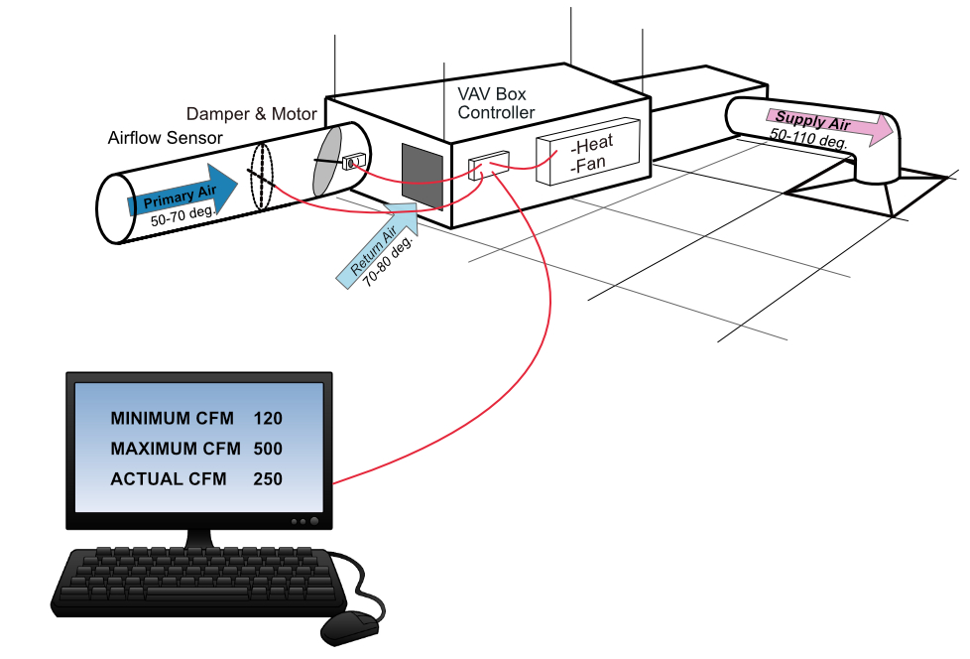
Minimizing VAV Re-Heat:
Damper position
Verify VAV damper minimum position is correct. If it’s too high, energy is wasted re-heating primary air.
Notes:
VAV boxes use air supplied by the AHU to provide ventilation to occupants (primary air). When the VAV box is in heating mode, the VAV damper does not close, but rather goes to minimum position to allow continuous ventilation of the occupied space. In pressure dependent systems, the damper minimum position is based on a fixed damper position (% open). Pressure independent systems (more common) use a flow tube or flow ring to send a calibrated pressure signal the DDC control system to calculate CFM. If damper minimum is too high, energy is wasted re-heating the primary air. If the damper minimum position is too low, the space could be at risk of poor indoor air quality (IAQ).
VAV damper minimum is typically set during balancing or commissioning of the system. However, errors made during installation, adjustments made by maintenance personnel, damper or damper actuator failures, the need for sensor calibration, or changes to the space occupancy necessitate the need to verify, and if needed, re-set the VAV damper minimum position. Typically, a qualified air balancer sets VAV damper minimums. However, building operators need to be aware of the causes of minimum position errors, and should periodically check minimum position on a sampling of VAV boxes to determine if large scale re-balancing or re-commissioning is needed. Minimums can be checked by placing the VAV box in minimum position, then measuring flow at each diffuser served by the VAV box, using a flow hood. The total of all diffuser flows should be within 15% of the VAV box flow as shown on the control system.

Slide 25
Minimizing VAV Re-Heat:
Discharge temperature reset
Use AHU discharge air temperature reset to minimize re-heating of primary airflow
Notes:
Another way to reduce VAV box re-heat is through discharge temperature reset at the AHU. Most VAV system controls can be configured to re-set the AHU discharge air temperature based on zone demand, or less commonly via outside air temperature. By re-setting discharge air temperature up to the highest temp that will still satisfy the worst case zone cooling load, energy can be saved by not having to unnecessarily re-heat primary air for all the VAV zones that are in heating mode, or triggering a zone heating call for zones at minimum position.
VAV AHU discharge temperatures are commonly fixed at 50F-55F. Discharge temperature reset allows the AHU to reset from 50F up to 60F, or some cases even higher, depending on building loads. Discharge temperature reset works best in buildings that have significant heating demand. In buildings with significant cooling demand, re-heat energy savings by resetting the discharge air temperature may be offset by the higher fan energy needed to deliver increased CFM to meet cooling load. Also, note that areas with high outdoor humidity levels may need lower discharge air temperatures to de-humidify the building.
For discharge air reset and discharge air pressure reset strategies, consider having the control system ignore the 2 or 3 worse case zones, to prevent rogue zones from driving the re-set schedules.

Slide 26
Common Mistakes Operating
Terminal Units
Series – adjusting fan speed
Parallel – adjusting air flow setting
Balancing valve or damper
Thermostat calibration
Notes:
Series - A common mistake by technical field staff not qualified in air balance is to adjust the fan speed because they think they can push more air to and solve temperature complaints. While adjusting the fan speed will provide additional air, it must be understood that this additional air is likely going to be the introduction of plenum air, which is at room temperature. The objective of providing additional air is countered by the addition of higher temperature air (in a cooling configuration). In some cases, the fan speed can be increased too high, forcing conditioned air out of the intake opening of the VAV box and into the plenum.
Parallel - Maintaining proper air balance with both series- and parallel- fan powered VAV boxes is critical to ensure the proper volume of air at the proper temperature is provided to the space. A field technician should never change the airflow settings set by the air balancer when the system was commissioned. If space and/or occupancy conditions have changed, the HVAC design should be evaluated by a qualified mechanical contractor to determine if system changes are required. It is not uncommon for the well-meaning field technician to make VAV box adjustments in an attempt to offset the costs incurred by hiring a mechanical contractor to do this properly. This is one of the primary reasons building HVAC systems go out of balance and must be re-tuned, at significant expense.
Balancing Valve or Damper - A Balancing Valve (sometimes called a Balancing Damper) is installed between the terminal unit and the room diffuser. When the HVAC system is designed, the mechanical contractor calculates the BTU’s required to heat and cool the space. They then compare those values to the airflow and temperatures the VAV will provide to the space. Based on those values, the mechanical contractor determines how much air each room diffuser should receive to properly heat and cool the space. When the VAV box is commissioned, the air balancer will adjust the balancing valve to achieve design airflow at each diffuser, within 10% variance of design. Once this has been established, the balancing valve should only be adjusted by a technician properly trained and qualified in air balance, using air balancing tools. By improperly adjusting these balancing valves, every diffuser attached to the respective VAV box will then be out of balance. This is another primary reason why HVAC systems require retuning.
Thermostats - Assuming the VAV system (including the balancing valves) are operating correctly and per design, and the space use and/or occupancy conditions have not changed from initial design, when troubleshooting an issue the first two values the field technician should check are the air handler discharge temperature and the air handler duct static temperature. This will tell the technician if the problem is a system issue or if it is a local issue. Assuming the temperature and pressure from the air handler are correct, the next place the technician should investigate is the thermostat.
Most distributed HVAC systems, incorporating terminal units, are known as “zoned systems”, meaning the area served by the air handler has been sub-divided into a number of HVAC zones. In a typical VAV system, this can include 4-5 individual offices or areas. There is usually one thermostat for each zone, meaning every other office or area attached to that zone is at the mercy of wherever that single thermostat is located. It would be cost-prohibitive to provide every office with their own VAV and thermostat, which is one of the reasons for zoned-HVAC.
The field technician should verify the thermostat is installed in the correct location. It should not be installed where it can be influenced by other sources of heat/cold, such as exterior walls, where direct sunshine would impact the temperature or above office machines that generate heat, such as printers or computers. The next step would be to verify the thermostat is calibrated correctly and that the proper heating and cooling set points are in place. There should be a minimum of 3 degrees difference for VAV systems and 4 degrees for heat pumps. If all of that is correct, then determine if the problem is airflow related (is there enough or too much air), if it’s temperature related, or both.
Installing “dummy” thermostats in an effort to create a placebo effect by fooling the occupant into believing they now have control over the system is poor practice. Once discovered, the occupant will lose trust in the building technical team. Sometimes, the temperature cannot be made to satisfy everyone in the zone. In these situations, a proposal should be made to the head of the department to explore other options, such as supplemental HVAC.
Common Mistakes in VAV Box Operation

Slide 27
Outside Air Usage
Typical problems with outside air:
The building envelope leaks.
Floor-to-floor partitions are not sealed.
Minimum ventilation rate was never adjusted for a change in occupancy.
Minimum ventilation rate is set by damper positions rather than by measured air flow.
The outside air damper leaks when closed during unoccupied times.
CO₂ sensor is improperly located.
Notes:
Note: In buildings with dedicated outside air systems (DOAS) and energy recovery ventilation (ERV), which use 100% outside air, ventilation rates may be evaluated differently than in conventional systems where the ventilation is coupled with space conditioning.

Slide 28
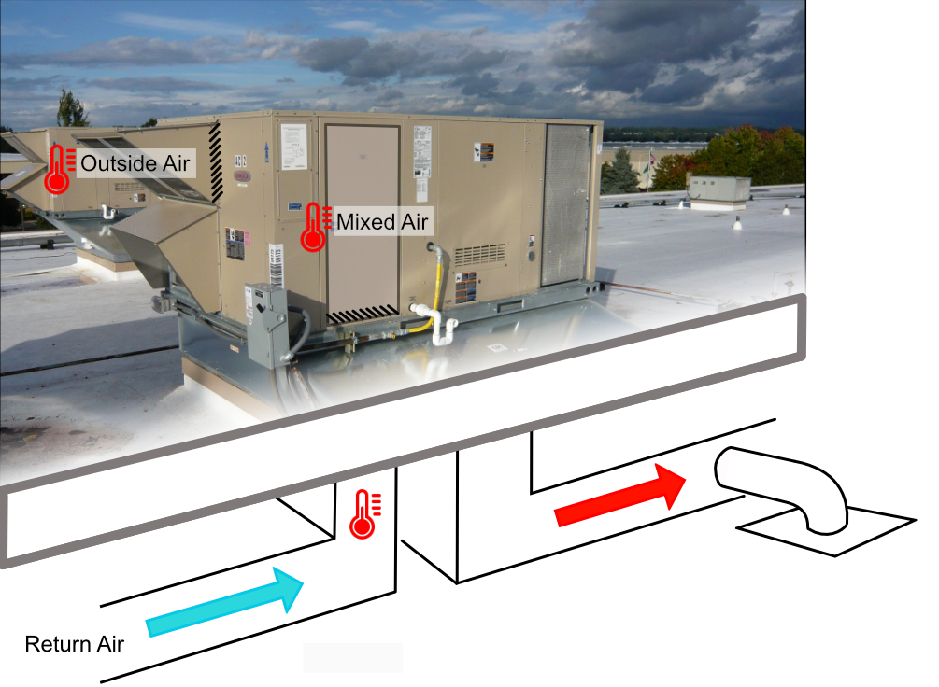
3 Step Process:
Checking RTU/AHU Outside Air
Step 1: Determine correct outside air percentage needed
Notes:
Too little outside air volume (under ventilated) and the building is at risk of having poor indoor air quality (IAQ). Too much (over ventilated) and energy is wasted heating and cooling the excess outside air. Almost all RTU’s and AHU’s have outside air intake dampers or an economizer minimum position setting which determines the amount of outside air intake during non-economizer operation.
Outside air volume is typically set during installation, balancing, or commissioning of the system. However, errors made during installation, adjustments made by maintenance personnel, damper or damper actuator failures, or changes to the building occupancy necessitate the need to regularly verify, and if needed, re-set the outside air volume.
Outside air volume can be measured and verified several ways. One method is to calculate the outside air percentage using temperature measurements taken at the RTU or AHU, as follows:
Step 1: Determine the correct outside air percentage needed by checking HVAC plans, or balance reports for the outside air CFM, then divide the outside air CFM by the total RTU or AHU CFM, to determine the outside air percentage (OSA %). If the outside air CFM is unknown or the space occupancy has changed, outside air CFM can be determined by multiplying the maximum occupancy count by the correct CFM per person, as defined by local code or ASHRAE standards.

Slide 29
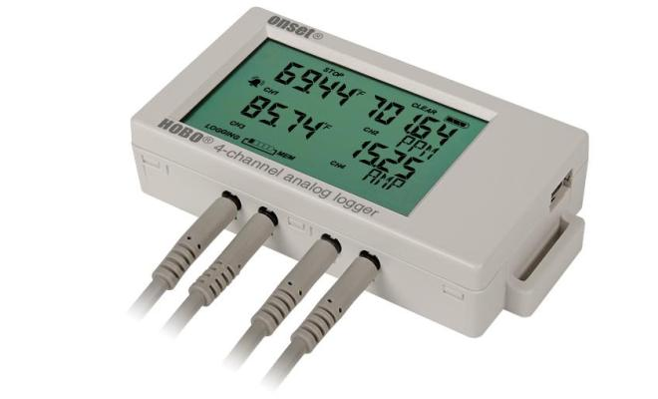
Checking Outside Air:
Steps 2-3
Outside Air Formula:
OSA % = RAT - MAT
RAT - OAT
x 100
Multi-channel data logger
Notes:
Step 2: With the RTU/AHU running, measure outside air temp (OAT), mixed air temp (MAT) and return air temp (RAT). If the AHU/RTU is air economizer equipped, be sure it’s at minimum position. Consider logging the temperatures over time with a multi channel data logger.
Step 3: Calculate the outside air percentage using the formula (subtract first), adjust and recalculate:
Example: 72 RAT- 64 RAT = 8 = .2963 x 100 = 29.63, or about 30%
72 RAT- 45 OAT 27
To ensure accuracy, complete the test below 55 degrees F or above 85 degrees F outside temp (note that above 85F will produce a negative % number). A large temperature difference between OSA and RA temp reduces the impact of sensor error on the result. It’s also helpful to write down the formula and your test results, and then complete the math by subtracting first, then dividing, then multiplying the result by 100.

Slide 30
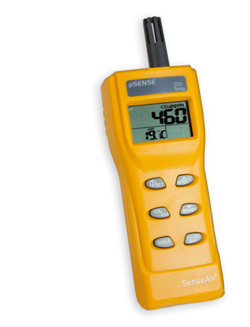
Alternative Method:
Checking Outside Air
Use handheld CO₂ meter
Spot check using meter
Measure building’s CO₂ levels
OSA CO₂ approx. 400 ppm
Inside Air (ISA) CO₂ 800-1100 ppm
CO₂ near outdoor levels indicates over ventilation
Check seasonally and log
Notes:
Another, perhaps simpler, way to check if the building is being over or under ventilated, is to spot check with a hand-held carbon dioxide (CO₂₎ sensor. As we learned previously, CO₂ is a measure of the HVAC systems ventilation effectiveness. Indoor CO₂ should be 400-700ppm above outside air CO₂ (usually about 400ppm), or 800-1100ppm. If indoor CO₂ is significantly below 800ppm the building may be over ventilated. If indoor CO₂ is above 1100ppm, outdoor air CFM may be too low.
Note that using CO₂ to measure OSA is effective when the OSA damper is at minimum condition. During economizer mode, since we are bringing in more outside air, we should have low CO₂ levels. This alternative method is best used if you are in the heating mode or mechanical cooling mode (above 75 degrees and below 50 degrees).
For accuracy, avoiding breathing directly on the CO₂ meter during testing, check the building CO₂ levels when all economizers are at minimum position (hot or cold outdoor conditions may be best), and when the building is at or near full occupancy. Consider logging your results-testing at various outdoor conditions and occupancies, or setting a CO₂ data logger to record over time. If CO₂ levels indicate outside air levels are too high or too low consider further testing of RTU’s or AHU’s for correct outside air intake. If the building is only occasionally at or near full occupancy, consider installing demand control ventilation using permanent CO₂ or occupancy sensors tied to RTU/AHU controls to modulate OSA based on demand.

Slide 31
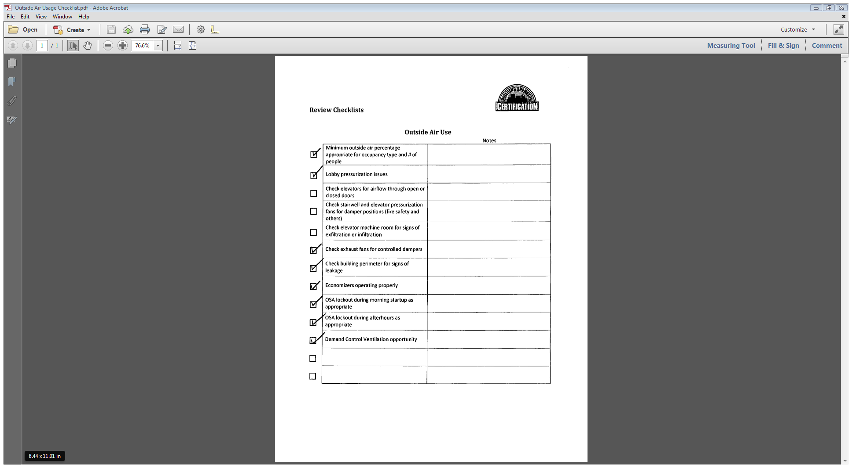
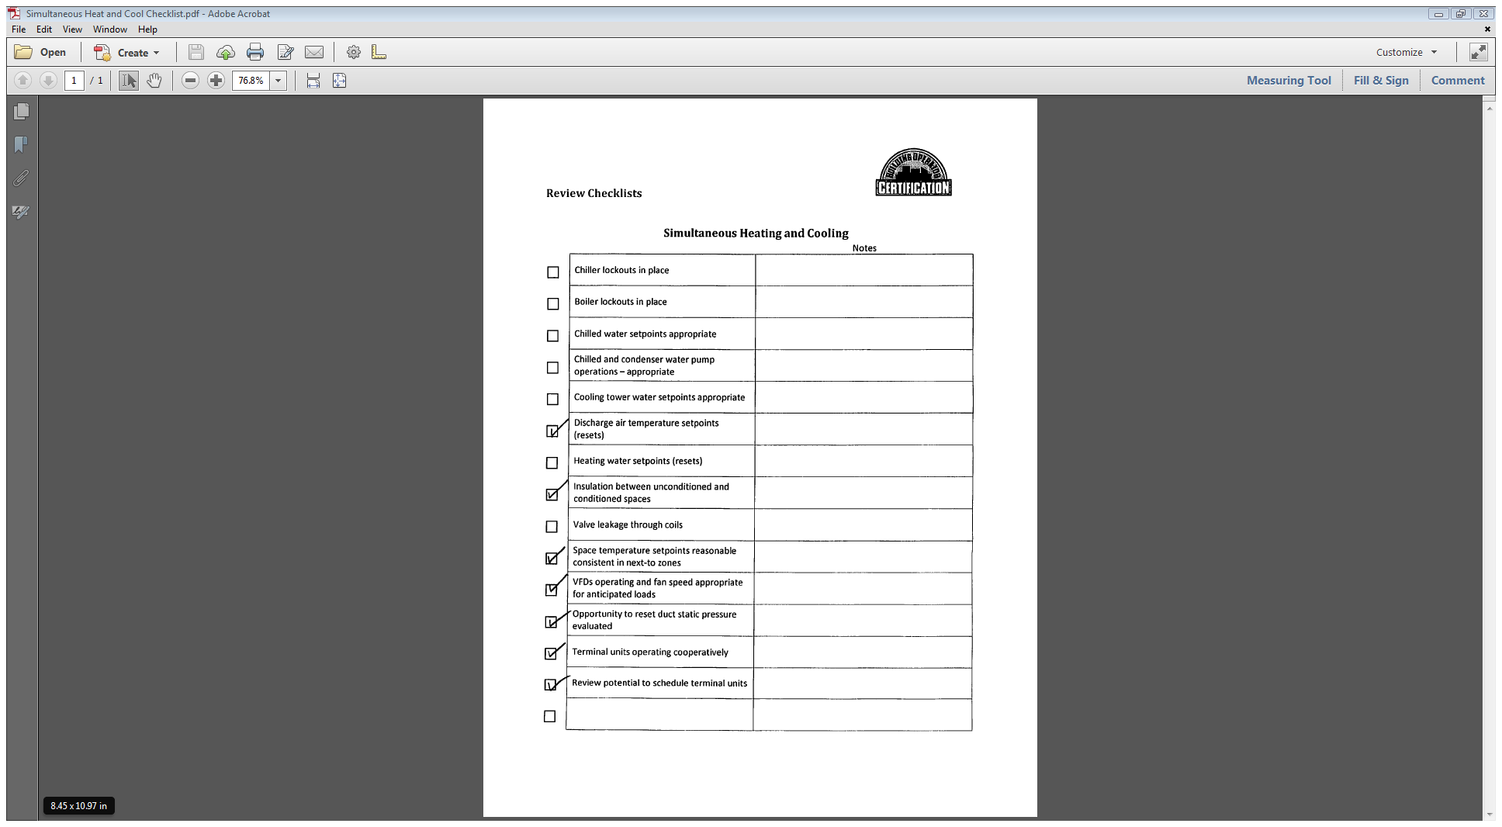
Activity 3 –
Using the O&M Checklists
20 minutes.
Go to Appendix
for O&M
Checklists
Your instructor
will provide
instructions
Notes:
Break up into small groups of about five people each.
Your instructor will assign each group an O&M Checklist from the Appendix to review and discuss.
Turn to the next page for Activity 3 instructions.

Slide 32
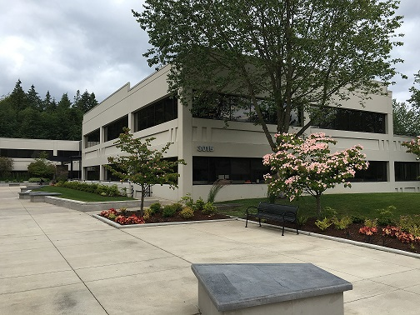
1988 Office Building
2 story, 30,000 sq ft.
6 tenants-various schedules
Hours: M-F 6am-8pm, Sat 6am-8pm
(1) 70 ton roof top packaged variable air volume AC unit with economizer.
Single large restroom exhaust fan
(10) cooling only VAV boxes, (15) VAV boxes with reheat
DDC system installed 2004
Notes:
Activity 3 – Using the O&M Checklists
Instructions :
Review the building description in the slide above. Turn to the Appendix and find the two checklists titled “Outdoor Air Use” and “Simultaneous Heating and Cooling.”
For each checklist, answer the questions and write your answer in the space below.
1. List 3 items on the list that would be appropriate to investigate for this building.
_________________________________________________________
_________________________________________________________
_________________________________________________________
2. List the item with the most potential energy savings
_________________________________________________________
3. Describe how you would verify the operation or condition of item.
_________________________________________________________
_________________________________________________________

Slide 33
Developing a Scoping Report
Action Plan: Step 4
Gather
  Basic building information
  Energy bills
  Daily utility load data
Analyze
  Energy Use Index (EUI)
  Benchmark result
  Trends, load factors
  Daily load data findings
Interview
  Available documents
  Known problems
  Staffing
  Review:
    Top four opportunities
    O&M task lists
Plan
  Operations map
  Walkthrough plan
Report
Notes:
Now we have completed the interview process and reviewed the four common opportunities as well as using O&M checklists. Next, we will look at a building systems operations map, a useful tool for organizing your knowledge of the building systems.

Slide 34

Building Systems
Operations Map
Tool to understand how a building is used
Documents:
  Major systems and occupancy types
  Schedules
  Setpoints
  Sequences of operation
Notes:
Developing a Building System Operations Map
Uncovering problems requires a thorough understanding of how a building is used, operated and maintained. One way to obtain that understanding is to develop a building systems operations map.
A building systems operations map documents the current conditions, focusing on scheduling and on targeting HVAC systems and equipment where common opportunities are found in similar buildings and systems. The map clearly identifies areas for immediate improvement (e.g., changing thermostat setpoints or equipment schedules) and provides the basis for additional evaluation. When completed, the map should document the current uses in the building and how well the operation of the energy systems matches the actual use.
The map should identify major energy-using systems and occupancy types by area. Developing the map requires reviewing utility bills, as-built drawings, and sequences of operations; interviewing building operations and maintenance staff; and briefly reviewing systems and equipment with a focus on targeting particular HVAC systems and equipment for potential energy savings.

Slide 35
Example Template
Building Name:___________________________________________ |  |  |  |  | Date: | 8/30/2006
Year Constructed_1991 | Building Size: 141,250 sq.ft. |  |  |  |  | Age of Chiller_12 Yrs
Age of HVAC System___12 Years | Number of Stories:___4__ |  |  |  |  | Age of Boiler__12 Yrs
Describe HVAC System Type: HVAC system is VAV with fan powered VAV perimeter boxes and hot water reheat.
4 Airhandlers with inlet vanes provide system air.
Occupancy Schedules
 | % of Building | Total Hours |  | Wks Per | #
Area |  | Wkdy | Wknd | Year | Occ. | Notes:
(Offices, Clinic) | 100 | 50 | 6-12 | 52 | 400
Notes:
The Building Operations Map documents basic information about the building in these four sections. A filled-in version of the BOM for the ACME Building is in the Appendix. A blank copy of the BOM is in the Level II Project Workbook.
Your instructor will step through the ACME operations map to show the level of detail provided and to note some of the comments. The information on intended schedules and lockouts will be needed to compare to actual operation during the walkthrough.
General Building Information
Building name, size and general HVAC system description
Building occupancy schedule
Lighting system description
Miscellaneous loads
Control system
Central Plant: Chillers, Cooling towers, Boilers
Air Handling Systems: Central air systems, Terminal units, Exhaust and other fan systems
Pumping systems: Chilled water, Condenser water, Heating water, Domestic water

Slide 36
Activity #4
Building Operations Map
Take 20 minutes
Practice completing Map for your building in Project Workbook
Work from memory
Volunteer your answers during discussion
Review ACME Building Map in Appendix
Notes:
Activity #4 – Complete the Building Operations Map
In this activity, you will get started completing the Building Operations Map (BOM). Find the BOM in the Level II Project Workbook.
Pick a building you know well. Work from memory using your knowledge of how the building is used and the operating systems. If you have a large building, select a portion of the building to complete for the activity (e.g., typical floor, temperature zone, typical classroom, or other).
Complete the Map to the best of your ability. You will revise it as part of your next project assignment.
ANSWER these questions, then work on completing the BOM.
1. What is the purpose of the Building Operations Map?
_________________________________________________________________
2. What documentation will you need to complete it?
_________________________________________________________________
3. Who will you need to work with at your facility to obtain the documentation needed?
_________________________________________________________________
4. Do you feel that you can complete this operations map for your project assignment?
___ Yes ___ No ___ Maybe

Slide 37
Check Your Knowledge - Question 1
What is the main purpose of a building operations map?
Shows the mechanical room equipment layout and main ducts
Tracks completion of preventive maintenance tasks
Shows which systems are responsible for the majority of energy use
Documents current building uses and operational requirements
Notes:
Question 1: Your answer is ______.

Slide 38
Check Your Knowledge - Question 2
A dual duct or multi-zone system is particularly vulnerable to which common problem?
Excessive outside air
Simultaneous heating and cooling
Sensor error
Scheduling conflicts
Notes:
Question 2: Your answer is ______.

Slide 39
Check Your Knowledge - Question 3
A spot measurement in an open office area during your initial walkthrough shows 1,500 ppm of CO₂. Which of the following is NOT a related area to investigate?
Heating equipment combustion efficiency
Damper failure
Original building design outside airflow assumptions
Control sensor calibration
Notes:
Question 3: Your answer is ______.

Slide 40
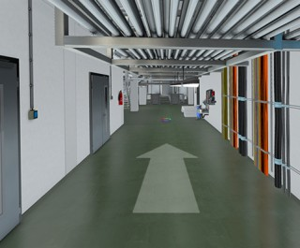
What is a Building
Walkthrough?
Get to know the building
Operating condition
Document checks
Equipment and system checks – HVAC, electrical, plant, pumps, motors, controls
Take safety precautions
Notes:
The purpose of the building walkthrough is to get to know the building better.
Your goal is to develop a general impression of the overall building condition, overall building design, and the HVAC system design. You will also collect some basic data on the building systems at a level of detail greater than the initial data collection.
The following are the major areas of the building to visit during a walkthrough:
Walk the outside of the building.
Walk the inside of the building.
Walk the roof.
Walk the air handlers.
Walk the plant area.
Review the building automation system (BAS) front end.
Attention to safety is important. Safety glasses, ear protection, and hard hats in construction areas are good things to have in your toolbox. Don't touch electrical systems (high voltage buses, etc.), be aware of potentially very hot surfaces in the mechanical room, and never wear a necktie or scarf, especially around motors.

Slide 41
Have a Walkthrough Plan
Building characteristics
System types
Utility use
Known issues for investigation
Personnel and tools
Locations to walk
O&M checklists
Safety precautions
Notes:
To make the best use of the time you have available for the walkthrough, it’s helpful to have a building walkthrough plan. The plan draws on all of the groundwork and information gathering you have done in your BOC 2001 project assignments.
The plan should contain this information:
Monthly Billing Analysis—Summarize the results of the analysis, especially any findings that indicate required follow-up.
System Summary—Write down your understanding of the existing system to confirm.
Document Checks—Evaluate the quality and availability of the O&M related documents previously listed in the interview.
Equipment and System Checks—Since the majority of energy savings in commercial buildings are obtained from the four common opportunity areas, scoping should focus on quickly evaluating them.
If the building you walkthrough is not your own facility, you should be accompanied by a knowledgeable operations staff member or service contractor familiar with the building. Always take the safety precautions. See safety recommendations on the earlier page.

Slide 42
Activity 5 – Walkthrough
Plan Checklist
20 Minutes
Let’s review an example Walkthrough Plan Checklist
Go to the Level II Project Workbook
Discuss questions in the notes page below
NOTE: You will use this checklist for the BOC 2002 project assignment
Notes:
Activity 5 – Walkthrough Plan Checklist
This discussion prepares you to complete a walkthrough plan for your building. On the walkthrough, you will identify opportunities to improve equipment operation and reduce the waste of energy. You will use the checklist to complete a building walkthrough plan.
Instructions: Find the Walkthrough Plan Checklist in the Level II Project Workbook. Take 15 minutes to answer the questions below. Prepare to share your answers during the instructor-led discussion.
1. What are your experiences with equipment operating when the building is unoccupied? _____________________________________________________________
2. How frequently should you check the operation of equipment? ________________
3. What are common opportunities will you look for during the walkthrough?
__________________________________________________________________________
4. Review the first 4 pages of the Building Walkthrough Plan. Do you have the information you need to complete the sections?________________________________
5. For your building, who would you recommend participate in the walkthrough? Why?____________________________________________________________________
6. The walkthrough should encompass the entire building, but key spaces to visit are found on page 6. What are the important locations to visit on the walkthrough of your building?____________________________________________________________
7. Operation schedules are important to verify (see page 7). For your building, which ones on the list are most relevant?____________________________________________

Slide 43
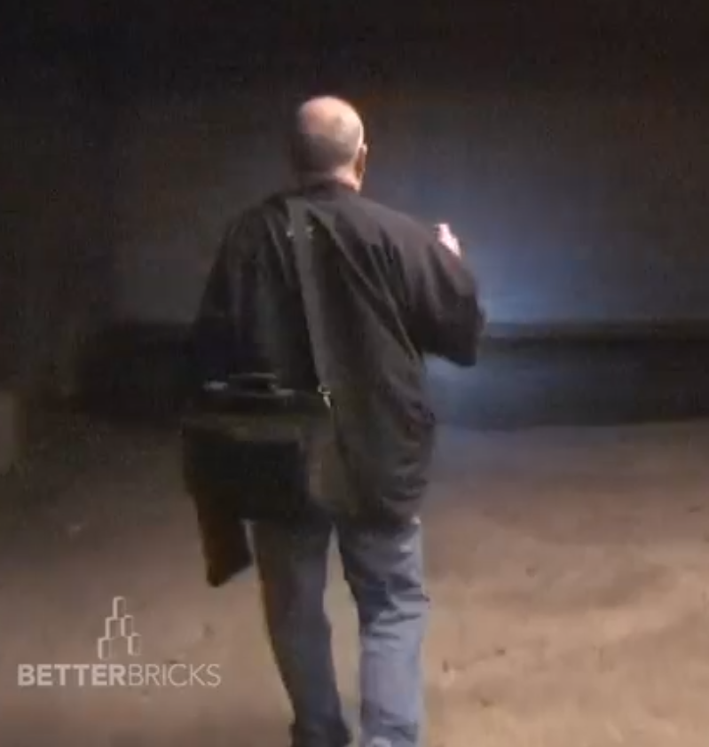
Watch Video & Discuss –
Building Walk-through Series
Walk through the ACME Office Building.
Boiler scheduling
Water heater circulation
Night walkthrough
https://www.youtube.com/playlist?list=PL6B04186FC605C883
Notes:
Now we will watch three short videos of a building walk-through for ACME office building. After the videos, your instructor will lead a discussion with the class about your “take-aways” and what you learned. These videos are available from BetterBricks on YouTube. Search for “betterbricks night walk” or go to:
https://www.youtube.com/playlist?list=PL6B04186FC605C883
Related resources can be found here:
https://betterbricks.com/articles/building-night-walk-video-series
One of the BOC Level II project assignments is to complete a walkthrough of your building. This activity will help you prepare for the assignment by learning about the walkthrough process and how to identify energy saving opportunities found in the video examples.

Slide 44

The Building Walkthrough
Boiler Scheduling
Notes:
Boiler Scheduling key concept: In this example, the pumps are off but the boiler is on stand-by and wasting energy.
Video link:
https://youtu.be/N75amxatFg0
In-Class Video Demonstration

Slide 45
The Building Walkthrough
Water Heater Recirculation Pump
Notes:
Water Heater key concept: Even though the hot water heater is off, the recirculation pump was left running, so this is another scheduling opportunity.
Video link:
https://youtu.be/tAcfDcbBDvU
In-Class Video Demonstration

Slide 46
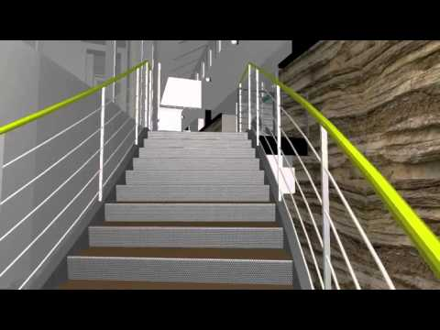
A Night Walkthrough
When your building is unoccupied, how do you know what is happening?
Periodic night walks are the key to finding out.
Notes:
Property management teams tend to focus on operations when the building is occupied and experiencing normal conditions. But for the majority of the year—likely between 5,000 and 6,200 out of 8,760 hours—buildings are unoccupied. A night walk is probably the best way to check for scheduling problems, since it will be obvious if lights are on or equipment is running. If you have time, it is recommended that you perform both a day and a night walkthrough. BetterBricks has a short guide to performing building night walks, which is included in the appendix of your handbook.
A night walk is a great way to track down building scheduling and envelope issues that might otherwise be hidden. Let’s now do a ride-along on a night walk of an office tower.

Slide 47
A Night Walkthrough
Sleuthing Out Energy Savings
Notes:
Video link:
https://youtu.be/ILggbRyeh-Y
Other videos in this series are available on YouTube. Search for “betterbricks night walk” or go to:
https://www.youtube.com/playlist?list=PL6B04186FC605C883
Related resources can be found here:
https://betterbricks.com/articles/building-night-walk-video-series
In-Class Video Demonstration

Slide 48
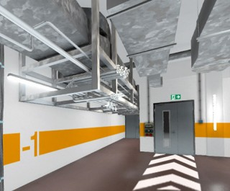
Class Discussion -
Your Take-Aways
Let’s discuss
Notes:
Discussion Questions
Why were the three areas in the video investigated?
(hint: one of these: ACME EUI, interview guide, building ops map, other)
___________________________________________________________________
What was found on the walkthrough?
___________________________________________________________________
What is your recommendation for addressing the problem?
___________________________________________________________________

Slide 49
BOC 2001
Supplemental Reading
Want to know more about doing a building walk-through?
Check out the 2001 Supplemental Reading at the BOC website, which includes the Building Walkthrough Video Series.
Notes:
Conducting Day and Night Walks of your building are good ways of identifying a multitude of operational issues that could be costing energy, money, time and tenant comfort. Quite often, these issues are easily addressed, providing the opportunity for immediate energy efficiency and building performance improvements. This video series provides real-world examples of common issues found during a Night Walk and guides you through the steps needed to conduct your own walk. Be sure to read the Building Night Walk Brief in addition to watching the videos. If you are interested in learning more about how to conduct building walkthroughs, review the BOC 2001 Supplemental Reading material at the URL below.
Supplemental reading material is available to students registered for BOC training at this URL. Please use the password below to access it.
http://www.theboc.info/student-partner-login/boc-supplemental-class-materials
Password: BOCstudent

Slide 50
Activity 6 -
Walkthrough Findings
Take 15 minutes
Problem: During the daytime walkthrough of a 20-story office tower, it is noted that the exterior doors are hard to open or don't close securely.
What is the cause?
What is the solution?
Notes:
Take 15 minutes
Review the problem below. Answer the questions.
Problem: During the daytime walkthrough of a 20-story office tower, it is noted that the exterior doors are hard to open or don't close securely.
1. What are possible causes? List 3 or more causes you can think of.
____________________________________________________________________
2. What are possible solutions? ____________________________________________________________________
3. Can you measure the problem?_________________________________________
4. What diagnostic tools will help you troubleshoot the problem?
____________________________________________________________________
5. What building systems or equipment would you want to look at to help diagnose the problems?
______________________________________________________________________
Note: Every cause does not have to be a problem.

Slide 51
Developing a Scoping Report
Action Plan
Gather
  Basic building information
  Energy bills
  Daily utility load data
Analyze
  Energy Use Index (EUI)
  Benchmark result
  Trends, load factors
  Daily load data findings
Interview
  Available documents
  Known problems
  Staffing
  Review:
    Top four opportunities
    O&M task lists
Plan
  Operations map
  Walkthrough plan
Report
Notes:
We have practiced compiling information for a systems operations map for our ACME building, and we have explored the process for developing a building walkthrough plan. After careful information gathering, analysis and planning, you will be ready for the building walkthrough. You will complete the walkthrough later in the Level II course as part of your take-home Project Assignment. Then you will write a report based on your findings and present the highlights of your report to your peers in the final class, 2005 Project Peer Exchange.

Slide 52
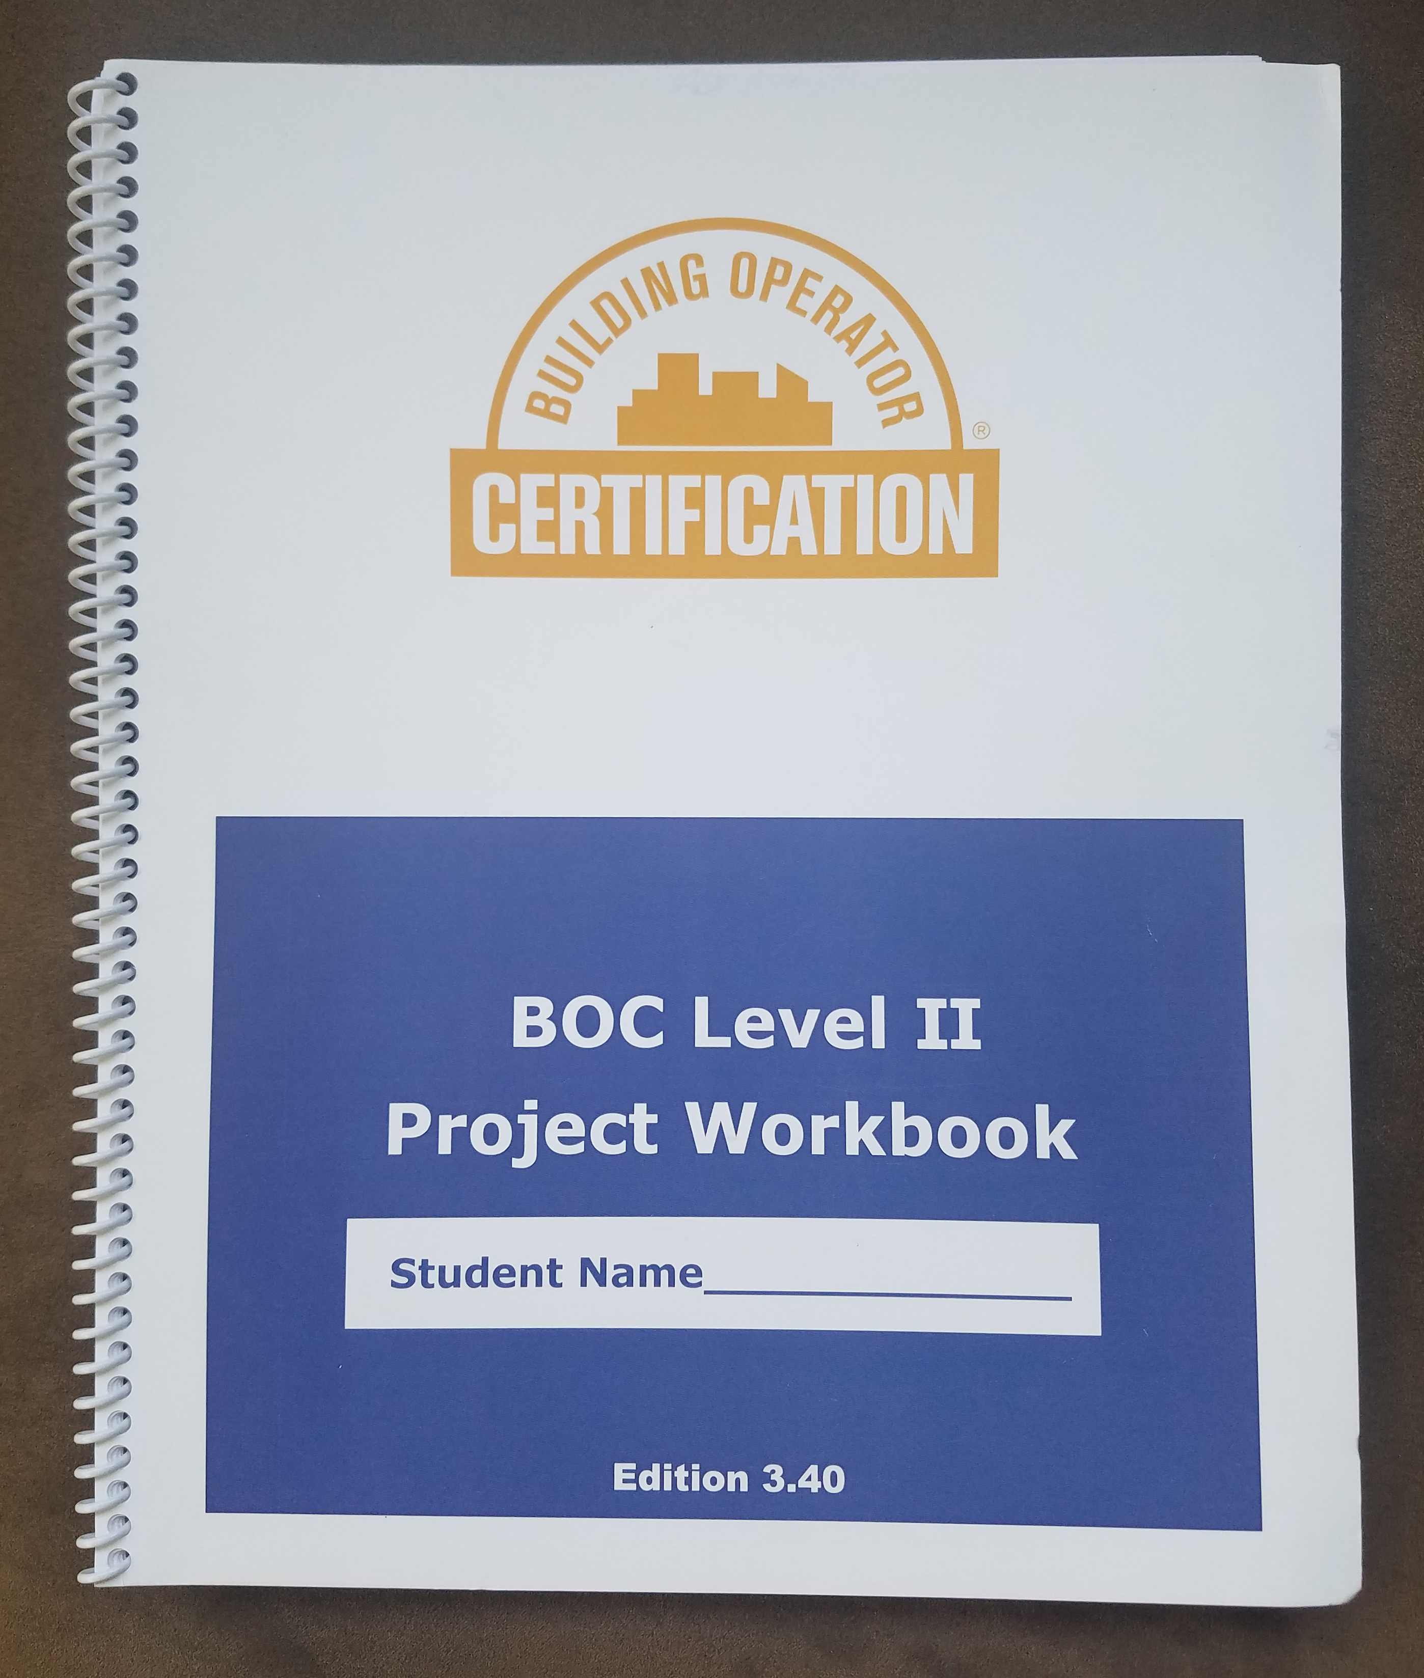
2001B Project Assignment
Take 15 minutes
Open Level II Project Workbook
Let’s review 2001B assignments:
  Scoping interview guide
  Building operations map
Answer the questions below
Notes:
The purpose of this assignment is to apply the information gathering steps for building scoping to your building. At the completion of the assignment, you will have information from the chief engineer or other qualified person about the building’s current operating condition, and opportunities for improvement. You will also have a building systems operations map documenting building uses and operational requirements.
Open your Level II Project Workbook. Refer to Assignment 2 for BOC 2001B. Read the description of the assignment and the rubric used for grading. In this assignment, you will complete two documents:
1. A Scoping Interview Guide documenting staffing, vendors, energy management practices, performance goals, occupant complaints, issues, known problems, and the status of mechanical drawings, control sequences, equipment repair records, and T&B reports.
2. A Building Systems Operations Map with the major equipment types, size, operating hours, and control systems for the plant, air systems, pumps, lighting and general equipment.
Answer these QUESTIONS:
Can you obtain this data for your building? ___Yes ___No ___Don’t Know
Where will you find it? Who can help? ________________________________
If you can’t obtain this data, what are your options for completing the assignment? ________________________________________________________

Slide 53

BOC 2005 Class
Project Peer Exchange
Present your final building scoping report
Classmates are your audience
7-10 minute presentation
Let’s prepare together
Notes:
BOC 2005 is the final class in the Level II course series, titled Project Peer Exchange: Present your final report. It will be a fun and engaging day.
Students will practice giving short presentations to classmates on the building scoping report they prepare for their building. See the appendix for an example scoping report on the ACME building. The building scoping report is Project Assignment #5 in the Project Workbook. Each student will have 7-10 minutes to present their report.
Presentations offer students the opportunity to practice communication skills and to share feedback with their peers. Following presentations, the class will wrap up with a discussion of effective strategies for presenting the scoping reports to management and winning support for their recommendations. Students attending this class will understand how to prepare and deliver an informative and coherent presentation on their building’s performance.
Look at your schedule to find the date of the BOC 2005 class. There is plenty of time to prepare your presentation, and we will help you by allotting time in each class to learn about ways to organize and deliver good presentations.

Slide 54
What Are
Presentation Skills?
Preparation:
Create talking points
Practice giving your talk
Delivery:
What the audience sees
Follow up:
Agree on follow up steps with audience
Ask for feedback
Notes:
Presentation skills refer to the qualities you need to create and deliver a clear and effective presentation. While what you say during a presentation matters, employers also value the ability to create supporting materials, such as slides and reports. Your employer may want you to deliver briefings and reports to colleagues and contractors, conduct trainings, present information to contractors, occupants/tenants, or perform any number of other tasks that involve speaking before an audience. Giving presentations is a job requirement for many positions including building operators.
Any presentation has three phases: preparation, delivery, and follow-up. All presentation skills fit into one of these three phases.
Preparation involves research and building the presentation. You will work from the BOC building scoping report (Project Assignment #5) which is a written report of your findings and recommendations. This means you won’t need to work from scratch to research the topic. Practicing your presentation is an important part of preparation. Practice as much as you need to feel comfortable delivering it with ease and confidence within the time allotted.
Delivery is the part the audience sees. A good delivery depends on careful preparation and confident presentation.
Follow-up includes properly breaking down and storing any equipment, contacting any audience members with whom you agreed to communicate further, and collecting feedback.
In the next class, we will discuss preparation tips for organizing an effective presentation.

Slide 55
Videos and Discussion:
Watch the videos
(5 mins)
V1 - Why do we give speeches?
Answer the questions on your notes page.
As a class, discuss answers to #1 and #2.
List on the board the answers to #3.
V2 – 5 reasons presentation skills are important
Notes:
Why Speeches Matter - https://www.youtube.com/watch?v=6LPXIaNtCRc
Why Presentation Skills are Important - https://www.youtube.com/watch?v=rRs4wFGPQ0o
1. What did people in the videos say about the purpose and value of presentations?
_______________________________________________________
_______________________________________________________
2. Do you agree with the following statements – yes or no?
Speeches inspire people to do something, believe something, take action at a moment.
Was there a time in your life where you changed your mind because someone you trusted made an argument you could understand?
Presentation skills are only valuable for people who give speeches – teachers, elected officials
3. Why are presentation skills valuable for building operators? (list 3 reasons)
_______________________________________________________
_______________________________________________________

Slide 56
Video – Bob Cowan
Engineering Director, Fred Hutchinson
Cancer Research Center, Seattle, WA
Watch the video
(1.5 minutes)
Answer the 6 questions on the notes page
Discuss as a class
Notes:
Bob Cowan - https://www.youtube.com/watch?v=NDsWvsDheew
1. How does Mr. Cowan introduce himself?
_______________________________________________________
2. How did he get your attention?
_______________________________________________________
3. What did he want you to do?
_______________________________________________________
4. Was he prepared? ____________________________________
5. What did you like about his delivery?
_______________________________________________________
6. Was there a follow up? ________________________________

Slide 57
Presentation skills are valuable because …
We have good ideas
We can help others do better
We can improve our building
We can make occupants happier and more productive
Our work contributes positively to the organization
Notes:
Remember these points as you look ahead to preparing and delivering your final presentation in BOC 2005.
There is plenty of time, and we will help you by allotting time in each class to learn about ways to organize and deliver good presentations.
In the next class, we will discuss our individual experiences preparing for and delivering presentations.

Slide 58
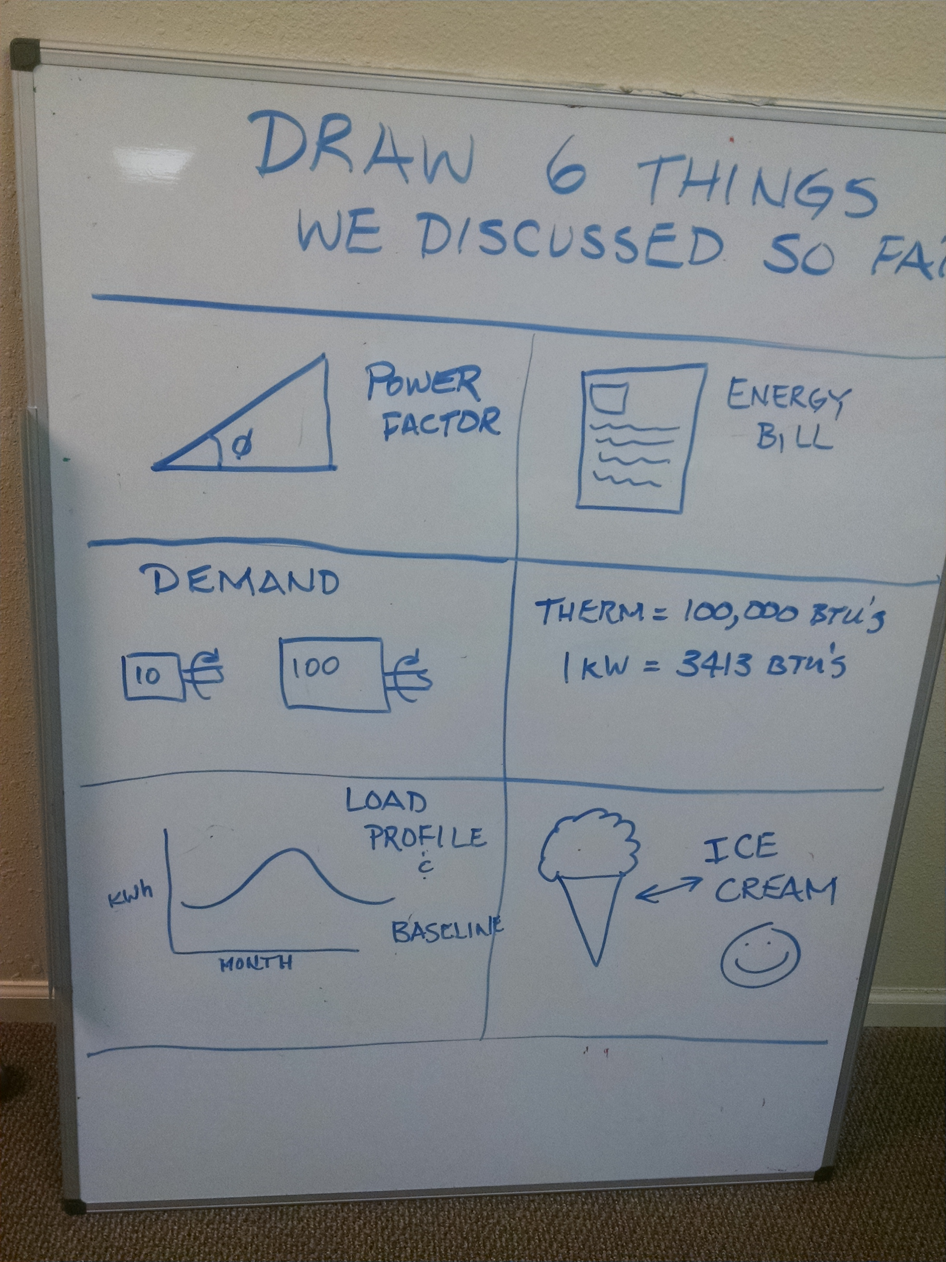
2001B Review
What did we cover today?
2001B test review and project assignment
Building scoping interview guide
Four common opportunities for improving building energy performance
Using O&M tune-up checklists
Preparing for a building walkthrough
Understanding the 2001B project assignment
Discussing the value of presentation skills
Completing a system operations map

Slide 59
BOC 2001B Test
The test is administered by your instructor, or online at the Learning Management System (LMS).
The test is open book and open notes.
You have one hour to complete the test.
Notes:
BOC 2001B Test
The test is designed to review the important content prescribed by the learning objectives and covered during the class day.
The test is open book. You have one hour to complete the test.
You will work independently to answer the questions. Teaming up with a classmate is not permitted.
If the test is administered via paper, provide your answers on the answer sheet, not the test booklet. Upon completion of the test, you may return the test booklet and your answer sheet to the instructor or your course manager.
The test will be graded following the class, and your score will be provided to you no later than at the next scheduled class in the BOC course series.
Good luck!

Slide 60
Appendix
Scoping Interview Guide for ACME Office
O&M Checklists
Building Operations Map for ACME Office
BetterBricks Building Night Walk Brief
Building Scoping Report for ACME Office
A lasting resource during and after the class
Notes:
Appendix
ACME Scoping Interview Guide A-1
O&M Checklists B-1
ACME Building Operations Map C-1
BetterBricks Building Night Walk Brief D-1
ACME Scoping Report E-1

