Slide 1

BOC 2002 Optimizing HVAC Controls for Energy Efficiency
Month Day, Year Instructor Name, Position
Instructor Company
Phone Name@email.com
Notes:
Instructor’s name: __________________________________________________________
Phone number: ____________________________________________________________
E-mail: ___________________________________________________________________
_________________________________________________________________________
_________________________________________________________________________
_________________________________________________________________________
_________________________________________________________________________
BOC 2002 Optimizing HVAC Controls
for Energy Efficiency
Edition 3.00

Slide 2

Safety Message
Notes:
Let's start with a safety reminder. This may be something from the course sponsor or site host; the instructor, moderator, or a student. Topics can include anything related to safety: site, health, personal, equipment, etc. What topic shall we address today?

Slide 3
Agenda
Project Debrief
Quick Review of Control Systems from Level I
Control System Optimization Strategies
Control Sequence of Operation
Troubleshooting & Testing Controls
Control System Maintenance
Advanced Building Controls
The Future of Building Controls
Project Assignment
Presentation Skills
Notes:
Class Overview
In this class, you’ll build on the knowledge gained from BOC Level I training to identify strategies for optimizing building controls, develop, adjust and maintain sequences of operation, and troubleshoot, test, and perform maintenance of building controls. Your instructor will also lead a short Presentation Skills activity to help prepare you for presenting your scoping report findings in the 2005 Project Peer Exchange class.
Agenda
Project Debrief
Quick Review of Control Systems from Level I
Control System Optimization Strategies
Control Sequence of Operation
Troubleshooting & Testing Controls
Control System Maintenance
Advanced Building Controls
The Future of Building Controls
Project Assignment
Presentation Skills

Slide 4
Learning Objectives
Refresh knowledge of HVAC controls
Describe control strategies for optimizing building performance
Understand a written sequence of operation (SoO)
Write a procedure for testing controls
Identify maintenance requirements for controls
Identify future trends in building controls
Prepare to complete the project assignment
Notes:
Learning Objectives
After this class, an operator should be able to:
Refresh knowledge of HVAC controls fundamentals
Describe control strategies for optimizing building performance
Understand a written sequence of operation for HVAC
Explain a procedure for testing the control system
Identify maintenance requirements for controls
Identify future trends in building controls
Prepare to complete the project assignment

Slide 5
BOC 2001 Project Assignment – Part B
Your project assignment was:
Scoping interview guide
Building operations map
How did it go? Let’s review.
Notes:
Open your Level II Project Workbook. Let’s review 2001 Part B assignment.
Your project assignment was to complete the following:
Scoping interview guide
Building operations map
The purpose of this assignment is to apply the information gathering steps for building scoping to your building. At the completion of the assignment, you will have information from the chief engineer about the building’s current operating condition, and opportunities for improvement. You will also have a building systems operations map documenting building uses and operational requirements.
1. A Scoping Interview Guide with the chief engineer documenting staffing, vendors, energy management practices, performance goals, occupant complaints, issues, known problems, and the status of mechanical drawings, control sequences, equipment repair records, and T&B reports.
2. A Building Systems Operations Map with the major equipment types, size, operating hours, and control systems for the plant, air systems, pumps, lighting and general equipment.

Slide 6
Section 1:
Control Systems Review
See Glossary for key terms & definitions
Notes:
Before we begin a discussion of optimizing HVAC control systems, let’s take a moment to review the purpose of HVAC control systems, the various control system types you are likely to see in commercial buildings, and how they are designed to work. In this section, we will review key concepts presented in BOC 1004 - HVAC Controls Fundamentals. This discussion will prepare you for the subsequent discussion of optimizing controls for energy efficiency, developing sequences of operation (SoO), and functional testing of equipment operation.
There is a glossary of HVAC controls acronyms, terminology and definitions in the appendix of the Student Handbook. Take a moment to find the glossary before we begin the controls review discussion. The glossary is a lasting resource for use during and after today’s class.

Slide 7
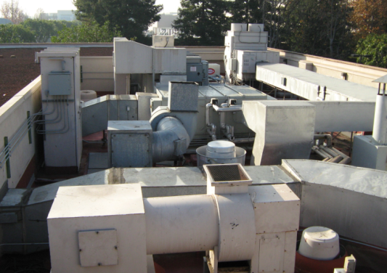
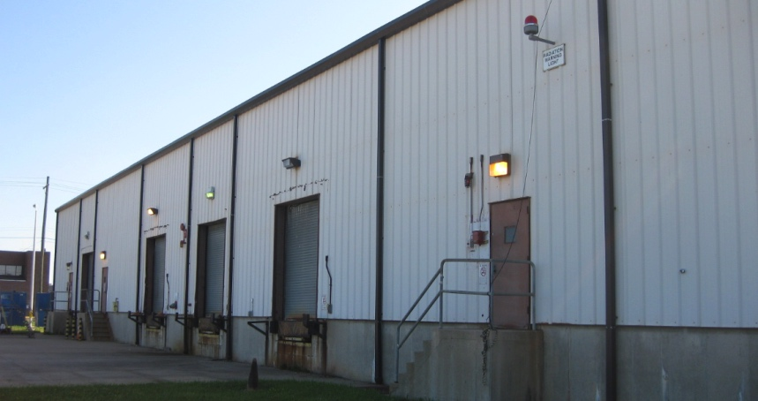
Controls Systems
Tell building equipment how to operate
HVAC equipment
Lighting/plug loads
Fire/life safety
Security
Elevators
EV chargers
Onsite energy generation/storage
Notes:
Most equipment installed in buildings does not operate continuously (24/7) at full power. Control systems tell the equipment (a) when to operate, and (b) how it should operate when it’s on. There are many systems and pieces of equipment requiring control. Examples include:
HVAC Systems chillers, boilers, air handling units, roof-top units, fan coil units, heat pumps and variable air volume boxes.
Lighting Systems. Both interior and exterior lights.
Plug Loads such as computers, copiers, and vending machines.
Fire/life safety items such as magnetic door holders, fire alarm strobes, and smoke dampers.
Security items such as door locks, card readers, and closed circuit video.
Elevators and escalators.
Power monitoring.
Plumbing and water monitoring.
Electric Vehicle (EV) chargers.
Onsite energy generation and storage such as solar photovoltaic (PV), generators, combined heat & power, battery/thermal storage.

Slide 8
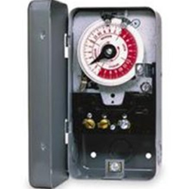
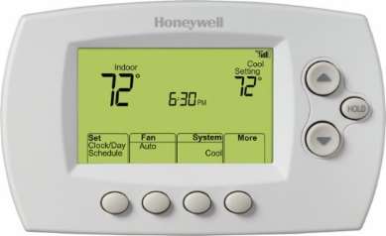
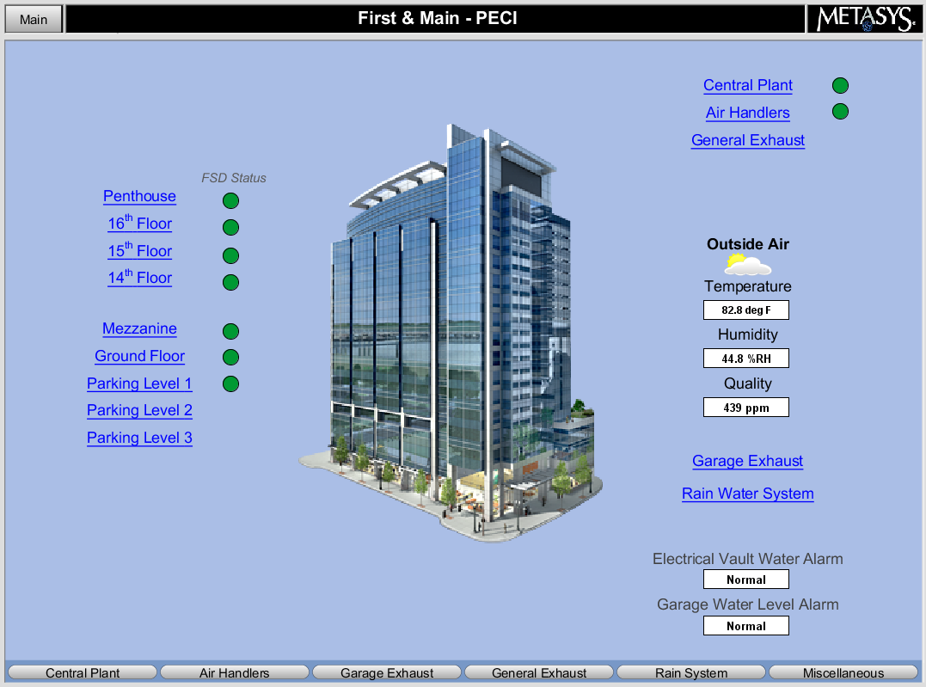
System Types
Stand-alone Controls
Control of individual equipment or systems
Central Controls
Integrated controllers connected to a local area network with centralized operator interface
Notes:
There are various types of control systems that can be used to control the particular pieces of equipment and processes in buildings. Central control systems tie all of the equipment together for control from a central location. Self-contained systems control only one piece of equipment, such as a rooftop unit thermostat that only controls the rooftop unit and does not communicate with any other systems in the building. There are various control methods as well.

Slide 9
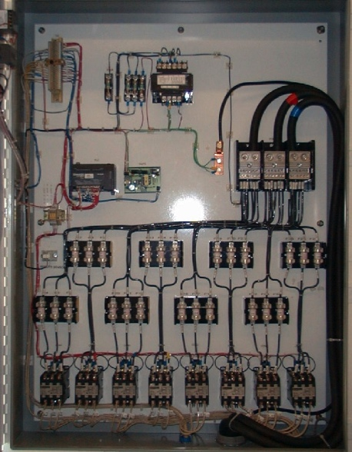
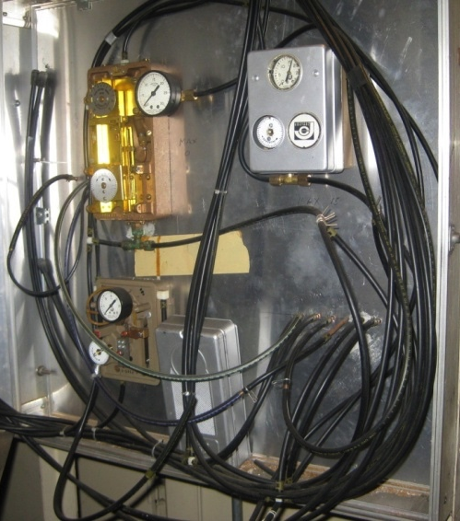
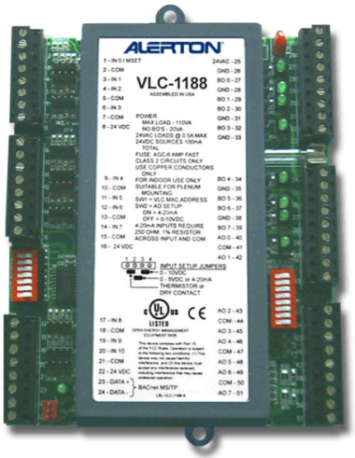
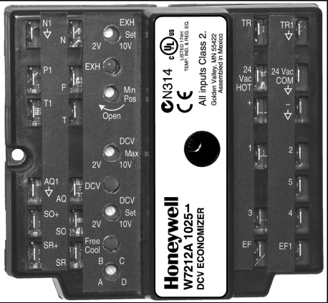
Energy Sources
Electric
Pneumatic
DDC
Programmable
Electronic
Notes:
Pneumatic control systems operate with compressed air and use mechanical means such as temperature-sensitive bimetal strips to perform control functions.
Electric control systems operate on low or line voltage and use mechanical means such as temperature-sensitive bimetal strips to perform control functions. They provide on/off or two-position control. An example of this would be a simple electric baseboard heater controlled by a wall-mounted thermostat.
Electronic control systems operate on low voltage and use solid-state components to amplify input signals and perform control functions. They provide on/off, two-position, or modulating control.
Microprocessor-based control systems operate on low voltage and uses a microprocessor to perform logic and control functions, such as providing an output signal to position an actuator. Microprocessor-based controls are digital whereas electric and electronic controls are analog.
The term direct digital control (DDC) systems describe the communication method used in modern devices (hardware and software). These systems use both electronic and microprocessor-based controls. They can also control pneumatic equipment, such as large pneumatic valve actuators.

Slide 10
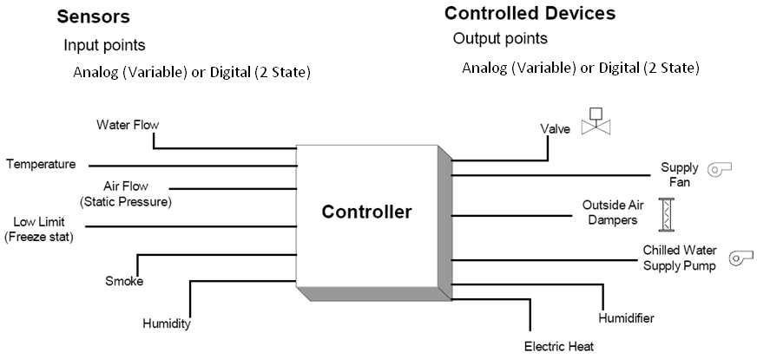
Control System Inputs & Outputs
The Controller Receives the Input and Processes an Output
Power Supply
Notes:
This basic control system diagram illustrates one controller with multiple sensor inputs and multiple controlled devices.
Power Supply

Slide 11
What is Controlled?
Valves
Dampers
Electric relays
Lights
Fans
Pumps
Compressors
Boilers
Chillers
Heat pumps
Variable speed drives (VSD) for fan & pump applications
Onsite Energy Generation
Notes:
Recall that there are many types of equipment, devices and processes that can be controlled (output). Generally, building control systems begin with control of mechanical, electrical, and plumbing systems. For instance, the HVAC system is almost always controlled, including control of its various pieces of equipment referred to as controlled devices.

Slide 12
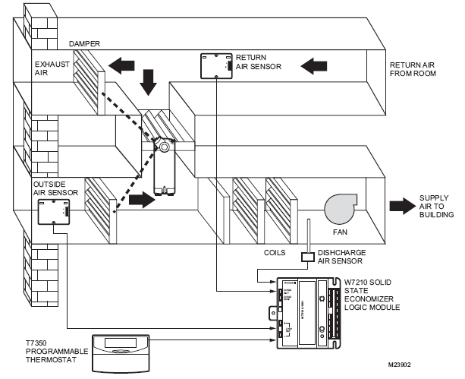
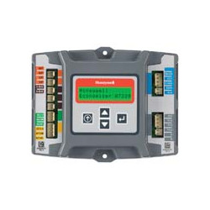
Electronic Control System
Can you identify the control variable, controlled device and control agent?
Honeywell Jade W7220 Controller
Images source: Honeywell Controls
Notes:
The Honeywell W7210 logic module is a good example of an electronic control system. These controllers have 2-10 volts of direct current (VDC) output for use with M7215 actuators and Modutrol Motors with 2-10 VDC control. The mixed-air control circuit is in the logic module and is not part of the actuator. The actuator can also be powered with the same 24 volts of alternating current (VAC) power as the logic modules, provided the internal grounding of the actuator is compatible. Note that some of the Siemens actuators are not compatible with the M7210. Older models that are no longer available are the W6210A and D models. These models were used in the mid 1990s with floating actuators.
Solid state economizer controllers have been replaced with micro-processor based controllers such as the W7220 Honeywell Jade controller. The new controllers offer advanced economizer control incorporating differential drybulb or enthalpy control and also incorporate demand controlled ventilation (DCV) strategies for limiting outside air usage based on indoor air quality. The Jade controller also offers users fault diagnostic routines to help technicians troubleshoot system problems.
Given the energy savings potential of proper economizer operation, and the fact that economizers are a common point of failure in HVAC systems, upgrading outdated controllers is recommended wherever possible.
Electronic Control System
Can you identify the control variable, the controlled device, and control agent?

Slide 13
Direct Digital (DDC) Control Systems
Hardware
Software
Points
Features and Capabilities
Microprocessor Systems
Open source
Closed source
Wireless
Notes:
Control for simple HVAC systems can be accomplished via thermostat on-off control. More complex HVAC systems typically consist of various controllers for equipment and processes, with a central host computer controlling the whole system. (This host computer is often located onsite, but it can also be located remotely and function virtually via the Internet).
Hardware refers to devices such as the computer, monitor, keyboard, or modem.
Software is the loadable programming which runs inside of the computer. Firmware is programming that is burned into the computer chip.
Points are typically associated with real physical connection locations. Virtual points are internal software points designed to calculate or store information, but are not associated with physical points.
The features and capabilities of the DDC computerized control system are dependent upon the vendor and equipment manufacturer. The HVAC industry is increasingly incorporating “internet of things” (IoT) devices into HVAC systems. IoT devices are equipped with various sensors and can communicate with each other, resulting in more efficient processes. IoT devices sometimes operate wirelessly, which can be beneficial in reducing installation costs.
All computerized control systems are microprocessor-based systems. Most controllers in the field have resident microcomputers, often called “intelligent” or “distributed” systems.

Slide 14
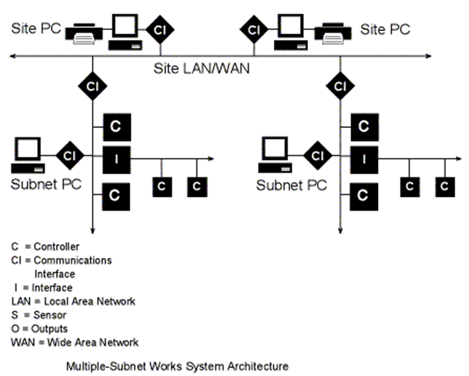

DDC Network Architecture: Large Systems
Courtesy DDC-Online Org
Notes:
DDC system controllers are connected together as part of an overall building DDC network, such as the network shown on this page. A local area network (LAN) or wide area network (WAN) is used to connect multiple sub-networks and site computers. A LAN is a computer network contained within a building or campus, while a WAN is a computer network that covers a broader area such as a region or nation. The Internet is an example of a WAN.
Communications interfaces may be required to allow information to be passed between various locations of the DDC network.
Information can be sent and received by each of the site computers, but cannot be subsequently shared from one computer to another. Sub-network computers may only be able to see their own sub-network. There may be a limitation on the number of site computers.
Information stored in the computers can typically be remotely accessed. This includes graphics, programming and stored trend and operational data.
Courtesy DDC-Online.org

Slide 15
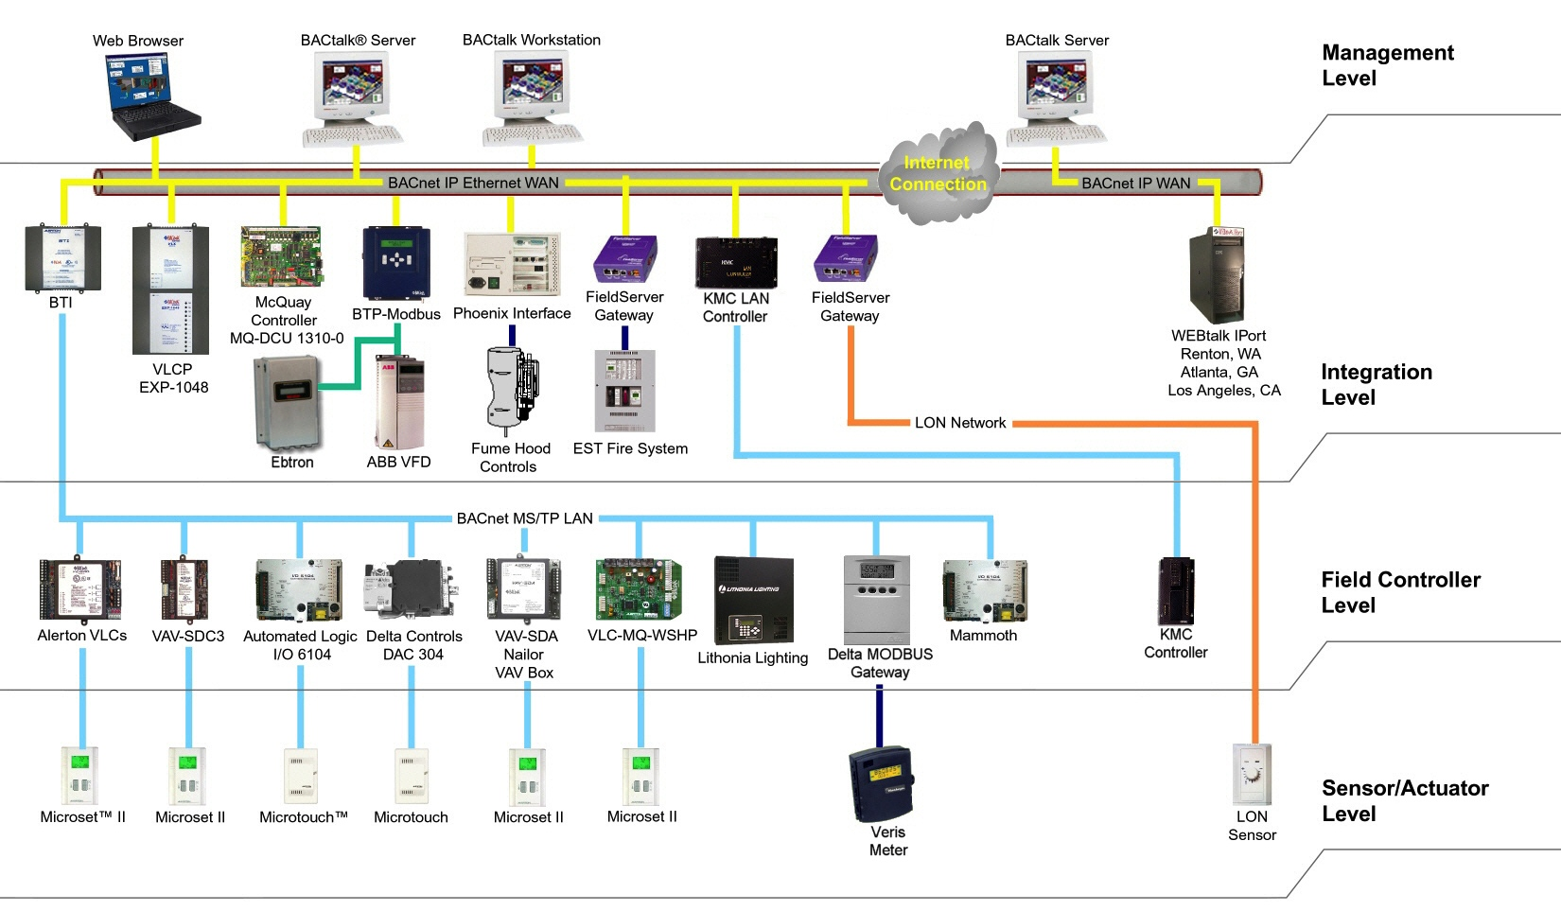
Modern DDC Controls: Four Level Architecture
Local Operating Network (LON)
Courtesy: Alerton Controls
Notes:
Large System DDC Control Networks are comprised of four level, working from the bottom-up. They include:
Sensor/Actuator (architecture) Level
Field Controller Level
Integration Level
Management Level
Note: Controls architecture may vary by manufacturer.

Slide 16
Communication Standards Software Integration
Automation systems allow communication with multiple vendors including:
HVAC Equipment
Fire alarm, security
Lighting, fan units
PLCs (Programmable Logic Controllers)
Boilers and chillers
Heat pumps
Notes:
Software Integration is the process of utilizing a single automation system to communicate with multiple vendors. It requires a gateway or translator device that converts one protocol to another. A protocol is a set of rules that determine how data is transmitted between devices in the same network. The most widely used interoperability protocols in the HVAC industry are BACnet, Modbus, and LonMark. They all take a different approach to interoperability. BACnet and Modbus are non-proprietary, open-standard protocols. BACnet was developed by ASHRAE. LonMark is a proprietary standard. (Related standard include LonTalk and LonWorks.)
Applications include:
• Fire and security alarms
• Lighting and fan units
• PLCs (Programmable Logic Controllers)
• Boilers and chillers
• Heat pumps
Sources: https://www.comptia.org/content/guides/what-is-a-network-protocol https://www.facilitiesnet.com/buildingautomation/article/BACnet-LonMark-and-Modbus-How-and-Why-They-Work--7712

Slide 17
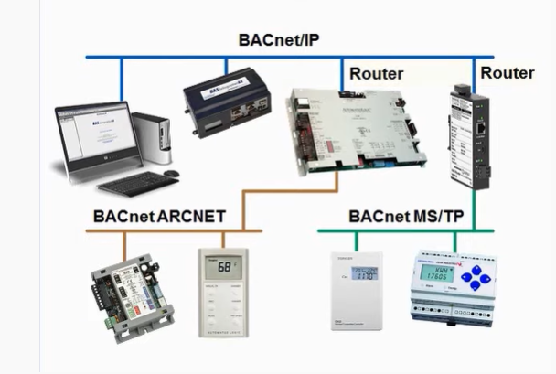
System Integration Through BACnet
Image Source: Contemporary Controls
Notes:
This example system layout illustrates a common BACnet network showing the capabilities of BACnet to communicate over different physical/data link layers. The most physical/data link used by BACnet in building control systems is the MS/TP (Master Slave/Token Passing) for the control level and the IP or Internet Protocol for the inter-network level data communications.

Slide 18
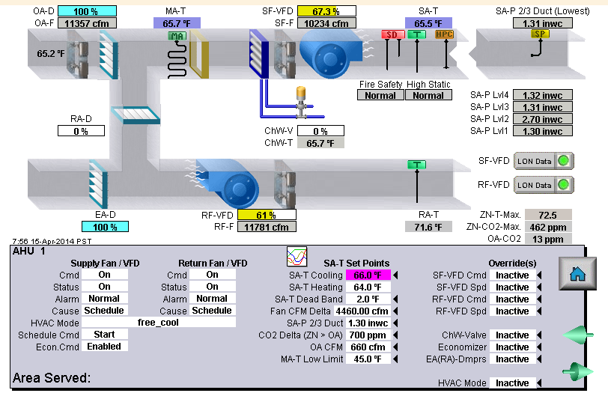
Graphical User Interface (GUI)
Notes:
A common name for a computerized control system is a Building Automation System, or BAS. Building operators can easily monitor real time operation through the Graphical User Interface, or GUI. An example GUI for an air handler is shown here.
Graphical User Interface (GUI)

Slide 19
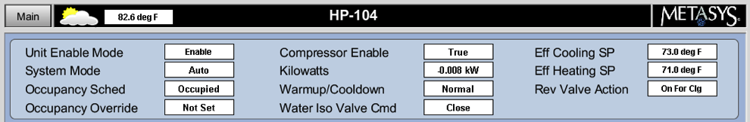
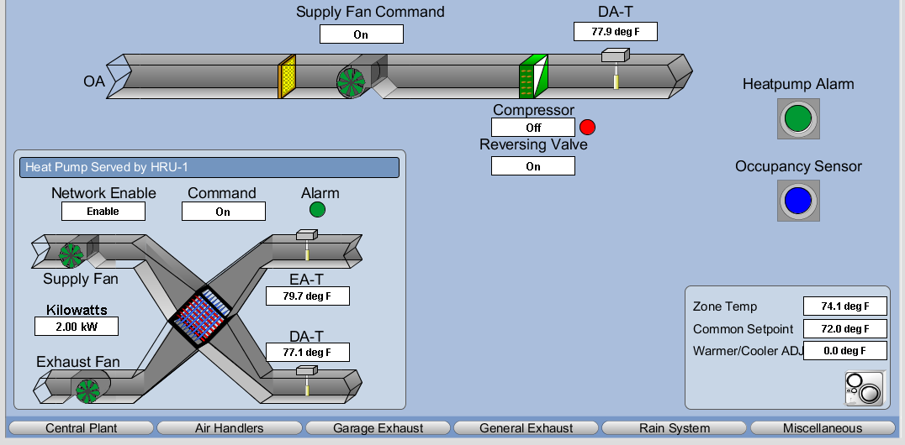
Graphical User Interface (GUI)
Notes:
Here is another example of a GUI. This screenshot shows a heat pump with heat recovery integrated into the system.
Graphical User Interface (GUI)

Slide 20
Control Systems Documents
Control System Drawings
Sequence of Operation
Decision Tree
Systems Startup Training Manual
Commissioning Training Manual
Notes:
Whichever automation and control system your building has, ideally you would like to have a complete set of documentation on the system. This may include:
Control Drawings. These should include the original verified as-built plans and schematics, continually updated as changes are made.
Sequence of Operation. There should be a sequence of operation for every major piece of equipment including details of system interactions.
Decision Trees. These are a convenient way to graphically represent control sequences. They can show overall high-level strategy or detailed control loops.
There will often be documents from manufacturers training at the time of the building systems’ start-up. If the building has been commissioned, look for a systems manual with details on equipment test sequences. Most commissioning includes a training phase which should also be documented.

Slide 21
Activity 1 – Tell us about
your control system…
Take 15 minutes.
Pair up with a classmate
10 mins - Interview each other using the 5 questions below
5 mins - Share your answers during the instructor-led “report out.”
(See notes page for questions)
Notes:
Activity 1 – Tell us about your building control system…
Instructions
Pair up with a classmate from another organization or with a different building from your own. Take 10 minutes to interview each other about your respective building control systems. Answer the questions below:
1. Interviewee’s name: __________________________________________
2. Building type & name: __________________________________________
3. Describe the building control system (e.g., What is the type of system? What is the controlled equipment?)
______________________________________________________________________________________________________________________________________________________________________________________________________________________________________________________________________________________________________________________________________________________________________________________________________________________________
4. How much interaction do you have with the control systems (e.g., daily, weekly, monthly, never…)?
_____________________________________________________________________
_____________________________________________________________________
5. What are the best and worst features of your control system?
_________________________________________________________________________________________________________________________________________________________________________________________________________________________________________________________________________________________________________________________________________________________

Slide 22
Section 2: Control System Optimization
Notes:
In this section, we will discuss the benefits of using the control system to improve building performance through specific optimization strategies building operators can implement for HVAC system operation.
HVAC systems in buildings, when complemented with a good control scheme, can maintain comfort under any load conditions. Efficient HVAC control is often the most cost effective option to improve the energy efficiency of a building. However, HVAC processes are nonlinear. Characteristics such as weather, occupancy, building use, equipment upgrades, etc. can change on a periodic basis, making it necessary for the operator to monitor the operation of the system and adjust the control strategy as needed.
An automated building can, for example, learn and begin to predict building and room occupancy. If a building operator can optimize the control system to inform the building when the demand for lighting or HVAC facilities will wax and wane, then it can dial back output when demand is lower. Estimated energy savings from simply monitoring occupancy range from 10-30%, which can add up to thousands of dollars saved on utilities each month.
A building can also sync up with the outdoor environment to maximize efficiency. This is most useful during the spring and summer, when there is more daylight (and thus less demand for interior lighting) and when it is warmer outside, allowing the building to leverage natural air circulation for comfort.

Slide 23

Control Optimization
Strategies
Basic guiding principles
If you don’t need it turn it off
If you don’t need it at full power turn it down
Make “smart” energy decisions when adjusting systems to the real building needs
Save energy without compromising the comfort of the occupants
Notes:
The goal of control optimization is to reduce energy waste without compromising the comfort of the building occupants. These are the guiding principles:
If you don’t need it turn it off. Lighting can be turned off when no one is in the room. HVAC distribution systems can be turned off during unoccupied periods. Domestic hot water re-circulation pumps can be turned off when there is no hot water demand.
If you don’t need it at full power turn it down. HVAC equipment and distribution system capacity is sized for peak load conditions. These conditions however occur 1% or less of the time meaning the HVAC system and equipment is oversized 99% of the time. When replacing HVAC equipment emphasis should be placed on part-load efficiency rather than peak efficiency. Three phase fans and pumps should be provided with variable speed drives to match part load conditions.
Make “smart” energy decisions when adjusting systems to the real building needs. Medical facilities, data centers, computer rooms, manufacturing facilities, food-handling systems or other facilities with mission-critical outcomes should be approached with extra care when either evaluating or implementing system adjustments.
Save energy without compromising the comfort of occupants. Changing zone temperature setpoints or reducing ventilation air can significantly reduce energy use but at the same time can create indoor air quality issues and negatively effect occupant comfort. Operators should start with strategies that reduce energy waste when the building is unoccupied or implement other control changes that do not adversely effect occupant comfort.

Slide 24
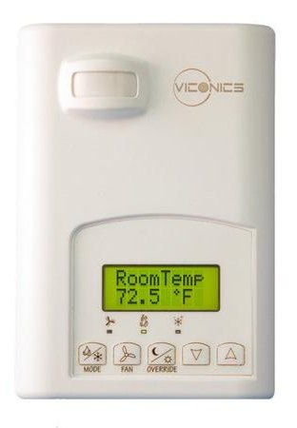
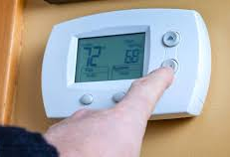
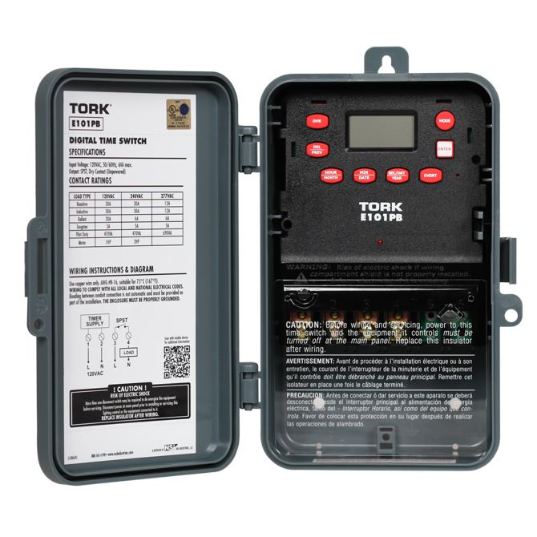
Equipment Scheduling
Turn off or turn down during unoccupied periods
Standalone timeclock, programmable thermostat or BAS
Holiday scheduling?
Intermittent occupancy?
Notes:
One of the simplest and most cost-effective ways of reducing energy waste in your building is to turn equipment off or down during unoccupied periods. Single zone package rooftop units, heat pumps, fan-coils, and split systems can be easily scheduled using programmable thermostats. Multi-zone systems are more complex and require computerized Building Automation Systems (BAS) to optimize scheduling of terminal units and system equipment.
General exhaust fans, domestic hot water re-circulation pumps and exterior lighting can be easily scheduled with stand-alone programmable timeclocks or the BAS system.
Regardless of the method for equipment scheduling, the equipment should have the capability of programming holiday shutdown. Some BAS systems will automatically schedule the holiday using a current year calendar. Stand-alone programmable thermostats and timeclock often require the operator to program the holiday schedule at the beginning of each calendar year. Your building systems deserve a holiday along with the occupants.
What if the use of the space or temperature zone is intermittent? For example hotel guest rooms may or may not be occupied depending on the time of day or season.

Slide 25








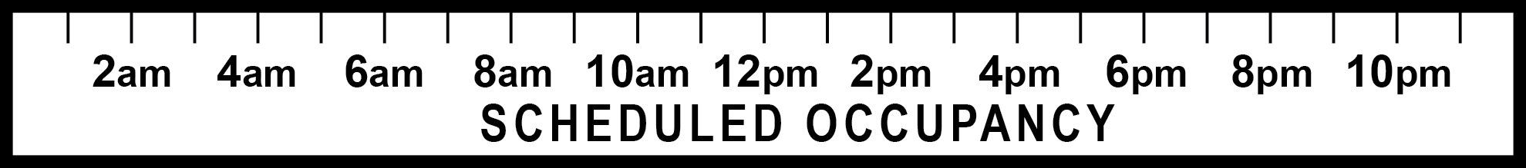
Optimum Start
Automatic adjustment of the HVAC system start time to meet occupancy requirements.
Potential Savings
Normal Start Time
= 7:45 AM
Early Start Time
= 5 AM
Notes:
Building Automation Systems and even stand-alone programmable thermostats have the capability to automatically adjust the HVAC system start time based on actual load conditions rather than peak load conditions.
In the past, building operators would manually set the HVAC start time based on the coldest day of the year representing the peak load conditions for pre-heating the building. Optimal start (or “intelligent recovery” ) will “learn” and automatically adjust HVAC start times to bring space temperatures within 1 to 2°F of occupied requirements, based on actual load conditions and occupancy schedules. During cold weather conditions, the system may start the HVAC system earlier to ensure the setpoint is achieved prior to occupancy, but during warmer weather the system may start later. This strategy results in reduced HVAC operation time and energy savings. Building operators should assure that the optimum start settings are enabled and the occupied time setting reflects actual occupancy schedules.
Intelligent recovery is especially important in heat pump applications, because it can help avoid using auxiliary heat during morning warm up sequences. Depending on the type of heat pump system, setting higher nighttime setback temperatures may maximize the overall efficiency by helping to avoid recovery issues that might trigger the use of electric resistance auxiliary heat, which is more expensive to operate than the heat pump.

Slide 26
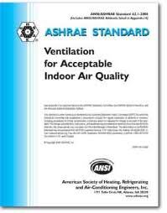
Ventilation Air
Determine amount of ventilation air required
Reduce or eliminate ventilation air during unoccupied periods
Demand controlled ventilation (DCV) using CO2 levels or occupancy
Image source: ASHRAE
Notes:
Ventilation air, while essential to maintaining occupant health and productivity, has a significant impact on energy consumption. It’s important to manage its use to minimize energy waste. The purpose of ventilation air is two-fold. The first is to provide adequate fresh air to maintain acceptable indoor air quality when the building is occupied. The second is to provide adequate fresh air to make up for air that is exhausted during normal building operations (i.e., general exhaust and building pressurization). The first step in controlling ventilation air is to determine how much fresh air is required. ASHRAE Standard 62 and the International Mechanical Code establish the minimum amount of ventilation air required to maintain acceptable indoor air quality. The minimum amount should be either the amount required to maintain air quality or the amount required to makeup for exhaust air systems, whichever is greater.
During unoccupied operations the requirement to introduce fresh air is reduced or even eliminated. Controls systems are used to keep outside air intake dampers closed during unoccupied and building warmup modes of operation.
Conference rooms, auditoriums, gymnasiums, retail, and movie theatres have varying occupancy and therefore variable fresh air requirements. Ventilation air is typically set for the peak load scenario when the spaces are at full occupancy which wastes energy when the spaces are unoccupied or partially occupied. Using demand ventilation controls based on CO2 levels in the space can significantly reduce the amount of ventilation air required and reduce energy costs to heat or cool ventilation air. Other options include using occupancy sensor controls to reduce ventilation air when the space is unoccupied.

Slide 27
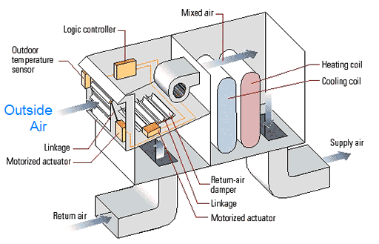
Economizer Control
Dry bulb vs enthalpy
Integrated vs non-integrated
Changeover temperature or enthalpy setpoint
Adequate provision for relief air
Notes:
On a rise in temperature in the zone, the first stage of cooling should be fresh air when outside air temperature or enthalpy is lower than the space conditions. This is referred to as the economizer cycle. Exhausting the warm air in the space and supplying lower temperature outside air is the most efficient method for cooling the space.
Integrated economizer controls allow for the simultaneous use of the economizer and mechanical cooling. Non-integrated economizer control provides either economizer or mechanical cooling but not at the same time.
Economizer controls use temperature or enthalpy to determine when to use economizers. Drier climates typically use temperature and wetter climates use enthalpy. Reference ASHRAE standard 90.1 for the recommended changeover setpoints for your climate.
Adequate relief air is required to enable full economizer capacity and energy savings. Barometric relief air systems rely on positive building pressure to “push” the excess ventilation air out of the building. “Powered” relief air systems use exhaust or return fans to remove warm air from the space or building.

Slide 28
HVAC System Controls
Single-zone systems
Multi-zone Systems
Multi-zone
Dual Duct
Variable Air Volume
Central Plant Equipment
Notes:
Control strategies depend on the type of system installed in the building. Single zone constant or variable volume systems are simple to operate and control. Multi-zone systems have multiple air-handlers, constant and variable air volume delivery, and zone terminal units adding to the complexity of the controls. Central plant equipment such as boilers, chillers, heat pumps and cooling towers generally operate independent of the zone terminal systems and require separate control strategies.
This next section discusses the control optimization strategies depending on system type.

Slide 29
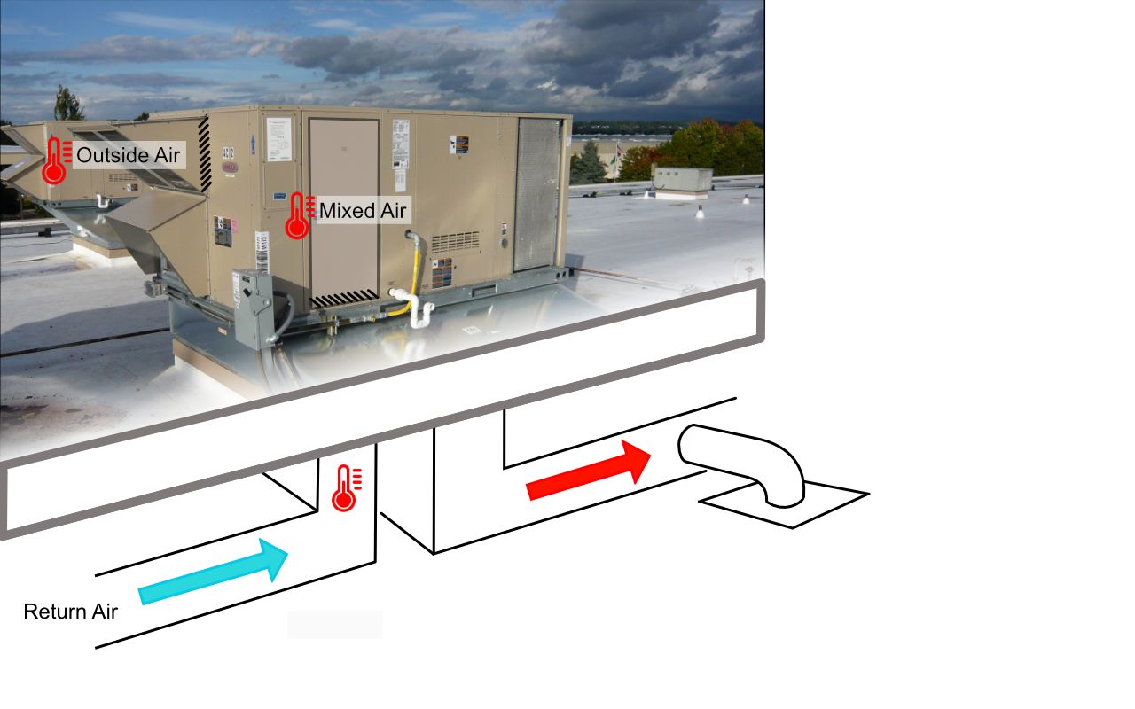
Single Zone Systems
Fan runs continuously in occupied mode
Control based on space temperature demand
Can utilize economizer, heating coils, cooling coils
Fan energy can be reduced with variable speed drive
Notes:
Single zone constant volume systems include heating and/or cooling coils which can be hot water, chilled water, DX cooling, gas heating, or heat pump heating and cooling. Systems can also include economizer control and staged cooling. The common operating characteristic of single zone systems is that the supply fan operates continuously and supply air temperature varies with heating or cooling demand in the zone.
Control optimization strategies for single zone systems include the following:
Scheduling – System is turned off or set to lower/higher setpoints when the building is unoccupied
Optimum Start – Variable start-time based on actual load conditions
Building Warmup Cycle -Keep the outside air damper closed during the building warm-up period
Demand Ventilation –CO2 sensors in the space over-ride the outside air damper position based on occupant density
Economizer-Free cooling when outdoor air conditions are favorable
Variable Speed Control – Use of a variable speed drive to slow the supply fan down when there no call for heating or cooling.

Slide 30
Multi-Zone Systems
Single air-handling unit that serves multiple temperature zones
Dual duct systems with mixing boxes
Single duct systems with zone terminal units
Constant or variable volume air delivery
Notes:
Multi-zone systems supply conditioned air to more than one temperature zone. Temperature control is achieved by controlling each zone’s supply air temperature with zone terminal units which respond to the heating or cooling demand in the space. Discharge air temperature from the main air handler is typically controlled to satisfy the zone load furthest from set point.
Dual duct multi-zone systems deliver hot and cold air to mixing boxes controlled by space temperature. Dual duct systems can be either constant volume or variable volume air delivery.
Single duct multi-zone systems serve single-zone variable air volume terminal units responding to the zone temperature. Interior zones are typically cooling dominated and use a throttling VAV terminal unit. Exterior zones requiring heat use reheat in the form of hot water or electric resistance heating coils.
Multi-zone systems are complex and are typically controlled by a building automation system. Older systems often use pneumatic actuators with electronic controllers. Newer systems are 100% electronic control.

Slide 31
Multi-Zone Systems - VAV
Notes:
Multi-zone variable air volume (VAV) systems are common in medium to large commercial office buildings. These systems provide independent temperature control for each zone and reduce fan energy use based on building demand for heating and cooling. Supply fan speed is determined by the discharge air pressure setpoint. On a rise in duct pressure above setpoint this is an indication of lower air demand and the fan is slowed down. A drop is air pressure below setpoint is an indication that more air is required and fan speed is increased. Building pressure is controlled by the variable speed return fan.
Control optimization strategies for multi-zone VAV central air handling systems include:
Scheduling – System is turned off or set to lower/higher setpoints when the building is unoccupied
Optimum Start – Variable start-time based on actual load conditions
Building Warmup Cycle - Keep the outside air damper closed during the building warm-up period
Demand Ventilation –CO2 sensors in the space over-ride the outside air damper position based on occupant density
Economizer-Free cooling when outdoor air conditions are favorable
Variable Speed Drive– Reducing fan speed with a variable speed drive when full cooling capacity is not required
Supply Air Temperature Setpoint Reset – Reset of supply air setpoint based on cooling load conditions.
Discharge Air Pressure Setpoint Reset – Reset of discharge air pressure setpoint based on air demand.

Slide 32
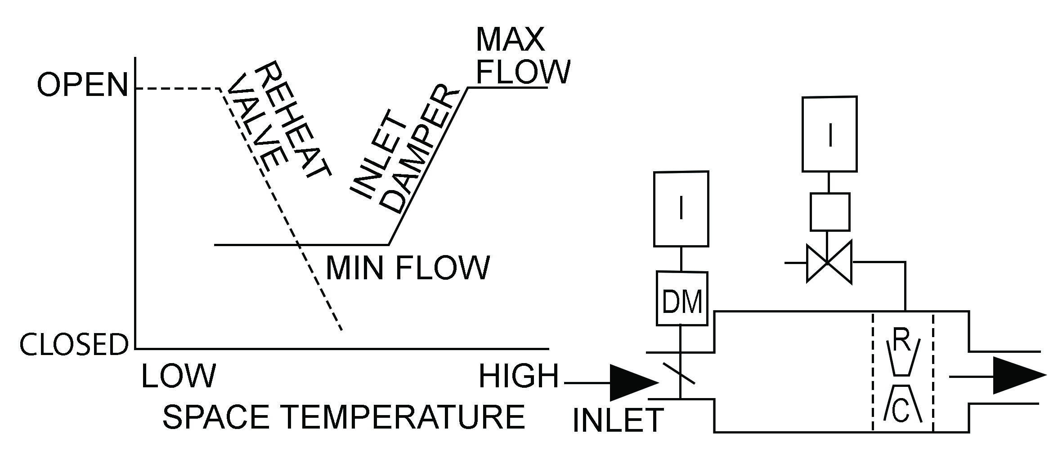
Throttling VAV Terminal Unit
Notes:
Throttling VAV terminal units typical serve cooling dominated zones in the building requiring minimal reheat. On a rise in temperature in the zone above setpoint, the inlet damper opens to provide more cooling capacity. On a drop in temperature, the damper closes to the minimum damper position required to meet ventilation requirements. If space temperature continues to fall the reheat valve is opened to provide heating capacity.
Control optimization strategies for multi-zone VAV central air handling systems include:
Scheduling – System is turned off or set to lower/higher setpoints when the building is unoccupied
Optimum Start – Variable start-time based on actual load conditions
Building Warmup Cycle –The inlet valve is 100% open and the reheat coil is enabled until the return air temperature reaches setpoint.

Slide 33
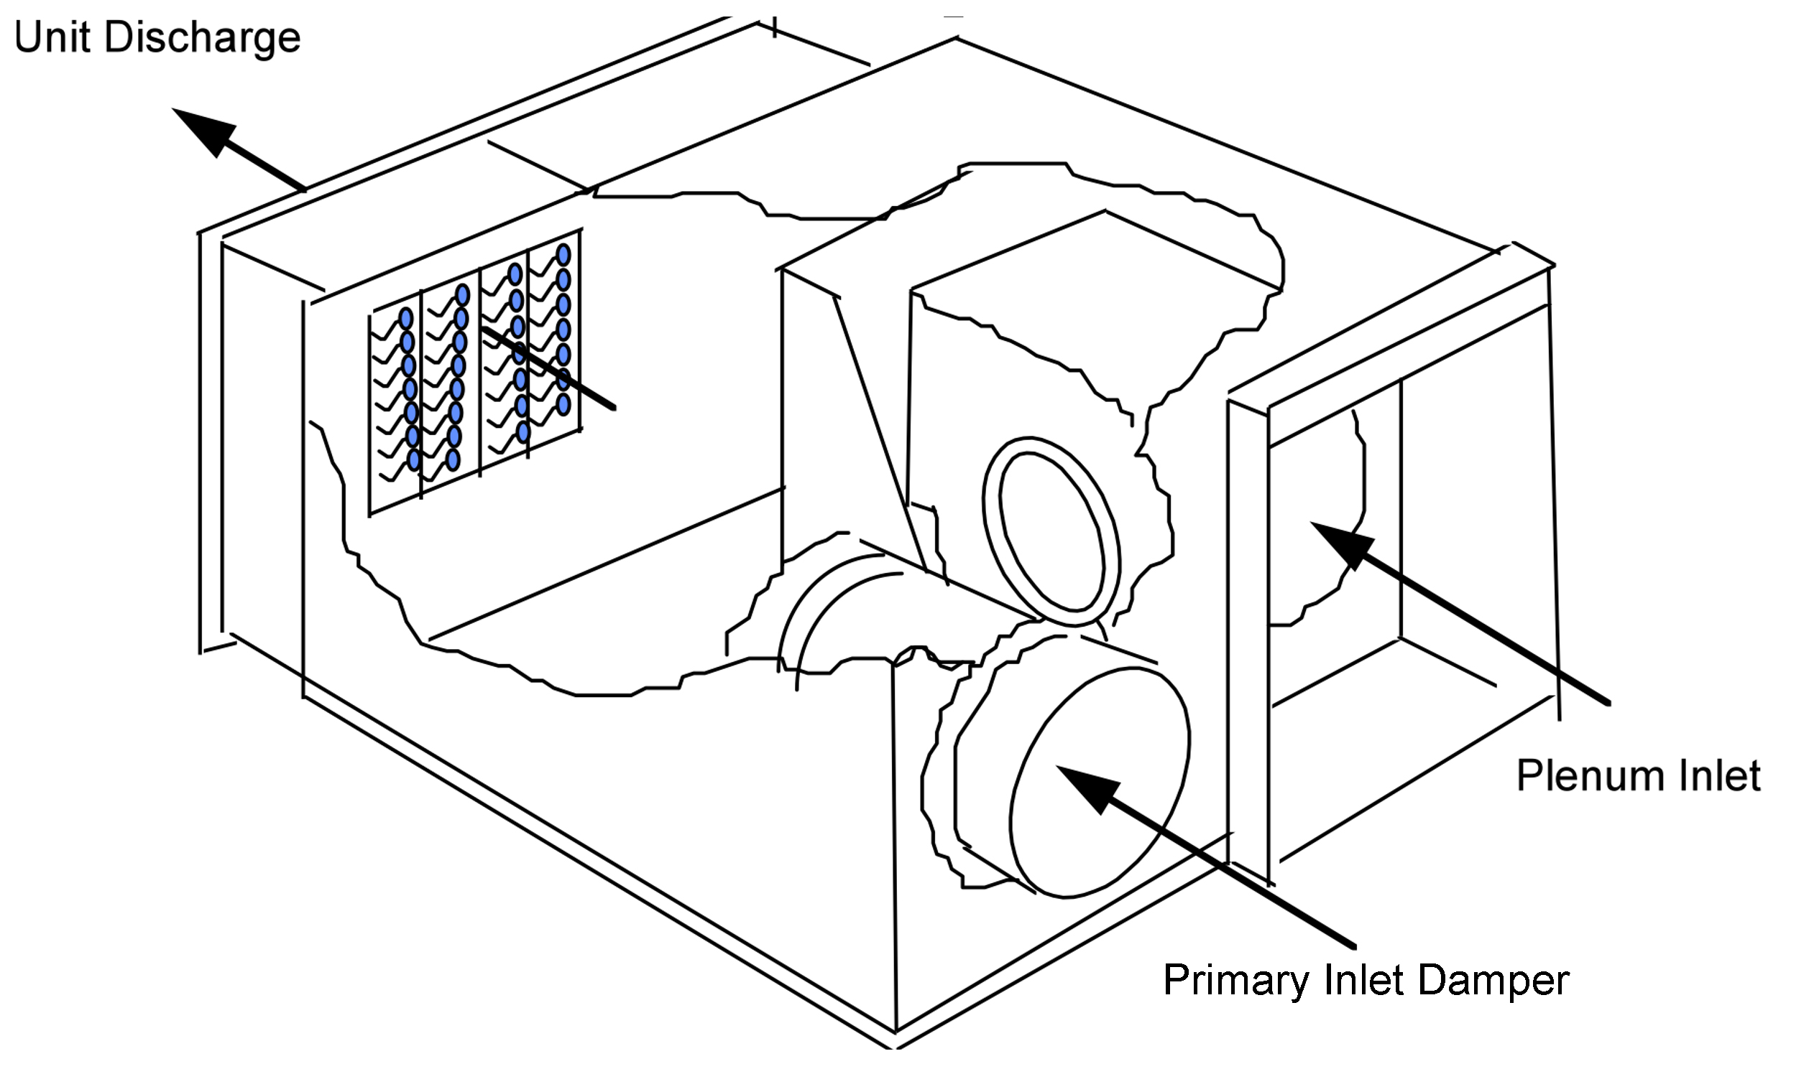
Fan Powered VAV
Terminal Units
Notes:
Constant fan powered units have an integral fan that provides constant volume of air to space. The fan is installed in series with primary air duct. These are typically referred to as series fan powered VAV terminal units.
Plenum powered units have a fan in parallel to maintain air circulation when damper modulates to minimum. These are sometimes called intermittent or parallel fan terminal units. A reheat coil is may be added to maintain heating temperature setpoint.
Control optimization strategies for multi-zone VAV central air handling systems include:
Scheduling – System is turned off or set to lower/higher setpoints when the building is unoccupied
Optimum Start – Variable start-time based on actual load conditions
Building Warmup Cycle –The inlet valve is 100% closed and the multi-zone air handler fan is off. The VAV fan is on and the reheat coil is enabled until the zone temperature reaches setpoint.
Demand Ventilation –CO2 sensors in the space set primary air damper minimum position based on ventilation demand
Single Zone Variable Air Volume Control– Newer VAV terminal units include brushless direct current fan motors. These motors are commonly referred to as electronically commutated motors (ECM motors). ECM motors have variable speed capacity. Significant fan energy savings can be achieved by varying fan speed based on air demand.

Slide 34
Central Plant Equipment
Boiler hot water reset
Chiller chilled water reset
Condenser water reset
Variable volume pumping
Notes:
Central plant systems such as boilers, chillers, cooling towers and pumping systems are sized based on peak load conditions, the coldest day of the year and the hottest day of the year. Consequently, these systems can be “turned down” during most of the year.
Hot water reset: Boiler capacity is typically sized for the coldest day of the year which occurs 1% of the time and may require 180°F to 200°F water. When outdoor temperatures are moderate, the boiler water supply temperature can be reset downward to reduce distribution heat loss and energy waste. For a non-condensing type boiler the minimum reset temperature should be 160°F or higher to prevent condensate from occurring in the heat exchanger. For condensing type boilers the minimum reset temperature can be as low as possible to meet the heating demand. Follow the manufacturer’s recommendations for minimum boiler temperatures depending on the boiler type and distribution system.
Chilled water reset: Chilled water system capacity is sized for the hottest day of the year. Typical chilled water temperatures of 45F can be reset upward to match actual load conditions. A reset range of 5F depending on outside air temp or cooling demand is typical for chilled water systems.
Condenser water: Cooling towers typically operate to maintain a fixed setpoint for leaving condenser water temperature. Depending on the chiller manufacturer, a lower condenser water leaving temperature setpoint can increase chiller efficiency.
Variable volume pumping: Heat exchange through hot and chilled water coils is directly proportional to chilled/hot water temperature and flow. During low load conditions the circulation pump speed (and flow) can be reduced to match actual load conditions. This significantly reduces pump energy without reducing occupant comfort.

Slide 35
Condenser Water Reset
Notes:
The colder the condenser water, the more efficiently the chiller operates. However, delivering cooler condenser water increases the energy requirements for the cooling tower fans. This increase in condenser fan energy use however is often more than offset by the reduction in chiller compressor energy use.
Check with your chiller manufacturer to determine the lowest recommended condenser water entering temperature setpoint. This will vary by manufacturer and chiller type. Consider your local weather data for the number of hours when the condenser water temperature can be lowered to the minimum setting and reduce compressor energy use.

Slide 36
Peak Demand
Load Shedding
Lowers electrical load peak demand
Targets a predefined KW limit
Turns electrical equipment off or sets to a reduced level
Demand response utility incentives
Notes:
Electrical demand load shedding is a control strategy with the goal of reducing utility peak demand charges. This strategy typically uses a pre-determined kW limit for building demand. When the building exceeds this demand limit the control system automatically cycles non-essential electric equipment off or turns equipment down to maintain building demand below the maximum setpoint.
Typical load shedding strategies include the following:
Increase cooling setpoints to minimize chiller energy demand
Turn off non-essential electric equipment such as water features (e.g., exterior fountains), drinking fountains, electric reheat, water heaters, and non-essential lighting
Reduce non-essential fan and pump speeds
Global dimming of lighting systems
Thermal energy storage (e.g. chiller systems creating ice storage overnight to be used for cooling during the day)
Battery energy storage/onsite energy generation.

Slide 37
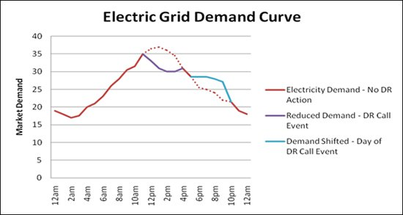
Utility Demand Response Load Profile
Image courtesy City of Glendale, CA
Notes:
Electric utilities may have a demand response program to reward customers who help them limit the market demand on the utility grid. For cooling dominated climates, this period usually occurs on hot summer days in the afternoon as shown in the illustration above. This peak demand period may also occur on cold winter days in those regions of the country that use a significant amount of electric heating.
Some electric utilities offer financial incentives for large building owners to reduce their building’s peak demand when the demand for electricity on the utility grid has the potential to exceed electric supply. These programs are generally called “Demand Response”. The Utility sends a signal to the Building Automation System to initiate the demand response condition. The BAS is programmed to automatically initiate control strategies to reduce building peak demand until such time that the BAS receives a signal from the utility that the demand response condition is over.

Slide 38
Activity 2
Take 15 minutes
Break into groups of 3-4 people
Refer to the multi zone variable air volume system diagram
Answer the questions below
Notes:
Activity 2 – Control Optimization Strategies for a Multi-zone VAV System
You will work in a small group with your classmates to recommend control optimization strategies for a multi-zone VAV system. You will also identify routine maintenance requirements to ensure that the control strategies function properly. Refer to the diagram on the next page and the assumptions about its operation. Discuss with your classmates and answer the questions.
Take 15 minutes
Break into groups of 3-4 people
Refer to the multi zone variable air volume system diagram and assumptions on the following page.
Answer questions 1 and 2 on the following page.
Multizone Variable Air Volume System with
throttling VAV terminal units

Slide 39
Activity 2
Notes:
Activity 2 – Control Optimization Strategies
Assumptions: The system serves a college classroom. The VAV central station air handler contains a hot water coil for heating and chilled water coil for cooling. The VAV terminal unit has a hot water reheat coil. Chilled water is provided by a water-cooled centrifugal chiller with cooling tower. The hot water is provided by a gas-fired boiler. Pumping for both the hot water and chilled water system is constant volume with three-way valves.
Take 15 minutes to answer the following questions:
What are the control optimization strategies you would recommend for this system and central plant?
_____________________________________ _____________________________________
_____________________________________ _____________________________________
_____________________________________ _____________________________________
2. What are the routine maintenance requirements to ensure that the control strategies function properly?
_____________________________________ _____________________________________
_____________________________________ _____________________________________
_____________________________________ _____________________________________
Multizone Variable Air Volume System with
throttling VAV terminal units

Slide 40
Section 3: Control Sequence of Operation
Notes:
A control Sequence of Operation (SoO) is a detailed written narrative of the operation for energy consuming equipment and systems. The SoO should include recommended equipment operational settings for all anticipated modes of operation. If the systems are commissioned, the commissioning provider uses the SoO to document the engineer's design intent and as the basis for functionally testing the equipment and control systems.
Sequences of operation are typically written and implemented by a consulting specifying engineer or a controls contractor on behalf of the building owner. In some cases, a building operator with control system expertise might be called on the write or modify an SoO for equipment in their building, however most building operators do not have the responsibility for developing the initial SoO .
That said, the sequence of operation should be tailored for how the building will be operated, as well as the experience of the facilities maintenance staff. For example, sequences developed for a large casino resort with a full-time, highly experienced, on-site maintenance staff may be more complex than those developed for a small office building with no dedicated maintenance staff. Sequences should always be as simple as possible while still meeting the performance requirements. Unnecessarily complex control sequences can overwhelm even the most experienced operator because they are more difficult to operate and maintain. A lack of operator understanding or a need to override the system may lead to the building operating differently than the designer intended.

Slide 41
Control Sequence of Operation (SoO)
A detailed written narrative of the equipment sequence of operation
Includes recommend settings and setpoints for all modes of operation
Internal verses external SoO
Notes:
The sequence of operation (SoO) is one of the most important design aspects of any HVAC system. Without a proper sequence, the system is left to operate wildly—or not at all. When approached methodically, the process can be broken into smaller segments. Over time these sequences are modified or even over-ridden to address a problem or issue. Often these over-rides are left in place resulting in inefficient operations and increased energy use.
Internal SoO: Internal SoO is provided by the manufacturer and controls the operation of proving and safety equipment including proving switches, gas valves, combustion air fans, high pressure cutout, low pressure cutout, high limit and low limit temperatures, gas ignition systems, etc…
External SoO: External SoO is provided by the building operator and controls the operation of the equipment including start/stop, temperature setpoints, economizer operation, damper operation, mixed air temperature, discharge air temperature reset, and more.
Control
Sequence
of Operation

Slide 42
Where can I find my SoO?
The SoO is commonly found in the following documents:
Plans
Specifications
Control Shop Drawings
O&M Manuals
Commissioning Report
Industry Guidelines
Notes:
Documentation of the control system operation and design intent is critical to verify proper operation of systems. Information on control system components and operating sequences can be found in the following documents:
Building Plans: The mechanical and lighting drawings often include the SoO
Specifications: The Building Controls section of the Specifications often includes the design intent for the building controls and equipment SoO.
Control Shop Drawings: Control shop drawings are provided by the installing control contractor and include a detailed inventory of control system hardware components, control diagrams, and SoO for controlled equipment.
Operations & Maintenance Manuals: O&M manuals typically include manufacturer data for maintenance of equipment and systems as well as internal control equipment and wiring diagrams.
Commissioning Report: Newer buildings may have participated in a formal commissioning process and there may be a Commissioning Report available for review. The Commissioning report will include the SoO for equipment and systems and the results of functional performance testing completed at the time of construction.
Industry Guidelines: ASHRAE Guideline 36 High Performance Sequences of Operation for HVAC Systems. The purpose of this guideline is to provide uniform sequences of operation for heating, ventilating, and air-conditioning (HVAC) systems that are intended to maximize HVAC system energy efficiency and performance, provide control stability, and allow for real-time fault detection and diagnostics.
Where Can I Find My SoO?
The SoO is commonly found in the following documents:
Plans
Specifications
Control Shop Drawings
O&M Manuals
Commissioning Report
Industry Guidelines

Slide 43
Modes of Operation
Occupied
Unoccupied
Holidays
Building warm-up
Building cool-down
Emergency/Fire alarm
Demand response
Others ???
Notes:
The SoO will vary depending on the system and equipment mode of operation which can change depending on the time of day or day of the week. Commonly used modes of operation include:
OCCUPIED: System or equipment operation when the space or building is occupied
UNOCCUPIED: System or equipment operation when the building is unoccupied
HOLIDAY: System operation when the building is unoccupied on a holiday
WARM-UP: System or equipment operation during the transition from unoccupied to occupied mode.
COOL-DOWN: System or equipment operation during the transition from occupied to unoccupied mode.
EMERGENCY: System or equipment operation when the fire alarm is activated or during emergency generator operation.
DEMAND RESPONSE: Strategies for reducing the building’s electrical peak kW demand during a demand response condition.
Modes of Operation
Occupied
Unoccupied
Holidays
Building warm-up
Building cool-down
Emergency/Fire alarm
Demand response
Others ???

Slide 44
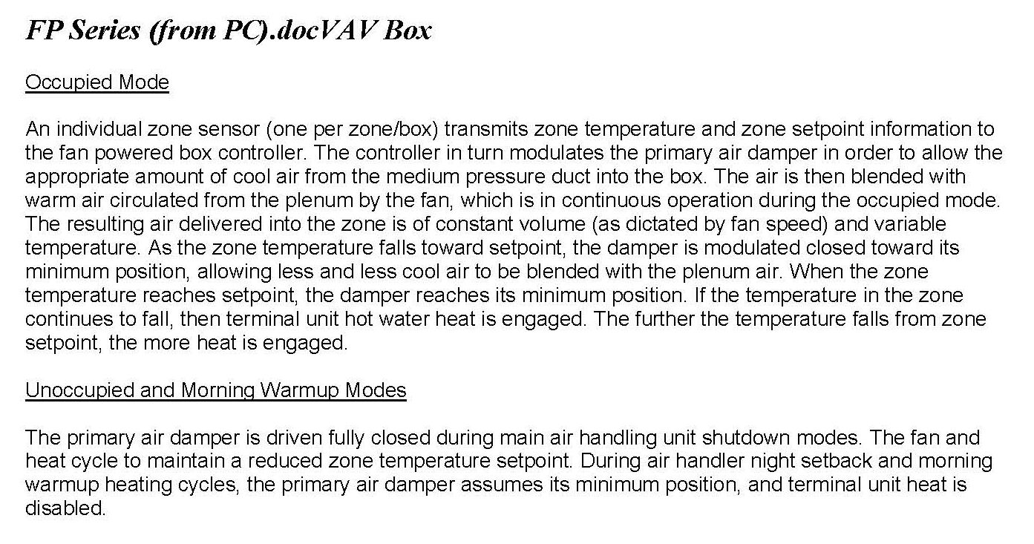
Example SoO
Notes:
Shown here is an example sequence of operation written for a VAV box. Sequences can be written in paragraph form, as in this example, or as a numbered or bulleted list.
Example SoO

Slide 45
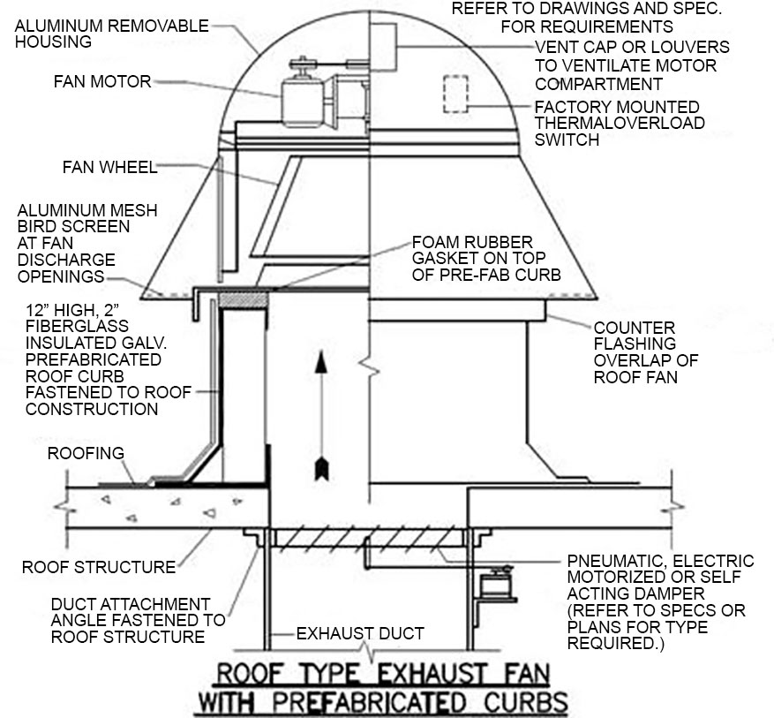
Class Discussion of an Example SoO
Roof mounted exhaust fan for toilet rooms
Building occupied M-F 8am-5pm
Closed Saturday, Sunday and Holidays
Start/stop control by timeclock
Notes:
CLASS DISCUSSION – Sequence of Operation for Exhaust Fan
The instructor will lead a class discussion of an example SoO for a rooftop mounted exhaust fan, EF-1, that serves toilet rooms. It is a simple system and will help us learn more about developing a detailed written narrative of the SoO for the control system.
Identify and list the possible modes of operation for this exhaust fan.
____________________________ ____________________________
____________________________ ____________________________
2. Write out the SoO for each operating mode listed above.
______________________________________________________________________________________________________________________________________________________________________________________________________________________________________________________________________________________________________________________________________________________________________________________________________________________________________________________________________________________________________________________________________
Roof mounted exhaust fan
Building occupied M-F 8am-5pm
Closed Saturday, Sunday and Holidays
Start/stop control by timeclock

Slide 46
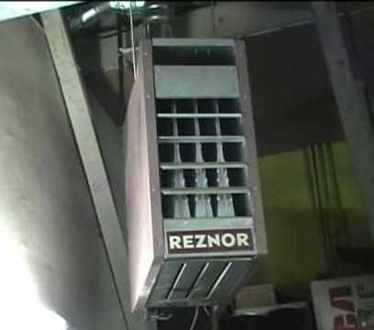
Example SoO
Gas-fired unit heater
Building occupied M-F 6am-5pm
Closed Saturday, Sunday and Holidays
Control via programmable thermostat
Notes:
CLASS DISCUSSION – Sequence of Operation for Unit Heater
The instructor will lead a class discussion of this example SoO for a gas-fired unit heater. These are commonly used in warehouse and shop areas for heating. It is a simple system and will help us learn more about developing a detailed written narrative of the SoO for the control system.
Identify and list the possible modes of operation for this gas unit.
____________________________ ____________________________
____________________________ ____________________________
2. Write out the SoO for each operating mode listed above.
______________________________________________________________________________________________________________________________________________________________________________________________________________________________________________________________________________________________________________________________________________________________________________________________________________________________________________________
_________________________________________________________________________
Gas-fired unit heater
Building occupied M-F 6am-5pm
Closed Saturday, Sunday and Holidays
Control via programmable thermostat

Slide 47
Activity 3
Take 15 minutes
Break into groups of 4-6 people
Write the SoO for the constant volume, single zone air system shown
Notes:
Activity 3 – Sequence of Operation for Single Zone CAV System
This activity prepares you to complete the in-facility project assignment. You will work in small groups to write the Sequence of Operation (SoO) for the single zone constant volume air system with economizer. Review the assumptions below to prepare the SoO.
Assumptions:
The cooling source is chilled water and the heating source is hot water.
The unit has controls for the economizer cooling cycle.
The unit serves a retail space that is open M-Sa 9am – 10pm, Closed Sunday & Holidays
Zone temperature control is by a programmable thermostat without holiday programming capability
Control System Diagram for
Single Zone Constant Volume Air System with Economizer

Slide 48
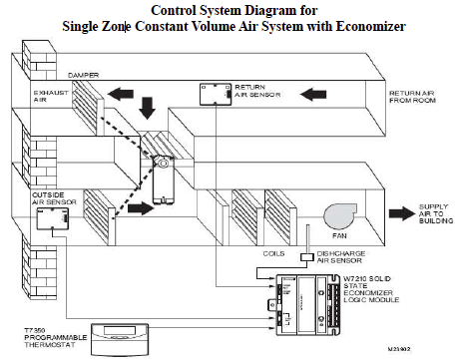
Activity 3
Assumptions:
Cooling: Chilled water
Heating: Hot water
Economizer controls: Yes
Retail hours: Mon-Sat 9a-10p
Closed: Sun/holidays
Zone temp thermostat: No holiday programming capability
Notes:
Activity 3 – Sequence of Operation for Single Zone CAV System
Work in a small group with your classmates. Write the Sequence of Operation for the single zone constant volume air system with economizer. Review the assumptions on the previous page to prepare the SoO. Take 10 minutes to complete the activity, documenting your answers for use in a later exercise. When finished, the instructor will lead a class discussion for 5 minutes.
Operating Mode: OCCUPIED
_____________________________________________________________________
_____________________________________________________________________
__________________________________________________________________________________________________________________________________________
Operating Mode: UNOCCUPIED
_____________________________________________________________________
_____________________________________________________________________
__________________________________________________________________________________________________________________________________________
Control System Diagram for
Single Zone Constant Volume Air System with Economizer

Slide 49
Section 4 - Troubleshooting and Testing Controls
Notes:
In the last section, we discussed sequences of operation (SoO) and the important role of the building operator in monitoring and adjusting the SoO. We also practiced writing SoO’s for simple and complex HVAC systems.
In the next section, we will discuss troubleshooting and testing the control SoO. Without periodic testing, the SoO can drift out of operation. Building operators can play an important role in monitoring the system, identifying operational problems, and taking corrective action.
We will discuss test procedures, diagnostic tools for testing, and how to develop a good functional test procedure.
Section 4 - Troubleshooting and Testing Controls

Slide 50
Verifying the SoO
Functional testing of the SoO (commissioning)
Functional testing methods
Physical observation
Data logging and verification
Trend logging with the Building Automation System
Notes:
Functionally testing the system and equipment SoO on a routine basis is critical to maintain peak operating efficiency. A written functional test procedure (FTP) will help the building operator verify correct operation and also provide a consistent testing methodology for all systems and equipment. Functional testing methods can include some or all of the following methods:
Physical observation of the equipment in all modes of operation
Use of data logging sensors or other diagnostic/monitoring tools.
Use of the Building Automation System to trend log conditions and functionally test operating conditions

Slide 51
Diagnostic Tools
Static measurements
Temperature/humidity
Airflow
Power
Data loggers
Temperature & humidity conditions
Electric motor start/stop times
Air and water pressure
Hydronic system GPM
Notes:
Diagnostic tools and building automation systems (BAS) help the building operator verify that the actual operation of systems and equipment is consistent with the SoO. These tools include instruments for static measurement such as infrared thermometers, vane anemometers, thermal anemometers, flow hoods, hydronic manometers, etc.
Building automation systems with trend logging capability and stand-alone data loggers are useful for verifying control actions and response times.

Slide 52
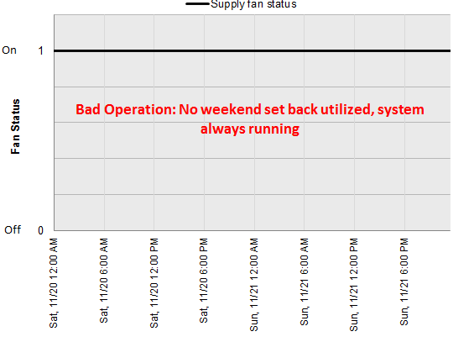
No Night or Weekend Setbacks
Graph of supply fan on/off status for weekend operation with no setback.
Source: Pacific Northwest Lab Building Re-tuning Program
Notes:
This is a graph of the supply fan on/off status for a weekend period with no night or weekend setbacks. The straight blue line indicates that the supply fan is on 24 hours a day, and possibly 7 days a week. No night setback, no weekend setback means lots of room for improvement.
Source: Pacific Northwest Lab, Building Re-tuning Program

Slide 53
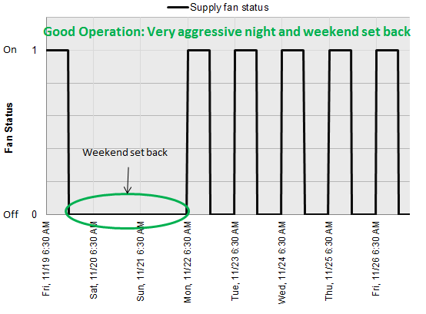
Night and Weekend Setbacks Implemented
Graph of supply fan on/off status for one week period, after night/weekend setbacks implemented.
Source: Pacific Northwest Lab Building Re-tuning Program
Notes:
This is a graph of the supply fan on/off status for a one-week period after night and week-end setbacks were implemented. “On” time indicates where plotline is at 1; “off” time indicates where plotline is at 0.
Source: Pacific Northwest Lab Building Re-tuning Program

Slide 54
Class Discussion: Example Test Procedure
Use the SoO for the rooftop exhaust fan completed earlier
Write a test procedure to verify operation of the fan is consistent with the SoO
Notes:
CLASS DISCUSSION – Write a Test Procedure for Exhaust Fan
The instructor will lead a class discussion for a test procedure for the SoO for the exhaust fan from the previous class activity. Follow along and write answers below.
Operating Mode: OCCUPIED
Test Procedure (list below):
1.__________________________________________________________________________
2.__________________________________________________________________________
3.__________________________________________________________________________
4.__________________________________________________________________________
Operating Mode: UNOCCUPIED
Test Procedure (list below):
1.__________________________________________________________________________
2.__________________________________________________________________________
3.__________________________________________________________________________
4.__________________________________________________________________________
Use the SoO for the rooftop exhaust fan completed earlier
Write a test procedure to verify operation of the fan is consistent with the SoO

Slide 55
Activity 4
Take 15 minutes.
Break into groups of 4-6 people
Use the SoO developed in Activity 3 for the single zone constant volume air system
Develop a checklist to functionally test the SoO
Discuss and list the maintenance tasks required to ensure the equipment continues to perform efficiently
Notes:
ACTIVITY 4 – Functional Test Checklist
This activity will prepare you to complete the project assignment. You have 10 minutes to complete the activity. When finished, the instructor will lead a 5 minute class discussion.
Test Procedure: OCCUPIED MODE
1.___________________________________________________________________
2.___________________________________________________________________
3.___________________________________________________________________
4.___________________________________________________________________
Test Procedure: UNOCCUPIED MODE
1.___________________________________________________________________
2.___________________________________________________________________
3.___________________________________________________________________
4.___________________________________________________________________
List the maintenance tasks required to ensure the controls perform efficiently.
1.___________________________________________________________________
2.___________________________________________________________________
3.___________________________________________________________________
4.___________________________________________________________________
ACTIVITY 4 – Develop a Functional Test Checklist
Take 15 minutes.
Break into groups of 4-6 people
Use the SoO developed in Activity 3 for the single zone constant volume air system
Develop a checklist to functionally test the SoO
Discuss and list the maintenance tasks required to ensure the equipment continues to perform efficiently

Slide 56
Section 5:
Control System Maintenance
Notes:
We have discussed control strategies for optimizing HVAC system performance, sequences of operation (SoO) for typical HVAC system components, and the procedure for functionally testing the control system to ensure the system is operating as required for optimal performance.
In this next section, we will discuss control system maintenance. There are two aspects of maintenance – physical, which involves maintenance of the mechanical parts and hardware in the system - and operational, which focuses on verifying the control system is performing as programmed. Building operators play an important role in each aspect.

Slide 57
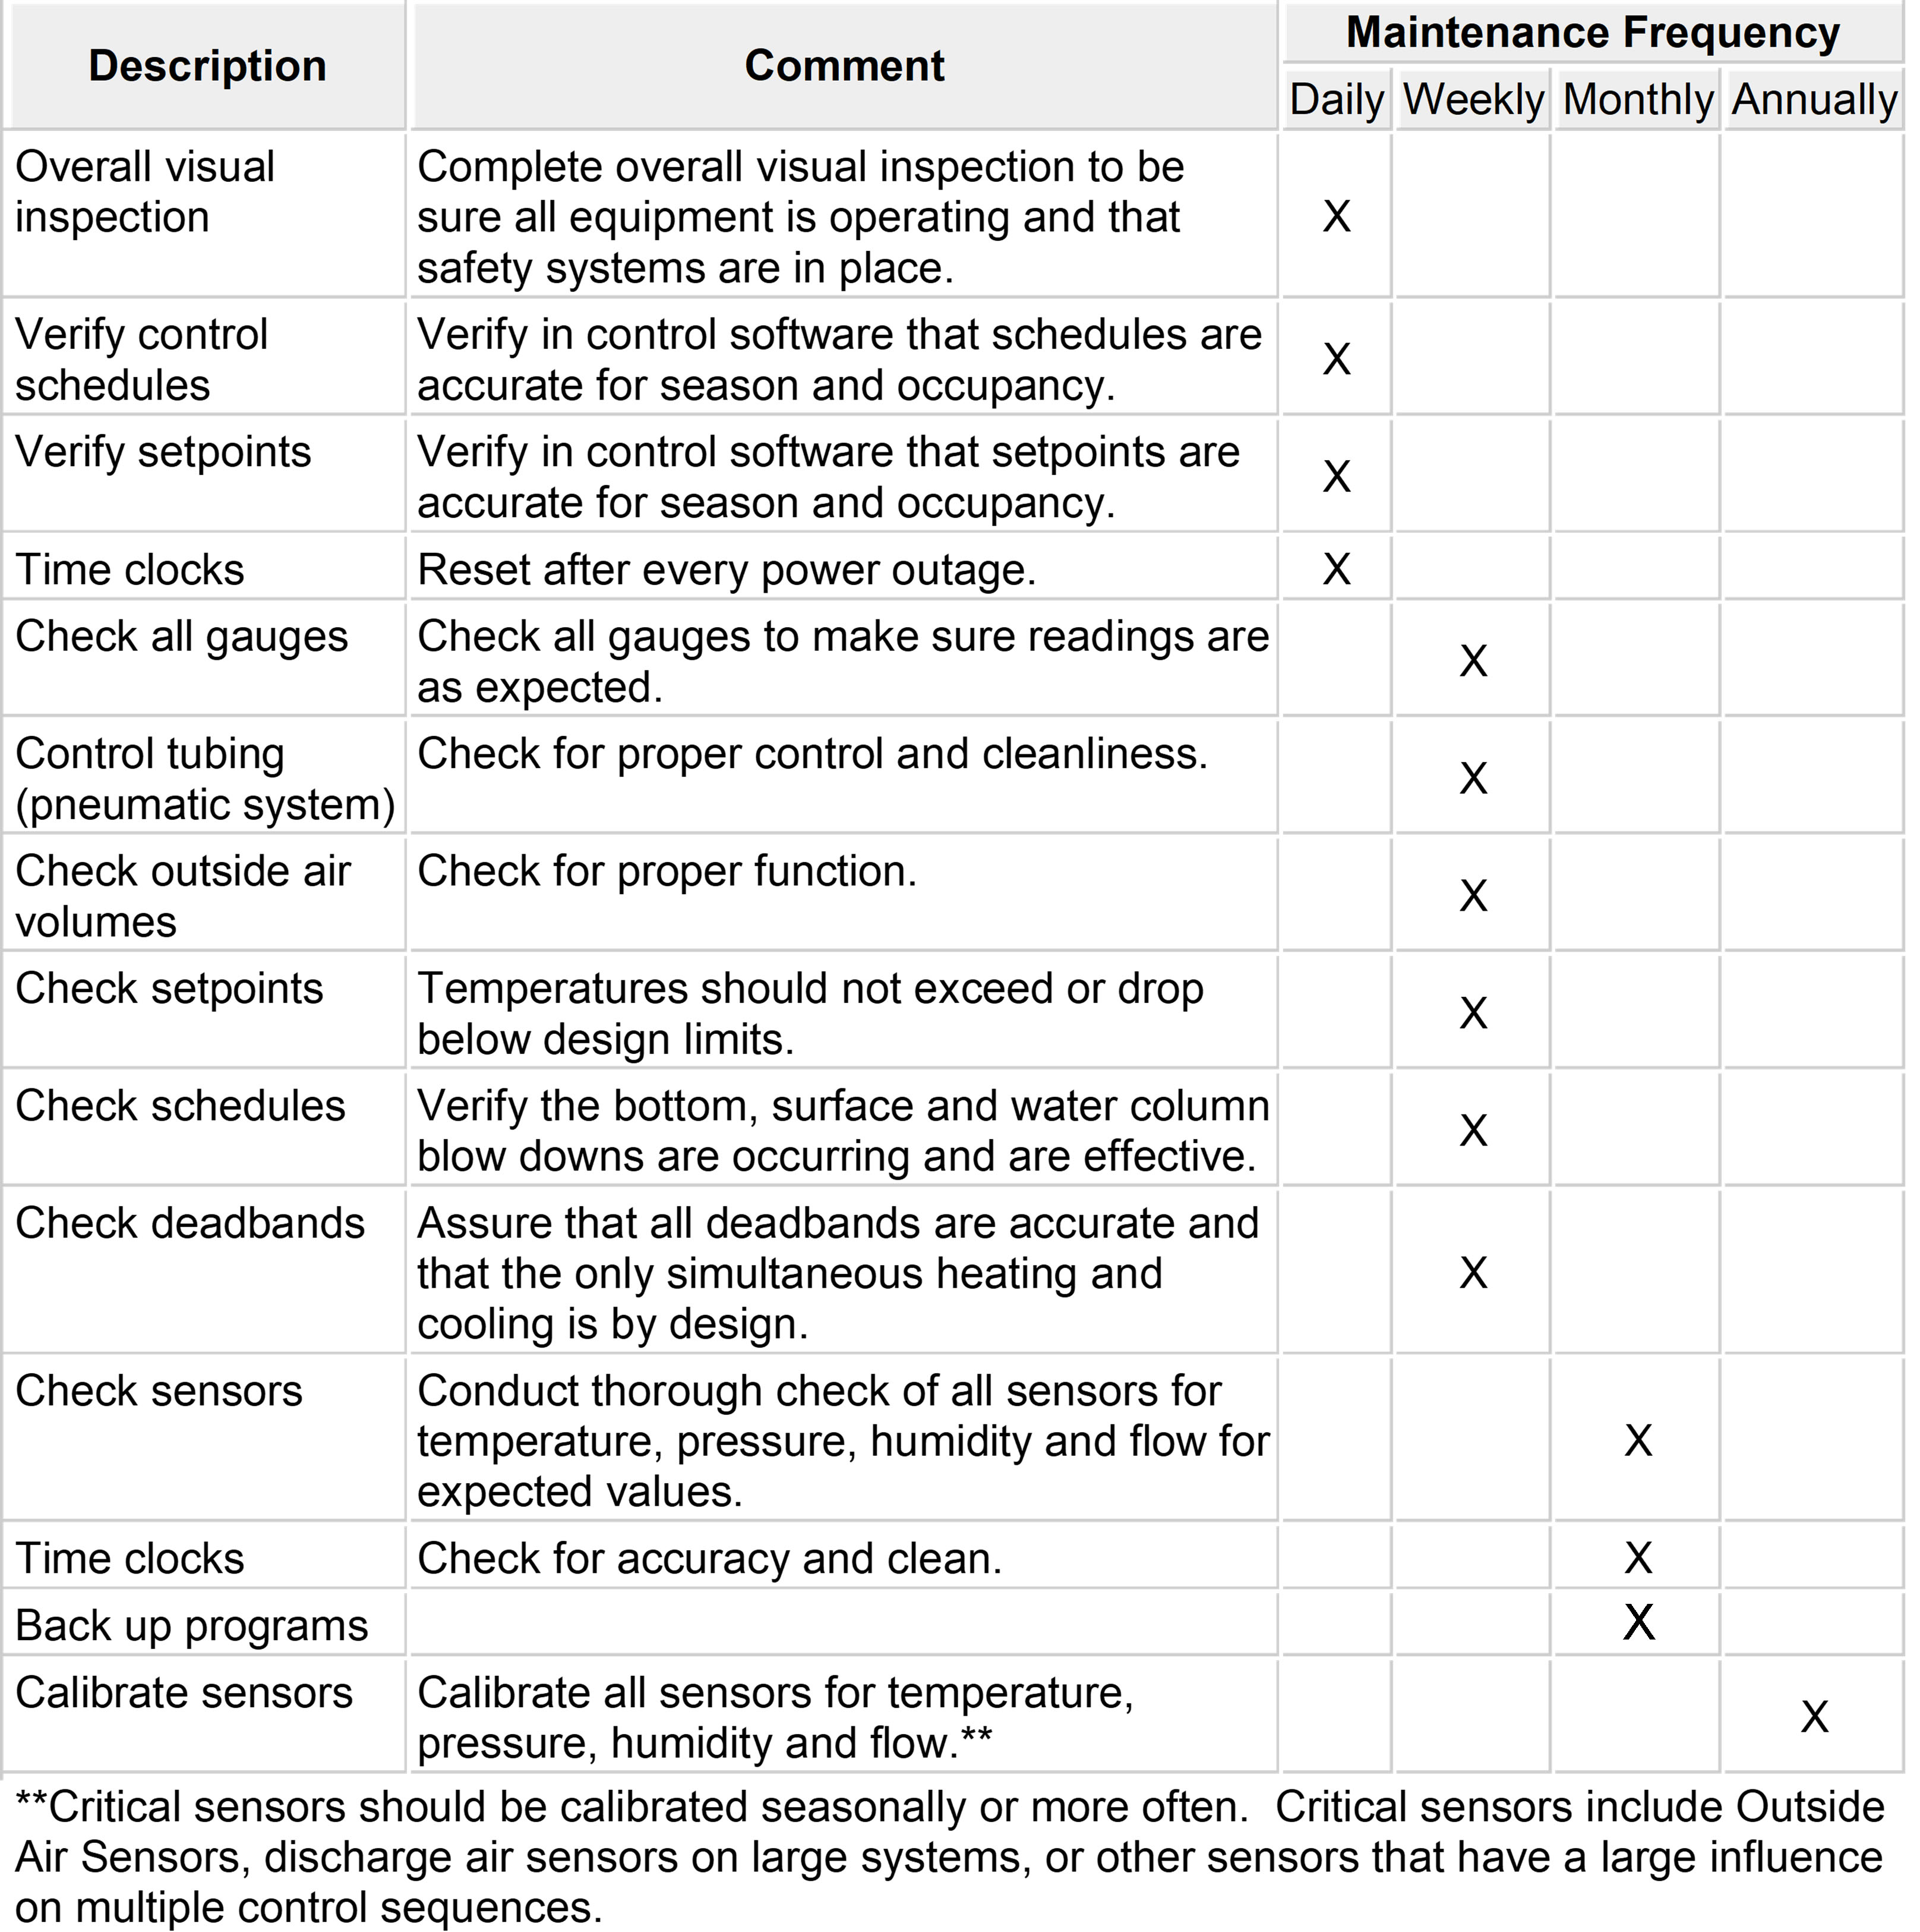
Preventive Maintenance
x
Note: Consult manufacturer before attempting calibration.
Notes:
Good maintenance of the control system is essential to optimal operation and efficiency. Controls require periodic calibration for accuracy. The location of sensors needs periodic evaluation to ensure accurate sensing of the medium. A preventive maintenance checklist based on Control Shop Drawings can be a useful aid in scheduling and performing required tasks.
This sample checklist can be used as a starting point for your own system. This and other information on O&M for control systems can be found at betterbricks.com.
Note: Consult manufacturer before attempting calibration.

Slide 58
Repair Mechanical
Problems
Check for air leaks at damper seals
Lubricate tight or stuck linkages
Adjust damper linkages to fully close on shut down
Replace loose or worn V belts
Check spring ranges when calibrating pneumatic actuators
Notes:
Worn spring operators on damper and valve actuators will affect control system response.

Slide 59
Pneumatic Controls
Listen to compressor
Check run time length
Check tank for water
Check for oil in the water
Inspect and replace all filters as needed
Check output pressures at controllers
Notes:
Listen to the compressor to check for cycle time. Expect 50% on/off time. If the compressor runs too long, it could indicate air leaks.
Check tank for water.
Check for oil in the water. The presence of oil may indicate compressor fatigue.
Inspect and replace all filters as needed.
Check output pressures at controllers.

Slide 60
Sensor Accuracy
& Checkout
Test all critical sensors regularly
Verify reading against accurate reference
Calibrate for zero and span
Re-test and verify upon completion
Notes:
Building control systems rely on the information provided to them by the various sensors throughout the building. Sensors for temperature, light level, carbon dioxide (CO2), and enthalpy (or total energy content of air) are just a few examples. If the critical sensors in a building are inaccurate, the building will not work efficiently, costs will increase, and comfort issues will result. Therefore, it is important for the building operator to test critical sensors regularly.
Verifying sensor accuracy should be done by reading against an accurate reference (for example, an ice water bath, or 4-20 calibrating instruments).
It is advisable to follow the manufacturer's tech sheet recommendations to calibrate for zero and span. Re-test and verify upon completion.

Slide 61
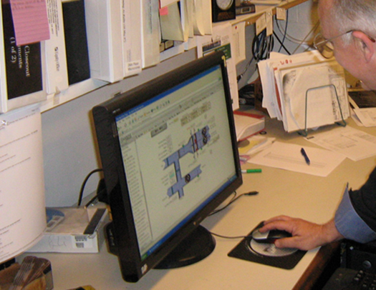
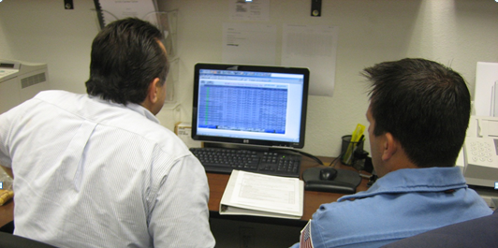
BAS Screen Checks
Observe & document operating conditions
Verify setpoints
Functional testing
Troubleshooting
Trending
Energy efficiency
Notes:
BAS screen checking is a highly cost-effective method of keeping tabs on mechanical equipment performance. We will use simple techniques for quickly reviewing the BAS graphic user interface screens for ongoing equipment optimization and troubleshooting.
BAS Screen Checks
The GUI as a Diagnostic Tool
Verification of GUI Accuracy
Gathering Building Information
Documenting Expected Operation
Screen Check Forms
Screen Check Process
Evaluation of Data
Reporting
Trending
Energy Efficiency
Common Problems
Key Performance Indicators

Slide 62
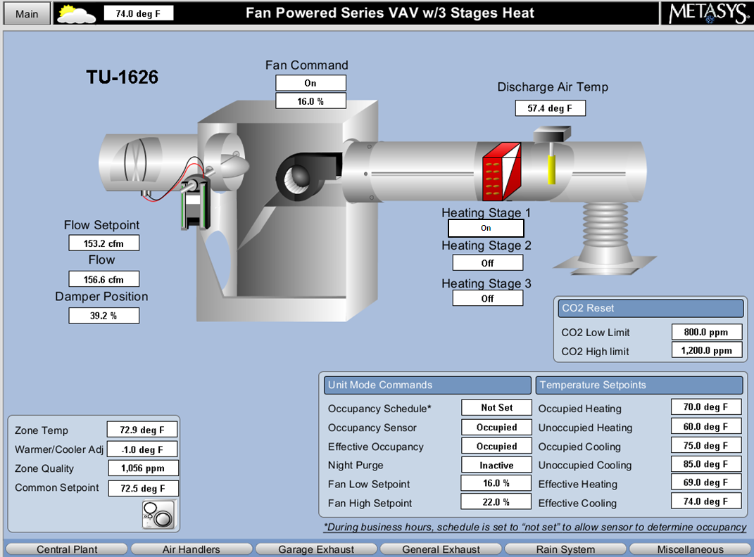
Class Discussion: Example Screen Check
Notes:
Here is a BAS screen capture for a fan powered variable air volume terminal. Nobody is complaining about comfort in the space. The operator is doing a routine BAS screen check of Key Performance Indicators.
1. Given a sequence of operation that states that fan speed should vary linearly between 16 percent (minimum) and 22 percent (maximum) corresponding to CO₂ levels between 800 ppm and 1200 ppm, respectively, what would you expect the fan speed to be at the current operating condition (approximately)?
___________________________________________________________________
___________________________________________________________________
2. Do you see any other potential operational problems with TU-1626? _________________________________________________________________________________________________________________________________________________________________________________________________________

Slide 63

Benefits of the BAS GUI
Use as a maintenance tool
Identify problems proactively
Verify proper HVAC performance
It’s quick!
Image: Williams, Chen & Gray
Notes:
Using the BAS GUI as a maintenance tool is a quick way to identify problems. As explained earlier, experience has shown it only takes two to ten minutes to review a BAS GUI and assess equipment operation and performance. Also, observing problems in this fashion is a proactive way to identify issues before they become a tenant complaint.
Finally, catching operational problems early reduces the energy waste associated with many operational problems. Many of these problems go undetected for extended periods of time.

Slide 64
Control System Tune Up
Ensure the system is operating per the SoO
Ensure critical sensors are calibrated.
Replace/repair faulty equipment
Notes:
Before relying on the BAS, it is important to ensure it can be trusted by verifying its accuracy. This is done with a point-to-point check, which verifies the points are correctly mapped in the BAS. It is also important that the sensors have been recently calibrated. If your building was commissioned, a point-to-point check should have been performed and sensors should be calibrated. These efforts should be documented. But if your building wasn’t commissioned, or if you question the reliability of any previously performed point-to-point check or calibration effort, another one should be performed and documented.

Slide 65
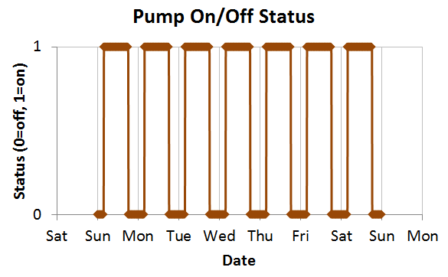
Use Trending to Verify Setpoints
Review trend data when more information is needed to support a screen check
Ability to trend depends on BAS capability
What to trend:
Outside air temperature
Supply air temperature
Hydronic temperatures
Setpoints, etc.
Notes:
The BAS screen gives a snapshot of how the equipment is running at a single point in time. In order to understand system performance over time, it is necessary to use trend data. A trend is a data point that is sampled either over a period of time or based on a change of state. If you note data that doesn’t make sense, appears to indicate problems, or is inconsistent with other data, it is often helpful to examine trends. For example, reviewing trend data over a full 24 hour day can tell you what is happening with the system at night. This will allow you to verify that equipment shuts off after hours as it should, temperatures are reset as expected, pressure sensors are calibrated, and more.
As another example, consider that you note a high building static pressure during an air handler screen check. With minimal trending, you can see whether the static pressure is always that high, whether it drops to near zero when the air handling unit is off, whether it’s related to the operation or failure of some exhaust fan, whether it is a recurring or one-time event, etc.
Your ability to review trend data to support your BAS screen check effort depends on the characteristics of your BAS system.

Slide 66
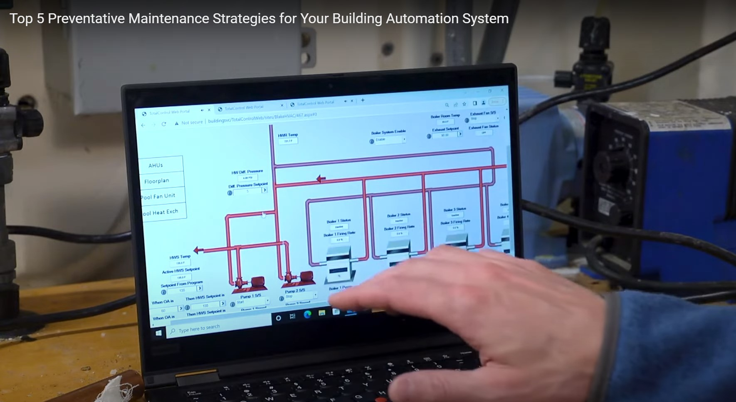
Video – Top 5 Preventive Maintenance Activities
Notes:
This video from Slipstream (approx. 8 minutes) demonstrates five of the most cost-effective BAS preventive maintenance strategies to improve occupant comfort and system performance and reduce wear and tear on equipment.
Video link: https://www.youtube.com/watch?v=xuvM0FP72gM

Slide 67
Section 6:
Advanced
Building Controls
Notes:
There have been profound advancements in building control systems in the last 20 years. The internet and web-based applications have had a significant impact on the way building operators interact with their building systems. Let’s discuss some examples of advanced building controls that have become increasingly adopted in both new buildings and as retrofits to existing buildings.

Slide 68
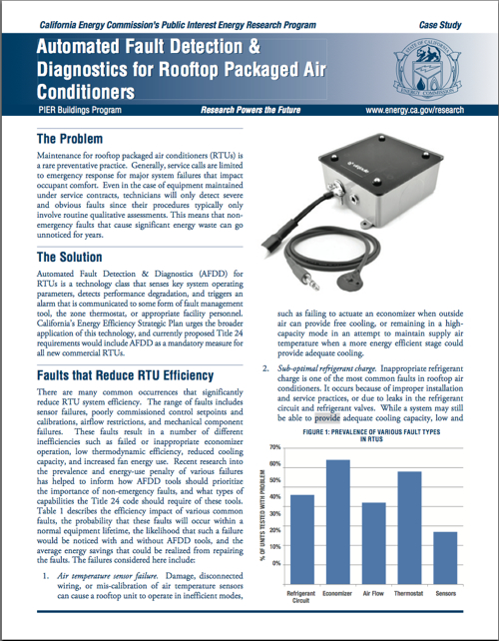
Economizer Fault Detection & Diagnostics
FDD system typically includes:
Temperature monitoring
Manual initiation capability for each operating mode
System status of operational variables
Fault reporting accessible to service personnel
Notes:
State energy codes are increasingly requiring that package rooftop air-conditioning units with economizer cooling be provided with automatic fault detection and diagnostics. These systems can be provided through OEM suppliers and to retro-fit existing systems. The objective of this requirement is to maintain peak performance of the economizer system over the life of the equipment
The Fault Detection & Diagnostics (FDD) system monitors mixed air temperature, damper position(s), refrigerant pressure, and heating/cooling status. When there is an anomaly (such as the outside air damper does not open in economizer mode), there is a fault code generated. The building operator can then troubleshoot the issue during routine preventative maintenance and correct the problem. Additionally, the FDD system allows the operator to over-ride the control system to verify correct operation of the system in different modes of operation.
ECONOMIZER FAULT DETECTION & DIAGNOSTICS
FDD system typically includes:
Temperature monitoring
Manual initiation capability for each operating mode
System status of operational variables
Fault reporting accessible to service personnel

Slide 69
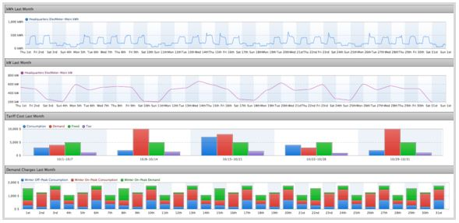
Monitor Based Commissioning
Continuous monitoring of system equipment and controls
Uses BAS generated real-time trend data
Automatic fault detection based on customized rule sets
OEM & Third-party solutions
Notes:
Building automation systems (BAS) are capable of generating large amounts of data that can be used to continuously monitor system operations. This data includes temperature conditions, control actions, control response, equipment operations, and building efficiency. A growing trend in the controls industry is to harvest this data in real time to monitor the performance of system. A set of custom rules is defined for each system depending on system type and equipment. When the monitoring system identifies a “fault” it notifies the building operator. Faults can be ranked in order of importance to maximize efficient use of the building operator’s time and resources.
Another feature of these monitoring systems is the capability of initiating diagnostic routines. For example, once per month during the building warm-up period or cool-down period the fault detection system can command the VAV primary air damper to close to zero CFM and record the CFM airflow. If the CFM value is significantly greater than zero the operator is notified that the primary air damper needs adjustment. Alternately the diagnostic routine can command the primary air damper to 100% open and record the CFM value and compare the design primary CFM value.
Monitor based commissioning systems are being offered by OEM control manufacturers as well as third-party service providers. These services are often provided via a subscription service.

Slide 70
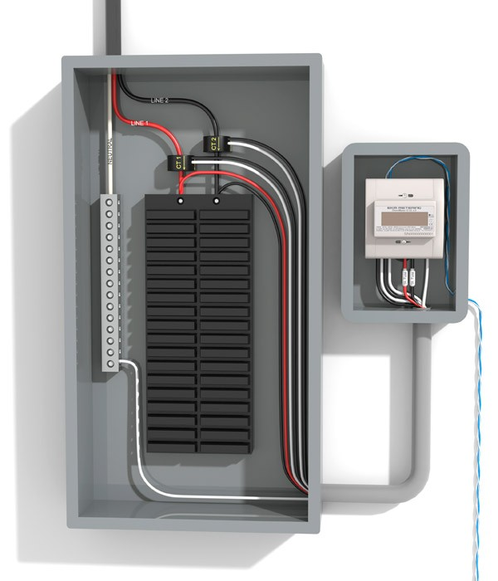
Sub-Metering
System level metering
Heating & cooling equipment
Fans and pumps
Lighting panels & fixtures
Plug loads
Renewable energy systems
Monitor and track energy
Use in real-time
Notes:
Sub-metering of building equipment and systems is an effective way of managing the energy consumption at the equipment level rather than at the building level. Electrical panels can be easily sub-metered to monitor the energy use of heating & cooling systems, distribution systems (fans & pumps), lighting systems and miscellaneous loads. Some boilers and chillers now come standard with Btu meters to allow measurement of system performance and operating conditions in real time. Sub metering provides the building operator with the information required to monitor and evaluate building system performance and evaluate energy savings strategies.
The latest building energy efficiency standards such as California’s Title 24 Part 6 standard now require building electrical loads to be separately metered per load such as lighting, HVAC, plug loads, water heating and pumps, conveyance (elevator/escalator), EV charging stations, etc.

Slide 71
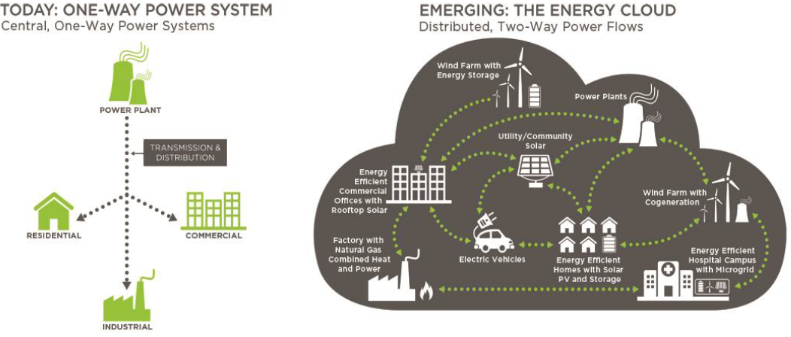
Distributed Energy Resources (DER)
Combined Heat/Power/Cooling (CHPC)
Solar PV
Wind
Battery and Thermal Energy Storage
Notes:
Distributed Energy Resources are small scale energy generation units generally found at or near the energy load they serve. There is a growing trend in the increase of DERs particularly from clean renewable sources such as Solar PV and Wind Turbines. Other forms of DER are as follows:
Turbine Generators Combined Heat and Power (CHP)
Internal Combustion Engines (IC)
Battery Energy Storage
Thermal Energy Storage
New buildings in many jurisdictions are now required by code to be solar ready and incorporate energy monitoring. Manufacturers are now equipping control systems to be capable of both.

Slide 72
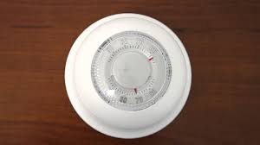
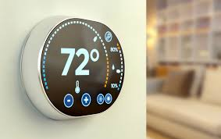
Machine Learning
Artificial intelligence (AI)
Data-based
Automatically learns and improves from experience
“dumb” thermostat
“smart” thermostat with AI
Notes:
Machine learning is an application of artificial intelligence (AI) that provides systems the ability to automatically learn and improve from experience without being explicitly programmed. Machine learning focuses on the development of computer programs that can access data and use it to learn for themselves.
Traditionally, building control systems have typically not employed AI capabilities. System controls and controlled devices react to operating conditions and do not incorporate past experience, other than the operator using their experience to fine-tune system settings. Systems using AI can anticipate building conditions based on previous “learned’ outcomes. These systems can initiate control action in advance and maximize the performance of systems.
These applications of AI in building systems are continuing to develop and are increasingly being deployed in “smart” building technology.

Slide 73
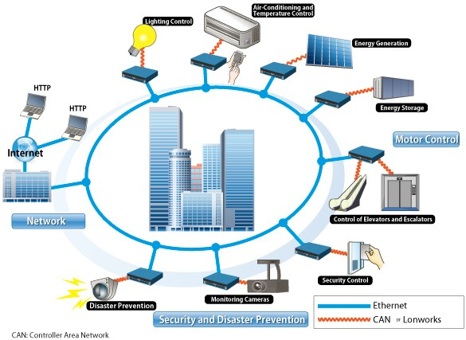
Smart Buildings
Notes:
“Smart buildings” utilize the data science from multiple platforms to improve building performance. These platforms are not limited to the to the HVAC Building Automation System data and can include:
Note: a building doesn’t necessarily need to be the newest and most modern to be equipped with or have potential for aspects of smart building technology.

Slide 74
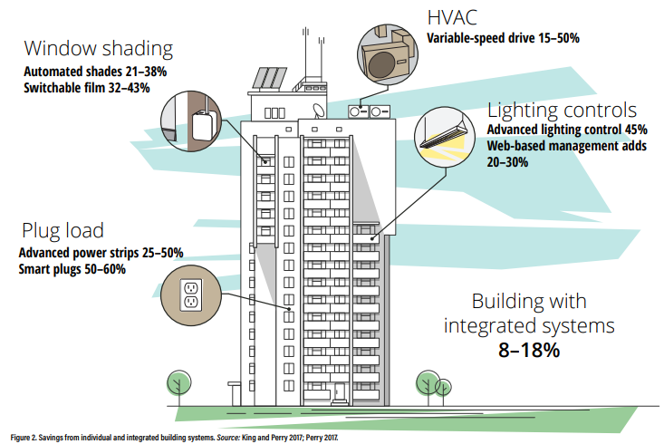
Integrated Building Systems
Optimized Energy Performance
Notes:
Smart Buildings have the capability for sustained and highly energy efficient performance due to their ability to integrate and coordinate building systems that are traditionally operated independently or in stand alone mode. According to a study by the American Council for an Energy Efficient Economy, buildings with integrated systems can save 8-18% of whole building energy consumption*. This integration can be made through software and using standard communication protocol to enable systems to communicate via common established standard. Most integrated building systems use one or more of the following communication protocols to share and pass along data to be used for integrated controls:
BACNET
MODBUS
LONWORKS
DALI
Enocean (wireless)
Zigbee (wireless)
Source: American Council for an Energy Efficient Economy, Achieving Deeper Energy Savings Through Integrated Building Systems, https://www.aceee.org/sites/default/files/eo-smart-buildings.pdf

Slide 75
Section 7:
The Future of
Building Controls
Notes:
We have discussed the profound advancements in building control systems in the last 20 years. The internet and web-based applications have had a significant impact on the way building operators interact with their building systems. What does the next 20 years look like? The following slides provide an overview of the direction building controls technology is taking now and continuing into the near future.

Slide 76
The Modern Energy Grid
Image Source: DOE Grid Interactive Buildings/Navigant
Notes:
Today’s electric grid has been transformed from a centrally sourced power generation and one-way power flow to a distributed and decentralized power grid where energy generation sources are located at or near the load that they serve and where power flows in multiple directions anywhere on the grid. Another key feature of the modern grid is the ever-increasing number and capacity of distributed energy generation from variable renewable sources and energy storage. Smart Buildings will play a critical role in the success of the new smart grid by providing load flexibility enabled by smart building technologies.

Slide 77
Role of Smart Buildings
in the Modern Grid
Reduce energy load (Automated Demand Response)
Provide load and resource flexibility
Serve as shock absorber
Serve as clean energy resources
Provide critical grid services
Notes:
Due to environmental, economic, and climate policy, jurisdictions across the nation are developing and adopting energy codes and policies to reduce energy consumption, generate savings, and reduce greenhouse gas emissions. As a result, the installation and deployment of renewable energy sources are experiencing historical growths. The modern energy grid is now comprised of Distributed Energy Resources (DER) such as wind, solar, and battery energy storage. With increasing DERs the resource variability has also increased due to abundant renewable generation resources during daily periods of low demand and the requirement for traditional generation during daily periods of high demand. Smart Buildings with the technology to reduce and shift their energy loads can provide the flexibility that the grid needs to compensate for resource variability and availability.
DERs
Variable Energy Sources
Generation vs Demand Timing Mismatch
The need for Grid Flexibility

Slide 78
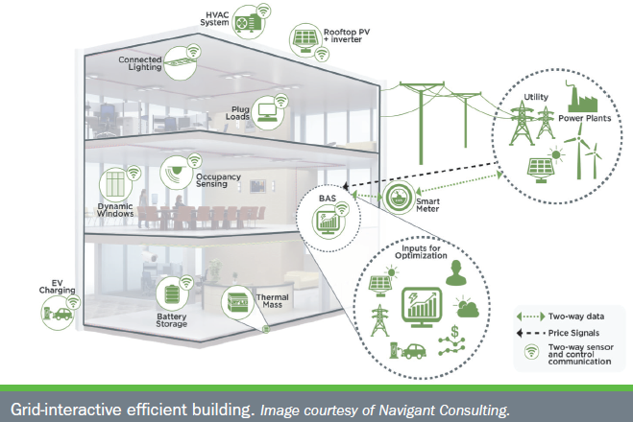
GEB Smart Technologies
Image Source: DOE Grid Interactive Efficient Buildings
Notes:
Grid-interactive Efficient Buildings (GEBs) represent a class of high performance buildings that are energy efficient and are capable of dynamically responding to the demands of the modern grid. These type of buildings are equipped with smart building systems that are integrated and configured to deliver grid demand flexibility. This means GEBs are capable of multiple modes of operations depending on what the grid needs. For example, GEBs are capable of ramping down their DER when there is sufficient supply on the grid or absorbing power from the grid when there is abundant energy supply. GEBs can financially benefit from these capabilities by providing grid services and from energy cost savings.

Slide 79
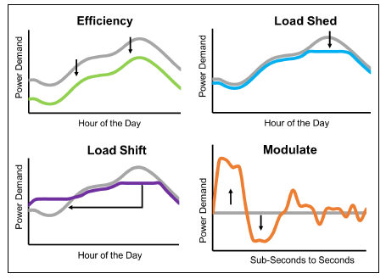
How building load profiles from demand flexibility benefits the grid: - Efficiency - Load Shedding - Load Shifting - Modulation
Demand Flexibility
Image Source: DOE Grid Interactive Efficient Buildings
Notes:
Grid-interactive Efficient Buildings can benefit financially from demand flexibility by controlling their load profiles based on the need of the grid. The value of building demand flexibility can be monetized by utilities or third party aggregators to deliver the following grid services:
Energy Efficiency
Load Shed
Load Shift
Modulate

Slide 80
Grid-interactive Efficient Buildings Demand Reduction Scenario
System Operator
Monitors Grid Conditions
Utility
Triggers Demand Response (DR) Program
GEBs
Forecasts Supply vs Demand
Issues Notification and Alerts for Demand Response
Receives Signal to Reduce Demand
Issues Third Party Aggregator DR Programs
Receive DR signal from Utility or 3rd Party Aggregator
Trigger Automated Demand Reduction Measures
Utilize DER or Energy Storage to meet local demand
Notes:
Regional power grids are typically managed by system operator entities. In California, the ISO or Independent System Operator is the party responsible for managing how power flows into and out of the state electrical system. In case of a projected generation shortfall due to increase in demand or shortage of generation, the ISO sends notifications to load serving entities such as local utilities to initiate their load demand reduction programs. One example of a load demand reduction program is ADR or Automated Demand Reduction which sends a signal to customers to initiate local demand reduction measures. For GEBs, this signal is automatically processed by the building EMS and triggers local demand reduction measures such as the following:
Shutdown major electric equipment i.e. chillers, cooling towers, AC Equipment
Adjust/lower zone setpoints
Adjust window shading systems
Enable thermal storage
Control DER such as Battery Energy Storage to discharge to supply local power and lower demand from the grid
Grid-interactive Efficient Buildings can process utility signals for demand reduction or even power take-up when the electrical grid must get rid of extra grid capacity making GEBs essential parts of the modern smart grid.

Slide 81
Common Demand Reduction Measures
Building pre-cooling
Zone level setpoint reset
Turn off or lower lighting levels in empty or non-critical spaces
Turn off non-essential loads i.e. water fountain pumps, signage/marquees
Turn off large cooling equipment i.e. chillers, compressors
Enable thermal or battery energy storage
Shut down or shift production times
Notes:
Smart Buildings can help relieve the electrical grid during periods of capacity shortages or transmission constraints by participating in demand response programs directly with local utilities or through third party aggregators. Organizations can financially benefit from DR programs based on the amount of capacity enrolled and actual demand reduction during DR events.

Slide 82

Demand Response and the Modern Grid
Image source: https://sitn.hms.harvard.edu/flash/2017/multitude-technologies-needed-electricity-storage/
Notes:
Demand response is further enabled by modern communication and energy technology resources, sometimes referred to as the Internet of Energy (IOE). Here we can see that solar and energy storage, on the left, are not nearly as effective as they could be with demand response applications (i.e. behaviors, technologies, policies, incentives, etc).
Image source: https://sitn.hms.harvard.edu/flash/2017/multitude-technologies-needed-electricity-storage/

Slide 83

Energy Storage
Image source: https://www1.eere.energy.gov/buildings/pdfs/80376.pdf
Peak period electrical energy consumption in residential and commercial buildings for major end uses.
Notes:
Currently, seasonal peaking load is met primarily by fossil fuel based electrical generation plants with long-term fuel storage capacity. In the U.S., natural gas is the primary heating fuel for a large share of buildings (42% of commercial and 49% of residential), so in most regions the seasonal peak electrical consumption on the grid is in the summer for electric cooling. Modeling shows that the electrification effort underway will eventually result in a switch from summer to winter peaking as a result of shifting the heating load from fossil fuel-based equipment to electrical equipment.
DERs and onsite energy storage will be required as a replacement to meet the seasonal peaking fluctuations without fossil fuels. Energy storage comes in many forms but the most common deployed in buildings are:
Thermal storage
Electrical storage (electrochemical batteries, capacitors)
Technology in both thermal and electrical storage continues to evolve quickly, as there is a concerted research and development (R&D) effort underway at a federal level to overcome technical and market barriers to more widespread adoption.
Source:
https://www.nature.com/articles/s41598-022-15628-2

Slide 84


Thermal Energy Storage
Image source: https://www.pnnl.gov/thermal-energy-storage-system
Notes:
Because almost 50% of building energy demand consists of thermal end uses (space cooling/heating, water heating, refrigeration), thermal energy storage (typically in the form of ice or hot water produced during off-peak hours) can be a good solution to buffer demand from the grid. Thermal storage can provide flexibility to shift or shed loads, resulting in better grid reliability and energy cost savings. Thermal storage can also provide increased thermal comfort for occupants and can contribute to heat pump performance and affordability.
Step 1
During night time, off-peak hours, water that contains 25% ethylene or propylene glycol is cooled by a chiller. That solution circulates inside the heat exchanger within the Icebank tank, freezing 95% of the water that surrounds the heat exchanger inside the tank. The water surrounding the heat exchanger never leaves the tank.
Step 2
Ice is created uniformly inside the tank in this case, using counter-flow-heat exchanger tubes. As ice forms, water still moves freely, which prevents damage to the tank. To fully charge this type of tank takes from six to 12 hours.
Step 3
During the day-time on peak hours, the glycol solution circulates through the ice storage tanks to deliver the stored energy to the building to augment or offset electric chiller cooling. The cold glycol is delivered at the proper temperature to the cooling coil in an air handler.
Step 4
A fan blows air over the coils to deliver cooling to the occupant spaces. People feel cool and comfortable and never know ice storage is being used to save money on cooling costs.
Sources:
https://www.nature.com/articles/s41598-022-15628-2
https://www.energy.gov/eere/buildings/thermal-energy-storage
https://betterbuildingssolutioncenter.energy.gov/sites/default/files/attachments/BB%20Energy%20Storage%20Guide.pdf
http://www.calmac.com/how-energy-storage-works

Slide 85

Electrical Energy Storage
Battery energy storage system paired with a solar PV system at the AES Lawai Solar Project in Kauai, Hawaii
Image source: NREL
Notes:
Electricity can be stored for later use when needed. Electrical energy storage in commercial applications are typically either electrochemical batteries or capacitors. The most common electrochemical technologies are advanced lead acid, lithium ion, and flow batteries. Lead acid batteries are relatively low cost and are often used for renewables integration, demand charge management, and backup power. Lithium ion batteries have good power, energy density, and cycle life and are typically used for renewables shifting/smoothing, demand response, and demand charge management. Flow battery chemistries include zinc bromine and vanadium redox and are used for long duration (>4 hour) energy shifting or backup power.
Capacitors (also known as “supercapacitors” or “ultracapacitors”) don’t use a chemical process, but rather they store potential energy electrostatically. They are capable of discharging small bursts of power, can store energy for very long periods and can be charged up repeatedly without a degradation in voltage. Batteries, on the other hand, lose voltage capacity over time and use. Capacitors are used for voltage or reactive power control (for example, in electric motors), frequency regulation, renewable smoothing, and wind turbine pitch control.
Sources: https://betterbuildingssolutioncenter.energy.gov/sites/default/files/attachments/BB%20Energy%20Storage%20Guide.pdf
https://www.energy.gov/eere/solar/solar-integration-solar-energy-and-storage-basics

Slide 86

EVs as DERs
Image source: https://www.energy.gov/eere/femp/bidirectional-charging-and-electric-vehicles-mobile-storage
Notes:
The International Energy Agency (IEA) conservatively estimates that 130 million electric vehicles (EVs) will be on the road globally by 2030. As the number of EVs grows and especially as larger trucks and buses electrify with larger batteries, there will be opportunities to use those batteries to also support the grid.
Bidirectional plug-in electric vehicles (PEVs) present immense potential for increasing the country's energy security, resilience, economic vitality, and quality of life while supporting the electrical grid. A bidirectional EV fleet could serve as both a sustainable mobility option as well as an energy storage asset that sends power back to everything from critical loads and homes to the grid. A bidirectional fleet could also create new revenue opportunities for EV owners or fleets.
Sources:
https://www.energy.gov/eere/articles/department-energy-announces-first-its-kind-collaboration-accelerate-vehicle
https://eepower.com/news/using-ev-batteries-as-renewable-energy-storage-for-office-buildings/#
https://www.energy.gov/eere/femp/bidirectional-charging-and-electric-vehicles-mobile-storage
Image source: https://www.energy.gov/eere/femp/bidirectional-charging-and-electric-vehicles-mobile-storage

Slide 87
Class Discussion: Smart Building Technology
What is your experience with smart building technology in your building?
Have you used fault detection and diagnostics?
How will this technology affect your job in the future?
Have you used social media to communicate with building occupants?
What is your experience with renewable energy and energy storage systems?
Notes:
The instructor will lead the class in a discussion of smart building technology. This discussion will take 10-15 minutes. Share your experiences with the class.

Slide 88
Section 8:
Resources, Class Review,
Project Assignment, Presentation Skills
& Test
Notes:
We are coming to the end of today’s class on Optimizing HVAC Controls for Energy Efficiency. In the last remaining slides, we will review the primary topics and learning objectives. There is a project assignment on HVAC controls which you will complete at your own facility following today’s class. Your instructor will review the assignment to prepare you to complete it successfully.
We will finish the day with an open-book test administered by your instructor.

Slide 89
Recommended Resources
Control Systems for Heating, Ventilating, and Air Conditioning 6th Edition by Roger Haines and Douglas Hittle, Springer Publications
DDC Online http://ddc-online.org
HVAC Controls by Ron Auvil, ATP Publishers
Honeywell Automation Controls Manual

Slide 90
Review Learning Objectives
Refresh knowledge of HVAC control fundamentals
Describe control strategies for optimizing building performance
Write a sequence of operation (SoO)
Write a procedure for testing the control system
Identify control system maintenance steps
Identify future trends in building controls
Prepare to complete the project assignment
Notes:
Learning Objectives
After this class, an operator should be able to:
Refresh knowledge of HVAC control fundamentals
Describe control strategies for optimizing building performance
Write a sequence of operation for HVAC
Explain a procedure for testing the control system
Identify control system maintenance steps
Identify future trends in building controls
Prepare to complete the project assignment

Slide 91

Project Assignment
Open your Project Workbook
Three parts:
Write a sequence of operation
Write a functional test procedure
Create maintenance checklist
Notes:
Level II Project Workbook
Open your Level II project workbook.
Turn to Assignment 4 - HVAC Control System Sequence of Operation and Functional Test Procedure.
This assignment has three parts. You will:
Write a sequence of operation for an air handler in your building.
Write a functional test procedure for verifying proper operation of the SoO.
Create a checklist for maintenance of the system.
Complete each part of the assignment for full credit.

Slide 92

Presentation Skills Quick Review
Practice your presentation skills in BOC 2005 class
Present your building scoping report
Classmates are your audience
Approx. 10 minute presentation
Let’s prepare together
Notes:
BOC 2005 is the final class in the Level II course series, titled Project Peer Exchange: Present your final report. It will be a fun and engaging day.
Students will practice giving short presentations to classmates on the building scoping report they prepare for their building. The building scoping report is Project Assignment #5 in the Project Workbook. Each student will have about 10 minutes to present their report.
Presentations offer students the opportunity to practice communication skills and to share feedback with their peers. Following presentations, the class will wrap up with a discussion of effective strategies for presenting the scoping reports to management and winning support for their recommendations. Students attending this class will understand how to prepare and deliver an informative and coherent presentation on their building’s performance.
Look at your schedule to find the date of the BOC 2005 class. There is plenty of time to prepare your presentation, and we will help you by allotting time in each class to learn about ways to organize and deliver good presentations.

Slide 93
Activity 5 – Your experience giving a presentation
(15 minutes)
Think about a time you gave a presentation
Told a joke
Gave a talk in your kid’s class
Made a toast at a celebration
Introduced yourself in job interview
Read the questions below and write your answers
Compare answers with your partner
Share one of your answers in the class “report out”
Notes:
Most of us have experience giving a presentation. For example, we may have told a joke at a party or made a toast at a wedding. Maybe we introduced ourselves in a job interview or to a new boss. Some of us may have given a talk in our kid’s class. These presentations may have been informal and short in length, but we had to take the same preparation and delivery steps we would for a more formal presentation.
Take 5 minutes to think about a time you gave a presentation. Answer these questions, then share with your partner.
1. What was the purpose of your presentation? _________________________
2. Who was your audience? __________________________________________
3. How well did you know the topic? __________________________________
4. How did you prepare? (e.g., wrote it? had pictures? practiced it aloud?
____________________________________________________________________
5. What was the outcome? (e.g., had fun, made friends laugh, helped my child, helped my spouse, got the job)
____________________________________________________________________
6. What did you learn from the experience? What would you do differently?
____________________________________________________________________

Slide 94
Video – Project Presentation Example
Watch the video – 9.5 minutes
Answer the 6 questions on the notes page
Discuss as a class
What was the purpose of his presentation?
Was he prepared?
How well did he know the topic?
Notes:
2005 Project Peer Exchange example video - https://vimeo.com/778248311/153fbe3755
1. What was the purpose of DJ’s presentation? (e.g., informative, instructional, persuasive, decision making)
_______________________________________________________
2. Who was his audience?
_______________________________________________________
3. Was he prepared? How well did he know the topic? _______________________________________________________
4. What did you like about his delivery?
_______________________________________________________
5. Did the delivery fulfill the purpose of the presentation (see #1 above)? Why or why not?
_______________________________________________________

Slide 95
Our Experiences With Presentations
We knew our audience
We knew the purpose and topic of our presentation
We prepared in advance
We had fun and learned some things
We will do it again
Notes:
As you look ahead to preparing and delivering your final presentation in BOC 2005, reflect on your past experience with presentations. What made your past presentations fun and effective?
You knew the audience
You knew the topic and purpose
You were prepared
You enjoyed doing it
There is plenty of time, and we will help you by allotting time in each class to learn about ways to organize and deliver good presentations. In the next class, we will discuss the various elements of an effective presentation.

Slide 96
BOC 2002 Test
Your instructor will distribute the test and review the instructions, or you will use the Learning Management System to complete the test online.
The test is open book.
Work independently to answer the questions.
If taking a written test, provide your answers on the answer sheet, not the test booklet.
You have one hour to complete the test.
Notes:
Your instructor will distribute the test and review the instructions. The test is designed to review the important content prescribed by the learning objectives and covered during the class day.
The test is open book. You have one hour to complete the test.
You will work independently to answer the questions. Teaming up with a classmate is not permitted.
Provide your answers on the answer sheet, not the test booklet.
Your instructor will be present throughout the test period to answer questions. He/she will clarify the questions, if needed, but may not provide the answers to any questions under any conditions.
Upon completion of the test, you may return the test booklet and your answer sheet to the instructor or your course manager.
The test will be graded following the class, and your score will be provided to you no later than at the next scheduled class in the BOC course series.
Good luck!

