Slide 1

BOC 2005 Project Peer Exchange: Presenting your final report
Month Day, Year Instructor Name, Position
Instructor Company
Phone Name@email.com
Notes:
Instructor’s name: __________________________________________________________
Phone number: ____________________________________________________________
E-mail: ___________________________________________________________________
_________________________________________________________________________
_________________________________________________________________________
_________________________________________________________________________
_________________________________________________________________________
BOC 2005 Project Peer Exchange:
Presenting your final report

Slide 2
Agenda
Welcome and introductions
Warm up activity
Roles & room set up
Presentations and debrief
Presenting your report to management
Wrap up and adjourn
Notes:
Class Overview
We will practice presentation skills by delivering a short presentation to classmates and the instructor on a scoping report for their building. The report is the culmination of four in-facility project assignments completed during the Level II course. It documents the operating conditions of their building and provides a set of recommendations for improving performance with a focus on energy efficiency. Presentations offer us the opportunity to practice communication skills and to share feedback with our peers. The class will wrap up with a discussion of effective strategies for presenting their reports to management and winning support for their recommendations.
Agenda
Welcome and introductions
Warm up activity
Roles & room set up
Presentations and debrief
Presenting your report to management
Wrap up and adjourn

Slide 3
Learning Objectives
Describe the elements of an effective presentation
Present a building scoping report to classmates
Actively participate during report presentations
Set a goal for delivering a scoping report to management
Notes:
Learning Objectives
After this class, an operator should be able to:
Describe the elements of an effective presentation
Present a building scoping report to classmates
Actively participate during report presentations
Set a goal for delivering a scoping report to manage

Slide 4

Warm Up Activity: Two truths and a lie
image
Count off in 7’s
Join the group with your number
Take turns telling 2 truths and a lie
15 minutes
Notes:
15 minutes
Instructions: Count off in 7’s. Each participant has a number 1 to 7. Participants with the same number form a small group. For example, all of the 1’s form a group and sit together.
Participants take 2 minutes to think about 2 truths and a lie to share with the group. You can tell something about your family, hobbies, food, travel, languages you speak, achievements, etc.
After 2 minutes, each participant takes a turn sharing 2 truths and a lie about themselves. The other participants must guess which one of the 3 statements is the lie.
Have fun!

Slide 5

Audience & Presenter Roles
Presenter
Stand up and introduce yourself
Present your report
Engage with your audience
Audience
Listen, take notes
Say “thank you” at end
Participate in debrief session
Notes:
We have two important goals for today’s presentations. The first is to practice presentation skills. The second is to practice listening and feedback skills. Everyone gets an opportunity to practice both. Today’s class is about practice, and more practice.
The presenter and audience play equally important roles in making today’s session successful. Let’s review the roles.
Presenters will speak from the front of the room using the AV equipment and props of their choice. They will have 10 minutes to introduce themselves, engage the audience, and present the findings and recommendations of their report.
Audience members will actively listen to and observe the presentations. They will use the presentation notes sheet handout to write their comment. Following the presentations, audience members will convene in small groups to discuss their observations.

Slide 6
Presentation & Debrief Format
Presentation delivery
5 presenters
10 minutes each
Debrief
Small group discussion
Feedback on presentations
15 minutes
Instructor
Distributes handout
Keeps time
Leads “report out” on debrief discussions
Notes:
Observing today’s presentations provides a valuable learning experience for everyone. You will have an opportunity to see how your peers address each of the components of a good presentation. How did they get your attention? What made them credible? What were the main points of their report? Use the Notes Sheet Handout to make note of your observations. Be prepared to share your comments during the debrief.
1. Attention getter – What did the presenter do to get your attention?
2. Your Credibility – What made them credible?
3. Thesis statement – Did they explain the main points? The action to take?
4. Body – What were the main points?
5. Conclusion – Did they give a summary? Ask for questions?

Slide 7
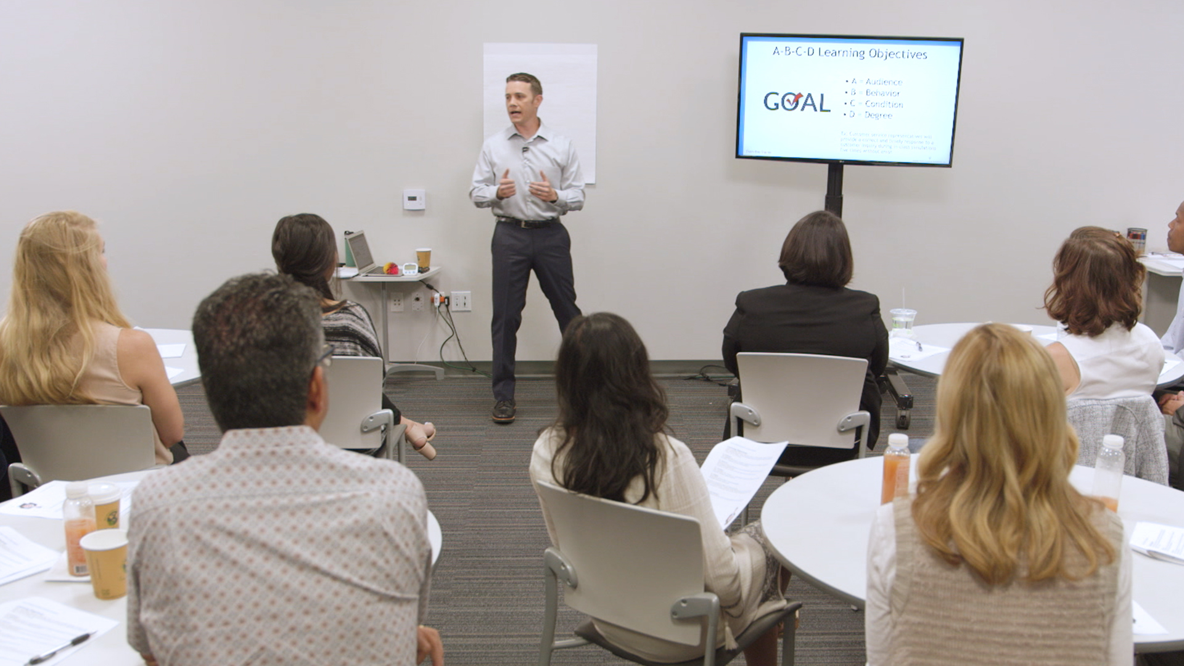
Room Set Up for Presentations and Debrief
Notes:
Room Set Up Checklist
Is the room set up appropriate for our presentations? Let’s review the list.
Arrive at least 30–60 minutes early to set up.
Technology and demo/prop tables are available and working properly (e.g., LCD projector, laptop). Test videos and microphone to ensure the audio is functioning appropriately (some trainings only).
All participant materials and sign-in sheets are available – sign up sheet for presentations, notes sheet for feedback.
Participant tables are positioned to maximize group discussion and view slide content.
Chart paper and markers are posted for the post-presentation debrief sessions.

Slide 8
Activity #2: Presenting to your boss
20 minutes
Take 5 minutes to answer the questions
Count off – 1 to 10. Team up with the person with your number.
Take 5 minutes to compare your answers
10 minutes - Share one of your answers during “report out”
Notes:
Your building scoping report contains valuable information about the operating condition of your building, and is based on many hours of work completed over the span of the Level II course. The benefits of this work are maximized by being able to effectively communicate the value to financial decision-makers so that recommended measures will be implemented. Tell us your plans for sharing the report with decision-makers in your organization.
Write your answers to the questions.
Will your Building Scoping Report benefit your organization?
___ Yes ___No Why? ____________________________________
Who should see the report? _____________________________________________________
What is the best way to share it with them? Why?
_____________________________________________________
4. What is your timetable for sharing it?
_____________________________________________________

