Slide 1
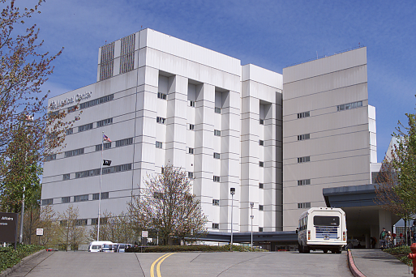
Preventive Maintenance & Troubleshooting Principles for Building Systems
BOC 2010
Notes:
Instructor’s name: __________________________________________________
Phone number: ____________________________________________________
E-mail:____________________________________________________________
The key to efficient operation of any commercial facility is a plan that incorporates operations analysis, troubleshooting and preventive maintenance.
Operations analysis provides an overall understanding of how building systems work.
Troubleshooting is both a method & skill that can be applied to any problem encountered in commercial facilities.
Preventive Maintenance (PM) includes the tracking of repairs & service on equipment, and the study of breakdowns in order to prevent them.
By the end of this course you will know how to benefit from the variety of approaches.

Slide 2
What We’ll Cover Today
Project Debrief
The Types of Maintenance
3. Best Practices for O&M
4. Examples of Basic PM Procedures
5. Key Performance Indicators (KPIs) for Energy Efficiency
6. Basic Troubleshooting Procedures
7. Computer Maintenance Management Systems (CMMS)
8. Equipment and Tools
Notes:
Communicating the value of PM to your management is very important. It is often hard to convince them of its importance, but part of your job is to demonstrate to management the importance of effective PM procedures and processes.
Maintenance is often categorized into several different types. This course will discuss those types and basic PM procedures for several different types of equipment.
Troubleshooting and solving problems on-site can be very complex. This course is designed to give you a set of tools to confidently assess complaints and logically solve problems at your facility.
Sample forms and exercises included in this course are designed to help implement these systems and offer the user a concise manner in which to document and manage on-site problems.

Slide 3
Project Debrief
Your BOC 2004 project assignment was:
Conduct a walkthrough of your building
Prepare a written report of the walkthrough findings
How did it go? Let’s review.
Notes:
In this assignment, you completed two steps:
A building walkthrough of your facility using the walkthrough plan developed earlier; and,
A written report of the findings from the walkthrough using a template of a Building Scoping Report.
Were you able to complete the Building Walkthrough as planned? If not, what changes to the plan did you make?
During the walkthrough, were you able to investigate known problems? What were they? What did you discover/learn?
Were you able to complete the Building Scoping Report assignment?
Name one finding and one recommendation you made in the scoping report.

Slide 4
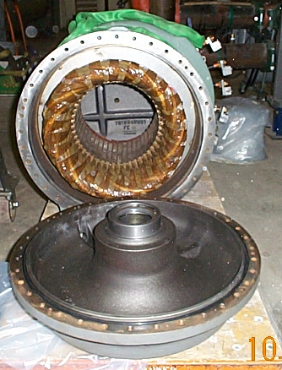
Types of Maintenance:
Emergencies & Priority Work
Fire-Life-Safety
Equipment Down
Priority Work
■ Remodels
■ Five-year overhauls
■ New construction
Notes:
Work priority is indicated on the work order. Work priority methods vary from facility to facility. A three level priority method is commonly used.
It can be:
• The first priority is work related to safety, downtime and personnel.
• The second priority level is periodic maintenance.
• The third priority type is long-term projects.
Some facilities identify work priority by completion time as immediate, within two weeks or timely. The size of the facility and the number of available personnel dictate work priority procedures.
For example, some facilities list PM tasks as the highest priority with only designated workers responding to emergency calls. Regardless of the work priority method, the maintenance worker is always alert for signs of potential maintenance problems and should carry their basic tools at all times.
For example, a change in the sound of a motor may indicate potential failure. The smell of hot electrical insulation requires immediate investigation. A glance at critical gauges can identify a problem.

Slide 5
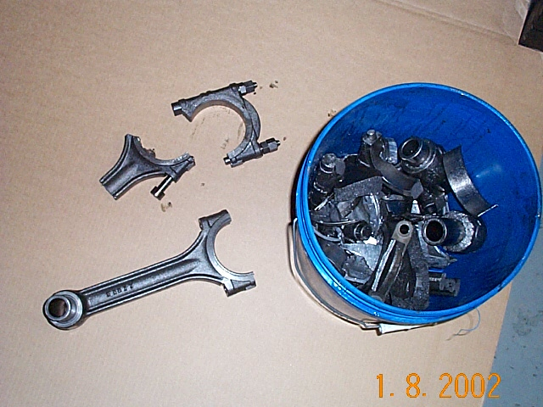
Types of Maintenance: Unscheduled Maintenance and Repairs
Emergency Work
■ Equipment maintenance that has
not been scheduled for PM work, but
must be repaired immediately
Breakdown Work
■ Failure of equipment that
is receiving no PM work
Equipment breakdowns such as
compressor failure is often Emergency
Work and must be repaired or replaced
immediately.
Notes:
Unscheduled maintenance is random service performed by the maintenance worker including emergency work and breakdown maintenance.
Emergency work is performed to correct an unexpected malfunction on equipment that has received some scheduled maintenance. Emergency work orders are issued to repair damaged equipment immediately. It represents a failure of the PM system. The goal of a PM system is zero breakdowns. Tracking and recording emergency repairs provides information that can improve maintenance procedures or equipment design by identifying common equipment problems.
Breakdown maintenance is service on failed equipment that has not received any scheduled maintenance. For example, incandescent light bulbs operate on breakdown maintenance because it is less costly to replace a bad bulb than to predict a bulb failure by testing. Breakdown maintenance is the least sophisticated maintenance work, and is used only on equipment that is inexpensive and non-critical to facility operations. However, if applied to the wrong equipment, breakdown maintenance can be the most expensive type of maintenance work, for example, waiting until the heating or cooling system fails!

Slide 6
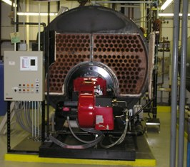
Types of Maintenance: Scheduled Maintenance
Work Orders
Periodic Maintenance
Corrective Work
Project Work
Cleaning and checking the condition of the combustion chamber should be a scheduled work order.
Notes:
Work orders detail and document the work required to complete specific maintenance tasks. Work orders are also used to organize, schedule and track all work. They commonly include the name of equipment, location, associated tasks, tools and supplies needed, approximate time required to complete the work, and space for comments by the person completing the task(s). Work orders can be generated using paper forms or a computerized maintenance management system (CMMS). (See the Work Order form in the appendix.)
Periodic Maintenance can be the regularly scheduled inspection, adjustment, measurement, & lubrication of equipment and systems within the facility.
Corrective Work is the repair of a known problem before a breakdown occurs. Corrective work is requested, discovered during periodic inspections, or discovered while performing other maintenance tasks. When corrective work is completed, data, including work completed, supplies used, cause of problem, costs and time for completion are recorded in the PM system.
Project Work is work on long-term projects that require advanced planning and more time than typical maintenance tasks. Project work commonly includes rebuilding or modifying equipment, renovating structures, or installing new equipment.

Slide 7
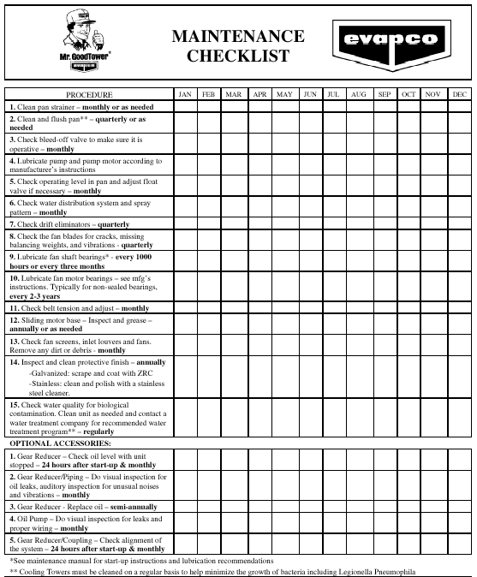
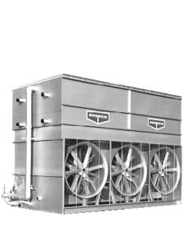
Types of Maintenance: Logs for Daily, Shift and Special Apps.
Personal logs
Shift logs
Weekly, Monthly, Quarterly, Annually
Specialized Applications
Checking the condition of the cooling
tower in the summer would be a Specialized
Log in the summer months.
Notes:
Log books should be kept as part of any PM system. Log books document all work performed during a shift, and list information needed to complete work by maintenance workers on other shifts. (See Sample Log Entry in Appendix) Maintenance workers begin each day by reviewing the log books from previous shifts. Based on information in the log, and the quantity and type of work orders issued, the maintenance worker makes a list of all work to be completed. The work is then prioritized as required. Emergency or high priority work requests are handled as they arise during the shift. In large facilities, a supervisor schedules daily activities. In smaller shops, maintenance workers do their own scheduling.
A Personal Log details all activities, the causes and solutions of problems. This is also a place for you to write down what you may need to learn or study to improve your skills.
Some maintenance organizations have specialized logs. For example, a maintenance department indoor air quality complaint log records all complaints regarding air quality conditions in the facility. In some cases, a personal log is used as a secondary means for documenting work completed.

Slide 8
Types of Maintenance: Predictive Maintenance
Visual & Auditory
Vibration Analysis
Non-Destructive Maintenance and Testing
Oil Analysis
Thermography
Electrical Analysis
This maintenance tech is checking
the electric motor for hot spots with a thermal imaging tool.
Notes:
Predictive Maintenance (PDM) is a growing area of preventive maintenance. PDM involves the use of electronic monitoring equipment to become aware of problems before they affect equipment performance. PDM requires a substantial investment in training and equipment and it is most commonly used on expensive or critical equipment.
PDM procedures include visual and auditory inspection, vibration analysis, lubricating oil analysis, thermography and electrical analysis.
Visual and Auditory inspection is simply looking at and listening to the operation of equipment. It is the simplest PDM procedure performed in a facility. Vibration analysis uses a sensor or sensors to measure the noise (sound waves) or vibration produced by moving parts in the equipment. Worn parts produce changes in vibration or noise which can be identified.
For example, vibration analysis of a bearing will indicate its condition. When the bearing is beginning to deteriorate, its vibration will change. This can be detected and the bearing changed before problems develop.
Lubricating oil analysis is used to determine the condition of the lubricating oil, and detect the presence of acids, dirt, fuel, and wear on particles that indicate problems inside the equipment. Wear particle analysis is the study of wear particles present in the lubricating oil. The equipment condition can be determined by monitoring the amount and type of wear particles in the lubricating oil.

Slide 9
Types of Maintenance: Infrared Thermo Scans
Photos courtesy of Fluke
Notes:
Thermal Imagers operate in the infrared spectrum and follow the same laws as infrared (IR) thermometers, but the similarity ends there. IR thermometers report an average “spot” temperature. IR Thermal Imagers are similar to digital cameras and, in practical terms, may be thought of as infrared cameras. An LCD display shows a “movie” of the IR image as the user selects the image, focuses, then pulls the trigger to record the image. While temperature variations and “hot-spots” can be viewed in real time through the LCD display, the power of the technology is not fully realized until the recorded image is downloaded to a computer, analyzed with the provided software, and saved in a comparative database along with descriptions, notes and an actual photograph to compare the IR with the visual image.
Within the computer program, the image can reveal specific spot temperatures, a grid of temperature readings, minimum-maximum-average temperatures of a selected area of the image. Emissivity and reflectivity can be adjusted, level and gain can be adjusted, the palette can be changed (color, grayscale, or iron bow, which is a smoother edged color palette), and more. Thermal imaging is gaining an invaluable predictive and diagnostic reputation in industries such as power distribution, plant maintenance, petro-chemical plants and process applications, to name a few.

Slide 10
Best Practices for O&M Level #1: Management
Goals: Incorporate goals for energy-efficient building operation into the strategic business plan. Efficient building operation increases a facility’s Net Operating Income (NOI).
Planning: Require an energy management plan with energy efficient operation as a primary component.
Energy Accounting: Use an energy accounting system to locate savings opportunities and to track and measure the success of energy-efficient strategies.
Notes:
Goals: Today’s business atmosphere of “downsizing” and reducing capital expenditures is fertile ground for energy-efficient building operation. Senior managers and building owners are focused on maximizing the return-on-investment (ROI), including assets such as facilities and O&M staff. This focus increases opportunities for energy managers, facility managers and property managers to demonstrate the relevance of energy-efficient building operation. Optimizing O&M strategies for keeping expensive building equipment and systems operating efficiently reduces the risk of early equipment failure, unscheduled down time, high utility costs and tenant losses. Also, efficient building operation can increase a facility’s net operating income (NOI), which in turn increases its value. Clearly defining O&M goals and objectives and communicating to senior management how O&M fits into the “big picture” increases management’s awareness and support for the O&M department’s efforts.
Planning: The primary objective of an effective energy management plan is to eliminate or minimize energy waste while maintaining a comfortable and safe environment. Effective energy management planning generally consists of three basic elements:
• Purchasing clean and reliable energy at the lowest cost
• Replacing old equipment and systems with new, efficient technologies
• Operating energy consuming equipment efficiently.
An energy accounting system can be used to better understand major drivers of a facility’s energy use, such as weather, increased occupancy, additional equipment, operational deficiencies, etc. Tracking whole-building energy performance provides insight into the overall energy and O&M fitness of the building.

Slide 11
Best Practices for O&M Level #2: Teamwork
Staffing: Hire or appoint an energy manager.
Training: Train building operators in energy efficient O&M activities.
Outsourcing: Require service contracts that support energy-efficient building operation.
Partnerships: Acknowledge energy-efficient operation as a cross-functional activity for managers and operators.
Notes:
Staffing: Assigning or hiring someone to take on the role of energy manager sends a message to the facility staff that the energy management process is important. A good energy manager engages the facility staff in the energy management process and supports and motivates staff efforts in energy-efficient operation. Often the cost savings generated by an experienced energy manager can easily cover his or her salary.
Training helps staff to continually improve and sustain operating efficiency as a proactive O&M function. Today’s building systems and controls are more sophisticated and complex than in the past. New technologies such as computerized energy management control systems (EMS) offer the ability to perform complicated energy efficient control strategies but are often under-utilized because of poor training.
Outsourcing: Building owners or managers may choose to hire outside service contractors to augment their own building O&M staff or they may outsource all of the O&M work, including the management. In either case it is important that service contracts require activities that address efficient building operation and include methods to track operating changes, improvements, and deficiencies over time.
Partnerships: It is important to understand who directly operates the energy-consuming equipment in a building as well as who influences when and why equipment operates. Depending on how the building is managed and on how contracts are negotiated, tenants, custodians and security personnel may be primary operators of equipment such as lights, HVAC equipment and office equipment (computers, printers, copiers).

Slide 12
Best Practices for O&M Level # 3: Resources
Documentation: Maintain continuity and reduce troubleshooting costs.
Tools: Equip O&M staff with state-of-the-art diagnostic tools.
Assessment: Perform a comprehensive
O&M site assessment.
Notes:
Documentation: Many large commercial buildings start out with adequate mechanical and electrical drawings and O&M manuals. Documenting the sequence of operation and energy-efficient control strategies for the energy using systems is essential to understanding building control. The control documentation is critical for maintaining energy efficient operation and effectively troubleshooting operational problems.
Tools: Many of today’s energy management control systems (EMCS) have trend logging capabilities and can be used to gather important data for troubleshooting and improving building operation. These capabilities can be used to detect energy waste. For buildings lacking an EMS or for those having an EMS with limited data points, building staff can use portable electronic data loggers to optimize equipment operation. Portable electronic data loggers are battery-powered, small, light and easily installed and removed without disrupting building occupants.
Assessment: A rigorous O&M tune-up requires performing a thorough assessment of the current operation and maintenance practices. Understanding why building systems are operated and maintained the way they are, and where and what improvements are most beneficial and cost-effective is the first step in the O&M tune-up process. The assessment systematically looks at all aspects of the current O&M program and practices as well as the management structures, policies, and user requirements that influence them. The assessment reviews schedules and control strategies to determine whether the building is being operated optimally and develops a list of recommended O&M improvements. It provides the starting point from which to measure the effectiveness of improvements and O&M activities.

Slide 13
Best Practices for O&M Level #4: Energy Efficient Operation and Maintenance
Tune Ups: Perform O&M tune-up actions.
Automatic Controls: Make full use of automatic controls to optimize efficient operation.
Scheduling: Operate equipment only when needed.
Tracking: Track actual performance against expected performance for major equipment.
Preventive Operation and Maintenance: Redefine preventive maintenance to include activities critical to energy efficient building operation.
Notes:
Tune-ups: Five to twenty percent of annual commercial building utility bill costs can be saved through low-cost O&M improvements—but only if they are implemented. The O&M tune-up activities may be the first step in developing a sustainable finance mechanism for the organization. This kind of sustainable finance mechanism requires monitoring and tracking savings so that they can be dedicated to future improvements.
Automatic Controls: Although many facilities have sophisticated, computerized energy management systems (EMS) in place, most do not take full advantage of the systems’ capabilities. Staff often use these systems only to turn equipment on and off. These systems can be programmed to accomplish control strategies such as optimal start/stop, air- and water-side economizing, chilled/heating water resets, night setback setup, night purge, morning warm-up, hot cold deck optimization, and lighting sweeps.
Scheduling: The number one way to waste energy is to leave equipment and lights on when they could be off. The payback for improved scheduling is almost immediate. Although individual pieces of equipment may be well maintained and perform efficiently, unless the control strategies and occupant needs are periodically reviewed, equipment may be operating more than necessary.
Tracking: It is vital to track the overall energy use and demand of a facility. When building O&M staff does not have adequate or correct information to assess day-to-day equipment performance, energy-saving opportunities may be lost. For O&M staff and managers to understand when major plant equipment is not operating as efficiently as it could be, they need to regularly track actual equipment performance data against expected performance data.
Preventive Operation and Maintenance: Typically, the primary goal of the preventive maintenance (PM) plan is reliability and increased equipment life. Buildings often have extensive maintenance-focused PM plans, which are rigorously carried out by the O&M staff. However, even if a piece of equipment or a system is meticulously maintained, if it is poorly operated using inadequate control strategies or improper scheduling, vast amounts of energy waste can occur. Also, poor equipment operation can lead to premature equipment failure (for example, short-cycling) and an increase in maintenance requirements.

Slide 14
Examples of Basic PM
Procedures
Examples of Major Types of Preventive Maintenance Procedures for:
■ Boilers, Steam and Hot Water Heating Equipment
■ Rooftop Units, Fan Systems, VAV Terminal Units
■ Air Filter Maintenance
■ Chiller Equipment and DX Cooling Systems
■ Control Systems
■ Lighting-Incandescent vs. Fluorescent
■ Utilizing Manufacturers PM Sheets
■ Motor and Pump Alignment

Slide 15
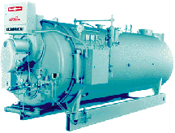
Basic PM Inspections
for Packaged Boilers
Check pop off relief valves as recommended by manufacturer.
Record operating temperature
and pressure.
Perform flue gas analysis, record flue
gas temperature,
O2 and CO2 gases.
Record gas or oil pressure.
Blow-down boiler
at bottom and make
up water float.
Check water level.
Check burner operation.
Photo courtesy of Cleaver-Brooks
Notes:
Record all boiler tests and any activities related to boiler operation.

Slide 16
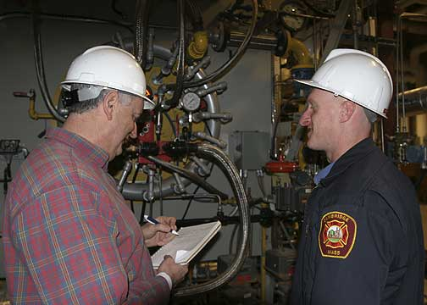
Boiler Maintenance Procedures
Regular inspections
Record keeping using log sheets
Accurate water treatment
Blowdown daily or weekly
Clean heat exchanger surfaces
Preventive maintenance checklist includes lubrication as needed
Notes:
Regular inspections and accurate record keeping are crucial to an effective boiler maintenance program. Accounting for changes in operating conditions and performance serve as a basis for future O&Ms.
Accurate water treatment requires sophisticated analysis of make-up water composition and operating conditions. An effective balance of chemical treatment and blowdown frequency can minimize maintenance and increase equipment longevity. Hot water boilers require water treatment when the system is filled or if substantial amounts of make-up water is added.
Blowdown frequency must be established in conjunction with a water treatment program. Blowdown should be based on chemical levels in the water, not simply on a set time basis. In addition, an automatic chemical feed system will produce better results and reduce water and energy costs due to excessive blowdown.
Keep the heat exchanger surfaces clean. Both fire and water sides of the system may have build-up from scaling or combustion condensation. This material insulates the water from the heat source and reduces the exchange efficiency.
Preventive Maintenance Checklist:
Inspect, test, and verify that operating and safety controls function as designed.

Slide 17
Boiler Log Sheets
Good Boiler Logs will provide the operator with data regarding:
■ The condition of boiler surface (fireside or waterside)
■ Combustion efficiency
■ Condition of refractory or insulation
■ Safety devices
■ Fuel filters
■ Water treatment
Notes:
A boiler room log sheet serves as a guide to a comprehensive maintenance program. The log sheet is used by conscientious boiler operators to evaluate performance and to help spot trends that may affect the boiler operating pressure (steam boiler), operating temperature (hot water boiler), and stack temperature. In addition, the log serves as a record for inspections of water level controls and safety devices. Keeping a boiler log is often legally required.
You can obtain a sample log sheet form from your local boiler representative or boiler inspection company. Rework the sample sheet to fit your particular needs. Routine sections of your log book should contain individual instructions on daily, weekly, monthly and yearly O&M procedures.
Don't ignore your backup fuel system. For example, if your boiler is capable of firing dual fuels (i.e., natural gas and No. 2 fuel oil) and your primary fuel is natural gas, you should fire the boiler with oil one day each month to ensure that the oil system is functioning at optimum efficiency, and then record the data.
Although each element of the boiler log and maintenance program is important, a boiler cleaning can result in reduced fuel consumption. Also, it’s an excellent deterrent against downtime. In the course of one year, soot, non-combustible materials, mineral scales and other deposits can form within the boiler. These particles are great insulators that inhibit heat exchange and cause the boiler to lose efficiency. For example, scale that is only 1/16" thick will cause the boiler to use 15% more fuel. By evaluating data from the boiler room log, you can determine when to:
• clean the boiler (fireside or waterside)
• adjust the combustion ratio
• repair or maintain the refractory or insulation
• replace safety devices
• replace fuel filters or gaskets
• adjust water treatment as needed.

Slide 18
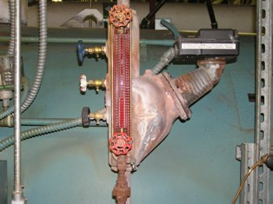
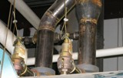
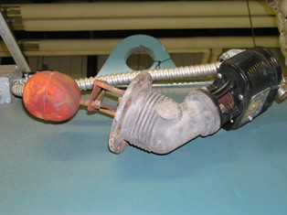
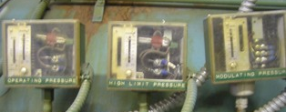
Boiler Maintenance Recommendations
Check water level
at try cock valves.
Annually clean and check the low water float safety controls.
Check pop off relief valves as recommended by manufacturer.
Check pressure controls.
Notes:
How do these compare to your facility?

Slide 19
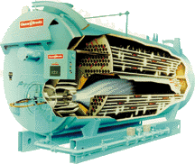
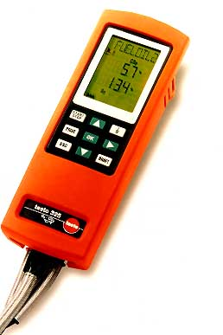
Boiler PMs Include Testing the Combustion Gases
Boiler “Tune-up” efficiency testing requires exhaust gas sampling to include:
■ CO₂, O₂, CO, NOx
Stack temperatures are used as an indicator to predict problems:
■ High stack temperatures
■ Low stack temp
■ Normal temp ranges
Photos courtesy of Cleaver-Brooks and Testo Tools
Notes:
“Tune-up” requires sampling combustion gases to analyze combustion and possible causes for incomplete combustion.
The primary gases sampled are CO₂, O₂, and CO. The percentage excess O₂, the percent of CO₂, and stack temperature are the primary indicators of efficiency.
High stack temperatures indicate excess air, but boiler surfaces can influence stack temperature. Normal temperature range is 350-400°F.
Tune-up is normally done with an electronic gas analyzer. Some larger facilities will do automatic monitoring and tune-up, but even these controls should be checked for accuracy.
Stack temperatures need to be monitored at all times because they give a good indication of boiler status.

Slide 20
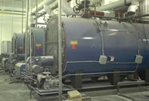
Boiler Combustion Efficiency
Combustion Efficiency is the most commonly applied measurement of boiler performance. It is calculated as follows:
Combustion Efficiency = (Energy Input - Stack Loss)
Energy Input
The following are the key factors to understanding efficiency calculations:
1. Flue gas temperature (stack temperature)
2. Fuel specification
3. Excess air
4. Ambient air temperature
5. Radiation and convection losses.
Notes:
Combustion efficiency is an indication of the burner’s ability to burn fuel. The amount of unburned fuel and excess air in the exhaust are used to assess a burner’s combustion efficiency. Burners resulting in low levels of unburned fuel while operating at low excess air levels are considered efficient. Well-designed burners firing gaseous and liquid fuels operate at excess air levels of 15% and result in negligible unburned fuel. By operating at only 15% excess air, less heat from the combustion process is being used to heat excess air, which increases the available heat for the load. Combustion efficiency is not the same for all fuels and, generally, gaseous and liquid fuels burn more efficiently than solid fuels.

Slide 21
Boiler Combustion Efficiency Example
1. Assume 15 lb. design, 100 HP CB Boiler, fired on gas at 100% of rating.
2. Stack temperature is 320°F and room temperature is 80°F. (320 - 80 = 240, the temperature difference).
3. You measure CO2 of 10% with no CO.
4. From the efficiency chart, at 240°F and 10% CO2, you get stack loss of 15.2% going up the stack. (See table 2.)
5. Add .4% for “Radiation and Convection Losses”. (For a CB Boiler, see table 1.)
6. 15.2% plus .4% = 15.6%
7. 100 - 15.6 = 84.4% Fuel-to-Steam Efficiency.
Information courtesy of Cleaver-Brooks Boilers

Slide 22
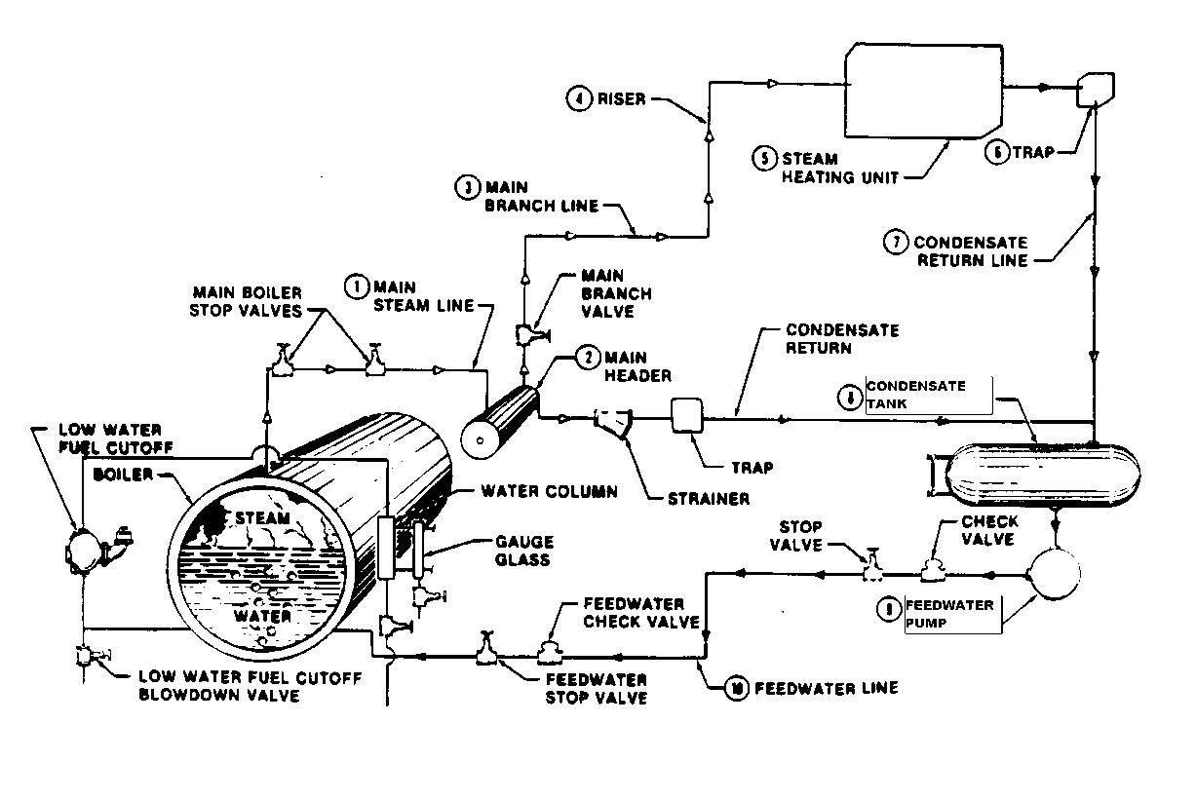
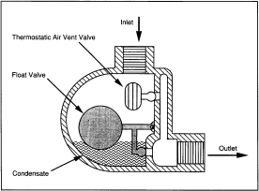
Steam Distribution Maintenance
Clean coils air as needed.
Trap maintenance.
Flush system as needed.
Check strainers
and valves.
Check pump pressures.
Check feedwater-condensate return water.
Notes:
Steam traps should be checked for a temperature difference across the trap which indicates the trap is functioning. The steam side should be significantly hotter than the condensate side.
Strainers should be cleaned upon startup or repair.
Air should always be vented automatically or manually if the system has been opened.
Pumps should be monitored by system flows and pressures to ensure adequate distribution throughout the system. Pumps should be lubricated on the manufacturer's recommended schedule.
Valves should be checked to determine if leakage is occurring when the valves are closed.
Develop a preventive maintenance checklist.

Slide 23
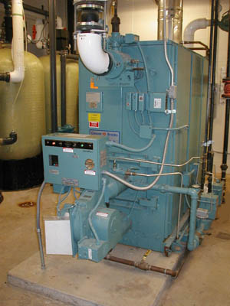
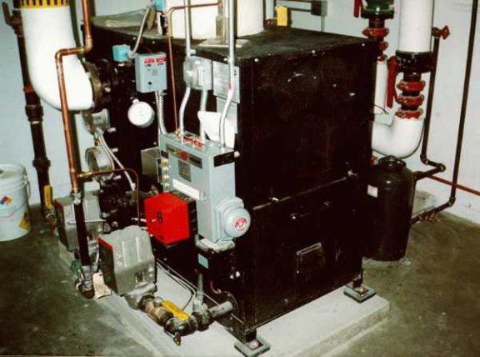
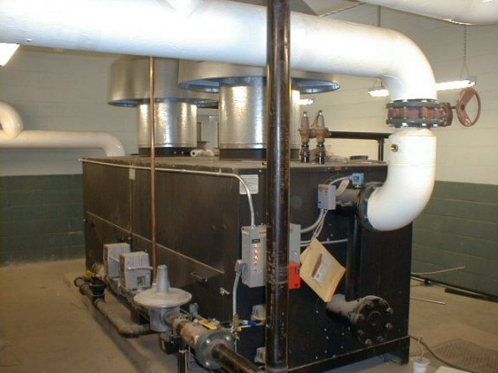
Hot Water Boiler Maintenance Recommendations
Test flame failure safety controls.
Check and test operating and safety controls as needed.
Check gas pressure at burner
during high and low fire conditions.
Notes:
Courtesy of High Performance HVAC.com (http://www.highperformancehvac.com/boilers.html#boiler_loop)

Slide 24
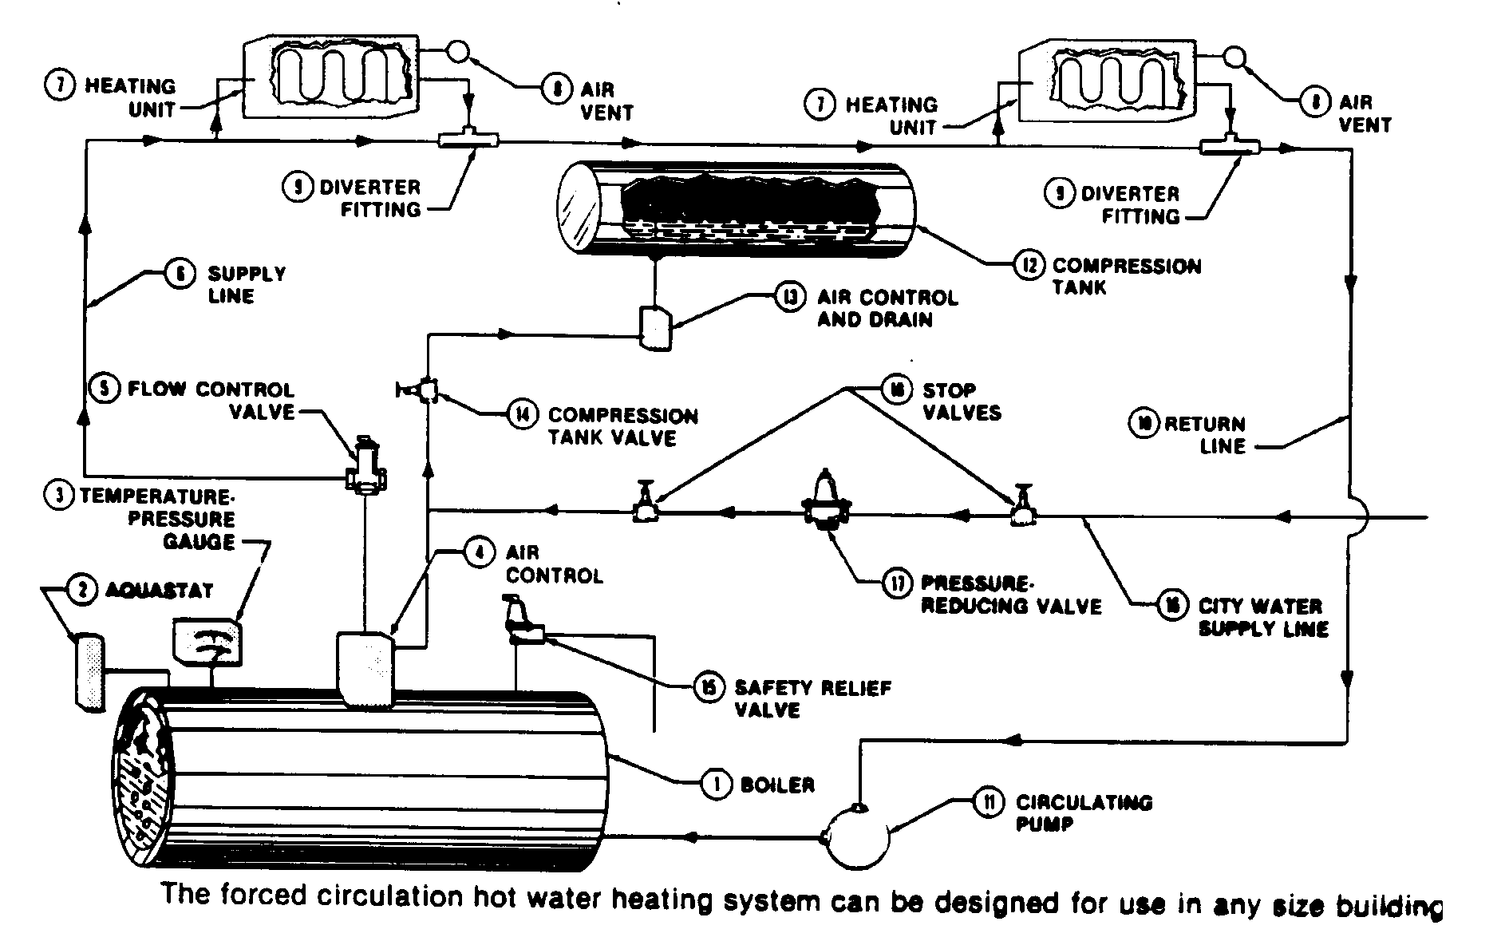
Hot Water Boiler System PM Maintenance Checks
Vent air as needed.
Check circ pump.
Test and check aqua-stat as needed.

Slide 25
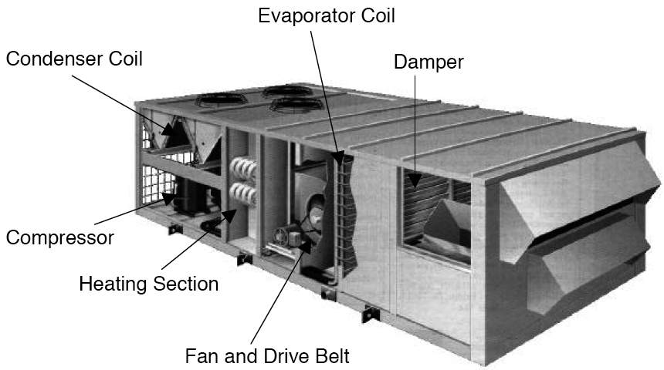
Before Maintenance Begins: Learn the Sequence of Operation and Locate Major Components of Unit that Needs Service
Source: York International Corp.
Notes:
Identify the major components and then learn the sequence of operations. It will then be easier to do maintenance on the unit. For example, you will need to know the approximate location of the filter bank before you open up all of the door on the rooftop unit to replace old filters. Also, the condenser coil should be cleaned annually, so you will need to determine the location of this coil when preparing to do maintenance. It will also be necessary to locate the modulating dampers and associated controls.
(Typical Sequence of Operation for a Rooftop AHU Unit)
Fan Off – The outdoor air dampers closed, return dampers open 100%, exhaust dampers closed.
Fan On – Outdoor air dampers open to min position (min position was set by design engineers and may/may not have changed over the years), return air damper closes slightly, exhaust air dampers open slightly to relieve building pressure.
Heat Mode – Thermostat cycles the heat valve/gas furnace to maintain space temperature.
Cool Mode – Thermostat cycles the cool valve/DX to maintain space temperature.
Economizer Mode – The mixed air sensor controls the outdoor air and return dampers to maintain a set-point, taking advantage of free outdoor air cooling.

Slide 26
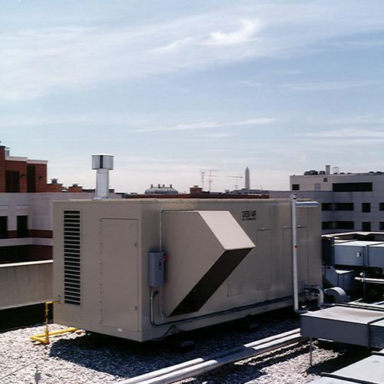
PM for Rooftop Units
with Gas Heating and AC
Check fan belts biannually and lube motor.
Check temp. drop
across heat exchanger.
Check outside air
intake for blockage.
Clean as needed.
Check supply air for CO gas annually.
Change air filters as needed.
Clean inside and outside
coils annually.
Notes:
Check operating and safety controls.
Keep air filters clean to give the proper air flow across the furnace.
If air flow is reduced because of a dirty filter, the discharge air temperature will rise. This reduces the heat transfer capability of the heat exchanger and causes the stack temperatures to increase. Outside air “blockage” can also be caused by inoperative damper motors. So motor operation should be checked. All these effects will reduce the efficiency of the unit.
Checking the amp draw of the compressor and fans is also a good idea to catch problems early.
Make burner adjustments for proper fuel-to-air ratios. Check flame condition regularly. Check discharge for Carbon Monoxide (CO) leaking through worn or cracked heat exchanger. This should be done monthly as a minimum, including on-site constant monitoring sensors and alarms.
Lubricate fan motors according to the manufacturers recommendations.
Inspect v-belts at least quarterly for proper tension and excessive wear.
Check all controls for fail mode. Make sure all components in the system are working.

Slide 27
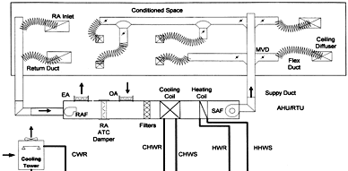
PM Procedures for
Fan System Maintenance
Inspect operation of all dampers.
Inspect VAV boxes and/or ceiling diffusers.
Service AHU.
Perform vibration analysis.
Clean cooling towers.
Replace or clean air filters.
Notes:
Fan system maintenance is important to maintaining peak operating efficiency of the HVAC system. It should include inspection of:
• Drive Systems, Filtration System, and the Air Distribution
Belts and drive systems should be inspected on a regular basis. Filters should be changed on a fixed schedule or as indicated by filter monitoring instruments.
Leaks in air distribution systems should be sealed to maximize delivered air quantity and quality to each space or zone. Ducting should be installed to the minimum requirements of appropriate energy and/or mechanical codes.
Develop and follow a preventive maintenance plan that includes maintenance schedules. Activities in the plan should include:
inspection of outside air dampers for nearby sources of contamination
ensuring that air dampers are clear of obstruction and operating properly.
regular replacement or cleaning of air filters
cleaning and inspection of drain pans
inspection and cleaning of heating and cooling coils
inspection of fan motors and belts
regular inspection and cleaning of air humidification equipment and controls
inspection and cleaning, as needed, of air distribution pathways and variable air volume (VAV) boxes.

Slide 28
PM Procedure to Determine
Efficiency of Mixing Dampers
OSA and EA dampers should be closed.
Return Air (RA) is 80°F.
EA
Outside Air
RA
Return Air
Outside Air (OA) is 40°F
Mixed Air Temp (MA) Should be 80°F
OA
Outside Air
SA
Supply Air
MA
Mixed Air
= 62.5% OSA
Command close the OSA dampers to 0% (100% closed).
All of the dampers in the mixed air and exhaust air should sequence together, no OSA should enter the building.
Supply Air (SA) should = mixed air and return air (RA).
If this test does not work, dampers are mostly likely
not sealing off 100% when closed. Inspect and repair as needed.
Temperature Sensor
Notes:
• When you command close the OSA dampers to 0% (100% closed), there should be no OSA entering the building.
The Supply Air (SA) should = Return Air (RA) and be 80°F.
If this test does not work, dampers are mostly likely not sealing off 100% when commanded closed.
Check the dampers for obstacles restrictions, or faulty damper operators if the dampers do not fully close.
To verify the OSA dampers will open to 100%, reverse this test by command opening the OSA dampers to 100%. The exhaust dampers should open 100% and the mixed air dampers should close off to 0%. The mixed air temperature and the supply air temperature should equal the outside air temperature of 40°F.
It is possible old dampers will not seal 100% due to age or original damper design. Older dampers can be retrofitted with seal strip kits to improve efficiency of the damper operation.

Slide 29
Exercise to Determine
Actual Outside Air Supply
Return Air (RA) is 80°F
EA
Outside Air
RA
Return Air
Outside Air (OA) is 40°F
Mixed Air Temp (MA) is 55°F
OA
Outside Air
SA
Supply Air
MA
Mixed Air
Use Outside Air Equation to determine % of OA
Tra - Tma
Tra -Toa
% OA = X 100
Temperature Sensor
Notes:
If Outside Air percentage needs to be checked, use the following process to accurately determine the true percentage of OSA that is coming into the building.
Example:
The Mixed Air is 55º F.
The Return Air is 80º F.
The Outside Air is 40º F.
The % of OSA would be determined as follows:
% OSA = 80ºF(Tra) - 55º F.(Tma) x 100 = 25 x 100 = 62.5 %
80ºF(Tra) - 40º F (Tosa) 40

Slide 30
Answer to Exercise to
Determine Outside Air Supply
Return Air (RA) is 80°F
EA
Outside Air
RA
Return Air
Outside Air (OA) is 40°F
Mixed Air Temp (MA) is 55°F
OA
Outside Air
SA
Supply Air
MA
Mixed Air
= 62.5% OSA
Using the Outside Air Equation to determine % of OA
Tra 80°F – Tma 55°F
Tra 80°F – Toa 40°F
80°F-55°F
80°F-40°F
= 62.5% OSA
Temperature Sensor
% OA = x100 =
Notes:
Return air fans move about 10% to 15% less
air than their related supply air fans
Doubling the ventilation rate will only dilute
an indoor pollutant by 50%.
Conversion Factors and Rules of Thumb

Slide 31
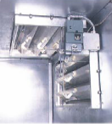
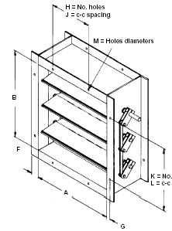
PM for Air Dampers
Check damper
seals and clean
as needed.
Check for air leakage
with damper motor
powered off.
Adjust damper as needed to begin normal starting position with power off.
Ceiling Fire Dampers
Courtesy of Ruskin Co.
Diagram with permission of Energy User News
Notes:
Maintenance requires cleaning, checking seals and adjusting linkage when units are off. Mechanical linkages change over time. It is important to check linkage for binding and control points. Fusible links on Fire and Combination Smoke/Fire Dampers should be checked periodically as the links will fatigue and fail over time.

Slide 32
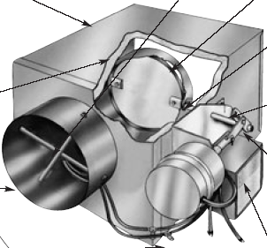
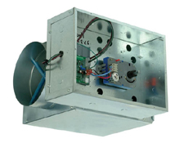
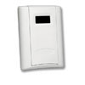
PM Maintenance on VAV Terminal Units with Electronic Controls
Learn to Identify and Check Operation of Key Components of VAV Terminal Unit Including:
Velocity Sensor
Damper Actuator
Controller
Room Thermostat or
Wall Sensor

Slide 33
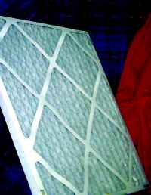
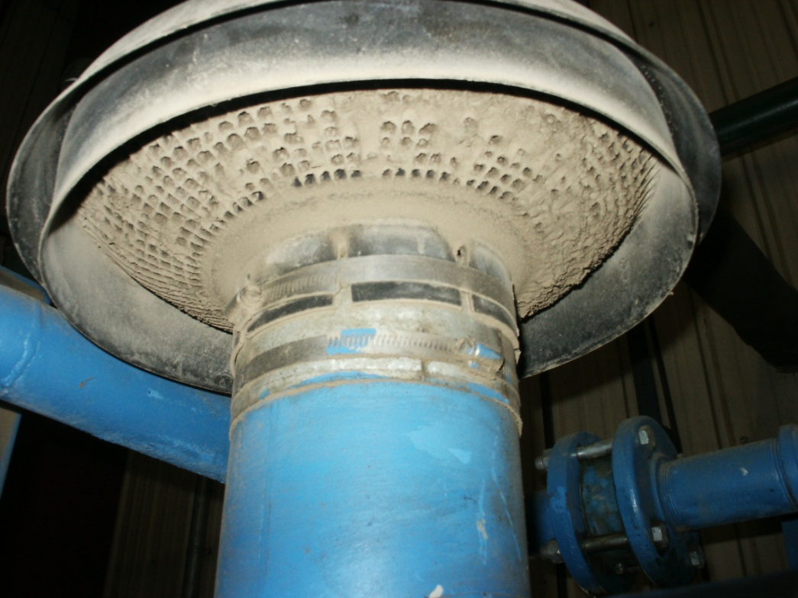
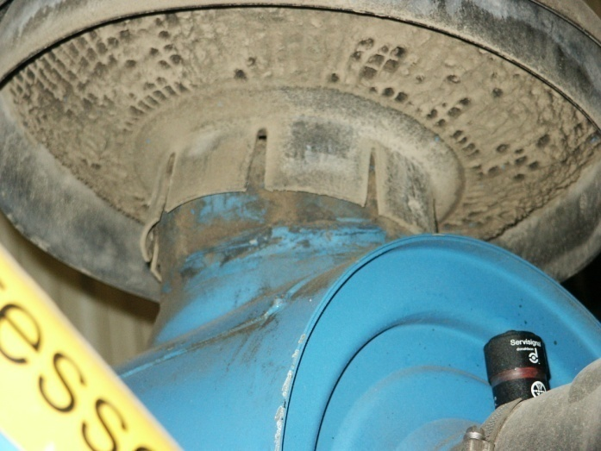
PM Air Filter Maintenance Saves Energy and Equipment
This is a clean air filter.
These are examples of
poor air filters/screens.
Notes:
Courtesy of High Performance HVAC.com (http://www.highperformancehvac.com/filter_hvac_p2.html)

Slide 34

PM Types of Extended Surface Air Filters

Slide 35
PM Efficiency and Performance of Air Filters

Slide 36
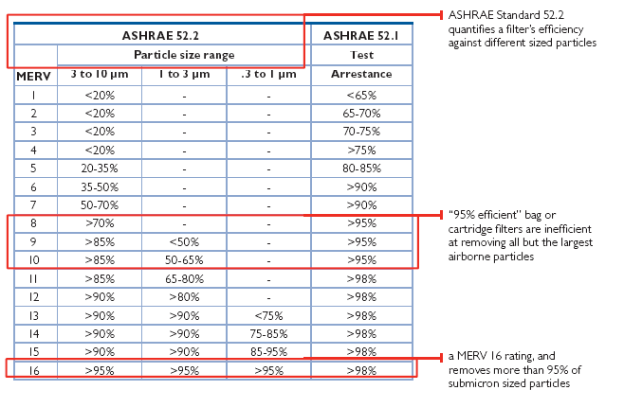
Air Filter MERV Ratings
Notes:
Two filter test methods are currently used in the United States: the American Society of Heating, Refrigeration, and Air-Conditioning Engineers (ASHRAE) Standard 52.1-1992 and Standard 52.2-1999. Standard 52.2 is the newer, more descriptive of the two. Whereas 52.1 expresses filtration efficiency in terms of the mass of particles removed, or arrestance, 52.2 quantifies a filter’s efficiency against different particle sizes. 52.2 states particle-size efficiency as a MERV (minimum efficiency reporting value) between 1 and 16. A higher MERV indicates a more efficient filter, and one that is particularly more effective against submicron-sized particles.
Filter manufacturers can choose to rate their products according to either standard, which can make selecting a suitable filter confusing to anyone unfamiliar with the differences. For instance under Standard 52.1, filters represented as “95% efficient” may be 95% effective against large airborne particles, but may remove at most 50% of submicron-size particles. Therefore, the engineer or facility manager sensitive to IAQ is best served by comparing air filtration solutions based upon MERV ratings. The chart presents the scale of MERV values, and compares them with 52.1 ratings.
What are your MERV ratings at your facility?

Slide 37
Filter Performance by Type

Slide 38
Methods of Mechanical Filtration
Source: Airguard Industries
Notes:
Straining
Straining occurs when a particle is larger than the opening between fibers and cannot pass through. It is a very ineffective method of filtration because the vast majority of particles are far smaller than the spaces between fibers. Straining will remove lint, hair, and other large particles.
Interception
Interception is a special case of impingement where a particle follows the airstream, but because of its size in relation to the fiber, it comes in contact with the fiber. It is not dependent on the inertia of the particle to bring it into contact with a fiber. The particle is retained by the inherent adhesive forces between the particle and fiber, called “van der Waals” forces.
Impingement
As air flows through a filter, it makes repeated changes in direction as it passes around each fiber. Dirt particles, especially larger particles, cannot follow the abrupt changes in direction because of their inertia. As a result, they do not follow the airstream, and they collide with a fiber. Filters using this method are often coated with an adhesive to help retain particles on the fibers.
Diffusion
Diffusion takes place on particles so small that their direction and velocity are influenced by molecular collisions (called “Brownian movement”). They do not follow the airstream, but behave more like gases than particulate. They are battered across the direction of flow in a random “helter skelter” fashion. When a particle strikes a fiber, it is retained by the adhesive forces (van der Waals forces) between the particle and the fiber.

Slide 39
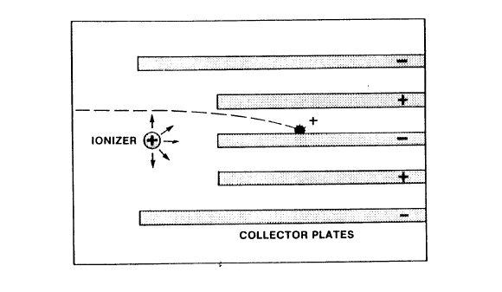
Electronic Filtration
Notes:
The electrostatic method of filtration is based on the principle that objects carrying opposite electrical charges are attracted to one another. As particles enter the filter they pass through the “ionizer” section where a field with an intense positive charge has been created, which is imparted to the particles. The particles are then carried by the airstream into the ”plate” area, consisting of alternately charged collection plates. Positively charged particles are attracted to the negatively charged plates.
The accumulated dust load is removed from the plates in one of two fashions. Either the plates are periodically washed, or the dust load is left to “agglomerate” on the plates until the enlarged particles are blown off the plates into the ”storage section.” The storage section consists of either an automatic roll filter or extended surface filters.

Slide 40
Group Exercise
.
Review the Information
on
“Types of Maintenance Procedures”
Notes:
In small work groups or as a class discussion project, discuss the following questions:
1. What does a “Tune-Up” mean when working with a boiler ?
____________________________________________________________________
____________________________________________________________________
What is the % of OSA on an air handler when the MA = 60ºF, the RA = 75ºF, and the OSA = 35ºF.?
____________________________________________________________________
____________________________________________________________________
3. Which air filter is better, a MERV of “5” or a MERV of “10”?
____________________________________________________________________
____________________________________________________________________
4. Predictive Maintenance (PDM) is a growing area of preventive maintenance. How does it differ from traditional Preventive Maintenance?
____________________________________________________________________
____________________________________________________________________

Slide 41
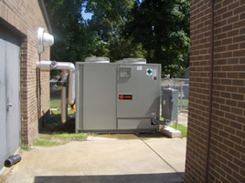
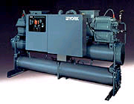
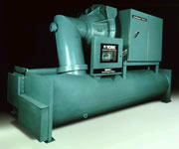
Maintenance and Optimizing Chillers and Cooling Systems
General maintenance considerations
Chiller maintenance
Cooling tower maintenance
Optimizing controls
Preventive maintenance checklist
Photos courtesy of York
Notes:
Good maintenance often requires simple but labor-intensive procedures and a PM checklist for the maintenance staff. Here are some minimum general guidelines.
Refrigerant leaks: These should be fixed as soon as possible according to law.
Condenser and Evaporator Coils: Condenser and evaporator coils should be cleaned regularly and checked for debris that could block airflow.
General maintenance considerations: Keep filters clean, check oil heaters, follow manufacturer-recommended inspections for overhaul procedures, and time frame. Megger motors annually.
Chiller maintenance: Check refrigerant quantity, system pressures and temperatures, water flow rates and oil analysis. Calibrate controls. Clean water side of vessels. Good chiller maintenance may require bringing in the factory reps annually to perform non-destructive testing.
Cooling tower maintenance: Check flows, water levels, clogged screens, sump, spray nozzles and water treatment. Check for corrosion and scaling. Also check pumps, fans, drives and freeze protection.
Optimizing controls: Check set point vs. control point. Verify minimum condensing pressures are being implemented. Controls always need to be checked for accuracy because they will drift out of calibration.

Slide 42
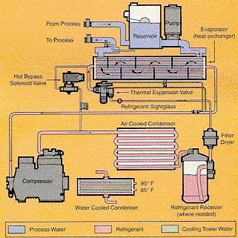
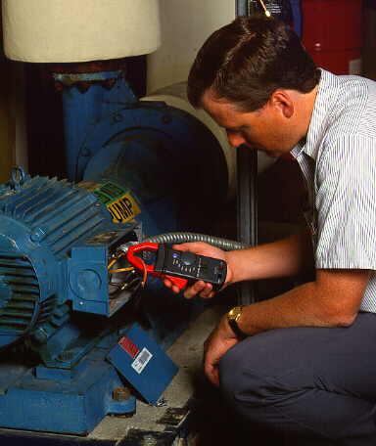
PM Procedures Chillers
and Cooling Systems
Lube and clean pump
motor as needed; annually
meg motor windings on
large motors.
Verify and check the water
treatment for chiller
and condenser, as needed.
Check sight glass
for refrigerant level.
Clean coils as needed.
Check crank case
heater for operation.
Use VOM meter.
Check compressor oil level.
Diagram courtesy of Fluke and Jack Schaub, www.chillers.com

Slide 43
Maintenance on Packaged Water Chiller with Flooded Evaporator
Check water temp differences on condensers and evaporator.
Check operating conditions at control panel.
Check refrigerant liquid level in evaporator.

Slide 44
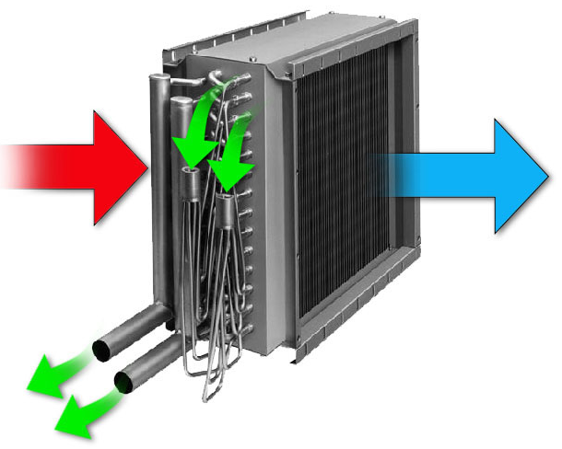
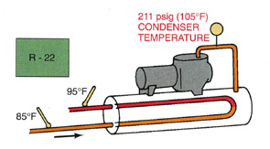
DX Cooling Systems PMs
Compressor
Evaporators
Condensers
Notes:
DX is direct expansion (see BOC 1001 Handbook). Delivered air temperatures should be about 20°F cooler than return air. Is there frost on the compressor? Is there frost anywhere? Frosting can mean low refrigerant and should be regarded as a problem that must be taken care of immediately. Are the coils clean? Is the chiller hermetic or semi-hermetic? What is the delivered water temperature? Somewhere above 40°F and somewhere below 50°F is standard. Below 40°F is dangerous for the equipment. Above 50°F probably won’t satisfy the load.
Are the cooling fins clean and straight? Clean the fins with coil cleaner. Straighten the fins with a fin comb. Is the condenser located in an area where air flow is not restricted? Is the condenser protected from vandalism or injury? Protect the condenser with a chain link fence or place on the rooftop.
Criteria for city water: Leaving water should be about 90°F.
Open evaporating cooling tower. Leaving water should be about 80°F. Entering water should be about 90°F to 95°F. Is it clean? Do all the nozzles spray? Are the baffles in good shape? Have the condenser tubes been cleaned? What type of water treatment? Closed cooling tower? Is the sump water clean? Are the coils clean? Look at the bottom of the coils.
What type do you have at your facility?

Slide 45
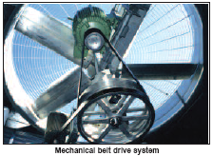
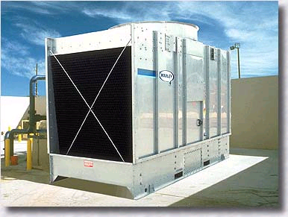
Cooling Tower
Maintenance Items
Service fan.
Check sprayer heads for blockage.
Check air intakes &
eliminators for blockage.
Inspect and clean float and sump of all biological organisms.
Pictures courtesy of Marley and BAC
Notes:
Direct contact
Condenser water is exposed to contaminants from outside air, i.e., leaves, twigs, pigeons, etc.
Algae can slime the condenser tube bundles, reducing flow and heat transfer capacity.
Sump and exposed water can freeze during cold weather operation.
Indirect contact
Algaecides still needed for condenser tube bundles.
The use of anti-freeze makes cold weather operation much safer.
Drain spray system and sump for cold weather operation.
Water testing.

Slide 46
Log Sheet and Psychrometrics
The Psychrometric Chart is a graph that shows the relationship between moisture and air dry bulb temperatures.
It can be used to calculate BTUs (enthalpy) and RH of the air conditions.
It can also be used to calculate the approach temperature of the tower which indicates the efficiency of the heat transfer at the cooling tower.

Slide 47
Psychrometrics Chart Exercise
Use your psych chart (provided in your appendix handouts) to determine the following:
1. What is the wet bulb when it is 90°F db and 50% RH? ______________
2. What is the wet bulb when it is 80°F db and 65% RH? ______________

Slide 48
Tower Approach Temperature
Approach Temperature is used by cooling tower manufacturers and maintenance personnel to determine the efficiency of the cooling tower.
Cooling Tower Approach Temperature is temp difference between leaving water temp and wet bulb temperature.

Slide 49
Determining Wet Bulb Approach for Cooling Tower Control
Determine wet bulb temperature.
Determine cooling tower leaving water temperature.
Calculate the wet bulb approach by subtracting the wet bulb temperature from the tower leaving water temperature.

Slide 50
Exercise Using the Wet Bulb Approach Method
Determine the Cooling Tower:
■ leaving water temperature = 80°F
■ the OSA dry bulb = 80°F
■ the OSA relative humidity = 50%
Calculate wet bulb temperature and then determine the approach temperature.

Slide 51
Example Using the Wet Bulb Approach Method
Leaving water temperature = 80°F.
80°F dry bulb and 50% relative humidity = 66.3°F wet bulb temperature.
To find the answer, subtract tower water temperature from WB temperature.
The Answer is : 80°F - 66.3°F =
13.7°F Approach Temperature.

Slide 52
Cooling Tower Efficiency Issues
Remember, for optimum efficiency, control cooling tower water temperatures based on wet bulb approach temperature.
Adjust tower capacity (through fan cycling or VSD speed adjustment) to maintain a user specified approach.
Typical approach set points are between 10°F and 20°F. A set point of 14°F to 16°F is recommended as a starting point. Experiment with the approach set point such that tower fan speed typically operates in the 50% to 80% range.

Slide 53
Cooling Tower Water Treatment Issues
Four basic water related issues that water treatment will address:
■ Scaling: the buildup of minerals
■ Corrosion: the gradual etching or wearing away of the coils inside the condenser
■ Silting: airborne materials accumulate in water and begins to plug up strainers, nozzles, troughs, pumps
■ Algae Growth: micro-organisms (living cells) are washed out of the air and settle in tower.

Slide 54
Water Treatment Issues
TDS (Total Dissolved Solids)
When there is a noticeable drop in the TDS levels, it could mean too much bleed or stuck float.
If your TDS levels go high, check your bleed solenoid valve, water treatment controls, and clean electrode.
Check for pH levels; a neutral pH of 7 or higher is best.
Notes:
pH, the abbreviation for Potential Hydrogen, is a measure of the acidity or alkalinity of a solution. It is used to determine if the water level is acidic, neutral, or alkaline. A pH of less than 7 is considered acidic, and ph of 7 is neutral, and a pH of greater than 7 is considered alkaline. It is always best to run your water treatment at a pH above 7. Typical pH levels are 7.5 to 9.0 depending upon the application. But it should never be below a 7 pH.

Slide 55
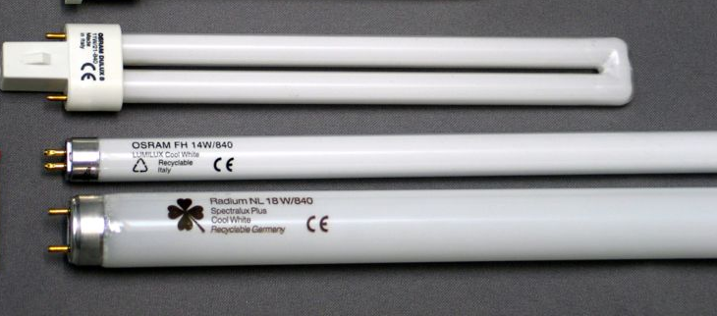
Lighting PMs and Maintenance
Maintenance is vital to lighting efficiency.
Light levels decrease over time because of aging lamps and dirt on fixtures, lamps and room surfaces. Together, these factors can reduce total illumination by 50% or more, while lights continue drawing full power.
Basic maintenance suggestions to keep your lights operating at their optimum energy efficiency:
■ Clean fixtures, lamps, and lenses every 6-24 months.
■ Replace lenses if they appear yellow.
■ Consider group relamping. Common lamps, especially incandescent and fluorescent, lose 20%-30% of light output over their service life.
Notes:
Maintenance is vital to lighting efficiency. Light levels decrease over time because of aging lamps and dirt on fixtures, lamps, and room surfaces. Together, these factors can reduce total illumination by 50% or more, while lights continue drawing full power.
The following basic maintenance suggestions can help keep your lights operating at their optimum energy efficiency:
• Clean fixtures, lamps, and lenses every 6–24 months by wiping off the dust. However, never clean an incandescent bulb while it is turned on. The water's cooling effect will shatter the hot bulb.
• Replace lenses if they appear yellow.
• Consider group relamping. Common lamps, especially incandescent and fluorescent lamps, lose 20%–30% of their light output over their service life. Many lighting experts recommend replacing all the lamps in a lighting system at once. This saves labor, keeps illumination high, and avoids stressing any ballasts with dying lamps.
• Clean or repaint small rooms every year and larger rooms every 2–3 years. Dirt collects on surfaces, which reduces the amount of light they reflect.

Slide 56
Fluorescent Lighting Re-Lamping
Schedule relamping at 70% of rated lamp life, the point on the lamp mortality curve at which 10% of burnouts have occurred.
Purchase 10% more lamps than required for the group relamping.
Use the 10% overstock only to replace burnouts that occur in that group after the group relamping.
Relamp that group again when the 10% stock is depleted.
Notes:
Scheduling regular lamp replacement has become a popular choice for managers seeking to maximize lighting system effectiveness and control lighting costs. Managers have several relamping strategies from which to choose. They can have workers replace lamps as they burn out, or they can schedule workers to replace all lamps in a small group of fixtures, such as those on one floor, at one time. Among the challenges for managers is to determine the relamping strategy that best fits their facilities’ needs.
Managers have several incentives to schedule lamp replacement. The main reason — one often overlooked by lamp manufacturers — is the high cost of lost worker productivity as lamp changers travel around a facility. Observations show that work often stops or slows down in the vicinity of a fixture as it is opened, burnouts removed and new lamps installed. Scheduled relamping offers several additional benefits, but the most important one relates to disruption. Managers should select those areas most vulnerable to disruption as first candidates when starting this practice. Many managers use formulas to determine group relamping intervals, but lamp life values used in these formulas usually are incorrect, leading to wrong answers. Managers might consider an alternate method obtained from a maintenance supervisor who has been using it for years, a method that works better and offers a simple, elegant, self-regulating solution.
How often do you change your lamps in your facility?

Slide 57
Lighting Maintenance Self-Check
To determine a lighting system’s level of effectiveness, use this lighting maintenance self-check:
1. Locate an area of 100 fixtures, preferably with the same number of lamps per fixture.
2. Count the number of missing, burned out, or flickering lamps.
3. Divide this number by the number of lamps per fixture.
4. Count the number of fixtures with broken, discolored lenses or missing parts.
5. Count the number of dirty fixtures.
6. Add the values from steps 3, 4, and 5.
Grade: 0-10, keep up the good work; 11-20, need to spend more time; more than 20, spend much more time or consider outsourcing.
Notes:
Lighting Maintenance Self-Check
1. To determine a lighting system’s level of effectiveness, maintenance and engineering managers can use this lighting maintenance self-check:
2. Locate an area of 100 fixtures, preferably with the same number of lamps per fixture.
3. Count the number of missing, burned out, or flickering lamps.
4. Divide this number by the number of lamps per fixture.
5. Count the number of fixtures with broken, discolored lenses or missing parts.
6. Count the number of dirty fixtures.
7. Add the values from steps 3, 4, and 5.
Grade: 0-10, keep up the good work; 11-20, need to spend more time; more than 20, spend much more time or consider outsourcing.

Slide 58
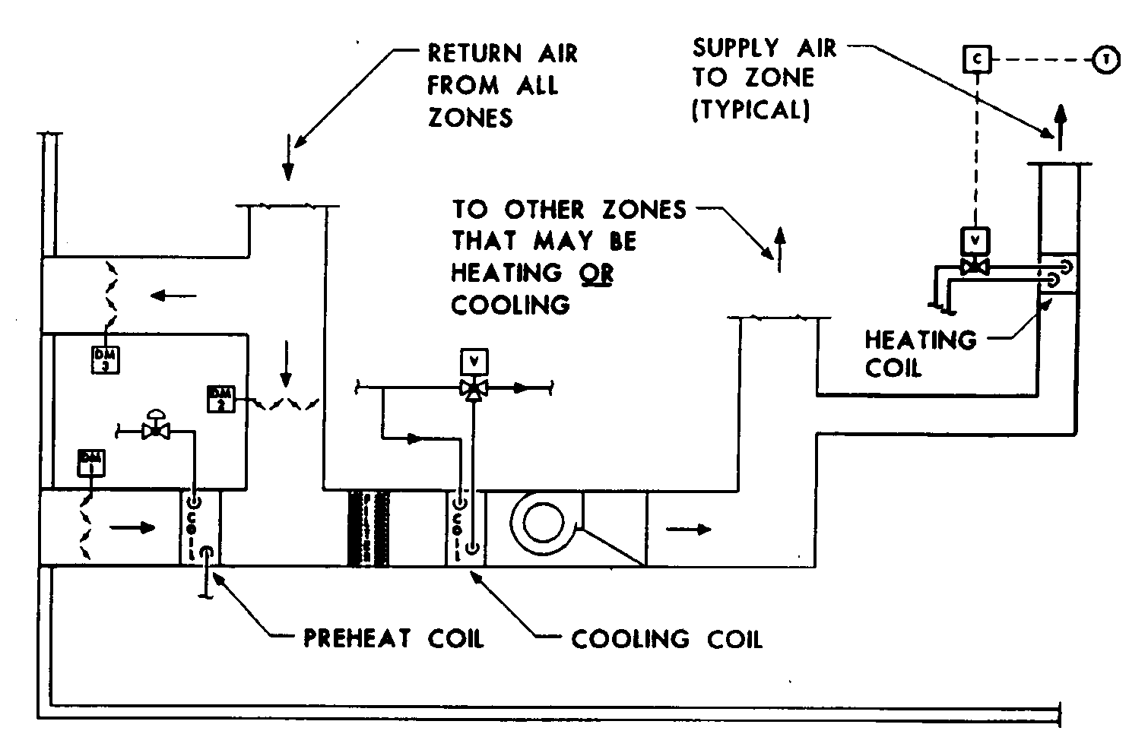
PM Inspection of Typical
Controls and Fan System
Identify control components
Cleaning schedules
Actuator operation
Fan system types
Temperature difference across the coils
Notes:
Are thermostats, control sensors and controllers installed in useful places or are there fittings to indicate that external thermometers were used to calibrate the system? Are the filters and heat exchanger coils clean?
What are the temperature splits across the coils (air)? Typical temperature splits are 10°F to 15°F. The typical split for DX air conditioning is 20°F. The coils’ (water) typical temperature split between inlet and outlet is 10°F.
What is the mixed air temperature? Typical (non-reset) mixed air temperature is 55°F, this is not the most efficient setting during most of the year. Typical reset mixed air temperatures would be 55°F @ 50°F OSAT & 62°F at 30°F OSAT for a building with interior heat gain. Reset schedule should be derived from experience and testing.
What type of fan system is it? Multi-zone? What are the hot and cold deck temperatures? Are the deck temperatures reset? Are the actuators calling for full cool or full heat on the average day? The actuators should be about half hot deck and half cold deck.
VAV system? Does the air delivery reduce for heating? Has someone adjusted the minimum/maximum setting for VAV terminal box?
Does the control for the fan speed or inlet vanes self-adjust to maintain a steady duct static pressure? What is the duct static pressure? You need to know this because VAV terminals require a specific range of pressures to operate properly.

Slide 59
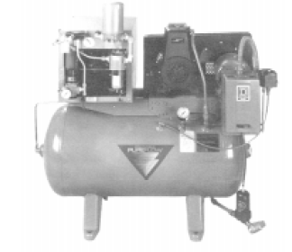
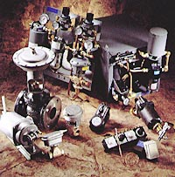
PM for Temperature Pneumatic Controls
Notes:
Pneumatics Check List:
• Check and drain water in compressor.
• Check and replace air filter on compressor as needed.
• Calibrate controls based on the middle of the spring range.
• Check output pressure before and after the pressure regulator.
• Listen and record compressor run time, if running over 50% of the time, compressor lines have air leak, or compressor starting to mechanically wear out due to age.

Slide 60
PM for Temperature Controls
Optimum set points
Calibration
Sensitivity adjustments
Preventive maintenance checklist
Notes:
Optimum set points means that the controls will automatically adjust the temperature or control point to best set point to maximize energy savings and to maintain comfort.
Calibration is the process of adjusting the set-point to equal the control point of the control process.
Sensitivity adjustments should be as high as possible to minimize hunting or rapid cycling of the controlled device.
A Preventive Maintenance checklist on modern controls is just as important as any other PM program. Controls modulate and can drift out of calibration, requiring regular maintenance. Normally the costs of maintenance when contracted with the original vendor are 5-10% of the initial sale price.
The controls and all actuators should be energized and manually inspected to see if they are actually moving into the correct position when required.

Slide 61
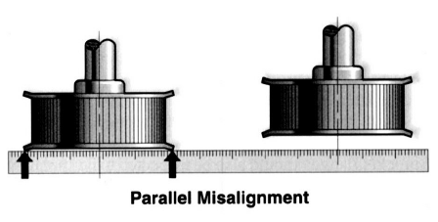
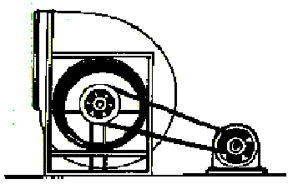
Belt Alignment Basics

Slide 62
Utilizing Manufacturer’s PM Sheets
Sample-Cooling Tower Maintenance Items
Notes:
See sample of PM Sheets in Appendix

Slide 63
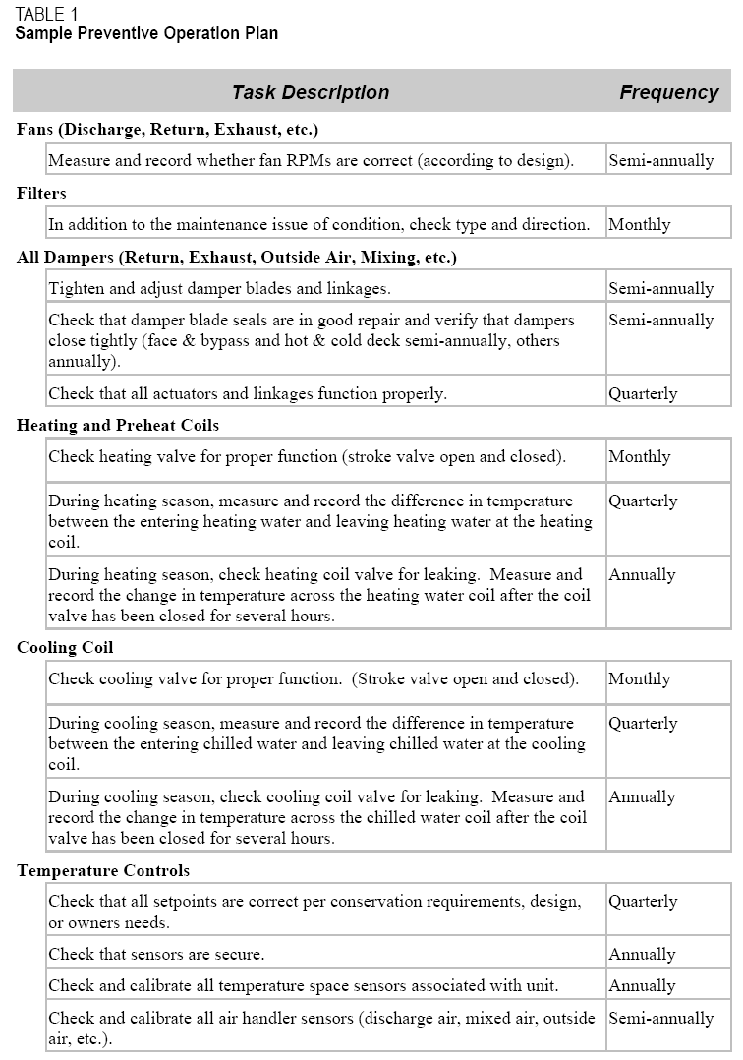
Sample Preventive Operation Plan
Courtesy of PECI, Inc.

Slide 64
Sample Preventive Operation Plan
Courtesy of PECI, Inc

Slide 65
Key Performance Indicators (KPIs) to Measure Energy Efficiency
Measurement of kW, Tons, COP, and kw/Ton of chilled water systems
Combustion efficiency test of boilers
Measuring temp difference in air flow over coils
Operating point on pump curve and fan curves
Sensor and Instrument calibration
Building schedules and optimum set points
Infra-red scans on electrical systems

Slide 66

KPIs for Compressor Chillers Range Peak Chiller Efficiencies
Courtesy of PECI, Inc
Notes:
What is your kW/ton rating of your chiller at your facility?

Slide 67

KPIs and Chiller Efficiency Curve kW/Ton vs. Percent Load
Courtesy of PECI, Inc

Slide 68
KPIs: Chiller Tons and KW Calculations
Measurement of kW on 3 phase chillers:
kW = Volts x Amps x 1.732 x PF
1000
Measurement of tons of cooling on chillers:
Tons = .0417 x gpm x (CHWRT-CHWST)
Measurement of COP on chillers:
COP = 12 / (kW/ton)
3.412
Notes:
Tons = 0.0417 x GPM x (CHWRT – CHWST)
kW = Volts x Amps x 1.732 x PF / 1000
GPM = Gallons per Minute chilled water flow
CHWST = Chilled Water Supply Temperature
CHWRT = Chilled Water Return Temperature
PF = Power Factor, available on startup or assume 0.85
Volts available on startup report
Conversion Factors
One ton of cooling is 12,000 BTU’s per hour
One ton of cooling cools about 300 to 400
square feet of space
One horsepower requires .746 kW
One kilowatt-hour is 3,413 BTU’s

Slide 69
KPIs: Sample Trend Data on Chillers
Courtesy of PECI, Inc

Slide 70

KPIs and Chiller Efficiency Curve kW/Ton vs. Percent Load Over Time
Courtesy of PECI, Inc

Slide 71
Determine the Tons and kW on the Chiller with Flooded Evaporator
55°F CHRT &
45°F CHST
Temp Differences
On Evaporator
@ 200 gpm
Compressor Operating Electrical
VAC = 480, 200 amps, .85 PF

Slide 72
Determine the Tons and kW on the Chiller with Flooded Evaporator
55°F CHRT &
45°F CHST
Temp Differences
On Evaporator
@ 200 gpm
Compressor Operating Electrical
VAC = 480, 200 amps, .85 PF
kW = 480 Volts x 200 Amps x 1.732 x .85 PF = 143 kW
1000
Tons = .0417 x 200 gpm x (55°F CHWRT- 45°F CHWST)
= 83.4 Tons

Slide 73
KPIs and Efficiency on Unitary (Packaged) Equipment
Unitary equipment is often used in small commercial buildings. “Unitary” refers to packaged air conditioning units, heat pumps, or other small equipment. Their overall performance is measured in an energy efficiency ratio (EER) (similar to the residential parameter of seasonal energy efficiency ratio or SEER). The higher these values, the better the efficiency. For example, a unit rated at 36,000 Btu (or 3 tons) with an electrical demand or 3600 Watts has an EER of 10.
Courtesy of PECI, Inc

Slide 74

KPIs for OSA Economizer Operating Curve @ 3% Change
Notes:
Courtesy of PECI, Inc.
http://www.peci.org/ftguide/ftg/IntegratedOperation/IOC-Figs-1-16/IOC-Fig-12.pdf

Slide 75
KPIs for OSA Economizer Operating Curve @ 23% Change

Slide 76

KPIs for Cooling Towers & Water Cooled Condensers
outdoor air wet bulb (wb) impacts tower efficiency
from condenser
to condenser
Sump
(need water treatment)
Scale in condenser decreases efficiency
Notes:
Here are some facts that you should know about water-cooled condensers.
The cooling tower should provide water that is about 7 degrees warmer than the outdoor wet bulb, so a 78 degree wet bulb should yield 85 degree water to the condenser. This is called the cooling tower ‘approach temperature.’ The cooling tower can reach an approach temperature of 7 degrees. There are towers with closer approach temperatures, but 7 degrees is typical. The dry-bulb temperature doesn’t influence the cooling tower water temperature. It is controlled by the wet-bulb temperature which is related to the evaporation rate.
2. Most condensers have a 10 degree rise in water temperature from the inlet to the outlet, so 85 degrees inlet should mean 95 degrees out. Many technicians refer to this as the ‘split’ in temperature. Remember, this is under full load. When the water-cooled condenser is only working at half load, here will be a 5 degree rise in condenser water temperature.
Courtesy of ACHR News.com

Slide 77
Determining Efficiency on Centrifugal Pumps
The pump is a device in the HVAC system that circulates liquids through piping.
Pumps are designed to deliver various flows based on system discharge pressure.
Pump laws provide mathematical equations to determine pump operating conditions to demonstrate:
■ flow is proportional to the speed.
■ pressure (head) is proportional to speed.²
■ power is proportional to speed.³
Notes:
A pump provides the pressure necessary to overcome the resistance to flow of a liquid in a piping system. Pumps can be classified into two groups according the way they develop the pressure, either by positive displacement or centrifugal force. The centrifugal pump is generally used in both hydronic heat and cooling and for cooling tower water applications because it is reliable, rugged, and efficient. The Pump Laws are utilized to demonstrate pump operating conditions and performance.

Slide 78
Pump Affinity Laws and Applied Formulas
Pump Law #1
Pump Law #2
Pump Law #3
Information and photos courtesy of Grundfoss and Bell and Gossett Pumps
Notes:
There are a number of relations concerning low rate (gpm), speed (N), power (HP) and head for any given centrifugal pump that are sometimes useful to the building engineer. These pump principles have basic laws and applied formulas that can be used to demonstrate effects on pump performance when conditions in the operation change, such as speed, gpm, and head.

Slide 79
Pump Affinity Laws and the Effect
Information courtesy of Grundfoss Pumps
Notes:
Pump Law 1 demonstrates that if the pump speed is slowed down, the gpm flow through the pump will slow down proportionately. This is often accomplished in modern buildings when the building DDC controls are utilizing Variable Frequency Drives (VFD’s) to control speed when building loads vary. This is especially common with primary and secondary heating/cooling loops which use two-way control valves at the heating or cooling coils. As the two-way control valves close down, the differential pressure increases sending a signal to the control system to slow up the pump on the VFD at the pump controller.

Slide 80
Pump Affinity Laws and the Effect
Information courtesy of Grundfoss Pumps
Notes:
Pump Law 2 demonstrates that as the RPM slows down at the pump, the ability of the pump to overcome the head pressure decreases non-linear. In this example, the RPM was reduced by 70% of the original speed, but the capacity of the pump versus head pressure is only reduced to 49% of the original value.

Slide 81
Pump Affinity Laws and the Effect
Information courtesy of Grundfoss Pumps
Notes:
Pump Law 3 demonstrates that as RPM speed is reduced, the energy or horsepower required to pump the fluid is substantially reduced in a non-linear relationship as a function of the cube (³) of the flow. This again is a clear example that as a DDC and VSD control process slows down the gpm flow at the pump, energy requirements at the pump is drastically reduced.

Slide 82


Pump Affinity Laws: An Example
Information and photos courtesy of Grundfoss and Bell and Gossett Pumps
Notes:
In this example, the circulating pump has been operating at 1750 RPM with a 50 GPM of water flow. The energy required to pump this water is .40 horsepower. (Note, this is a water circulation pump for this example.) The RPM is reduced by 60% of maximum flow from 50 GPM to 30 GPM.

Slide 83

Pump Affinity Laws: An Example
Information courtesy of Grundfoss Pumps
Notes:
This Pump Law example demonstrates that the feet of head that the pump will provide has decreased to only 6.8 Ft. However, the energy horsepower has substantially reduced from 40 horsepower to 9 horsepower or a drop of 78% in energy consumption. The pump law principle is the main reason that VSD drives are so popular in modern buildings on various applications including hot water, chilled water and cooling towers.

Slide 84
Pump Curve for this Example
Information courtesy of Grundfoss Pumps
Notes:
This pump curve graphically demonstrates the performance of this example before and after the speed was reduced. Reducing GPM’s reduces the pump head capacity as a function of the building load, but it substantially reduces the energy the pump consumes.

Slide 85
Group Exercise
.
Review the Information
on
“PM Procedures”
Notes:
In small work groups or as a class discussion project, discuss the following questions:
1. What is the process to determine a lighting system’s level of effectiveness ?
____________________________________________________________________
____________________________________________________________________
2. If an 83 ton chiller @200 GPM’s, with a 10°F temperature difference starts to run with a 8°F temperature difference, what happens to tons? What is the new tons on the machine?
____________________________________________________________________
____________________________________________________________________
3. If a 10 hp water pump operating at 1750 RPM’s, at 100 GPM’s is reduced to 50% speed, what is the new rpm and what is the new HP? ____________________________________________________________________
____________________________________________________________________
4. What are four simple maintenance checks which should be done annually on a tower?
____________________________________________________________________
____________________________________________________________________

Slide 86
Basic Troubleshooting
Procedures
Troubleshooting Requirements
Troubleshooting 5 Step Approach
Utilizing Manufacturer’s Resources
Examples of Troubleshooting Systems:
■ Boiler/steam systems
■ Chiller equipment and DX cooling systems
■ Air and fan systems
■ Air quality problems
■ Lighting
■ Locating cause of high energy bills

Slide 87
Troubleshooting
Requirements
Follow a logical process.
Develop critical thinking skills.
Utilize interpersonal communication skills with customers and fellow workers.
Stay calm and learn to listen.
Treat everyone with respect.
Notes:
Troubleshooting involves following a logical process to determine the cause of a problem and then correcting the source of that problem.
Develop critical thinking skills. Critical thinking is a mode of thinking the troubleshooter utilizes by imposing intellectual standards upon the situation. That person will gather and assess relevant information and interpret it effectively.
No matter how technically skilled the worker, he or she will never become an effective troubleshooter without utilizing effective interpersonal communication skills. Interpersonal skills are strategies and actions that allow a person to communicate effectively with others.
Sometimes people become very angry and frustrated when problems occur in a facility and this anger can be directed at the maintenance worker. Sometimes you, the person handling the complaint, can be angry about the problem also. When you are in a situation like this, remain calm and listen carefully to an explanation of the problem by the individual. Blame gets you nowhere. Emphasize your willingness to work with the individual to find a solution. Take clear notes during the conversation if necessary. Identify the specific steps to be taken, and the time frame required to repair the problem. Discuss the options , and agree on the appropriate action to take.
Seek to understand. Put yourself in their shoes. Answer all questions as courteously and as completely as possible. Treat everyone with respect and treat their questions with respect.

Slide 88
Troubleshooting:
5 Step Approach
1. Investigation
2. Listing of all possible causes
3. Test for the actual problem
4. Repair
5. Post evaluation
Notes:
As part of the investigation process, take accurate measurements. List all of the possible causes of the problem that might have caused the unit to malfunction.
For example, a heat coil is not performing as expected. Measure the entering and leaving temperature of both the water and air for a heating coil application. A 5°F air temperature difference exists when entering water to the coil is 160°F and leaving water is 155°F. What can we conclude from this?
Conclusion: Restricted air flow.
Find the cause: Is it a dirty coil, loose belt, closed damper?
If the cause of the problem isn’t evident, then evaluate a similar system that is working properly, and compare the two. The problem should show up in the difference in measurements.
Once the cause of the problem is found, take the necessary steps to correct it.
Evaluation: Evaluate how the system is working after the correction. Evaluate your performance in solving the problem. What would you do it differently next time? Is the customer happy? Are you happy? Did you keep them in the information loop?

Slide 89
Learn to Utilize
Manufacturer’s Resources
Fault codes and status indicators
Computerized systems
Technical manuals
Web resources
Notes:
Most manufacturers supply troubleshooting recommendations and symptom diagnosis guides with their equipment. This material should be organized for easy access. It is impossible to operate modern equipment without using manufacturers’ manuals and other resources.
Many systems are equipped with fault monitoring systems that display error codes. When a problem occurs in the system, numbers and words are displayed on a digital readout attached to the equipment or in a control room. The explanation of the code is usually found in the equipment manual.
For example if air pressure is lost in the system, the maintenance worker goes to where error codes are displayed. If the display reads 04, ‘temperature sensor failure’, the worker checks the temperature sensor, and its connections and connecting wires. Usually a protocol is listed in the operations manual. Otherwise, the manufacturer would need to be contacted directly.
Some electronic fault monitoring systems are computerized. When a problem occurs, the monitoring system is accessed using a computer (desktop/laptop or hand-held device) connected to the monitoring system. The error code will be displayed on the computer screen, followed by instructions about how to test the components and make the repair.

Slide 90
Manufacturer’s Resources
Phone & email
Flow charts, graphs
Web-based
Notes:
You can access information from manufacturers and distributors by phone or email. Many manufacturers have toll free numbers that provide access to service personnel. However, sometimes technical support services are part of a service contract and can be costly, therefore it is important to use these resources as efficiently as possible.
When contacting technical support, have all information about the problem written down and handy. Have all related manuals and tools ready for use. Mobile phones are useful for on-site help. In some cases, service technicians can access via computer the equipment’s fault monitoring system remotely and run their own diagnostic tests. Some manufacturers host knowledge databases or other information services where information is posted for those using the manufacturer’s equipment. Also chat rooms, and list serves are another avenue to access helpful information and get answers to your questions.

Slide 91
Utilize Troubleshooting &
Service Bulletins (TSBs)
TSBs are used to track & retrieve information about the causes & solutions to problems including:
■ Equipment identification number
■ Problems & symptoms
■ Test procedures
■ Cause(s)
■ Repair procedures
■ Preventive measures
Notes:
Equipment Identification Number: The identification number used for the equipment in the preventive maintenance program so that this information can be reviewed quickly.
Problem/Symptoms: Completely describe all the symptoms of the problem.
Test Procedures: Describe the cause(s) of the problem. It may also be advisable to describe any testing procedure used to determine the cause(s) of the problem.
Repair Procedures: Describe how the problem was corrected.
Preventive Measures Suggested: Describe preventive maintenance procedures or design changes that could be implemented to prevent the problem from recurring. Work orders might be generated as a result of these suggestions.

Slide 92

Examples of
Troubleshooting Systems
Major Types of Equipment and Problems:
■ Heating/cooling systems
■ Chiller equipment and DX cooling systems
■ Boiler room systems
■ Air and AHU fan systems
■ Air quality problems
■ Control systems
■ Locating cause of high energy bills

Slide 93
Troubleshooting Heating
and Cooling Systems
Who is complaining about comfort?
What are the comfort complaints?
Does the air feel stale or fresh? IAQ problems might exist.
Is the proper mechanical equipment operating?
Notes:
Nature of complaint
Does the complaint relate to the heating system or the cooling system? If the complaint is related to heating system follow steps to correct the problem. If it is not the heating system, make sure the cooling system is not causing the problem. Records should be kept for all complaints and work done. If there are more than three or four complaints, then there is most likely a problem that needs attention.
Who is complaining about comfort? Source area?
How many hours is the person with the complaint there? All day? A few? Are there existing records of comfort complaints and calls for service? How does the building smell? Sensitive people can give you a heads up of a problem before it goes on too long. If the air appears stale and is not fresh, it is possible, you have IAQ problems.
What mechanical equipment is running?
Is the refrigeration equipment running or is the heating/boiler system on? Which should be running? It is possible during the spring and fall seasons to have heat and cooling operating at the same times.
Any rattles? Squeaks and squeals when you open the AHU fan door? Are the mechanical rooms overly hot or uncomfortably cool? Are there water leaks?

Slide 94

Troubleshooting Procedures:
Chillers and Cooling Systems
Check inlet and discharge
pump pressures.
Check supply and
return water temperatures
on chiller and condenser.
Use Electronic
Leak Detector to
check for leaks.
Check refrigerant
charge by looking for suction and
discharge pressures.
If compressor not running,
use VOM to check for supply
voltage and control power.

Slide 95
Troubleshooting Procedures:
Boiler/Steam Systems
Is the heating coil
surface restricted?
Is there air trapped
in the piping?
Purge as needed.
Is the steam pressure
high enough for entire
building load?
Is the steam trap
leaking steam?
Measure for TD.
Has boiler failed on L\low water cut-off?
If so, lock-out
boiler and
determine
cause
Is condensate pump
operating at normal
pressures?
Is boiler operating at normal water level?

Slide 96
Troubleshooting Procedures: Hot Water Boiler Systems
Possible Causes
■ Boiler has no power
■ Water level is low or water is not flowing
■ Pilot or electronic burner ignition malfunction
■ Thermostat or aquastat
malfunction
■ Unit out on manual safety
■ No load or low return water
temperature
Notes:
When troubleshooting a boiler or any piece of equipment, learn to check the power source first to verify that there are no breakers locking out the circuit.
Make sure there are adequate water levels in all powers before turning on the equipment.
Pilot ignition systems are a common source of problems. Learn to check these components of the boiler to verify the boiler is attempting to ignite. The thermostat, aquatstat or boiler pressure switch is the primary operational control that needs to send a signal to initiate the start sequence.

Slide 97

How Does a Building Operator Know When Something on the AHU is not Operating Properly?
Where should they look and what are some key Indicators?
Is the problem with mechanical equipment or is it a controls and/or sensors problem?
One Approach - Establish Some Rules or Logic Checks (example)
■ Determine general operation and mode of operation heat/cool/economize.
■ Check to be sure there is a “No Heat” or “No Cool” condition.
■ Is it only a cooling problem?
■ Is it only a heating problem?
■ Check to be sure if it is a ventilation-related problem.
■ Is Unit Efficiency getting worse as problem progresses?
Notes:
One Approach - Establish Some Rules or Logic Checks
1. General Operation - Heat/Cool/Economize
Measure and determine key air temperatures, i.e., Toa < Tma < Tra, If not, check dampers or sensors.
Tma is approximately equal to Tra - Outdoor air damper may be closed.
Toa is approximately equal to Tma - Return damper may be closed.
2. No Heat or Cool
Tda is approximately equal to Tma + (1 to 2) F (if motor in air stream). If not, check the sensor, or for leaky heat/cool valve.
3. Cool
If Tda is 54-55°F for proper dehumidification.
If Tda lower, may indicate low air-flow problems, belt slip, filter plugged, refrigeration charge.
If Tda higher, may indicate high air-flow problems.
4. Heat
Is Tda - Tma proper temp rise per unit (could be two heat stages)? Must compare with unit operating specs.
If Tda low, may indicate high air flow, belt slip, filter plugged.
If Tda high, may indicate low air flow.

Slide 98
Notes:
5. Outdoor Air Ventilation
CO2 Return Air > 1,000 PPM, insufficient outdoor air, reset economizer min position.
CO2 Return Air between 325 and 800 PPM, too much outdoor air, consider reset economizer min position.
6. Unit Efficiency
Measure Amps, Volts & Calculate Power.
Compare Measured Power with unit specifications at given outdoor air condensing temperatures and entering air temperatures charts in vendor performance specifications and trend data over time.

Slide 99
Troubleshooting Procedures:
Air and AHU Fan Systems
High velocity air noise?
Is the Unit Box restricting CFM?
Are the coils restricted?
Are they dirty?
Are the Actuators
operating?
Is the air flow CFM lower
than required to
cool or heat the space?
Drive or bearing noise?
Notes:
Useful Fan Air Flow Information when Troubleshooting
Total Air Pressure= Velocity Pressure (VP) + Static Pressure (SP)
Velocity Pressure = Total Air Pressure – Static Pressure
Cubic Feet Per Minute (CFM) = Duct Area x Velocity (fpm)

Slide 100

Troubleshooting Fan Noise Problems
Courtesy of Greenheck

Slide 101
Troubleshooting Procedures:
Air Quality Problems
Is there an inaccurate or faulty CO2 sensor? Check CO2 levels.
Have poor maintenance practices created or caused pollutants?
Is the ventilation outdoor airflow rate low?
Have building renovations affected the HVAC systems?
Have the VAV units reduced the ventilation when zone thermally satisfied?
Notes:
The CO₂ level is an indicator of the need for ventilation. Many control systems will have a permanently installed CO2 sensor in the return air stream. Check to make sure CO2 sensor is accurate. You will need to check it with a portable calibrated field instrument or span gas.
Poor building maintenance can cause molds, bacteria, and other pollutants to grow in your building and HVAC system. This includes at the cooling tower, the sump of the cooling coil, or within your ductwork because of a faulty humidifier.
According to OSHA, CO 2 levels should not exceed 5000 ppm, according to ASHRAE 62.1 , reference levels should not exceed 1000 ppm. If CO₂ levels are increasing beyond the action level for the workplace standard, the outside air supply is inadequate to meet the needs of the space. (This presumes constant and relatively low outside CO₂ levels of ~350ppm.)
Ventilation rates (OSA) need to increase if CO₂ levels get too high.
Contaminant sources can also cause poor IAQ conditions which may require source control measures and spot exhaust ventilation or an overall change in the ventilation strategy. This will depend on whether the contaminant is localized or dispersed in the facility.
Improperly set VAV boxes will not provide sufficient fresh air into the zone.

Slide 102
Troubleshooting Procedures-
Air Quality Problems
Are the zone CO2 sensors
accurate and calibrated?
Are VAV boxes providing minimum cfm?
Check CO2
Levels.
Is OSA fresh
air adequate?
Is there bacteria in
the cooling tower and
at the cooling coil?
Are air filters dirty and polluting the air?
Notes:
Identify the basics:
Are the zone CO2 sensors accurate?
Measure CO2 Levels and the return air stream?
Is there bacteria growing in any of the HVAC equipment?
Are the air filters clean?
Is the OSA fresh air open far enough for adequate building ventilation?
Are the VAV boxes open far enough for occupant fresh air requirements?
If there are pollutants, determine the pathways for the pollutants to get into the space.
Use Qualified Help if IAQ is severe and find a permanent fix to the problem.
Agency Guidelines and Standards for CO₂:
OSHA levels 5000 ppm
ASHRAE/Washington State 1000 ppm
CO₂ levels depend upon ventilation rates and contaminant sources.

Slide 103
Troubleshooting and Locating Cause of High Energy Bills
Who reported the high energy use?
What is the energy index? BTU/ft²?
Determine the energy profile.
Record the hours of use versus needed hours of operation.
Check temp. set points, time clock or computer start/stop time operations.
Purchase power monitoring metering and record power use for suspected high use zones.
Notes:
Locating Cause of High Energy Bills
Has an accountant or building manager complained about the high electric bill? Was the high bill during the air-conditioning season? Is the building heated by electrical resistance? Do you know the energy index for your type of building in BTU/ft²? Have energy rates recently increased causing bills to increase though consumption has not?
Determine Energy Profile by graphing the energy usage of each fuel separately and compare over time.
Do the hours of use coincide with hours of operation?
Many buildings operate year around with settings based on extreme weather conditions. They should be reset to match current weather conditions. Time clocks should be set to match seasonal cycles & time differences.
Is the building being heated or cooled to accommodate a couple of people? Is the entire building heating & cooling at the same time? Is this necessary? Does the building HVAC zoning follow its use pattern? How about building orientation, cold north walls, warm south walls? Is there a pattern with these effects?
Purchase power monitoring metering and record power use for suspected high use zones.

Slide 104
Group Exercise
.
Review the Information
on
“Troubleshooting Procedures”
Notes:
In small work groups or as a class discussion project, discuss the following questions:
1. Why are interpersonal communication skills so important when troubleshooting?
____________________________________________________________________
____________________________________________________________________
2. What manufacturers’ resources are available at your facility? Are any resources lacking that would help you troubleshoot your equipment? Explain.
____________________________________________________________________
____________________________________________________________________
3. When troubleshooting a boiler, what is one of the most important inspections or tests that you can make?
____________________________________________________________________
____________________________________________________________________
4. What would a high CO2 level mean to you or your building occupants?
____________________________________________________________________
____________________________________________________________________

Slide 105
Selecting Computer Maintenance
Management Systems (CMMS)
Important Features of the CMMS:
■ Automatic work order with status of all outstanding work.
■ Records service calls with automated time/date stamping.
■ Allows operations or facility users access to the system.
■ Provides reports for budgets, staffing analysis, program evaluation, performance.
■ Automatically produces PM work orders on the right day.
■ It is easy to use for novices.
■ System can be integrated to purchasing, engineering, payroll/accounting.
■ The vendor should have been in business for several years.
■ There should be a phone number for tech support.

Slide 106
Computerized Maintenance Management Software Options
Vendor Options and Costs
Predictive Maintenance
Preventive Maintenance
Scheduled Maintenance
Easy to Use
Free Tech Support online or on phone

Slide 107

CMMS Systems Can Issue and Track Work Orders
Courtesy of BENCHMATE

Slide 108

CMMS Systems Can Maintain
Equipment Inventory

Slide 109

CMMS Systems Will Predict and
Schedule Preventive Maintenance

Slide 110




Equipment and Tools
for Maintenance Staff
Diagnostic tools and meters for PM and for
Troubleshooting Building Systems
■ Electrical Meters
• VOM Meter/True RMS (Volt Ohm Amp): should be able to measure equipment power and current, $100-$400.
• Megger: used to measure motor winding insulation, $120-$5000.
• Power Meter/Harmonics Analyzer: used to measure power and harmonics at individual loads, $200-$3000.
Reproduced with permission of Fluke

Slide 111



Equipment and Tools
for Maintenance Staff
Gas Analysis
■ Portable CO2 and CO-Used for IAQ Testing, $180-$500.
■ Gas Combustion Analyzers-Used for Boiler and Gas Heat Applications, $250-$6000.
Air Flow
■ Flow Hood (used to measure cfm at diffusers), $2500-$4000.
■ Pitot Tube and Manometer (used for duct fpm), $30-$750.
■ TrueFlow plates for measurement of CFM (approx.
$5,000 for plates and spacers)
Miscellaneous
■ Electronic Thermometer, $80-$500.
■ Electronic Refrigerant Leak Detector, $150-$350.
■ Data Loggers
Reproduced with permission of Fluke
Reproduced with permission of ALNOR/TSI Products and Testo Tools

Slide 112



Diagnostic Tools to Measure Energy Efficiency and Performance Should Include the Following:
■ Data Loggers
■ Infrared Temperature vs. Thermal Imaging
■ Meggers
■ IAQ Analysis
■ Air Flow Measuring
■ Water Treatment Testing
■ Light Level Analysis
■ Noise Measurement
■ Equipment Oil Analysis
■ Harmonics and Power Quality Testing
■ Laser Alignment
Notes:
Diagnostic tools like these are increasingly available to borrow for free from energy tool lending libraries emerging in many areas. The Smart Buildings Center Tool Lending Library website has many free tutorials available that show how to use various energy monitoring and diagnostic tools for assessing building performance and opportunities for improvement. (https://www.smartbuildingscenter.org/tool-library/tool-resources)

Slide 113
BOC 2010 - What have you learned?
The Types of Maintenance
3. Best Practices for O&M
4. Examples of Basic PM Procedures
5. Key Performance Indicators (KPIs) for Energy Efficiency
6. Basic Troubleshooting Procedures
7. Computer Maintenance Management Systems (CMMS)
8. Equipment and Tools

Slide 114
The Final Test
Open Book
Use Your Notes
and
Good Luck!

