Slide 1

BOC 2011
Motors in Facilities
Edition 1.00
Month Day, Year
Instructor Name, Position
Instructor Company
Phone
Name@email.com
Notes:
Instructor’s name: __________________________________________________________
Phone number: ____________________________________________________________
E-mail: ___________________________________________________________________
_________________________________________________________________________
_________________________________________________________________________
_________________________________________________________________________
_________________________________________________________________________
BOC 2011
Motors In Facilities
Edition 1.00

Slide 2
Project Debrief
What has gone well?
What hasn’t gone well?
Why did things happen?
What will you do differently/better next time?
How will you use this?
Notes:
Project Workbook Assignment 5: BOC 2004, Building Scoping Report
Part 1: Using the building walkthrough plan you prepared for PW4, schedule a date for a building walkthrough of your facility. Conduct the walkthrough of your facility using the tools and personnel identified in your plan. Visit each location identified in your plan. Make note of your findings during the walkthrough. You will use these notes to complete the building scoping report form.
Part 2: Review the Building Scoping Report Form in the Project Workbook to refresh your knowledge of the report contents and the information you will need to complete the report form. You will need three documents you completed for earlier project assignments to complete the report form. These include the Building Scoping Interview Guide for PW Assignment 2; Building Operations Map for PW Assignment 2; and Building Walkthrough Plan for PW Assignment 4. In addition to the documents above, you will need to reference the notes you take during the building walkthrough. Working from the three documents and your notes, Complete the Building Scoping Report Form on the following pages.

Slide 3
Agenda
Class Overview and Discussion
How Motors Work
Motor Driven System Operation Costs
Nameplate Data
Motor Maintenance
Service Centers Maintenance: Repair-Rewind
Motor Management
Notes:
Class Overview
Motor decisions are often made at the time of motor failure and come at the price of heavy downtime costs. This leaves limited time for analyzing repair and replace options or identifying service vendors. BOC 2011 covers topics including: how motors work, motor maintenance, management of motor failure, replacement motor criteria. The goal of this class is to help you manage motor failure and make important decisions about the electric motors in your facility. We hope at the end of the day you will be more comfortable working with motor issues and feel empowered when dealing with motor vendors.
Agenda
Class Overview and Discussion
How Motors Work
Motor Driven System Operation Costs
Nameplate Data
Motor Maintenance
Service Centers Maintenance: Repair-Rewind
Motor Management

Slide 4
Learning Objectives
Describe how motors work.
Identify uses and applications of motors in facilities.
Identify equipment and define relevant terminology.
Identify motor failure causes and effects.
Calculate motor-driven system operation costs.
Analyze repair and replace decisions.
Notes:
Learning Objectives
After this class, an operator should be able to:
Describe how motors work.
Identify uses & applications of motors in facilities.
Identify equipment & define relevant terminology.
Identify motor failure causes and affects.
Calculate motor driven system operation costs.
Analyze repair & replace decisions.

Slide 5
Action Plan: Part 1
Write your mailing address on the provided envelope.
On the top of one side of the provided 3x5 card write “Things to remember.”
On the top of the other side write “Things I will do.”
During the day, add your notes to the card.
Notes:
Handbook review by sections, additional reference slides, and glossary.
During the workshop, write down short notes of “Things to remember” and “Things I will do.” At the end of the day you’ll place the card in the self-addressed envelope, seal it and in 30 days or so we’ll mail it to you as a reminder.

Slide 6
Roundtable Discussion
What about motors would you like covered today?
How many motors are in your facility?
What is the horsepower of the largest motor in your facility?
Do you have critical motors?
If a critical piece of equipment fails, what happens?
Notes:
To better tailor today’s discussion, please let us know motor issues or topics you’d like covered. We can’t promise we’ll be able to cover everything or have all the answers, but we’d like to try and we’d like to customize today’s activities to better address your specific needs.

Slide 7

How Motors Work
Notes:
This video can be found in the supplemental reading material available to students registered for BOC training at the following URL. Please use the password below to access it.
http://www.theboc.info/student-partner-login/boc-supplemental-class-materials
Password: BOCstudent
Video tutorial notes: ________________________________________________________________________________________________________________________________________________________________________________________________________________________________________________________________________________________________________________________________________________________________________________________________________________________________________________________________________________________________________________________

Slide 8
AC and DC Motor
Fundamentals
Ohm’s Law: Resistance = Voltage / Amps (Current)
Watt’s Law: Watts = Volts x Amps
V
V = Voltage
Ω = Resistance (Ohms)
A = Amps
V
V
A
=
A
Ω
A
Ω
Ω
V
V
V
Ω
=
V
=
A
Ω
A
Ω
A
A
Ω
Notes:
Ohm’s Law mathematically describes the relationship between voltage, current, and resistance(ohms). Watt’s Law is useful in sizing electrical equipment, determining resistive loads using these simple electrical calculations. As presented in the video we just watched, the law applies to motors in that amperage (current) is the measurement of the flow of electrons in a completed circuit. Voltage or pressure forcing electrons to flow in a circuit (including resistance) directly affects the measurement of amperage. Resistance plays a significant part in accepting various voltages.

Slide 9
Basic Electrical Concepts
Section One
Notes:
Simply stated, voltage is a pressure exerted on either a conductor or insulator. A good conductor allows electrons to flow with less voltage or pressure than an insulator.
Good conductors: gold; silver; copper; aluminum; steel; concrete; non-distilled water
Good insulators: plastic; glass; ceramic; rubber; wood; paper, cambric

Slide 10
Ohm’s Law:
Voltage = Resistance x Current
Resistance
Amps
Voltage
Amps
Resistance
Resistance
Amps
Voltage
Voltage
Notes:
A seesaw illustrates Ohm's Law and the relationship of voltage, amperage (current), and resistance. If voltage in a circuit is unchanged and the resistance is decreased then amperage increases by the same proportion. In turn, decrease the resistance and the amperage will increase proportionally. If the resistance changes then voltage and amperage must change as well. In most working loads, like motors, when voltage increases from 120 volts to (exactly double) 240 volts, then amperage will go up from 24 Amps to 48 Amps. To prevent this, the resistance of the wire must increase from 24 ohms at 120 volts to 48 ohms or double at 240 volts. So the length of wire at 120 volts, if the diameter and composition remain the same, would double at 240 volts. This will get us that new resistance we need and, generally speaking, always happens proportionally.
This relationship holds true for purely resistive loads with DC current. Since motors are primarily inductive loads operating on AC current, the relationship between Voltage, Current and Inductance follows a pattern which allows amperage to decrease as voltage is increased.

Slide 11
Ohm’s Law:
Resistance versus Induction
Resistance
Amps
Voltage
Figure 1. DC and/or resistive seesaw relationship
Voltage
Amps
Resistance
Figure 2. AC inductive seesaw relationship
Notes:
In Figure 1 above, a seesaw illustrates Ohm's Law and the relationship of voltage, amperage (current), and resistance. In DC and resistive (loaded) circuits, if voltage is unchanged, decreasing resistance will increase amperage proportionally. In turn, decrease resistance and amperage will increase proportionally as presented in previous BOC classes.
In Figure 2, the relationship changes significantly in AC circuits when inductive loads, such as motors, are introduced. Magnetic induction introduces power factor into the equation causing voltage to be interchanged with resistance in our seesaw. In an AC inductive load, if voltage increases, amperage will decrease proportionally. In turn, if voltage decreases, amperage will increase proportionally.

Slide 12
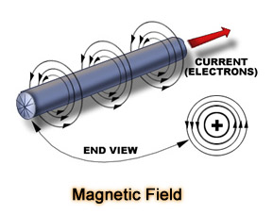
Electrical Field Forces
(b)
(a)
Notes:
From the short video, we discovered the hypothetical electrical field around one conductor (a) and the combined electrical fields of two conductors (b). The conductors of both (a) and (b) are, in our example, carrying the same amount of current.
Example (a) hypothetically has four lines of electrical force. By adding a second wire of the same size in parallel (b) we see the lines of force have doubled in strength to eight, while each wire is still carrying the same current or amperage load. If another wire of the same diameter were added in parallel, this would strengthen the electrical force field to twelve and so on as conductors in parallel are added while each conductor continues at the same current level.

Slide 13
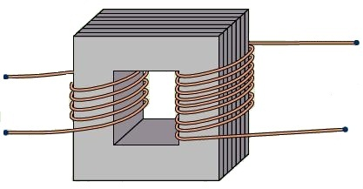
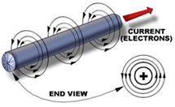
Magnetic Induction
Two primary principles:
Magnetic field
Electrical field
T-1
E-1
E-2
T-2
Transformer
Notes:
From our video, when another conductor is within the electrical field of an energized conductor, it too becomes energized. The two conductors do not electrically touch and may be insulated from one another but the conductor becomes electrically energized by induction. And too, if a material capable of magnetism (e.g. steel lamination) is within the electrical field of a conductor, it becomes a magnet and capable of magnetically inducing a field of force onto another conductor or metal.
In the above illustration, if voltage is applied to a transformer at E-1 and E-2, by induction, voltage would be available at T-1 and T-2. The voltage transformation would occur or be induced proportionally to the ratio of conductor (wire) turns from E connections to T connections.

Slide 14
Magnetic Reactance
Direct Current Circuits
(a)
(b)
Notes:
In a resistive circuit (a), when D.C. power is applied we see amperage rise almost instantly, as is the case when power is switched off. In an inductive circuit (b), placing wires through an iron lamination the same lines of force will be exerted into the iron, or induced upon it. In example (b) when power is applied it takes time for the magnetic field to be created causing polarization. When power is maintained (without voltage variation) the field is stable, the amperage line is flat. When power is interrupted it takes time for the magnetic field to collapse, which is indicated by current continuing beyond the interruption point. If current is alternated, at say 60 times per second, the current would always be lagging behind the voltage due to the time it takes to create a magnetic field.

Slide 15
Resistive and Inductive Loads
Notes:
In resistive circuits with A.C. power applied to things like incandescent light bulbs and heating elements, there is no magnetic reactance time. Therefore amperage and voltage look very symmetrical, falling at the same time or rate.
In an inductive load, because amperage lags behind voltage the sine wave becomes a little out of sync. When voltage has switched from positive to negative, in our alternating circuit, the collapse of the force field could produce power and send it back to the power source on the negative voltage cycle as it collapses. For a split-second the metal lamination becomes a generator to the electrical circuit, in a manner of speaking. The “generated power” is unusable because it is reversed on the next half cycle. That percentage of generated power on the cycle change is more appropriately termed power factor. It is expressed in inductive devices as a percentage, such as in motors, transformers, solenoids, etc. *Power factor can be an issue in alternating current inductive load circuits, particularly when larger electric motors operate. Since this power is only “borrowed” and then returned, it does not show up on many utility meters. The utility has to provide enough equipment and transmission lines to supply all the power including this borrowed power, so many utilities charge an additional fee when that “borrowed” or power factor becomes excessive.

Slide 16
Power Factor Correction
Capacitor
1.
Capacitor
Foil 1
Foil 2
Switch
Battery
2.
Capacitor
Capacitor charged
3.
Switch closed
Switch opened
Battery
Battery
Notes:
Power factor can be corrected or re-synchronized by adding capacitance. Adding capacitance in an A.C. circuit will change the timing of the amperage and voltage sine wave. In a D.C. circuit, if a capacitor is added, negatively charged electrons (current) flow or align toward one pole of the capacitor and positive align toward the other pole much like the opening video demonstrated. In a capacitor, amperage induction is accomplished by an electrical field and occurs almost instantaneously but voltage builds more slowly and therefore lags behind. How much capacitance is required to almost realign or sync (unity) the amperage and voltage wave forms depends upon how much magnetic reactance exists in the circuit. There are many manufacturers of power factor correcting capacitors and monitoring equipment that have tables laid out to select the right equipment and capacitance, so that really isn’t something we need to dwell on here. Just an understanding of what’s happening and the reason to add capacitance will help.
Power factor correcting equipment, once installed and sized properly, should be trouble free. Heat is a factor and over-cycling or switching in and out could cause contact points to wear and capacitors to over-heat. In some instances the capacitor bank is installed with cooling fans so a check of operation and air-filters occasionally would be in order. The capacitor bank should be free from moisture, dust and pest debris. If there is any contactor switching devices, a check of the contact points by a qualified electrical technician or electrician would be warranted. If you’re qualified, wear suitable protective gear per NFPA 70-E and be sure the equipment is disconnected and has been properly discharged before attempting any maintenance. Safety first!

Slide 17
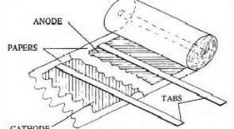
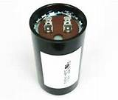
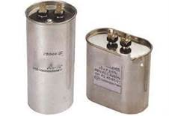
Single Phase Motor Capacitors
Notes:
There are many types of capacitors found in everything from electronics to power transmission. Pictured are several common single phase motor capacitors. The black or electrolytic capacitor is very often used to start a single phase motor. The silver (run) capacitors are often used to add the single phase start winding in the run mode to add horsepower.
Internally most capacitors are made of two pieces of foil separated by a paper insulator submerged in a non-conductive liquid. The foil pieces are connected to input power and output load to apply capacitance to the system. In a single phase motor, adding a capacitor to a start winding temporarily creates, in a manner of speaking, a new (temporary) power leg causing the motor to rotate. The start winding and capacitor are generally disconnected at about 75 percent of nameplate RPM.

Slide 18
Single and Three Phase
Alternating Current
1)
2)
3)
SAE/Metric
Notes:
Single phase alternating current on a scope looks like the first illustration (1). Three phase, much more complex, looks similar to the second illustration (2). To better understand that we’re working with degrees, we’ve used a circle in the third illustration(3), cut it in half, and slid the bottom half forward. 90 degrees straight up, 180 degrees goes down through 0 voltage, 270 degrees straight down and 360 degrees completes the circle’s “rotation” back through 0 voltage – much like a motor.

Slide 19
AC Conversion to Coil Groups
Notes:
This illustration shows how the coil groups of a three phase motor emulate the three phase sine wave.
Three coils of wire comprise a group as in the lower half of this picture, and replicate the circle representing alternating current from the previous page; 0 degree, 90 degree, 180 degree etc. These coils can be placed in an iron or steel lamination of a motor and will maintain their electrical degrees, similar to the sine wave we just discussed.

Slide 20
Three Phase Windings
Concentric Winding
Lap Winding
Notes:
Random windings are for the most part either concentric or lap, as seen in this slide. Again the electrical degree angles of the three phase sine wave are maintained when placed in a motor’s lamination. The electrical field force then induces a magnetic field onto the lamination, each copper wire is independently insulated and does not electrically touch another wire or the lamination.

Slide 21
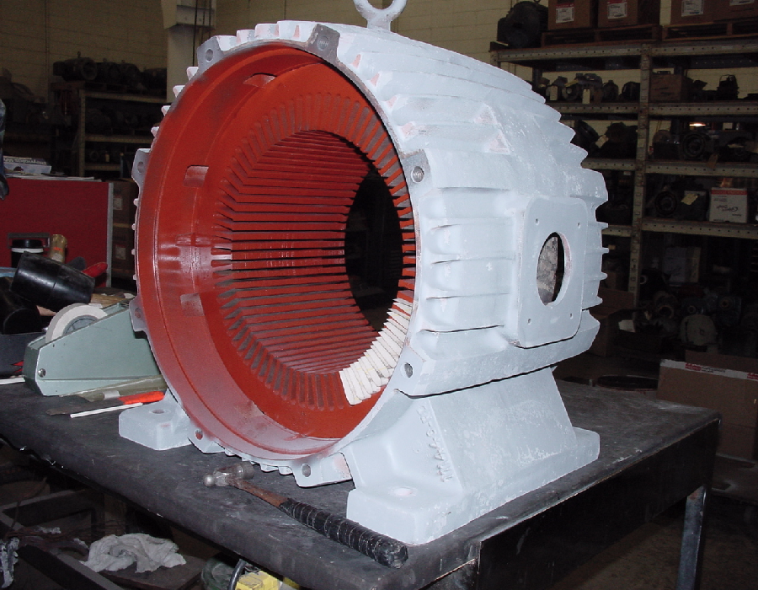
Notes:
This is a three phase 100 HP 4 pole or 1800 RPM motor core about to be rewound. The lamination core has been tested, stripped down to bare metal, cleaned, tested, painted, and about ten slots insulated. When a motor is rewound improperly it will probably lose efficiency and be less reliable. Original motor efficiency can be maintained if there is no damage resulting from failure-events and it is rewound correctly.

Slide 22
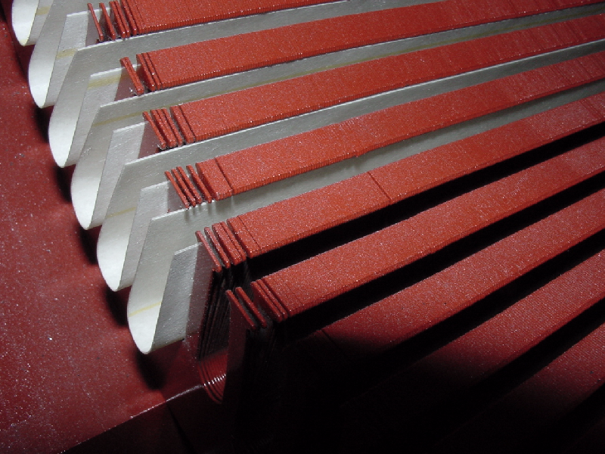
Notes:
In this close up you can see the slot insulation and the individual metal segments that make up the lamination. Each lamination piece is electrically insulated from the next so that each one can be induced independently. The more efficient the motor, the narrower or thinner the lamination pieces and the more there are – easier to magnetize and demagnetize. Remember the wire with the magnetic field around it from the opening video and the time it takes to create that field. A thinner piece of metal will take less time to energize and de-energize than a thicker piece and will have more fieldforce capacity per pound of material.

Slide 23
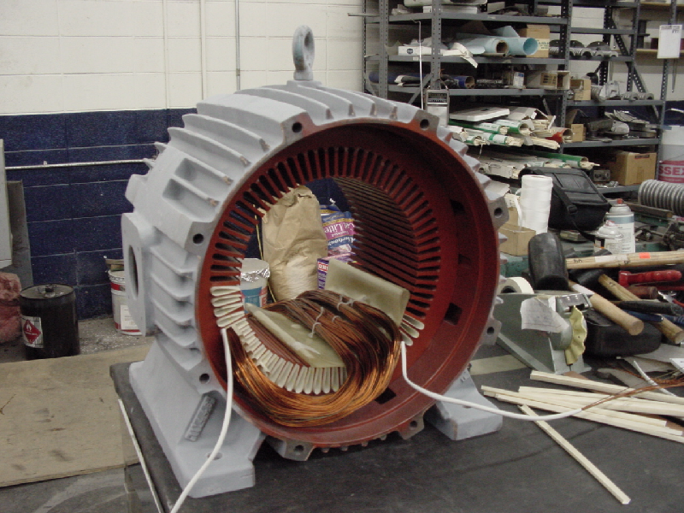
Notes:
The first coil group is half installed in the stator. One side is in the cell. The other side is left out so that another group can be inserted in the bottom, and the remaining side of this coil can lay on top.

Slide 24
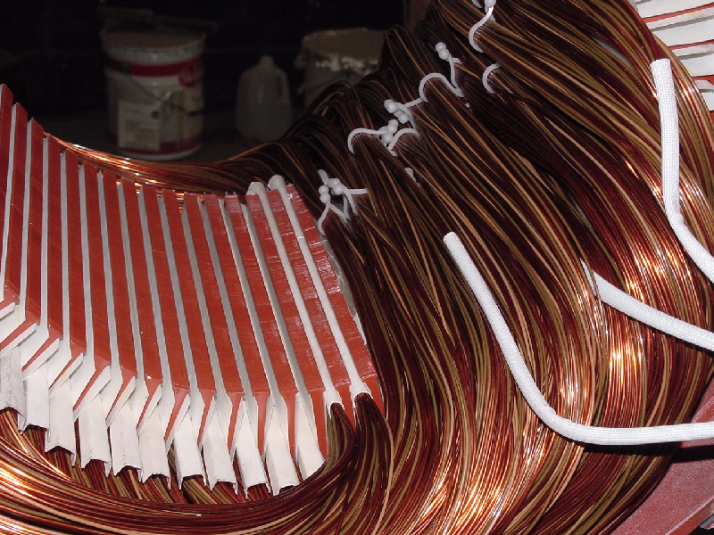
Notes:
After several more coil groups have been installed and insulation placed on top of them, the top of the first coil group can finish filling the cell. A slip wedge or top stick is then installed to hold the coils firmly in place.

Slide 25
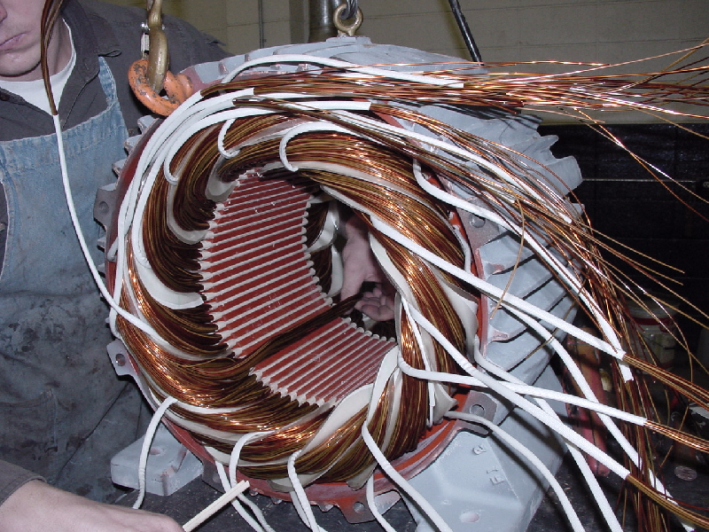
Notes:
Final coils installed, ready for connections. More complex than the opening video but utilizes that same theory.

Slide 26
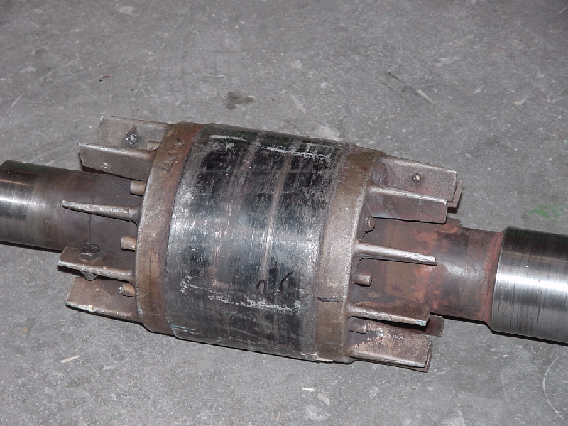
Rotor Current Flow
Applied by Induction
Aluminum End Ring and Fins
Iron Lamination
Notes:
Remember, the number of coil wires in parallel increase electro-magnetic field strength. When a rotor is placed inside a magnetized lamination and the magnetic force field is powerful enough to extend or be induced upon the rotor, the rotor can become magnetized, causing induced voltage and current to flow as was the case in the video demonstration. The voltage is very low, usually less than 2.5 volts while the current (e.g. the seesaw) is very high, making the rotational force more powerful than the force from the stator lamination alone. Variable frequency drives (VFD) can increase rotor voltages beyond 2.5 volts resulting in bearing damage. The rotor sometimes begins acting like a capacitor, storing energy and discharging that energy through the balls or cylinders of the bearings to ground.

Slide 27
Magnetic Poles
Frequency (60) x 120
number of poles
120 = 60 positives + 60 negatives
7200
= 3600
2
SAE/Metric
Notes:
We saw pictures of conductors or wire inserted into a motor, now how does that all get connected?
Magnetic poles determine the RPM of a motor. The circle represents a three phase, two pole motor. The letters ABC indicate each phase of three phase power or one pole and the other ABC as the second pole. The order of the alphabet or electrical phasing represents the rotational direction of the motor. If you went CBA, that would represent a reverse in motor direction. This is why interchanging any two power leads to a three phase motor will reverse the direction of rotation. If power is alternating positive and negative sixty times per second we know that in a one minute period we must have, because there are sixty seconds in a minute, at least 60 positives and 60 negatives or 120 total of both. Since we’re in the USA and use the SAE measuring system our power alternates 60 times per second or base 12. Metric electrical power alternates 50 times per second. Taking 60 Hz. (alternations per second) and multipling by 120 equals 7200 RPM. We can divide by the number of poles in the motor and get the synchronous speed. A two-pole motor is 3600 RPM and a four-pole motor is 1800 RPM and so-on. But that’s in a perfect world. It takes time to induce fields and for the rotor to get around to the next pole and there are other forces dragging it back – in an induction motor this is termed “slip.” A high performance or NEMA Premium efficient motor turns faster than a less efficient motor. A standard motor may run 1725 RPM where a NEMA Premium of the same horse power may run 1760 RPM, at full load or 35 RPM less slip.

Slide 28
Two Pole “Y”
Parallel Series
Notes:
A two pole (3600 RPM) “Y” connected motor.
If wound to this diagram, we could drop this winding in a motor and it will run, provided we’ve done a number of other things right. Examining the connection of the lower voltage or parallel connection, the power will travel through the coils of wire half as far as the higher voltage or series connection. Parallel and series circuits are used in a motor so they can run on lower or higher voltage without burning up. This goes back to Ohm’s Law or our seesaw, and the opening video’s demonstration with light bulbs. Let’s say we apply 230 volts of pressure to the lower voltage connection traveling only half the distance, then it would follow that we would need to apply 460 volts of pressure or twice the voltage to travel twice as far through the coils in the higher voltage or series connection.

Slide 29
Delta Connection
Notes:
In a delta connection, though the connections are different, the principle is the same. Taking an ohmmeter and connecting to terminal 1 and 4 the resistance will be exactly the same as 2 and 5 and 3 and 6. However 7 and 8, 8 and 9, or 7 and 9 will exactly double the resistance of 1 and 4, 2 and 5, or 3 and 6. If we connected per the lower voltage diagram and read an ohmmeter connected to the power leads we might read 5 ohms resistance. Reconnecting to the higher voltage or series connection and putting our ohmmeter on the power leads again, we will read 10 ohms or double the resistance. In motors over 50 HP a regular ohmmeter may no longer work because the internal coil wire gets too big and has very little resistance. To measure a larger motor’s coil wires, a bridge-milometer or similar device is used. When troubleshooting, this is extremely useful information since a bad winding will show a “short,” “open,” or even a slight resistance variation. This makes the term “short” make sense.

Slide 30
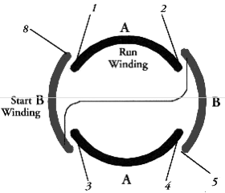
Single Phase Winding
Connection | Line A | Line B | Join
High Volts Std | 1 | 4,5 | 2, 3, 8
High Volts Rev | 1 | 4,8 | 2, 3, 5
Low Volts Std | 1, 3, 8 | 2, 4, 5 | —
Low Volts Rev | 1, 3, 5 | 2,4, 8 | —
Notes:
A single phase winding has only phase “A” making it easy to see the parallel or series connection. If powered there would be no rotation as with the three-phase diagram, it just sits there going up and down not going around. A single phase motor is like a bumblebee, in that it really shouldn’t fly, so in order to make it start rotating, a start winding is added. Power is temporarily applied to the start winding (except in the case of shaded pole motors and permanent-split capacitor motors) in series with an electrolytic capacitor and centrifugal switch until the motor reaches 75 percent speed. The start winding is then disconnected. If more power, at full speed, is needed, manufacturers may add one or more run capacitor(s) and leave the start winding connected. If an electrolytic capacitor is used in conjunction with oil filled run capacitor, the electrolytic is still disconnected at 75 percent speed and the oil filled is left in the circuit. Aside from enclosures, single phase motor types are determined for the most part by the amount of torque they can produce during the start sequence. Shaded pole and split phase are used mainly on centrifugal application as they have lower starting torque. Capacitor start and capacitor start/run are used on more general application including mechanical loads as they have higher starting torque. Capacitors, as discussed earlier, are used because they electrically induce current almost instantaneously with voltage lagging. The effect is to artificially create another phase so the motor can start.

Slide 31
Single Phase Motor
Notes:
Exploded view of a single phase motor

Slide 32
Three Phase Motor
Notes:
Exploded view of a three phase motor

Slide 33
Motor Fundamentals Review
Resistive and inductive loads are very different.
Electrical and magnetic induction occur at different rates.
Three and single phase equipment is also very different but the physics are the same.
Notes:
Notes: ________________________________________________________________________________________________________________________________________________
________________________________________________________________________________________________________________________________________________
Is there anything to add to your 3x5 reminder card?

Slide 34
Motor Driven Systems Operation Costs
Successful electric motor management (or decision making) is about more than saving money on first purchase costs.

Slide 35
Motor Operation Cost
Specific Load
or (motor nameplate)
Calculated
Or (Hour Meter)
Converts HP to kW
HP x Hours of Operation x .746
Motor Efficiency (Decimal)
Kilowatt Hours
or kWh
=
(may or may not be on motor nameplate)
(kWh x Aggregate Cost per kWh) =
Approximate Motor
System Operating Cost
From above
kWh Price from power bill
Notes:
Here is a simple way to calculate the electrical costs necessary to run a motor driving a load. There are a number of variables you’ll need to apply:
HP (horsepower) is specific load. For example, the motor nameplate may say 10 HP but the motor is only 75 percent loaded as evidenced by amperage. You would apply 7.5 HP to the calculation. Most motors you will deal with are relatively efficient from 50 to 100 percent. Loads below 50 percent will decease efficiency, increasing errors in your results. By the way 75 percent of load, in most cases, is the best efficiency point of induction motors less than 200 HP.
Hours of operation is the cost over a time span. For example, if you’re interested to know the cost of a motor running for a year 24/7 (365.25 days x 24 hours) you would insert 8,766 hours.
.746 converts horsepower (SAE) to kilowatts (metric).
Motor efficiency can be found on the motor nameplate and would be inserted as a decimal. For example .855 would be used for an 85.5% efficient motor.
Aggregate cost per kWh is the total utility power billing divided by the total number of kilowatt hours. The aggregate can be adjusted by removing power factor, demand, or other charges based on the use of the result.

Slide 36
Motor Efficiency Over Time
20 HP, 1800 RPM, TEFC
95
93.0
93.0
93.0
90
92.0
Percent of Efficiency
91.0
90.0
88.5
89.0
88.0
87.5
87.5
85
1945
1955
1965
1975
1985
1995
2000
2010
Oil Embargo
Energy Policy
Act of 1992
Effective
October 1997
World War II
Energy Independence
and Security Act of 2007
Effective 12-19-2010 Requires Mostly NEMA Premium®
T Frame Re-rate of 1964
Notes:
From the previous slide, the three variables in the first calculation, efficiency was a key input. Motor efficiency has varied over the years for a number of reasons. This chart plots a 20 HP motor’s efficiency journey back to World War II.

Slide 37
Exercise 1A: Calculation
20 HP, 7200 hrs, $0.10 per kWh full load
Year | Standard Efficiency | Year | Standard Efficiency | Premium Efficiency
1945 | 88%
1955 | 90% | 1985 | 87.5% | 92%
1965 | 88.5% | 1995 | 89% | 93%
1975 | 87.5% | 2000/2010 | 91% Epact | 93%
( HP x 7200 hrs) x .746
=
kWh
Efficiency (Decimal)
kWh x $ 0.10
= $ Est. Operating Cost
Notes:
Using this template, fill in the information listed and calculate the approximate cost of operating this fully loaded motor. Do several calculations using various efficiency and note the impact of variables. What could be done to reduce energy use and operating costs?
Find the solution to this Exercise 1A in the Appendix of your BOC 2011 Student Handbook.

Slide 38
Exercise 1B: Calculation
20 HP, 2400 hrs, $0.10 per kWh full load
Year | Standard Efficiency | Year | Standard Efficiency | Premium Efficiency
1945 | 88%
1955 | 90% | 1985 | 87.5% | 92%
1965 | 88.5% | 1995 | 89% | 93%
1975 | 87.5% | 2000/2010 | 91% Epact | 93%
( HP x 2400 hrs) x .746
=
kWh
Efficiency (Decimal)
kWh x $ 0.10
= $ Est. Operating Cost
Notes:
Please, run the numbers once again, reducing the run hours per year from 7,200 down to 2,400 hours.
Find the solution to this Exercise 1B in the Appendix of your BOC 2011 Student Handbook.

Slide 39
Operation Costs Review
Horsepower, hours, price per kWh, efficiency, and load make a big difference in system costs.
It’s easy to use a simple lifecycle cost analysis when making driven system component repair/replace decisions.
Notes:
Notes: ________________________________________________________________________________________________________________________________________________
________________________________________________________________________________________________________________________________________________
Is there anything to add to your 3x5 reminder card?

Slide 40
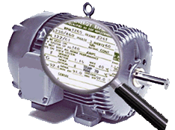
Nameplate Information
Nameplate data is not an absolute, but it is a good guide and a place to focus. Most values fall within a bandwidth or within a tolerance at full load.

Slide 41
Nameplate Information
Identify and grasp the extensive nameplate information available at your fingertips
Easily define many motor characteristics based on nameplate data
In addition you’ll have a handle on:
Nameplate abbreviations
The value of the data
Where to easily find an explanation.
Notes:
In this group exercise, you’ll use this handbook including the reference and glossary to define terms found on a typical name plate. Each group, then explains the values found on their assigned nameplate.

Slide 42
Exercise 2: Group A
Work together to define and explain each of the following:
Horsepower (HP)
Phase (PH)
Design (Des)
Duty
Thermal (Therm.)
Notes:
Notes:
________________________________________________________________________________________________________________________________________________________________________________________________________________________________________________________________________________________________________________________________________________________________________________________________________________________________________________________________________________________________________________________

Slide 43
Exercise 2: Group B
Work together to define and explain each of the following:
Frame (FR)
Hertz (HZ)
Service Factor (SF)
Insulation Class (CL)
Notes:
Notes:
________________________________________________________________________________________________________________________________________________________________________________________________________________________________________________________________________________________________________________________________________________________________________________________________________________________________________________________________________________________________________________________

Slide 44
Exercise 2: Group C
Work together to define and explain each of the following:
RPM
Amps
Ambient (Amb.)
Nominal Efficiency (Eff.)
Notes:
Notes:
________________________________________________________________________________________________________________________________________________________________________________________________________________________________________________________________________________________________________________________________________________________________________________________________________________________________________________________________________________________________________________________

Slide 45
Exercise 2: Group D
Work together to define and explain each of the following:
Enclosure (Enc)
Voltage (Volt)
Code Letter (Code)
Power Factor (PF)
Notes:
Notes:
________________________________________________________________________________________________________________________________________________________________________________________________________________________________________________________________________________________________________________________________________________________________________________________________________________________________________________________________________________________________________________________

Slide 46
Nameplate Reporting
Group 3: RPM; Amps; Ambient (Amb.); Nominal Efficiency (Eff.)
Group 2: Frame (FR); Hertz (HZ); Service Factor (SF); Insulation Class (CL
Group 4: Enclosure (Enc); Voltage (Volt)
Code Letter (Code); Power Factor (PF)
Group 1: Horsepower (HP); Phase (PH)
Design (Des); Duty; Thermal (Therm.)
Notes:
Notes:
________________________________________________________________________________________________________________________________________________________________________________________________________________________________________________________________________________________________________________________________________________________________________________________________________________________________________________________________________________________________________________________

Slide 47
Motor Nameplate Review
Motor nameplates display a great deal of valuable information.
This workbook contains easy-access motor reference material that can be used as needed.
Notes:
Notes: ________________________________________________________________________________________________________________________________________________
________________________________________________________________________________________________________________________________________________
Is there anything to add to your 3x5 reminder card?

Slide 48
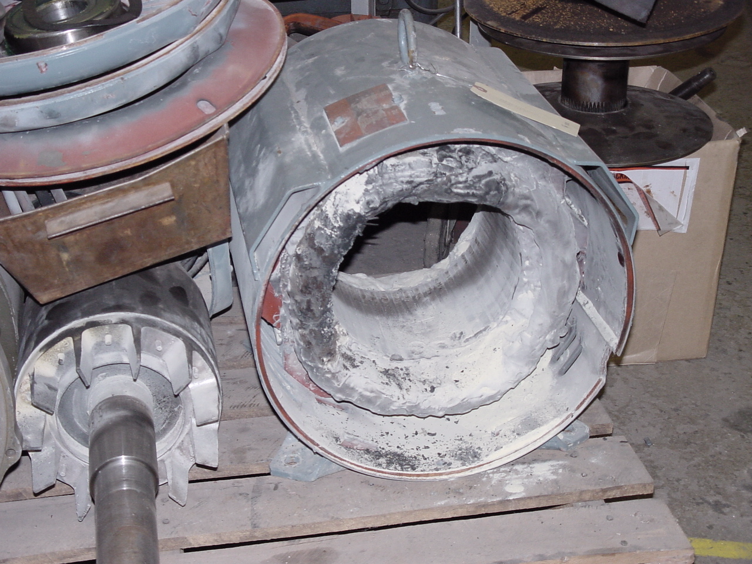
Motor Maintenance
Notes:
Alternating current motors require very little maintenance as compared to DC motors. The good news is that in this class, DC motors are not being addressed because there are fewer of them around since the variable frequency drive (VFD) is taking their place. Single phase motors require more maintenance than three phase motors because of the switching mechanisms and capacitors. Since that is usually done by motor service centers, today’s work continues to get easier. The environment motors are subjected to can make a difference in maintenance considerations. U-frame motors, a larger design from 1952 to 1964 (and present day), can be literally buried in material like sand and continue running, never overheating. T-frame motors, on the other hand, must typically be able to dissipate heat into the atmosphere or ambient temperature of less than 104°F or they will overheat and probably burn up prematurely. NEMA Premium motors typically run faster and can overload as a result which is particularly true on centrifugal loads (e.g. centrifugal pumps, fans and blowers).

Slide 49
Maintenance Best Practices
Ventilation restriction problems corrected
Corrected misalignment
Lubricate per manufacturer’s specs
Test for/avoid imbalanced/improper voltage
Avoid excessively high ambient temps
Correct overloading beyond 100%
Correct excessive vibration
Use a repair purchase specification.
Notes:
________________________________________________________________________________________________________________________________________________________________________________________________________________________________________________________________________________________________________________________________________________________________________________________________________________________________________________________________________________________________________________________________________________________________________________________________________________________________________________________________________________________________________________________________________________________________________________________________________________________________________________________________________________________________________________________________________________________________________

Slide 50
Motor Failures
Notes:
Now that we have a better understanding of an electric motor’s internal workings, let’s take a look at component failures.
EASA’s (Electrical Apparatus Service Association) “Distribution of Failures on Failed Components” is a very useful graphic. From this information we can better consider where time and effort is best spent in dealing with motors. It’s apparent that bearings are the place to start and to turn most of our attention.

Slide 51
Bearing Lubrication
Remove relief plug*
Let motor run for 20-30 minutes before replacing plug.
Safety First Priority*
(All of the above.)
Notes:
Lubrication is probably the most important maintenance topic we can discuss. Lubrication compatibility, over-lubricating, or under-lubricating a motor can cause damage and reliability issues.
Motors of less than 10 HP often have either shielded or sealed bearings – lubrication will not directly enter the bearing. Even though the motor has sealed bearings, lubrication may push some contaminants away from the bearing and keep the grease, factory installed in the bearing, moist. Therefore, the amount of lubrication and the frequency should be limited. One motor manufacturer recommends the following: If a motor is ¼ to 40 HP and operates 24 hours a day 7 days a week, lubricate one to two full strokes from a grease gun yearly; 50 HP to 200 HP, lubricate every 9 months 3 to 4 strokes from a grease gun. Use a lubrication recommended by the motor manufacturer or your service center. But, how much is one stroke?
[Author Note: Grease lubrication fittings should be replaced before lubrication, if not then cleaned carefully. *The relief screw removed, and 2-3 pumps of grease injected. Allow the motor to run 20 minutes before replacing the relief screw.]
*Remove and replace fittings and screws when the motor is at a stand still. Safety must always come first. Motors (including all of the above) that are subjected to high ambient temperatures, dirty or moist locations, vibration, or where the shaft gets hot, increase your lubrication intervals. Keep the grease gun tip clean. Do not mix non-compatible greases as the grease will either turn to a thin liquid and run out of the bearing or will turn to a solid like a brick. Do NOT fill motors with grease! Over-lubrication causes overheating, electrical insulation chemical breakdown, and the motor to fill with grease (or all of the above).

Slide 52
Grease Compatibility Table
Greases | C = Compatible B = Borderline I = Incompatible
 | 1. | 2. | 3. | 4. | 5. | 6. | 7. | 8. | 9. | 10. | 11. | 12.
1. Aluminum Complex |  | I | I | C | I | B | I | I | I | C | I | C
2. Barium Complex | I |  | I | C | I | C | I | I | I | I | I | B
3. Calcium Stearate | I | I |  | C | I | C | C | C | B | C | I | C
4. Calcium 12 Hydroxy | C | C | C |  | B | B | C | C | C | C | I | C
5. Calcium Complex | I | I | I | B |  | I | I | I | I | C | C | C
6. Calcium Sulfonate | B | C | C | B | I |  | I | B | B | C | I | C
7. Clay Non-soap | I | I | C | C | I | I |  | I | I | I | I | B
8. Lithium Stearate | I | I | C | C | I | B | I |  | C | C | I | C
9. Lithium 12 Hydroxy | I | I | B | C | I | B | I | C |  | C | I | C
10. Lithium Complex | C | I | C | C | C | C | I | C | C |  | I | C
11. Polyurea Conventional | I | I | I | I | C | I | I | I | I | I |  | C
12. Polyurea Shear Stable | C | B | C | C | C | C | B | C | C | C | C
Source: EASA Currents, May 2009, By Jim Bryan
“Lubrication – Improving Bearing Performance & Reliability”
Notes:
This table is a handy check for grease compatibility. We suggest you use your lubrication supplier’s information rather than this general table when possible.
About ten years ago many motor manufacturers began switching to Polyurea Conventional but began experiencing a big increase in bearing-related warranty claims. They found out later it was due to grease compatibility issues. Good news, they have since switched to the more compatible Polyurea Shear Stable. The lesson here might be to check the owner’s manual or motor service center for the specified grease type and compare compatibility with what you might be using.

Slide 53
Typical Lubrication Intervals
Notes:
For lubrication intervals always reference your electric motor owner’s manual instead of this table. However, if manufacturer’s lubrication information is unavailable this table may provide some guidance.

Slide 54
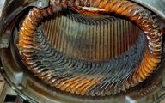
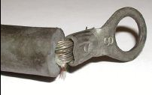
Electrical Failure
Excessive loading
Single phasing
High or low voltage
Unbalanced voltage
Voltage spike and
Old age
Notes:
Electrical failure covers issues that, to diagnose, will require an electrician or qualified electrical technician. Working with live power is necessary to monitor an operating electric motor and is extremely dangerous (reference NFPA 70E). That being said, we can discuss the six bullet points here:
Excessive loading would be indicated by amperage readings exceeding the nameplate full load amps. Amperage is accurate at full load but only an indicator if not at full load.
Single phasing is a term that indicates one leg of a three phase circuit has been interrupted while the other two remain energized. As pictured, it gives a pattern of two discolored coil groups and one unaffected group. Therefore, two of the three phases were powered and one de-energized.
Low or high voltage is voltage that is outside plus or minus 10 percent of nameplate voltage
Unbalanced voltage is voltage that exceeds an unbalance of 1 percent. See the Unbalanced Voltage Formula on Reference page 76.
Voltage spike can occur if power is disconnected and reconnected quickly. For example, if a power line is hit by a car and the utility switch gear redirects power to keep the system operating, this could cause a spike. When a pulse width modulated VFD is switching, 2,500 times per second to manufacture a power wave form, each time it switches there is a potential for a voltage spike.
Old age: Many of the insulation components in a motor winding are susceptible to oxidization. Given time the atmosphere will eventually degrade the insulation system, even if it’s just sitting on a temperature controlled shelf.

Slide 55
Mechanical Failure
Misalignment
Coupling
External Devices
Notes:
When motors fail and it is time to remove and replace them, alignment is critical. Misalignment will cause motor bearings to fail faster than you can imagine. Additionally, misalignment causes vibration, noise, coupling failure, and bearings to overheat and/or fail. Before reinstalling a motor, always check the underside of the motor’s mounting feet to be sure there is no foreign object(s) or material. Be sure to check the mounting surfaces for cracks or loose support structure. When aligning two shafts, use laser alignment tools or at least a dial indicator. Remember, alignment is a three dimensional proposition, although sometimes it seems like more.
If alignment is accurate couplings and bearings tend to last much longer. However before reusing a coupling, check it carefully for wear as drive-end motor bearings or other influences can damage the coupling during a failure event and reinstalling the damaged coupling in-turn causes bearing and again coupling failure.

Slide 56
Service Center Maintenance
How do you improve motor reliability and retain efficiency?
A visit and brief tour of the motor service center will help.
Provide and require a motor repair specification be followed.
Notes:
When a motor is sent in for repair there are ways to insure it will be repaired and returned as reliable and efficient as it was when manufactured. First of all, the motor repair shop needs to have some time to make quality repairs. With no other jobs in front of yours, it takes at least two work days, during the workweek, to do a reasonable rewind job. So making decisions ahead of time and having spares on hand or a backup plan will help.
It’s a good idea to develop a personal relationship with the service center by visiting and looking over the shop. In addition, a repair specification along with information about the motor to be repaired should be provided. Included in your packet is a Motor Repairing Specification for your convenience. This specification was originally developed by the Northwest Energy Efficiency Alliance (NEEA) and is updated and maintained by the Green Motors Practices Group (GMPG), commissioned by the Bonneville Power Administration (BPA). GMPG is a non-profit organization whose Board of Directors is comprised of motor service center executives, the Group provides utility motor rewind incentive administration and 3rd party motor service center process training and review.
Another, more extensive specification, is available from the Electrical Apparatus Service Association (EASA) at www.easa.com entitled EASA/ANSI AR100. If the repair facility follows either of these specifications, in all probability, you can expect the motor to come back and operate as reliably and efficiently as it was when it was first manufactured.

Slide 57
Motor Rewind Purchasing
If you don’t use a specification, here are a few rewind points:
Lamination core should be tested before and after stripping;
Final core test should not be more than 20% higher than the first core test;
Final core test result should not be greater than 4 watts lost per pound.
Notes:
The health of the lamination’s magnetic capability can be tested using a core loss test machine. The lamination is measured, the weight is computed based on measurements, and a cable is passed through the core and electrically energized. By measuring the overall core’s watts consumed by the lamination, the watts lost in the process are determined and expressed as watts lost per pound. If the final test result increases by more than 20 percent of the first test, an efficiency loss becomes measurable. An acceptable final test of a NEMA Premium motor lamination losses per pound are normally less than 3, an EPAct (manufactured between 1997 and 2011) will be 4 or less and pre-EPAct (before 1997) less than 5. Therefore 4 watts lost per pound is becoming the accepted rewind industry go no-go threshold. If you take the time to go through one of the specifications you’ll find many other critical points, but watts loss per pound is most often overlooked by motor service centers and is an important indicator of a motor’s efficiency and reliable operation going forward.

Slide 58
Motor Management
Inventory all connected and stand-by motors.
Make a pre-failure repair/replacement plan.
Require vendors follow repair specifications.
Notes:
In order to “manage motors,” the first step might be to have an idea of how many, what kind and which are critical. So an inventory of the population of motors with nameplate data, connected and stand-by really must be accomplished. When a motor fails, and they all will eventually if they are being used or not, the information needed by the repair shop, motor vendor, or your purchasing department to replace or repair the motor is on the nameplate. You can choose to collect the information from the nameplate ahead of time or when the motor fails. Provided the nameplate is still on the motor and that when it failed it didn’t burn up with the motor winding, some motors have plastic nameplates. A decision will need to be made to repair or replace. It is my hope that it be made ahead of time and a plan is in place as well. Haste based decisions at the time of failure generally leads to inefficient systems from poor choices and therefore more costly operations.

Slide 59
Continuous Improvement
Startup Elements:
Identify goals and responsibilities.
Determine performance indicators.
Evaluate and layout an action-plan.
Identify and obtain necessary resources (i.e. components, training).
Utilize qualified vendors.
Courtesy : Green Motors Practices
Notes:
Point 1. It is important that someone take ownership or responsibility of the process. Absent a leader and decision maker, the best of plans most often fall short.
Point 2. Before the process starts, define indicators that will demonstrate movement toward the identified goal. Looking for road-signs and milestones after a journey begins may or may not lead to your intended destination.
Point 3. Work to understand what is to be improved, document steps to be taken, and determine when to implement the action(s).
Point 4. Within the Action Plan, the identity, location, and cost of items necessary to make improvements that will positively affect performance indicators should be noted (e.g. replacement equipment, professional training, metering devices, or outsourcing professional services).
Point 5. Before purchasing equipment, supplies, or services identify and document vendors you consider qualified. Separate the chaff from the wheat by requiring a set of reasonable cost-to-value standards and performance expectations be met.

Slide 60
The Ongoing Process
Plan for improvement
opportunities
Execute your plan
when opportunities
appear
Do
Check
Quantify
Communicate
Plan
Communicate
successes
to everyone
Check results
against
indicators
Quantify results linking to goal identified
Courtesy : Green Motors Practices
Notes:
A “continuous improvement” or adaptive management process is ongoing. It is the journey not the destination. Once an opportunity is identified and the plan is implemented, you’re not finished. It is necessary to check to see if the action obtained the results needed based on your key indicators. Did the result save energy, money, or improve safety or possibly the comfort of building occupants? Communication to others (i.e. supervisor(s), co-worker(s), or maybe a member of this BOC group) is important as others may benefit from your success, may be replicated or provide improvement suggestions. Then one must begin again to plan for the next improvement opportunity possibly with the same system or another. At some point you’ll need to come back and revisit systems already considered as time, people, or process changes may impact indicators and identified goals.

Slide 61
Exercise 3: Motor Improvement Plan
Put together a hypothetical “Continuous Motor Improvement” process using startup elements and the continuous improvement circle.
Pick a motor system or appropriate example to improve from one of your Group Member’s experience. Please include costs per kWh.
Establish key performance indicators and an action plan.
Choose personnel to involve.
Determine an expected success and identify qualified participating trade allies.
Notes:
Notes:
________________________________________________________________________________________________________________________________________________________________________________________________________________________________________________________________________________________________

Slide 62
Exercise 3: Motor Improvement Plan
Group Reporting
Notes:
Notes: ________________________________________________________________________________________________________________________________________________
________________________________________________________________________________________________________________________________________________
Is there anything to add to your 3x5 reminder card?

Slide 63
Review in the Round
Electric concepts
Nameplate data
Motor control
Managing your motors
Motor system operation costs
Notes:
________________________________________________________________________________________________________________________________________________________________________________________________________________________________________________________________________________________________________________________________________________________________________________________________________________________________________________________________________________________________________________________________________________________________________________________________________________________________________________________________________________________________________________________________________________________________________________________________________________________________________________________________________________________________________________________________________________________________________

Slide 64
Action Plan: Part 2
Take the test.
Put the 3x5 card in your self-addressed envelope.
Complete your evaluation form.
Turn in all of the above.
Begin and continue to use today’s ideas…

Slide 65
Resources

Slide 66
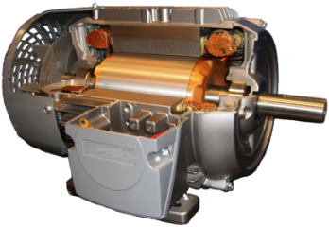
Failure Decision Flow Chart
Failed Motor
Is the motor appropriate
for the application?
No
Yes
Are stator core and rotor
tests within tolerance?
No
Non-NEMA standard,
or excessive cost
Yes
Are their signs of prior catastrophic core damage?
Yes
Is the cost to repair greater
than a new motor?
No
No
Yes
Is the motor NEMA Premium® or custom built?
Yes
No
Is a suitable replacement available and lead-time acceptable?
No
Is NEMA Premium® cost payback acceptable? (2010)
Yes
Yes
No
Repair Motor
Replace Motor
Notes:
________________________________________________________________________________________________________________________________________________________________________________________________________________________________________________________________________________________________________________________________________________________________________________________________________________________________________________________________________________________________________________________________________________________________________________________________________________________________________________________________________________________________________________________________________________________________________________________________________________________________________________________________________________________________________________________________________________________________________

Slide 67
15 HP 1725 RPM Characteristics
100%
Efficiency
80%
Amps
60%
Power Factor
40%
Load
20%
0
2
4
6
8
10
12
14
16
18
Horsepower
15 HP nameplate
or 100% Rated Load
7½ HP or 75% load is likley the peak efficiency point
Notes:
________________________________________________________________________________________________________________________________________________________________________________________________________________________________________________________________________________________________________________________________________________________________________________________________________________________________________________________________________________________________________________________________________________________________________________________________________________________________________________________________________________________________________________________________________________________________________________________________________________________________________________________________________________________________________________________________________________________________________

Slide 68
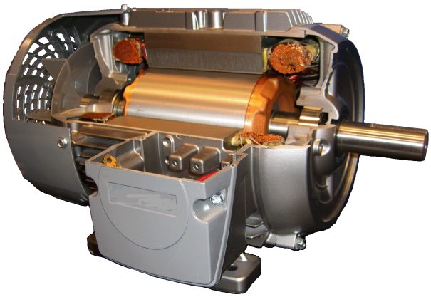
Motor Efficiency Losses
NEMA Premium® 5HP, 4 Pole, 3Ø, 89.5% Motor
100% Power
89.5% Out
Stator
Res.
Rotor
Res.
Iron
Core
Stray
Losses
Friction/
Windage
Total
Percent of
Losses
40%
25%
20%
10%
5%
100%
Percent of
Input
4.2%
2.6%
2.1%
1.1%
.05%
10.5%
Notes:
________________________________________________________________________________________________________________________________________________________________________________________________________________________________________________________________________________________________________________________________________________________________________________________________________________________________________________________________________________________________________________________________________________________________________________________________________________________________________________________________________________________________________________________________________________________________________________________________________________________________________________________________________________________________________________________________________________________________________

Slide 69
Full Load Efficiencies NEMA Premium®, Table for TEFC
 | 2 Pole |  |  | 4 Pole
HP | Nominal | Minimum |  | Nominal | Minimum
1 | 77.0 | 74.0 |  | 85.5 | 82.5
1.5 | 84.0 | 81.5 |  | 86.5 | 84.0
2 | 85.5 | 82.5 |  | 86.5 | 84.0
3 | 86.5 | 84.0 |  | 89.5 | 87.5
5 | 88.5 | 86.5 |  | 89.5 | 87.5
7.5 | 89.5 | 87.5 |  | 91.7 | 90.2
10 | 90.2 | 88.5 |  | 91.7 | 90.2
15 | 91.0 | 89.5 |  | 92.4 | 91.0
20 | 91.0 | 89.5 |  | 93.0 | 91.7
25 | 91.7 | 90.2 |  | 93.6 | 92.4
30 | 91.7 | 90.2 |  | 93.6 | 92.4
 | 2 Pole |  |  | 4 Pole
HP | Nominal | Minimum |  | Nominal | Minimum
40 | 92.4 | 91.0 |  | 94.1 | 93.0
50 | 93.0 | 91.7 |  | 94.5 | 93.6
60 | 93.6 | 92.4 |  | 95.0 | 94.1
75 | 93.6 | 92.4 |  | 95.4 | 94.5
100 | 94.1 | 93.0 |  | 95.4 | 94.5
125 | 95.0 | 94.1 |  | 95.4 | 94.5
150 | 95.0 | 94.1 |  | 95.8 | 95.0
200 | 95.4 | 94.5 |  | 96.2 | 95.4
250 | 95.8 | 95.0 |  | 96.2 | 95.4
Values continue unchanged through 500 HP
Notes:
________________________________________________________________________________________________________________________________________________________________________________________________________________________________________________________________________________________________________________________________________________________________________________________________________________________________________________________________________________________________________________________________________________________________________________________________________________________________________________________________________________________________________________________________________________________________________________________________________________________________________________________________________________________________________________________________________________________________________

Slide 70
Possible Skewed Motor Efficiencies
Average
Duplicates Manufactured
Efficiency
Cause may be variations in materials, process, and/or tests
Source: Electrical Apparatus, May 2003
Verifying Motor Efficiency No Easy Task by: Richard Nailen P.E.
Notes:
________________________________________________________________________________________________________________________________________________________________________________________________________________________________________________________________________________________________________________________________________________________________________________________________________________________________________________________________________________________________________________________________________________________________________________________________________________________________________________________________________________________________________________________________________________________________________________________________________________________________________________________________________________________________________________________________________________________________________

Slide 71
Horsepower
NEC2005 430 (A) (7) Marking on Motors
T x S
HP =
5252
33'
T = Torque in FT. LBS
S = Speed in RPM
One horsepower equals 33,000 foot pounds per minute. For example: Lifting 1,000 lbs., 33 ft. per minute or 2,000 lbs., 16 1/2 ft. per minute
16' 6 "
1000 lb
2000 lb
Notes:
________________________________________________________________________________________________________________________________________________________________________________________________________________________________________________________________________________________________________________________________________________________________________________________________________________________________________________________________________________________________________________________________________________________________________________________________________________________________________________________________________________________________________________________________________________________________________________________________________________________________________________________________________________________________________________________________________________________________________

Slide 72
Motor Starting Current
Code Letter
Range
Code Letter
Range
A 0.00 - 3.14
B 3.15 - 3.54
C 3.55 - 3.99
D 4.00 – 4.49
E 4.50 – 4.99
F 5.00 – 5.59
G 5.60 – 6.29
H 6.30 – 7.09
J 7.10 - 7.99
K 8.00 – 8.99
L 9.00 – 9.99
M 10.0 – 11.19
N 11.2 – 12.49
P 12.5 – 13.9
R 14.0 – 15.9
NEC 2005
Single Phase
Inrush Amperes = Code Letter x HP x 1,000 / rated voltage
Three Phase
Inrush Amperes = Code Letter x HP x 577 / rated voltage
Notes:
________________________________________________________________________________________________________________________________________________________________________________________________________________________________________________________________________________________________________________________________________________________________________________________________________________________________________________________________________________________________________________________________________________________________________________________________________________________________________________________________________________________________________________________________________________________________________________________________________________________________________________________________________________________________________________________________________________________________________

Slide 73
Voltage Drop
Feeders – 215.2 (A) (3)
Recommended “reasonable efficiency”
Limit voltage drop to 3%
Maximum of both feeder and branch 5%
Conductors – 310.15 (A) (1)
Tabulated ampacities based on current
Branch Circuits – 210.19 (A) (1)
Recommended, limit voltage drop to 3%
Maximum of both feeder and branch 5%
Sensitive Electronic Equipment – 647.4 (D)
Mandatory: 2.5% Maximum with only 1.5% of that in the branch
NEC 2005
Notes:
________________________________________________________________________________________________________________________________________________________________________________________________________________________________________________________________________________________________________________________________________________________________________________________________________________________________________________________________________________________________________________________________________________________________________________________________________________________________________________________________________________________________________________________________________________________________________________________________________________________________________________________________________________________________________________________________________________________________________

Slide 74
Added Voltage Drop
Voltage variation at the source is covered by ANSI C84.1 This table allows a drop of 4.6%.
Add to that the NEC figure of 5%.
This gives us 9.6% – within NEMA 10%.
ANSI C84.1 allows a drop from 480 to 440 volts if limited in extent, frequency, and duration.
Add 4.3 to the NEC figure and we’re at 13.9%, well outside the allowable 10%.
Notes:
________________________________________________________________________________________________________________________________________________________________________________________________________________________________________________________________________________________________________________________________________________________________________________________________________________________________________________________________________________________________________________________________________________________________________________________________________________________________________________________________________________________________________________________________________________________________________________________________________________________________________________________________________________________________________________________________________________________________________

Slide 75
Reduced Voltage Impacts
A typical 10 HP, 1800 RPM, 460 volt motor
13% voltage drop
Increase winding temperature by 20%
Efficiency will be reduced by about 2%.
Courtesy : Green Motors Practices
Notes:
________________________________________________________________________________________________________________________________________________________________________________________________________________________________________________________________________________________________________________________________________________________________________________________________________________________________________________________________________________________________________________________________________________________________________________________________________________________________________________________________________________________________________________________________________________________________________________________________________________________________________________________________________________________________________________________________________________________________________

Slide 76
Unbalanced Voltage Formula
Unbalance =
(largest voltage difference less average voltage)
(average voltage)
Example: For 445v, 455v, 460v, the average = 453 volts.
Unbalance = (453-445) / 453 = 1.8%
2% imbalance = 10% increase in motor losses
5% imbalance = 30% increase in motor losses
Courtesy : Green Motors Practices
Notes:
________________________________________________________________________________________________________________________________________________________________________________________________________________________________________________________________________________________________________________________________________________________________________________________________________________________________________________________________________________________________________________________________________________________________________________________________________________________________________________________________________________________________________________________________________________________________________________________________________________________________________________________________________________________________________________________________________________________________________

Slide 77
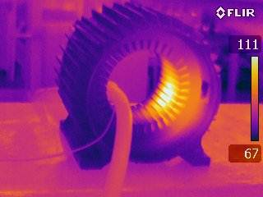
Core Loss Testing
Notes:
________________________________________________________________________________________________________________________________________________________________________________________________________________________________________________________________________________________________________________________________________________________________________________________________________________________________________________________________________________________________________________________________________________________________________________________________________________________________________________________________________________________________________________________________________________________________________________________________________________________________________________________________________________________________________________________________________________________________________

Slide 78
Efficiency Losses
Motor and VFD
100
95
Motor,
Drive
direct on line
90
Efficiency, %
85
80
Motor,
Combined drive
on drive
and motor
75
20
40
60
80
100
Load, % of rated
Courtesy: Don Casada, Steve Bolles
.
Notes:
________________________________________________________________________________________________________________________________________________________________________________________________________________________________________________________________________________________________________________________________________________________________________________________________________________________________________________________________________________________________________________________________________________________________________________________________________________________________________________________________________________________________________________________________________________________________________________________________________________________________________________________________________________________________________________________________________________________________________

Slide 79
Centrifugal Load
Speed Changes
3
New HP = Original HP X (New Speed/Original Speed)
Fully Loaded Standard Motor to NEMA Premium™ Motor
3
New HP = (20) X (1765/1725) = 21.2 HP
Apply a VFD and reduce the speed by 25%
3
New HP = (20) X (1294/1725) = 8.4 HP
Application system characteristics
may cause considerable deviation (errors) !
Courtesy : Green Motors Practices
Notes:
________________________________________________________________________________________________________________________________________________________________________________________________________________________________________________________________________________________________________________________________________________________________________________________________________________________________________________________________________________________________________________________________________________________________________________________________________________________________________________________________________________________________________________________________________________________________________________________________________________________________________________________________________________________________________________________________________________________________________

Slide 80
Typical 100 HP Pump Load
Without Static Head
100
Restricted Flow
75
Required Horsepower
VFD
50
25
25
50
75
100
Percentage of Flow
Courtesy: Don Casada, Steve Bolles
Notes:
________________________________________________________________________________________________________________________________________________________________________________________________________________________________________________________________________________________________________________________________________________________________________________________________________________________________________________________________________________________________________________________________________________________________________________________________________________________________________________________________________________________________________________________________________________________________________________________________________________________________________________________________________________________________________________________________________________________________________

Slide 81
Typical 100 HP Fan Load
100
75
Restricted Air Flow
Required Horsepower
VFD
50
25
25
50
75
100
Percentage of Flow
Courtesy: Don Casada, Steve Bolles
Notes:
________________________________________________________________________________________________________________________________________________________________________________________________________________________________________________________________________________________________________________________________________________________________________________________________________________________________________________________________________________________________________________________________________________________________________________________________________________________________________________________________________________________________________________________________________________________________________________________________________________________________________________________________________________________________________________________________________________________________________

Slide 82
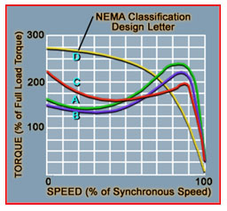
Motor Design
(Slip Characteristics)
Notes:
________________________________________________________________________________________________________________________________________________________________________________________________________________________________________________________________________________________________________________________________________________________________________________________________________________________________________________________________________________________________________________________________________________________________________________________________________________________________________________________________________________________________________________________________________________________________________________________________________________________________________________________________________________________________________________________________________________________________________

Slide 83
Typical Utility Bill
Notes:
________________________________________________________________________________________________________________________________________________________________________________________________________________________________________________________________________________________________________________________________________________________________________________________________________________________________________________________________________________________________________________________________________________________________________________________________________________________________________________________________________________________________________________________________________________________________________________________________________________________________________________________________________________________________________________________________________________________________________

Slide 84
Demand (kW) 19%
Demand is an average number relating to how much energy is consumed during a (15 min.) metering interval
kW
Time
Typically 15 or 30 Minute Meter Interval
Courtesy : Green Motors Practices
Notes:
________________________________________________________________________________________________________________________________________________________________________________________________________________________________________________________________________________________________________________________________________________________________________________________________________________________________________________________________________________________________________________________________________________________________________________________________________________________________________________________________________________________________________________________________________________________________________________________________________________________________________________________________________________________________________________________________________________________________________

Slide 85
Demand and Motor Starting
Design B / Code J
Current
Current
Across Line Contactor
(Operating losses 0)
Soft Starter
(Operating losses approx. 4 watts per Amp)
(Parallel a contactor, operating losses 0)
Current
VFD Start
(Operating losses approx. 14 watts per Amp)
Courtesy : Green Motors Practices
.
Notes:
________________________________________________________________________________________________________________________________________________________________________________________________________________________________________________________________________________________________________________________________________________________________________________________________________________________________________________________________________________________________________________________________________________________________________________________________________________________________________________________________________________________________________________________________________________________________________________________________________________________________________________________________________________________________________________________________________________________________________

Slide 86
Dynamic and Static Head
Head
DYNAMIC
STATIC
Flow
Notes:
________________________________________________________________________________________________________________________________________________________________________________________________________________________________________________________________________________________________________________________________________________________________________________________________________________________________________________________________________________________________________________________________________________________________________________________________________________________________________________________________________________________________________________________________________________________________________________________________________________________________________________________________________________________________________________________________________________________________________

Slide 87



Belt Driven Opportunities
Belt efficiency ranges from 90-99% depending on type, construction, and application.
Major energy losses are attributable to:
bending hysteresis
sliding friction.
When tested, cogged belts operating on a 3.4 inch sheave produced a 3-6% efficiency improvement.
Source: Third World Energy Engineering Congress
The Assoc. of Energy Engineers, Atlanta, Georgia
Notes:
________________________________________________________________________________________________________________________________________________________________________________________________________________________________________________________________________________________________________________________________________________________________________________________________________________________________________________________________________________________________________________________________________________________________________________________________________________________________________________________________________________________________________________________________________________________________________________________________________________________________________________________________________________________________________________________________________________________________________

Slide 88
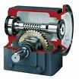
Right Angle Gear Opportunities
Worm-gear efficiencies range from 50 to 95% depending on ratio, input speed, tooth shape, and lubrication
Ratio has the most affect on worm-gear efficiency:
A lower ratio has more threads engaged and
less sliding resulting in better efficiency;
Higher ratios with less threads engaged slide
more thereby lowering efficiency.
Helical gearing is typically 96% efficient per gear mesh.
Source: Machine Design, Worm-gear reducers reach new heights
June 3, 2004 by Kenneth J. Korane
Notes:
________________________________________________________________________________________________________________________________________________________________________________________________________________________________________________________________________________________________________________________________________________________________________________________________________________________________________________________________________________________________________________________________________________________________________________________________________________________________________________________________________________________________________________________________________________________________________________________________________________________________________________________________________________________________________________________________________________________________________

Slide 89
Motor and Pump
Efficiency Relationship
89% vs. 94.5% efficient motors on a 50% efficient pump
  .89 X .50 = .445
  .945 X .50 = .472
  5.5% 2.7% motor w/system efficiency
89% vs. 94.5% efficient motors on a 70% efficient pump
  .89 X .70 = .623
  .945 X .70 = .662
  5.5% 3.9% motor w/system efficiency
Consider a pump losses about 2% efficiency each year!
Courtesy : Green Motors Practices
Notes:
________________________________________________________________________________________________________________________________________________________________________________________________________________________________________________________________________________________________________________________________________________________________________________________________________________________________________________________________________________________________________________________________________________________________________________________________________________________________________________________________________________________________________________________________________________________________________________________________________________________________________________________________________________________________________________________________________________________________________

Slide 90
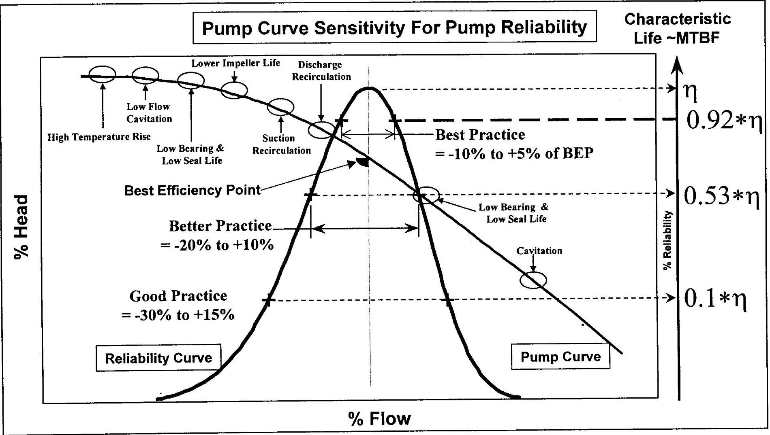
Pump Efficiency and Reliability
Courtesy: P. Barringer
Notes:
________________________________________________________________________________________________________________________________________________________________________________________________________________________________________________________________________________________________________________________________________________________________________________________________________________________________________________________________________________________________________________________________________________________________________________________________________________________________________________________________________________________________________________________________________________________________________________________________________________________________________________________________________________________________________________________________________________________________________

Slide 91
Pump Opportunity
Indicators
Throttle valve-controlled systems
Bypass (recirculation) line normally open
Multiple parallel pump system with same number of
pumps almost always operating
Constant pump operation in a batch environment or
frequent cycle batch operation in a continuous process
Cavitation’s noise (at pump or elsewhere in the system)
High system maintenance
Systems that have undergone a change in function
Courtesy: Don Casada’s Evaluating Pump Systems
Notes:
________________________________________________________________________________________________________________________________________________________________________________________________________________________________________________________________________________________________________________________________________________________________________________________________________________________________________________________________________________________________________________________________________________________________________________________________________________________________________________________________________________________________________________________________________________________________________________________________________________________________________________________________________________________________________________________________________________________________________

Slide 92
Calculating Ampere for Electric Motors
kV = 1,000 volts (Kilovolts)
kW = 1,000 watts (Kilowatts)
kVA = 1,000 volt-amps (Kilovolt-amps)
Inductive kW calculation:
(Amps X Volts X Power Factor X 1.732) /1,000 = Kilowatts
Notes:
________________________________________________________________________________________________________________________________________________________________________________________________________________________________________________________________________________________________________________________________________________________________________________________________________________________________________________________________________________________________________________________________________________________________________________________________________________________________________________________________________________________________________________________________________________________________________________________________________________________________________________________________________________________________________________________________________________________________________

Slide 93
Test Time!
Get yer motors runnin’ !!!
Good Luck!!!
Notes:
________________________________________________________________________________________________________________________________________________________________________________________________________________________________________________________________________________________________________________________________________________________________________________________________________________________________________________________________________________________________________________________________________________________________________________________________________________________________________________________________________________________________________________________________________________________________________________________________________________________________________________________________________________________________________________________________________________________________________

Slide 94
Appendix
Notes:
Appendix
Glossary A-1
Exercise Answers B-1
Electric Motor Repairing Specification –2012 C-1

Slide 95
Exercise 1A: Answers
20 HP, 7200 hrs, $0.10 (cents) per kWh
Year | Efficiency | Operation Cost | Efficiency | Operation Cost
1945 | 88% | $ 12,207
1955 | 90% | $ 11,936
1965 | 88.5% | $ 12,138
1975 | 87.5% | $ 12,277
1985 | 87.5% | $ 12,277 | 92% | $ 11,677
1995 | 89% | $ 12,070 | 93% | $ 11,551
2000/2010 | 91% Epact | $ 11,805 | 93% | $ 11,551
New Motor 2010 Epact Price:
New 2012 NEMA Premium Price:
Complete Rewind (approx.) Price:
$ 1,200
$ 1,515
$ 896
10 year life power cost of 1997 Epact:
10 year life power cost of NEMA Premium:
$118,050
$115,510
Notes:
Here’s a table containing calculation results and associated costs. Did you get the same answers? Notice the insignificance of prices associated with purchase or repair of this 20 HP motor in comparison to ten year costs. If you have an older motor, is it better to buy new or rewind it?

Slide 96
Exercise 1B: Answers
20 HP, 2400 hrs, $0.10 per kWh full load
Year | Efficiency | Operation Cost | Efficiency | Operation Cost
1945 | 88% | $ 4,069
1955 | 90% | $ 3,979
1965 | 88.5% | $ 4,046
1975 | 87.5% | $ 4,092
1985 | 87.5% | $ 4,092 | 92% | $ 3,892
1995 | 89% | $ 4,023 | 93% | $ 3,850
2001 | 91% Epact | $ 3,935 | 93% | $ 3,850
New Motor 2010 Epact Price:
New 2012 NEMA Premium Price:
Complete Rewind (approx.) Price:
$ 1,200
$ 1,515
$ 896
10 year life power cost of 1997 Epact:
10 year life power cost of NEMA Premium:
$39,350
$38,350
Notes:
Here’s a table containing the various associated costs. At 2,400 hours, is it better to buy new or rewind? If the failed motor is NEMA Premium, is it better to rewind or replace it?

