Slide 1

Fundamentals of Energy Efficient Building Operations
Part 5: Energy Conservation Opportunities
Notes:
Instructor’s name: __________________________________________________________
Phone number: ____________________________________________________________
E-mail: ___________________________________________________________________
_________________________________________________________________________
_________________________________________________________________________
_________________________________________________________________________

Slide 2
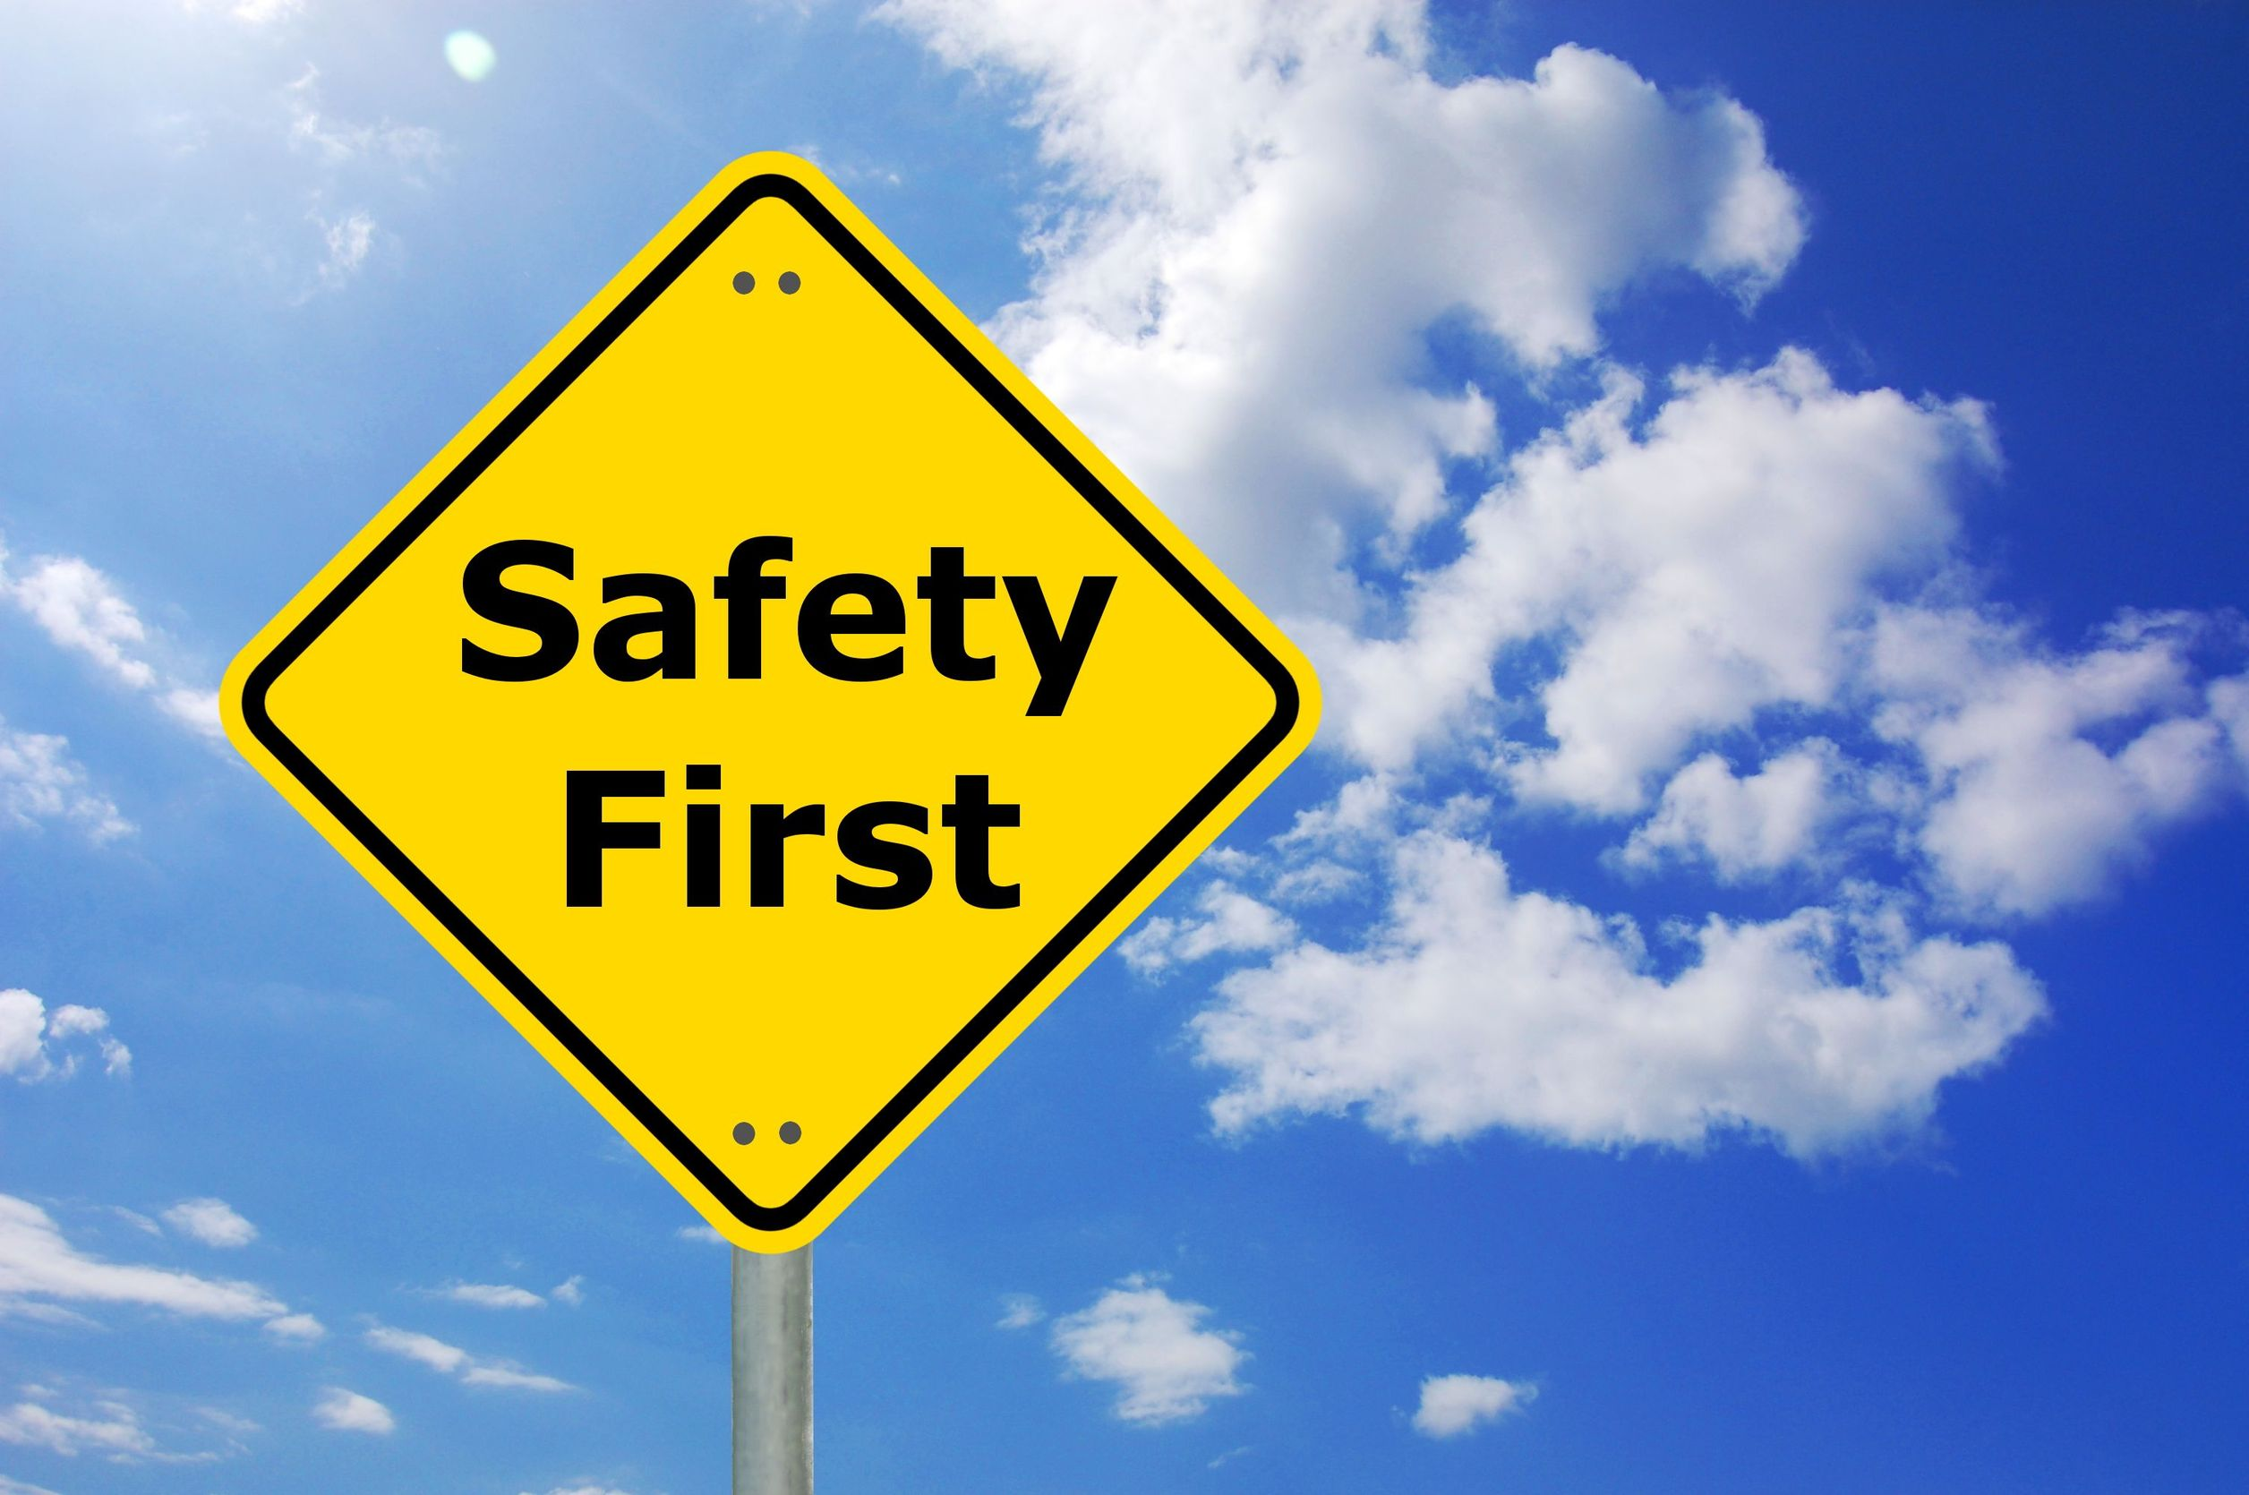
Safety Message
Notes:
Let's start with a safety reminder. This may be something from the course sponsor or site host; the instructor, moderator, or a student. Topics can include anything related to safety: site, health, personal, equipment, etc. What topic shall we address today?

Slide 3
Part 5 Agenda
Energy Conservation and Facility Management
Basic Test Instruments
Equipment Scheduling
Simultaneous Heating and Cooling
Outside Air Usage
Learning Activity – Energy Conservation Opportunities
Lighting Opportunities
Controls Strategies
Notes:
In Part 5, we will discuss facility management concepts related to energy conservation and introduce some basic testing instruments. We will also identify several common opportunities for reducing energy consumption, including optimizing equipment scheduling, eliminating unwanted simultaneous heating and cooling, utilizing outside air for cooling, and lighting and controls strategies.

Slide 4

Energy Conservation and Facility Management
Notes:
This section will discuss some of the steps needed to put together a plan for achieving future energy efficiency at your facility.
It will require gathering additional information, discussions with employees and managers, and financial decisions. Yes, it is an act of juggling.

Slide 5
Energy Conservation and Facility Management
Facilities O & M
Efficient
Purchasing
Efficient
Operation
1
2
Efficient
Equipment
3
Notes:
There are three components of efficient building operation & maintenance (O&M):
Efficient Purchasing: The purchasing of energy fuels at the lowest cost. These decisions and job functions do not usually lie with the operations and maintenance departments but are quite crucial to the efficiency and savings potential of commercial facilities.
Efficient Operation: The actual operation of the equipment, and how it is run on a day-to-day basis. Operations has the greatest impact on the actual use of energy by the facility.
Efficient Equipment: The upgrade or replacement of equipment and the efficiency of that equipment.
Efficient Operations usually offers an abundance of opportunities for those who look closely. Let’s examine this a bit more.

Slide 6
Energy Conservation and Facility Management
Steps for Efficient Operations
Determine current performance (Refer to O&M Checklists in the Appendix)
Determine potential performance
Identify & correct problem areas
Measure and verify improvements
Notes:
To begin, a review of historical energy use and a preliminary site assessment are performed, which lead to the development of energy management goals and policies. See the Appendix for maintenance and operation checklists. These goals are prioritized, often listing actions in order of payback. The list of goals should include energy conservation measures (ECMs) as well as operation and maintenance measures (O&Ms). O&M measures are often listed as a first priority because they are more easily done and can save energy at little or no cost. Mechanical improvements and implementation of more expensive measures are often scheduled over a period of several years.
To many operators, the expression “energy management” may sound like the job of a manager, facilities engineer or energy expert -- not a building operator. The reality is that good energy management must involve building owners, managers, operators, and any professional staff involved in design, changes, or retrofits to the facility.

Slide 7
Energy Conservation and Facility Management
Identify Energy
Using Equipment
Measure Energy
Usage
Evaluate Usage
and Operations
Prioritize and Make
Operation
Improvements
Notes:
Effective energy management is not a once-time process but an on-going effort. It requires monitoring the performance of measures and periodic review of progress in all areas. Eventually, several activities from audits to implementation may be occurring simultaneously.
Let’s take a look at the typical steps involved in implementing energy efficiency improvements.

Slide 8
Energy Conservation and Facility Management
Steps for Efficient Operation
Determine current performance
Evaluate collected data
Benchmark building
Set goals
Determine potential performance
Capital improvement
Low cost/no cost
Operational strategies
Prioritize areas of energy saving opportunities
Notes:
We have discussed evaluating initial performance and some areas to look for in determining potential performance. Always start with the operational strategies first, as outlined on the next slide. Refer to the Maintenance and Operations Checklists in the Handbook Appendix for additional resources.

Slide 9
Energy Conservation and Facility Management
Operational Strategies
Improve energy efficiency
Operation & maintenance, equipment modifications
Reduce “On” hours
Time clocks, building occupant sensors
Reduce the need to use energy
Conservation measures, building occupant behavior
Just meet the loads – and no more
Calibration, overheating, and overcooling
Notes:
Energy management consists of developing a set of basic strategies to meet the needs of a facility and, at the same time, reduce energy consumption and costs. When looking for energy conservation opportunities, keep these four basic concepts in mind:
Improve energy efficiency through better operational practices or by equipment or building modifications.
Reduce “On” hours. Implement a policy of lights out in rooms left unoccupied for more than 15 minutes. Set the time clock to reduce the hours the hot water circulation pump is on.
Reduce the need to use energy. Add ceiling insulation, weatherize the envelope, insulate and seal overhead doors, encourage occupants to use blinds and draperies to block heat gain and loss.
Just meet the loads -- no more. Calibrate controls to avoid over-heating or overcooling. Recover to desired occupied temperatures no earlier than necessary.

Slide 10
Energy Conservation and Facility Management
Ongoing Steps for Efficient Operation
- Identify and correct problem areas
• Assign responsibility
• Operational changes
• Capital improvement
- Monitor progress: Measure and verify
- Compare against baseline benchmark

Slide 11
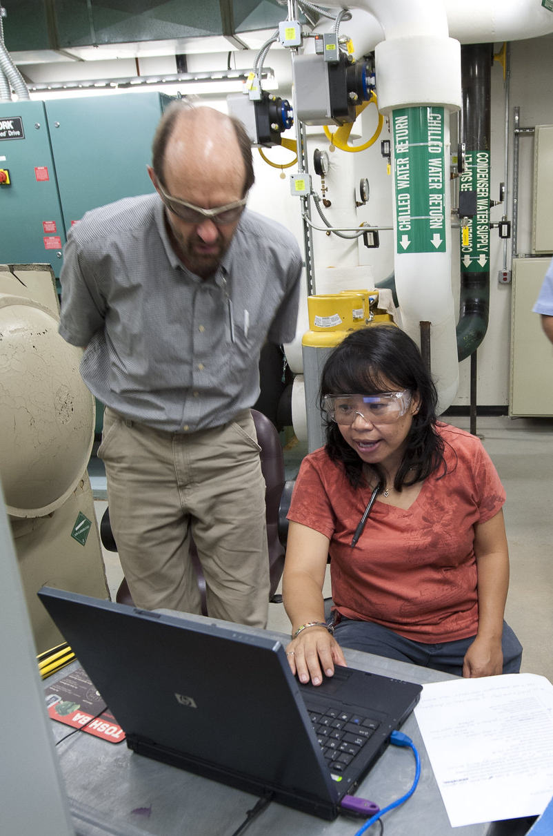
Energy Conservation and Facility Management
Energy Management Recap
Awareness of where and when energy is used
Proper O&M of energy systems
Realistic goals
Designate who is responsible
Evaluate actions
Image source: Resource Media

Slide 12
Three Key Practices to Start
Develop a building system operations map.
Determine EUI & start benchmarking.
Target HVAC systems and equipment.
1
2
3
Notes:
In order to have a solid starting point, we will identify three key practices that, if employed, will provide you with a basis to help make informed decisions.

Slide 13
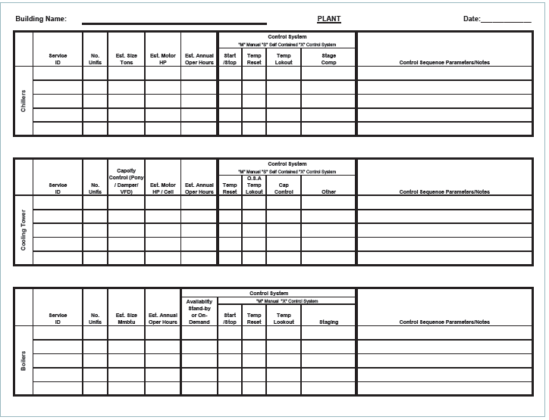
Practice 1: Building System Operations (BSO) Map
Developing the BSO map requires:
Reviewing utility bills & as-built drawings
Reviewing sequences of operation
Interviewing building operators and maintenance staff
Periodically reviewing systems and equipment with a focus on targeting potential energy savings
The BSO map should document:
Major energy-using systems
Occupancy types by area
Notes:
Uncovering problems requires a thorough understanding of how a building is used, operated, and maintained. One way to obtain that understanding is to develop a building systems operations (BSO) map.
Research for developing the BSO map is extensive, requiring review of utility bills, as-built drawings, and sequence of operations. It also involves talking with building occupants and interviewing maintenance staff for their observations regarding the building. A BSO map documents current conditions, focusing on scheduling and on targeting HVAC systems and equipment where common opportunities are found in similar buildings and systems. The map clearly identifies areas for immediate improvement, such as changing thermostat setpoints or equipment schedules, and provides the basis for additional evaluation.

Slide 14
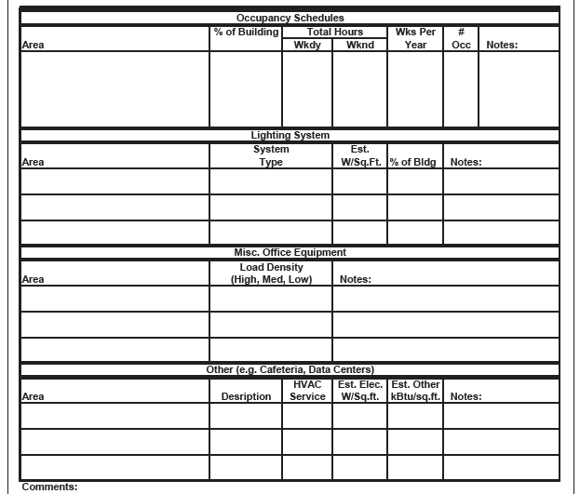
BSO Map Template for General Building Information
Image: IFMA Foundation
Notes:
A BSO map should include the following for each major occupancy:
Occupancy schedule
Equipment, equipment characteristics, areas served and maintenance responsibilities
Equipment schedules, temperature and other setpoints, and control methods, including areas served
Lighting and lighting control schedule, including location, luminaire identifier, control, recommended settings and circuiting for each piece of lighting equipment.
The building system operations map should be used to continually document on-going problems and what building operators are doing to compensate for the following:
Undersized equipment
Oversized equipment
Spaces that can't maintain temperature settings
Indoor air quality issues
Building pressurization problems
Major HVAC equipment with higher failure rate than typical.

Slide 15
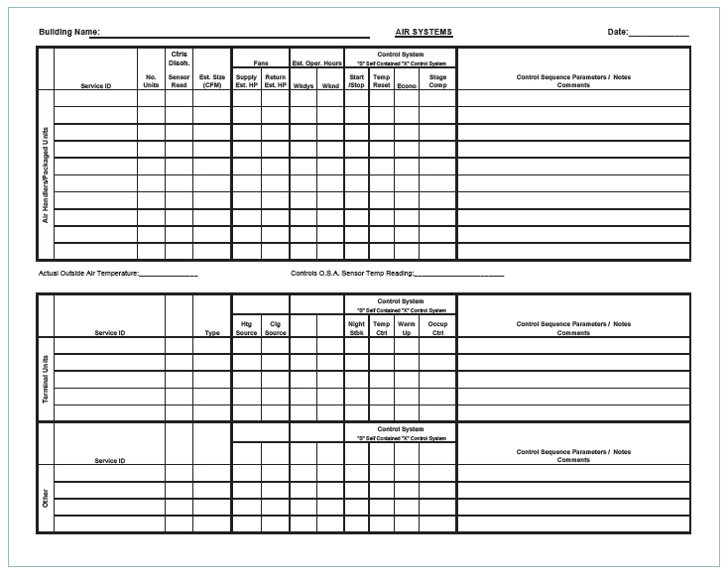
BSO Map Template for Air Systems
Image: IFMA Foundation
Notes:
A BSO map for major fan systems should include:
The operating schedule and setpoints
Occupancy schedule of the areas supplied, noting any areas with special extended operating hours
Any capability of terminal units or baseboards to run independent of main fan
Sequence of operations for terminal units/baseboards
Sequence of operations for air handlers with particular focus on outside air dampers, mixed air temperature and supply air temperature controls
General maintenance practices, safety and equipment condition.
Image: IFMA Foundation

Slide 16
BSO Map Template for Central Plant Equipment
Image: IFMA Foundation
Notes:
This template (and the templates that follow) can be modified to reflect different facility types.
Spending the time to gather this information and documenting it in one location helps to identify areas of improvement or system deficiencies.
Examples may include:
Knowing the chiller size (tons) and noting the HP or kW can help operators easily identify a common chiller efficiency rating (kW/ton).
Documenting the outside temperature in the “notes” section can make it easy to recognize when a chiller (or boiler) is operating unnecessarily (when outside air [OA] temperature is low or high).
Image: IFMA Foundation

Slide 17
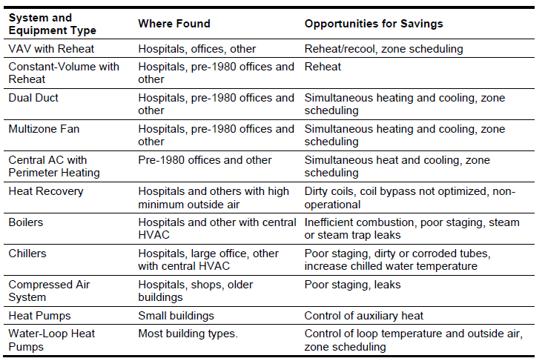
Practice 3: Targeting HVAC Systems and Equipment
Chart: Better Bricks
Notes:
Practice 2, “Determine EUI and start benchmarking”, was covered in Part 4. So now we’ll discuss the third key practice.
Any HVAC system can be targeted to improve scheduling, outside-air use and sensor calibration. The design of the HVAC system types listed above makes them prone to excessive energy use in certain situations.

Slide 18
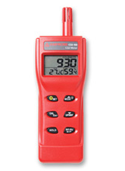
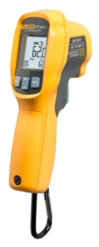
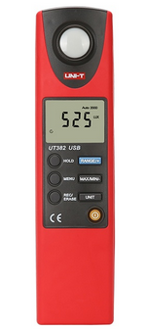
Basic Test Instruments
CO₂/temperature/
humidity meter
Infrared thermometer
Light meter
Notes:
Low-cost tools include an infrared temperature gun which lets you take temperature measurements around a room, a light level meter which measures light levels in the space, digital camera, tape measure, flashlight, tools for opening panels, etc.
Higher cost tools might include a thermal imaging camera, carbon dioxide (CO2) monitor (may be combined with other functions such as temperature and humidity sensors), digital manometer, airflow hood, etc.

Slide 19
Discussion Question
Which tools would you use for the building envelope?
Infrared thermometer
Thermal imaging camera
Digital camera
All of the above

Slide 20
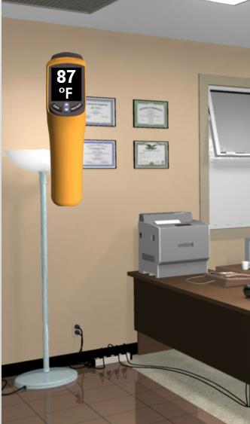
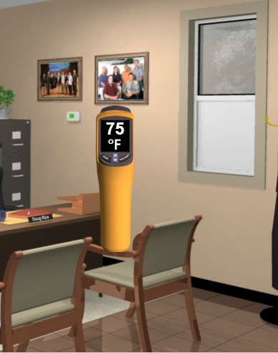
Basic Troubleshooting Techniques: Insulation Example
This wall is 87°
This wall is 75°
What could be causing the differences?
Notes:
Here is an example with a problem in the building envelope.
An occupant tells you he feels too warm at his desk despite the air conditioning being on.
Think: Where is the heat gain coming from? Was a window left open? Is there a bigger issue?
Use your temperature gun to survey the temperatures of the surrounding walls. Look for a significant difference in temperature readings near the desk.
Now that you’ve found the source of the heat, investigate into the causes. Take more readings on that wall. If it’s even warmer around the window frame, you might have poor sealant. If the heat distribution is steady across the whole wall, it may not be insulated.

Slide 21
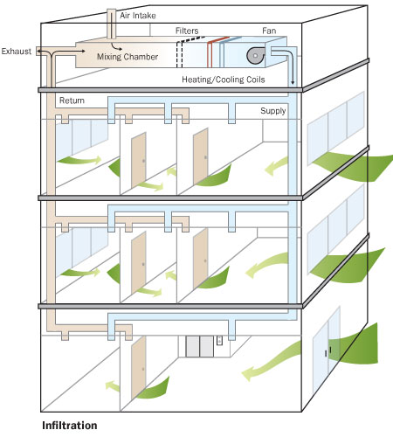
Thermal Imaging
Wind
High
Pressure
Positive Pressure
Negative Pressure
Uncontrolled air entering a building around the windows and roof.
Image courtesy: UPMC
Notes:
The top left image is a photo of the exterior of a building, and the bottom left image is the same image taken with a thermal imaging camera (also known as infrared camera). The thermal image shows temperature differences around the windows and roof caused by infiltration.
Infiltration is the uncontrolled passage of outdoor air into a building through unintended leaks in the building envelope. Infiltration paths include seals around operable windows, cracks or seams between wall sections, wall-floor connections, corners, the roof-wall interface, doorjambs, and shell penetrations such as holes for wiring or roof curbs for HVAC equipment. Air flowing into or out of these leakage paths is driven by pressure differences caused by natural forces (e.g., wind and temperature), building shape, HVAC system design, and envelope tightness. Infiltration, like exfiltration, is driven by air pressure differences (stack and wind) that exist between the inside of a building relative to the outside of a building across the building envelope. The rate of infiltration or exfiltration is a function of the interaction of these factors. Studies confirm that office and other commercial buildings are subject to larger infiltration rates.
A 2004 study from the National Institute of Standards and Technology (NIST) shows continuous air barrier systems can reduce air infiltration by up to 83 percent and energy consumption for heating and cooling by up to 40 percent. A cost effectiveness calculation was performed using the scalar ratio methodology employed by ASHRAE SSPC 90.1.

Slide 22
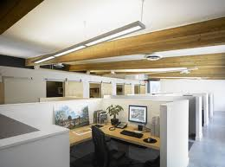
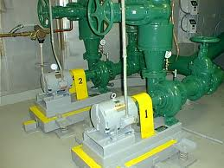
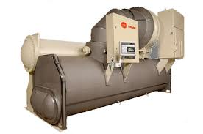
Equipment Scheduling
The easiest way to save equipment energy is to turn it off!
Longer operating hours:
Result in shorter equipment life
Increase the frequency of parts replacement
Cause the need for more frequent cleaning (chiller bundles, boiler tubes, fan coils, etc.).
A good first step is to walk through the building when it is unoccupied.
Image: Ledalite
Image: LBL
Image: Trane
Notes:
A plan or procedure should be put in place to check occupant requirements and re-evaluate equipment operating schedules regularly. Typically, the plan should be performed twice a year and whenever there is a major tenant change.
Walking through the building when it is unoccupied is a good first step in identifying unnecessary equipment operation. If equipment is running, look for a reason. It is usually obvious that a lamp or printer should be off, but HVAC equipment may be running to supply a computer room that needs continuous conditioning, or to condition a process load.
Systems that experience scheduling problems include:
Lighting
Plug and process loads
Fan systems
Chillers and boilers
Pumps

Slide 23

Equipment Scheduling: Lighting
Time clock or BAS control:
Does the programming match the occupant schedule?
Does the schedule account for holidays and weekends?
Is someone responsible for checking the programming regularly to make sure it meets current occupancy requirements?
Do the lights actually turn off as programmed?
Have temporary, special event schedules been reprogrammed back to normal schedules?
Has correct time been reset after a power outage?
Motion sensors:
Has the time interval to switch the lights off after occupancy been properly set?
Are they properly oriented to sense occupants?
Are motion controls used wherever possible?
Are batteries checked regularly?
Other:
Has anyone done a night walkthrough to ensure that lights are off when the building is unoccupied?
Does the custodial staff turn off lights when they are done?
Notes:
Manually controlled wall switch lights are usually turned on by occupants as they arrive, but not always turned off as they leave. Occupants may not hesitate to turn off lights in a small room, but are reluctant to turn off large banks of lights if they think someone else might still be in the space.

Slide 24
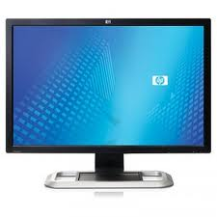
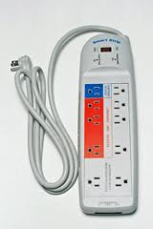
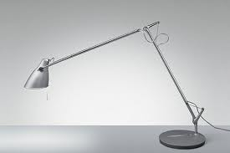
Equipment Scheduling: Plug Loads
Plug loads:
Does IT department have a policy or system in place to:
Encourage employees to turn off their equipment when leaving?
Are computer monitors, printers, scanners, and desk lamps turned off when not in use?
Make sure computers with an ENERGY STAR power saving mode have it enabled?
Notes:
Plug and process loads are generally manually controlled by occupants. Like manually controlled lighting, these loads are normally turned on by occupants, but are often left on longer than necessary.

Slide 25
Energy Use In Cubicles: Plug Load Case Study
 | kWh | Cost | Consumption %
Standard Devices per Day | 709.08 | $78.00 | 68.78%
Additional Devices per Day | 321.886 | $35.41 | 31.22%
Standard Devices per Year | 258814.2 | $28,469.56 | 68.78%
Additional Devices per Year | 117488.39 | $12,923.72 | 31.22%
Total per Day | 1030.966 | $113.41
Total per Year | 376302.59 | $41,393.28
Notes:
Here is a case study on plug loads. This organization is spending $28,469 on standard office devices per year in one department. Additional devices, which are not essential to business operations costs them another nearly $13,000. If you looked at that across the entire organization, unessential devices are costing hundreds of thousands of dollars per year.
Standard devices– e.g.computers, pencil sharpener, monitors, etc.
Additional devices– e.g. cell phone chargers, coffee pots, fish tanks, microwaves, extra printers, personal refrigerators
In addition to setting policies around occupants’ supplementary devices, strategies for reducing energy consumption from plug loads include installing smart outlets and using smart power strips or other power management controls.

Slide 26
Equipment Scheduling: Plug Loads
Phantom load – device plugged in but not in use
Example:
1 phantom load (2 W) per person
Devices are operating as phantom loads 20 hours/day, 7 days per week
1,200 person building
50% of the occupants each have one device that counts as a phantom load
Cost of electricity is $0.14/kWh
= 8,760 kWh = $1,226*
*does not include peak demand charges
Notes:
In addition to energy consumed when devices are used, there is also phantom load that is consumed when a device is plugged in but not being used. Here is an example of how phantom load can add up to substantial energy consumption.
2 watts x 20 hours/day x 365 days/year x 600 = 8,760,000 watt-hours or 8,760 kWh
Annual operating cost = 8,760 kWh x $0.14/kWh = $1,226 (does not include peak demand charges.
In this example we are spending $1,200 a year on things that are not in use.

Slide 27
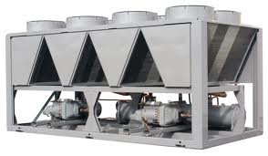
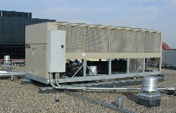
Equipment Scheduling: HVAC Equipment
Do programmed schedules for fans, pumps and other equipment match requirements, and is the schedule being implemented?
Are general exhaust fans scheduled off when the building is unoccupied?
Is optimum start and stop programming being used? (Intelligent start/stop of HVAC system based on outside air and space temperature)
Images: Carrier, McQuay
Notes:
Over-ventilation represents a common opportunity for saving fan energy. If the airflow volume that is supplied to the space is not needed to maintain building static pressures, or for ventilation purposes, reduce the outdoor airflow rate.

Slide 28
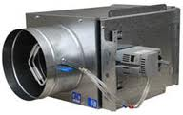
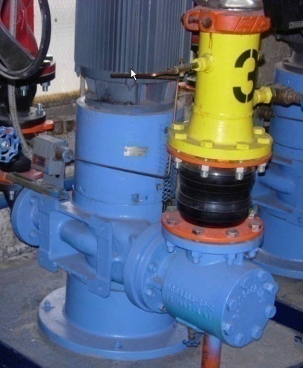
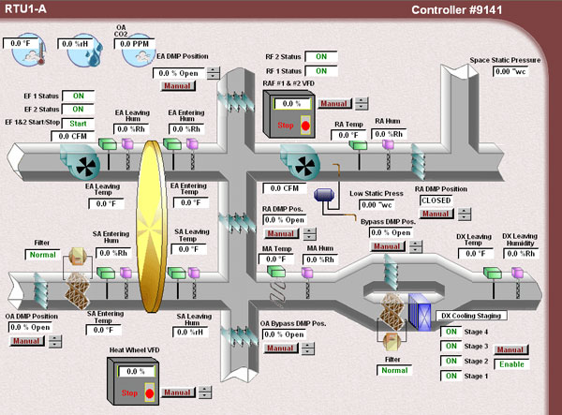
Equipment Scheduling: HVAC Equipment (continued)
Are fan-powered VAV boxes scheduled for morning warm-up?
Are baseboard heaters scheduled to match occupancy and not allowed to create a simultaneous heating and cooling situation?
Are the chiller and boiler prevented from operating at the same time?
How are after-hours overrides being used?
Are programmable thermostats that are networkable and accessible through the Internet for packaged equipment appropriate?
Images: PECI, McQuay
Notes:
Other common energy savings opportunities may include:
Bathroom/general exhaust fans: Turn off during unoccupied hours.
Fan powered VAV boxes with reheat used during for morning warm up: Warm up at zone level rather than whole building.
Baseboard heating: Match use with occupancy schedule (vs. manual on/off) to prevent simultaneous heating and cooling.

Slide 29

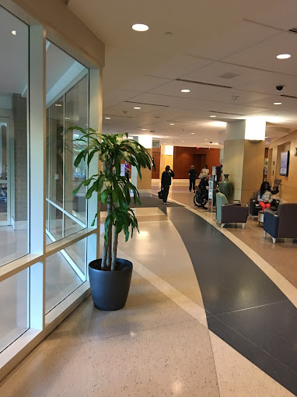
Equipment Scheduling: Case Study
Regions Hospital - St. Paul, Minn.
Previous to adjustments:
Air-handling units ran 24/7, even in areas that were unoccupied (many at 100%)
Results after adjustments:
65% energy savings for air-handling units
$52,464 annual savings on gas
3.5% overall energy savings
6.5% reduction in peak demand
Notes:
The hospital’s central monitoring system had not been adjusted to reflect changes in occupancy.
Air-handling units ran 24/7, even in areas that were unoccupied on nights and weekends. In many cases, the units were drawing 100% outside air 24 hours a day. Tailoring ventilation airflow to the actual occupancy schedule yielded 65% energy savings for these units.
The facility optimized outside air dampers and air temperature controls using occupancy sensors, resulting in $52,464 annual savings on gas.
Savings from the overall project: 3.5% overall energy savings and 6.5% reduction in peak demand.
Source:
https://www.ashe.org/system/files/media/file/2022/04/14_Reevaluate-HVAC-equipment-scheduling.pdf

Slide 30
Simultaneous Heating and Cooling
Common culprits of simultaneous heating and cooling:
Variable air volume (VAV) systems with reheat
Constant volume systems with reheat
Dual duct systems
Multizone fans
Central air conditioning systems with perimeter heating.
The Golden Rule:
Don’t use energy for both heating and cooling within the same system at the same time.
Notes:
Central fan systems are designed to supply space conditioning to multiple areas in a building. Each area has its own space conditioning needs.
Typically, a central fan supplies cool air to one or more zones. To meet the conditioning requirement of each zone, most central HVAC fan systems use some form of reheat. At the zone level, the quantity of air is usually modulated to satisfy the cooling load or may be reheated to meet a heating load.
A typical office building floor will have electric or hydronic coils installed in the ductwork or in the VAV fan boxes serving the perimeter areas, while the central area is cooled only. The temperature of the cool air leaving the air handler at the primary supply determines the amount of reheat required in the various zones.

Slide 31


Causes of Simultaneous Heating and Cooling
Over conditioning outside air
Overlapping control loops
Leaking valves or dampers
Sloppy valve or damper controllers (especially pneumatic)
Rogue zones
Abandoned overrides
Missing/damaged pipe or duct insulation
Notes:
Energy codes and standards, including ASHRAE 90.1, already have provisions to prohibit simultaneous heating and cooling. However, with widespread heat-cool overlap observed in so many buildings constructed under an energy code, there must be a disconnect somewhere between the code phase and the operations phase.
In addition to energy costs, simultaneous heating and cooling increases operational costs. When the central system delivers cooler air than required, the zone reheat coils must temper the air before it is delivered to the space. The heating and cooling systems work against each other.
Sometimes, when one part of the system is not operating correctly, this can be disguised by other functions compensating for the failure. A typical example of this is when more heat than necessary is delivered to an area while, at the same time, the temperature is controlled by the cooling system. This leads to both excessive heating and cooling being delivered unnecessarily to the same place.

Slide 32
Solutions to Simultaneous Heating and Cooling
Cause
Offending system types (e.g. constant volume [CV] dual duct, double-deck multi-zone, central AC with perimeter reheat, VAV reheat)
Tune the controls to minimize simultaneous heating and cooling
Intelligent supply temperature reset schemes
Heating and cooling setpoints at least 5ºF apart
Deadband & throttling ranges that prevent hunting between heating and cooling
Potential Solution
Notes:
If your facility exhibits symptoms of simultaneous heating and cooling, here are several potential solutions to minimize energy waste. Deadband is the temperature range above and below setpoint when no heating/cooling occurs. ASHRAE requires a deadband of at least 5 degrees; in other words, if temperature setpoint is set to 70.0º F, the controller will not take corrective action unless the space temperature is below 67.5º F, or above 72.5º F.
To minimize the occurrence of simultaneous heating and cooling, building operators should evaluate and implement supply air reset schemes based on industry standards.

Slide 33
Solutions to Simultaneous Heating and Cooling
Cause
Cause:
Overlapping control loops
Use BAS (building automation system) screen checks to observe simultaneous heating & cooling for the following:
OA damper greater than minimum setting and heating valve open
OA damper at minimum, cool OAT (outside air temperature), and mechanical cooling
Mechanical heating and cooling both on (or cycling between them)
Then correct the settings in the BAS.
Potential Solution
Notes:
Overlapping or competing control loops can adversely affect HVAC systems. For instance, chilled water valve operation can be controlled by both humidity and temperature sensors.
Care must be taken that the outputs from each sensor do not fight each other.

Slide 34
Solutions to Simultaneous Heating and Cooling
Cause
Cause:
Unusual zone load, such as computer room, drives down supply air temperature setpoint, forcing excessive use of reheat
Potential solutions:
Remove rogue zone from SAT (supply air temperature) reset sequence and serve zone with separate fan coil unit
Increase air flow to rogue zone
Weight other zones more heavily in SAT reset sequence.
Potential Solution
Notes:
Rogue (also known as “wild”) zones are caused by loads that are not anticipated during design.
For example, space initially intended to be for storage becomes a data room and houses many servers, requiring mechanical cooling. This forces the entire zone into cooling, regardless of what the other spaces within the zone require.
A potential solution is to remove this zone from the SAT reset sequence and serve this zone with a dedicated unit.

Slide 35
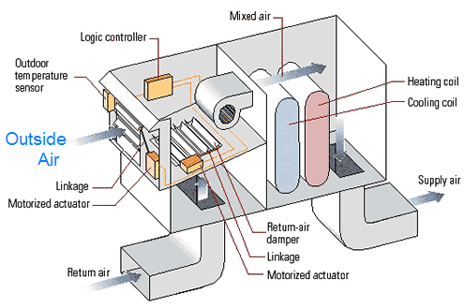
Outside Air Usage: Economizers
Economizers = FREE COOLING
However, if you have one, it may not be working!
Failed outside air sensor
Incorrect thermostat
Incorrect control logic
Broken linkages
Image: Better Bricks
Notes:
Many buildings use an outdoor air economizer, which uses outside air for “free” cooling when its temperature is below the return air temperature. The economizer varies the outside air quantity from the minimum ventilation rate up to 100% outside air as needed to cool the building.
Economizer scheduling: Energy codes generally require that outside air dampers be closed when the building is unoccupied, and open to the minimum ventilation rate when it is occupied and being heated. When the building requires cooling, the economizer activates and allows additional outside air when the outside air is cooler than the return air.

Slide 36
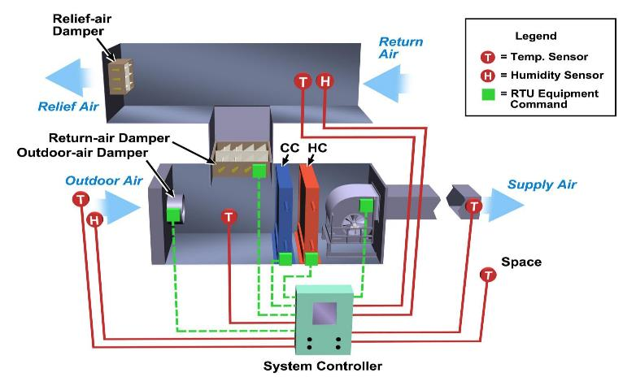
Air-Side Economizer
Required by ASHRAE 90.1/IECC Energy Codes (some exceptions)
Useful when cooling is required during cool weather
Are outside air intakes large enough?
Dry bulb or enthalpy control?
Sensor reliability?
Notes:
Economizer control is required by ASHRAE 90.1/IEEC energy codes for all climate zones in the United States except for 1A/1B [Hawaii, Island Territories, Broward Co. FL (Miami area)].
Other exceptions are if the cooling system <33,000 BTU, if outdoor air will affect supermarket open refrigerated casework systems, is used <20 hours/week, and a few other miscellaneous exceptions.
Enthalpy control is typically mandated in warm-humid requirements. Dry-bulb control is typically allowed in cooler or dry climates.
(See ASHRAE 90.1 or IEEC for climate zone exceptions.)

Slide 37
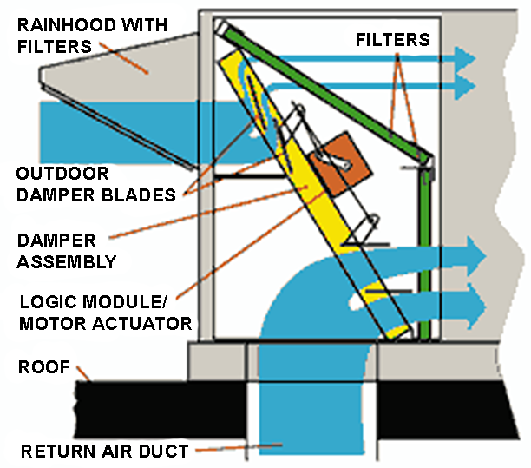
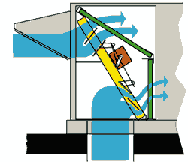
Packaged Unit Economizer
Minimum Outside Air Position
Maximum Outside Air Position
Notes:
This graphic shows the basic anatomy and functionality of air economizers and damper positions for both minimum OA (for ventilation) and maximum OA (for economizer cooling).

Slide 38
Causes and Symptoms of Poor Outside Air Control
Economizers
Indoor Air Quality (IAQ)/ Minimum ventilation
Control strategy [straight line versus mixed air temperature (MAT) setpoint]
Improper OA sensor location
Poor return air temperature (RAT) and MAT sensor readings
Jammed damper blades
Failed damper motor actuator
Operator initiated lockout
Broken damper linkages
Changeover setpoint
OA lockout after hours and during warm-up or cool-down cycle (depending on climate)
Too much/little ventilation air
Minimum ventilation rate never adjusted for change in occupancy
Minimum ventilation rate set by damper positions rather than by measured airflow
Damper leaks when closed during unoccupied times
CO₂ sensor is improperly located
Notes:
Regulating the outside air flow is a challenge. With excess ventilation air, the air handling system serves an unnecessary heating load during cold outside conditions, and an unnecessary cooling load during hot and humid conditions.
Many issues with outside air are caused by setpoints or control strategies that have never been updated when space use has changed. Building operators should take time to review the OA requirements of their facilities and make adjustments as allowed.
Several examples of poor outside air control that are easily fixed are listed above.

Slide 39

Learning Activity #5
Energy Conservation Opportunities
Turn to the Appendix of your handbook
Notes:
Please turn to the Appendix of your handbook and refer to the image on the following page to complete Activity 5.

Slide 40
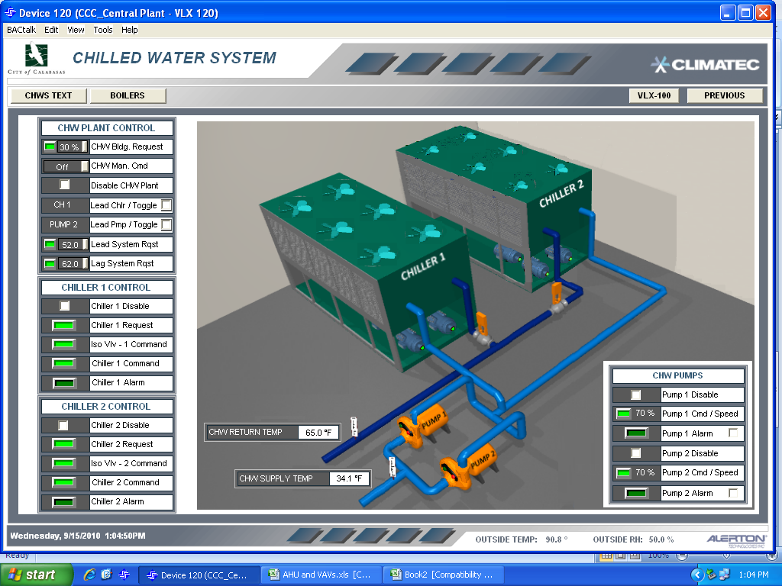
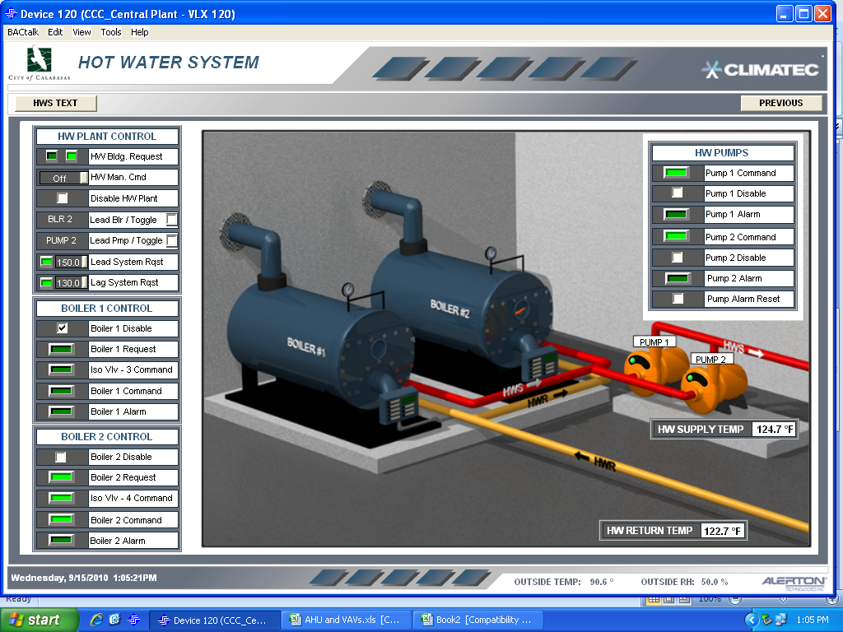
Learning Activity #5
BAS Screen Shot: Chiller Plant
BAS Screen Shot: Boiler Plant
Notes:
BAS Screen Shot: Boiler Plant
Refer to Learning Activity #5 in Appendix

Slide 41
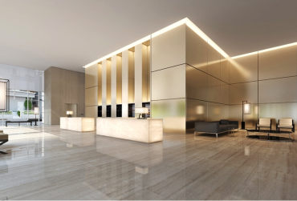
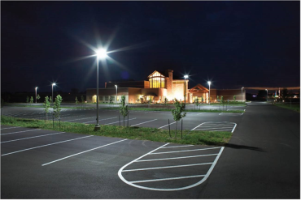
Lighting Opportunities: Discussion
What lighting projects have been completed in your facilities?

Slide 42
Five Low-Cost Lighting Efficiency Opportunities
Schedule lighting
Match light levels to tasks
Clean fixtures
Install more efficient technology
Maintain and fine-tune
Notes:
Lighting is often considered the “low-hanging fruit” of energy conservation opportunities. We discussed scheduling lighting earlier in this class, and in Part 3 we discussed matching light levels to tasks (measuring light levels and adjusting levels when too high or too low) and cleaning fixtures. Next, let’s look at how energy savings can be achieved by installing more efficient technology, and other considerations for maintaining and fine-tuning lighting systems.
Consider the following recommendations.
Take light level measurements using a light meter. Reduce lighting levels where they are too high and increase them where too low.
Take advantage of existing daylight AND turn off or turn down electric lighting. Also, reduce the hours of lighting (and energy) use through the use of controls, such as occupancy/vacancy controls.
Install more efficient tubes, ballasts & fixtures
Schedule fixture cleaning at the time of re-lamping.
Finally, periodically check facility spaces to make sure that control schedules are matching occupancy schedules.

Slide 43
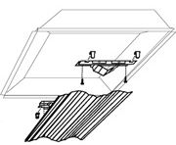
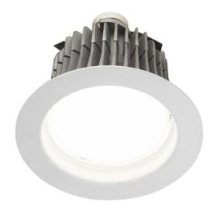
Efficient Lighting Technology
Retrofit
Upgrade existing fluorescent lighting to LED
Retrofits are more sustainable than re-lighting due to re-use of material
When changing fluorescent to LED is not an option, use lower wattage lamps
When asbestos in ceiling – has to be retrofit (unless you also do an asbestos abatement project!)
Notes:
A lighting upgrade is any strategy that reduces the system's energy use.
Retrofit means re-using existing fixtures. Lighting retrofits are usually performed by professional lighting retrofit companies.
A lighting retrofit is the practice of replacing components in the system with counterparts that make it use energy more efficiently. This is more sustainable than re-lighting (replacing existing fixtures with all new fixtures) because some materials are re-used.
Sustainability and cost-effectiveness are improved when long-life, high efficiency bulbs/tubes are used. Upgrading to LED is always recommended whenever possible.
Retrofit kits for upgrading fluorescent “troffers” (fixtures that use tubes) to LED are widely available. Note: when performing these types of retrofits, it is important to verify that new components are listed by UL (Underwriters Laboratories, a leading safety organization that tests and certifies various products) and installed properly by qualified personnel.
For more information on lighting retrofit economics, visit:
www.lightsearch.com/resources/lightguides/retrofitecon.html

Slide 44
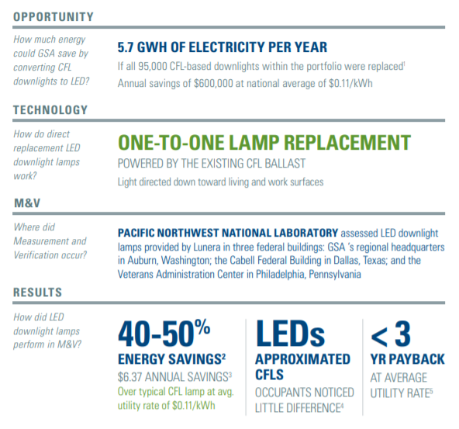
Case Study
LED Replacement:
Energy savings: between 40-50%
Same light levels and quality
Simple payback: under 3 years
Pacific Northwest National Laboratory (PNNL)
Notes:
Pacific Northwest National Laboratory (PNNL) evaluated a retrofit opportunity within GSA (General Services Administration, a U.S. federal government agency that manages federal buildings) using LED replacement lamps that use the same four-pin socket and electronic ballast as an incumbent CFL. Results showed energy savings between 40-50%, matching light levels and quality, with a payback of under 3 years.

Slide 45
Lighting: Maintain & Fine-Tune
Survey facility to identify and record maintenance condition of each lighting system
Follow a lighting maintenance policy so correct bulbs/tubes & ballasts are used & cleaning is done
Consolidate and standardize bulbs/tubes to reduce inventory of number of different types of lamps
Incorporate scheduled maintenance in new & upgrade projects and ensure a budget for them
Notes:
Understanding lighting systems is key to better maintenance. Knowing what equipment, bulb/tube inventory, color preferences and types used can help evaluate the effectiveness of that system.
Good documentation of the existing systems and maintenance efforts can help in purchasing and re-stocking the correct lamps (bulbs/tubes), ballasts, and controls for the facility.

Slide 46
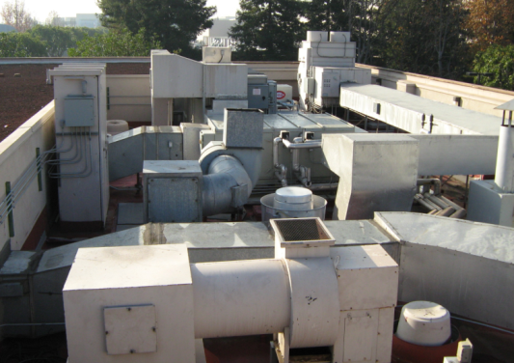
Introduction to Control Systems
Control systems tell building equipment how to operate
HVAC equipment
Lighting
Plug loads
Fire/life safety
Security
Elevators
Notes:
Most equipment that’s installed in buildings does not operate continuously (24/7) at full power. Control systems tell the equipment when to operate, and how it should operate when it is on. There are many systems and pieces of equipment requiring control.
Examples include:
HVAC Systems
Lighting Systems
Plug Loads
Fire/life safety items
Security equipment
Elevators and escalators
Power monitoring
Closed-circuit video (CCTV)
Card and keypad access
Plumbing and water monitoring

Slide 47
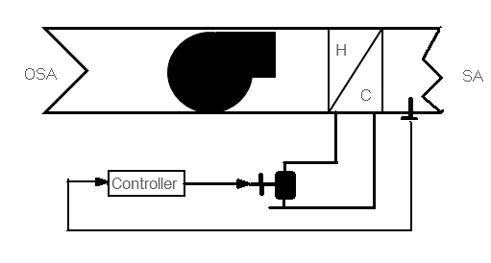
Introduction to Control Systems
What is controlled?
Valves
Dampers
Electric relays
Fans
Pumps
Compressors
Variable speed drives for fan & pump applications
Notes:
Recall that there are many types of equipment, devices and processes that can be controlled (output).
Generally, building control systems begin with control of mechanical, electrical, and plumbing systems.
For instance, the HVAC system is almost always controlled, including control of its various pieces of equipment referred to as controlled devices.

Slide 48
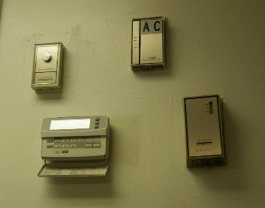
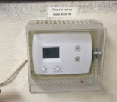
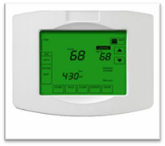
HVAC Systems and Controls: Basics
Control Systems
Sensors
Temperature
Relative humidity
Carbon dioxide
Occupancy
Manual or automatic controls
Thermostats
Dampers
Economizers
Notes:
Building controls moderate the interaction of all of the important building functions.
The most commonly identified controls are the thermostats that regulate temperature within a given space in the building.
Other area controls monitor and regulate humidity and CO2 levels.
Most modern building control systems are complex and manage the interaction of hundreds of sensors and pieces of equipment such as electric motors, fans, compressors, pumps, air exchangers, cooling towers, pneumatic tubes, heaters and other equipment.

Slide 49
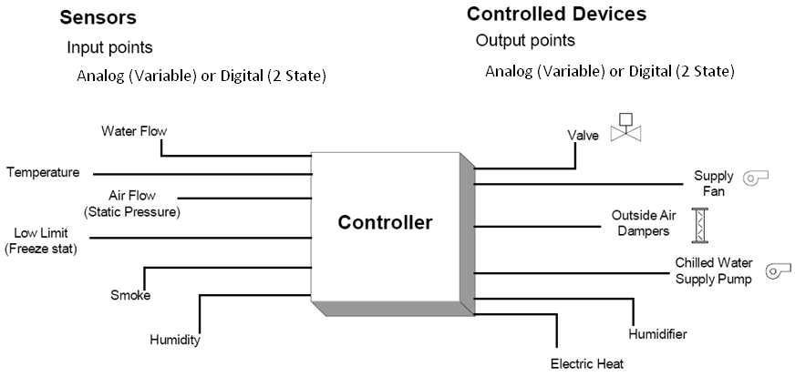
Introduction to Control Systems
The controller receives the input and processes an output
Notes:
This basic control system diagram illustrates one controller with multiple sensor inputs and multiple controlled devices.

Slide 50
Introduction to Control Systems
 | Input | Output
Digital | Two state information from the building into the System Control Unit Switches: Differential Pressure/Proof Smoke Alarm Level Alarm High/Low Pressure Alarm Filters | Two state information from the System Control Unit out to the building On/Off Control – fans, pumps, lights Open/Close 2-position valve damper Control of 2-speed motors Energize/De-energize E/P valves for heat/cool and day/night changeovers
Analog | Variable Information from the building into the SCU Temperature – room, duct, outdoor Humidity – room, duct, outdoor Pressure – static, velocity, total Flow rate – water and air | Variable information from the SCU out to the building Modulate valve, damper, actuator Motor speed control Modulate fan inlet volume dampers Adjust air pressure to P/E switches

Slide 51
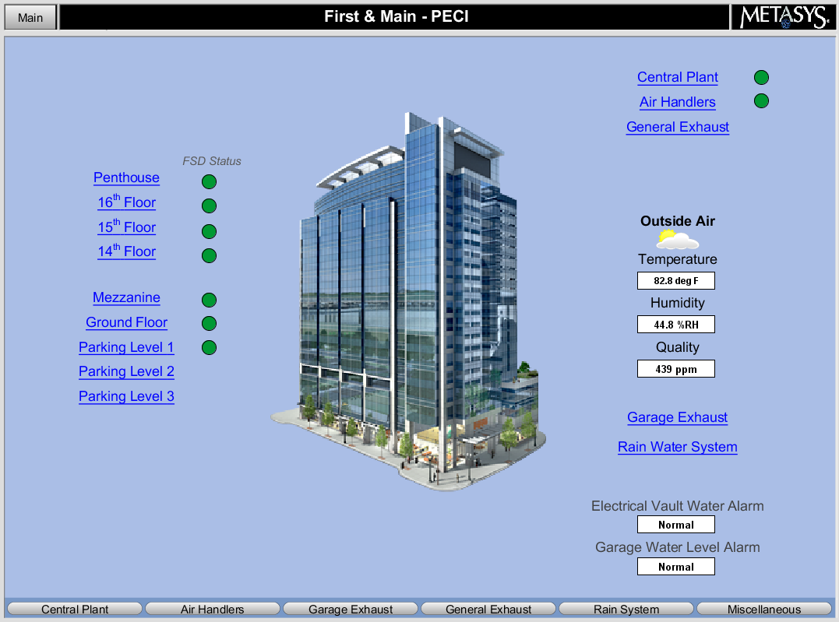
Introduction to Control Systems
Control System Types
Communicating
Non-communicating
Notes:
There are various types of control systems that can be used to control the particular pieces of equipment and processes in buildings.
Communicating control systems tie all of the equipment together for control from a central location.
Non-communicating systems are self-contained and control only one piece of equipment, such as a rooftop unit thermostat that only controls the rooftop unit and does not communicate with any other systems in the building.

Slide 52
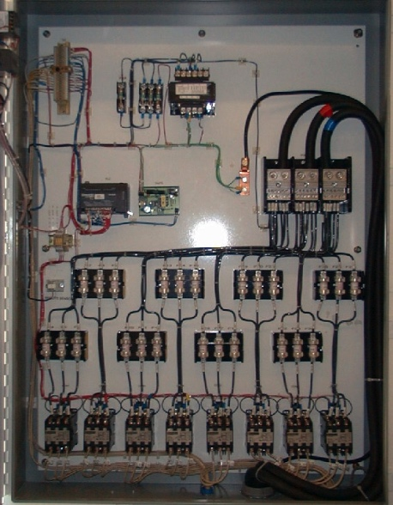
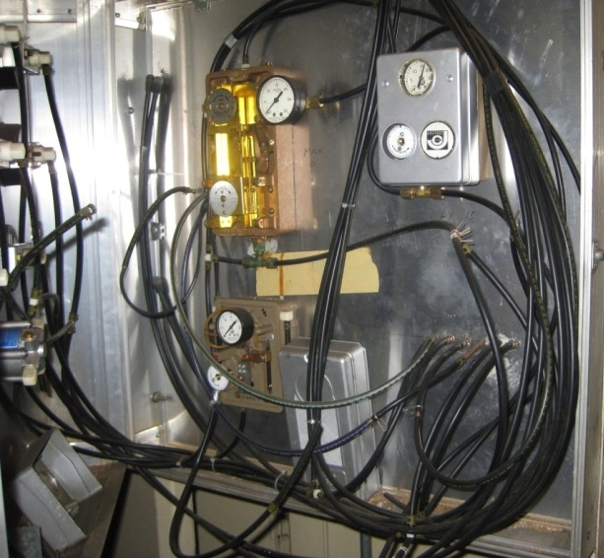
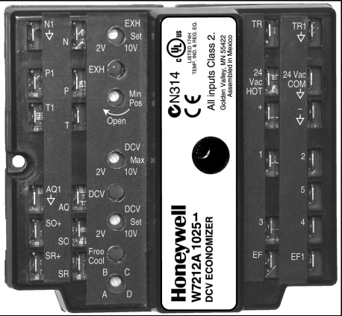
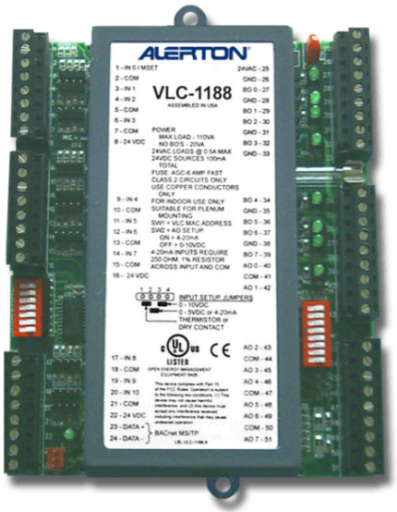
Introduction to Control Systems
Control Methods
Electric
Pneumatic
Electronic
DDC
Notes:
Some of the various control methods include:
Electric control systems operate on low or line voltage and use mechanical means such as temperature-sensitive bimetal strips to perform control functions. They provide on/off or two-position control.
Electronic control systems operate on low voltage and use solid-state components to amplify input signals and perform control functions. They provide on/off, two-position, or modulating control.
Pneumatic control systems operate with compressed air and use mechanical means such as temperature-sensitive bimetal strips to perform control functions.
Direct digital control (DDC) systems are used in modern devices. These systems use both electronic and microprocessor-based controls. They can also control pneumatic equipment.
The control methods listed above utilize signals. Analog and digital refer to the input/output signal type. Analog is a continuously variable signal, while digital is either on or off, or a precise value with step increments.

Slide 53

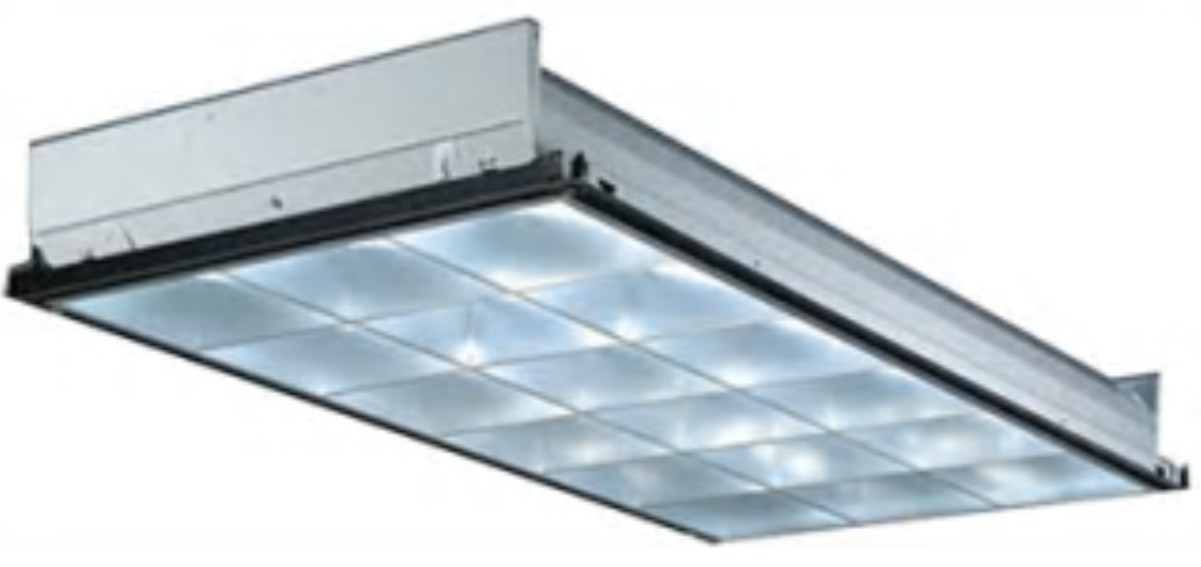
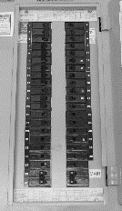
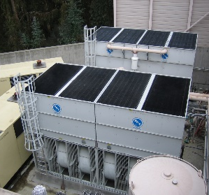
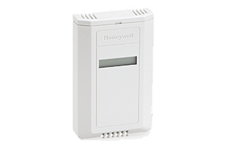
Introduction to Building Automation System (BAS)
Centralized control system; controls and monitors mechanical and lighting systems
Accessible from a single location
May be accessible remotely
Helps manage system setpoints
Provides information about system operation
Lights
Lights
Space Sensor
Space Sensor
Space Sensor
Space Sensor
Notes:
A common name for a computerized control system is Building Automation System, or BAS (also known as Building Management System, or BMS). Building operators can easily monitor real time operation through the graphical user interface, or GUI.
The next few slides show examples of DDC system architecture, including how the computer with the GUI interfaces with the rest of the control system.

Slide 54

Introduction to Building Automation System (BAS)
Notes:
We used a BAS GUI screenshot to complete Activity 5. Here is another example of a screenshot from a BAS GUI controlling a boiler hot water system that supplies space heating to a building.

Slide 55

Introduction to Building Automation System (BAS)
Notes:
This screen shows an overview of the functioning of the air handling unit serving the lower level of building E.
The previous screen showed the outside air temperature as 69.6 °F, but the mixed air temperature is 71.9 °F with what looks like 100 percent outside air. Why do you think this is?

Slide 56

Introduction to Building Automation System (BAS)
Notes:
This graphic has a lot of very useful information.
Let’s step through a few questions:
Is the unit running? How do you know?
Look at the OAT. Would you expect to be in heating mode, cooling mode?
Look at the space temperature. Is it reasonable? Why or why not?
What mode (heating, cooling, fan-only) is the unit in?
Is the unit operating with minimum OA? What % of OA is being delivered?
Does this system have dehumidification?

Slide 57
Controls Strategies for Improving Energy Efficiency of HVAC Systems
Use the building’s BAS to identify and correct building operational problems related to:
System setpoints
Scheduling
Start-up/shutdown
Optimizing system operation
Year 1
Year 2
Year 3
Notes:
The building’s BAS can be used to identify and correct system and building operations problems.
Look at the graphic. What is it telling you? How do the four elements listed above relate to the graphic?

Slide 58
Sequence of Operations
Sequence of Operation. There should be a sequence of operation for every major piece of equipment including details of system interactions.
?
What would you expect to find
in a sequence of operations?
Notes:
It is important to familiarize yourself with the system design and the control sequences of the building’s HVAC equipment.
Once you are familiar with the systems and control sequences, you can identify the various modes of operation you wish to verify with the screen check process. Modes of operation can be determined by several factors including time of day, day of the week, heating or cooling load, and outside air temperature.
By understanding how the building is supposed to operate under the various conditions, you will be able to review the BAS screens and quickly see discrepancies between expected building operation and actual operation.
Refer to the Appendix for an example of a written Sequence of Operation.

Slide 59

Sequence of Operations
Notes:
Let’s look at an example of some different modes of operation determined by time of day and day of the week.
During unoccupied hours, the system in this building should be set back so that the system does not continue to operate.
In some buildings’ BAS, the supply fan status may not be available, but reviewing the plot of the duct static pressure versus time can reveal if there is night set back or not.
It appears that there is no night set back for this AHU because when the building goes into an unoccupied mode, the duct static pressure should drop to half of the daily occupied static pressure or lower, but preferably to zero, if night set back is being utilized correctly.

Slide 60

Sequence of Operations
Notes:
This graph shows that a night setback is in place.

Slide 61

Sequence of Operations
Notes:
This graph shows that a more aggressive setback strategy is in place, which includes nights and weekends.

Slide 62
Using the BAS to Solve Common Problems
Low supply-air temperature will cause:
Overcooling
Reheating in cooler zones
Portable heaters in offices
Drafts and cold complaints
Extra load on the cooling plant
Excess supply-air pressure
Excess energy in reheating the overcooled zones
Notes:
Some of the common problems with HVAC systems include simultaneous heating and cooling, incorrect damper position, and mechanical cooling that is on when not needed.
All of these problems can result in significant amounts of wasted energy.
You can quickly identify these problems through BAS screen checks.
Low temperature is the most common problem.

Slide 63




End of Module I
What Did We Learn?

Slide 64

Energy Conservation Considerations
Energy management is a continual process
Reduce total energy consumption
Reduce peak loads
Upgrade to more efficient equipment
Satisfy minimum requirements while providing better control and comfort:
Temperature
Relative humidity
Ventilation
Notes:
Remember – energy management is a continual process of assessing performance, identifying and implementing conservation measures, and measuring the effectiveness of those measures.
Reducing total energy consumption is the goal, which also reduces peak loads. Energy use reduction can be accomplished with various low-cost strategies such as optimizing equipment scheduling, avoiding unwanted simultaneous heating and cooling, using outside air with economizers to minimize mechanical cooling costs, optimizing lighting equipment and controls, and using the BAS GUI to help identify potential issues. Upgrading to more efficient equipment can also help to reduce energy use.
As systems are optimized, energy costs will most likely go down. Optimizing equipment operation can also help maintain occupant comfort and can result in using less energy while satisfying the minimum requirements.

Slide 65

Additional Energy Conservation Opportunities
Start with low-hanging fruit.
Consider:
Assessing air leakage/damper seals
Energy standards vs. productivity setpoint
Upgrading to variable speed drives
Implementing heat (or energy) recovery
Night purge
Don’t over-ventilate – consider Demand Controlled Ventilation (DCV)
Notes:
State or local energy codes are good guidelines for determining minimum efficiency and energy conservation strategies for buildings. ASHRAE Standard 90 has been adopted by many states as the standard for energy efficiency in commercial buildings. Check with your local building official to determine what energy conservation standards are in place.
Simultaneous heating and cooling which occurs with dual duct, VAV, and constant volume reheat systems should be limited, if possible. Electronic variable speed drives (VSDs) should be considered for variable volume fan systems.
Heat recovery systems should be considered for buildings with large exhaust and make-up air requirements.
Economizers should be used for building cooling when outdoor air conditions are favorable.
Demand Controlled Ventilation (DCV) is a method of controlling ventilation based on occupancy or CO2 levels to avoid ventilating a space when it is not needed.

