Slide 1

Fundamentals of Energy Efficient Building Operations
Part 6: Indoor Environmental Quality
Notes:
Instructor’s name: __________________________________________________________
Phone number: ____________________________________________________________
E-mail: ___________________________________________________________________
_________________________________________________________________________
_________________________________________________________________________
_________________________________________________________________________

Slide 2
Part 6 Agenda
Indoor Environmental Quality (IEQ) Overview
IEQ Program
Fundamentals of IEQ
IEQ Dynamics
Pollutant Control Strategies
Preventing and Addressing IEQ Problems
Effective Communication
Learning Activity: Communications Case Study

Slide 3
Indoor Environmental Quality
Comfort
Productivity
Health
Notes:
Indoor environmental quality pertains to items in the indoor environment that affect occupants’ comfort, health, and productivity. In facilities, our job is to create a comfortable, safe, and healthy indoor environment for the occupants of our facility so that they can meet the mission of the organization. Many factors affect the comfort and productivity of the occupants, and we will discuss these concepts in this section.

Slide 4
Fundamentals of IEQ
Air Quality
Thermal Comfort
Lighting
Noise
Notes:
Comfort for whom? Think about the range of occupants served by this class, even within one building or across the tenants in one commercial property.
There are many factors that affect indoor environmental quality (IEQ). This class primarily focuses on indoor air quality (IAQ), and slightly on the intersection of IAQ with comfort, especially how heat, air, and moisture flows impact comfort. In addition to these qualities, things like lighting, noise, ability to navigate in the space, ergonomics, and water quality also affect IEQ.

Slide 5
Discussion Question
What issues are we concerned about with indoor environmental quality?
Air quality
Thermal comfort
Lighting
Noise
All of the above

Slide 6

Why is IEQ Important?
20-30% of commercial buildings have IEQ problems
Occupants spend half of their waking hours indoors
People spend 75-90% of their time indoors
Pollutant levels can be 100-1000x higher indoors
IEQ problems increase operation and overhead costs
Notes:
Nationally, U.S. Environmental Protection Agency (EPA) studies estimate 20 to 30 percent of commercial buildings have IEQ problems. With workers and students spending half of their daylight hours indoors, their exposure becomes significant.
It is also estimated that the average person spends 75 to 90 percent of their time indoors where pollutant levels are often far higher than outdoors – up to 100 or even 1,000 times higher!
When IEQ problems arise, it is often expensive and difficult to diagnose the cause or causes of the problems. Prevention is the key to satisfied occupants, energy and resource efficiency, and budgetary savings.

Slide 7

Why is IEQ Important?
It Impacts Our Productivity!
Department of Energy
6% increase in productivity is possible with improved air quality
Lawrence Livermore Study
Improved air quality can decrease health care costs and sick time
Respiratory illness 9-20%
Allergies and asthma 18 -25%
Other non-specific 20-50%
Notes:
Studies show that productivity is impacted by the indoor environment and that improvements in the indoor environment can increase productivity. Department of Energy studies show there is a potential of a 6% increase in productivity with improved indoor air quality.

Slide 8

Costs of IEQ Problems
Reduced productivity and worker morale
Costs of inspections and testing to identify and mitigate problems
Workers’ compensation costs
Increased absenteeism
Owner liability
Notes:
IEQ-related illnesses and dissatisfaction lower productivity and increase absenteeism, creating economic and legal implications.
Costs related to IEQ problems are indisputable. The range of costs can be extremely broad, and the total costs to a particular facility are difficult to pinpoint. For example, how do you calculate the actual productivity losses due to a sick building or hysteria?
How many tenants moved due to IEQ problems?
How many valuable employees terminated their employment due to dissatisfaction with the building? New hires are expensive to recruit and train and lost experience cannot be easily replaced.
Knowledgeable facility staff can often effectively diagnose and correct many common IEQ situations for a fraction of the cost of an outside professional.

Slide 9
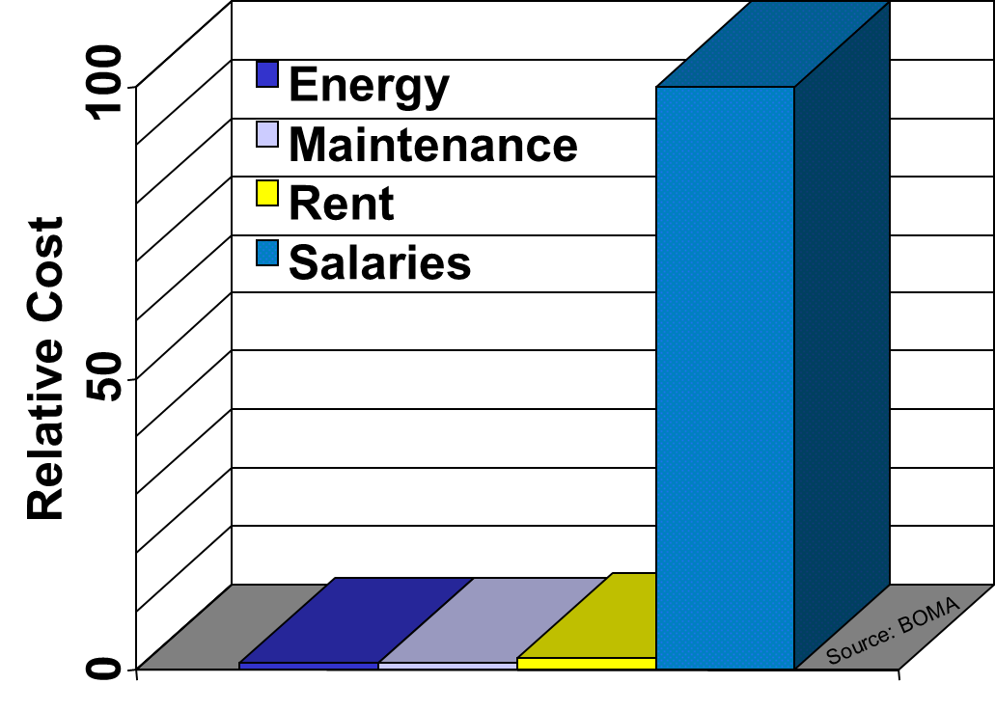
Operating Costs vs. Productivity Factor
… a 1% increase in productivity more than pays the energy cost, and a 2% increase more than pays the total operating cost.
Notes:
Increased energy use adds up to only a FEW MINUTES of workers’ time. Productivity is the dominant economic factor.
This should not be taken a license to waste energy or use energy to overcome a building deficiency. Energy and IEQ need to be balanced through management of resources.
It is estimated that billions of dollars are spent on health care for workers as a result of poor IEQ.
Sources:
BOMA
EIA/DOE
Productivity Research: Productivity and health care costs from a landmark study by Fisk and Rosenfeld:
Fisk, W.J. and Rosenfeld, A.H. 1997, 'Estimates of Improved Productivity and Health from Better Indoor Environments' , Indoor Air, vol. 7 (3), pp. 158-172.

Slide 10
Causes of IEQ Problems
Building Design & Construction
Occupant Use & Care
Operation & Maintenance
Remodeling
Lack of Commissioning/ Retrocommissioning
Notes:
Experience has shown that many IEQ problems are often not the result of a single cause. Buildings are complex and dynamic.
Obvious design problems are outside air intakes located where they pick up pollutants, inadequate insulation, lack of shading from direct sunlight, etc.
Building usage and interior configurations often change numerous times over the lifetime of a building. HVAC and other systems are often not adequately redesigned or modified.
Operation and maintenance can easily suffer due to lack of budget and administrative support. Preventive maintenance is too often reduced to “breakdown” or emergency maintenance. Unintended exposures to pollutants, compromised HVAC system effectiveness, climate control and proper ventilation too often result from remodeling projects.
New buildings should be commissioned to ensure they perform as designed and as expected. Retro- or re-commissioning needs to be performed after renovations and reconfiguration of spaces, and significant modifications to HVAC and control systems. It should also be performed periodically to ensure building performance continues to meet expectations.
Monitoring building performance parameters over time is essential to alert operators when systems need to be tuned-up.

Slide 11

Common Health Symptoms
Eye irritation
Headache
Sinus congestion
Nose irritation
Skin irritation
Fatigue
Dry throat
Cough
Sneezing
Dizziness
Nausea
Shortness of breath
Increased sensitivity
Source: National Institute of Occupational Safety & Health (NIOSH)
These symptoms are largely “non-specific.”
Notes:
The National Institute of Occupational Safety & Health (NIOSH) lists the symptoms above as typical reactions to an indoor environmental quality problem.
Specific reactions to conditions vary with each individual. It is not uncommon to hear a variety of different complaints to an IEQ problem.
It is important to understand that “complaints” are often an early warning that something may – or may not – be wrong. A prompt response in terms of communication and investigation is important to prevent small issues from potentially mushrooming into a large and expensive problem.
Ignoring a problem only increases the size and duration of the problem! The longer a problem persists, the longer it takes to solve.

Slide 12
Discussion Question
Think of a building you spend a lot of time in. Which indoor environmental qualities do you think the occupants in that building care most about?
Air quality
Comfort
Visual and light quality
Acoustics
Navigation in the building
Water quality
Notes:
Which qualities of IEQ do you think the occupants care most about? Choose up to three of the options below:
Air quality
Comfort
Visual and light quality
Acoustics
Navigation in the building
Water quality
What aspect of indoor environmental quality do you think you can impact the most with your role and daily responsibilities?
_________________________________________________________________________

Slide 13
IEQ Program
Communication of your efforts
Education of occupants & staff
Accountability & documentation
Prevention
Strictly following good practices
Rapidly and effectively responding
Notes:
The maintenance staff can have the greatest impact on indoor environmental quality when they are aware of the effect of their job and actions on the indoor environment.
It is important that maintenance crew members take responsibility for their involvement in the program elements described above.

Slide 14
Benefits of an IEQ Program
Enables effective communication
Establishes boundaries on expectations for both facilities, staff and occupants
Adds credibility and promotes occupant confidence in operations
Establishes accountability and defines standards of practice
Notes:
Effective communication is critical. All too often facilities staff do not adequately inform or educate the occupants on all the thinking and effort that is dedicated to ensuring a comfortable, healthy, productive, and energy efficient building. Occupants need to know that their health and wellbeing is being addressed and that facilities staff are responsive to their needs.
Again, an IEQ program will help establish practical expectations for the occupants and the O&M program. Without established boundaries on expectations, things can quickly get out of control.
An effective IEQ program will define procedures and accountability, and ideally specify measurable operating parameters. For instance, “the building will be operated to provide comfort within the range of ASHRAE 55” or “lighting levels will meet guidelines from the Illuminating Engineers.” Without measurable parameters there is no basis for meeting expectations.

Slide 15
Create Your Own IEQ Program
Your program will likely be
Easier
More effective
Less expensive
Personally rewarding
Notes:
Facilities staff are encouraged to take the initiative to create and adopt a custom IEQ program tailored to the unique needs and challenges of their buildings. A cookbook IEQ program may work OK, but chances are it will be either less than ideal or overkill. By taking a serious, proactive approach, facilities staff can avoid being forced to follow someone else’s program. Throughout classroom discussion opportunities, think about what might be incorporated into your IEQ Program. The discussion topic later in the class will be an opportunity to focus your ideas.
For help in creating an IEQ Program, check out the Easy Three-Step Program provided by the Washington State University Cooperative Extension Service. The program was created for schools, but many of the concepts are applicable to different types of properties as well.
http://www.energy.wsu.edu/Documents/3step_iaq_program.pdf

Slide 16
Fundamentals of IEQ
Air Quality
Thermal Comfort
Lighting
Noise
Notes:
Now that we’ve discussed some of the aspects of developing an IEQ program for your facility, let’s dive into more detail about the fundamentals of IEQ. We’ll start with air quality.

Slide 17
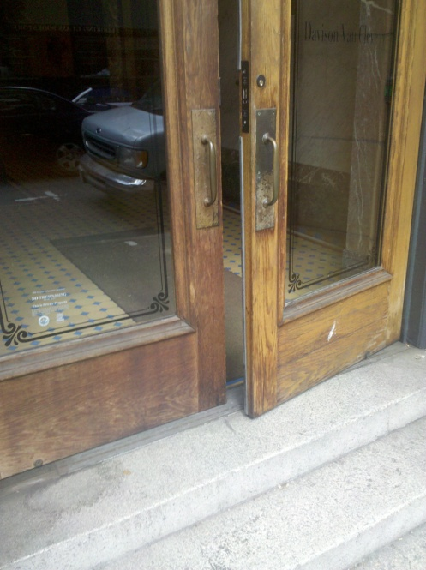
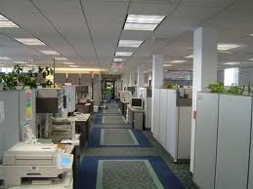
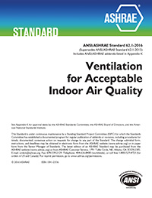
Potential Air Quality Concerns
Ventilation & outside air:
Code requirements (minimum ventilation rates)
Maintain proper building pressures
Maintain indoor air quality
Images: CT.gov, Better Bricks, ASHRAE
Notes:
Outside air is supplied to a building by the ventilation system in order to displace indoor air pollutants and provide adequate ventilation for the building occupants. Proper ventilation rates are needed to maintain indoor air quality. Building codes require a minimum ventilation rate, usually based on ASHRAE Standard 62.
Note the photo of the door. Doors and windows that aren’t properly shut may result in over ventilation of spaces. In many spaces, open doors or windows during a heating or cooling cycle may be providing plenty of outside air to a space without requiring delivery by a mechanical system. Because the control system has no way of knowing if extra air is being brought in, mechanical systems will provide the scheduled amount of outside air.

Slide 18
Potential Air Quality Concerns
Carbon Monoxide
Carbon Dioxide
Particulates
Volatile Organic Compounds (VOC)
Natural gas equipment
People (Ventilation)
Processes (e.g. print shops), dust
Chemicals (e.g. cleaning, maintenance, carpets, furniture)
Notes:
Buildings contain many potential air quality concerns. How we operate and maintain our facilities plays a significant role in the quality of the environment within the building.
Carbon monoxide (CO) and carbon dioxide (CO₂) are often confused with each other. CO is a dangerous gas even at relatively low concentrations, while CO₂ is produced naturally by exhalation and is generally harmless (except in very high concentrations). But CO₂ levels can be an indicator of proper or improper ventilation. Higher levels of CO₂ indicate less fresh air in the space.
It is VERY IMPORTANT to note that during nearly all major power outages, the leading cause of death is from carbon monoxide (CO) poisoning due to generators and stoves and improper ventilation. Occupant education should include warnings not to operate any combustion-based items inside, even during a power outage.
Particulates, or small particles suspended in air, can be harmful to health, especially small particles that can penetrate deep into the lungs.
Volatile organic compounds (VOCs) are emitted by chemicals that are present in many different common products, such as building materials and furnishings. They can cause eye, nose, throat, and skin irritation, headaches, dizziness, and nausea. They can also cause serious health concerns such as cancer and damage to the liver, kidneys, and central nervous system.

Slide 19
Potential Air Quality Concerns
Asbestos
Lead
Radon
Mold
Viruses
Bacteria
Building Materials
Soil
Moisture
People
Water systems (Legionella)
Notes:
The age of a building plays a factor in what hazards may be in it. Some forms of asbestos were banned in the United States including spray applied asbestos, flooring felt, rollboard, corrugated paper, specialty paper, commercial paper, and new uses of asbestos. Other uses of asbestos such as brake pads, gaskets, and roofing products are still legal.
OSHA requires building owners to presume certain materials are asbestos-containing in buildings constructed no later than 1980.

Slide 20
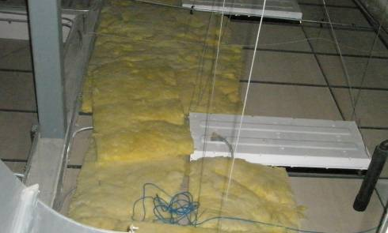
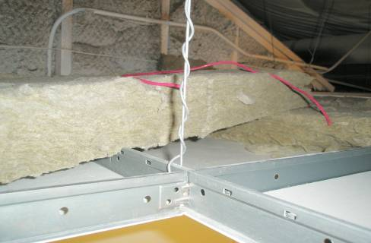
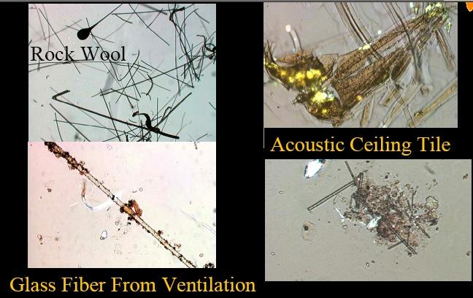
Pollutants from Building Materials
Insulation above ceiling tiles
Acoustic ceiling tile
Glass fiber from insulation under a microscope
Particles from acoustic ceiling tile under a microscope
Notes:
This slide shows some common IEQ pollutant sources in typical buildings. Filtration cannot be expected to prevent exposures to these types of irritants. Removal of the source and proper housekeeping go hand in hand with filtration.

Slide 21
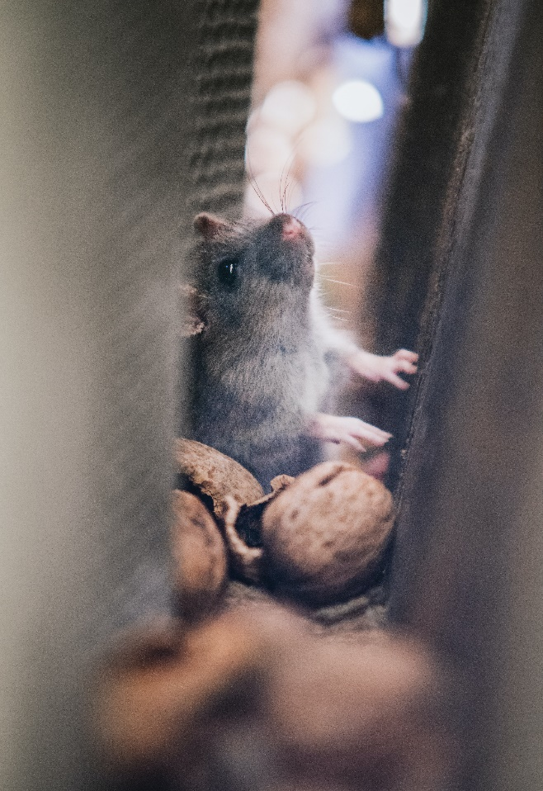
Pests
Sources:
Moisture in the walls, envelope issues, food remains.
Health Effects:
Pesticides are associated with cancers (prostate and breast cancer of high concern)
Respiratory problems
Reproductive complications
Remediation:
Adopt and implement an Integrated Pest Management (IPM) Plan
Keep common areas clean (especially food & moisture sources)
Lightly dust gaps between the walls with boric acid before closing
Educate occupants on the connection between moisture, dust and pests
Reduce carpeting and clean carpets often
Photo by David Bartus from Pexels
Notes:
All living things need food and water. Excessive moisture in walls/on surfaces and/or remnants of food can attract pests such as rodents or insects.
Some pests can carry harmful diseases. Bacteria and other particles can be distributed via dust in indoor spaces. Some harmful insects, such as cockroaches and dust mites, thrive in conditions of excess moisture. Conversely, excessively dry conditions can exacerbate the spread of dust in the air. Keeping humidity levels in a moderate range (between 40-60%) can help reduce pest attraction and help dust particles to stick together, becoming too heavy to float in the air and instead settling on surfaces, making cleaning easier. Carpets are a notorious harbor for dust and should be cleaned regularly or replaced with other flooring options.
Many pesticides used to mitigate pest intrusions are themselves harmful, associated with cancer, respiratory problems, and reproductive complications. As long as there are suitable conditions for insects and pests, no insecticide/pesticide will work long-term. The safest strategy is to remove or minimize the things that attract pests, such as excess moisture or remnants of food.

Slide 22
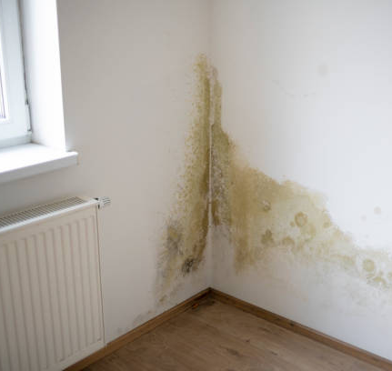
Mold
Sources:
Mold grows indoors when spores land on damp materials (e.g. food, wood, paper, carpet, drywall, ceiling tiles, upholstered furniture)
Interior Mold:
Unvented bathrooms/kitchens
Plumbing leaks
Condensation
People & pets
Exterior Mold:
Roof leaks
Flashing
Windows
Air leakages
Health Effects:
Allergic reactions
Fungal infections
Sinuses
Digestive tract
Lung
Skin
Pneumonitis
Remediation:
Control moisture and completely remove mold-contaminated materials.
Notes:
Mold and fungi can cause and/or contribute to adverse health conditions. Growth may or may not be obvious or visible. Mold growth in buildings is a process, not an event. Moisture control is the key to mold control. Most buildings contain materials conducive to mold growth. Add water and mold will grow even on unlikely surfaces like steel and glass due to presence of nutrients on these inorganic substances. Don’t ignore water leaks. Even those causing minor damage can cause moisture problems and can be expensive disasters in terms of cosmetic and structural damage and health impacts.
Investigate high moisture-prone areas.

Slide 23
Prevent Biological Contamination
In cases of leaks or flooding, thoroughly dry carpets
and building materials
within about 48 hours.
Notes:
This is a general rule. Mold can grow exponentially, so time is a critical factor in preventing significant contamination from occurring.
When drying building materials, heat is often added to increase the evaporation rate of the liquid water. This water vapor must be exhausted and replaced by dryer air. Where the outside air has high relative humidity, mechanical dehumidification may be required.
Due to snow loading on roofs, etc., it is sometimes impractical to solve a water incursion problem immediately. In these situations, ensure that the water does not contact “mold foods.”
Water in the sink = no problem
Water in sheet-rock wall = molds

Slide 24
Discussion Question
Which factor is the most important to control to prevent mold growth?
Temperature
Moisture
Nutrients
Air Flow
Spores

Slide 25
Moisture Dynamics
Moisture flow is from warm to cold.
Moisture moves from more to less.
Air carries moisture from high pressure areas to low pressure areas.
Gravity pulls water down.
Water wicks up.
Drainage is critical.

Slide 26
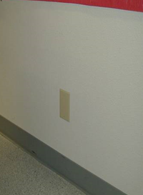
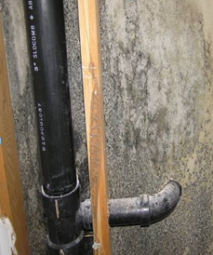
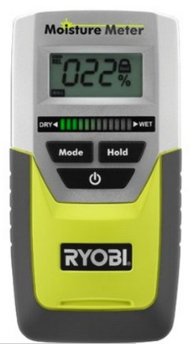
Moisture Dynamics
Moisture meter
Suspected water leak (mold growth) in wall cavity –
visual inspection proved positive
Notes:
Moisture and molds are often difficult to diagnose without some invasive or destructive visual inspections. Note the “blank” electrical box plate used to quickly and easily cover an inspection penetration.
Before doing a major invasive or destructive visual inspection, to help pinpoint locations it is often valuable to use less invasive equipment first. As mentioned previously, an infrared temperature gun can often detect surface temperature differences. Also, a moisture meter often provides valuable information. There are meters that are non-invasive surface meters, and meters that are minimally invasive with small sensor pins.
There is a wide variety of price and accuracy of moisture meters. As with all meters, experience is the best teacher. Information on purchasing and using electronic meters is included later, in the section ‘IEQ Measurement Devices’.

Slide 27
Fundamentals of IEQ
Air Quality
Thermal Comfort
Lighting
Noise

Slide 28
Thermal Satisfaction: 2nd Lowest Category
“How satisfied are you with the temperature in your workspace?”
10,000
8,000
HVAC buildings
19%
6,000
15%
16%
16%
Number of responses
14%
13%
4,000
6%
2,000
-
-3
-2
-1
0
1
2
3
very dissatisfied
very satisfied
42% of workers are dissatisfied with the thermal environment
Notes:
Historically, complaints point to thermal comfort as the most common occupant complaint in buildings. This emphasizes the importance of the building operator - the thermal conditions and occupant satisfaction needs to be monitored continuously to ensure that the building is performing satisfactorily. O&M personnel are often asked to reconfigure the interior spaces. Equipment is added or removed. Windows are upgraded. Large conference rooms are turned into offices. How does this internal change affect occupant comfort? What are some ideas that help solve these problems?

Slide 29
Sources of Thermal Discomfort
(one-person/one-vote) (total number of complaints = 32,806)
Source of dissatisfaction with temperature in CBE survey database
My area is hotter/colder than other area
14%
Thermostat is inaccessible
13%
Thermostat is adjusted by other people
13%
Air movement too low
11%
Heating/cooling system does not respond
9%
Drafts from vents
7%
Air movement too high
5%
Incoming sun
5%
Other
5%
Humidity too high (damp)
4%
Hot/cold surrounding surfaces (floor, ceiling)
3%
Humidity too low (dry)
3%
Drafts from windows
3%
Heat from office equipment
3%
Air coming out of vents too hot/cold
2%
Clothing policy is not flexible
1%
Heating/cooling capacity is insufficient
1%
0%
5%
10%
15%
% of total thermal dissatisfaction votes
Notes:
So what is causing these complaints, and what can the operator learn from this? For the first three complaints – area hotter/colder than others, thermostat inaccessible, or controlled by other people – operators can monitor to check for uniformity of thermal conditions, make sure that thermostats are not locked, and educate the occupants about where they are and how to use them (perhaps even considering installing signs above the thermostat with instructions).
Complaints about air movement being too low are fairly common. In many cases people want more movement, even in winter. Operators can look at the settings of local vents to ensure there is adequate mixing.

Slide 30
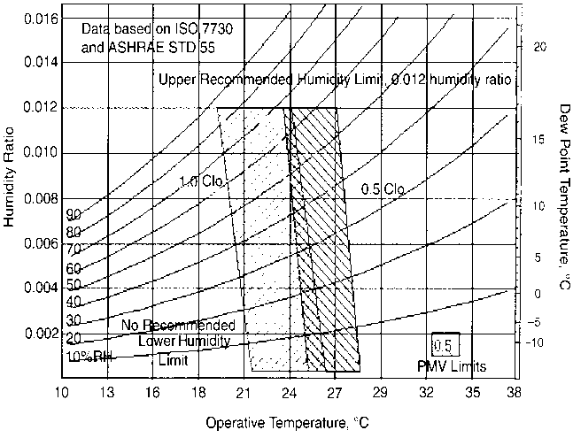
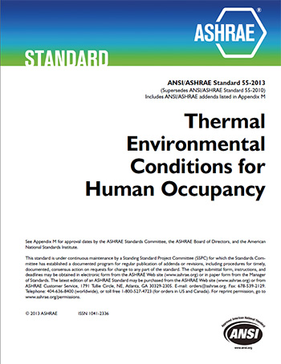

What do thermal comfort standards say?
Conventional standards…
Are based on laboratory experiments (that don’t always match real buildings)
Follow one-size-fits all principle, universally applied to all climates, cultures, and building types
Energy intensive: Broad application of narrow setpoints exaggerates the “need” for air conditioning.
Notes:
Where can building operators turn to for guidance on what makes people comfortable? ASHRAE Standard 55 – Thermal Environmental Conditions for Human Occupancy.
Comfort is primarily affected by various conditions including dry bulb temperature, mean radiant temperature, humidity, air speed, clothing level, and human activity level. Lab experiments were correlated to a heat balance model of the human body, with the lab subjects’ votes helping to define the perception of acceptable comfort. The results assumed that all people would perceive their surrounding conditions the same as the lab subjects. It assumed that people were not capable of adapting, either physically or psychologically, to varying or local conditions. It assumed comfort could be defined by a single equation, for all people, in all climates, at any time of day or any season.

Slide 31
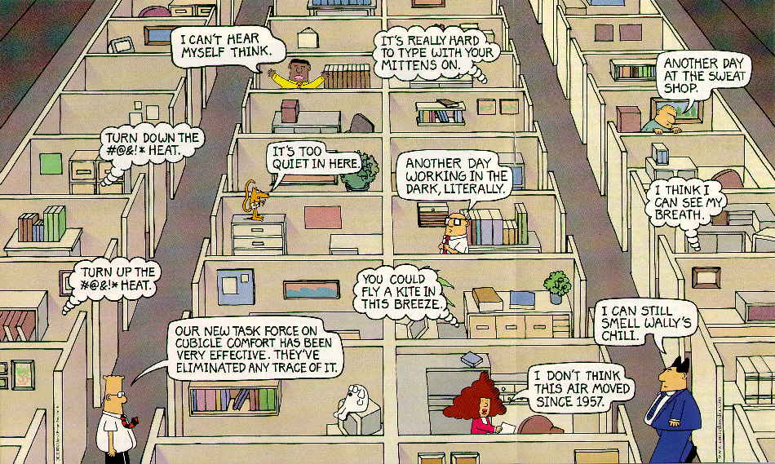
The Challenge of Occupant Comfort
Notes:
Everyone wants something different, and the building operators and facility managers hear a range of complaints. This is a challenge to operators but, like any challenge, is also an opportunity. If we can collect and use this information, we can think of the occupants not just as complainers, but as an array of highly sensitive sensors – a rich and under-utilized source of information.
Also, people only complain about the things they think can be changed, such as temperature (and this is what the operator will typically hear about) and don’t tell operators about things that are working well, which operators want to learn also.

Slide 32
What Impacts Thermal Comfort?
Air temperature
Surface temperature
Fresh Air
Relative Humidity
Air Velocity
Notes:
Use ASHRAE Standard 55 as a place to start for evaluating comfort concerns and for operating and maintaining HVAC systems.
Note that the air temperature must be considered along with surface temperature.
Clothing choices are important due to the wide variation in human factors such as metabolism rate, activity level, age, health, weight, body type, etc.
People want control, so it isn’t surprising that so-called “dummy thermostats” tend to result in higher comfort satisfaction rates. Dummy thermostats are not a particularly good answer. Real comfort control is more appropriate. Clearly the more control occupants have over their environment the more satisfied they will be, and this can result in higher productivity, higher tenant and employee retention, less absenteeism, and less money and time spent “chasing problems”.

Slide 33
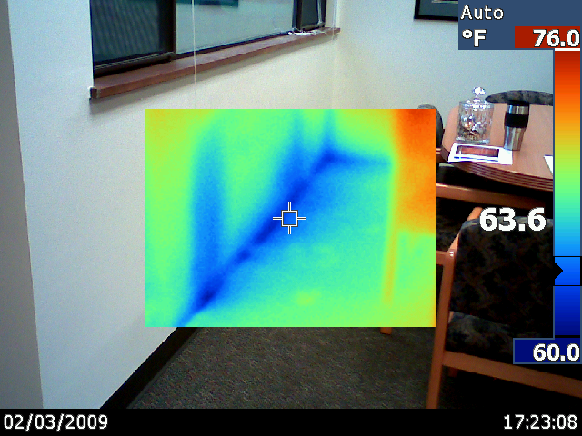
Surface Temperatures
Notes:
Wet materials and cool “condensing” surfaces can be quickly identified using infrared thermography.
The infrared temperature gun that HVAC technicians commonly use, will display surface temperatures and so can also be used to identify the cool "condensing" sources.
When there is mold, there is a moldy odor. To locate sources of odors there are sophisticated electronic meters that measure very low concentrations of VOCs emitted from molds and fungi. However, the human nose can be particularly sensitive to odors. The odor threshold of many chemicals is far, far below the OSHA’ 8-hour threshold limit value.

Slide 34
Relative Humidity
Notes:
According to studies reported in the Lawrence Berkeley National Laboratory’s Scientific Findings Resource Bank, the performance (speed and accuracy) of office work tasks is maximized with air temperature of approximately 71° F. Performance decreases, on average, by 0.43% per each 1° F increase in temperature between 71° F and 80° F. Performance decreases, on average, by 0.37% per each 1° F drop in temperature between 71° F and 65° F.
EPA Study of 100 representative U.S. office buildings found*:
33 percent of sites had workday maximum temperature at least 5° F above 71° F.
72 percent of sites had a workday maximum temperature at least 3° F above 71° F.
Only 1.4 percent of sites had a workday minimum temperature below 65° F.
Source:
https://iaqscience.lbl.gov/
*Measurement sites located at a height of 4 or 5.6 ft above the floor.

Slide 35
Fundamentals of IEQ
Air Quality
Thermal Comfort
Lighting
Noise

Slide 36
Lighting Levels
Examples of maintained foot-candle guidelines:
OFFICES
work areas = 30-50
accounting = 50-100
computer use = 5
conference areas = 20-70
CLASSROOMS
desk work = 30-50
lecture rooms = 100
study halls = 30-50
demonstration = 100-200
Based on guidelines from the Illuminating Engineering Society (IES)
Notes:
Lighting levels can have a significant effect on occupant comfort in a building. Over-lit or under-lit areas can cause eye strain, headaches, and nausea which can be misinterpreted as an air quality problem.
Daylighting and views to the outdoors have been shown to increase occupant satisfaction and productivity, plus it has the advantage of reduced energy consumption.
*Green Buildings, Organizational Success, and Occupant Productivity. Published in a special edition of Building Research and Information
Vol. 28 (5), 2000:353-367 London, UK

Slide 37
Fundamentals of IEQ
Air Quality
Thermal Comfort
Lighting
Noise

Slide 38
Acoustics
Excessive noise can cause:
The general recommended decibel range for office work is 55 to 65 decibels.
Speech privacy is also a common problem.
Telephone or other conversations can be distracting in open plan offices - consider sound absorbing barriers and other strategies to reduce impacts.
Stress
Fatigue
Nausea
Other impacts on occupants.
Notes:
The potential impacts of noise on human health and comfort are numerous. Depending on the activities and uses of spaces within your building, consider how to prioritize comfort and productivity with regard to acoustics.
Practical solutions to noise problems can include substituting/replacing or relocation of noisy office equipment and adding sound absorbing materials.
HVAC noise can cause serious problems. Get expert help to mitigate noise. Avoid duct lining for noise control, as it can as it can cause IAQ issues over time as the insulation materials break down, and other maintenance challenges.
Noise criteria (NC) are commonly used to rate interior noise levels of general office spaces. (NC numbers represent a series of curves of octave-band sound pressure levels).
Noise Criteria by type of office space:
Studios: NC–20 to 25
Boardrooms, teleconferencing rooms : NC–25 to 30
Conference rooms: NC–30 to 35
Private offices, apartments: NC–35
Lobbies, toilets, corridors, computer terminal rooms, retail spaces: NC–40
Storage, locker rooms, laboratories without fume hoods: NC–45
Kitchens, laundry, computer rooms: NC–50
Garages, laboratories with fume hoods: NC–55+

Slide 39

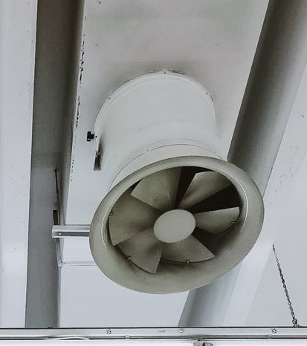

IEQ Problem Components
Occupant
Transport Mechanism
Source
Notes:
Like the fire triangle you likely learned about as a child, it takes three things to create an indoor environmental quality problem: a source of contaminant, an occupant who is susceptible to the contaminant, and a transport mechanism to get the contaminant from the source to the occupant.
To solve the problem, you can intervene at the source, the occupant, or the transport mechanism. For example, sources can be removed and either replaced or not. The occupant can be removed, fitted with respiratory protection or treated medically. The transport mechanism can be changed by changing the direction of air flow, so that the contaminant is carried away from the occupant. Or additional outdoor air can be introduced to dilute the contaminant before it reaches the occupant. Filters in the air handler can have the same effect.

Slide 40
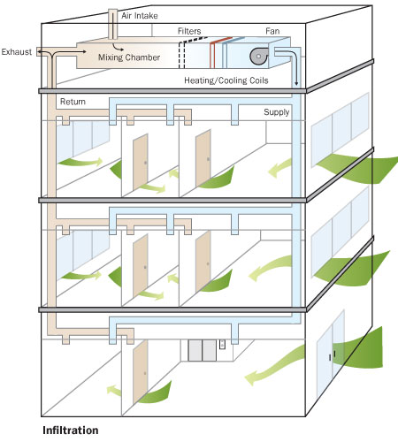

Fundamental IEQ Dynamics
IEQ Triangle
Pathways
Driving Forces
Sources
Wind
High
Pressure
Positive Pressure
Negative Pressure
Image courtesy: UPMC
Notes:
These basics are key to understanding IEQ for prevention, diagnostics, and mitigation.
Another way of remembering them is the “P” list:
Pathways
Pollutants
People
Pressures
Regarding Pressures:
Heat always flows from the warmer side of the building shell to the colder side. Infiltration and exfiltration are driven by air pressure differences (stack and wind) that exist between the inside of a building relative to the outside of a building across the building envelope.
Stack effect generally refers to the pressure difference created by warm air inside a building rising.
The total pressure effects on the building are a combination of all the pressures being applied to the building, including mechanical ventilation.

Slide 41
IEQ Sources, Pathways, and Driving Forces
Exhaust
Exhaust
Building:_____________ Date:__________
Zone:________________ Initials:________
Parking Lot
Parking Lot
Air
Handling
Unit
Air
Handling
Unit
s
s
s
O.A.
s
s
s
R
R
R
R
s
s
To
East Wing
Hallway
To
East Wing
Hallway
R
R
s
s
s
s
s
s
s
s
s
s
Sources Pathways & Driving Forces
equipment identify pathways
products indicate air flows
activities/processes
outside sources
Notes:
Routine documentation of air flow directions (pressures) helps establish how the building operates normally. Should a problem arise, comparing pressures to “baseline” pressures will often help pinpoint the source of the problem. At the very least it helps rule out potential causes and allows investigators to focus on other causes.
R = return grilles
S = supply diffusers
Arrows indicate air flow direction.
Pressure measurements with reference to adjoining spaces or rooms can also be included.

Slide 42
Pollutant Sources
Exterior Sources
Poor outdoor air quality
Vehicle exhaust
Re-entrainment
Soil gas
Interior sources
Materials and furnishings
Equipment and activities
Biologicals
People
Notes:
Exterior sources of pollutants are usually brought into the building through some opening in the exterior building envelope (doors, windows, utility service penetrations). The outside air intake can also be a prime source, so note its location with respect to interior exhaust outlets, parking areas, loading docks, refuse storage areas, and other possible sources of pollutants.
Interior sources are brought into the building. The furnishings and finish materials of the structure itself are often sources of pollutants in the initial years. The building occupants can also bring in pollutants via furnishings, chemicals in cleaners, or through behaviors such as smoking or vaping.
The indoor air cannot be cleaner than the outdoor air, unless air cleaning is used to treat incoming air.

Slide 43

Pathways and Driving Forces
Maintain “clean to dirty” air flow direction
Air flow rules:
Air always goes where it is pushed or pulled (high pressure to low pressure).
Air always takes the path of least resistance.
Notes:
Most buildings have zones with odors, chemicals, moisture, particles, unwanted heat, and combustion products. These zones should be “downstream” from occupied zones.
Occupants may believe that they are getting fresh air when they open a window, but typical mechanical systems pressurize buildings, resulting in air going out their window.

Slide 44
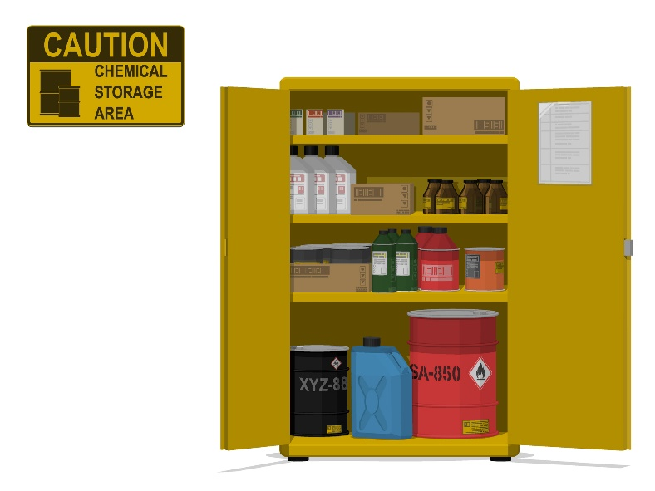
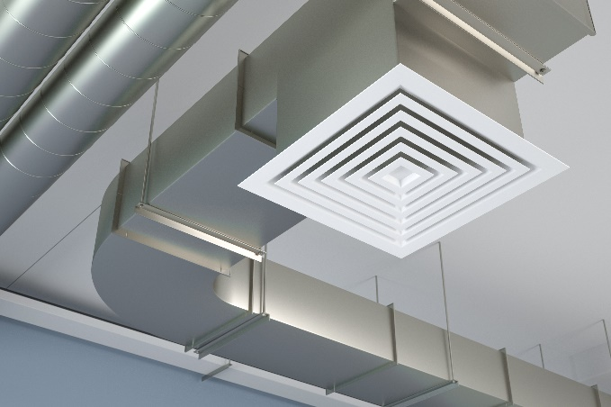
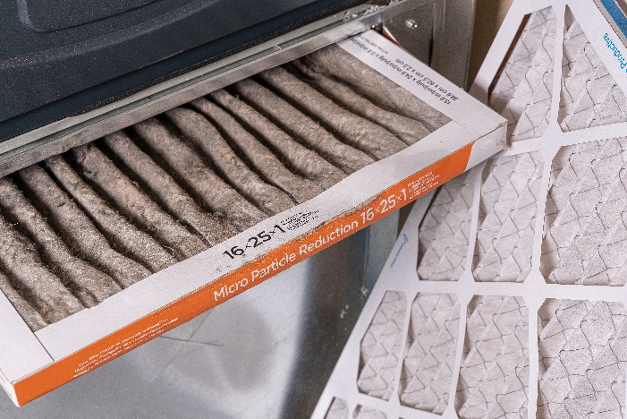

Four Control Strategies
Ventilation
Source
Control
Air Cleaning
Exposure Control
Notes:
There are four general categories of control, listed here in the order they should typically be performed:
Source control
Ventilation
Air cleaning (most commonly by filtration)
Exposure control
Depending upon the actual pollutant or pollutants, each of these approaches may have a significant role to play.
Some pollutants (at low strengths) are easily diluted with ventilation, while others are not. Some pollutants can be easily filtered, while others cannot.
Each of these strategies is discussed in more detail on the following pages.

Slide 45
Preface to Control Strategies
OSHA’s “Hierarchy of Controls”
Required when there is risk of actual over-exposure
Implement controls in this order:
Engineering Controls
Work Practice & Administrative Controls
Personal Protective Equipment (PPE) Controls
Notes:
OSHA’s “Hierarchy of Controls” is required when there is risk of actual over-exposure. It is recommended to implement controls in this order:
Engineering Controls – This category can include some of the control strategies we mentioned on the previous page: source control, ventilation, and air cleaning.
Work Practice & Administrative Controls – This category can include policies governing source control as well as O&M and other safety measures (notice that there may be some overlap with the previous category).
Personal Protective Equipment (PPE) Controls – This category correlates with exposure control.

Slide 46
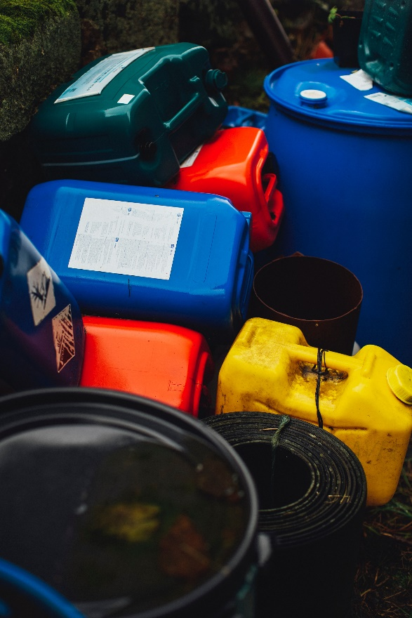
Remove the Source: Examples
Select low emission products.
Remove pollutants from building. Provide ventilated/remote or outside storage.
Clean cooling towers, coil drip pans, refrigerator drains.
Remove old carpet.
Notes:
Note that removing the source eliminates the pollutant from the facility.
Ventilation only reduces or “waters down” the concentration.
In situations where the pollutant source can be identified and removed, this is the most effective and reliable treatment.

Slide 47
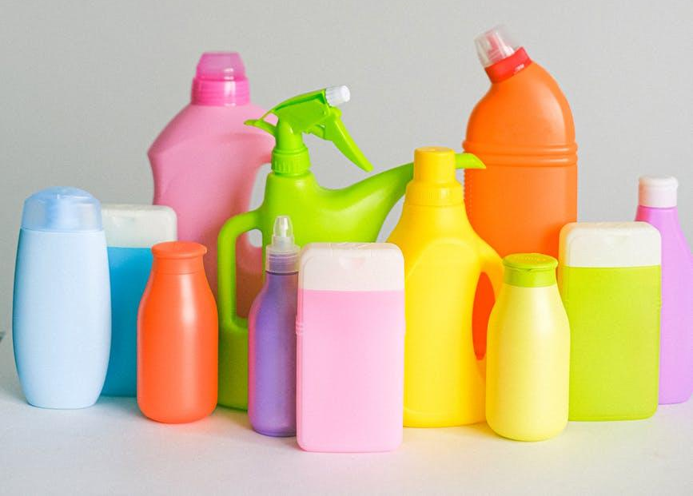
Reduce Potential Sources
Eliminate
Entry of moisture, dirt, insects, rodents, outdoor pollutants, unplanned air flows; enact policies against occupants or staff bringing in pollutants.
Indoor sources and re-entrainment of combustion flue gases (indoor CO levels should be no higher than outdoor levels).
Reduce
Use less chemicals, keep building clean, provide adequate filtration, reschedule cleaning activities for unoccupied times.
Select products with low:
VOC and particle emission
Risk of toxicity and irritancy characteristics
Risk of chemical reactivity
Risk of fungal contamination
Maintenance requirements.
Notes:
The same principles that apply to the management of pests, dirt and moisture can be applied to other sources as well.
First, keep it out. Buildings with combustion equipment should have carbon monoxide detectors to alert when mechanical equipment fails to operate properly or when re-entrainment (re-intake of exhaust fumes) occurs.
Reduce exposures by substitution with something less likely to cause problems. A wealth of occupant and environmentally friendly products have become available: e.g. low-VOC paints and finish products, “green cleaning products”, etc.
Consider the risks for contaminants released by the product itself, the use and maintenance of the product, and how badly things can go wrong in the event of an accident.

Slide 48
Isolate or Divert the Source
Keep pollutant containers tightly covered.
Keep areas with pollutant sources closed off from other spaces and check pressure differentials.
Ensure no infiltration or re-entrainment from exhausts.
Provide direct exhaust to capture and remove pollutant at the source.
Indoor smoking areas should have exhaust-only system. Prohibit smoking near outdoor air intake or building entry.
Notes:
Isolation or diversion is effective and can eliminate exposure. It is not as reliable or perhaps durable as removal, since isolation or diversion implies a need to monitor the effectiveness of the mechanical solution, and energy is often required to power fans and blowers.

Slide 49
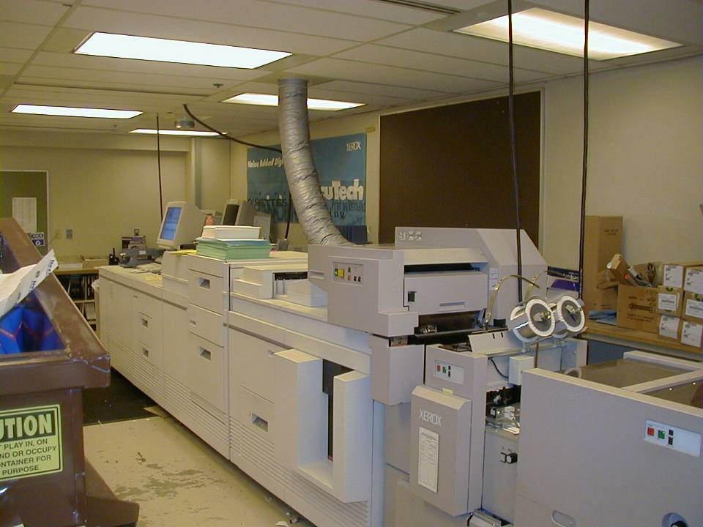
Direct Source Control
Notes:
This large machine has a dedicated exhaust to provide direct source control. By capturing and exhausting pollutants, exposures are reduced and energy efficiency is increased because a small exhaust fan is used rather than aggressive ventilation for the entire zone.

Slide 50
Typical Radon Mitigation System
Exhaust
Sub-slab suction
reverses the pressure
between occupied
space and the source
by creation of a negative
pressure field under
the slab.
Fan
Radon Exhaust Pipe
(typically hidden in
closet or between walls)
Seal around
Entry Points
System Failure
Warning Device
Important for Radon Zone 1 and 2
Notes:
Air pollutants originating from soil can include: moisture, odors, radon, VOCs, fuels, methane, etc.
Pressure differential between the building and the soil can easily draw these pollutants into the building. Driving forces can include stack effect, mechanical pressures, and wind. Removing the source from under an existing building is obviously not an option in most cases.
Since an airtight foundation is usually impractical, solutions to preventing pollutant entry generally requires pressure controls. The building can either be operated in a pressurized mode, or a negative pressure can be established under the occupied zones of the building.
Pressurizing the building relative to the soil or substructure can be energy intensive and is easily defeated.
Pollutants in the soil or under the building are more effectively controlled with a sub-slab ventilation system. A negative pressure is created under the building, relative to the interior of the building using a pipe or series of pipes routed from below the building and exhausted to the outdoors. This is a common control strategy used for commercial and residential structures. These pipes may be powered with an exhaust fan as necessary; passive vents are sometimes sufficient.
Radon gas is a pollutant from soil and is a colorless, odorless, and tasteless gas and therefore is not detectable by human senses alone. Radon itself is the immediate decaying product of radium, a naturally occurring element in the earth. It is usually found in igneous rock and soil. According to the EPA there are no safe levels of radon gas in a building and some building codes in high radon locations require a ventilation system below the building to safely collect and vent the radon gas outside the building.

Slide 51

Green Cleaning
What does Green Cleaning Mean to You?

Slide 52

Green Cleaning
Components of a Sustainable Cleaning Program
Sustainable products
Sustainable equipment
Standard operating procedures
Training program
The LEED Existing Buildings O&M (EBOM) certification program outlines these components in detail
Notes:
A truly sustainable cleaning program encompasses more than the cleaning products used. The components of a sustainable cleaning program include:
Utilizing sustainable, non-toxic or low-toxicity products
Utilizing sustainable equipment
Using dilution strategies
Using the appropriate product for the task
Developing standard operating procedures
Providing training for maintenance personnel
Developing strategies to promote hand hygiene
Developing guidelines for safe handling and storage of chemicals, including a plan for hazardous spills
Considering the impacts of daytime cleaning on vulnerable occupants and taking steps to protect them
Inviting occupant feedback
For more information, see the LEED EBOM Green Cleaning Policy:
https://leeduser.buildinggreen.com/credit/EBOM-v4/EQp3#tab-credit-language

Slide 53




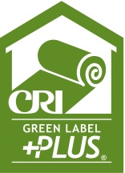


Cleaning Products
Third party certifications for cleaning products
Notes:
These are some of the standards identified in the US Green Building Council’s LEED for Existing Buildings rating system. They are a good resource for determining what products could be considered sustainable. There are also standards for paper products and hand soap.
See the LEED-EBOM list of standards for cleaning products and materials at the following link for more info on product standards for specific applications:
https://www.usgbc.org/credits/existing-buildings-interiors-existing-buildings/v41/eq130

Slide 54
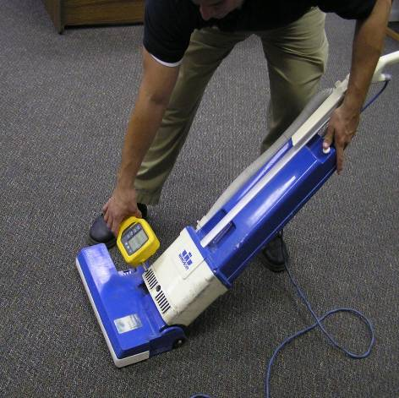
Cleaning Equipment
Standards for sustainable cleaning equipment
Vacuum cleaners – CRI Green Label
Carpet extraction equipment – CRI Seal of Approval
Equipment sound levels less than 90 or 70 dBA
High efficiency, low emissions engines – CARB or EPA standards
Battery powered equipment
Ergonomically enhanced powered equipment
Equipment with safeguards
Notes:
These standards are identified in the US Green Building Council’s LEED for Existing Buildings rating system. They are a good resource for determining what equipment could be considered sustainable. The CRI’s Green Label program tests carpet, cushions and adhesives to identify products with very low emissions of Volatile Organic Compounds (VOCs). Specific criteria include:
Vacuum cleaners operate with a sound level of less than 70dBA.
Powered floor maintenance equipment equipped with devices for capturing fine particulates and operates with a sound level of less than 70dBA.
Propane-powered floor equipment has high-efficiency, low-emissions engines that meet the California Air Resources Board (CARB) or EPA standards and operate with a sound level of less than 90dBA.
Powered equipment is ergonomically designed to minimize vibration, noise and user fatigue.
Equipment is designed with safeguards, such as rollers or rubber bumpers, to reduce potential damage to building surfaces.

Slide 55
Cleaning Best Practices
Reduce the need for cleaning products.
Use appropriate cleaning products and methods.
Use low toxicity and irritancy products.
Use as little as possible.
Reduce chance of exposure to concentrated product.
Invest in quality equipment and training.
Notes:
By managing the entry of dirt into a building, exposure to the contaminant in the dirt can be reduced while at the same time exposure to contaminants from cleaning products can be reduced.
After taking actions to reduce cleaning product use, exposure can be further lowered by using cleaning methods that reduce airborne contaminants.
Damp wiping rather than spraying greatly reduces the release of airborne contaminants. Micro-fiber cloths hold more particles.
Review the ingredients of each cleaning product used for toxins, irritants, allergens and asthma triggers.
Invest in quality cleaning equipment and proper training for custodial and housekeeping staff.

Slide 56

Green Cleaning Hurdles
What Does Clean Smell Like?
Notes:
One hurdle is getting over the perception that green cleaning products that don’t smell aren’t cleaning. Through training and awareness, we can change that perception of what clean smells like.

Slide 57
What Does Ventilation Do?
• Dilutes pollutant concentrations
• Removes pollutants
• Controls pressure differentials
• Has limited effectiveness with high source strengths
• Energy costs with increased ventilation may be a trade off
but…
Notes:
Combinations of exhaust ventilation in high pollutant source areas with balanced outside air can provide good results. However, high source strengths can overwhelm even the most aggressive ventilation strategy.

Slide 58
Filtration: MERV Ratings
MERV RATING | PARTICLE SIZE (μm*) | TYPICAL CONTROLLED CONTAMINANT
1 - 4 | >10.0 | Pollen, sanding dust, textile and carpet fibers
5 - 8 | 3.0 – 10.00 | Mold, spores, hair spray, cement dust
9 – 12 | 1.0 – 3.0 | Legionella, lead dust, welding fumes
13 – 16 | .3 – 1.0 | Bacteria, most tobacco smoke, insecticide dust, copier toner
17 – 20 | ≤ 0.3 | Virus, combustion smoke, radon particles
Notes:
The most common method of air cleaning is by filtration.
The Minimum Efficiency Reporting Value (MERV) rating is intended to help simplify the air cleaner selection process for users. It is derived by combining the cleaner’s average efficiency at removing the particle size fields.

Slide 59
Discussion Question
What are most of your filters in your building rated (MERV)?
1-4
5-8
9-12
13-16
I don’t know

Slide 60
Exposure Control: Administrative Changes
Examples:
Relocate equipment or occupants.
Schedule contaminant-producing activities when building is unoccupied.
Store new furnishings in well-ventilated areas until out-gassing diminishes.
Notes:
We have discussed direct source control, ventilation, and air cleaning. The last of the control strategies we’ll discuss is exposure control.
Exposure control is generally applied to a condition where the majority of occupants are not experiencing problems with the existing conditions, and contamination levels are very low (background levels). A few sensitive individuals may need some accommodation by enlisting the approaches mentioned above.
Additional “reasonable accommodation” for sensitive occupants can include room HEPA air cleaners, removal of carpeting, alternative cleaning chemicals, and removal of laser printers, photo copiers, and/or other sources of irritants.
Exposure control can involve providing occupants with personal protective equipment (PPE), such as respirators/masks, goggles, or ear protection. Generally, this strategy is undertaken after other control strategies have been performed. Of course, this strategy may also need to be used while implementing other control strategies. For example, facilities staff may need to wear PPE while handling contaminants to remove them from the indoor environment.

Slide 61
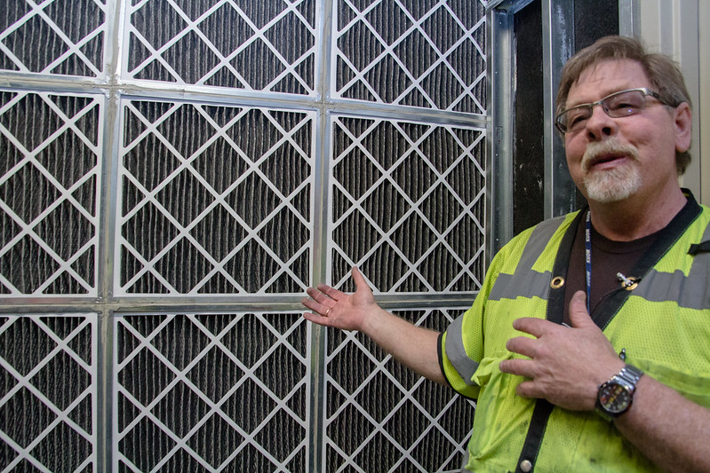
Preventing IEQ Problems
Image courtesy of Resource Media
Notes:
The key to prevention is knowledge of IEQ fundamentals and building systems at all levels in an organization. Establishing an IEQ program requires participation by:
• building operation and maintenance staff
• occupants
• facility administration
• human resources department
• contractors and service providers.
The more everyone inside and outside of the organization knows about IEQ, the easier it will be to adopt and sustain good IEQ practices.
Since the maintenance staff is the primary contact between the building operation staff and the building occupants, they have a key role in making the program work.
The top priorities for maintenance staff are continuous and positive communication and prompt and effective response to occupant concerns, or issues such as water leaks, HVAC problems, spills, and other events.
Experience has shown that once a building gets a “sick building” reputation it is virtually impossible to remove that label. Suspicions linger and small events trigger major reactions.

Slide 62
Preventing and Solving IEQ Problems
Understand and educate people.
Establish and Meet IEQ Benchmarks.
Reduce pollutant sources and exposures.
Control unplanned airflows.
Provide capture exhaust ventilation for unavoidable point sources.
Provide source dilution ventilation for renovation locations.
Provide whole-building dilution ventilation for people and unavoidable sources.
Notes:
A comfortable, healthy indoor environment is an important objective for building design, construction, and operation. Several elements for providing a healthy and productive indoor environment are listed above.
Indoor environmental problems can be avoided – or created – during the design, construction, operation, maintenance, and occupation of a building.
IEQ is a constant and on-going task. Various examples include:
•A building designed without regard for wind-driven rain intrusion that will eventually become contaminated by mold; inadequate exhaust allows contaminants to reach the occupants; disregard for low-VOC cleaners and adequate cleaning techniques increases exposures.
• Mechanical equipment controls fail, sensors go out of calibration, cooling equipment loses refrigerant charge, fire dampers close, occupants tamper with thermostats and diffusers.
• Decisions made during construction or in the operation of air handling equipment may drastically reduce outdoor air flow or accidentally transport contaminated air from a contaminated location – say beneath the building, storage areas, tunnels – to occupied zones.
• Occupants read about a building in the community evacuated due to a mold contamination and worry about their own building.

Slide 63
Communicating to Prevent IEQ Problems
Provide accurate information.
Clarify responsibilities of building management, staff, and occupants.
Establish a system for responding to complaints. Keep detailed IEQ log including successful corrective measures taken.
Notes:
With routine and positive communication, you demonstrate to the occupants that you are paying attention and are one step ahead of any problems.
Information up front makes you look informed and professional, while information provided in response to inquiries looks like you were not paying attention, perhaps negligent, and making excuses.
Since buildings are complex and dynamic and facilities staff are generally wearing a dozen different hats, it is very important to establish an easy, non-threatening (anonymous), and effective method for occupants to alert facilities staff of potential IEQ issues. Occupants are the “canaries in the coal mine” and thus one of the most valuable early warning systems for problem identification and solutions.

Slide 64
Benchmarks for “Good Practice”
Dry
Clean
Comfortable
Control Pollutants
Adequate Ventilation
Notes:
These five benchmarks encompass the key elements for IEQ and provide a simplified way to discuss IEQ with occupants, contractors, maintenance staff, custodial staff, etc. Clearly, if there is a concern it will fall into one of these categories.
Dryness can be verified with visual inspection and moisture meters.
Cleanliness is relative. Building Owners and Managers Association (BOMA) has guidelines and checklists. It should be clean enough to meet the “expectations” of the occupants.
Comfort: Use American Society of Heating, Refrigeration and Air Conditioning Engineers (ASHRAE) Comfort Standard 55.
Controlling Pollutants: This covers a lot of territory. This includes removing and excluding potential pollutant sources, controlling pressures and air flows, management of unplanned air flows, proper cleaning equipment and filtration, etc.
Adequate Ventilation: Follow ASHRAE Standard 62 guidance for ventilation. However, more aggressive ventilation may be required to control strong sources from remodeling, new carpet, spills, etc.

Slide 65
Walk-Through Assessments
During the walk-through:
Explain inspection is routine.
Allow occupants to point out concerns/problems.
Respond positively to suggestions.
Take immediate action on items occupants identify.
Document findings.
Update O&M procedures based on walk-through findings.
Maintain record of problems, inspection results, and solutions.
Notes:
Before beginning an IEQ assessment in your facility, take a moment to explain its purpose to the occupants. Impress upon them that this is a routine assessment necessary to ensure that changes in building systems and O&M are monitored, in order to correct any unintended negative changes.
This is an educational opportunity that can build trust and good will between facility staff and occupants.
Enlisting an outside expert to assist with the initial walk-through has been shown to be a very useful approach. The expert lends credibility and can provide insights into building science and IEQ issues that may be not be obvious to facility staff. The expert can also demonstrate equipment use and assist with practical and effective solutions and help you select and adopt effective elements into your IEQ program.

Slide 66
Is the Problem Building-Related?
Solving IEQ Problems
Does the problem:
occur at particular time?
associate with a particular zone or the entire building?
show improved symptoms when occupants leave the building?
relate to a particular event, activity, operating condition?
affect other occupants?
Notes:
A critical step in establishing the source of the problem is asking, “Is it the building?” Begin by asking questions and listening carefully to the actual complaint and personal history of the individual.
The questions above are very important to ask in the early stages of an IEQ investigation. Even if it turns out that the reported problem is not building-related, these questions will serve to focus your efforts and guide solutions.
Documentation is critical for both solving the problem, and for legal considerations. An occupant diary helps occupants define their concerns/reactions – many occupants tend to initially provide exaggerated or incomplete information such as, “it’s always cold or hot” or, “I get headaches every day.” Careful documentation of symptoms, operating parameters, dates and time will help not only in-house staff but outside consultants focus on possible causes and solutions.

Slide 67

Solving IEQ Problems
Communicate throughout the process.
Ensure problem is building-related.
Identify the basics.
Get qualified help as needed.
Look for a permanent fix.
Notes:
Communication is an overarching priority when problems arise. It is critical to engage the occupants in the diagnosis and, most importantly, in any solutions, as this will help ensure success.
The things you need to do to solve IEQ problems include:
Know your building.
Respond immediately to complaints.
Communicate throughout the process.
Ensure problem is building-related.
Identify the basics: sources, pathways, and driving forces.
Do your homework.
Get qualified help as needed.
Look for a permanent fix.

Slide 68
IEQ Profile Measurements
Pressures & air flow direction
Temperatures (air and surfaces)
Air velocity
Relative humidity & materials moisture
CO₂ concentrations
Also: carbon monoxide, radon and particulates
Notes:
Two other common pollutants are radon and carbon monoxide (CO).
Test for radon if it is common to your geographic area. Check with your local health department for guidance.
If your facility has combustion equipment, monitoring for CO may be warranted. CO is colorless and odorless, and symptoms of exposure mimic those of flu.

Slide 69
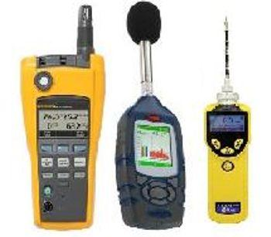
Sampling Air for Contaminants & Indicators
Do not begin with complex air sampling.
Testing for thermal and ventilation problems is routine.
Pollutant sampling:
can be expensive.
is often inconclusive.
Measure only what can be reasonably interpreted and leads to a solution.
Notes:
Many investigators estimate that approximately 75 percent of IEQ problems can be solved relatively easily in-house with common measurements. Start with the basics, not exotic testing. Just because science (and consultants) can test for virtually anything, that doesn’t mean we should. “Science projects” often yield more information than is useful and at a cost that is not necessary.
When is sampling for specific pollutants warranted?
If your basic investigation does not yield results, and if specific health symptoms are shown to be directly related to the workplace, then air sampling may be warranted.

Slide 70
Air Sampling Checklist
How will the results be used?
What substances should be measured?
Where and when should samples be taken?
What type of testing devices?
Calibration and quality control?
What method should be used?
Who should make the measurements?
Notes:
Do your homework: Answer the questions above before you proceed to air sampling. Many, many facilities have learned the hard way. They’ve spent large sums of money on sampling/testing only to discover that the results were not useful in diagnosing and/or solving the problem. In fact, reams of scientific data that don’t lead to a solution can actually scare the occupants and lead to panic.

Slide 71
IEQ Measurement Devices
Factors to Consider:
Ease of use
Cost
Output
Mechanical/Physical vs. Electronic
Quality assurance
Notes:
Often mechanical/physical devices, such as a sling psychrometer, pitot tube manometer, or smoke tube, will be as or more accurate and reliable than an electronic meter with a multitude of features. For electronic meters, be sure to check how often it must be calibrated. Also, to check if your electronic meter is going out of calibration, find something that is easy to measure that is stable and repeatable and measure it regularly. For example, when you have an accurate newly calibrated temperature and humidity meter, find a nearby weather station on the internet that regularly has readings that match your meter, especially for humidity. Some humidity sensors will not stay in calibration for very long. Then if the humidity reading starts to vary from the weather station value, that is an indication that the meter is going out of calibration. Then you should have the electronic meter checked for accuracy. For a humidity meter it could be checked against a mechanical sling psychrometer, which does not go out of calibration.

Slide 72

IEQ Program Discussion
What instruments and/or equipment are essential?
What features of instruments or equipment are most useful or desirable?
What are some sophisticated measurements or sampling to consider for investigations?
How do you choose a consultant?
Notes:
Use this discussion to gain from others’ experiences with instruments and testing. Others in the class may have similar buildings or needs and their first-hand experience can be very valuable.

Slide 73
Discussion Question
An effective IEQ program has many benefits. One of these benefits is it ______:
establishes accountability and defines standards of practice.
can be placed in a binder and easily found.
protects the organization from litigation.
removes responsibility from the operations staff.

Slide 74

Effective Communication
DEFINITION OF GOOD COMMUNICATION:
“To create a common understanding between two or more people”
Notes:
As a building operations professional, you likely interact with various people on a daily basis. A good understanding of effective communication is important to be able to communicate with people you will be interacting with.

Slide 75

Effective Communication
Communication Is a Two-Way Street
Notes:
Effective communication relies on the right message being communicated the best way and at the right time.
Remember the telephone game and how fun that was as a child? It is not so fun when your message is distorted as it makes its way through the group. To be effective, whether verbal or written:
The message must be clear
The receiver must pay attention to it
The sender must be credible
The receiver must be willing and able to act
Communication is a two-way street. In addition to conveying your message, you must also be able to listen. Listening to what building occupants are telling you is an important aspect of addressing IEQ concerns.

Slide 76
Example of Non-Effective Communication
How would we make this message more clear and concise?
Memo: From now on, I want everyone to take their breaks in the cafeteria because we have had food left in the work area which causes bugs and creates a terrible work environment. Anyone who eats food outside of the cafeteria will be violating a company rule.
Notes:
What is wrong with this message?
It does not have a start date.
It is wordy – not clear or concise.
It is overly harsh. We don’t need to say this creates a terrible work environment.

Slide 77
Example of Effective Communication
Improved Example:
Memo – May 31: To eliminate spills and damage, effectively immediately, no food or beverages will be allowed outside of the cafeteria.
Notes:
This memo is clear and concise.

Slide 78

Learning Activity #6
Communications Case Study
Turn to the Appendix of your handbook

Slide 79
What Did We Learn?
Building Operators play a role in occupant comfort and productivity
How to effectively manage IEQ in buildings
Benefits of an IEQ program
Importance of effective communication

