Slide 1

Fundamentals of Energy Efficient Building Operations
Part 7: Putting It All Together

Slide 2
Part 7 Agenda
Putting it all together:
Finding a balance between interconnected systems
Building a plan for your facility
Determining baseline and setting goals
Identifying energy conservation opportunities
Monitoring energy consumption
Measuring success and telling your story
Engaging occupants
Notes:
We have covered a lot of ground throughout this course. In this last part, let’s do a little review of what we’ve learned and put it all together.

Slide 3
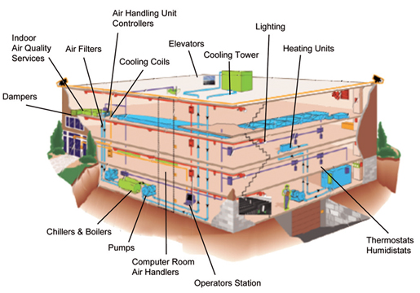
A System of Systems
Notes:
We have learned about many different systems found in buildings and the components that comprise them. We’ve discussed HVAC system equipment, including boilers, furnaces, chillers, cooling towers, heat pumps, packaged HVAC units, air handlers, and other ventilation components. We’ve also looked at lighting systems and their components. Even the building envelope (exterior elements that separate the interior from the outside elements) is a system comprised of components such as the foundation, walls, roofs, windows, and doors.
Over the duration of the course, you have likely recognized ways that each of these systems can affect the other systems, and how they all interact to affect energy consumption and the building occupants, for better or for worse. For example, air pressures in a building are driven by external forces acting on the building envelope (e.g. wind, stack effect) and internal forces (e.g. mechanical ventilation), and in turn can greatly affect the amount of energy needed to heat or cool various zones within the building. Air pressures can also directly affect the health and comfort of the occupants (e.g. due to infiltration of cold air or entrainment of pollutants). Lighting, too, affects both the occupant experience as well as energy consumption, both in direct electricity costs as well as in energy for mechanical cooling systems to offset its heat gain.
Image source: https://technovator.com.sg/index.php?page=integrated-building-automation-systems

Slide 4
Finding a Balance
Energy Use
Comfort
Health
Indoor Environment
Notes:
Often, we try to save energy to reduce costs, but the way energy is used also plays a role in the indoor environmental quality (IEQ) of a building, affecting the health and comfort of its occupants.
Take the example of HVAC: Too much or too little heating, cooling, and/or ventilating a building can potentially make an occupant uncomfortable or unwell.
Finding the “sweet spot” between conserving energy and preserving IEQ is key to both energy use and occupant productivity.

Slide 5

Building a Plan
For Your Facilities
Building a Plan for Your Facilities…
Notes:
Understanding the systems in your facilities and how they interact with each other is essential for optimizing the performance of your building, both in energy use and indoor environmental quality. Over the course of this training, we have discussed the components for developing a plan for optimizing your facilities. Through the learning activities completed so far, you should have a framework for your plan.

Slide 6

Building a Plan
For Your Facilities
Determine baseline and set goals
Identify energy saving opportunities
Monitor energy consumption
Measure success
Notes:
Building a plan is essential to executing one—and it’s more than just numbers.
Goals should be focused on achieving desired outcomes. Collect and analyze meaningful data.
Don’t forget to celebrate successes!

Slide 7
Determine Baseline
& Set Goals
Energy Use Intensity/Energy Utilization Index (EUI):
a measure of the total energy consumption
over the course of a year
=
Energy Consumption (kBTU)
Building Square Footage
Notes:
A baseline is essential to measuring improvement, as it outlines a starting point and allows you to monitor progress over time.
The lower the EUI, the better the energy performance tends to be.

Slide 8
Determine Baseline
& Set Goals
Defining Outcomes
Desired Outcome | How Will You Know?
Have great customer service | Timeliness of response Reliability of services Work quality Positive interactions
Improved building performance | Increased ENERGY STAR Score Decrease in energy consumption Decrease in EUI Increased reliability of systems
Reduce down-time | Manage scheduled down-time for lowest impact Improve critical system reliability Perform the right amount of maintenance at the right time
Notes:
When defining outcomes, it is helpful to think through what will tell the story of success. Use creativity in getting your point across. Think about delivery methods that will best showcase successes.

Slide 9
Determine Baseline
& Set Goals
Building Level
Monthly energy consumption (kBtu)
Annual energy consumption (EUI, kBtu/SF)
Monthly peak demand (kW)
Monthly energy cost ($/SF)
Carbon footprint, annual
Hot/cold complaints, monthly
Systems Level
Equipment run time, building on-hours, interior temperature
OA damper position, outside air temperature, interior temperature, equipment status (on/off)
Interior temperature, heating status (on/off), cooling status (on/off) (on/off)
Notes:
It may be helpful to organize your measures of success in terms of high-level at the ‘Building’ level, and a more zoomed-in look at the ‘Systems’ level.
The Building Level would be useful when reporting on metrics, monitoring them less frequently (monthly/annually) and looking at them as a whole.
The Systems Level would be useful for more frequent monitoring and making sure the systems are running most effectively, contributing to the Building Level measures.

Slide 10
Identify Energy Saving Opportunities
Focus on optimization of building operations
Look at entire building; all systems plus exterior
Perform tests and identify corrective actions that are the most impactful and can be made with limited time and resources
“…up to 20% of energy used in commercial buildings is wasted because of improper and inefficient operations”
-PNNL

Slide 11
Energy Conservation Strategies
Operational Strategies
Improve energy efficiency
Operation & maintenance, equipment modifications
Reduce “On” hours
Time clocks, occupancy/vacancy sensors
Reduce the need to use energy
Conservation measures, building occupant behavior
Just meet the loads – and no more
Calibration, reduce overheating/overcooling
Notes:
Energy management consists of developing a set of basic strategies to meet the needs of a facility and, at the same time, reduce energy consumption and costs. When looking for energy conservation opportunities, keep these four basic concepts in mind:
Improve energy efficiency through better operational practices or by equipment or building modifications.
Reduce “On” hours. Implement a policy of lights out in rooms left unoccupied for more than 15 minutes. Set the time clock to reduce the hours the hot water circulation pump is on.
Reduce the need to use energy. Add ceiling insulation, weatherize the envelope, insulate and seal overhead doors, encourage occupants to use blinds and draperies to block heat gain and loss.
Just meet the loads -- no more. Calibrate controls to avoid over-heating or overcooling. Recover to desired occupied temperatures no earlier than necessary.

Slide 12
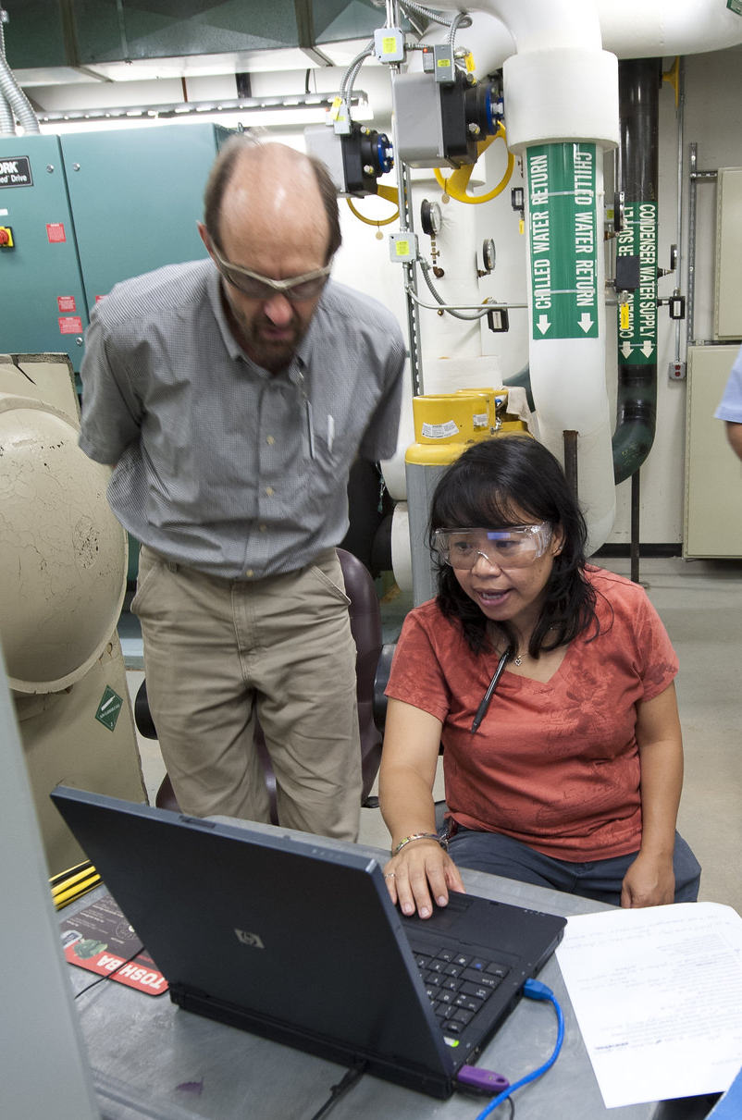
Common Opportunities for Improvement
Equipment scheduling
Address simultaneous heating & cooling
Utilize outside air for “free” cooling
Maintain & fine-tune lighting
Use the BAS to optimize HVAC control settings
Image source: Resource Media
Notes:
Recall the common opportunities for operational improvement we explored in Part 5, summarized here.

Slide 13




Technical and Financial Support for Pursuing Fixes/Retrofits
Changing Perception
From: Facilities as a Cost Center
To: Facilities are an Investment in Organizational Success
Notes:
Identifying and quantifying potential financial savings from energy conservation measures can help convince decision makers to invest in them. As projects are implemented and savings are realized, your credibility increases and gaining support for other projects becomes easier.
Through best practices in maintaining facilities and continually working to optimize buildings, you can:
Save money
Help meet energy conservation goals
Help meet sustainability goals
Create a healthy, productive, and reliable workspace
These outcomes can all help to change the perception of facilities as a cost center to an investment in organizational success.

Slide 14
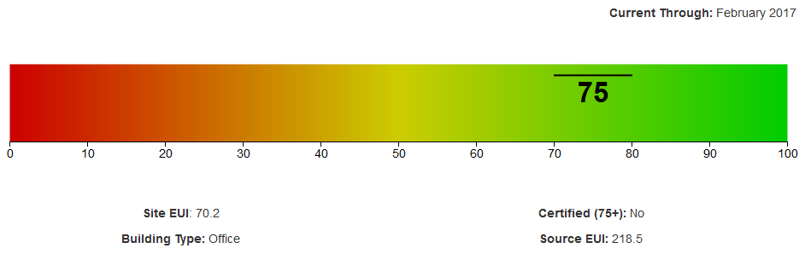
Monitoring and Measuring
“If you can’t measure it, you can’t improve it.”
-Peter Drucker

Slide 15
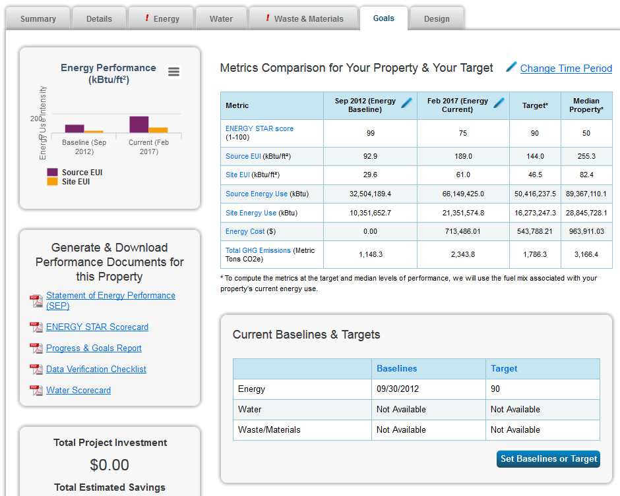

Tracking Goals with
ENERGY STAR
Notes:
ENERGY STAR tools and resources help organizations identify cost-effective approaches to managing energy use in their buildings and plants - enabling energy savings, increased profits, and greater competitiveness.
The program’s popular free online tool, ENERGY STAR Portfolio Manager®, is used to measure and track the energy, water, greenhouse gas emissions and/or waste and materials. Since 1992, the program has helped businesses and organizations avoid around $200 billion in energy costs and around 2.7 billion metric tons of emissions.
The tool calculates a 1–100 ENERGY STAR score, which has become the industry standard for rating a facility’s energy performance (the higher, the better).
The tool also calculates a weather normalized EUI (the lower, the better).
Source:
https://www.energystar.gov/buildings/about-us/facts-and-stats

Slide 16



Monitoring Energy Consumption
Your Resources:
Tools specific to your area (BuildSmart DC, etc.)
ENERGY STAR Portfolio Manager
Building Automation System
Notes:
There are several resources to monitor your facilities’ energy consumption:
Tools specific to your area (e.g., BuildSmart DC):
Interval electricity
Utility data
ENERGY STAR profile
ENERGY STAR Portfolio Manager (or other benchmarking software):
ENERGY STAR Score
Weather normalized EUI (WNEUI)
Specific reporting
Greenhouse gas emissions
Building Automation System:
Trend data
Troubleshooting using GUI

Slide 17
Measuring Success
Goals
S
S
C
E
C
S
S
S
U
E
C
C
S
U
0
1
2
3
4
5
6
7
8
9
10
11
12
13
14
15
16
17
18
Metrics
Notes:
When determining how to measure your success, ask these three questions:
What metrics do you want to measure?
What will help you determine if your initiatives are successful?
Do the metrics tie back to your goals?

Slide 18
Measuring Success:
Tell Your Story
Tips for Success
1
Know your audience and how people think
2
Sketch it out
3
Use graphics
4
Use trends
5
Include the future as well as the past
6
Keep the focus on the right information
Notes:
How you tell your story can be as important as the story itself.
Understanding your audience and how they process information will help you to effectively get your message across. Would you tell your story differently to the occupants of your building than you would to your boss?
Identify communication methods and include a variety of communication styles and methods that will appeal to the various stakeholders.

Slide 19

Telling Your Story
Changing Perception
Treatment Option A:
10% Mortality
Treatment Option B:
90% Survival
Notes:
Understanding how others perceive what you say will help you deliver your message in a way that is convincing to your audience.
In this example the treatment options are exactly the same and the outcomes are the same, but the story is told differently. Emphasis is placed on the outcome and there is an emotional reaction to the terms “survival” and “mortality.”
It is much more preferable to think about survival. Overwhelmingly, people will tend to choose the more positively framed option.

Slide 20

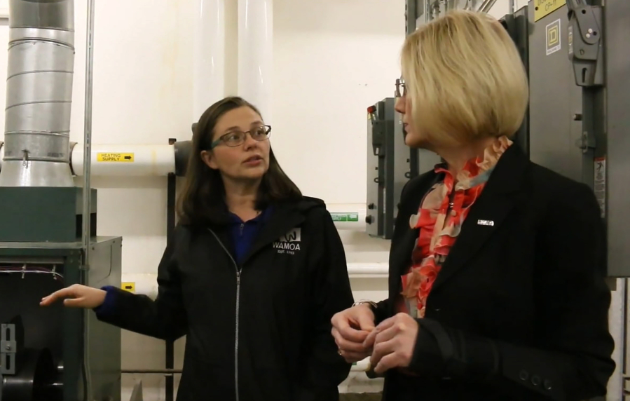
Engaging With Occupants
You are the link between
occupants and the organization
Notes:
Who are your customers?
Your customers are the building occupants. You have tasks in maintaining buildings that are comfortable, safe, and productive for those who are inside them.
Engaging with the occupants will make you more aware of their needs, while at the same time letting them know that you’re there to help.
With established mutual trust and proactive, clear communication, your customers will be more likely to come to you with information that will help you solve building problems.

Slide 21
Putting It All Together
Efficient operation & maintenance of building systems
Impact of Indoor Environmental Quality on occupants
Awareness of where and when energy is used
Effectively communicating with occupants
You Can Play a Major Role
In Your Building’s Efficiency

