Slide 1
BOC Level 1 Course
Course Format and
Completion Requirements

Slide 2
LMS (Learning Management System)
The following slides review the key features of the LMS along with the general class requirements.
It is an evolving tool launched in 2019, so please provide any feedback you have on how we can improve your learning experience.
This is a general overview, there are variations from year to year in course delivery so check with your Course Manager if you have any questions.

Slide 3
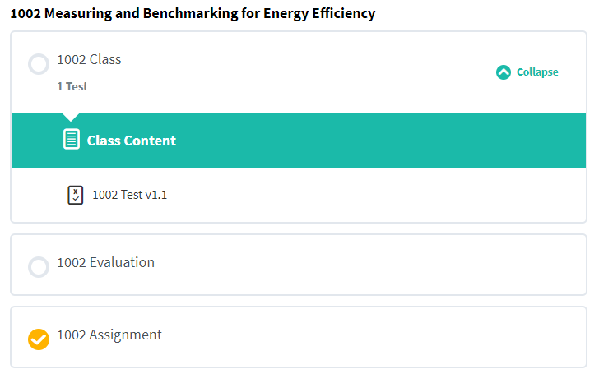
Class Sections in LMS
Click to go to class page
Open and close class content
Test
You are required to complete an evaluation for each class
Get assignment forms and upload completed work here

Slide 4
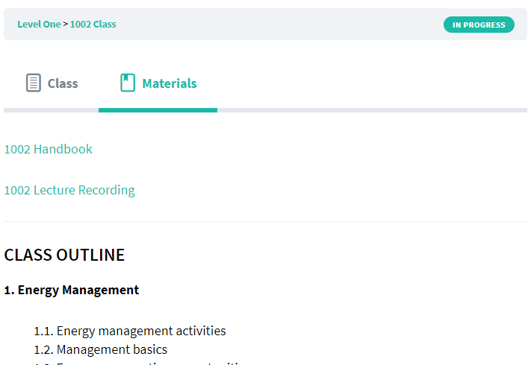
Materials Tab
On the class page, look here for links to the Handbook, Lecture recordings for class makeup and other resources.
Materials
Handbook if missing paper book
Recording for make up if absent
Outline for overview of topics to be covered

Slide 5
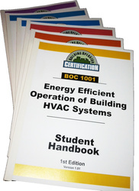
Attendance
Let your Course Manager know as soon as possible if you plan to be absent.
Make arrangements to get the Handbook for that day (if you don’t already have it)
Confirm make-up preference
another live class series (check schedules at theboc.info), or
online here using recorded lectures

Slide 6
Class Format
Each class day includes:
A presentation by an instructor with expertise in the subject for that day
A Handbook with the slides and notes
Several small group exercises/activities and discussions – this is great opportunity to get to know your classmates/professional colleagues – your contribution is valued!
Breaks including lunch, and
A test
(for livestream classes, format may be 2 half days, lunch on your own, test on day 2)

Slide 7
Tests
Each class concludes with an open-book 20 question, multiple choice test to review key concepts from the day. The answers are in the book.
Read all the answers and choose the best one, even if some others seem like they might also apply
A score of 70% (14 of 20 correct) on each is required to pass the course.

Slide 8
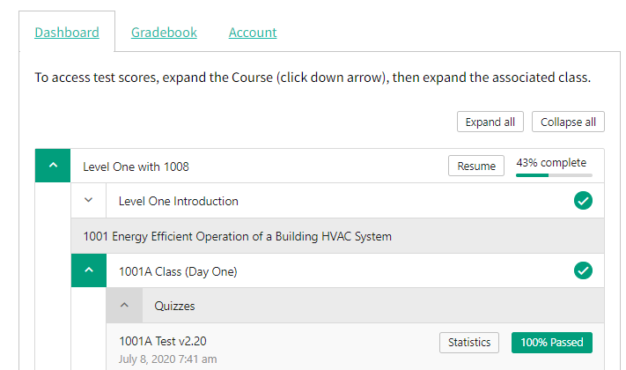
Tests, continued
You may retake the tests a few times
Online tests are scored immediately
Right after the test, click the “show questions” button to see detailed results.
Later you can access this in the dashboard page by clicking “Statistics” Link
Incorrect answers offer a tip for the page reference to review

Slide 9
Evaluations
Evaluation surveys are included in each class and are required.
They are in the LMS and some live locations may have a paper option as well.
While a bit tedious, especially when repeated for each class, they provide critical feedback on the curriculum, instructors and overall program.
Feedback helps us continually improve and communicate to sponsoring utilities and future participants
Manually mark the unit complete after submitting the form

Slide 10
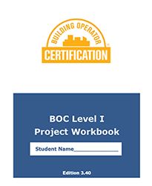
Assignments
You will receive a project workbook (paper and/or online) on the first day for your five required assignments.
The workbook includes detailed instructions
The LMS assignment includes an overview of the assignment requirements, links and downloadable files where appropriate, and a place to upload completed work.
Your Course Manager will review assignments, give a score and comments

Slide 11
Assignments, continued
Bring your Project Workbook to each class
Instructors will provide a check-in on the assignment from the previous class and a review of the next assignment (if there is one).
It may not be their area of expertise so ask questions of your classmates and share experience to get the most out of the exercises
You may also keep your work in the Workbook and the course manager will mark it on days they attend.

Slide 12
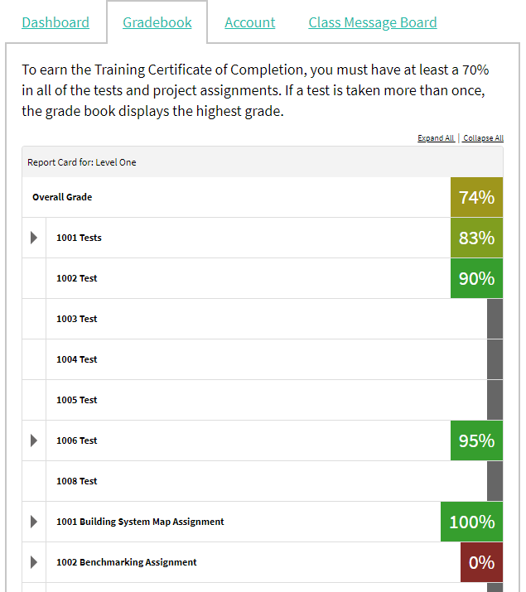
Course Completion
Check the Gradebook tab to confirm all class requirements are met, manual entries are not reflected in the ‘course progress’.
In some cases, test scores or assignments maybe entered manually.

Slide 13
Credential Application
By the end of the class, complete the Training Certificate of Completion (TCOC) Application form (see Assignment 1006 to download).
This form provides an update of your contact preferences and confirms your eligibility (work/education requirements)
You will need to fill it out completely, sign it and get a supervisor signature.
Even if you have classes, tests or homework to make up, please turn in the form, this helps us help you finish up when you are able.

Slide 14
Eligibility
Eligibility for the Level I TCOC is based on work experience and education, AND completion of BOC classes, tests and on-the-job projects.
It is highly recommended that applicants for the training credential have a high school diploma or GED, and must have one of the following:
two or more years of experience working in operations and maintenance of a commercial or institutional facility,
OR
a minimum of one year of experience working in operations and maintenance of a commercial or institutional facility AND BOC Fundamentals of Energy Efficient Building Operations certificate OR one year of technical college level education in facilities engineering related program,
OR
two or more years of experience in energy management of facilities with a focus on operations and maintenance.

Slide 15
Credential Maintenance
You will receive your TCOC in the mail and if you registered for the BOC Certification exam you will be sent instructions to schedule that.
Your TCOC is valid for the year you complete training and the full calendar year after.
In the spring after the first full calendar year, you will need to report five Maintenance Points and pay a fee (currently $75) to maintain your credential. See the Quick Links for more information for earning Maintenance Points (which includes just continuing to work in building operations!)

Slide 16
Additional Credentials
BOC Level II Training Certificate of Completion
and
Certified Building Operator - CBO
You can pursue either or both after completing Level I. (Level I is recommended but not mandatory for either)
See theboc.info website for more information on both options

